Slide 1
Case Study
(c) IAIABC 2013

Slide 2




Employer Information
Metal Fabrication, Inc., based in Safety Town is a custom fabricator of heavy metal gates, grating, guards, grills, fencing, and other similar items.
MFI is a family-owned company and is currently insured by Don’t Mess It Up Insurance Company (DMIUIC).

Slide 3

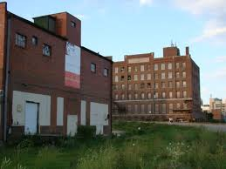

Employer Information
Safety Town has been given a grant to beautify its decaying downtown, and MFI has won the bid to construct new fencing and tree grills.
In order to accommodate the additional work, MFI added a second shift from 3:00-11:00 PM.
MFI pays its employees every other week on Wednesdays for the two week period from Sunday to Saturday.

Slide 4
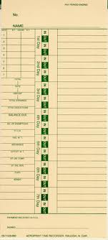


Employee Information
Marilyn Munro has been a machine operator for MFI for the past 8 years. Marilyn was promoted to supervisor for the new shift and on days when some of the workers are absent, Marilyn fills in on the machines so that MFI can keep the pace to meet the production deadline.

Slide 5
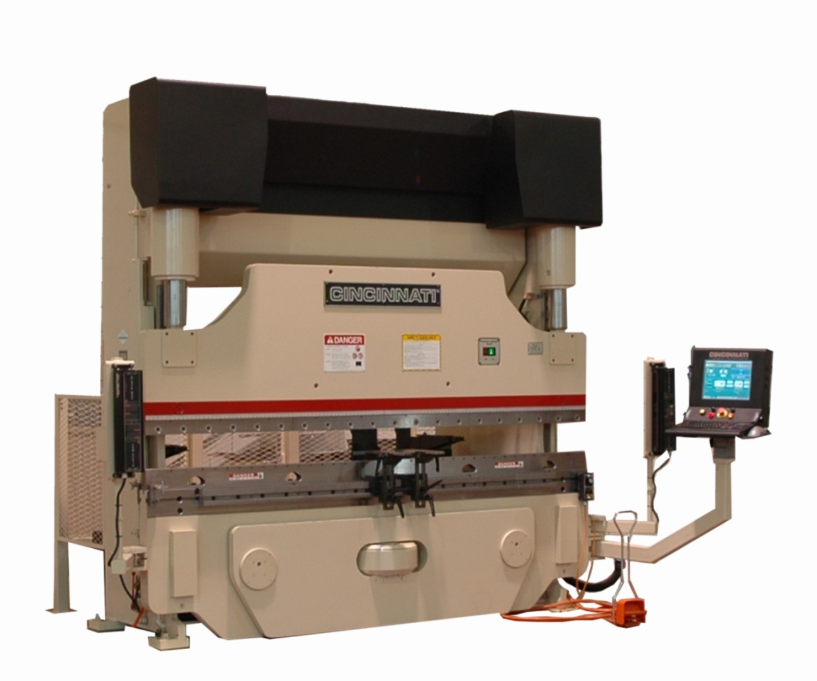
Accident Information
On Thursday, October 31, 2013, Marilyn went to work and learned that of the 20 employees scheduled to work, 4 were absent. As a result, Marilyn filled in on the press brake.

Slide 6


Accident Information
It had been a while since Marilyn had worked on that particular machine. At approximately 9:30 pm, Marilyn was distracted when another employee, Jim DiMaggio, asked her a question and she activated the press brake and cut off the top of her right ring finger below the first phalange (she is right hand dominant).
Jim helped Marilyn to the foreman’s office, where the foreman, Art Gable, called an ambulance. Art filled out the paper First Report of Injury form and immediately faxed it to DMIUIC.

Slide 7
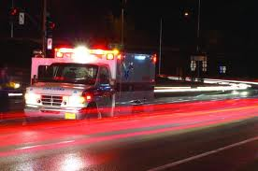
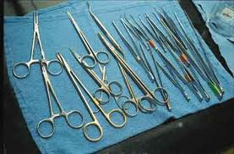
Initial Treatment
Marilyn was transported via ambulance to the hospital. She was transferred immediately from the ER to surgery, where Dr. Hugo Hefner, a plastic surgeon, reattached her finger.
Marilyn was kept in the hospital so the doctors could monitor how well the finger was healing, but on November 4th, it was clear that the reattachment was a failure, so the finger was amputated.
After the surgery, Marilyn was hospitalized for 2 more days and then released to home, but not yet released to go back to work. Marilyn was scheduled for a post-op visit with Dr. Hefner on Wednesday, November 13th.

Slide 8



Claim Administrator Information
On Friday, November 1, DMIUIC received the paper FROI and assigned Marilyn’s claim to Mike Rooney. Mike immediately contacted Art Gable to confirm the accident details.
Art informed Mike that the employer would continue Marilyn’s salary for up to 4 weeks (pay periods 11/3-11/16 and 11/17-11/30) and agreed to complete the Wage Statement and Fringe Benefits Worksheet.
Mike reviewed the statute and noted that Marilyn is due 11 weeks of benefits based on the schedule of specific loss benefits in Section 212(3).

Slide 9


Case Study
Step | Claim Activity | EDI Transaction
1 | Although Mike has up to 7 days to report the injury to the state, Mike files a ¹ on Monday, November 4. What is the initial date disability began? | FROI 00 (DN0056=11/1)
2 | MFI is continuing Marilyn’s salary while she is out for up to 4 weeks. Mike files a ² with the state. What benefit type code should Mike report? | SROI EP (DN0085=230)
3 | The report rejects (TR) due to Permanent Impairment Body Part Code - DN0083 was blank. What needs to be filed to fix the error? ³ | SROI EP
4 | Marilyn sees Dr. Hefner on November 13 and will remain out of work until her next visit on December 12. Mike needs to file what with the state? ⁴ | N/A
Answer
Answer
Answer
Answer

Slide 10
Case Study
Step | Claim Activity | EDI Transaction
5 | Mike receives Marilyn’s Wage Statement which includes the differential for the second shift and some overtime wages from the summer. Mike determines that because Marilyn’s base salary is less than her AWW, she is due partial benefits while on salary continuation. He issues a check for $500.00 covering the difference owed for four weeks of salary continuation. What needs to be filed? ⁵ What LSS code should be reported? | SROI PY (DN0293=NS)
6 | Mike confirms that Marilyn will be paid her salary through November 30. Knowing that Marilyn will be out until at least December 13, Mike issues a check in the amount of $625.00 to Marilyn for her first week of total benefits covering the period of December 1– December 7. What needs to be filed to reflect this payment? ⁶ What benefit type code should Mike report? | SROI IP (DN0085=030)
7 | Mike received an email from Judy at the Comp Board informing him that he calculated Marilyn’s AWW incorrectly because he did not exclude the week of injury. Judy has determined that the new WCR is $633.00. Mike puts Marilyn on repetitive pay at the new rate and sends out a check for $32.00 for the amount due to date. What EDI reports are required? ⁷ Is a WCB-8 required? | SROI CA (no, would be yes if rate was overestimated) SROI PY (DN0293=NS)
Answer
Answer
Answer
Answer

Slide 11
Case Study
Step | Claim Activity | EDI Transaction
8 | Marilyn sees Dr. Hefner on December 13 and is released to return to work “regular duty” with the only restriction that she is not to operate any machinery. She returns to work on her next scheduled work day Monday, December 16. Mike monitors Marilyn’s wages and calculates that Marilyn is due partial benefits totaling $100.00 for the benefit period of December 15 – December 21. What does Mike file? ⁸ | N/A (employee entitled to 11 weeks of specific loss benefits)
9 | On January 3 Marilyn is released to regular duty with no restrictions. Mike issues the final payment of specific loss benefits covering the period through January 18 and files.⁹ What if Marilyn was still incapacitated after the specific loss period? Or what if she was released but decided not to return? | SROI S1 SROI CB (DN0085=050) SROI S7 (WCB-8)
10 | Marilyn is experiencing some tightness and limited range of motion in her hand and asks Mike if she can see a hand specialist in Boston that she saw interviewed on 60 Minutes. Instead Mike “approves” 5 weeks of intensive OT which begins on February 3. Marilyn misses 2 hours a day from work in order to make the appointments and receives partial benefits during this time. Mike pays $50 each week and makes adjusting payments when Marilyn’s gross wages are received. What must Mike file? ¹⁰ What benefit type code should he report? | SROI PD (medical in part) SROI RB (DN0085=070) SROI PY (for each check that is adjusting to actual)
Answer
Answer
Answer
Answer
Answer
Answer

Slide 12
Case Study
Step | Claim Activity | EDI Transaction
11 | Marilyn is discharged from occupational therapy on March 7. Mike files what? ¹¹ | SROI S1
12 | Mike receives a request for mileage reimbursement from Marilyn for the 5 weeks of OT and issues her a check in the amount of $220.00. What report needs to be filed? ¹² | N/A
13 | On April 25, Mike closes the claim and files a ¹³ to report total benefits paid to date on the claim. | SROI FN
14 | Marilyn’s claim was audited by the MAE Program and the auditor found that Marilyn was not paid for the period 11/1-11/2. Mike issues payment for the missed days and the corresponding $1,500.00 penalty to Marilyn. What gets reported to the state? ¹⁴ | SROI PY (DN0293=NS) SROI FN
Answer
Answer
Answer
Answer
Answer

Slide 13
Case Study
Questions?

