Slide 1
Agenda
Agenda for the UI Stakeholder Group Meeting on 12/15/2021
Welcome
Introductions
Review of Previous Meetings
Presentation on Economic Situation by Mark McInerney, Director of the Center for Workforce Research and Information
Overview of the claim filing process and review of resources
Review of the ID.ME verification process
Wrap-up
Closing

Slide 2
Topics Discussed
A. Methods of connecting employers and unemployed workers following the pandemic related to coronavirus disease 2019;
B. Processes and methods to improve the efficiency and effectiveness of the worksharing plan established under Title 26, section 1198;
C. A determination regarding whether the provisions of Title 26, section 1044 are working effectively to achieve the protection of rights and benefits goals;
D. Methods to streamline and facilitate application for unemployment insurance benefits that will increase access for unemployed workers, simplify reporting requirements for employers and determine any clarifications or modifications that may be needed related to the submission of partial unemployment claim forms in accordance with Title 26, section 1194, subsection 1-A;
E. How an employer liaison contract might be designed to provide assistance to the business community in interacting with the unemployment insurance program, focused on the goal of reducing administrative burden and improving user experience, including recommendations of a funding source to support such a contract;
F. Whether unemployed individuals have completed reemployment services and eligibility assessment with the Department of Labor within the prior 5 years and whether these individuals should be considered to have good cause for not participating in reemployment services and eligibility assessment under Title 26, section 1192, subsections 2 and 13; and
G. Any software or technology issues contributing to delays, claims processing issues and paperwork burden to businesses that may be resolved through technological means or any ways to promote improved claimant or employer user experience and interface with the unemployment insurance system.

Slide 3
Review of 10/20/21 Meeting
During this meeting, the group received presentations and discussed topics A, B, C, and F.
A presentation was done on topic B, which is the workshare program. Stakeholders were supportive of the workshare program and its benefit to both workers and employers.
A member asked if RESEA could integrate information about credentials and opportunities for claimants to expand their skill base.
In discussing topic A, there was heavy interest in what obstacles exist that are keeping workers from going back to work. Staff talked briefly about the survey that was conducted by the Department on barriers to reemployment.
During the presentation on topic D, it became clear that there was a separate issue at hand. Members of the group seemed to agree that it would be good to provide outreach and education to employers on the requirement to tell workers about unemployment benefits. The Department committed to including this information in the UI Tax Rate notification to employers.

Slide 4
Review of 11/17/21 Meeting
During the next meeting, the group received presentations and discussed topics D, E, and G.
Discussion on topic D focused on what ways the Department can help employers create an easier process to file a large amount of claims similar to work share.
During the discussion on the Employer Liaison program, members did not commit to a program but wanted to make sure resources are shared with small employers. One member suggested sending a monthly email to employers with resources and helpful information.
Director Boyett presented on the software and technology used for the Unemployment Compensation program. These discussions centered around accessibility for individuals who are accessing the system.

Slide 5
Common Themes
Stakeholders were interested in how the Department can limit the amount of administrative burden for both workers and employers.
There was an emphasis placed on making resources accessible and available in the locations that an individual may need them the most.
This includes posting videos/FAQs on ReEmployME when claimants go to file for a claim.

Slide 6
Update on Workforce Conditions December 15, 2021
Mark McInerney, Director
Center for Workforce Research and Information
Maine Department of Labor December 15, 2021

Slide 7
Overview
Tight labor market conditions are creating a competitive environment for employers to attract and retain workers
72 percent of net job losses occurring at the beginning of the pandemic have been regained
Reduced labor force participation is preventing further jobs recovery
Unemployment remains elevated by pandemic and has quickly fallen from pandemic peak

Slide 8
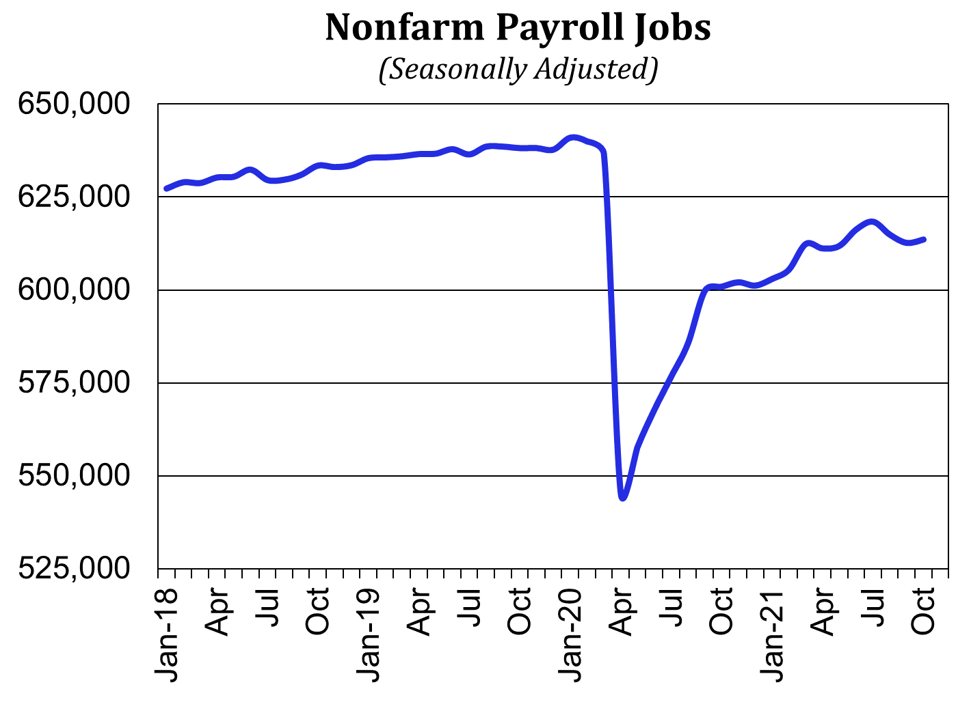
The jobs recovery has been relatively flat over the past seven months
68,100 net job losses have been recovered
There remain 26,400 fewer jobs

Slide 9
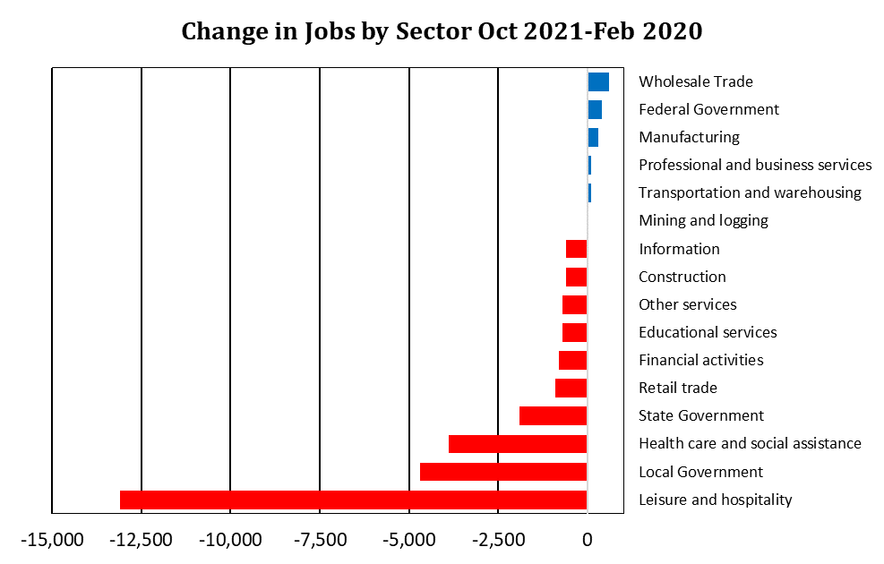
Jobs remain down most in leisure and hospitality, state and local government (mostly education) and health care and social assistance

Slide 10
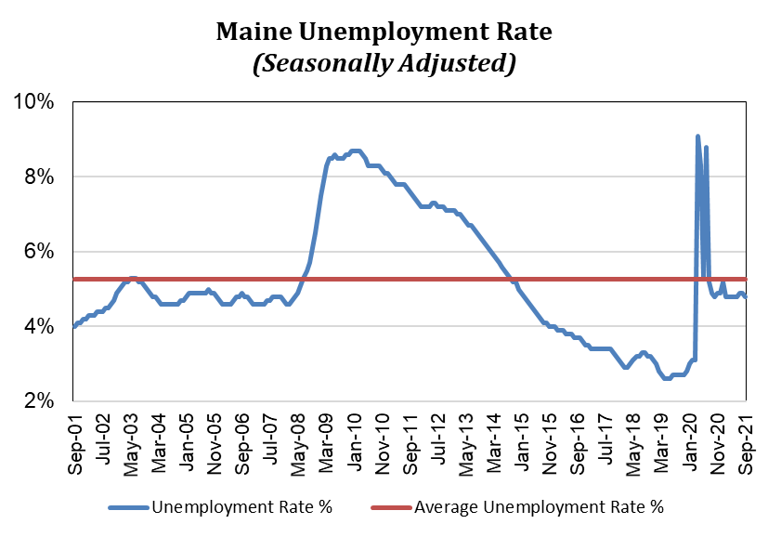
Tight labor market conditions have quickly re-emerged. The unemployment rate has already dropped below the 20-year average

Slide 11
Understanding current conditions
Tight labor market is the result of a combination of factors
Some unrelated to the pandemic:
Resumption of pre-pandemic labor market trends
Long term demographic trends
Some pandemic related affecting labor force participation:
School closures, remote/hybrid learning
Lack of safe, affordable or available childcare
Personal safety concerns
Altered retirement decisions
Fewer foreign workers via visa programs

Slide 12
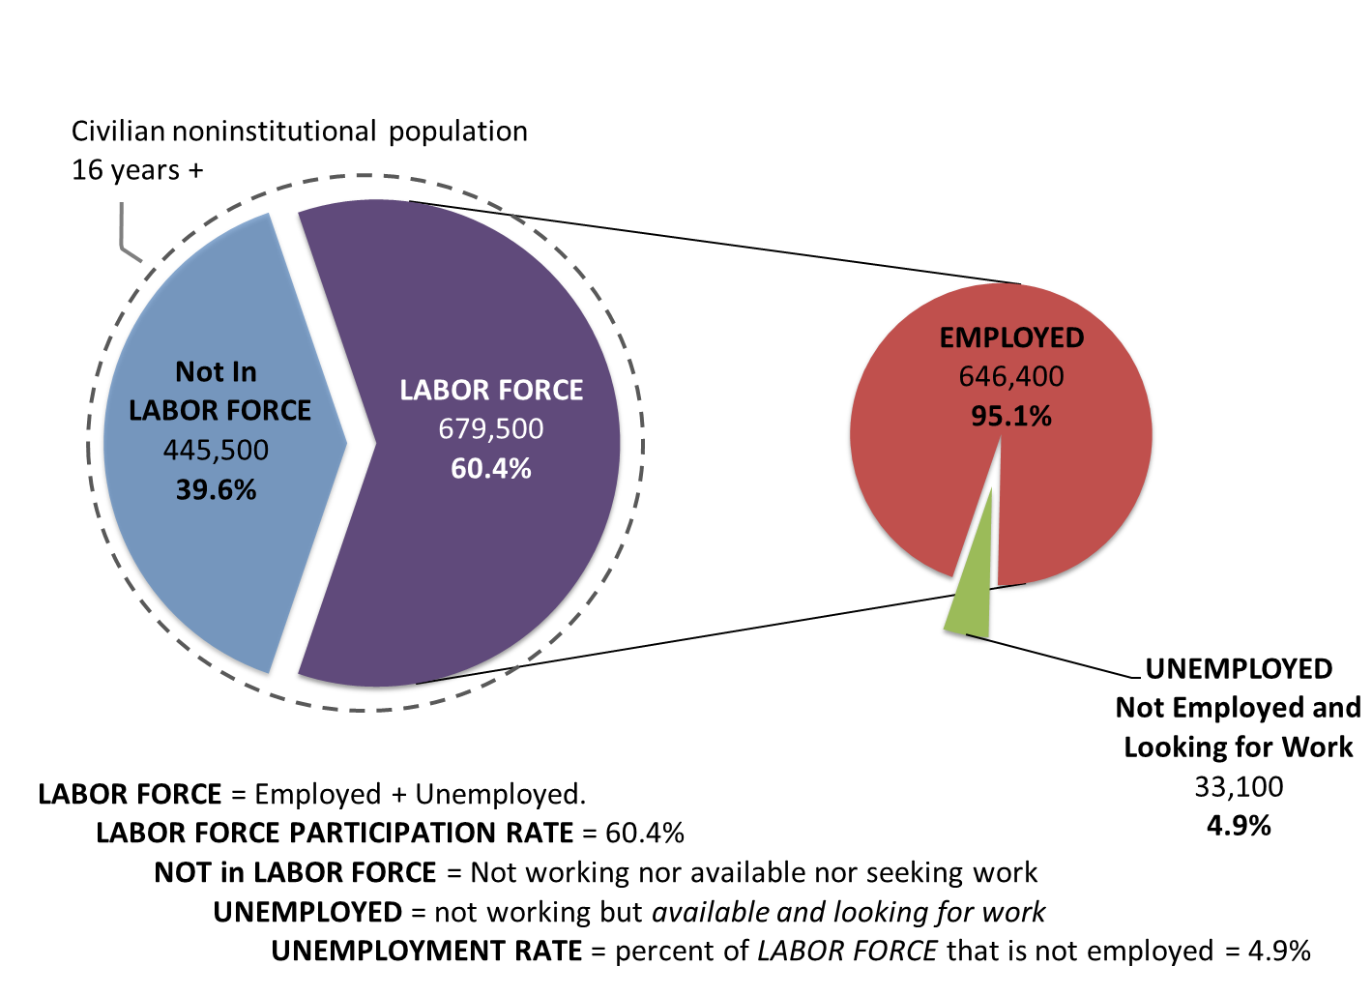
Maine’s Labor Force (Oct 2021)

Slide 13
Unemployment Rate: what it measures
Primarily determined by a monthly survey of households
Identifying the labor force status of Maine residents (whether employed, unemployed, or not in the labor force)
Unemployment measures more than workers who lost their job:
young people completing their education as they look for a job;
re-entrants into the labor force (who left to provide care, pursue additional training/education, the formerly incarcerated);
those voluntarily leaving jobs and seeking new opportunities

Slide 14
Unemployment Insurance Claims
The unemployment rate and unemployment insurance (UI) claims tend to move together
But do not measure the same group of people
UI claims only capture the unemployed who have lost a job, applied for benefits and remain eligible
Some people are still jobless when their benefits run out
Many more are not eligible at all or delay or do not apply for benefits

Slide 15
There would be 22,500 additional people in Maine’s labor force today if labor force participation matched that of prior to the pandemic

Slide 16
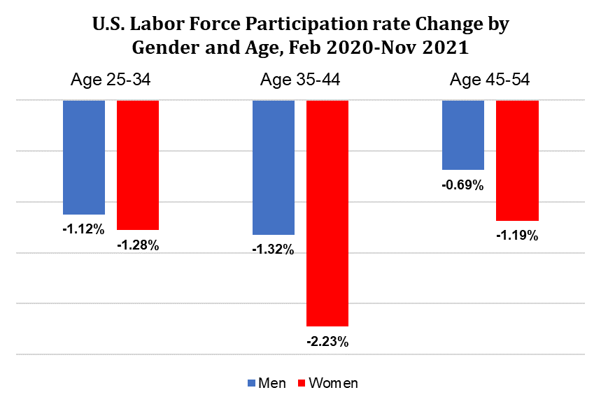
Nationally, the decline in labor force participation among those under 55 was greater among women than men.
Among younger age groups, participation has decreased substantially more among women compared to before the pandemic, likely driven by childcare and school disruptions

Slide 17
Retirement is also contributing to labor force participation decreases, which may be influenced by the pandemic.
Nationally, there was a 4.8% decrease in labor force participation for those age 55+ (from Feb 2020-Nov 2021)
The Federal Reserve recently estimated that more than half of the decrease in labor force participation may be due to retirement (from Feb 2020-May 2021)
Retirement decisions are not necessarily permanent
High stock and home prices, economic stimulus may have enabled some to retire sooner than they planned. Improvements in public health may encourage some to re-enter the workforce in the future

Slide 18
Lower labor force participation is contributing to a very competitive labor market. Job openings are historically high, quits are up, and wages are increasing

Slide 19
The number of hires hasn’t changed much as labor force participation remains suppressed. Layoffs have fallen to low levels after surging in the spring of 2020

Slide 20
Younger people face difficult choices with better job prospects. Overall, there are fewer young people entering the labor force compared to other age groups currently not in the labor force
https://www.pressherald.com/2021/11/07/maine-college-enrollments-drop-as-pandemic-job-market-pull-students-from-classrooms

Slide 21
Demographic Overview
Maine’s total population has changed little over the past 15 years
Explained by a decline in the birth rate
Maine experienced a natural population decrease in 8 of 9 years from 2011-2019
Modest population growth has been driven by in-migration in recent years

Slide 22
In the last 30 years, the largest segment of Maine’s population has moved from prime working ages (25-44) toward later career or retirement ages (55-74)
1990 Decennial Census
2019 American Community Survey

Slide 23
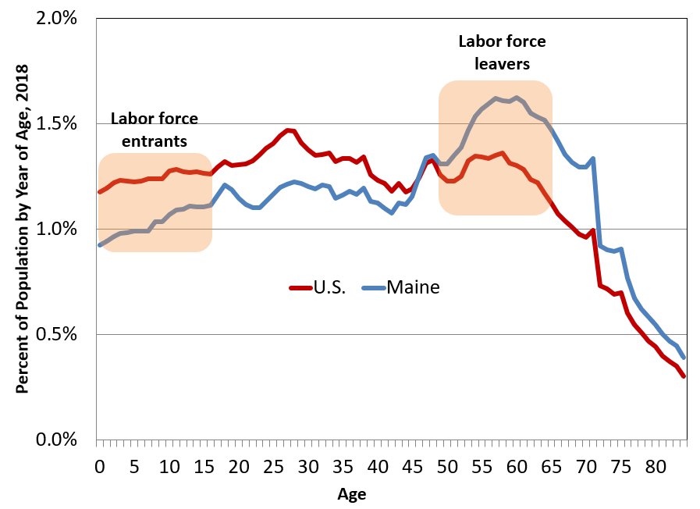
Fewer births left Maine with an imbalanced population structure. We have a high share of people in their 50s and 60s and low share of youths relative to the nation.

Slide 24
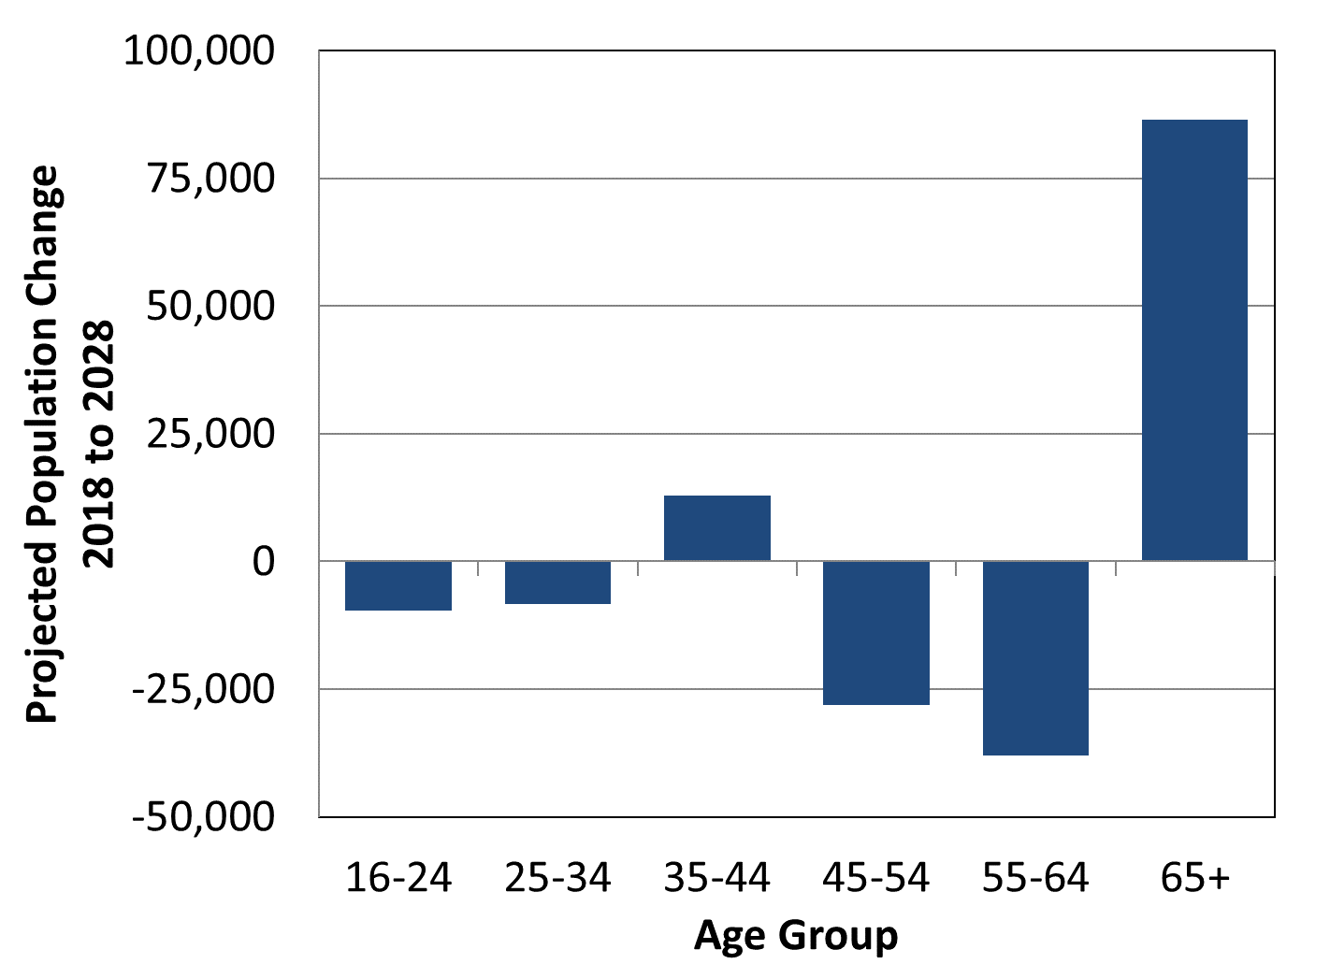
Maine’s population aged 45-64 is expected to decline as more baby boomers advance in age.

Slide 25
How to Access Unemployment Benefits & Resources for Assistance
Suzan McKechnie, Deputy Bureau Director
Bureau of Unemployment Compensation
Maine Department of Labor December 15, 2021

Slide 26
Accessing Unemployment Benefits
2 filing methods:
Online application (available 24 hrs/day, 7 days a week)
Staff-assisted by phone (8 am to 3 pm M-F) – includes access to language interpreters
Initial claim establishes benefit eligibility
Monetary (earnings history – base period)
Qualifying Separation
Able & Available (A&A)
Weekly certification + work search report determines if benefits will be paid
Weekly requirements (A&A, work search)
Report any earnings

Slide 27
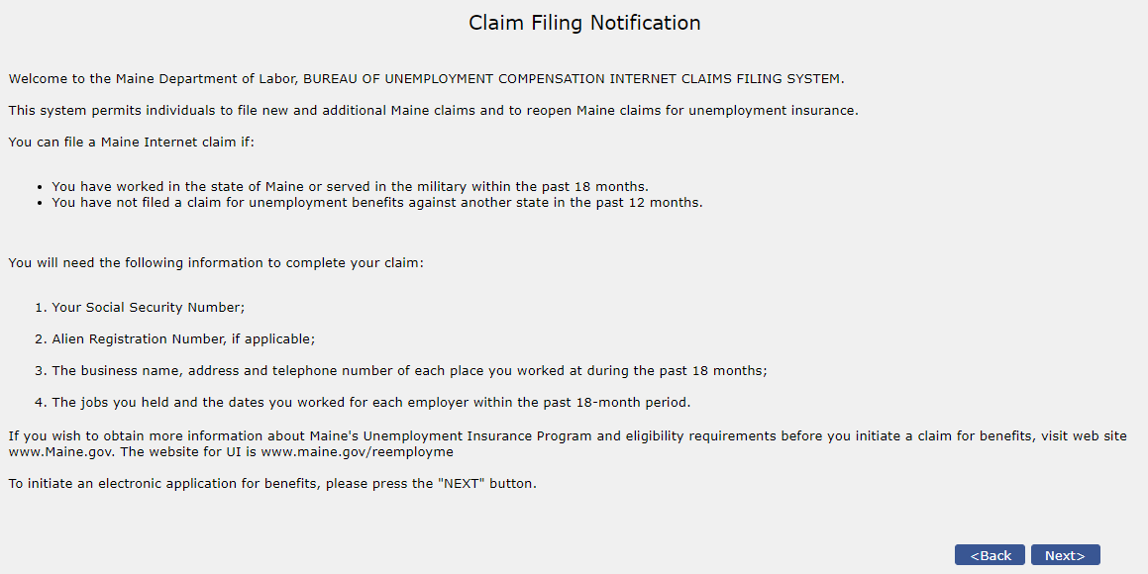
Instructions Prior to Filing

Slide 28
Available Resources to Assist Benefit Filing
Online Videos (https://www.maine.gov/unemployment/videos/):
What Should I do if I become unemployed?
Creating an Account
How to file a claim
I Just Filed my Unemployment Claim. What's Next?
Unemployment Benefits: Responsibilities
Unemployment Filing: Common Mistakes
Earning Money While Collecting Unemployment Benefits
Partial Wages?
How to Appeal an Unemployment Decision
The Unemployment Appeals Hearing Process

Slide 29
Sample Video - Responsibilities

Slide 30
Additional Assistance – Frequently Asked Questions (FAQs)
File for Unemployment (https://www.maine.gov/unemployment/faq/)
What is Unemployment Insurance?
When should I apply?
How do I apply?
How much will I receive?
How long will I get benefits?
What is the Work Search requirement?
How do I upload my tax info for PUA increase?
How to change your unemployment account password
Weekly Claim Information
What is an overpayment?
1099G Information

Slide 31
Additional Assistance – FAQs
Fraud Reporting (examples – more available)
How do I verify my identity for my claim?
What do I do if my ID was used fraudulently?
What is Unemployment Insurance fraud?
How can I prevent overpayment of UI benefits?
How does MDOL track fraud/overpayments?
Appeals (examples – more available)
What can I expect?
Do I need an attorney?
What happens in the hearing?
I can’t attend at the scheduled time, what should I do?
When will I get a decision?

Slide 32
Additional Assistance – Common issues https://www.maine.gov/unemployment/uifilingtips/
Calling (see next slide for current hold/wait times):
What do I do if I call and there are long wait times?
Computer or Mobile Access
What if I don’t have a computer or access to the Internet?
I’m using my phone to try to apply for unemployment. Why can’t I see the whole page?
Account Issues:
How can I avoid getting locked out of my unemployment account?
Why did my session time out as I was filling out my claim?
My account says I’ve had a break in filing. What do I do?
Why was my claim denied? What do I do now?
Weekly Certification:
What does “able and available mean?
Why must I register with the Maine JobLink when I apply for unemployment?
Payment:
What is the best way to receive unemployment payments, direct deposit or debit card?

Slide 33
Additional Assistance – Snapshot phone wait times, December 2021

Slide 34
Additional Assistance – Specific Topics
What does my status mean?
Entire page of claim status terms an individual might see and what each means
What is the Work Search requirement?
15 additional FAQs related to all aspects of the work search requirement
Unemployment Guide Book
Handbook for individuals filing for benefits explaining unemployment insurance and requirements
ReEmployME Portal Guide Book
How to use the ReEmployME system
Re-employment Checklist (new guide)
Maintaining My UI Eligibility (new guide)

Slide 35
Planned Enhancements in 2022
Chatbots – Text & Voice
Available 24/7
Key word search functionality
Initial phase in English but additional languages planned in subsequent phases within the coming year
Web Responsive – Mobile Friendly
Adapts to whatever size screen is being used – smartphone, tablet, laptop or PC
Redesign of all customer facing system interfaces & apps
Human-centered design
Continued Rewrite of Correspondence & Forms
Plainspeak

Slide 36
ID Validation
Paul Jerome, Benefit Payment Control Team Leader
Bureau of Unemployment Compensation
Maine Department of Labor December 15, 2021

Slide 37
Why Validate Identity?
Nationally, the expansion of Unemployment Insurance Benefits and additional funds provided criminals an incentive to exploit the UI System.
UI Systems nationwide relied on only the claimant knowing the claimant’s SSN, Date of Birth, Address, and Employment Information.
This information is now readily available via the Dark Net because of data breaches at major retailers and businesses.
Every benefit dollar paid on fraudulent claims impacts legitimate claimants and employers by drawing down the UI Trust Fund.

Slide 38
What has Maine Done?
Maine started ID Validation by requiring claimants to email ID documents if the claim was suspected of being fraudulent.
Validation was done by Call Center Staff, who were also answering phone calls and assisting claimants.
A means of uploading documents directly to the ReEmployMe system was developed. This is more secure than email and allowed work items to be created for workflow tracking.
The Benefit Payment Control Team (Fraud Unit) took over the validation of ID.
Project lead by experienced ID validator
Augmented BPC staff with Call Center Staff and Dept. of Corrections Staff
Documents upload through REME portal were normally reviewed within 3 business days.
Emailed documents could take 1 week to be validated.

Slide 39
And Now, ID.Me
Maine opted to use an outside vendor for ID validation, and subsequently chose ID.Me for multiple reasons.
ID.Me is used by Federal Agencies, such as the VA and IRS.
Claimants with an existing ID.Me account can use it to verify themselves for Maine Unemployment.
ID.Me provides validation in multiple states. If a claimant is validated for UI in another state, they cannot validate in Maine until approved by us.
ID.Me can validate the ID in as little as ½ hour through self-service.
This time can increase if there are issues.
However, most claims can be resolved within hours, not days.
Alternative ID Validations have been developed to assist claimants who have on-going or severe issues.
In-person assistance and validation at CareerCenter (by appointment)
Can switch claimant to REME upload portal
ID.Me rolling out other in-person validation locations
Email, though unsecure, is still a last resort option.
The switch to ID.Me has allowed BPC to reassign Fraud Investigators from ID Validation to benefits fraud detection and recovery.
Cost of ID.Me was covered a fraud detection/prevention grant from USDOL.

Slide 40
How it works
Requires a smart phone or computer with camera.
A username and password is created for ID.Me they do not have one already.
ID.Me is used for both IRS and VA websites
Claimants are provided a link to upload the photo ID Document and a selfie.
Passport/Passport Card
Driver’s License/State ID
ID.Me uses a liveness test to ensure it is a real person submitting the selfie.
Claimant moves head as directed and takes a photo.
If the self-service method is not successful, the claimant is connected with a Trusted Referee through video chat. Additional ID methods are allowed.
Utility or Medical Bill
Financial Document
Pay Stub
Once validated, the validation is transmitted to REME automatically.
If the Trusted Referee process is used, the claimant will need to go from REME to ID.Me, have the validation appear on screen, and then log back into REME.

