Slide 1
Agenda
Agenda for UI Working Group, November 17th, 2021
Welcome
Introductions
2022 UI Tax Schedule
Facilitating and streamlining applications for Unemployment insurance pursuant to Title 26 Sec. 1194 Sub-sec. 1-A
Creation of Employer Liaison program
Review of UI technology and software
Closing and Next steps

Slide 2
2022 UI Tax Schedule
Laura Boyett, Director
Bureau of Unemployment Compensation
Maine Department of Labor November 17, 2021

Slide 3
2022 UI Tax Schedule
Governor Mills transferred additional $88 million to Trust Fund (combination of CARES Act Relief & ARPA funds)
As a result, UI tax rate will remain at Schedule B
Without fund transfer, Schedule E (56% increase)
Adjusted Annual Rates will range from a low of $63.60 to a high of $739.20, with an average (new employer) rate of $268.80 per employee paid on the first $12,000 in wages
20 rate categories – individual employer rate based on their total taxable wages, total contribution history and their unemployment experience in relation to other employers

Slide 4
Comparison to 2021 & Schedule E
Adjusted UI Rates | Schedule B - 2021 | Schedule E in 2022 if $88 million not transferred | Schedule B in 2022 w/$88 million transfer
Lowest annual rate | $58.80 | $100.80 | $63.60 ($4.80 increase over 2021)
Highest annual rate | $697.20 | $1,066.80 | $739.20 ($42.00 increase)
Average annual rate | $253.20 | $394.80 | $268.80 ($15.60 increase)

Slide 5
Filing for Benefits and Employer Reporting: Current state, challenges, and planned enhancements
Suzan McKechnie, Deputy Bureau Director
Bureau of Unemployment Compensation
Maine Department of Labor November 17, 2021

Slide 6
Overarching Question
D. Methods to streamline and facilitate application for unemployment insurance benefits that will increase access for unemployed workers, simplify reporting requirements for employers and determine any clarifications or modifications that may be needed related to the submission of partial unemployment claim forms in accordance with Title 26, section 1194, subsection 1-A;

Slide 7
Filing for Benefits
Current State:
1. Claimants: online
Self-service
By phone with a staff person
2. Claimants & Employers:
Workshare:
Employer submits Workshare plan
Claimant files initial claim for benefits
Claimant and employer file weekly claims for benefits
Partial claim forms under 1194(1)(A):
Form B-9 (“Green Slip”): First one both initial and weekly claim form
Subsequent Green Slips: Weekly claim form
Challenges:
Misinterpretation
Technological challenges
Wait times on the phone
Resolving mistakes
Workshare depends on claimant and employer
Green slips are a paper process.
Green slips are limited to a single submission without earnings
Claims filing (initial and weekly) requires a claimant certification.
Pending enhancements:
Human-centric re-design of claims process
Mobile friendly app
Significant hiring
Workshare enhancements and outreach
Review of green slips process

Slide 8
Employer Reporting
Current State:
Wage information and Separation response options (Me. B-1):
Paper (fax, mail, email)
SIDES (via Third-Party Administrator/TPA)
SIDES E-Response (via web service)
Fact-Finding Notice:
Paper (fax, mail, email)
Wage Verification Forms
Paper (fax, mail, email)
Quarterly Wage Reports:
Electronically
Bulk upload
Paper (fax, mail, email)
Challenges:
Paper processing delays
Mail delivery times increased
Volumes of paperwork
Receiving quarterly reports without a matching employer record in system
Employers knowing whom to contact for different issues (Tax or Benefits)
Employers having different contacts for payroll, HR, claims paperwork
Pending enhancements:
Increased promotion of SIDES E-Response
Secure
Faster reporting false claims
Quicker knowledge of claim filing
Integration of the wage audits into the SIDES product

Slide 9
Maine Bureau of Unemployment Tax Division: An Overview
Kerry Hekl, Tax Division Director
Bureau of Unemployment Compensation
Maine Department of Labor November 17, 2021

Slide 10
Overarching Question
E. How an employer liaison contract might be designed to provide assistance to the business community in interacting with the unemployment insurance program, focused on the goal of reducing administrative burden and improving user experience, including recommendations of a funding source to support such a contract;

Slide 11
Overview of Tax Division
Currently maintain approximately 50,0000 employer accounts
49,000 rated employer
1,000 direct reimbursable accounts
Around 80% of employers use a Third-Party Administrator (TPA) or transmitter to file their quarterly tax and wage reports through a bulk upload process and pay contributions through ACH credit.
Remaining 20% of employers file and pay electronically in ReEmployME or by paper
Employer Services Provided
Register new businesses and process acquisitions
Provide assistance with questions and issues
Assist in understanding Maine UI laws and employer requirements,
Assist with navigating the system (self service portal)
We are available to speak to business associations about UI tax matters
Provide account maintenance

Slide 12
Employer Services and Resources
In ReEmployME employers have access to their accounts for inquiry, account maintenance, filing reports and making payments. This was not available with the prior UI tax system.
Correspondence continues to be updated to make it easier to read and understand - new format and everyday language. Correspondence has been “tested” with employers. (examples on next slides)
Online resources are available including:
Employer Guide to UC Tax, benefits and appeals
Frequently Asked Questions and Tax Glossary
Videos that show how to register a business, create a ReEmployME portal account and how to protect your business from higher UI taxes
ReEmployME self-service manual for employers and TPAs
A specific webpage for Payroll Providers, TPAs and Transmitters
Tax phone lines are open from 8 -12:30, Monday through Friday
UC Tax email address for employers to email questions and documents. Email is noted on all correspondence and after hours phone line recording.
Constituent Messaging Portal

Slide 13
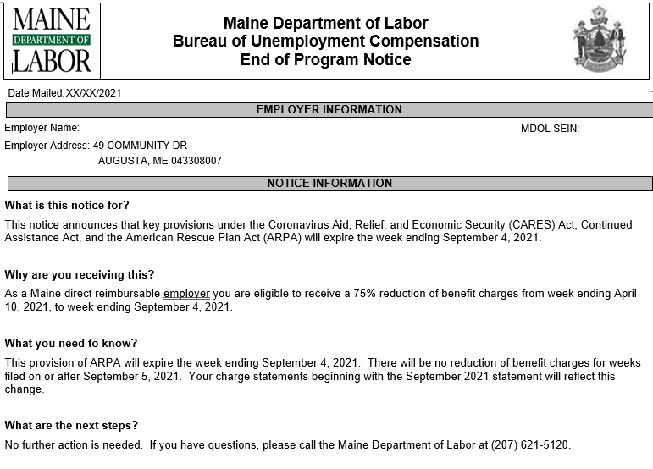

Slide 14
ReEmployME System: Planned Improvements to Improve Access
Laura Boyett, Director
Bureau of Unemployment Compensation
Maine Department of Labor November 17, 2021

Slide 15
Overarching Question
G. Any software or technology issues contributing to delays, claims processing issues and paperwork burden to businesses that may be resolved through technological means or any ways to promote improved claimant or employer user experience and interface with the unemployment insurance system.

Slide 16
ReEmployME System
Benefits implemented in late 2017, Tax in 2018. Replaced 40+ yr old brittle, inflexible, unreliable & unsupportable systems
Powerful back-end, rules-based engine – Cloud hosted, enhanced security & fraud protections
Multi-state core program plus individual state unique programming
Flexible & readily adaptable to changing needs
Benefits & Tax systems fully integrated – previously had been separate with complicated bridge system that limited functionality

Slide 17
ReEmployME System
Benefits:
Pre-pandemic: supported 9 - 10 ongoing State & Federal UI Benefit programs (reg UI, UCX, UCFE, EB, DWB, TRA, ATAA, DUA, RESEA, plus MEO although not currently active).
During early pandemic: rapidly added 6 new & complex benefit programs (PUA, PEUC, FPUC, LWA, PRP, MEUC)
Since 3/15/20: processed over 154 thousand (not ID theft) initial claims (95% found eligible) & 4.6 million weekly claims
Paid close to $2.5 billion in state & federal benefits

Slide 18
ReEmployME System
Tax:
Currently supports just under 50,000 taxable & direct reimbursement employers
Full, online functionality – reduced reliance on paper
Provides employers with in-depth view of their own account including:
unemployment history,
payments,
changes

Slide 19
ReEmployME System
Advantages:
New system is far more robust, stable, adaptable & powerful
Leverages multi-state funding for new & ongoing functionality
Increased capacity to remain current & modernized
But:
Existing customer interface does not meet needs of all individuals & employers for four reasons:
Unemployment terms and text used is not easily understood by those outside of the unemployment program
Look & feel of online screens can make navigation confusing
Not web/mobile responsive
Difficult for those with limited English proficiency

Slide 20
Goal – Equitable Access For All
Improvements using human-centered design began in Fall 2020 and continued through Winter/Spring:
Used claimant surveys, interviews, design feedback & prototype testing to:
Create confirmation email/screen
Redesign weekly claim app & work search form
Update claim status terminology
Incorporated “Plainspeak” in correspondence – claimant & employer
Workshare improvements based on employer interviews
Strengthened System Integrity – Fraud Protections

Slide 21
Current & Ongoing Improvement Plans:
Multi-state consortium commitment to improving customer experience for both claimants & employers
Claimants:
Currently redesigning claimant registration & account screens which will be followed by:
Initial claims
Review weekly claim
Appeals & remaining functions
Chatbot & Voicebot (multi-lingual)
Web Responsive Apps (mobile friendly)
Improved communications – plainspeak, nano-videos

Slide 22
Goal – Equitable Access For All
Employer application plans:
Chatbot & Voicebot
Workshare improvements – self assessment tool, online login, inquiry screen, dashboard & reports, online application & weekly certifications
Improved communications (plainspeak) w/employer input & testing
Employer Portal improvements – communication hub

Slide 23
Maine Involvement w/National Initiatives
US Digital Services – UI Modernization Project
USDOL Office of Data Evaluation – Equitable Access Initiative

Slide 24
Next Meeting
December 15th meeting items to discuss (December 15th 2-4 pm):
Initial findings
Additional discussion
Report Deadline to Committee is January 15th
Working Group Webpage:
https://www.maine.gov/unemployment/stakeholders/
Working Group Email:
UIStakeholdersGroup.DOL@maine.gov

