Slide 1
Agenda
Agenda for UI Working Group, October 20th, 2021
Welcome
Introductions
What changes are being made or could be made to the workshare program
Changes to the RESEA program to increase participation
How to connect employers with the unemployed post-pandemic
Review effectiveness of Title 26 Sec. 1044
Closing and Next steps

Slide 2
Maine WorkShare Program: Pandemic Experience and Planned Improvements
Laura Boyett, Director
Bureau of Unemployment Compensation
Maine Department of Labor October 20, 2021

Slide 3
WorkShare Pandemic Experience
March 2020 through September 2021:
246 WorkShare Plans covering 5,000+ employees
Prevented 3,044 layoffs
Not all smooth though:
Pre-Pandemic (low unemployment): 1-2 plans/yr.
Processed manually & paper driven
Labor intensive for both employers & UI staff
Generated processing & benefit delays & problems

Slide 4
Process Improvement Plan
Customer - centered approach: 4 companies interviewed (2 lg, 1 med, 1 small)
Findings:
Process steps rigid
Inconsistency in payment timing
Employer WorkShare Administrator – no dashboard visibility into the system data or employee status
Not enough MDOL staff resources to meet demand
Application questions designed for State UI staff – confusing and counterintuitive for WorkShare participants
Reliance on manual data entry by employer and MDOL staff

Slide 5
Program Improvements
Initial Work (done)
updated programming to eliminate payment issues & delays
secure portal to upload ER weekly spreadsheet
RPA (BOT) technology to speedup processing
additional staff support
Planned future state
WorkShare program information including instructional videos
Workshare self-assessment tool
Online ER initial application & weekly ‘spreadsheet’ certification
Employer login, inquiry screen & dashboard
Redesigned weekly Workshare claim application (plainspeak)
Internal MDOL Workshare dashboard & reports

Slide 6
RESEA Service Delivery Overview
Andrew Robinson, Program Manager
Bureau of Employment Services
Maine Department of Labor October 20, 2021

Slide 7
What is RESEA?
Federal-state UI programs provide benefits to individuals who have lost their jobs through no fault of their own as long as they remain able & available to work and are actively seeking employment.
In 2018, the Reemployment Services & Eligibility Assessment Program became a permanent part of the Social Security Act laws governing State & Federal UI programs.
The program is jointly administered by the Bureau of Unemployment Compensation and the Bureau of Employment Services.
RESEA has 4 purposes:
Reduce UI duration through improved employment outcomes,
Strengthen UI program integrity (through eligibility assessment),
Promote alignment with the vision of the Workforce Innovation and Opportunity Act (WIOA), and
Establish RESEA as an entry point to other workforce system partners.

Slide 8
What does an RESEA session consist of?
The term “initial RESEA” refers to the first meeting between a RESEA service provider and a UC claimant who reported to the meeting in response to an official notification of selection and required participation in RESEA services. The initial RESEA session is “completed” when the following components have been provided:
An unemployment compensation eligibility review including review of work search activities, (Review of work search log)
Relevant and individualized local labor market information, including live use of Maine’s Center for Workforce Research and Information (CWRI) website, (CareerOne stop o’net, myskills, my future websites to show labor market information)
Enrollment in Wagner Peyser Act funded employment services, (Relevant referral job fair, career center training)
Development, review, and recommendations on an individualized reemployment plan (IRP), (IRP plan)
Individualized and relevant referrals to services, jobs, other agencies, and additional reemployment resources as needed, (Referral to ACAP, Goodwill (job fairs), referral to DHHS, CCSP, vocational rehab etc, adult ed, specific job referral for those customers that have a full MJL profile set up)
An introduction and orientation to all the services the CareerCenter has to offer, including self-directed options and specific program eligibility, (Tell them about the career Centers)
Enhanced job matching and referral profile assistance in Maine’s JobLink (Make sure Job link account is accurate)

Slide 9
What does an RESEA session consist of?
Participation in reemployment services at levels appropriate to meet individual participant needs may include the following:
Access to job hunting in Maine guide,
Tools, tips, and strategies on conducting a successful job search,
Information on how to obtain further skill assessments and individualized job search services,
Introduction to USDOL’s online assessment and job search, tools, such as MySkills MyFuture™, O*NET tool, and My Next Move (aka Career Profiler), and
Coordination of activities with other programs and services.
At least one of the following career services based on need:
Referral to training or other workforce activities including WIOA,
Labor exchange-in-demand industries,
Information on availability of community based or WIOA support services,
Financial aid resources outside of WIOA,
Financial literacy services, and
Career readiness including resume writing and interviewing.

Slide 10
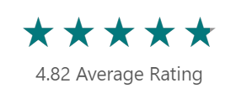
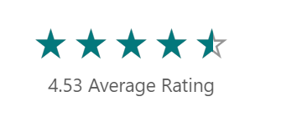
Current RESEA Participant ratings and response
How satisfied are you with your RESEA appointment.
The information was presented in a clear, useful manner.
I feel more confident in finding my next job after my RESEA session.
Success Stories
“Robyn” is an older worker with barriers to re-employment and “Steve” is a formerly incarcerated individual.
Staff worked with both to provide individualized services, including highlighting applicable jobs and wage levels.
Both Robyn and Steve were employed by the time staff followed up in two weeks after their RESEA session.

Slide 11
The RESEA appointment supports participant reemployment by leveraging effective program features and providing a positive customer experience
Re-enter job market
Participants is hired and RESEA and UI supports end
Follow-up from RESEA appointment
Follow-up communication to drive participants to action
RESEA appointment
Educational session with resources and live support to guide participants
Preparation for RESEA appointment
Tailored communication to remind participants of program objectives, resources, and solicit participant interests / questions to tailor session
RESEA Career Consultants help educate participants on RESEA requirements and assist them in navigating the resources needed to support job search and skill building / reskilling.
Enter UI
Participant begins receiving UI benefits after job loss

Slide 12
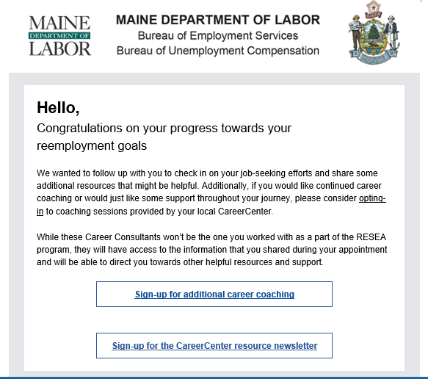
The Career Consultant will engage the participant after the appointment and offer ongoing support from the CareerCenter
Follow-up from RESEA appointment
Post-appointment summary email
After the appointment, Career Consultants email the discussion items from the appointment including:
Copy of completed Individual Reemployment Plan (IRP),
Referral to relevant program, service, or job posting
Follow up motivational email
1 week after the appointment, Career Consultants email the the customer a motivational email which includes:
A link to an RESEA satisfaction survey
An offer to sign up for additional Career Counseling services
2 week post appointment follow up call
2 weeks after the appointment, Career Consultants call the customer to follow up on job search efforts and offer additional career counseling services

Slide 13
Connecting Jobseekers to Employment
Kimberley Moore, Bureau Director
Bureau of Employment Services
Maine Department of Labor October 20, 2021

Slide 14
Maine CareerCenters
Maine’s CareerCenters are designed to provide a full range of assistance to job seekers and employers under one roof. The Centers offer jobseekers employment assistance including career coaching, job listings/referrals, and connections to programs and supportive services needed to land their next job.
Services focused on meeting jobseekers and employers where they’re at:
In Person/On-Site Services for Those Who Need Them
Saving a Trip: Virtual CareerCenter Services
Live Chat, CareerCenter Hotline, Consultant of the Day
Virtual Job Fairs and Employment-Focused Workshops
Partnership with Libraries, Community Partners, and Ethnic-Based Community Organizations (ECBO’s)

Slide 15
Workforce barriers are individualized, nuanced and complex. Many relate to the need for:
Relevant, accessible training & job opportunities
COVID-19 health safety
“Quality” jobs with supportive wages, benefits, flexibility & safety
Social supports & infrastructure

Slide 16
Customized Connections- Let us help you find your perfect match!
Looking for work today means finding that perfect match. Jobseekers have unique priorities to consider like flexible hours, distance from home or childcare, work environment, benefits- and businesses are responding!
CareerCenter’s close connection to employers gives us an inside look, beyond the basics found in a job description.
Consultants can use that knowledge to develop employment goals, then host events that match jobseekers interests and skill set to the interests and skills sought by invited employers.
Focused approach ensures that the talent in the room is aligned with the employers’ needs and streamlines the process of finding the right match!

Slide 17
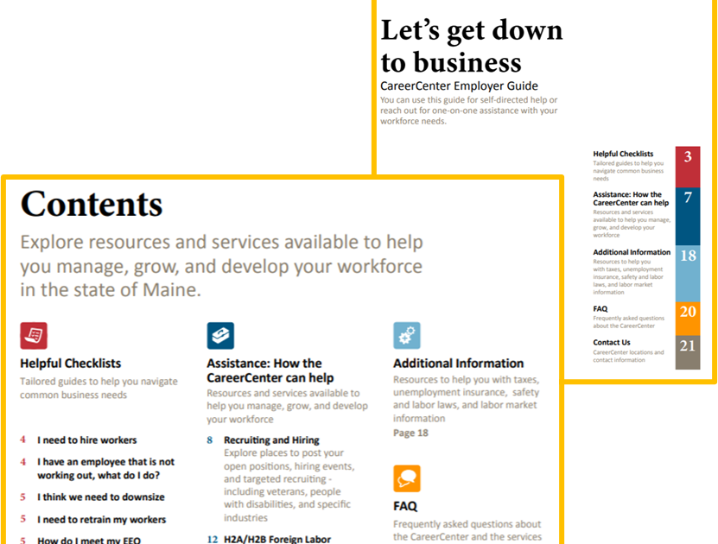
Best Practice: Customer Centered Design
Jobseeker and Employer
Resource Guides

Slide 18
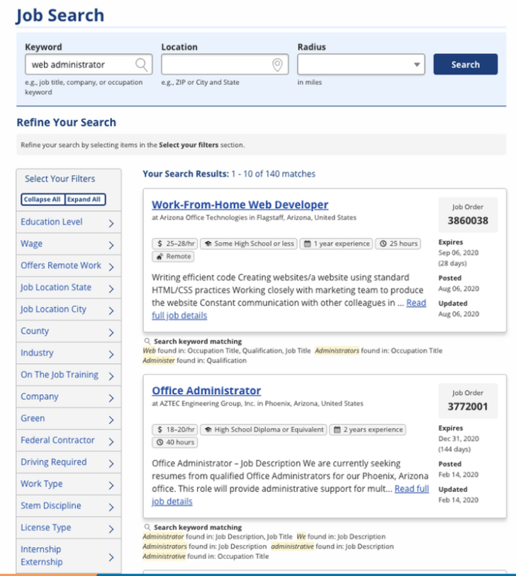
Maine JobLink
We’ve updated our job search, giving more information to jobseekers at-a-glance, including:
Tags for wages, education, and experience needed, as well as hours available
Information on posting, expiration, and updated dates
New “Offers remote work” filter and flag
Keyword matching

Slide 20
On the Horizon
Expanded capacity in the CareerCenters focused on connecting those most affected by COVID-19 and struggling to reenter the job market to employment opportunities through targeted outreach, focused career guidance and planning, and enhanced partnerships
Virtual American Jobs Center (DOL CAREER Grant)- in partnership with the Local Workforce Areas, will focus on coordinated, streamlined, accessible virtual service delivery

Slide 21
Is Title 26 Section 1044 Working Effectively?
Laura Boyett, Director
Bureau of Unemployment Compensation
Maine Department of Labor October 20, 2021

Slide 22
Title 26 Section 1044
§1044. Protection of rights and benefits
1. Waiver of rights void; penalty. Any agreement by an individual to waive, release or commute his rights to benefits or any other rights under this chapter shall be void. Any agreement by an individual in the employ of any person or concern to pay all or any portion of an employer's contributions, required under this chapter from such employer, shall be void. No employer shall directly or indirectly make or require or accept any deduction from wages to finance the employer's contributions required from him, or require or accept any waiver of any right hereunder by any individual in his employ.
Any employer or officer or agent of an employer who violates any provision of this subsection shall, for each offense, be guilty of a Class E crime.
2. Limitation of fees; penalty. No individual claiming benefits shall be charged fees of any kind in any proceeding under this chapter by the commission or its representatives or by any court or any officer thereof unless otherwise provided by Title 5, section 8001 et seq. Any individual claiming benefits in any proceeding before the commission or a court may be represented by counsel or other duly authorized agent; but no such counsel or agents shall either charge or receive for such services more than an amount approved by the commission.
In the event a claimant has retained counsel for the purpose of prosecuting an appeal from a decision of the commission, and the final decision of such court results in a reversal, in whole or in part, of the decision appealed from, the fees for such service shall be paid by the commissioner from his administrative fund.
Any person who violates any provision of this subsection shall be guilty of a Class E crime.
3. No assignment of benefits; exemptions. Any assignment, pledge or encumbrance of any right to benefits which are or may become due or payable under this chapter shall be void. Such rights to benefits shall be exempt from levy, execution, attachment or any other remedy whatsoever provided for the collection of debt. Benefits received by any individual, so long as they are not mingled with other funds of the recipient, shall be exempt from any remedy whatsoever for the collection of all debts except debts incurred for necessaries furnished to such individual or his spouse or dependents during the time when such individual was unemployed. No waiver of any exemption provided for in this subsection shall be valid.
https://legislature.maine.gov/legis/statutes/26/title26sec1044.html

Slide 23
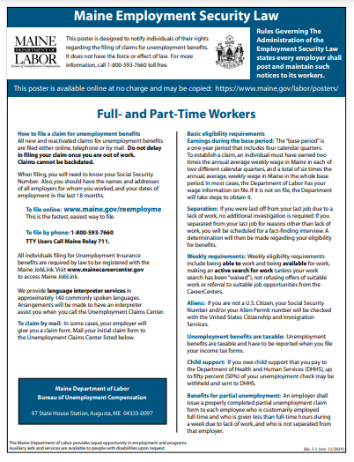
Current Practice
§1194. Claims for benefits
1. Filing. Claims for benefits shall be made in accordance with such regulations as the commission may prescribe. Each employer shall post and maintain printed statements of the regulations in places readily accessible to individuals in his service and shall make available to each such individual at the time he becomes unemployed a printed statement of those regulations. The printed statements shall be supplied by the commissioner to each employer without cost to him.
A free poster is available online and required to be posted by employers. (https://www.maine.gov/labor/docs/2019/laborlaws/MaineEmploymentSecurityLaw_1119.pdf)

Slide 24
Next Meeting
November 17th meeting items to discuss (November 17th 2-4 pm):
Streamline and facilitate application for UI benefits that will increase access for unemployed workers
Creation of an employer liaison program and how that may be utilized
Review UI technology system to identify potential enhancements to improve access and streamline processes for claimants and businesses
Working Group Webpage:
https://www.maine.gov/unemployment/stakeholders/
Working Group Email:
UIStakeholdersGroup.DOL@maine.gov

