Slide 1
Department of Economic
& Community Development
Maine’s 10 Year Economic Strategy Update:
State Workforce Board
June 2023

Slide 2
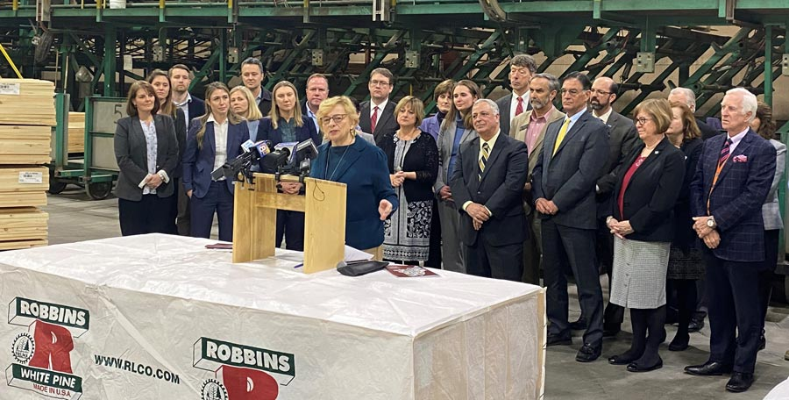
Strategic Plan
Three Goals

Slide 3
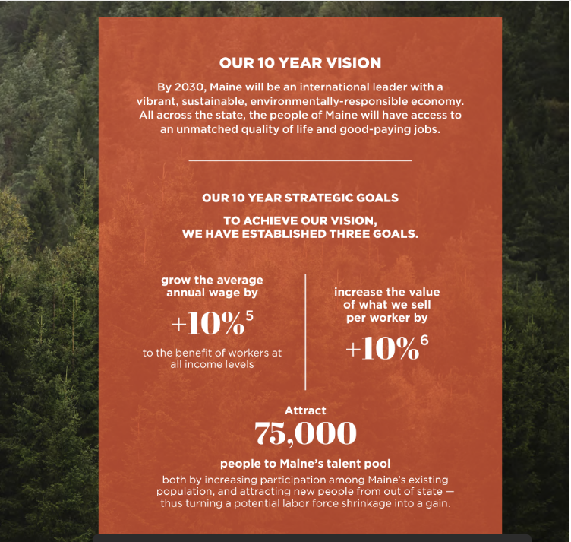

Slide 4
Strategic Plan –
Seven Strategies

Slide 5
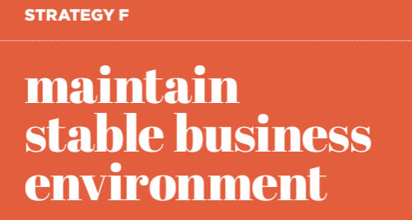

Slide 6
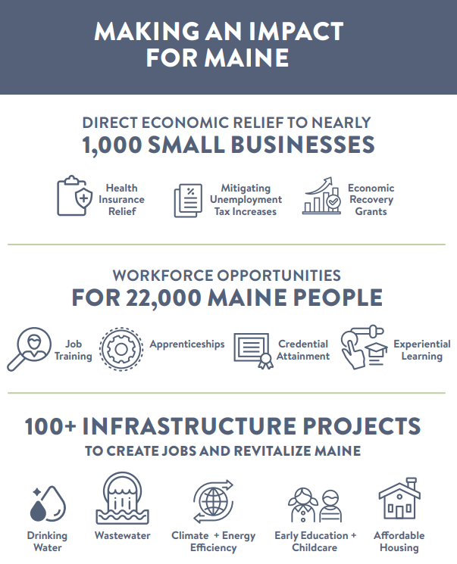
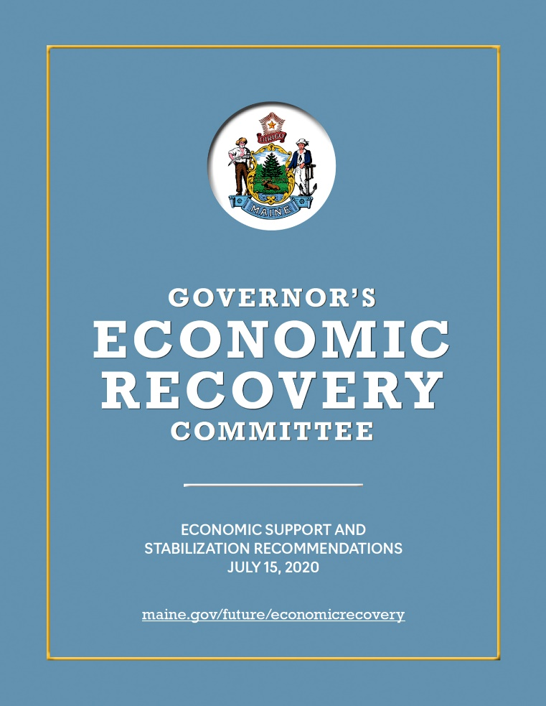
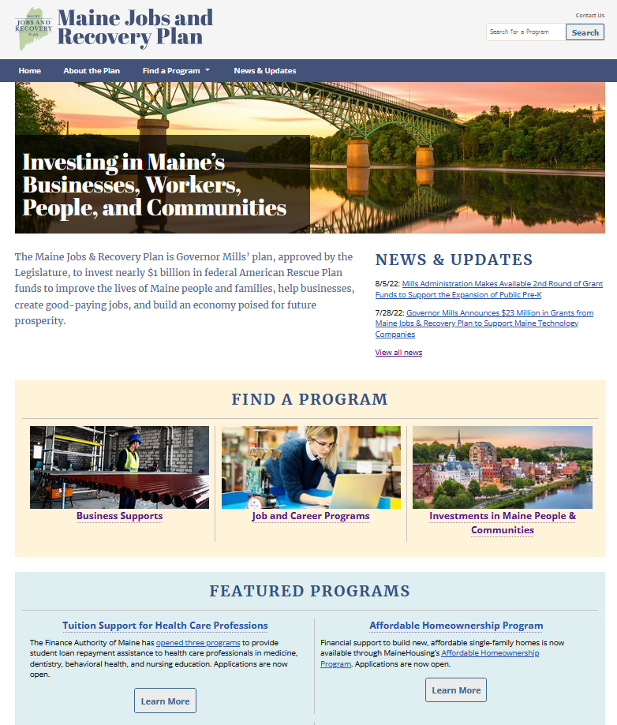
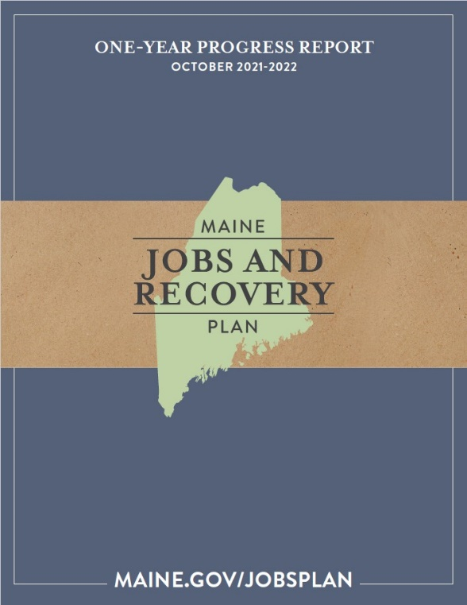
Investing to advance our 10-Year Plan goals: Maine Jobs & Recovery Plan
MAINE JOBS & RECOVERY PLAN AT 12 MONTHS
2019
Maine’s 10-Year Economic Strategy
2020
Governor’s Economic Recovery Committee
2021
Maine Jobs & Recovery Plan
(LD 1733)
2022
MJRP 1-Year Progress Report
Maine.gov/jobsplan

Slide 7
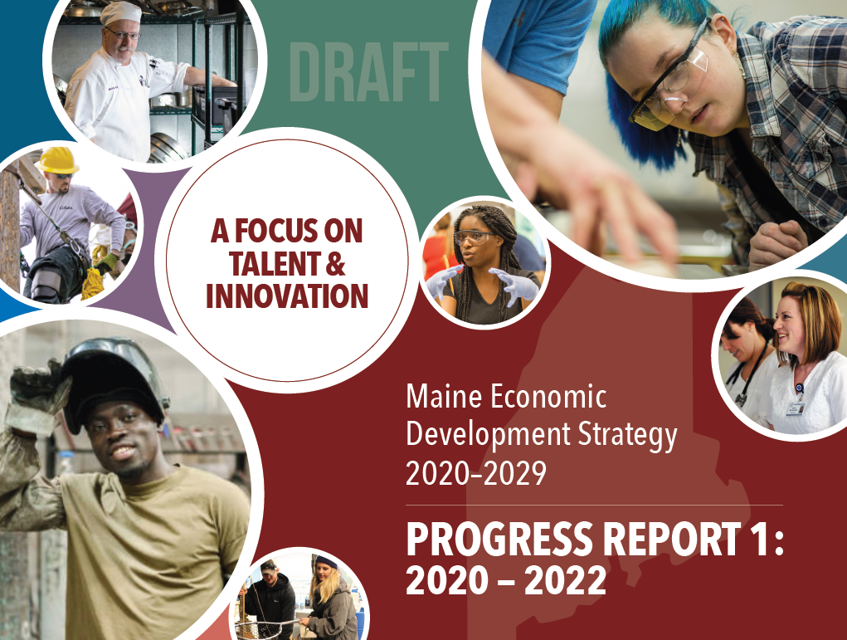

Slide 8
Department of Economic
& Community Development
Economic
Update
Grow wages by 10%
Difference Made 11.6%
7th best in the U.S.
Increase productivity by 10%
Difference Made 12.8%
3rd best in the U.S.
Attract 75,000 to Maine’s Talent Pool
Difference Made: ~13,400 to Maine’s talent pool
7th best domestic in-migration in the U.S.

Slide 9
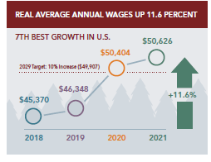
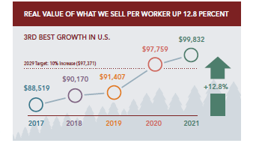
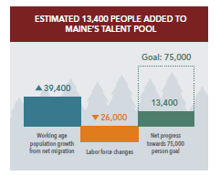
Department of Economic
& Community Development
Economic
Update

Slide 10
What’s in the Maine Jobs & Recovery Plan?
Business Supports
Jobs & Career Programs
Investments in Maine People &
Communities
DEIB Initiatives
Small Businesses
($120M)
New Businesses
($8M)
Heritage Industry & Sector- Specific Supports
($109M)
Apprentice-ships
($11M)
Career Counseling
($10M)
Career Exploration
($25M)
Broadband
($21M)
Clean Water
($68M)
Climate & Energy Efficiency
($78M)
Economic Dev’t
($103M)
Regulatory Reform
($13M)
Worker Attraction, Dev’t, & Retention
($24M)
Education & Job Training
($109M)
Health Sector Careers
($18M)
Clean Energy Careers
($4M)
Early Childhood
& Family Caregiving
($31M)
Gov’t Services
($72M)
Housing
($65M)
Agriculture
Commercial Fisheries
Forestry
Innovation Economy
Clean Energy
Legal Assistance
($5M)
Outdoor Recreation
($72M)
Public Health & Safety
($27M)

Slide 11
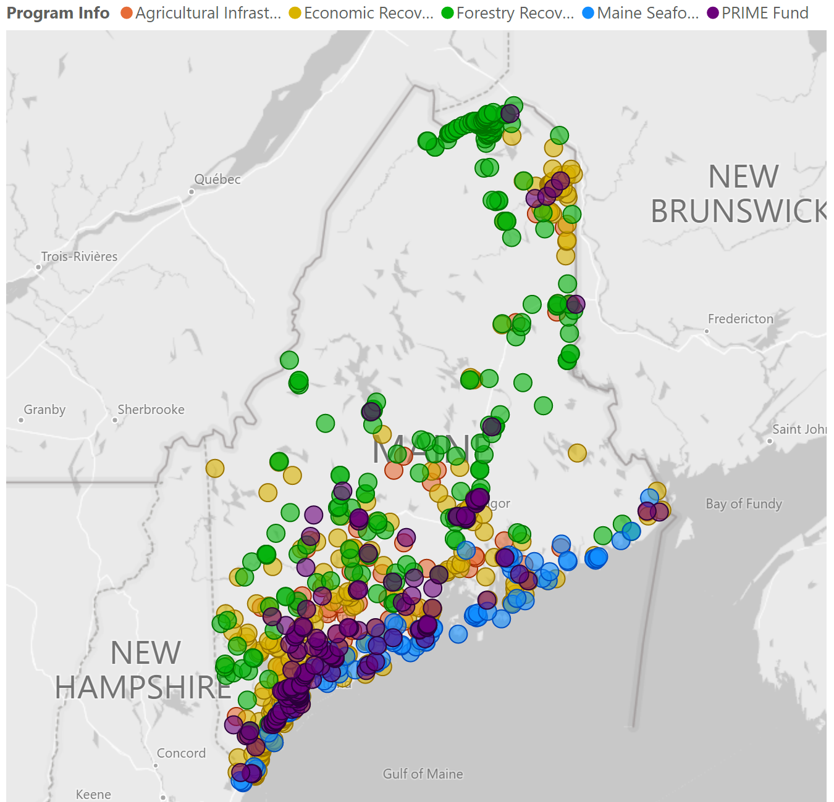
Delivering relief to +1,000 businesses
Ongoing & Still Ahead
DECD Domestic Trade program
DECD Economic Recovery Hubs, including grants for new businesses
DECD Electric Grid Upgrade Grants
FAME Grow Maine (SSBCI)
DOT Workforce Transportation Pilots
EMT Energy Efficiency Incentives
Research and technical assistance opportunities through Umaine
Additional rounds of DECD Economic Recovery Grants, MTI Prime Grants, and FAME Thrive loans
Notes:
Totals
ERG (MRJP)
Agr Infrastructure
Forestry Infrastructure
Seafood Infrastructure
PRIME
= 1002 grants @ $89.5 million

Slide 12
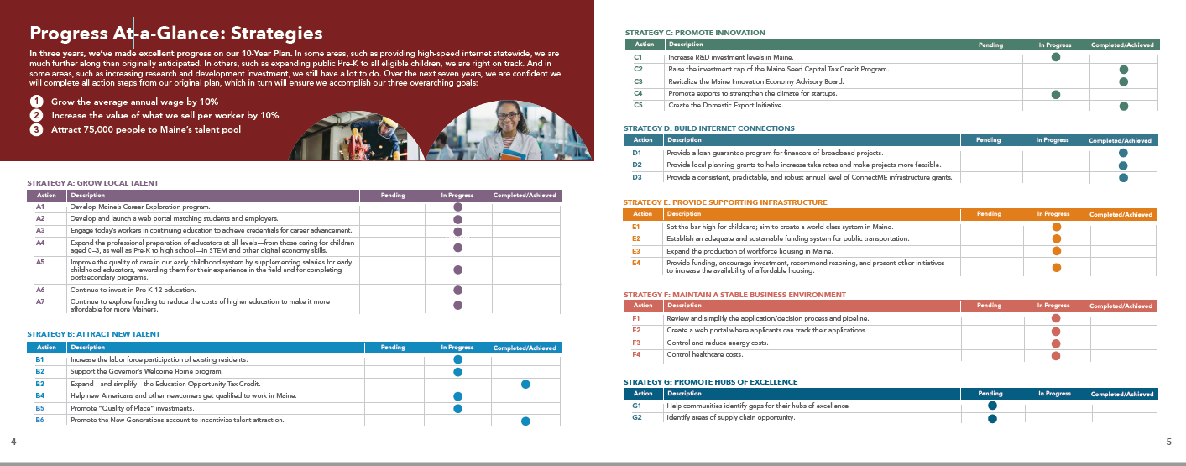

Slide 13
Department of Economic
& Community Development
Stakeholder Engagement to:
Share Progress Report Findings
Identify New Set of Actions through:
Existing opportunities
Customized in person regional and sector-based gatherings
Statewide virtual engagement
Next Step

Slide 14
Stakeholder Engagement Mapping
Opportunities for Engagement | Jun | Jul | Aug | Sep | Oct
GROW LOCAL TALENT
Sea Maine
ForMaine
State Workforce Board
Local Workforce Boards
SWB Industry Partnership Grantees
ATTRACT NEW TALENT
Workforce Cabinet Working Group
External Stakeholder Engagement Sessions

