Slide 1
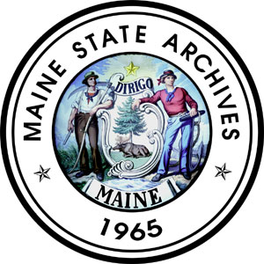
Records Management Training for
Records Officers and Assistants
Records Officer Training March 2026

Slide 2
Welcome to Records Management!
Topics Covered:
Introduction to Maine State Archives
Records and Records Management
Records Management Processes
Public Records and FOAA
Review of Electronic Record Management/Email
State Records Center

Slide 3
Steps to Complete Training
Go through the training at your own pace making sure that you understand all the Records Management concepts.
When you complete the last section there will be a link to a form on the last page. There you will find some “review” questions to answer.
Submit your name, department and division to verify completion of training. (Training should take approximately 30 minutes.)
You will be responsible for your agency’s Records Management program. The Maine State Archives wants to make sure you have the information you need to help YOU so you can help YOUR AGENCY.

Slide 4
Maine State Archives
Laws and Rules
Maine Title 5, Chapter 6, State Archivist
Archives and Records Management Law - it is the policy of the State to make the operations of State Government and local government more efficient, more effective and more economical through records management; and, to the end that the people may derive maximum benefit from a knowledge of state affairs, preserve its records of permanent value for study and research.
Rules (Secretary of State (29)/Maine State Archives (255)
Chapter 1 – State and Local Government Agency Records Programs
Chapter 2 – State Records Center Facilities and Services
Chapter 3 – Imaging State Records
Chapter 4 – Rules for the Public Use of Materials and Facilities in the Maine State Archives

Slide 5
What is a Record?
Record means all documentary material, regardless of media or characteristics and regardless of when it was created, made or received or maintained by an agency in accordance with law or rule or in the transaction of its official business. Record does not include extra copies of printed or processed material of which official or record copies have been retained, stocks of publications and processed documents intended for distribution or use or records relating to personal matters that may have been kept in an office for convenience.
Record includes records of historic and archival value to the State, regardless of the date of their generation, including all documents determined to have such value to the State by statute and, when appropriate, by the State Archivist.

Slide 6


VS.
Examples of Potential Records:
State Government correspondence, studies, FOAA requests, meeting minutes, grants, contracts, case files, and policies
Examples of Non-Retention Materials or Non-Records:
Vendor catalogs, duplicate copies saved for convenience, stock copies (bulk forms, etc.), and personal messages

Slide 7
Specific Types of Records
Archival/Permanent Records - Records required to be kept indefinitely because they have enduring or historical significance. Once business needs of the agency are met, archival records contain a secondary, research value.
Closed Records - This typically occurs when the normal business process has concluded. Records would then either be destroyed or a retention period would begin.
Confidential Records - Records which are exempt from public inspection according to law.
Current (Active) Records - Those records needed for day-to-day business use. Electronic Records - Records that cannot be read without the use of electronic equipment. Includes both digital and analog records.
Essential Records - These are records necessary to re-start an organization's operations in the event of a disaster.
Non-Records - Non retention materials
Temporary Records - Records which will be destroyed once they have met their agreed to retention period. These can be short or long-term retention records.
Transitory Records - Records having short-term value. Usually, we think of correspondence in this category which would typically be less than 30 days.

Slide 8
Drafts and Working Documents
Working documents and drafts are public records but might only need to be retained for a brief period if they do not have significant administrative, legal, fiscal or historical value.
Considerations when retaining working documents and drafts:
Significance of the document being drafted;
Specific legal requirements relating to the retention of certain preliminary drafts;
Need for records as evidence that the agency practiced due diligence in the drafting process;
Unique/substantive information relating to formulation and execution of high-level policies or decisions.
For more information on DRAFTS see the RM Advice Bulletin available on our website.

Slide 9
Your Records are Informational Assets
People will come and go but the agency continues to operate because RECORDS provide the continuity for the ongoing operations and mission of the agency.

Slide 10

What is Records Management
“…field of management responsible for the efficient and systematic control of the creation, receipt, maintenance, use and disposition of records including the processes for capture and maintaining evidence of and information about business activities and transactions in the form of records.” (ISO 15489)
Records Management is all about CLASSIFICATION - knowing what you have, where you have it and how long you need to keep it.

Slide 11
Major Reasons Why Good Records Management Is Vital
Supports Better Management Decision Making
Improves Efficiency and Productivity
HOW – by organizing active records, by setting retention and disposition of all agency records and therefore managing all inactive records
Promotes a Positive Reputation for State Agencies
Protects the Agency and the Records
HOW – ensures compliance with laws and policies and provides consistency throughout the agency (so all employees are keeping records for the same amount of time)
Safeguards Essential/Vital Information
HOW – provides the agency with an inventory and plan to protect all the records which are necessary to re-start the agency’s operations in the event of a disaster.

Slide 12
Records Officers and Assistants
A Records Officer Coordinates the Department’s Records Management Program and ensures records management activities are performed in accordance with standards and procedures.
You don’t need to be an expert on everything, but you need to know enough to be able to ask the right questions and provide proper records guidance. It’s important to communicate across your agency that records management is an integral part of state government operations.
RM responsibilities:
Answer questions regarding the State General Schedules
Answer questions regarding Agency Schedules
Complete Schedule and Inventory forms
Assist staff with packing boxes and completing transmittal forms
Assist staff with records request forms

Slide 13
Additional RO Expectations
Assign card holders
Coordinate record transfers
Direct other agency employees
Maintain agency RM program
Help conduct inventories
Create internal guidelines
Conduct regular reviews of schedules
Prepare and submit agency schedules
Staff training
Maintain RM files
Sign RM forms

Slide 14
Conduct a Records Inventory Identify Agency Records
An Inventory is an important first step in determining what records your agency is creating and retaining. It is a gathering and documenting of all the information created, received and stored by your agency.
A Records Inventory can tell you:
Records Series
Format
Location
Date range
Volume of material
An Inventory is perhaps the most important, often overlooked step in the Records Management process. BUT…if you don’t know what you have, how can you properly schedule your records and determine what should stay and what should go.
Contact Records Management to help you get started on an inventory of records in your agency!

Slide 15

Building a Structure
Once you know something about your records, analyze results and think about their functions, determining how records are used and build a structure that reflects those different uses.
Things to Consider
What records are you retaining, for how long, and for what purpose?
What format are the records in?
Do any statutory retention requirements apply to your records; any rules or policies exist which outline retention?
Where are records stored and who has access to them?
What process is in place to destroy records once retention is reached (for both paper or electronic records)?

Slide 16
Managing Your Records
In order to have the information you need (when it’s required), there needs to be a way to identify, manage and retain records for the right amount of time. This is done by Record Retention Schedules

Slide 17
What Is a Records Schedule?
A Records Retention Schedule lists all the titles of a records series, length of time each series will be retained as an active record, the reason for its retention and disposition agreed by the agency and Records Management.
Basically, the retention schedule is a set of work instructions for everyone in the agency.
Without these written instructions, staff can’t be expected to be held accountable and keep records on a consistent basis.

Slide 18

Schedules Provide a Defensible Position
Schedules provide the defense and support for any actions your agency takes regarding the records in your office. If there is ever any question about records being kept or destroyed or any legal issues, you have the schedules as your justifiable defense provided:
all agency records are on a schedule;
schedules are up to date;
retention periods can be justifiably explained.

Slide 19
Why Bother with Retention Schedules
For obvious reasons schedules are necessary because things need to be written down so everyone in the office has a description of what is what (even after the rest of us are gone).
You might know what the record means to you today and how long to retain it, but will you still know a year from now? Will the person who comes after you know what files are being retained and why (either in paper format or electronically)?
Schedules provide a vital tracking mechanism for agency records.

Slide 20

How a Schedule Can Work for Your Agency
Agency policy document
List of work instructions
Compliance document
A major goal is to provide clear guidance for agency employees on how long they should be retaining records and to make sure everyone in the agency is retaining records in a consistent manner.

Slide 21
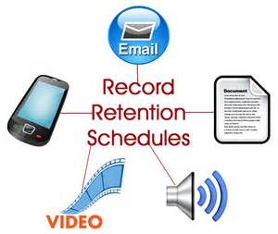
What Records Need to Be on a Schedule?
ALL state government records must be covered by retention schedules.
This includes records that are retained and destroyed in the agency (not just those that are sent to the State Records Center or Archives).
It applies to electronic records just as it applies to paper.

Slide 22
Types of Retention Schedules
General Record Schedules - issued by the Maine State Archives to provide retention and disposition standards for records common to most State agencies
Agency Schedules – for those records unique to the office

Slide 23
State General Schedules
The State General Schedules were updated in March 2022. There are nine schedules for the following categories:
GS1 Administrative Records
GS2 Financial Records
GS3 Payroll Records
GS4 Personnel Records
GS5 Correspondence Records
GS6 Electronic Records
GS7 Records Management
GS8 Meeting and Board Records
GS9 Miscellaneous/Short-Term Materials

Slide 24
Retaining Records Per the State GS
It is highly recommended that agencies review the updated guidance of the State General Schedules. There are many changes, new schedules and new series to provide minimum standard guidance for those records common to most state agencies.

Slide 25
Retaining Records Per the State GS
State General Schedules may be used to retain and destroy the records in your office EXCEPT under the following conditions:
You will be sending records to the State Records Center for any reason, or any listed archival records which must be sent to Maine State Archives (Commissioner’s Correspondence for example). An agency schedule will then be required to provide unique schedule and series identifiers to transfer records.
Records are required to be retained longer than GS minimum recommendations per specific laws or other mandates. An agency schedule would then be necessary.

Slide 26

When you Find Documents in Your Agency - Schedule Process
Before you create an Agency Schedule for any documents you find in your office, consider the following:
Are these actual records documenting the functions of the agency or are they possible reference/non-record materials?
Are these records covered by the State General Schedules which can be retained in the office until they are destroyed?
Do the records already exist on an Agency Schedule?

Slide 27
If the documents are records and not on a General Schedule or existing Agency Schedule, then a new schedule will need to be created.
The Agency Records Officer submits an Application for Records Retention Schedule and Inventory Form (available on our website) with proper justifications for the chosen retention times. Samples of the materials are also submitted.

Slide 28
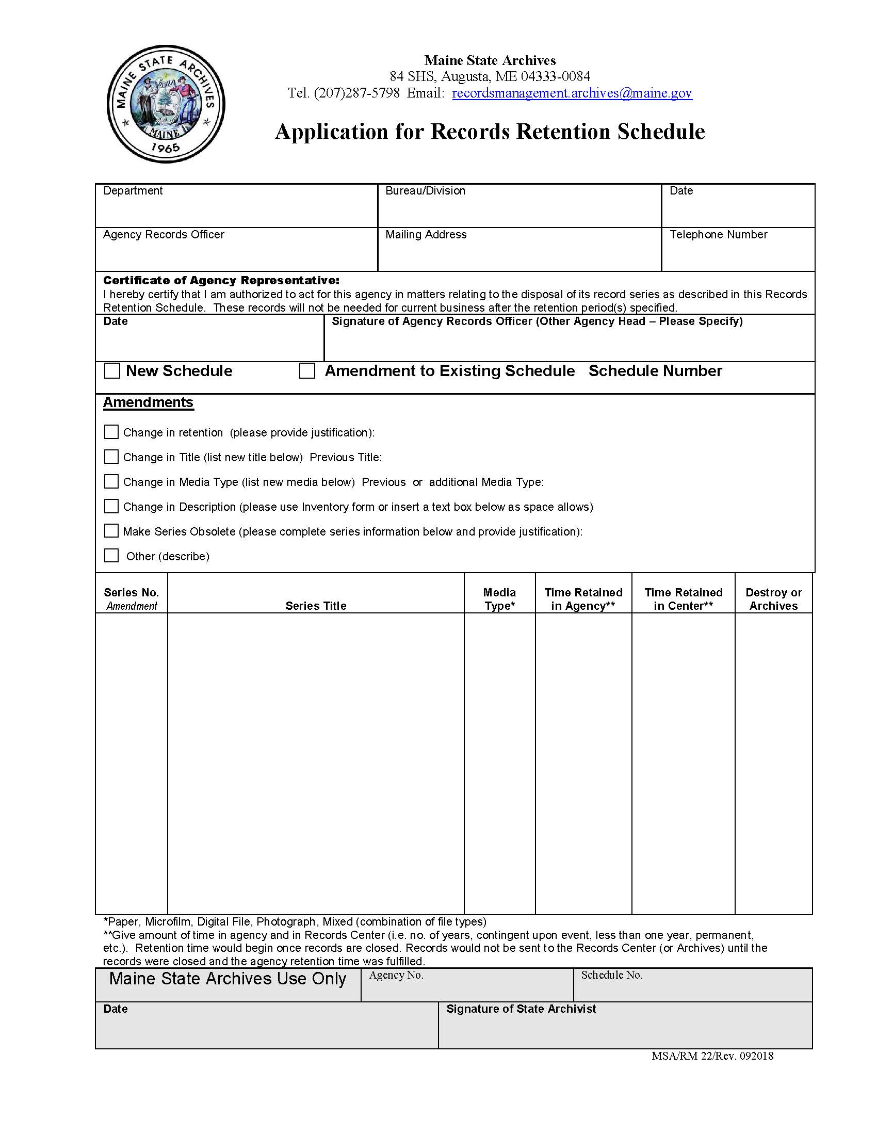
The Record Retention Schedule application provides general information about each series to be scheduled and the Inventory form provides detailed information, including the series description.
More than one series can be included on the Schedule form however, each series would require its own Inventory form.
(Consider the Record Retention Schedule as a “batch form” to group related record series.)

Slide 29

When looking at reasons a record is kept you may want to consider the following:
Day-to-day business operations
Audit and Budget
Agency Policy
Strategic planning
Regulatory requirements
Claims or investigations
If a record is required by law or statute, it may have a retention period that you can apply to it. In this case, you would need to research and cite your source.

Slide 30
Review and Approval
Any new schedules or amendments are submitted to the Records Management Analyst for initial review.
If there are any basic questions or retention justifications that need to be made, the Analyst will send a request back for further information or clarification. If the Analyst agrees with the submitted schedule or amendment, it will move on to the State Archivist and Archives Advisory Board for final approval and adoption.
A signed copy will be returned. This is considered an agreed to contract between the submitting agency and the State Archives. Agencies are expected to follow agreed to retentions and disposition.

Slide 31
What Makes a Record Series
A series is a grouping of records that support similar business processes or contain similar information and have related legal or operational retention requirements.
Some characteristics of a record series are:
Produced by the same activity
Documents a certain kind of transaction
Relates to a particular subject
Arranged under a single filing system
Each record series consists of a description of the process the records support and examples of the types of records that fall under the series.
A retention period is associated with each record series (and must be the same for all records in a series).

Slide 32
Series to AVOID
Avoid series categories such as “miscellaneous” or “general.” Agency schedules should list unique records and there isn’t any place for a “general” record at the agency level.
Creating a general category is like developing some “catch-all” type of category for unrelated records, creating the exact opposite effect of what the agency retention schedule is supposed to provide – exact instructions for your employees on what to do with specific records.

Slide 33

How to Determine Retention Periods
Most agency retentions will be based on the business process for the agency.
An important thing to remember about business need in support of an active process is that it’s typically a finite need.
There may also be archival purposes beyond the active business needs.
An agency needs to look at the value of the records. If they have met business need and legal obligation – ask why the agency would need to keep them. Is there some historical/enduring value to the record?
Records Management staff can assist agencies, but it is the agency’s responsibility to know their business process and be able to appropriately judge the value of their records.

Slide 34
Determining Retention Periods 4 Part Criteria
Administrative use: Value of the records in carrying out the function of the organization. Records are needed for immediate retrieval. Day to day business operation; correspondence, memos, reports – typical need for these records is under 5 years.
Legal requirements: Records specified with certain periods for compliance with statutes, agency rules or protection of legal rights and interests. State/Federal retention periods involved. Records mandated by law or regulation which may be needed as evidence in legal cases or leases, contracts, court case files. There may be specific language stating how long records are required to be retained for legal purposes.
Fiscal requirements: Records required to be retained for the completion of fiscal activities such as audit or budget. They document an agency’s fiscal responsibilities; invoices, receipts, purchase orders. Typically, audit records are kept 6 or 7 years. Some Federal requirements may be 10 years.
Historical or research purposes: These records may document historical events or the history and development of the organization. Records which have archival/enduring value; board minutes, agency policy decisions, Commissioner’s correspondence.

Slide 35

It would be easy just to keep everything for as long as possible just in case someone, someday might want the records or in case they will provide some evidentiary information for a possible lawsuit or investigation.
However, this type of retention is both costly and impractical and would be considered poor records management.

Slide 36

When Does Retention Begin?
Retention starts at some Trigger Event - something which occurs to initiate the beginning of the retention period. Typically, for most state government records, it is when a record is considered closed (when the normal business process has concluded).
For other records it could be based on a specific event such as the close of a Legislative session; termination of employee; specific age of client; or settlement of litigation.
Decide what your trigger event for your records will be so you know when the retention period begins.

Slide 37
Determining Final Disposition
ARCHIVAL
First, determine if the records have any historical significance. Once they have served the needs of the agency, will these records show: the history of the agency or historical events; how policy was formed; or other significant records which will be important to the general public hundreds of years in the future?
Other things to consider:
Is this a publication? By the agency or outside entity?
Is this duplicate material which can be found elsewhere?
Is this confidential (for how long)?
Is this a collection of miscellaneous items valuable to one (for reference purposes) but, can either be found elsewhere, or would not necessarily be of value to the public for research/history?
Is this found on media which will potentially become obsolete?
If Non-Archival - DESTROY
If you have determined records are non-archival (non-permanent), retention is based completely on the record’s time-value to the business functions of the agency. Records will be destroyed once they have met their retention.

Slide 38
Schedule Amendments
After a retention schedule has been approved by the Maine State Archives, your agency may need to change it.
You might need to do this because of a change in statute or law, agency policy, in your business needs, or simply because experience with the records tells you they are being accessed differently than expected when writing the current schedule.
It could be the program has ended and these records are no longer being created and the schedule and series will be made obsolete.
Perhaps your agency is changing from paper to digital records and there will be a change in media and retention times.

Slide 39
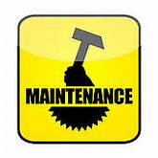
Record Maintenance
We recommend you review your schedules every 2 years. Schedules that are 40 years old are probably as ineffective and inefficient as having no schedules at all.
Review new laws and regulations that effect records retention requirements. Retention schedules can quickly become outdated.
Review programs, policies and procedures, and disposal processes on a regular basis. Clean out inactive records or those which have met their retention periods, including electronic records. Schedule a records “clean-up” day on a quarterly (or other regular) basis which every employee participates in.

Slide 40
Using Retention Schedules for FOAA
If retention schedules have been well designed, they can help considerably when processing FOAA requests.
The retention schedule tells you what you have and don't have - When you get a 10-year request for records, but your schedule states records are only kept for 6 years (and if you have followed your retentions correctly) this can save you time, so you know what or how much to search for.
Your schedule functions as an index - The schedule provides a list of records you have, how much you have, what format they’re in and where they should be stored.
The schedule helps you explain absent records - When there is a request and someone complains about the absence of records, you should be able to demonstrate that their absence is entirely legitimate based on properly justified retention periods – a defensible position.
NOTE: Any records requested by a FOAA request must be provided even for those records which should have been destroyed but were not (per the schedules). It is important to follow retention schedules and systematically destroy records.

Slide 41

Things to Consider
If your retention decisions are called into question, your retention periods must comply with applicable laws, so make sure that they do.
You need to be able to justify retention periods and understand the functions of your records. If nobody in your agency can explain how the schedule was developed, this could be taken as a sign of negligence.
The destruction of records should occur as a routine business process in accordance with the retention schedule.
Organizing and managing records (including electronic records) limits your liability and helps to ensure the integrity of the agency.

Slide 42
How to Comply With FOAA
As a state employee, you are creating public records every day. Never delete or destroy public records without referring to the applicable retention schedule. Manage your public records so that reasonable due diligence will uncover all relevant documents in a FOAA search.
If you do receive a FOAA request, immediately contact your agency FOAA representative or your supervisor to coordinate the response.
If you do become aware of a lawsuit or other type of discovery, any relevant records cannot be destroyed until it is determined that the matter is resolved, or the legal hold is lifted.
Further Information State FOAA website: http://www.maine.gov/foaa/

Slide 43
Records Management Policy
A Records Management program should always include a policy to define objectives and establish organizational support. A policy provides guidance and establishes the authorization and approval processes for the program.
The policy should address the following:
Purpose for an RM program
Scope of the policy
Benefits of the RM program
RM procedures
Staff responsibilities
Management directive
A policy will guarantee all employees are following the same records management procedures.

Slide 44
Keep Employees Informed and Trained
Be sure all staff members know about their recordkeeping responsibilities. Inform senior management on the importance of the records management program and train office staff on how it works.
Monitor and enforce the program to ensure employees are doing their part: appropriately classifying, managing, and destroying records. Have oversight procedures for employee compliance.
Records Management staff can help. We offer information on our website or can conduct training for Records Officers, Directors or personnel dependent upon the needs of the agency.
Refer staff to our website: www.maine.gov/sos/arc/records/state/

Slide 45
Electronic Records Management

Slide 46

Electronic Records
Electronic records are public records and subject to the same laws as paper records. Public records include anything created during public business regardless of format.
The retention and disposition of records is determined by their content, not by their format or storage location. There is no blanket retention period for email messages or other electronic files. Retention is always based on content (value), regardless of format.

Slide 47
Remember, a record, is a record, is a record. Electronic records must be managed just as paper records. This means when the record copy is in electronic format, it must follow the retention schedule; be retained and purged appropriately. (In other words, just because you CAN keep records indefinitely, doesn’t mean you SHOULD.)

Slide 48

Electronic Recordkeeping
Many agencies have transitioned to electronic recordkeeping systems or are in the beginning stages of converting from paper to electronic formats.
STOP and ask the following questions:
Are electronic record formats reflected in the schedules?
How long are electronic records being retained and how are they being managed?
If they are being retained longer than 10 years, is there a migration plan in place?
Has anyone from the agency talked to the Digital Archivist at the State Archives or reviewed the Chapter 3 Rules to make sure proper procedures are being followed for retaining electronic records?

Slide 49
When Scanning Records
Contact the Maine State Archives prior to imaging any state government records.
Comply with guidelines and standards in MSA Chapter 3 Rule: IMAGING STATE RECORDS.
Identify the appropriate retention schedules for the records involved.
Consider whether the agency will be able to manage the imaged records for the duration of the retention period.
Preserve original archival documents which are scanned. These records will be scanned for access only (not for “scan and toss”). Any original archival paper records must be transferred to the Maine State Archives.

Slide 50

Electronic records are generally suitable for official copies that will be retained for 10 years or less. These records can be saved with reasonable assurance they will remain readable until they have fulfilled their retention periods.
Think beyond your working lifetime for those records being retained 25, 50 years or longer.
Agencies must ensure that all records in an electronic system are retrievable and usable for as long as needed to conduct agency business and to meet approved dispositions.
Agencies must develop procedures to enable the migration of records and their associated metadata to new storage media or formats in order to avoid loss due to media decay or technology obsolescence.

Slide 51
When records are kept in more than one format, you should identify an official “record copy” to which the full retention period will be applied. When the record copy is electronic, it’s important to identify the storage location (directory and subdirectory) so that records are purged once they have met their retention.

Slide 52

Email Records
Email is a format, not a record. Retention is determined by the content of the email.
If you are conducting government business in an email it is considered a record (communication sent or received in the transaction of government business.)
Email is subject to the same retention requirements as paper correspondence.

Slide 53

Email Retention Periods
Most state employees will have little, if any, email requiring permanent retention. Generally, senior administrators through the division director level have a greater proportion of permanently valuable email, given its greater degree of policy content.
Email is generally considered correspondence. See State General Schedule 5, Correspondence Records, for further guidance.

Slide 54
When a message is created or received, determine if it is part of agency business. Non-record materials should be deleted immediately. Examples may include: personal messages, spam, and unsolicited email.
All email messages do not have the same value. Retention of email records are based on content and functions the messages perform. Just as it wouldn’t make sense to retain all paper records under a single retention period (based on the fact they are paper), the same principle applies for email.
Most employees will have email with short term value. However, email is also used to discuss program records, policy information and other records having significant administrative, legal, or research value requiring longer retentions.
As public records, email messages must be retained and disposed of according to approved retention schedules.

Slide 55
Good News
The Maine State Archives is aware of how difficult it is to manage email and has been working with Maine IT (as well as the Council of State Archivists) to create policies for employee email management.
What employees should be doing NOW…

Slide 56

Organizing Email/Set Up Folders
It is best to set up folders in your Outlook mailbox that organize email messages according to your retention schedules, with sub-folders set up by year and month.
This will make it easy to delete messages that have fulfilled their retention periods, without having to look at individual messages again.

Slide 57
Set Up Rules
Set up Rules for things like listserv items or other informational type materials you get on a regular basis that you may want to review periodically but don’t need cluttering up your inbox. These can be sent to named folders automatically with Rules and are much easier to manage (and delete).

Slide 58
Get Rid of the ROT
Delete those emails which are Redundant, Outdated and Trivial information or the records past retention.
Search for common keywords for records that are incidental, transitory, junk or spam. Use the lowest “common denominator” types of terms you can think of such as: breakfast, lunch, dinner, birthday, congratulations, announcement, weather, traffic.
Note: You can also use key words to manage records that are needed as proof and evidence of business transactions and file them accordingly.

Slide 59
Email Items to Consider
Non-retention material such as spam or personal messages should be deleted immediately; transitory messages should be deleted as soon as possible.
If emails are CC’s or Forwards where no action is taken or required, they typically can be deleted.
Don’t use personal email for professional business - Your personal email account could become subject to FOAA.
Limit the use of email in general. Because email is so convenient, we tend to overuse and misuse its intended state business purpose.
Fill in/use meaningful subject lines. This will help sort, organize, index and search for emails.
Plan daily email management times. Use 10-15 minutes first thing in the morning or at the end of the day to devote to email.

Slide 60

Departing Employees
When an employee leaves a position, computer files, including email, may NOT be automatically deleted!
Senior administrators should take action to ensure the electronic records of employees are maintained as required, especially if an employee leaves a position.
Maine State Archives must be notified when Commissioner/Executive level employees leave to ensure the preservation of archival records.

Slide 61
State
Records
Center

Slide 62
Structure of the Maine State Archives
State Records Center (located in Hallowell) – for records that have a disposition destroy or for those records fulfilling a retention time which will then be transferred to the State Archives (pre-archival records).
State Archives – for permanent records with historical/archival value
(NOTE: We currently do not take digital records but are working on acquiring a digital preservation system for archival/long-term records)

Slide 63
Ownership of Records
All records in Records Center status, including pre-archival records, remain under legal control of the agency that created them. Records in the Records Center are released only to cardholders (includes ROs & Assistants) of the creating agency.
All ARCHIVAL records transferred to the Maine State Archives come under legal authority of the Maine State Archives and after 75 years any Archival records shall be available for public inspection according to MRS Title 5, §95-C.

Slide 64

Transfer of Records to the State Records Center
A records retention schedule must be approved by the Maine State Archives before records will be accepted for transfer.
Records Center Boxes – archival boxes ordered from WB Mason
Make out a Transmittal of Records Form and email it to Records Management where it will be reviewed. (Archival records, send to Maine State Archives.) The transmittal must be signed by an authorized Records Officer or RO Assistant.
Upon approval, our agency will process your transmittal and will contact you to arrange pick up (in the Augusta area) or delivery.
In order for any records to be transferred, agencies must use correct boxes, pack them according to policy, fill out transmittal forms appropriately and have signed by their Records Officer or Assistant RO.
For further information on the Transfer of Records, visit the Maine State Archives website: www.maine.gov/sos/arc/records/recordsctr

Slide 65
Records Research & Retrieval
The State Records Center is a closed facility, but agencies can submit records requests from the Records Center on any workday between 8 a.m. and 4 p.m. The Records Center provides its customer agencies with centralized, economical storage for their inactive and pre-archival government records. Agencies are required to use the Online Request for Reference Service Form available on our website to order records (unless making other arrangements with RC staff).
Once all correct referencing information is received, requests will (normally) be fulfilled within 24 hours – excluding days when State offices are closed.
Only those persons who have been issued a Records Center Use Card (or Access Card) may order agency records.
Records Officers use the Application for Records Center Use Cards, available on our Records Management Forms website, to request access cards for employees who are authorized to retrieve agency records.
Access cards are not transferable. We will not accept requests from someone using an access card number not assigned to them.
For further information on Records Retrieval, visit the Maine State Archives website: www.maine.gov/sos/arc/records/recordsctr

Slide 66
When Records Management Destroys Records
Records stored in the Records Center and eligible for destruction are destroyed only after:
Records Management sends a Records Center Disposition Notification to the creating agency’s Records Officer
The Records Officer approves and signs the disposition
The Records Officer returns the signed disposition notice to the Records Management.
This is the agency’s chance to determine if there is any reason why destruction or transfer to Archives should be delayed.

Slide 67

Records Management Staff
Tammy Marks, Director
tammy.marks@maine.gov
Record Retention/Creating/Amending Schedules
Susan Verrier
Tiffany Tattan-Awley
recordsmanagement.archives@maine.gov
State Records Center - Record Transfer, Disposition and Retrieval
Brian Libby, Records Center Supervisor
Ed Democracy
Brian Pushard
recordscenter.archives@maine.gov
Maine State Archives/state records: http://www.maine.gov/sos/arc/records/state/

Slide 68
Get Credit
To receive acknowledgement for this Records Management Training:
Click on the Get Credit button below, answering the review questions and filling out your name and other requested contact information. Submit this form to verify that you have read and understand the content of this training. The form will go to the Records Management Department at the Maine State Archives and they will record your training completion.
THANK YOU!
Get Credit
Feedback

