Slide 1
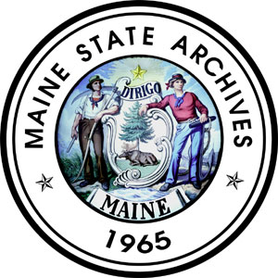
Records Management
Basic Principles
For Maine State Employees
Records Management Training - March 2026

Slide 2
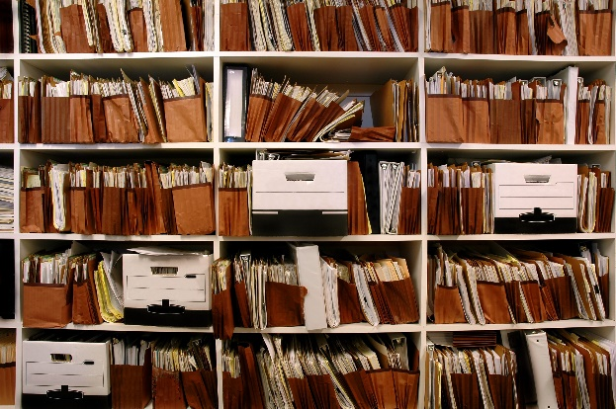
Maine State Government Needs All Staff to Be a Part of Records Management
How records are managed by an agency can directly
impact its ability to operate efficiently and effectively.

Slide 3

Is Managing Records YOUR Responsibility?
YES!
All state employees are responsible for creating records needed to do the business of their agency, and documenting activities for which they are responsible. As a government employee, you are responsible for managing all public records (including email) for which you are the custodian.

Slide 4

Why You Should Care About Records Management
Whether we realize it or not, we are all an integral part of the agency and how it conducts its business. Agency records are an asset which must be protected. They can help to ensure day-to-day business functions while also protecting the integrity and reputation of the agency.

Slide 5

RM Law and Rules
Maine Title 5, Chapter 6 specifically states what a record is and describes the responsibilities of agencies regarding Records Management.
Maine State Archives Chapter Rules 1, 2 and 3 give details on Records Management practices including retention schedules, the State Records Center and imaging records.

Slide 6
Managing Your Records
In order to have the information you need (when it’s required), there needs to be a way to identify, manage and retain records for the right amount of time.
This is done by creating Record Retention Schedules.

Slide 7
Record Retention Schedules
Schedules are a necessary tool for effective and efficient recordkeeping
Schedules hold great importance, listing records created by agencies and serving as legal authority to retain and purge them.
Schedules identify record retention and disposition, whether they will be destroyed or retained permanently.
Schedules capture all record formats created and used by agencies.
Schedules ensure consistency so everyone in the agency is retaining records for the same amount of time!
Schedules also identify which records have archival/historical value. These records will be transferred to the Maine State Archives for permanent preservation when they are no longer needed by the creating agency for business purposes.

Slide 8
Two Types of Retention Schedules
There are two types of Retention Schedules that must be followed by all agencies.
General Schedules –issued by the Maine State Archives to provide retention and disposition standards for records common to most State agencies.
Agency Specific Schedules – are those created because of unique programs or activities within the agency.

Slide 9





Schedules cover all records in all formats including:
Paper
Photographs
Microfilm
Email
Digital Files

Slide 10

Determining Retention
Retention periods for records depend on content and business process, not the format of the record. There is no single retention period for formats like email, text messages, web pages, and social media postings, just like there is no single retention period for paper. It is the content of the records which will determine retention.

Slide 11
Determining Retention
4 Part Criteria
Administrative use: Records with administrative value are the ones that help your office do its day-to-day work. Typical retention is 5 years or less.
Fiscal requirements: These records document fiscal obligations and transactions and are often subject to audit. Typical retention is 6 or 7 years. Some Federal requirements may be 10 years.
Legal requirements: Records containing evidence of legally enforceable rights or obligations which can be subject to official actions such as investigations or lawsuits. Retentions are sometimes found in law or rule, unfortunately not often in Maine law.
Historical or research purposes: Historical or archival records document significant events, actions, and decisions. These are often unique records not found elsewhere and valuable for the government or its citizens for hundreds of years to come.

Slide 12
What is a Record?
Record means all documentary material, regardless of media or characteristics and regardless of when it was created, made or received or maintained by an agency in accordance with law or rule or in the transaction of its official business. Record does not include extra copies of printed or processed material of which official or record copies have been retained, stocks of publications and processed documents intended for distribution or use or records relating to personal matters that may have been kept in an office for convenience.

Slide 13

State employees are responsible for retaining records which document decisions, activities and the services of their agency.
Examples of potential records:
Items created during daily business or to
complete a business/financial transaction:
Examples: correspondence, agreements, contracts,
grants
Items which document agency activities and actions:
Examples: meeting minutes, project reports, studies, case files
Executive or policy level items:
Examples: guidance documents, policies, procedures

Slide 14
The following materials in your office may be considered non-retention material (or non-records):
Reference materials:
Example: publications (magazines, books, reports, professional literature or brochures) from outside agencies kept for referral but not part of official study documentation; duplicate copies of other records retained for reference purposes only (never retain these longer than what is considered the “record” copy).
Copies kept for convenience:
Example: distribution notices or information; email messages you are copied on where no action is required; paper copies of electronic records when electronic is the official record (see note above); data extracts and printouts from agency information systems.
Items related to your personal affairs:
Example: personal messages or other similar items which do not
document or are not related to work activities (“Can we do lunch?”)

Slide 15
Other Record Types of Note
Drafts
Transitory Records
Temporary Records
Archival Records

Slide 16

Are Drafts Considered Records?
Drafts or working documents are records but might only need to be retained for a brief time if they do not have significant administrative, legal, fiscal or historical value.
Examples of drafts that might be immediately discarded following the creation of a new draft are those which contain only minor non-substantive changes such as correction of grammar and/or spelling or minor “word-smithing.”
For more information on DRAFTS see the RM Advice Bulletin available on our website.

Slide 17
Transitory Records
These can be public records which document work activity but typically have no value once the activity is complete. They document information of temporary, short-term value, provided the records are not needed as evidence of a more specific business transaction. Includes, but is not limited to:
miscellaneous notices or memos not related to the functional responsibility of the agency
voicemail to return a phone call
letters of transmittal not adding any information to the transmitted materials
email messages requesting office hours or directions

Slide 18
Temporary Records
These can be records which will be destroyed once they have met their agreed to retention period. These can be short or long-term retention records so can encompass a wide range of records including transitory type records.
We might think of temporary records for things like general correspondence records, financial transactions or grant records. However, they can also be longer term records such as case files and personnel records.

Slide 19
Archival Records
These are records required to be kept indefinitely because they have enduring or historical significance. Once business needs of the agency are met, archival records contain a secondary, research value.
Any records which are deemed archival per record retention schedules must be sent to the Maine State Archives.

Slide 20


The management of records (especially electronic records) can seem daunting, but on the plus side, most employees are only responsible for maintaining a few different types of records on a regular basis to support their job duties.

Slide 21
1. How Do You Manage Your Records?
Start by asking yourself: What types of records you create?
Examples could include client files, project documents or administrative type records such as invoices or agency general correspondence.
It’s important to consider the aspects of your job and the types of records you might be creating.

Slide 22
2. What Type Of Records Do I Create?
Next Review: Why are these records created and maintained?
There are many valid reasons for creating files such as statute, policy, and program administration.
There are also less valid reasons such as reference or personal convenience.
Concentrate your attention on the files that directly support the agency’s mission.

Slide 23
3. Who is Responsible for the Records?
Then Think About: Who is responsible for these records?
Generally, there should only be one “custodian” for each type of record.
All employees in your office should be following the same process and know what records they are responsible for, where records are located and how long records need to be retained.

Slide 24
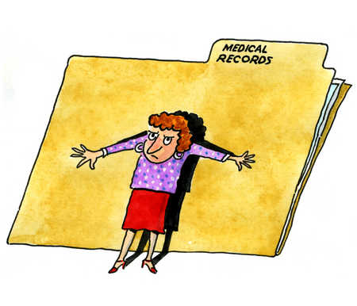
Need Help? Records Officers and Assistants
Your Records Officer should have a thorough knowledge of agency functions, the records created to fulfill those functions and the schedules which define the retention and disposition of the records. A list of all appointed Records Officers and Assistants can be found on our website.

Slide 25
Where Records Are Located
Temporary material is located at the Maine State Records Center in Hallowell. Most of this material has a destroy disposition (once retention has been met) and agencies will be notified when the material is eligible for destruction. Only the agency (authorized agency cardholders) have access to this material. (Note: any pre-archival records will be transferred to the State Archives once retention is met.)
Archival material is located at the Maine State Archives. As noted previously, once business needs of the agency are met, archival records contain a secondary, research value. When archival records have met any retention time, they will be transferred to the State Archives and be made available for public inspection.

Slide 26

Electronic Recordkeeping
Many agencies have transitioned to electronic recordkeeping systems or are in the beginning stages of converting from paper to electronic formats.
We understand this is the direction of records and management.
However…

Slide 27
When Scanning Records
Contact the Maine State Archives prior to imaging any state government records.
Comply with guidelines and standards in MSA Chapter 3 Rule: IMAGING STATE RECORDS.
Identify the appropriate retention schedules for the records involved.
Consider whether the agency will be able to manage the imaged records for the duration of the retention period.
Preserve original archival documents which are scanned. These records will be scanned for access only (not for “scan and toss”).

Slide 28

Something to Consider
Electronic records are generally suitable for official copies that will be retained for 10 years or less. These records can be saved with reasonable assurance they will remain readable until they have fulfilled their retention periods.
Think beyond your working lifetime for those records being retained 25, 50 years or longer.
Additional action (such as migration plans) are required to ensure the continued readability of electronic records with longer retention periods.

Slide 29
When records are kept in more than one format, you should identify an official “record copy” to which the full retention period will be applied. When the record copy is electronic, it’s important to identify the storage location (directory and subdirectory) so that records are purged once they have met their retention.

Slide 30


What About Email?
Because these are potential records and just like records in paper format, they must be managed so they can be retained, accessed and destroyed at the appropriate times.

Slide 31
When a message is created or received, determine if it is part of agency business. Non-record materials should be deleted immediately. Examples may include: personal messages, spam, and unsolicited email.
All email messages do not have the same value. Retention of email records are based on content and functions the messages perform. Just as it wouldn’t make sense to retain all paper records under a single retention period (based on the fact they are paper), the same principle applies for email.
Most employees will have email with short term value. However, email is also used to discuss program records, policy information and other records having significant administrative, legal, or research value requiring longer retentions.
As public records, email messages must be retained and disposed of according to approved retention schedules.

Slide 32

Good News
The Maine State Archives is aware of how difficult it is to manage email and has been working with Maine IT (as well as the Council of State Archivists) to create policies for employee email management.
What employees should be doing NOW…

Slide 33

Organizing Email/Set Up Folders
It is best to set up folders in your Outlook mailbox that organize email messages according to your retention schedules, with sub-folders set up by year and month.
This will make it easy to delete messages that have fulfilled their retention periods, without having to look at individual messages again.

Slide 34

Set Up Rules
Set up Rules for things like listserv items or other informational type materials you get on a regular basis that you may want to review periodically but don’t need them cluttering up your inbox. These can be sent to named folders automatically with Rules and are much easier to manage (and delete).

Slide 35

Get Rid of the ROT
Delete those emails which are Redundant, Outdated and Trivial information or the records past retention.
Search for common keywords for records that are incidental, transitory, junk or spam. Use the lowest “common denominator” types of terms you can think of such as: breakfast, lunch, dinner, birthday, congratulations, announcement, weather, traffic.
Note: You can also use key words to manage records that are needed as proof and evidence of business transactions and file them accordingly.

Slide 36

Email Items to Consider
Non-retention material such as spam or personal messages should be deleted immediately; transitory messages should be deleted as soon as possible.
If emails are CC’s or Forwards where no action is taken or required, they typically can be deleted.
Don’t use personal email for professional business - Your personal email account could become subject to FOAA.
Limit the use of email in general. Because email is so convenient, we tend to overuse and misuse its intended state business purpose.
Fill in/use meaningful subject lines. This will help sort, organize, index and search for emails.
Plan daily email management times. Use 10-15 minutes first thing in the morning or at the end of the day to devote to email.

Slide 37
Records Retention and FOAA
If you become aware of a lawsuit or other type of discovery proceedings, any relevant records cannot be destroyed until it is determined that the matter is resolved, or the legal hold is lifted.
Organizing and managing records (including electronic records) limits any liabilities and preserves the integrity of the agency. Remember, if public records exist (in any format) and someone asks to see them, the agency must produce them (provided there are no confidentiality restrictions).
For more information on Freedom of Access Act go to the FOAA website: www.maine.gov/foaa/

Slide 38
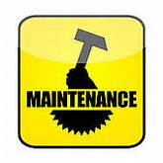
Record Maintenance
We recommend agency schedules are reviewed every 2 years. Schedules that are 40 years old are probably as inefficient as having no schedules at all. (Check with your Records Officer to see if your schedules are up to date.)
When cleaning up files, check applicable retention schedules to identify records that are eligible for transfer to the State Records Center or State Archives.
Systematically, clean out inactive records or those which have met their retention periods, including electronic records.
Destroying records which don’t need to be retained makes it easier and faster to find what you need and ensures efficiency and accuracy.

Slide 39

Records of Employees
When an employee leaves a position, computer files, including email, may NOT be automatically deleted!
Senior administrators should take action to ensure the electronic records of employees are maintained as required, especially if an employee leaves a position.
Maine State Archives must be notified when Commissioner/Executive level employees leave to ensure the preservation of archival records.

Slide 40
How Long to Keep Files/Documents
Checklist
Determine if these are actual records
Determine if you are the official record keeper
Determine if records are kept in more than one format and what the official record format is
Are these records on the State General Schedules
Are these records on the Agency Schedules
If not on a schedule, do you know who your Records Officer is
Can you look at the 4-part criteria and make a retention recommendation to your RO

Slide 41
Retention Schedule Process
If you have records you know need to be scheduled, talk to your Records Officer to see if they can write the schedule for you or help you to write a schedule for the records. They would submit an Application for Records Retention Schedule and Inventory Form (available on our website) with proper justifications for the chosen retention times. Samples of the records would also be included.
Retention Schedules are reviewed and approved by: Agency maintaining records, Records Management, State Archivist, and the Archives Advisory Board

Slide 42

Maine State Archives Records Management
Our staff can assist with training, schedule or transfer questions or other record related questions.
Records Management (schedule and retention): recordsmanagement.archives@maine.gov
Records Center/transfer of records: recordscenter.archives@maine.gov
Archives (archival records): maine.archives@maine.gov
Also, go to our website for schedule and records officer listings, training and resource information and records management forms.

Slide 43





Final Words
Thank you for taking this Records Management Training. As a state employee, your involvement in Records Management is a daily responsibility and vital component for all of us working together towards an agency-wide comprehensive Records Management system.
We covered basic information, but you will need to review the latest versions of the General and Agency Schedules to know your specific responsibilities concerning records retention. Contact our staff or visit our website for further information.

