Slide 1

The Transition Work-Based Learning Model Demonstration Grant
Findings and Recommendations
CFDA Number: 84.421B
Disability Innovation Fund Grant
Rehabilitation Services Administration
January 31, 2022

Slide 2
Acknowledgements - on behalf of Director Libby Stone-Sterling and Assistant Director Samantha Fenderson
Thanks to Grant Manager Elizabeth Nitzel, Rehabilitation Counselor I Diane Bridge and Rehabilitation Counselor I Valerie Brown who helped bring the grant to life!
The AIR Evaluation Team led by Dr. Garima Siwach and Dr. Michelle Yin (Northwestern University) for their commitment to high quality evaluation from beginning to end!
The ICI/UMass Boston Team led by Dr. Susan Foley with Kelly Haines, Cecilia Gandolfo, and Linda Mock for their technical assistance, training and long-time partnership with Maine DVR!
Craig Larrabee, Nate Pelsma, Matt St. John and the whole JMG Team for their commitment to intentional inclusion
The Council of State Administrators of Vocational Rehabilitation (CSAVR) – with special thanks to John Connelly, Director of Research and Grants, for his insights, connections and assistance with dissemination!
The Maine Department of Labor’s Center for Workforce Research and Information Team for their data management and analysis assistance!
Our Community Rehabilitation Provider partners who make Jobsville work!
Lastly, special note of appreciation to former DVR Director Betsy Hopkins who had the vision to see the value of this opportunity!

Slide 3
Why this Study?
Maine Division of Vocational Rehabilitation is committed to:
Improving youth engagement in DVR services
Learning more about effective Work Based Learning approaches – particularly for rural youth
Ensuring DVR clients have at least one paid work experience before high school graduation
Carrying out the principles and recommendations of Employment First

Slide 4
What Does TWBL Success Look Like?
“Jay”, a young man with autism, participated in the JMG program at Bangor High School and was referred to Progressive Employment in his senior year. He did not think that he was going to be employable because he thought “People don’t really like me and I am not really good at anything.” A CRP took him on a tour and interview at a local barbecue restaurant. Jay discovered during his interview that workers could have a free meal and soda during each shift. The manager saw the sparkle in his eye and heard the enthusiasm in his voice, “I can work, get money, and free root beer?” Jay began a Paid Work Experience and was hired at its completion!
Jay returned to his JMG class with his barbecue restaurant hat on and announced to his VRCI and JMG Specialist - “I got a job!”
Jay enrolled at the University of Maine at Augusta following graduation

Slide 5
Transition Work Based Learning Model Demonstration Grant
US Department of Education-funded
5-year initiative (2016-2021) to implement and evaluate two work-based learning interventions with students with disabilities in the Augusta and Bangor areas
1. Enhanced JMG
2. Progressive Employment
Goal: Over 90% of participants enter post-secondary education or employment within one year of high school graduation. All participants engage in two paid work experience. Increase professional capacity to provide work-based learning experiences.
.
In Partnership with:
Jobs for Maine’s Grads (JMG)
Institute for Community Inclusion (ICI) at UMass Boston
American Institutes for Research (AIR)
Council of State Administrators of Vocational Rehabilitation (CSAVR)
Center for Workforce Research and Information (CWRI) – MDOL
Funding: $9 million
Target Population: 200 students with disabilities within two years of high school graduation in the Bangor and Augusta areas
Notes:
Why were we interested in this grant, JMG – intentional about serving students with disabiltiies, now in the 5th year, wanted to serve an area of the state that didn’t always get as many grants, understand the needs of rural students

Slide 6
Selected Interventions – Enhanced JMG (E-JMG)
JMG provides for credit courses to high school students using a competency-based curriculum to put students on the path to college or a career - focusing on academic knowledge, career development skills, leadership, and teamwork
  Developed 5 new JMG school-based programs in the Bangor area
  Cross-trained all JMG Specialists as ACRE-certified employment specialists
  Embedded Rehabilitation Counselor I’s in the JMG classroom

Slide 7
Selected Interventions – Progressive Employment
Progressive Employment is a dual customer team approach to work-based learning integrating vocational counseling and business engagement services through highly structured communication strategies (Institute for Community Inclusion, 2021)
  Adapted from Vermont – Core belief that “Everyone is Ready for Something”
  Utilizes a unique team approach called “Jobsville”
  May Include: Mock Interviews, Informational Interviews, Business tours, job shadows, paid work experience, and OJT
  Launched in Bangor and Augusta with trained Community Rehabilitation Providers and VR staff

Slide 8
Implementation Fidelity (AIR, 2021)
Key Program Implementation Components | Implementation Fidelity
200+ New Students Receive Progressive Employment | 355 Students Received Progressive Employment
200+ New Students Receive Progressive Employment and E-JMG services | 151 Students Received Progressive Employment and E-JMG
Project Participants participate in at least two WBL activities | 131 youth across the two sites had completed at least two WBL activities
JMG program expands to five new high schools in Bangor area | Completed with fidelity
ACRE certification for all JMG Specialists | Completed with fidelity

Slide 9
Implementation Fidelity (AIR, 2021) cont.
Key Program Implementation Components | Implementation Fidelity
ACRE trainings delivered with high quality | All trainings completed; quality varied over cohorts
Implementation of ACRE strategies in JMG | JMG Specialist implemented ACRE strategies that were more aligned to their role in serving students with barrier, but noted challenges with some other strategies
CRPs and VR Counselors trained on Progressive Employment | Completed with fidelity
Progressive Employment trainings delivered with high quality | Completed with fidelity
Biweekly Jobsville meetings held in Augusta and Bangor | Completed with fidelity
Ongoing technical support to VR Counselor and Employment Specialists | Completed with fidelity
Collaboration between JMG and Progressive Employment | JMG Specialists in Bangor reported collaborating with VR counselors at a higher rate that elsewhere, they also noted challenges
Increase employer engagement and dual customer approach | Completed with fidelity

Slide 10
Selected Challenges to Implementation
Parental expectations
  Apprehension about potential loss of SSI/SSDI benefits
  Preference for youth getting a job over engagement in Work Based Learning activities
Inclusion of students with disabilities in JMG
  Lack of time to provide 1-1 support
  Difficulty in differentiating instruction in the JMG classroom
  Similar levels of support provided to students with and without disabilities

Slide 11
Key Findings
(AIR, 2021)

Slide 12
VR Services Significantly Impact Labor Market Outcomes
Delivering Vocational Rehabilitation (VR) services through an Individualized Plan for Employment (IPE) improves employment and earnings of VR clients. For the eight quarters after VR case closure, having an IPE increases the average quarterly employment rate by 15.4 percentage points and average quarterly earnings by $1,442.
Note. Standard errors in parentheses. IPE = Individualized Plan for Employment; VR = vocational rehabilitation. Coefficients show the relationship between IPE implementation and – (1) probability of employment; and (2) quarterly earnings. *p < .10. **p < .05. ***p < .01.

Slide 13
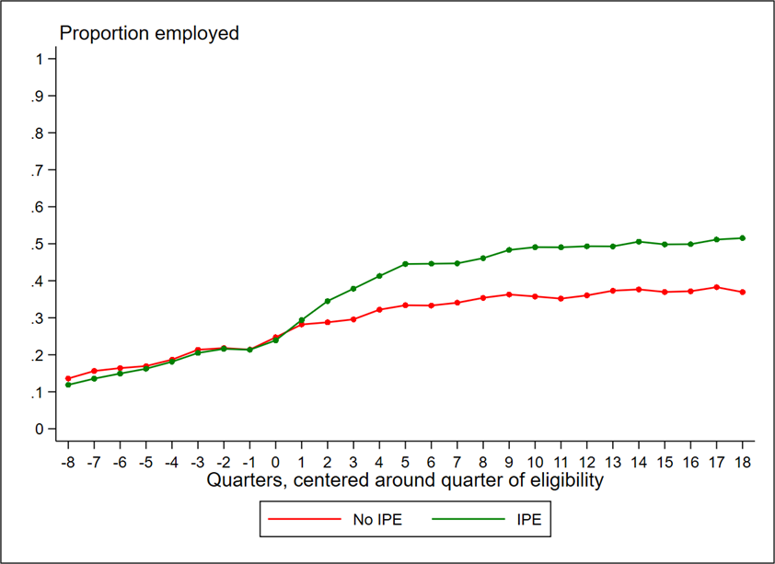
Quarter-by-Quarter Change in Employment by IPE Receipt
Notes:
Note. N = 9,334. IPE = Individualized Plan for Employment.

Slide 14
JMG participation improves high school graduation outcomes
Students with disabilities who participated in JMG had an 11% increase in their likelihood of graduating from high school and a similar decrease in the likelihood of dropping out
Comparison of employment trends after high school among VR applicants suggests that VR applicants who received JMG in high school had significantly higher levels of quarterly employment rates and earnings by age 21 compared with VR applicants who did not receive JMG
Notes:
For swd who did JMG in 12th grade – increase of 19% likelihood of graduating

Slide 15
E-JMG Lead to Greater Inclusion of Students with Disabilities
E-JMG did increase the numbers of students with disabilities participating in JMG but didn’t result in other noticeable changes in practices
The proportion of JMG students in high school who had a disability-related barrier increased from an average of 30% before 2019 to 42% by 2019
Notes:
JMG Specialists didn’t alter practices significantly after ACRE

Slide 16
Improved Outcomes Through Progressive Employment Implementation
Maine DVR services had a large and significant impact on employment outcomes among youth with disabilities even prior to the grant
Those who got Progressive Employment activities compared to those who received baseline services had increased access to career services (5.3 more services) and improved employment outcomes (13.5% in Bangor) within four quarters of VR service start but did not have significant effect on earnings during this period
Notes:
May have been too early to measure earnings level
Augusta – more WBL but Bangor better collaboration and better impact on employment outcomes

Slide 17
No Additional Benefits from E-JMG for Progressive Employment Clients
Receiving E-JMG didn’t offer additional employment benefits for clients who received Progressive Employment
BUT
E-JMG did improve employment outcomes for clients who received traditional VR services

Slide 18
Limitations (AIR, 2021)
Quasi-experimental design
  Rigorous but not random selection
Short time-frame
  Many individuals still in transition process at close of study, open cases may underestimate impacts
Matching challenges across systems
  Maine Department of Education data does not record SSNs.
COVID-19 Pandemic limited data collection methods

Slide 19
Impact of COVID-19 Pandemic (Years 4 & 5)
Pivot to virtual services at the onset of the pandemic
  Challenge for those students without stable internet access
  “Zoom fatigue” later in the pandemic
  Benefit to employers to be able to engage virtually – reach multiple students at once
  Reduction in travel time for staff offered more time for student engagement
Out of 10 JMG students interviewed, 7 felt pandemic had restricted activities, 5 reported no impact on their career goals and 8 felt pandemic had not impacted their perspective on JMG. (AIR, 2021)

Slide 20
Impact of COVID-19 Pandemic (Years 4 & 5)
Challenges to community-based activities
  Safety concerns of families and businesses
    Some youth preferred to delay access to services
  Schools closed to VR counselors and other providers
However, some essential employers (like grocery stores) and outdoor businesses more open and available to youth
                (AIR, 2021)

Slide 21
Policy Implications (AIR, 2021)
Cross-agency infrastructure and collaboration
  Commitment of resources and time leads to information and data exchange
Coordination across service providers
  Leads to improved outcomes for youth through focus on individualized interests and goals
Continuous Training and Technical Assistance
  High-quality training offered regularly ensures fidelity and consistency in service provision
Employer Engagement Strategies
  Progressive Employment provides flexibility for employers that may overcome reservations about hiring individuals with disabilities – leading to improved youth outcomes
Building upon existing interventions
  Align proposed enhancements with existing program framework – JMG as well-established program

Slide 22
Resources
Financial Literacy Guide: https://www.maine.gov/rehab/dvr/youth_transition.shtml Designed for families, educators, VR counselors, employment supports, and case managers to assist youth with disabilities to explore financial literacy. This resource contains lessons, activities, local resources, games, and a smartphone app.

Slide 23
For Additional Study
Return on Investment– Initial analysis suggests a significant return on investment created by investment of VR funding
Longitudinal Analysis – Many participants were still in the transition process at the grant’s completion – excluding potential future positive impacts
Long-term COVID-19 impacts – Much is unknown about what the long-lasting impacts of the pandemic will be on youth and educational and employment outcomes

Slide 24
Video Resources: Visit DVR Youth and Transition web page https://www.maine.gov/rehab/dvr/youth_transition.shtml
Progressive Employment Model: Jobsville
See Progressive Employment up close in this captioned video that introduces the viewer to the model and highlights how it supports both Maine youth on their pathway to employment – and Maine employers looking for their next generation of workers!
Mitchell and Gabby found their employment paths through Progressive Employment. Their journeys are outlined in the videos below:
Mitchell Video
Gabby Video

Slide 25
For Additional Information
Libby Stone-Sterling, PhD
Director, Maine Division of Vocational Rehabilitation
150 State House Station
Augusta, ME 04333—0150
(207)623-7943 office /(207)215-5688 cell
Libby.stone-sterling@maine.gov
The Maine Department of Labor provides Equal Opportunity in employment and programs. Auxiliary aids and services are available to individuals with disabilities upon request

