Slide 1

Transition
Career Exploration Workshop
Learning Styles
Notes:
The Transition Career Exploration Workshop is a product of the Maine Department of Labor. We encourage partners to use the tools provided here, but request that the Maine Department of Labor, Division of Vocational Rehabilitation branding remain on all materials. Please contact your local Division of Vocational Rehabilitation (DVR) office with any questions. www.maine.gov/rehab

Slide 2
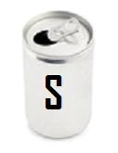

How do I learn best?
And why is it important to know?
2
2
2
2
2
Notes:
Facilitator Notes:
LEARNING OBJECTIVE: Participants will learn the importance of learning style in determining future employment goals and its utilization in the workplace.
Begins an introduction to the concept of Learning Styles.
There is a Self-Exploration component to this section, indicated by the Soda can in the upper left-hand corner.

Slide 3
By Seeing?
3
3
3
3
Notes:
3
Facilitator Notes:
Do we learn best through what we see?
3

Slide 4
By Hearing?
4
4
4
4
Notes:
4
Facilitator Notes
Through our hearing?
4

Slide 5
By touching?
5
5
5
5
Notes:
5
Facilitator Notes:
By touching – for example, using a computer or writing things down with a pen or pencil, etc.
5

Slide 6
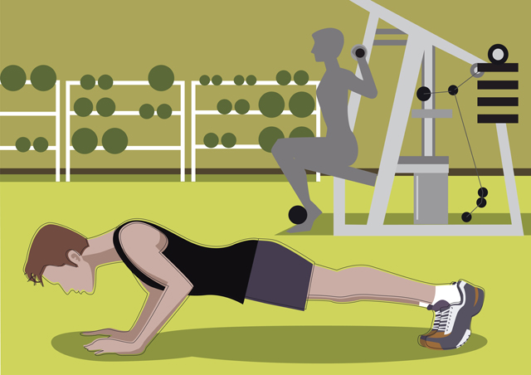
By doing?
6
6
6
6
Notes:
6
Facilitator Notes:
By doing something with our body.
6

Slide 7
Learning Style
How we learn best is called our “learning style”!
7
7
7
7
Notes:
7
Facilitator Notes:
How we gather and learn information best is called our “learning style.”
The following suggested activity, if you choose to use it, helps participants to understand the vocabulary for learning styles.
This activity also prepares them to complete the Barsch Learning Style inventory.
7

Slide 8

Learn the vocabulary of learning styles!
8
8
8
8
8
Notes:
Facilitator Notes: Projected Time: 15 mins.
FLY SWATTER VOCABULARY GAME
Materials Needed:
2 Fly swatters; Chalk board/white board and Chalk/dry erase markers
Before the game starts, the Facilitator/teacher will write the vocabulary words in random order on the board and divide the class into two teams. The vocabulary words and definitions are only in the facilitator manual located after this page. The facilitator will need to have the materials cut out and ready in advance for this activity.
When the game starts, one person from each team is given a fly swatter and is called up to the board.
The teacher will read off a definition of one of the vocabulary words, and the two students will look for the word on the board that fits that definition.
When the student finds the word, they will hit it with their fly swatter. The first student to find and swat the correct word earns a point for their team. Then the next two students come up to the board, etc.
The team with the most points at the end of the game is the winner.

Slide 9
What is my Learning Style?
We gather and use information in a variety of ways called learning styles!
We usually have a preferred learning style:
  AUDITORY – we hear
  VISUAL – we see
  TACTILE – we feel
  KINESTHETIC – we move.
9
9
9
9
Notes:
9
Facilitator Notes: Projected Time: 5 mins.
This will be a brief introduction to the four learning styles –
From here, you are moving into completing the Barsch Learning Style inventory.
9

Slide 10
Barsch Learning Style Inventory
Why are you going to be completing the Barsch Learning Style Inventory?
To gain a better understanding of yourself as a learner.
To help you learn the way you prefer to learn.
Once you understand your preferred learning style, you can increase your learning efficiency.
10
10
10
10
Notes:
10
Facilitator Notes:
You may want to use index cards to help individuals understand the vocabulary of the words that they will find in the BARSCH if you think your participants would benefit from this activity. Otherwise -
Distribute the inventory booklets to participants.
Assist them to score their inventories once they have finished.
10

Slide 11

Barsch Learning Style Inventory
Activity: S – Self Evaluation
We are now going to invite you to take the Barsch Learning Style Inventory.
Once you have finished, we will help you tally your results, following the directions for scoring on the back of the inventory.
11
11
11
11
Notes:
11
Facilitator Notes: Projected Time: 30 mins.
Materials Needed: Barsch Learning Style Inventory
Introduce the Barsch Learning Style Inventory. To gain a better understanding of yourself as a learner, you need to evaluate the way you prefer to learn. We all should develop a style that will enhance our learning potential. The Barsch evaluation is a short, quick way of assessing your learning style.
This is not a timed test. Try to do as much as you can by yourself. You surely may ask for assistance when and where you feel you need it. Answer each question as honestly as you can. There are thirty-two questions. The answers are rated either Often, Sometimes or Seldom.
When you are finished, transfer the number that corresponds with your response to its proper place on the last page. Then total each of the four columns on that page. You will then see very quickly what your best method of learning is - whether you are a Visual, Auditory, Tactile, or Kinesthetic learner. By this we mean, whether you as an individual learn best through seeing things, hearing them through the sense of touch, or through actually performing the task.
If several scores are within 4 or 5 points of each other, it means you can use any of those senses for learning tasks. You may learn different subjects or tasks using different styles, i.e., history by hearing, science by seeing, math by tactile.
11

Slide 12
Visual (Seeing) Learning Style
I learn best if I:
  SEE what I’m learning
  READ what I’m learning
  Use charts, maps, videos, written notes, pictures
  Practice spelling and doing math in your head
  WRITE out items for quick visual review
12
12
12
12
Notes:
12
Facilitator Notes: Projected Time: 15 mins.
Go over each of the next four slides to highlight and describe each of the four learning styles.
If you are a visual learner, you got a high visual score, then you need to see materials -
Use brightly colored markers to highlight your reading assignments.
Practice visualizing or picturing spelling words or doing math in your head.
It might be helpful to get a show of hands of those who have high scores in each of the four styles as you describe them.
12

Slide 13
Auditory (Hearing) Learning Style
I learn best if I:
  LISTEN carefully
  Sit or stand where I can HEAR CLEARLY & LISTEN
  TAPE lectures or directions and review often
  After reading something, summarize it on tape
  Review information by talking & listening with another person
13
13
13
13
Notes:
13
Facilitator Notes:
Spend some time reading and answering any questions they may have.
If you are an auditory learner, you got a high auditory score. It would help if you recorded lectures if you are a student. Sit where you can hear clearly what is going on. Verbally review what you have learned with others, like in a group.
13

Slide 14
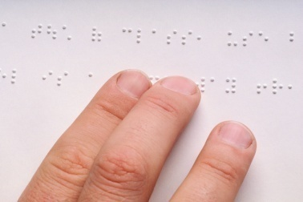
Tactile (Touching) Learning Style
I learn best when I:
  Work with something that can be TOUCHED
  TRACE words as I say them
  WRITE it several times
  Keep a supply of scratch paper and WRITE myself notes!
14
14
14
14
Notes:
14
Facilitator Notes:
If you are a tactile learner, you achieved a high tactile score. Information that must be learned should be written several times. Many times a tactile learner will also have a secondary style of learning like visual or auditory that work great together.
14

Slide 15
Kinesthetic (Doing) Learning Style
I learn best if I:
  Learn hands-on – physical, building, mechanical, sports, dancing, moving, doing
  Use physical objects, i.e., make or use models
  Use flashcards
  Use role-playing – act out what I’m learning
  Use hand gestures or “body language”
  Move around while I think
15
15
15
15
Notes:
15
Facilitator Notes:
If you are a kinesthetic learner, you got a high Kinesthetic score. This means you involve your body in the process of learning. People with a high score would benefit from taking a walk while studying notes or flashcards; it would be important to involve the movement while trying to memorize, like riding a stationary bike or walking on a treadmill. Many times there is a secondary learning mode that could work in conjunction with movement activities.
15

Slide 16
So, What is Your Preferred
Learning Style?
What are your two preferred learning styles – highest scores?
Do those learning styles seem to make sense, based on your learning experiences?
Any surprises or questions?
16
16
16
16
Notes:
16
Facilitator Notes: Projected Time: 10 mins.
Facilitators could disclose their learning style and talk about their experience with learning.
Facilitators could have each student report out their two highest scoring Learning Styles and ask if they think it fits them.
Always verify that their “scores” support what they know about themselves, better than any inventory.
Ask if there were any surprises that they learned during this exercise.
16

Slide 17
Summary Statements
If several of your scores are within 4 or 5 points of each other, it means that you can use any of those senses for learning tasks.
When you are in a hurry, you use your best learning styles.
When you have extra time, try to do activities that will increase the other styles so you can study and learn more efficiently. (Jeffrey R. Barsch, EdD)

Slide 18
How Can I Make the Best Use of My Learning Styles?
Take a look at the suggestions for your preferred learning styles in the blue “Effective Study Tips” pamphlet
Participant Workbook: Record your learning style next to the title “Barsch Learning Style Inventory.”
Place your Barsch Learning Style Inventory in the folder.
18
18
18
18
Notes:
18
Facilitator Notes: Projected Time: 10 mins.
Distribute copies of the “Effective Study Tips” (usually Blue pamphlet).
Using the “Effective Study Tips” booklet, give an example of suggestions under each learning style.
Encourage them to apply their learning style information throughout the rest of the workshop.
Call their attention to the Soda Can near the bottom of the page. It is a reminder to participants to document this self-exploration activity on learning styles in their Participant Workbook.
Have participants record their two highest learning style scores next to the “Barsch Learning Style Inventory ” box on the “S” page in the Participant Workbook.
18

Slide 19
Learning Styles Game
Scenario: Jane Is having difficulty learning about ____________________.
She has just discovered that she is a _____________ learner and wants to use her learning style to help her understand the material.
What could Jane do to make learning the material easier for her?
Brainstorm some activities that would help Jane learn more efficiently.
Choose and develop one activity to share with the group.
19
19
19
19
Notes:
19
Facilitator Notes: Projected Time: 25 mins.
Note to students that the Sun icon indicates that they will be participating in a learning activity. The slide is a sample exercise to do with the entire class.
Materials Needed: Paper, Pencils
Scenarios:
1. Jane is having difficulty learning how to ride a horse, and she is a Visual Learner.
2. Jane is having difficulty learning a foreign language, and she is a Kinesthetic Learner.
3. Jane is having difficulty learning algebra, and she is an Auditory Learner.
4. Jane is having difficulty learning history, and she is a Tactile Learner.
Divide the class into four small groups; each group will be assigned one of the learning styles. Each group will be given a scenario where they have to teach a person who has a particular learning style. Each group will be given 2-3 mins. to brainstorm different activities that would help that person learn a particular concept more easily, using their preferred learning style.
After the groups are finished brainstorming, they will need to pick one of their ideas to turn into an activity (example: one group may come up with a short role-play while another may create flash cards).
When the groups are finished, they can share their activity with the class.
19

