Slide 1

Transition
Career Exploration Workshop
Employment Readiness Scale (ERS)
Notes:
The Transition Career Exploration Workshop is a product of the Maine Department of Labor. We encourage partners to use the tools provided here, but request that the Maine Department of Labor, Division of Vocational Rehabilitation branding remain on all materials. Please contact your local Division of Vocational Rehabilitation (DVR) office with any questions. www.maine.gov/rehab

Slide 2

Soooo, What Do I Know About Me?
2
2
2
2
Notes:
2
Facilitator Notes:
Now we’ll begin the workshop activities to learn about ourselves and to help us in our career search.
The first self assessment we will be discussing is the Employment Readiness Scale or ERS. Probably all of the VR participants will have completed the ERS.
To understand the language of the ERS, the participants will be completing a fun activity.
2

Slide 3
The ERS?
The Employment Readiness Scale or ERS – what was that all about?
3
3
3
Notes:
3
Facilitator Notes: Projected Time: 30 mins.
The following activities and slides will be introducing the language and explaining the individual components of the Employment Readiness Scale (ERS).
Why did they complete the assessment? What do they think it was about?
More directions for the Vocabulary Matching Game are on the page after the next slide. You may way to review these.
3

Slide 4

ERS – A Little Preparation
Employment Readiness Scale Vocabulary Memory Match Game
4
4
4
Notes:
4
Facilitator’ s Notes: Projected Time: 30 mins.
LEARNING OBJECTIVE: Participants will learn about the purpose and utilization of the Employment Readiness Scale in developing a useful Individualized Plan for Employment. The goal of the game is to match the ERS word with the corresponding definition. The cards will either contain a word or a definition. Have fun!
Employment Readiness Scale (ERS) Vocabulary Memory Match Game
Materials Needed: Work Sheet and Scissors
Instructions:
- Students could gather in small groups for this activity, and each group would need a set of cards.
- This activity will assist students in understanding some of the vocabulary that they will encounter when they are doing the Employment Readiness Scale assessment.
- There are some blank cards that can be used if students are having difficulty with other words in this section.
Have students cut out the cards from the work sheet and mix them up, face down, on the table. Students will then take turns trying to pull out matches from the face down cards. This activity can be done in pairs or alone.
The Instructions and the Game cards are in both the facilitator manual and the participant workbook.
4

Slide 5

The Employment Readiness Scale (ERS)
Employment Readiness –
  is defined as being able (with little or no help) to find, acquire and keep a job, as well as manage transitions to new jobs as needed.
Helps you understand what changes will increase your chances of being effective in your work life
The results are based on how you see yourself at this point
  Your current employment readiness portrait
Results will change as you work with VR and move closer to that “ideal” job!
5
5
5
Notes:
5
Facilitator Notes:
This slide defines employment readiness and begins an introduction to the Employment Readiness Scale assessment, which participants will have taken sometime prior to this session.
It is critical that they have an understanding of the purpose and use of the ERS results.
Remind them that this is only a current “portrait” of where they are today, and this will change over time as they work with their VR Counselor, the school and practice some of the tools they will be learning during this workshop.
5

Slide 6
Employment Readiness Scale
ERS is a 3-part inventory of your readiness to prepare, pursue & maintain employment over a lifetime--your “career”.
Part 1 covers five Employability Skill Areas.
Part 2 covers the Coping Skills necessary to adjust to work-related challenges.
Part 3 covers the three types of work-related Challenges.
6
6
6
Notes:
6
Facilitator Notes:
Emphasize that there are basically 3 parts to the ERS:
Part One: covers the five Employability Skill Areas
Part Two: looks at the Coping Skills that are necessary to adjust to work-related challenges and what it will take to manage stressful situations
Part Three: looks at three types of Challenges that individuals could face when looking for, getting and keeping a job.
The ERS is also looking at the “big” picture in terms of their career (life-long), not just where they happen to be today. It looks at how to keep a job and manage a career over time.
6

Slide 7
Employability Skill # 1 –
Career Decision-Making
    How ready are you to select and pursue a career?
      Do you know how to gather information about yourself & occupations and use that information to make a career decision?
      Do you have an employment goal and plan to pursue that goal?
      Do you have the training necessary to pursue that goal?
      Do you know how to seek employment?
7
7
7
Notes:
7
Facilitator Notes:
Here, we begin to explain each of the five employability skill areas separately.
This is Career Decision-Making. The questions are related to some of the issues that need to be dealt with in Career Decision-Making.
You could ask the students to talk about these questions (what are the steps) and relate them to what they have learned so far in the workshop:
7

Slide 8
Employability Skill # 2 –
Skills Enhancement
How ready are you to know and pursue the skills/education/experience necessary to get the job that you want?
  Do you need more training to get the job you want?
  Do you know where that training is available?
  Do you know how long the training takes?
  Are you prepared to pay for that training?
8
8
8
Notes:
8
Facilitator Notes:
These are questions related to Skills Enhancement:
8

Slide 9
Employability Skill # 3 –
Job Search
How ready are you to actually enter the search for the job of your choice?
  Do you have:
    Resume
    Cover Letter
    Recommendations
    Job (People) Network
    List of available jobs
    Interview skills?
9
9
9
Notes:
9
Facilitator Notes:
These are questions related to Job Search.
9

Slide 10
Employability Skill # 4 –
Job Maintenance
How prepared are you to actually hold down a full-time job over an extended period of time?
  Do you have experience with:
    Supervision
    Self-Management Skills
    Interpersonal Skills on the job
    Teamwork?
10
10
10
Notes:
10
Facilitator Notes:
These are questions related to Job Maintenance.
10

Slide 11
Employability Skill # 5 –
Ongoing Career Management
How prepared are you to maintain a multi-job “career” over a number of years?
  Do you know how to maintain success & progress in your current job?
  Are you prepared to change jobs when necessary?
  Would you know how to pursue another job if you were laid off?
  Would you recognize the need and process of pursuing another or different job?
11
11
11
Notes:
11
Facilitator Notes:
Finally, these are questions related to Ongoing Career Management.
We are trying to expose participants to life-long career management skills, not just deciding on a job now.
11

Slide 12
Let’s look at the Challenges
3 Types of Challenges to Job Success:
  1. Personal Challenges
    These are challenges that are under your control:
      Is there a need for more education/training?
      Do you have health/disability challenges?
      Are your personal relationships stable?
      Do you have a need for additional income?
      Can you think of other things?
12
12
12
Notes:
12
Facilitator Notes:
Here, we begin the section discussing the 3 types of job-related challenges.
You may ask participants to suggest other personal challenge areas that are under their control. We want to think about the fact that there are some situations and challenges they are in control of and can change with a bit of effort.
These challenges ultimately become part of the decision-making process.
12

Slide 13
Challenges to Job Success Continued
Environmental Challenges
  Outside responsibilities that could interfere with your success at work:
    Children - childcare
    Parents - eldercare
    Spouse or Partner
    Care of a pet (the pet needs to be fed and walked)
13
13
13
Notes:
13
Facilitator Notes:
These are challenges that are current realities in your environment; they cannot be ignored and may influence your readiness to work.
13

Slide 14
Challenges to Job Success Continued
Systemic or Community Challenges:
  Learning to work with Vocational Rehabilitation as a system
  Transportation
  Housing
  Work Credentials, licensing, etc.
  Training Institutions
  Financial Aid
14
14
14
Notes:
14
Facilitator Notes:
These are the “bureaucratic” challenges that will have to be dealt with in the planning process in order to be successful.
Systemic or Community Challenges
Learning to work with Vocational Rehabilitation as a system
Transportation
Housing
Work Credentials, licensing, etc.
Training Institutions
Financial Aid
14

Slide 15
Which challenges need to be addressed?
Look at “Type of Challenges” at the bottom of page 3 and top of page 4 of the assessment report:
  Low = indicates not an area that needs focus
  Medium = indicates could be an area that needs focus
  High = indicates an area that needs focus and a plan for change
15
15
15
Notes:
15
Facilitator Notes:
Help participants to become aware that, based on their answers, these ERS “indicators” will identify which challenges are most in need of their time and energy at this point in the process.
Low = indicates not an area that needs focus.
Medium = indicates could be an area that needs focus.
High = indicates an area that needs focus and a plan for change.
They will need to focus on any areas that have a “High” indication of a challenge.
These should be discussed with their VR counselor as part of their plan development.
15

Slide 16
How Do I Deal with these Challenges?
Sources of strength for coping with challenges – pg. 3
  Self-Efficacy
    Your belief in your ability to perform well
  Outcome Expectancy
    Whether or not you feel that you can succeed at what you attempt
  Social Supports
    Whether or not you know where to turn for help
  Work History
    Your past experience with work
16
16
16
Notes:
16
Facilitator Notes:
Coping effectively with stresses or challenges draws on these 4 sources of strength:
These four types of coping skills are necessary to address the challenges that have been discussed in the planning process.
Be sure to go over the definitions of each of the supports to ensure that participants understand what they are:
Sources of strength for coping with challenges – (page 3 of the assessment report)
They also need to understand what their “indicators” in each area mean.
Again, remind them that their results are totally dependent on their responses on the ERS Inventory, and the ERS is a self-evaluation, not someone else’s views.
16

Slide 17

Mapping Me!
This kind of mapping & planning!
No, not this kind of mapping!
17
17
17
Notes:
17
Facilitator Notes:
This introduces planning strategies for participants as they consider the next steps in their employment planning – “Mapping out their future plans for employment.”
What is the plan, and where is this going to take place?
Are people going on to college, or are they planning to find a job? If so, where are they going to be doing these things.
Suggest to participants that as they create this plan, they have more choices available and more decisions to make. How are they going to go about making these decisions?
17

Slide 18
Mapping ME!
This activity will help you think about your future plans while planning available support if you decide to move out of Maine.
The second map is the State of Maine; you can use this map to see where people that you know live. Think about where you have connections once you leave school for assistance in work and independent living.
18
18
18
Notes:
18
Facilitator’s Notes: Projected Time: 20 minutes
The following activities will help students to think about their future plans while visualizing where they have supports available (friends/family) if they decide to move out of state. The full-page worksheet is in the Participant Workbook.
Materials Needed:
Map worksheet
Colored pencils/markers/crayons (3 or 4 different colors per student)
Once the worksheet is handed out, the facilitator will instruct the students to follow the written directions.
(Ask them to write in the name of the color they will use for each of the three activities, then outline or color in the states/counties that fit in that section. For example – I will use green for the places I want to go; yellow for the places I have been; and blue for the places where I have family and friends.)
A discussion about support systems and future planning should either precede or follow this activity. You could come back to this activity after they have used ONET and help them to complete the section on research and companies.
Relate this activity to the previous discussion re: supports/coping skills.
18

Slide 19
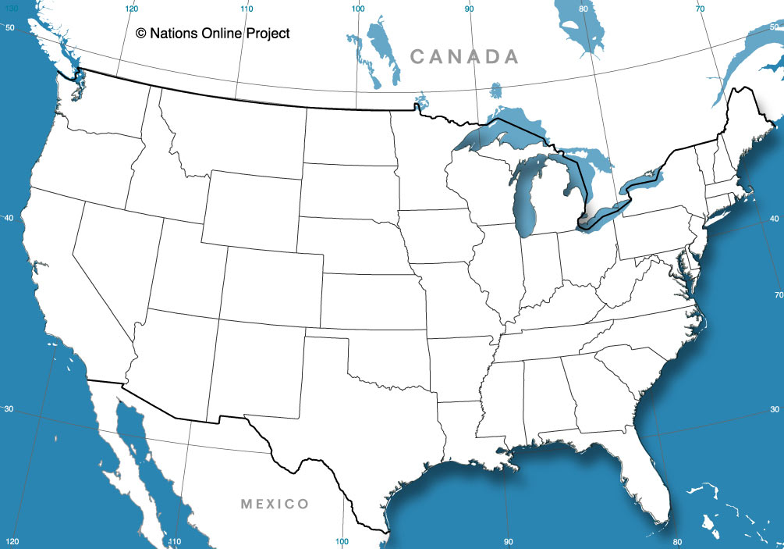
NAME:_________________ DATE:______________
1) Write in the name of the color that you will be using.
2) Outline or color in each state that fits in that category with that color.
3) Repeat steps 1 and 2 for the other two colors.
Color _____: States you want to visit or have lived in
Color _____: States where you might find a job match
Color _____: States where you have Family or Friends; do they have job leads.
Research and list 3 names of companies where you could apply
19
19
19
Notes:
Facilitator Notes:
The full-page handout of this activity is in the Participant Handbook.
Suggested questions relating to this activity:
- What does moving out of Maine mean to them?
- Will that be an issue with their parents?
- Where would they move and why? Is it related to work, college or some other reason?
Do they have the resources to move out of the state of Maine? (self management skills along with financial resources)
- What challenges would moving represent? (personal, environmental, systemic).

Slide 20
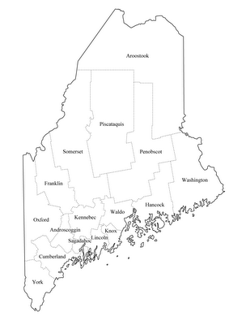
NAME:__________________ DATE:______________
1) Write in the name of the color that you will be using.
2) Outline or color in each county that fits in that category with that color.
3) Repeat steps 1 and 2 for the other two colors.
Color ____: color/outline the County you live in
Color ____: Counties you have visited in Maine
Color ____: Counties where you have Family
or Friends
Color ____ : Counties where you might find a
job in your field.
Research and List 3 companies in that county
where you could apply.
Notes:
Facilitator Notes:
The full-page handout of this activity is in the Participant Handbook.
Suggested questions:
Why do you want to stay in the state of Maine? (family, friends, church)
- If they move to a different area of Maine, will that be an issue for their parents or for them?
- Where would they move to and why? Is it related to work, college or some other reason?
Do they have the resources to move to different parts of the state of Maine? (self management skills along with financial resources)
What challenges would moving represent? (personal, environmental, systemic)
Again, there is a suggestion to come back to this activity after they have learned to use ONET.

