Slide 1
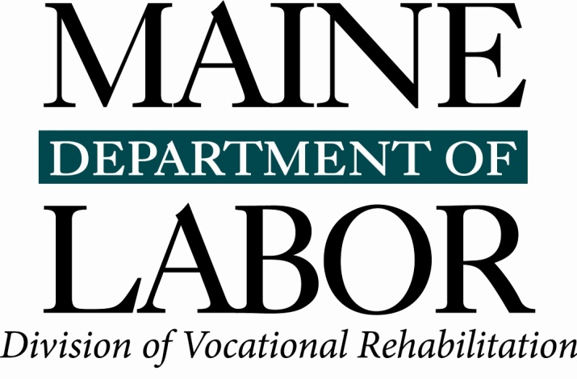
Transition Career Exploration Workshop
What is Vocational Rehabilitation?
Notes:
The Transition Career Exploration Workshop is a product of the Maine Department of Labor. We encourage partners to use the tools provided here, but request that the Maine Department of Labor, Division of Vocational Rehabilitation branding remain on all materials. Please contact your local Division of Vocational Rehabilitation (DVR) office with any questions. www.maine.gov/rehab

Slide 2
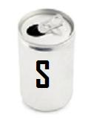
Various Icons
Throughout this workshop, you will see three different types of icons on some of the slides. Each of them represents a different reminder:
Indicates a learning activity
Indicates a Self-Exploration component/activity
Indicates an Occupational Exploration component/activity
2
2
2
2
Notes:
2
Facilitator Notes:
Remind participants of the three different types of activities.
These icons will also be used as reminders to document the results of particular activities in your SODA packet, which will be explained in a few minutes.
2

Slide 3
What Is Vocational Rehabilitation?
State of Maine
Bureau of Rehabilitation Services
Division of Vocational Rehabilitation
Division for the Deaf, Hard of Hearing and Late Deafened
Division for the Blind & Visually Impaired
3
3
3
3
Notes:
3
Facilitator Notes: Projected Time: 20 mins.
LEARNING OBJECTIVE: Participants will understand the purpose of Vocational Rehabilitation.
You could show the Orientation Video,
Or
Go through the “new” VR Orientation PowerPoint presentation.
Explain to the participants that the Bureau of Rehabilitation Services (BRS) includes two Divisions:
The Division of Vocational Rehabilitation, also known as DVR, which includes the Division for the Deaf, Hard of Hearing and Late Deafened.
The Division for the Blind and Visually Impaired, known as DBVI.
Discussion/Questions & Answers.
3

