Slide 1

Transition
Career Exploration Workshop
Story Circle
Notes:
The Transition Career Exploration Workshop is a product of the Maine Department of Labor. We encourage partners to use the tools provided here, but request that the Maine Department of Labor, Division of Vocational Rehabilitation branding remain on all materials. Please contact your local Division of Vocational Rehabilitation (DVR) office with any questions. www.maine.gov/rehab

Slide 2
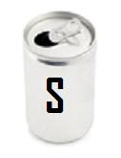

Story Circle Activity
Story Circle is an opportunity to share a personal achievement or success within a small group.
The purpose is to begin building a list of skills that you have already learned.
The whole group may want to establish some basic rules for the small groups in order to ensure that individuals are comfortable sharing their stories.
2
2
2
2
Notes:
2
Facilitator Notes:
LEARNING OBJECTIVE: Participants will learn how to turn past achievements into future skills. There is a copy of the instructions in the Participant Handbook.
Materials Needed:
Sticky Notes
Writing utensils
Poster board/large Post-It Note Wall sheet
The students sit together in a circle and determine the rules for sharing safely.
The students take turns telling a story about a time when they were successful or accomplished an achievement.
The student who is telling the story has a piece of poster board beside them and all of the other students have sticky notes and something to write with.
As the student is telling his/her story, everyone else in the circle writes any skill(s) that they hear or can assume that the person had to have in order to have achieved that activity or the accomplishment.
When students are finished writing, each participant, in turn, will read the skills they heard and place their sticky notes on the poster board for the story teller to see.
This process continues until everyone has had a chance to share a story.
2

Slide 3
Story Circle Results
From the skills you identified of your achievements and from the feedback from other participants. You can write this information in your workbook.
Participant Workbook: Write a few of the skills that you documented in the Story Circle on the “S” page next to the box titled “Story Circle Skills.”
3
3
3
3
Notes:
3
Facilitator Notes:
Make sure that everyone has had a chance to tell their story.
Be sure to have all of the individual results recorded into the Participant Handbook in the SODA grid.
It is important to have participants record any skills that they identified in the Story Circle Activity on the SODA in the Participant Handbook for future reference.
3

Slide 4

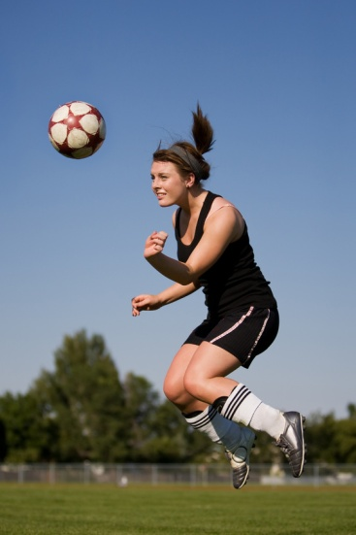
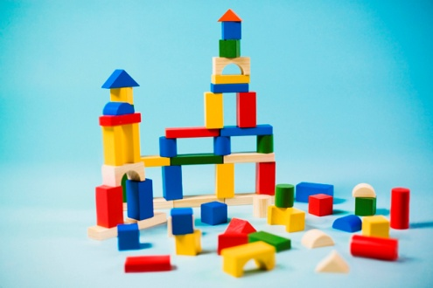

So, you do already have some skills!
4
4
4
4
Notes:
4
Facilitator Notes:
Yeah! They could applaud themselves for the great skills they do have. Celebration is an important part of acknowledgement.
The good news is that you do have some skills and over your lifetime can improve and add to those skills.
The next slides begin the conversation about disability.
4

