Slide 1
Manufactured Housing Board
Qualifying Education
(207) 624-8612 Office
(207) 624-8637 Fax
Web Address: www.maine.gov/professionallicensing

Slide 2
Qualifying Education for Licensees
The training shall consist of but not limited to training in the following areas:
  A. Statutes and rules relevant to all types of Manufactured Housing regulated by the board;
  B. The installation and servicing of HUD-code homes; and
  C. The installation and servicing of state certified modular homes.

Slide 3
Course Objectives
Rules & Regulations
Manufactured Housing Warranties
Modular Housing
HUD Installation Standards

Slide 4
Reference Materials
10 M.R.S., Chapter 951 Manufactured Housing Act
02 385 Chapter 320-381 Rules for Licensing Manufacturers, Dealers, Developer Dealers, Installers and Mechanics
10 M.R.S., Chapter 213 Manufactured Housing Warranties
11 M.R.S., Implied Warranty Law
02 385 Chapter 890 New Manufactured Home Installation Standard
02 385 Chapter 110 Rules for State Certification of Modular Housing

Slide 5
PFR Mission Statement
The mission of the Department of Professional and Financial Regulation is to protect the citizens of Maine through the regulation of numerous professions and occupations providing services to the public.
The Department protects consumers through its licensing, examining, and auditing activities; by conducting programs aimed at increasing voluntary compliance with State Laws; by investigation possible violations of law; and by undertaking enforcement actions. The Department responds to consumer complaints and requests for information and conducts educational and outreach programs to make consumers aware of their rights under Maine laws.
In order to encourage the development of sound ethical businesses which serve the needs of Maine citizens, the Department fosters a healthy business environment through competent, impartial and efficient regulation.

Slide 6
When are licenses required?
  Any person who engages in the business of manufacturing, selling, installing and servicing State Certified Modular, HUD, and Pre-HUD manufactured homes shall first obtain a license issued by the board.

Slide 7
License Categories

Slide 8
Dealers
M.R.S. 10, §9022 (1)
Dealers who are licensed may sell, install or service, or may have their employees install or service any manufactured housing in compliance with the Manufactured Housing Act.
This applies to HUD, Pre-HUD and State Certified Modular homes.

Slide 9
Developer Dealer
M.R.S. 10 §9002 (2-A)
A person who purchases state-certified modular housing from a licensed manufacturer or dealer for placement on property owned by the developer dealer and who offers modular housing for sale to the initial purchaser. The developer dealer may not install such modular housing but may contract with the manufacturer or dealer for the installation.

Slide 10
Manufacturer
M.R.S. 10, §9022 (2)
A manufacturer who is licensed may manufacture, sell to licensed dealers, install and service both HUD and State Certified Modular homes.

Slide 11
Mechanics
M.R.S. 10, §9022 (3)
Licensed mechanics may install or service HUD and Pre-HUD manufactured homes.

Slide 12
Installers
M.R.S. 10, §9022 (4)
Licensed installers may install or service State Certified Modular homes.

Slide 13
Department Functions
Administration/licensing
Complaint processing
Complaint/license investigations
Technical assistance/training
Inspections

Slide 14
Board Functions
Consumer protection
Rule-making
Final complaint resolution
Adjudicatory hearings
Enforcement of rules

Slide 15
Complaint Procedure
If a consumer files a written complaint with the board against the manufacturer, dealer or installer within one year after occupancy of new manufactured housing, it tolls the statute of limitations for purposes of bringing action to enforce any applicable warranty.

Slide 16
When a consumer complaint is received staff contacts the dealer and/or the manufacturer to try to resolve the issues prior to it becoming an official complaint. (The staff realizes that there are two sides to every situation and the consumer is not always right!)

Slide 17
If no resolution or agreement is reached, a copy of the complaint is sent to the dealer, manufacturer, and/or installer.
Licensees must respond in writing within 20 days upon receipt of the complaint.

Slide 18
When the response is received all documents will be reviewed. If a reasonable agreement is reached and then resolved, no further action is required.

Slide 19
If no resolution is reached we will schedule an inspection of the home to view the alleged warranty violations. (The manufactured housing board has no authority to enforce contractual issues.)

Slide 20
Order of Correction
If warranty violations are found, an “order of correction” will be issued to all licensees involved.
Licensees must respond in writing within 30 days upon receipt of the “order of correction” outlining their actions necessary to address the conditions cited.

Slide 21
Licensees have 45 days from receipt of the order of correction to make all the required repairs.
Licensees have the right to appeal an “order of correction” to the Manufactured Housing Board. A written appeal must be received within 30 days.

Slide 22
Disciplinary Action
If the “order of correction” is not resolved within the 45 days, disciplinary action may be taken against the licensees.

Slide 23
Prohibited Practices
02-385, Chapter 350 (3)
No licensee may engage in the practice of fraud or deceit in connection with the manufacture, sales, offering for sale, brokering, distribution or service of manufactured housing.

Slide 24
No licensee may engage in conduct that evidences a lack of ability or fitness to discharge the duty owed by the licensee.
No licensee may engage in conduct that evidences a lack of knowledge or inability to apply principles or skills to carry out the practice for which the license was issued.

Slide 25
No licensee may fail to maintain a good business reputation.
No licensee may engage in conduct that demonstrates a lack of trustworthiness or financial responsibility.

Slide 26
No licensee may contract for electrical, plumbing, oil burner or propane work in connection with the installation or servicing of a home unless the contractor is properly licensed to perform the work by the appropriate licensing board within the Department of Professional & Financial Regulation, Office of Professional & Occupational Regulation. To verify whether or not a license is active go to:
http://pfr.informe.org/almsonline/almsquery/SearchCompany.aspx

Slide 27
State Certification Seal
Purchased by the manufacturer.
To be affixed only on State Certified Modular Housing (one seal is required per home).
Affixed at the factory under the supervision of the third party inspection agency.
Affixing the seal signifies that the modular home is built in compliance with the rules and codes adopted by the Maine Manufactured Housing Board.

Slide 28


Slide 29
New Home Warranty Seal
Purchased by the manufacturer.
Affixed at the factory on both HUD and State Certified Modular Homes.

Slide 30


Slide 31
Installation Warranty Seal
Purchased by the manufacturer, dealer, installer or mechanic.
To be affixed by the installer of HUD and State Certified Modular homes at the time of installation.
A copy of the completed seal (yellow copy) must be submitted to the Manufactured Housing Program monthly.

Slide 32
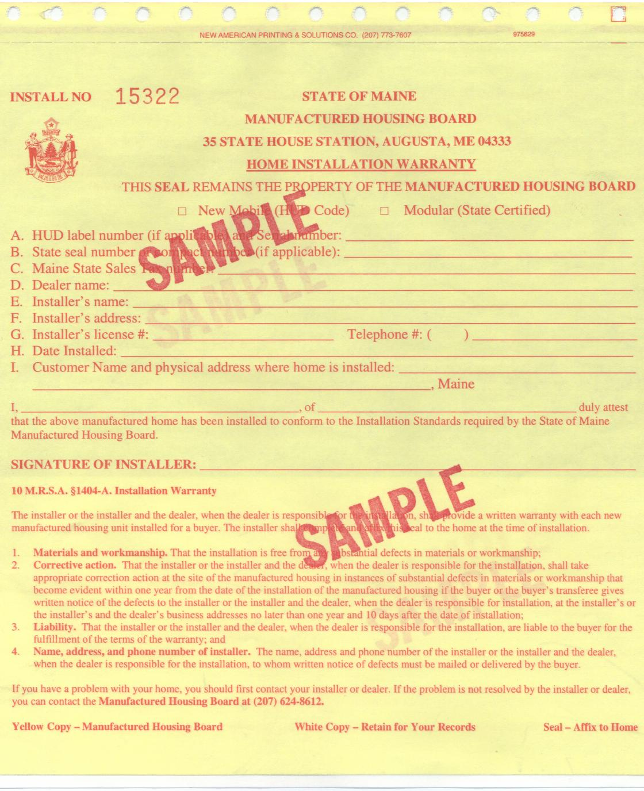

Slide 33
General Provisions
M.R.S. 10, Chapter 951
The production and utilization of manufactured housing and the use of new and improving technologies, techniques, methods and materials have and will increase the available supply of housing at prices that residents of the State can afford.

Slide 34
The intent is to provide protection to the public against hazards from poorly constructed or installed manufactured housing.
To provide and enforce uniform performance standards for construction and installation of manufactured housing.

Slide 35
Exemption
Manufactured Housing as defined in M.R.S. 10, 9002 (7) (A-C) which is manufactured, sold, installed or serviced in compliance with these rules shall be exempt from all state or other political subdivision codes, standards or regulations which regulate the same matters.

Slide 36
Exemption for Modular Housing
M.R.S. 30-A, 4358(2)(E)
Notwithstanding any other provision of law, any modular home that meets construction standards for state-certified manufactured homes adopted pursuant to M.R.S. 10, 9042 must be allowed in all zones where other single-family homes are allowed.

Slide 37
WARRANTY

Slide 38
Manufactured Housing Warranties
There are 3 warranties that pertain to all new manufactured homes sold in the State of Maine that may be applied to determine a substantial defect:
1. Express
2. Statutory
3. Implied

Slide 39
Express Warranty
Provided by the manufacturer or dealer.
Not enforced by the Manufactured Housing Board.
It is important to the consumer when making a big purchase, such as a home.

Slide 40
Express Warranty
It is based on the Purchase and Sale Agreement and is typically in a written format.
The length of the express warranty can vary.

Slide 41
Statutory Warranty
Set forth in M.R.S. 10, Chapter 213.
Provides a warranty on the home and the installation of the home.
The manufacturer and dealer must certify that the home and the installation are free from any substantial defects in material and workmanship.

Slide 42
Implied Warranty
Set forth in Title 5.
It is not widely known by the consumer.
Has three qualifying conditions to be considered a violation:
  The item must be seriously defective;
  The item must not have been abused, and
  The item must not have exceeded its useful life.

Slide 43
Implied Warranty
The statute of limitations for the implied warranty is maximum of four years from the date of allowable occupancy.
This is in addition to any statutory warranty.

Slide 44
Warranty Liability and Responsibility
The manufacturer and dealer are jointly and severally liable to the consumer for the fulfillment of the terms of the warranties related to the correction of substantial defects in materials and workmanship.

Slide 45
The dealer and installer are liable to the consumer for the fulfillment of the terms of the warranties related to the correction of substantial defects in materials and workmanship of the installation of the home.
The dealer is ultimately responsible for the supervision of its employees and/or subcontractors.

Slide 46
The warranty on housing also provides that the dealer and manufacturer are responsible for any corrective action related to all appliances.
The consumer should report all complaints to the licensees.

Slide 47
Substantial vs. Cosmetic
Defects
A substantial defect is being of considerable importance, value, degree, amount or extent.
A cosmetic defect is ornamental rather than functional having little or no significance.

Slide 48
Defects
It is the inspectors’ determination whether a defect is considered a substantial or a cosmetic defect.

Slide 49
Warranty Guidelines
The applicability of the warranty standards is conditioned upon the fact that the home is constructed in compliance with:
  HUD Standards for HUD homes
  2015 International Residential Code (IRC) for Modular homes

Slide 50
Journeyman Quality Workmanship
Workmanship that equates to the second or intermediate level of development of proficiency in a particular trade or skill, and reflects the work of a skilled worker but without the perfection of a master craftsman.

Slide 51
Freezing Warranty Rights
In order to preserve the statutory warranty rights for corrective action on possible defects, a written notice to the dealer and manufacturer must be sent within one year.
In order to preserve the implied warranty rights for corrective action of possible defects, a written notice to the dealer and manufacturer must be sent as soon as possible when the defect or defects are noticed.
Only the items complained about in writing will be “frozen” for any future corrective action.

Slide 52
Modular Homes
Also called:
State-certified manufactured housing
2015 International Residential Code (IRC) homes.

Slide 53
Identification of Modular Homes
State certification seal vs. HUD label
Almost never designed for installation on a simple concrete slab
Occasionally constructed on a permanent steel frame

Slide 54
Standards for Construction
2015 International Residential Code (IRC).

Slide 55
Standards for Installation
2015 International Residential Code
Manufacturer’s installation instructions

Slide 56
Structural Difference between Modular and Stick-built
The modules of modular homes are split along the longitudinal center and must be connected at every horizontal plane.
A portion of the roof load for most modular homes bears at the mate line. This load must be transferred to the basement column support system.

Slide 58
Advantages of Modular Homes
Built in a controlled environment
“Instant” housing
Consumer may be able to view home before purchasing
Generally, most code-compliant homes in Maine?
Regulation (Manufactured Housing Board)

Slide 59
THE 3 BIG PROBLEMS
Contractual – no Board jurisdiction
Installation – compliance and quality of
Service – timeliness and quality of

Slide 60
Misconception
“I’ve always wanted to be a builder. I’ll just purchase modular homes and put the halves together.”

Slide 61
“A” Work vs. “B” Work
“A” work = structural – requires Board license
1. Completed fastening schedule
2. Basement support columns
3. Completed roof system (when supplied
by the manufacturer)
4. Weather tight (field-installed siding not included)
“B” work = non-structural – no Board license required (trade licenses required where applicable)

Slide 62
Inspection of Closed Construction
3rd party (PFS, TRA, NTA, RADCO, UL)
1. Plans
2. Quality assurance program
3. Manufacturer’s installation instructions
4. In-plant inspections

Slide 63
Set-up Manual/Manufacturer’s Instructions

Slide 64
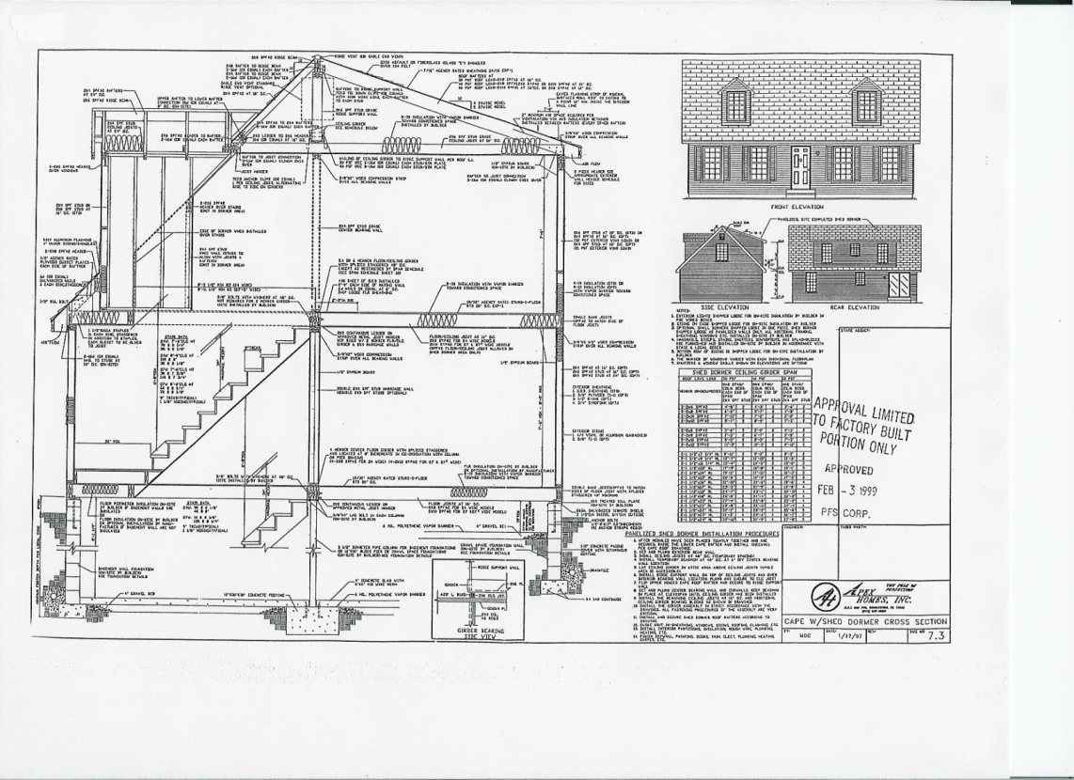
Cape w/Shed Dormer Cross Section
Installation/set-up manual will be detailed.

Slide 65
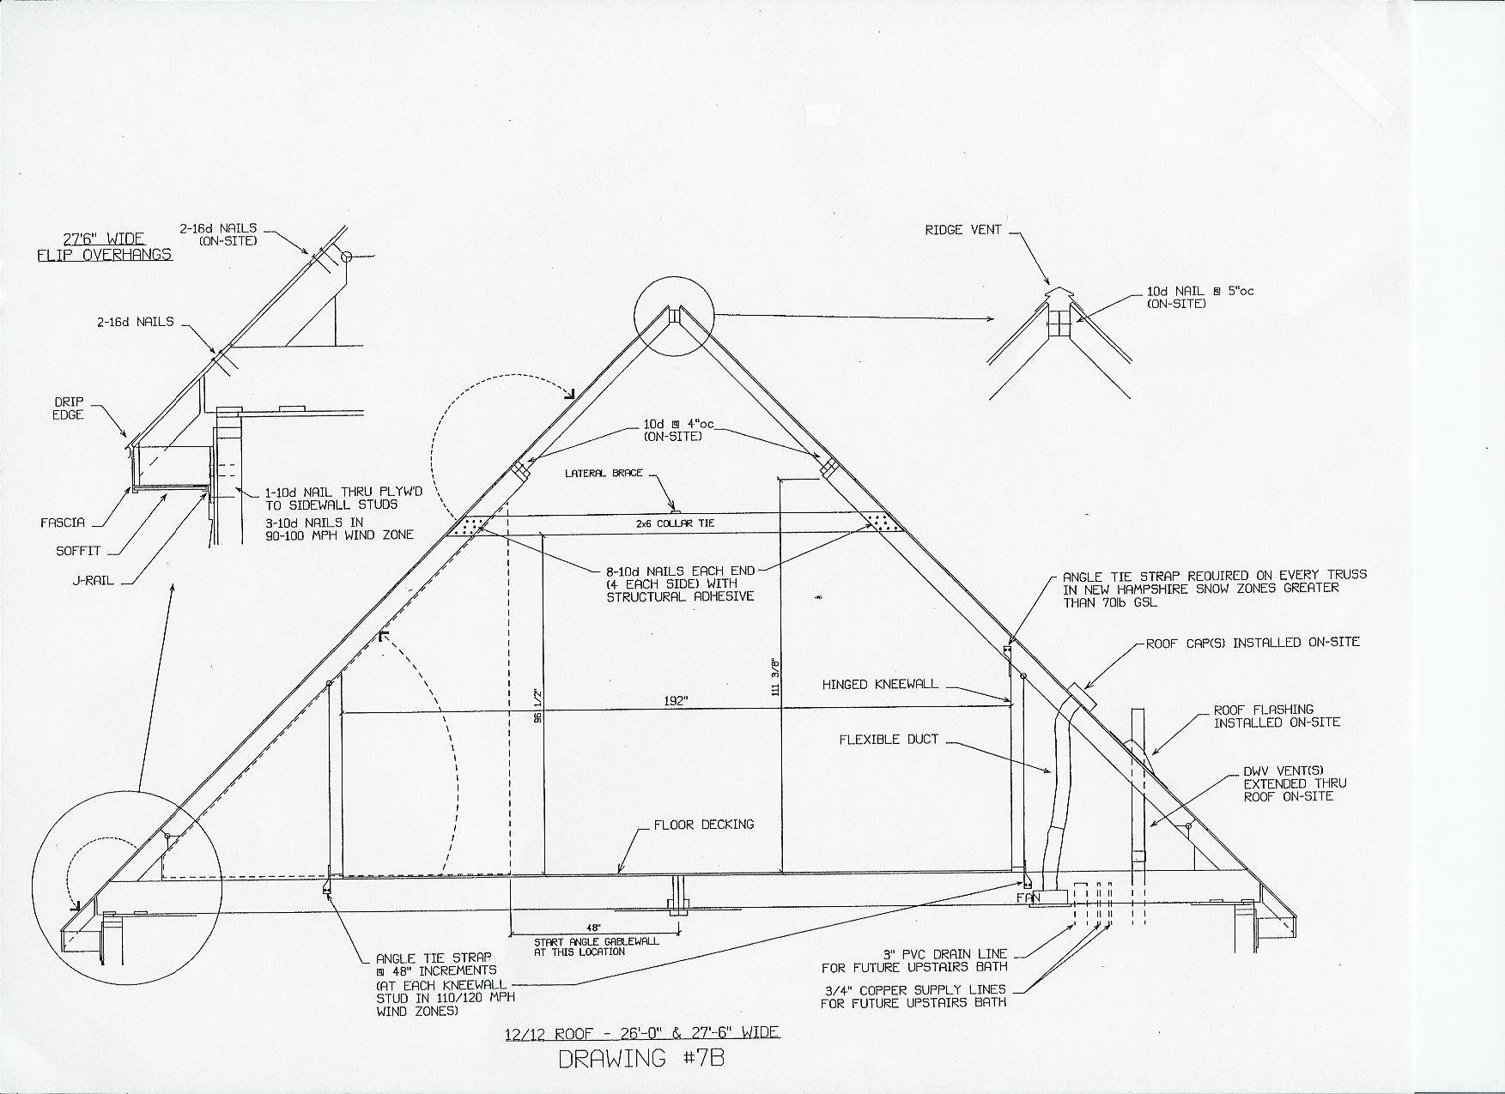
Fastening Detail

Slide 66
Rules: Chapter 350 (2) (C)
A copy of the manufacturer’s installation instructions and, for a state certified modular home, a copy of the manufactured home plans, shall be left with the installed home.

Slide 67
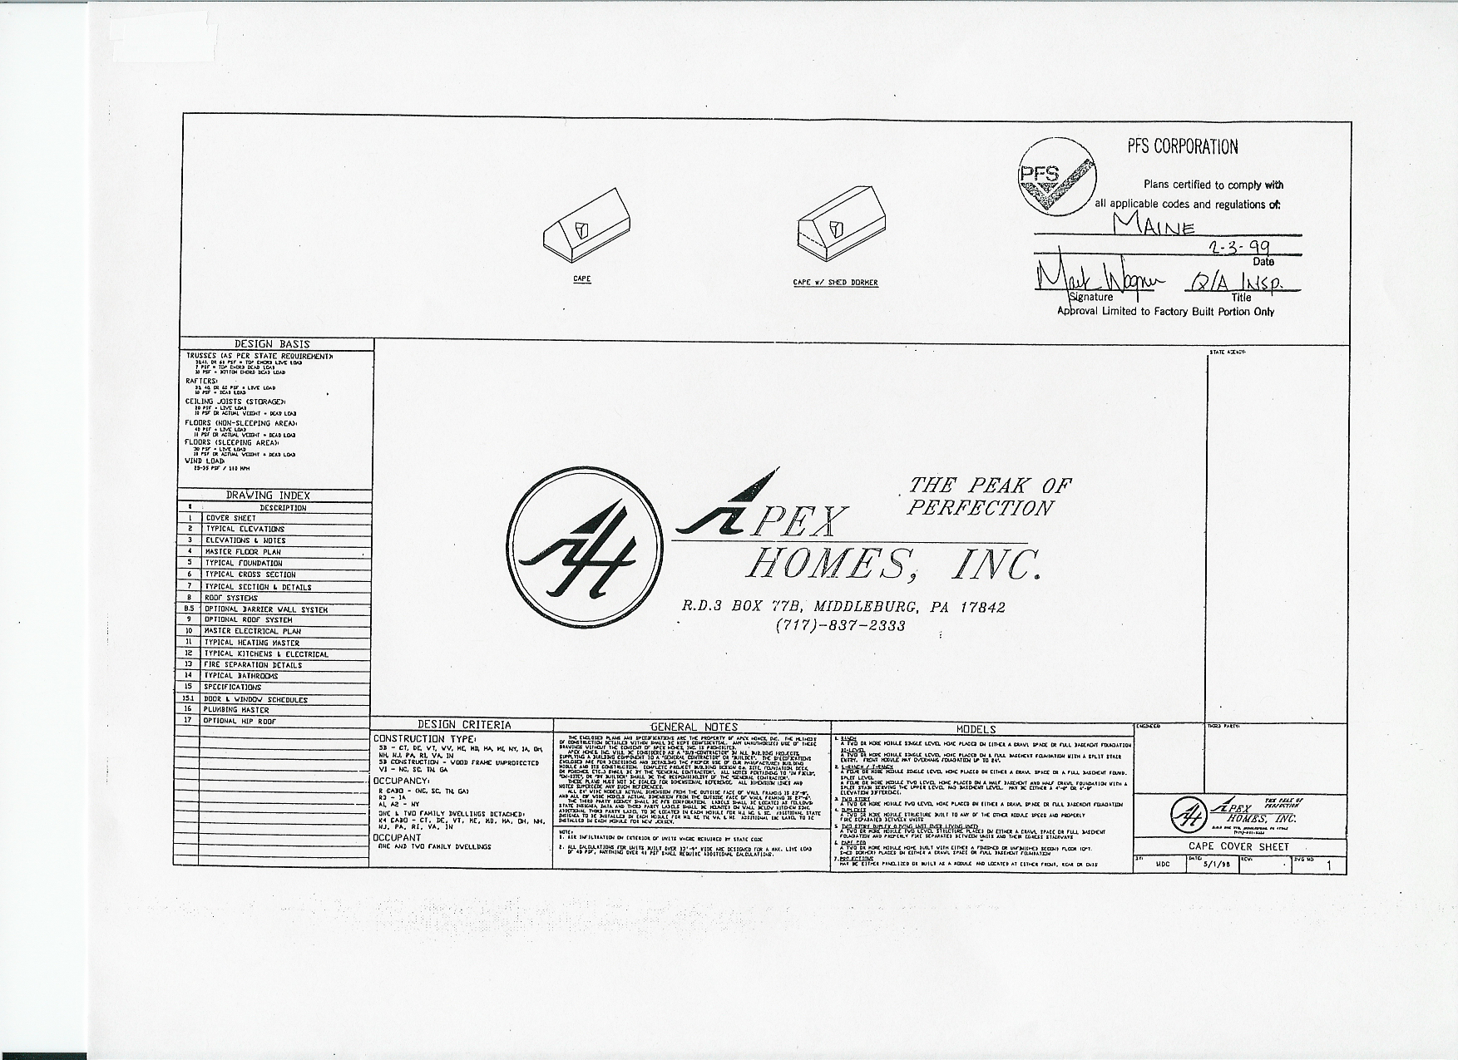
Approved Plans – Complete Set
TO BE LEFT WITH THE HOME!
To be left with the home!

Slide 68
General Set-up Method
Crane Installation

Slide 69
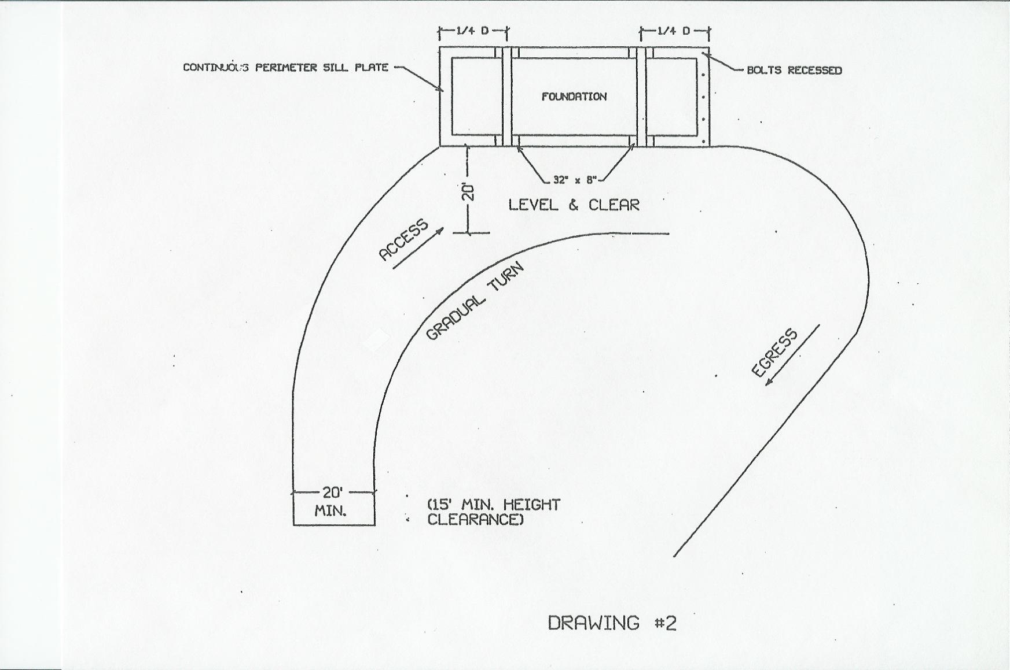
Access

Slide 70
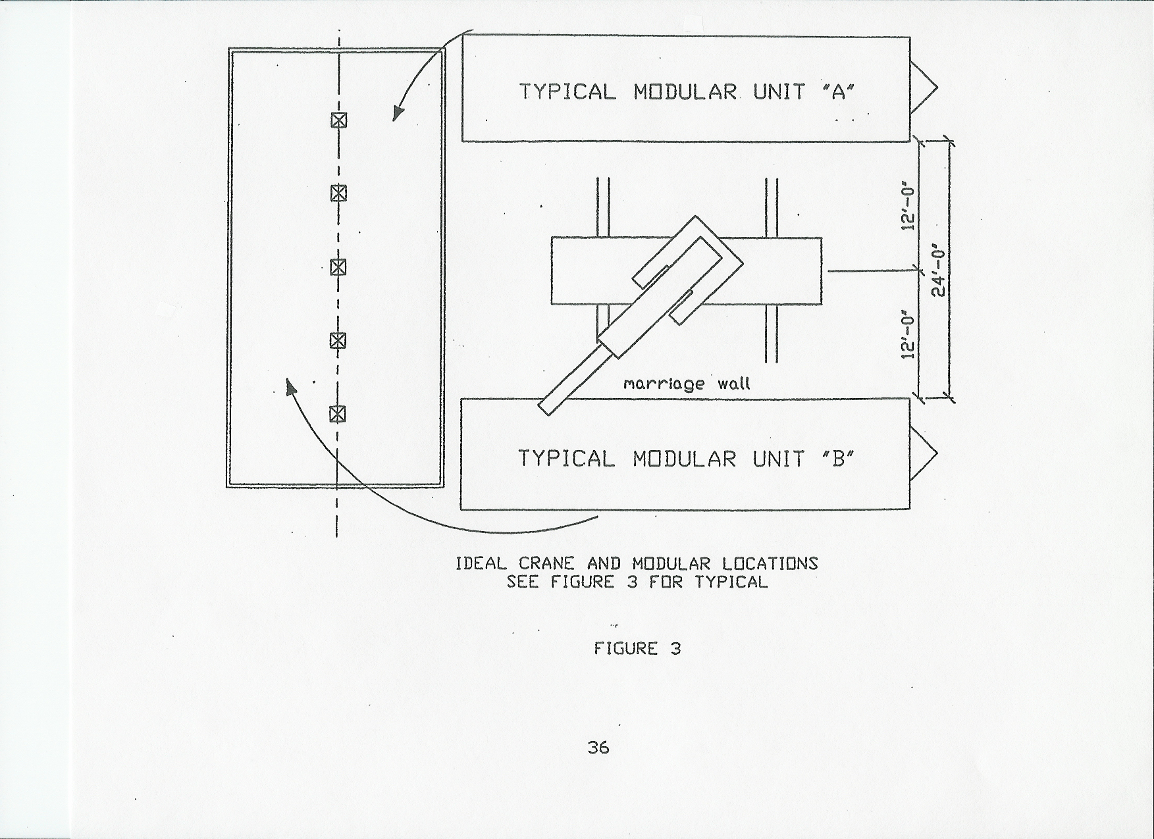
Crane Location Relative to Modules and Foundation

Slide 71
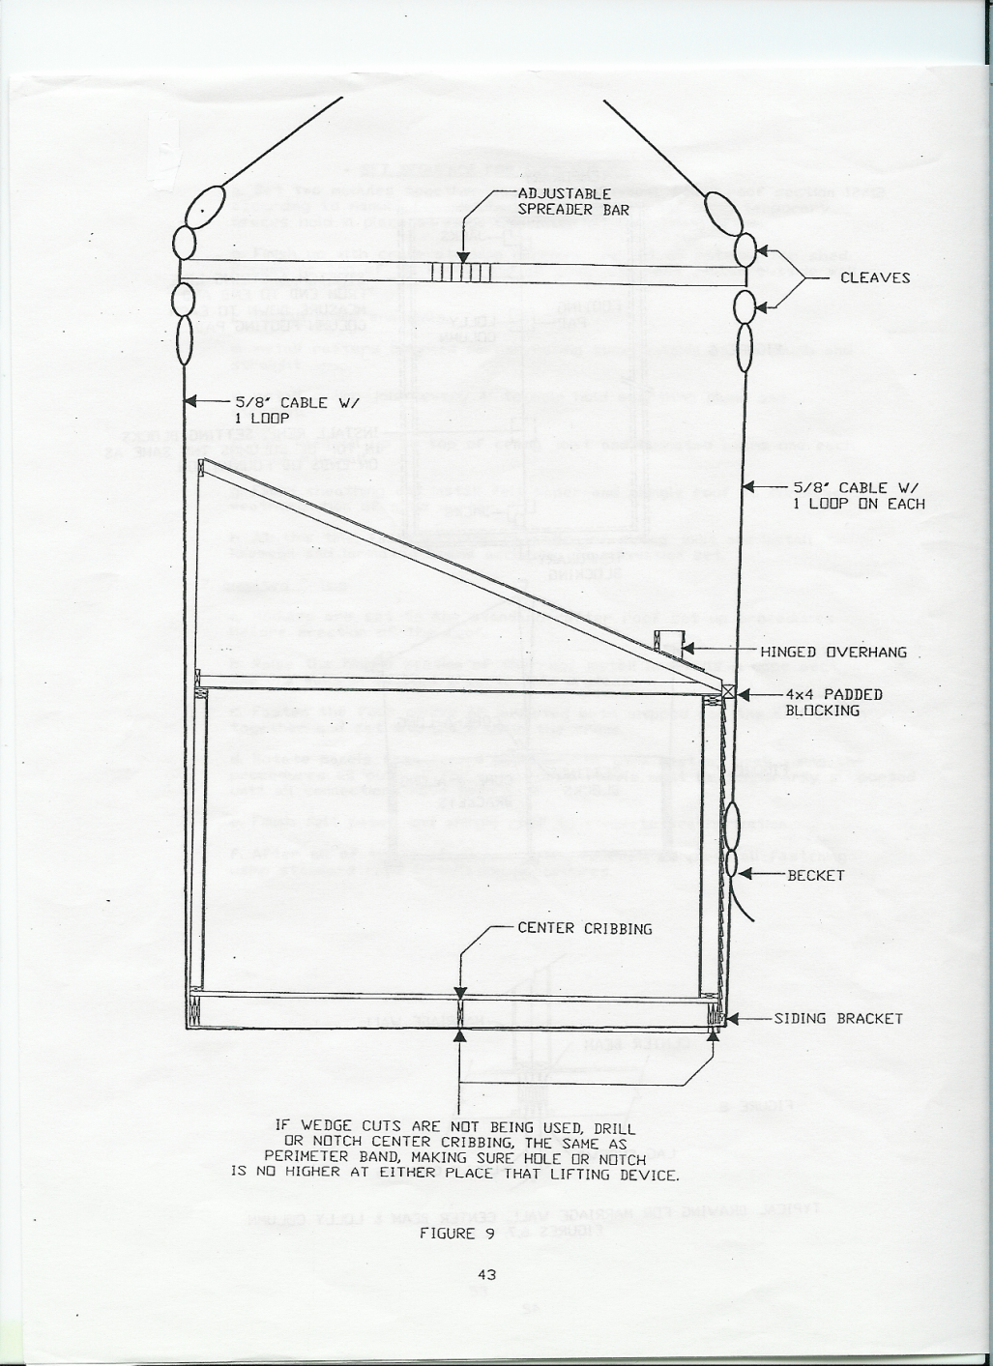
Crane Installation
End View

Slide 72
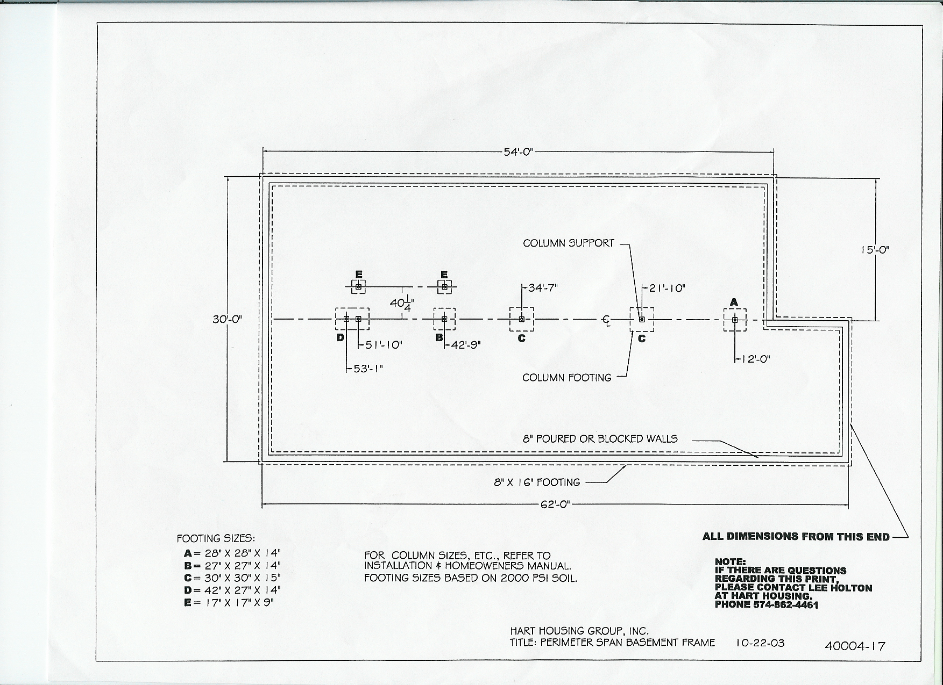
Foundation Plan
Note: specific column spacing

Slide 73
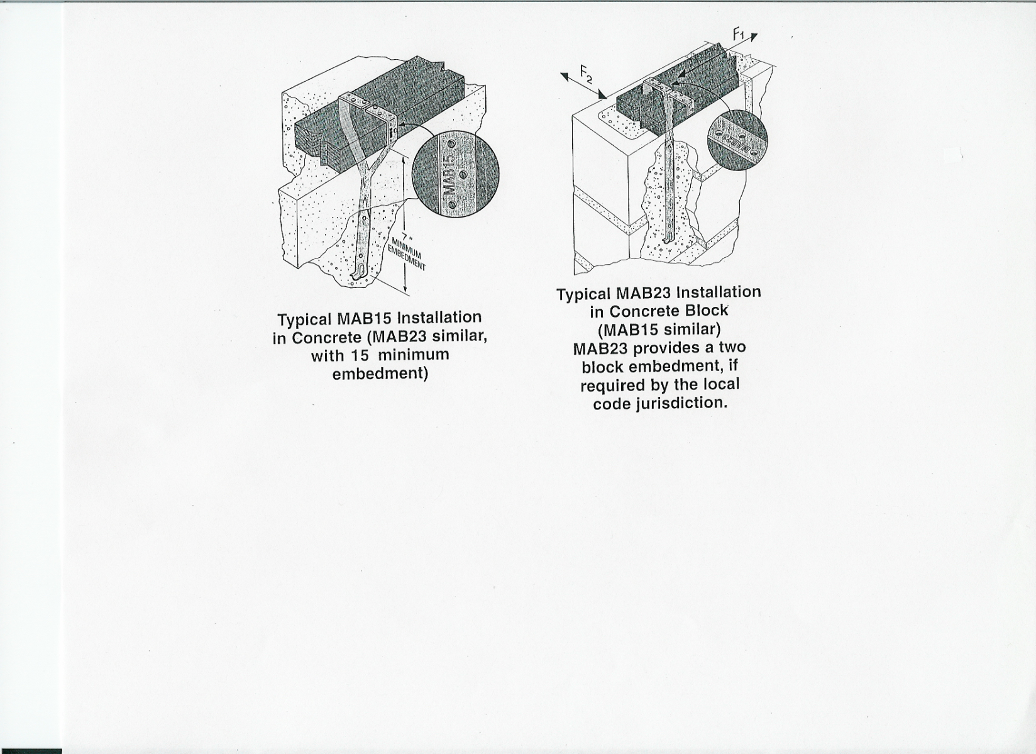
Approved Anchors

Slide 74
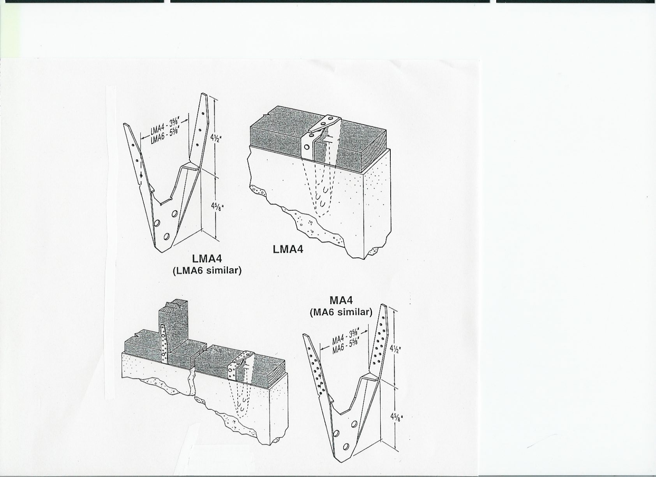
Approved Anchors

Slide 75
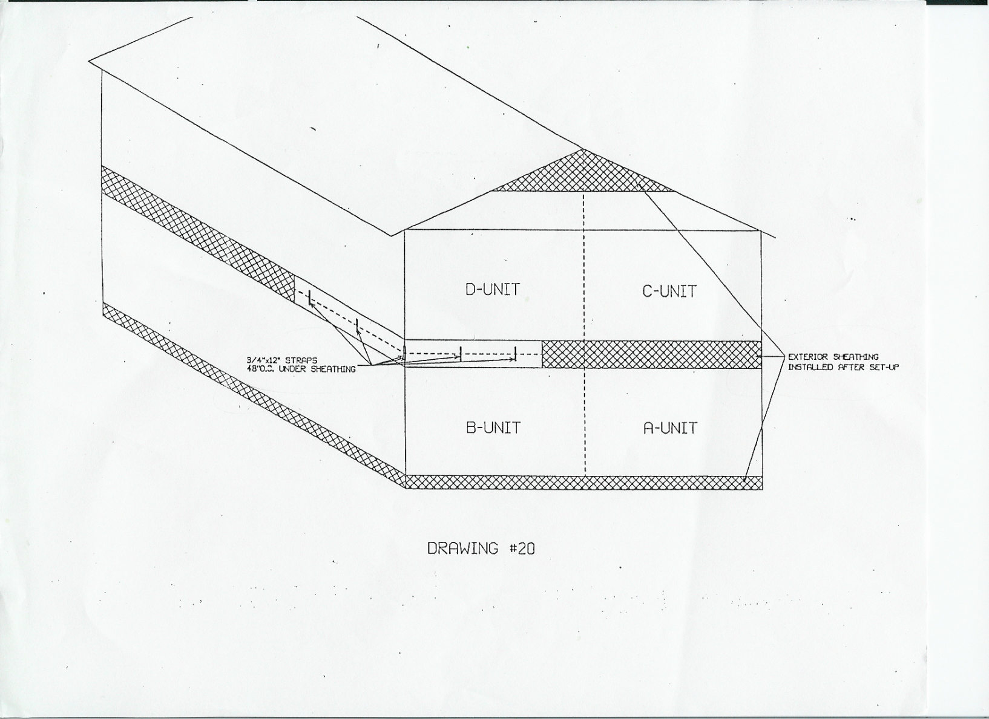
Vertical Mating for 2-story Homes

Slide 76
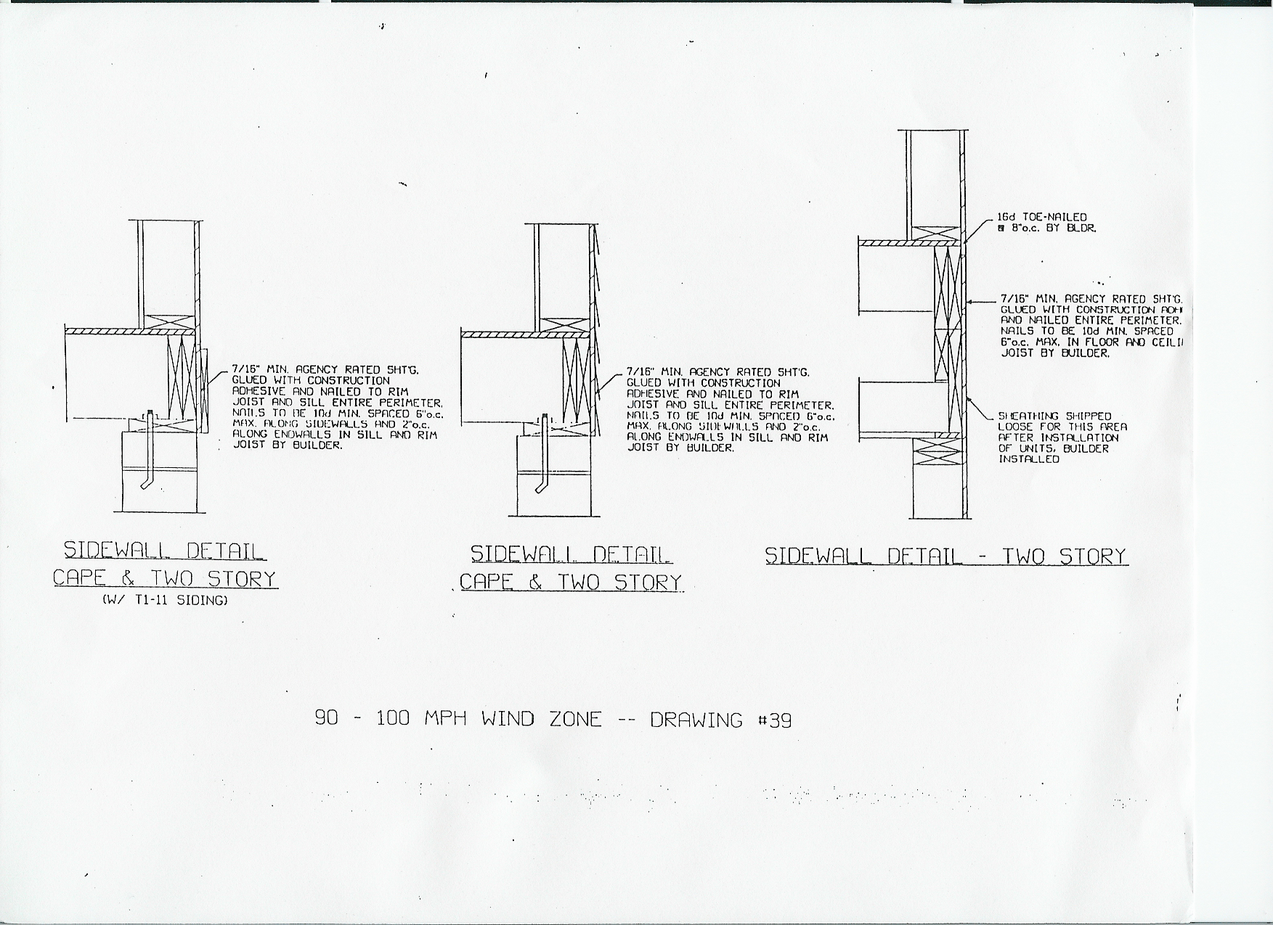
Don’t Forget the Perimeter Insulation

Slide 77
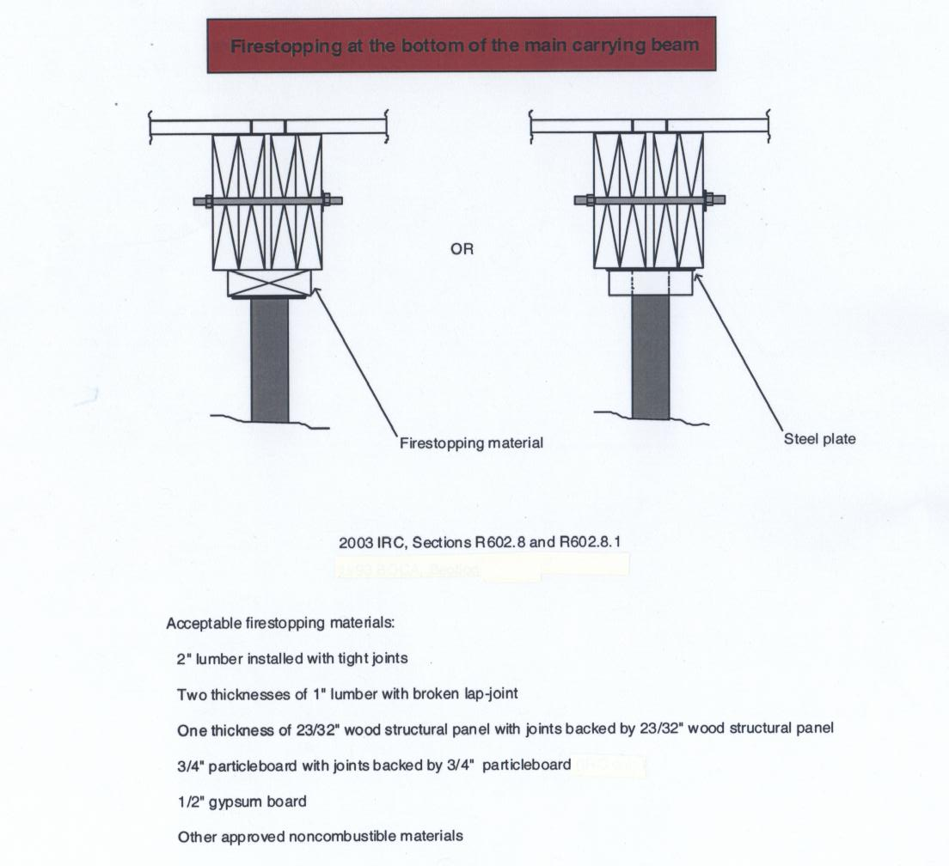
Firestopping at the bottom of the main carrying beam.

Slide 78
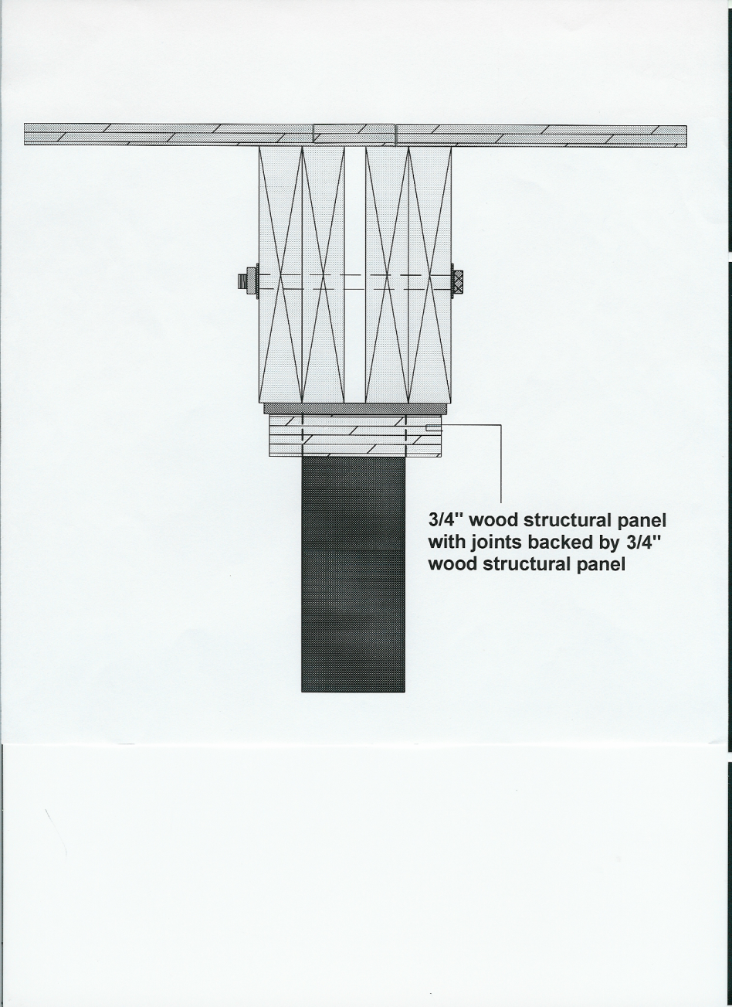
FIRESTOPPING
Firestopping

Slide 79
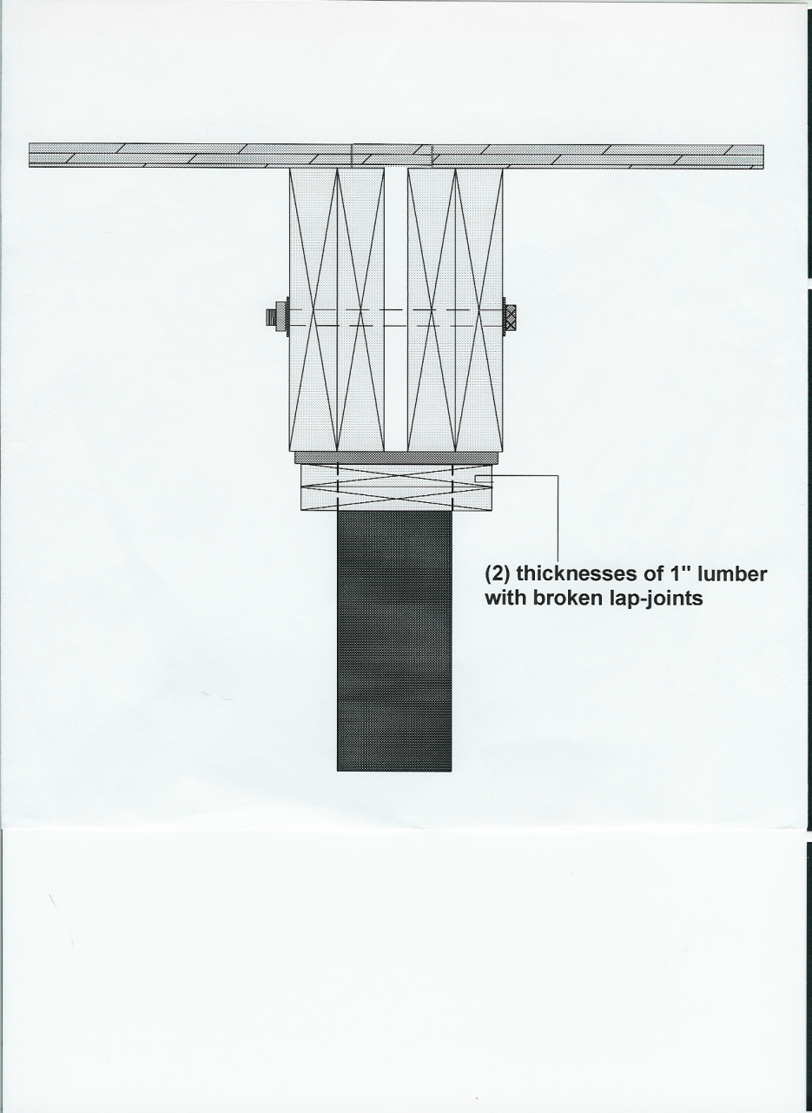
Firestopping

Slide 80
Stair Geometry
8 ¼” Riser
9” Tread
Applies also to basement stairs when part of the factory design, and the necessary basement height is stated.

Slide 81
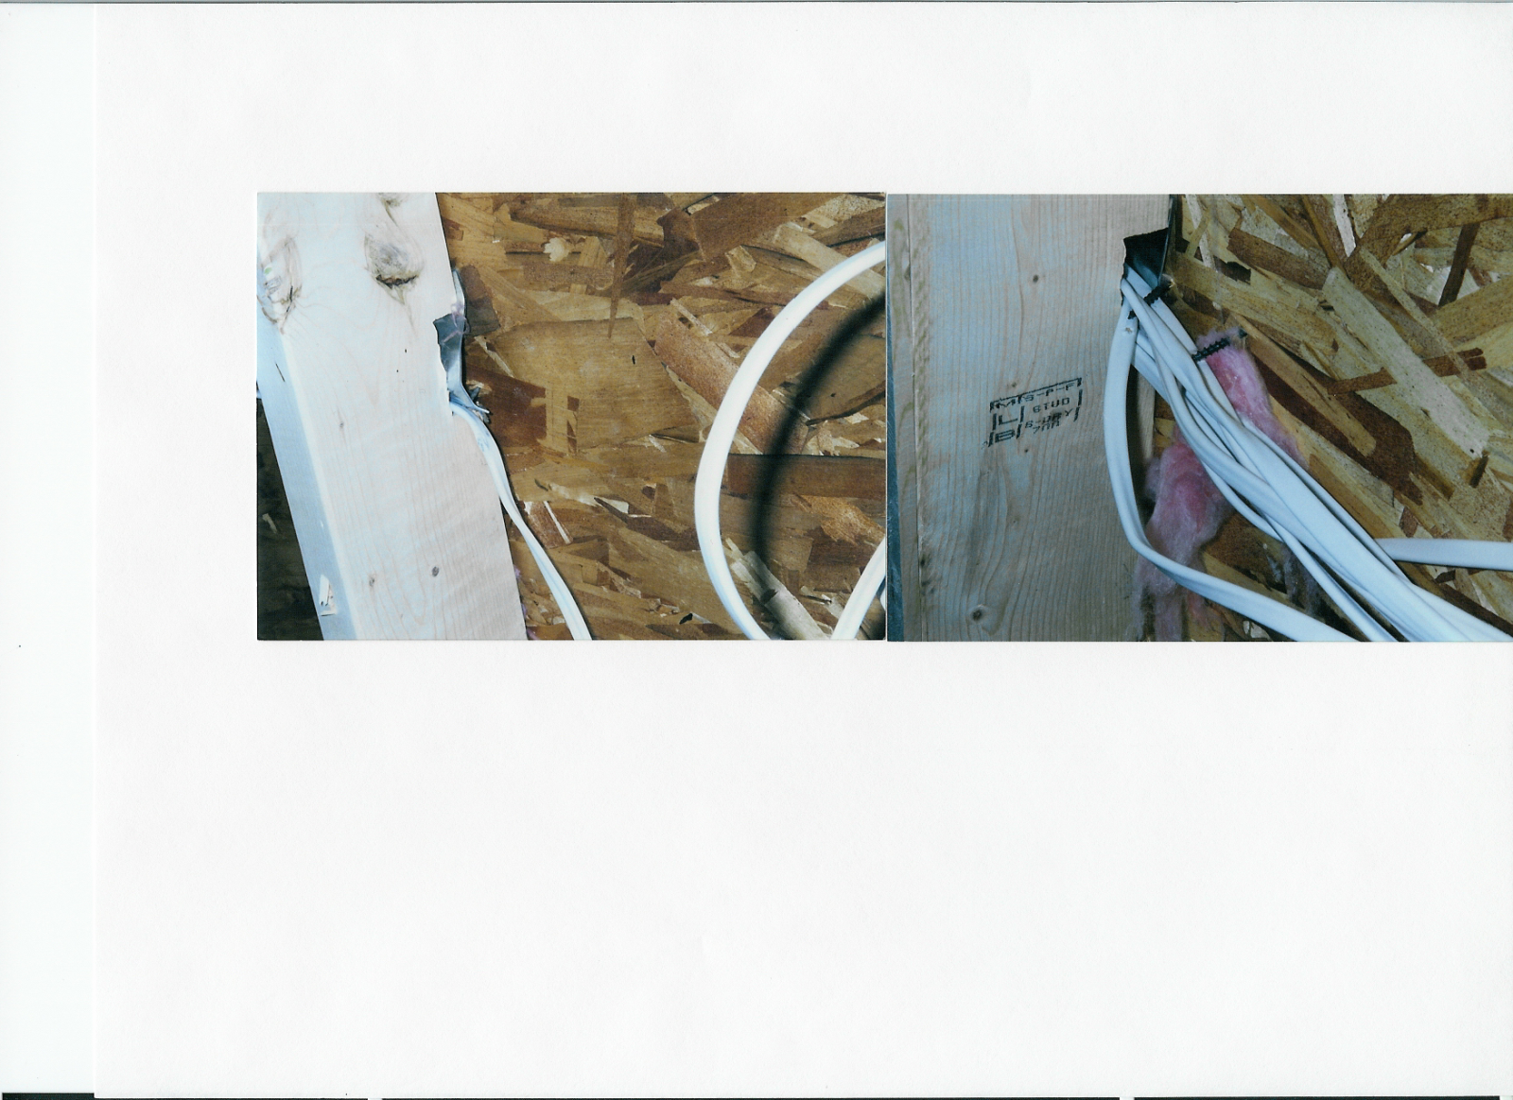
CAUTION
Wire notches covered with a metal plate are allowed
by code, however you must use caution when using nail
guns on the exterior sheathing.

Slide 82
Installation Standards
For New HUD Homes

Slide 83
24 CFR Part 3285
Federal Standards mandate that all states implement a new installation standard that meets or exceeds the Model Installation Standards adopted by HUD.

Slide 84
Pre-occupancy Inspections
Board staff are required to conduct pre-occupancy inspections on 30% of all new manufactured HUD homes. The 30% will be selected randomly from locations throughout the state.

Slide 85
Pre-occupancy Inspections
Inspection Costs
The licensed dealer will be charged an inspection fee, which will be the actual cost of the inspection. The fee is currently $300 statewide.

Slide 86
Pre-occupancy Inspections
For homes that pass inspection, a label will be placed under the kitchen sink cabinet certifying that the installation is in compliance with this standard.

Slide 87
Pre-occupancy Inspections
For homes that do not pass inspection, a notice of violation and order of correction will be issued to the dealer or mechanic who performed the installation in the manner described in Chapter 370, Section 5(A) of the board’s rules. The licensee shall respond to the notice of violation and order of correction as set forth in Chapter 370.
If a violation was found upon initial inspection and an order of correction was issued, a re-inspection will be conducted. If the violation was found to be corrected in its entirety, there will be no charge for the re-inspection.
Notes:
PP

Slide 88
SUBCHAPTER A
GENERAL

Slide 89
Scope
This standard provides minimum requirements for the initial installation of new manufactured homes wherever located in the State.

Slide 90
Intended Usage
This standard applies to new manufactured homes (single section, multiple section or expanded types) for the use as a single family dwelling.

Slide 91
Manufacturer Installation
Instructions
A manufacturer must provide with each new manufactured home, installation designs and instructions that have been approved by the HUD Secretary or the Design Approval Primary Inspection Agency (DAPIA).

Slide 92
Variations to Installation Instructions
Before an installer provides support or anchorage that are different than those methods specified in the manufacturer’s installation instructions or when the installer encounters site or other conditions that prevent the use of the instructions, the installer must obtain an alternative design prepared & certified by a professional engineer or registered architect for the support and anchorage of the manufactured home.

Slide 93
Installer Certification
The installer must certify that the completed installation is in compliance with either the manufacturer’s installation instructions or with an engineered alternative installation design by affixing a completed Maine Installation Warranty Seal to the home.

Slide 94
SUBCHAPTER B
PRE-INSTALLATION CONSIDERATIONS

Slide 95
Installation in Flood Hazard Areas
  Prior to the initial installation of a new manufactured home, the installer is responsible for determining whether the manufactured home site lies within a special flood hazard area.

Slide 96
Installation Zones
A. Sites prepared in Washington, Hancock, Aroostook, Somerset, Waldo, Penobscot, Knox, and Piscataquis counties require 24 inches of compacted fill as part of the engineered foundation.
B. Sites prepared in York, Cumberland, Kennebec, Sagadahoc, Lincoln, Franklin, Oxford and Androscoggin counties require 18 inches of compacted fill as part of the engineered foundation.

Slide 97
Wind Zone
Manufactured homes must not be installed in a wind zone that exceeds the design wind loads for which the home has been designed, as evidenced by the wind zone indicated on the home’s data plate.

Slide 98
Wind Zones
A. Wind Zone I
Aroostook, Somerset, Waldo, Franklin, Penobscot, Oxford, Piscataquis, York, Cumberland, Kennebec, Sagadahoc, Knox, Lincoln and Androscoggin counties.
B. Wind Zone II…100 mph
Hancock and Washington counties.

Slide 99
Roof Load Zone
Manufactured Homes must not be located in a roof load zone that exceeds the design roof load for which the home has been designed as evidenced by the roof load zone indicated on the home’s data plate.

Slide 100
Roof Load Zones
A. Counties with 40 psf roof load: Washington, Hancock, Aroostook, Somerset, Waldo, Penobscot, Knox, and Piscataquis.
B. Counties with 30 psf roof load: York, Cumberland, Kennebec, Sagadahoc, Lincoln, Franklin, Oxford and Androscoggin.

Slide 101
SUBCHAPTER C
SITE PREPARATION

Slide 102
Soil Conditions
To help prevent settling or sagging, the foundation must be constructed on firm, undisturbed soil or fill compacted to at least 90 percent of its maximum relative density.

Slide 103
Soil Conditions
All organic materials such as grass, roots, twigs, and wood scraps must be removed in areas where footings are to be placed.
After removal of organic material, the home site must be graded or otherwise prepared to ensure adequate drainage.

Slide 104
Soil Classifications and
Bearing Capacity
The soil classification and bearing capacity of the soil must be determined before the foundation is constructed and anchored. The soil classification and bearing capacity must be determined by one or more of the following methods:

Slide 105
Soil Classifications and
Bearing Capacity
A. Soil tests. Soil tests that are in accordance with generally accepted engineering practice; or
B. Soil records. Soil records of the applicable Local Authority Having Jurisdiction (LAHJ); or
C. A pocket penetrometer; or

Slide 106
Soil Classifications and
Bearing Capacity
D. If the soil appears to be composed of peat, organic clays or uncompacted fill, or appears to have unusual conditions, a registered professional geologist, registered professional engineer, or registered architect must determine the soil classification and maximum allowable soil bearing capacity.

Slide 107
Site Drainage
All drainage must be diverted away from the home and must slope a minimum of one-half inch per foot away from the foundation for the first 10 feet.

Slide 108
Ground Moisture Control
Vapor Retarder & Materials
When a home is installed on an approved engineered designed gravel pad, a vapor retarder must be installed to cover the ground under the home.
A minimum of six mil polyethylene sheeting or its equivalent must be used.

Slide 109
Ground Moisture Control
Proper Installation
The entire area under the home must be covered with the vapor retarder except for areas under open porches, decks, and recessed entries. Joints in the vapor retarder must be overlapped at least 12 inches.

Slide 110
SUBCHAPTER D
FOUNDATIONS

Slide 111
FOUNDATIONS
GENERAL
PIERS
FOOTINGS

Slide 112
GENERAL
All systems must be designed by an engineer or architect.
TYPES
Manufacturer’s
Alternative
Flood Hazard Areas

Slide 113
PIERS
CONCRETE BLOCK
MANUFACTURED

Slide 114
MANUFACTURED PIERS
ALLOWED…BUT
Piers must be listed by a nationally recognized listing agency.
Design (exact pier, listing, location, etc.) must be engineered for each home
Must have a complete stamped design on site prior to installation

Slide 115
CONCRETE PIERS
STRAIGHTFORWARD
Standard designs in the rule
Only need pier locations supplied by manufacturer or engineer

Slide 116
CONCRETE PIERS
GENERAL REQUIREMENTS
IN THE RULES
Construction
Caps
Gaps
Clearance under Home (12 inches)
Height

Slide 117
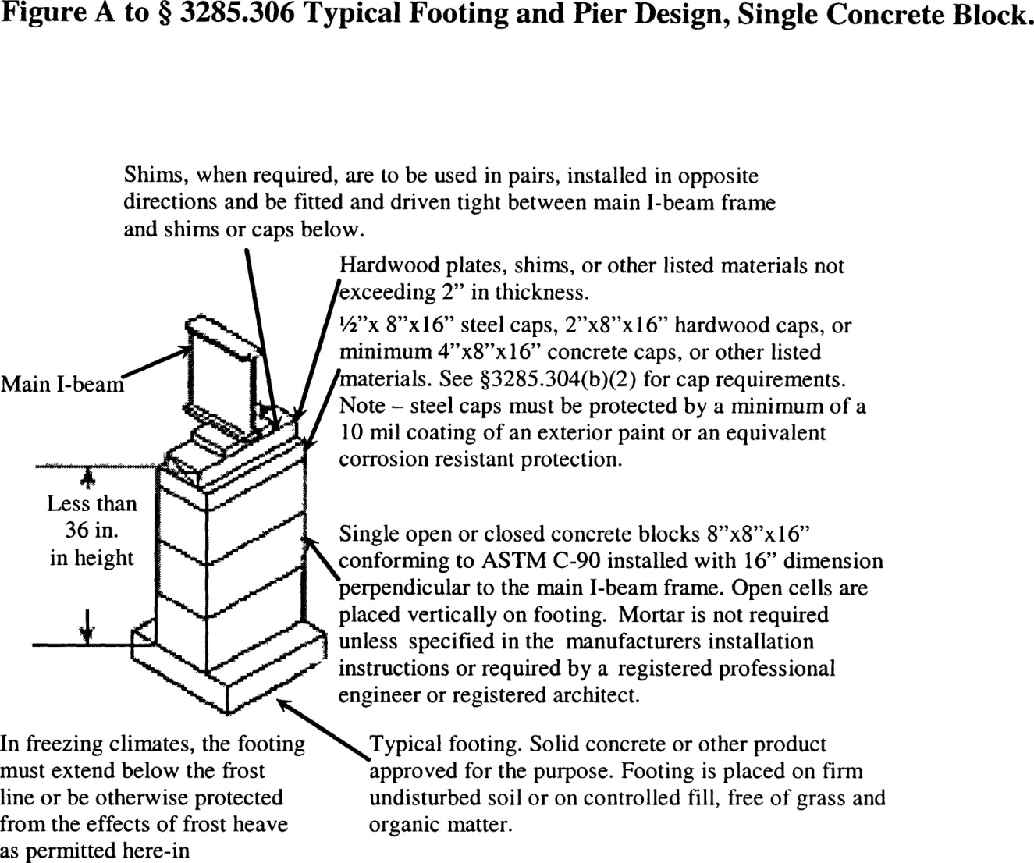
FIGURE A-SECTION VI
Design Procedures for Concrete Pier Blocks

Slide 118
FIGURE B-SECTION VI
Design Procedures for Concrete Pier Blocks

Slide 119
Other Pier Requirements
All piers over 48 inches must be designed by an engineer or architect.
Piers must be installed within 2 feet from both ends and no more than 10 feet apart under main beams.
Piers are required at side wall openings greater than 48 inches, porch posts, and fireplaces/stoves.

Slide 120
SUBCHAPTER F
OPTIONAL FEATURES

Slide 121
INSTALLER’S DUTY
Know the listing
Install to the listing and manufacturer’s instructions
Know the dryer vent requirements
Know the ventilation requirements
Know the skirting requirements

Slide 122
DRYER EXHAUST SYSTEM
Installation of the exhaust system must be in accordance with the dryer manufacturer instructions.
Dryer exhaust system must not contain reverse slope or terminate under the home.

Slide 123
Skirting
Skirting, if used, must be of weather-resistant materials or provided with protection against weather deterioration.
Skirting must not be attached in a manner that can cause water to be trapped between the siding and trim or forced up into the wall cavities trim to which it is attached and must not impede the contraction and expansion characteristics of the homes exterior.

Slide 124
Skirting
All wood skirting within 6 inches of the ground must be pressure-treated in accordance with AWPA Standard U1 for Use Category 4A, Ground Anchor Contact Applications, or be naturally resistant to decay and termite infestations.

Slide 125
Crawlspace Ventilation
A crawlspace with skirting must be provided with ventilation openings. The total area of ventilation openings may be reduced where a uniform 6-mil polyethylene sheet material or over vapor barrier is installed.

Slide 126
Crawlspace Ventilation
Ventilation openings must be placed as high as practicable above the ground.
Openings must be located on at least two opposite sides to provide cross-ventilation.

Slide 127
Crawlspace Ventilation
Dryer Vent & Combustion Air Inlets
Dryer vents and combustion air inlets must pass through the skirting to the outside. Any surface runoff from the furnace, air conditioning or water heater drains must be directed away from under the home.

Slide 128
SUBCHAPTER G
DUCTWORK AND PLUMBING & FUEL SUPPLY SYSTEMS

Slide 129
Field Assembly
Home manufacturers must provide specific installation instructions for the proper field assembly of manufacturer-supplied and shipped loose ducts, plumbing, and fuel supply system parts that are necessary to join all sections of the home and are designed in accordance with applicable requirements.

Slide 130
Water Supply
Maximum Supply Pressure & Reduction
When the local water supply pressure exceeds 80 psi to the manufactured home, a pressure-reducing valve must be installed.

Slide 131
Water Supply
Mandatory Shutoff Valve
An identified and accessible shutoff value must be installed between the water supply and the inlet.
The water riser for the shutoff valve connection must be located underneath the home. The shutoff valve must be a full-flow gate or ball valve, or equivalent valve.

Slide 132
Water Supply
Mandatory Shutoff Valve
Water riser pipes shall be a minimum ¾ in. nominal diameter and extend a minimum of 6 in. above ground elevation. Surface water shall be diverted from the riser.

Slide 133
Water Supply
Wells as a Source of Supply
A well shall not be located within the boundaries of a manufactured home pad.

Slide 134
Water Supply
Freezing Protection
Water line crossovers completed during installation must be protected from freezing.
1. If subject to freezing temperatures, the water connection must be wrapped with insulation or otherwise protected to prevent freezing.
2. Only pipe heating cable listed for manufactured home use is permitted to be used, and it must be installed in accordance with the cable manufacturer installation instructions.

Slide 135
Water Supply
Testing Procedures
The water system must be inspected and tested for leaks after completion at the site.

Slide 136
Drainage Systems
Proper Slopes
Drain lines must not slope less than one-quarter inch per foot, unless otherwise noted on the schematic diagram.
A slope of one-eighth inch per foot may be permitted when a clean-out is installed at the upper end of the run.

Slide 137
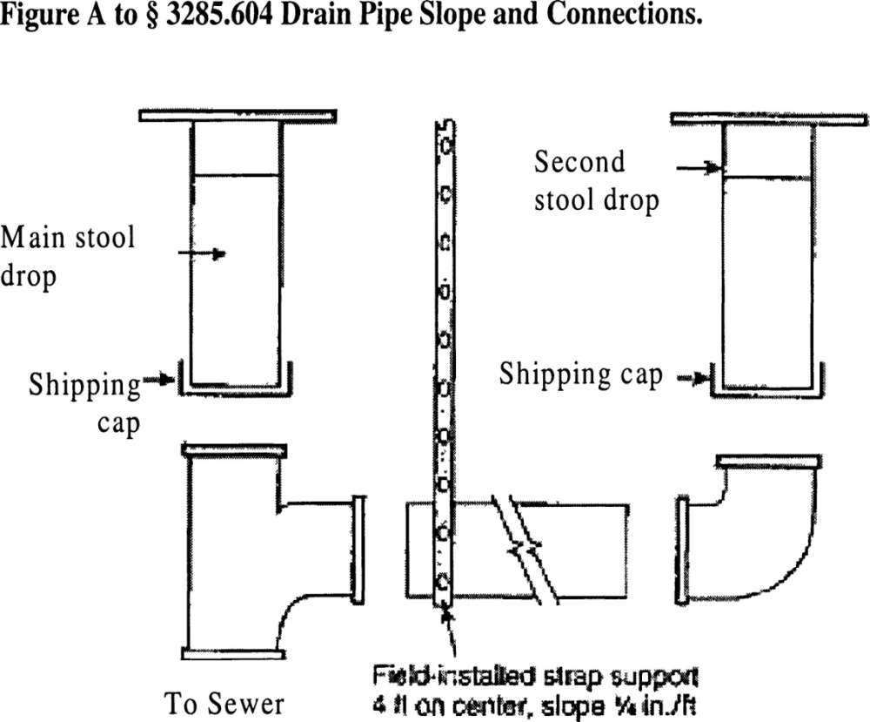
Drain Pipe Slope & Connections

Slide 138
Drainage System
Testing Procedures
The drainage system must be inspected and tested for leaks after the completion at the site.

Slide 139
Fuel Supply System
Testing Procedures
The gas system must be inspected and tested for leaks after the completion at the site.

Slide 140
Ductwork Connections
Multi-section homes with ductwork in more than one section require crossover connections to complete the duct system of the home. All ductwork connections, including duct collars, must be sealed to prevent air leakage. Galvanized metal straps or tape and mastics must be used around the duct collar and secured tightly to make all connections.

Slide 141
Ductwork Connections
Crossover ducts outside the thermal envelope must be insulated with listed materials.
In-floor or ceiling crossover duct connections must be installed and sealed to prevent air leakage.

Slide 142
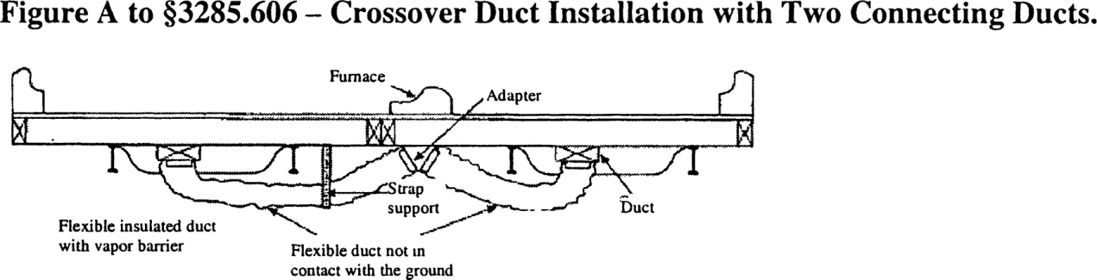
Crossover Duct Installation with Two Connecting Ducts
Crossover Duct Installation with Two Connecting Ducts.

Slide 143
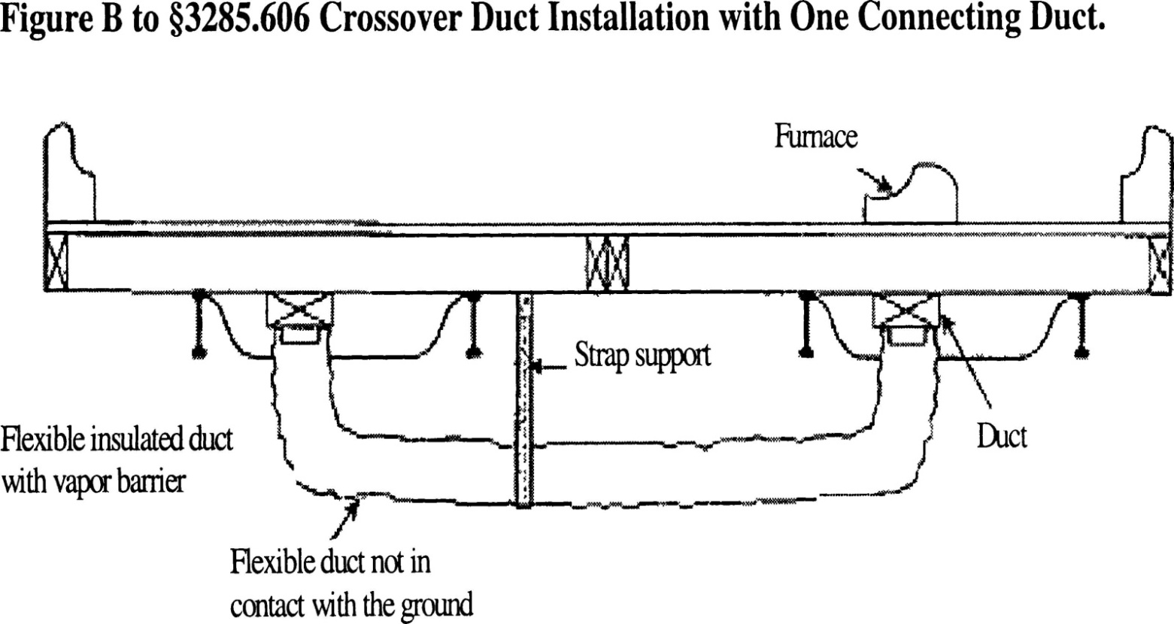
Crossover Duct Installation with One Connecting Duct
Crossover Duct Installation with One Connecting Duct.

Slide 144
SUBCHAPTER H
ELECTRICAL SYSTEMS AND EQUIPMENT

Slide 145
Electrical Crossovers
Multi-section homes with electrical wiring in more than one section require crossover connections to join all sections of the home. The crossover must be designed and completed in accordance with the directions provided in the installation instructions.

Slide 146
Miscellaneous Lights and Fixtures
Grounding
All the exterior lighting fixtures and ceiling fans installed must be grounded by a fixture-grounding device or by a fixture-grounding wire.
For chain-hung lighting fixtures both a fixture-grounding device and a fixture-grounding wire must be used. The identified conductor must be the neutral conductor.

Slide 147
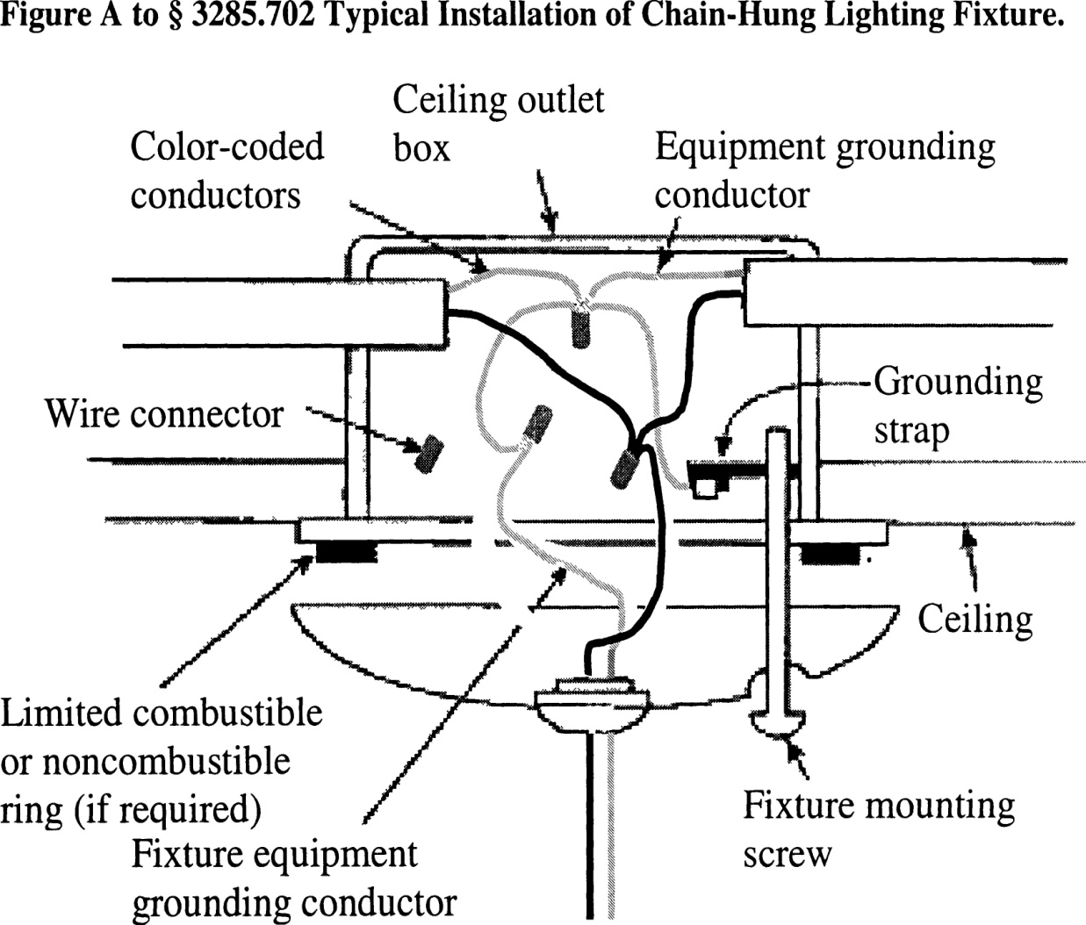
Typical Installation of a
Chain-Hung Lighting Fixture

Slide 148
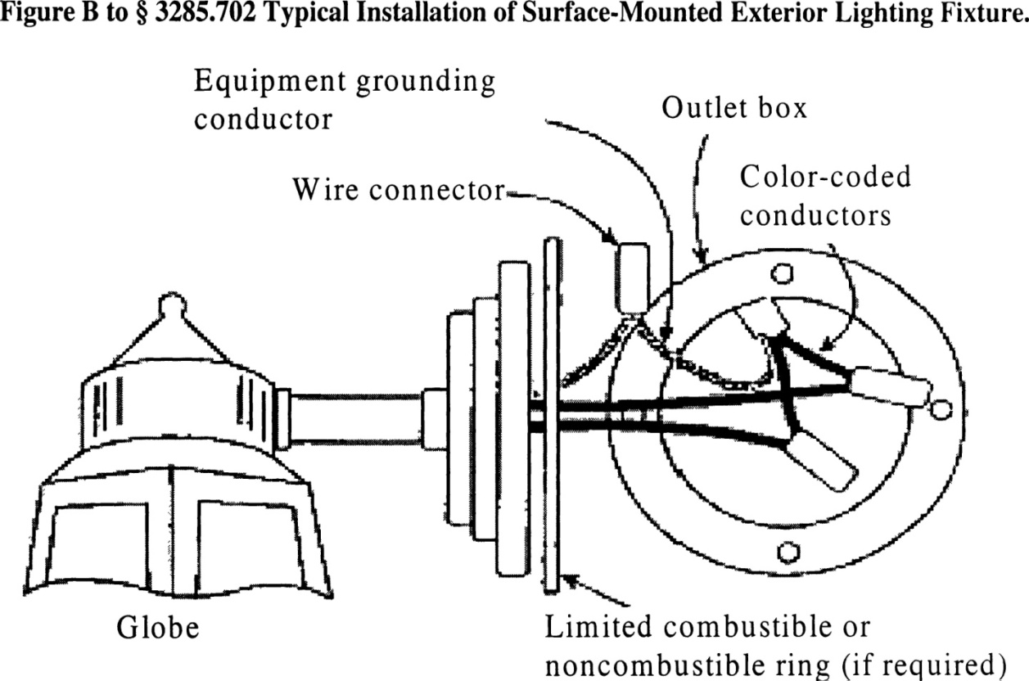
Typical Installation of a Surface-Mount Exterior Lighting Fixture
Typical Installation of Surface-Mounted Exterior Lighting Fixture.

Slide 149
Miscellaneous Lights and Fixtures
Exterior Lights
The lighting fixture must be caulked around its base to ensure a watertight seal to the sidewall.

Slide 150
Miscellaneous Lights and Fixtures
Ceiling Fans
Ceiling-suspended (paddle) fans must be connected to the junction box listed and marked for ceiling fan application.
The ceiling fan must be installed with the trailing edges of the blades at least 6’4” above the finished floor.

Slide 151
Miscellaneous Lights and Fixtures
Testing
After completion of all electrical wiring and connections, including crossovers, electrical lights, and ceiling fans, the electrical system must be inspected and tested at the site.
The installation instructions must indicate that each manufactured home must be subjected to the following tests:

Slide 152
Electrical Testing
1. An electrical continuity test to ensure that metallic parts are properly bonded;
2. Operational test to demonstrate that all equipment, except water heaters, electric furnaces, electric ranges, dishwashers, clothes washers/dryers, and portable appliances are connected and in working order; and
3. For electrical equipment installed or completed during installation, polarity checks to determine that connections have been made properly made. Visual verification is an acceptable electrical polarity check.

Slide 153
Smoke Alarms
Smoke alarms must be functionally tested in accordance with applicable requirements of the smoke alarm manufacturer instructions.
Home manufacturers must provide specific written instructions for installers on how to inspect and test the operation of smoke alarms during the installation of the home.

Slide 154
SUBCHAPTER I
EXTERIOR AND INTERIOR CLOSE-UP

Slide 155
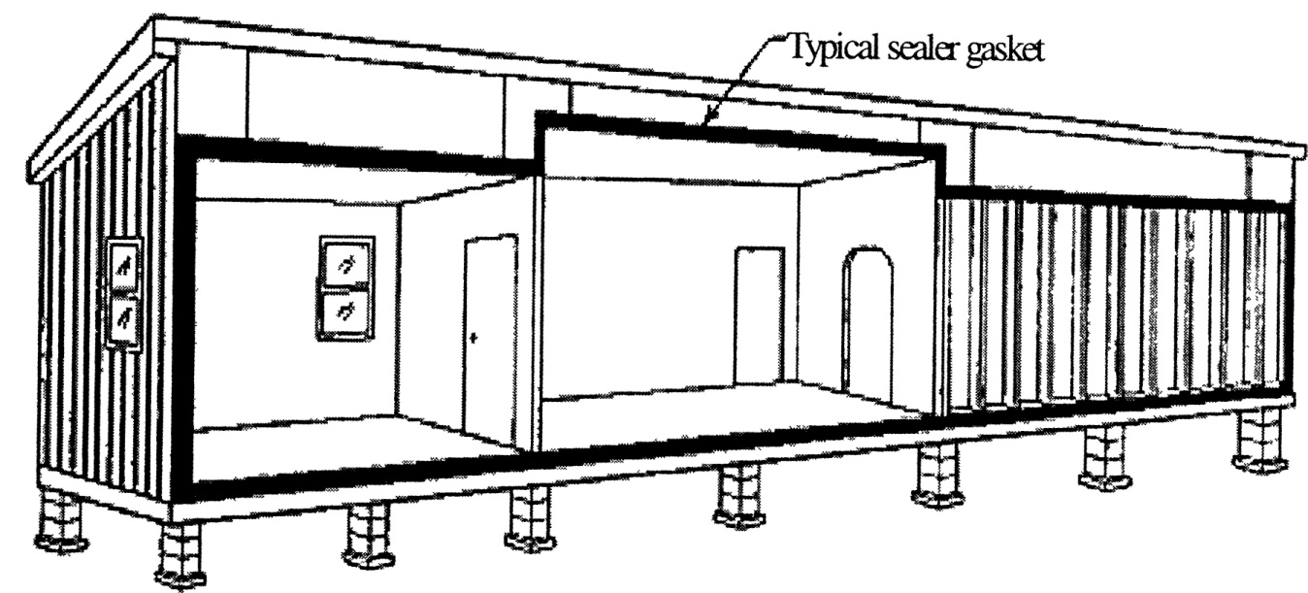
Mate-Line Gasket
On multi-section manufactured homes, install the sealer gasket on the ceiling, end walls, and floor mate-line prior to joining the sections together.

Slide 156
Bottom Board Repair
The bottom board covering must be inspected for any loosening or areas that might have been damaged or torn during installation or transportation. Any missing insulation is to be replaced prior to closure and repair of the bottom board.

Slide 157
Bottom Board Repair
Any splits or tears in the bottom board must be resealed with tape or patches in accordance with methods provided in the manufacturer’s installation instructions.

Slide 158
SUBCHAPTER J
ADDITIONAL REQUIREMENTS

Slide 159
General
Exemption
Manufactured homes, which are installed in compliance with this standard, are exempt from all state or political subdivision codes, standards or regulations covering the same matters. Other matters are under the authority of the LAHJ.

Slide 160
General
Installation of On-Site Structures
Onsite structures attached to the home shall be installed according to the home manufacturer’s installation instructions or be designed and approved by a registered engineer or registered architect.
Onsite structures which support their own live load and dead loads and are not attached to the home are not covered by this standard and come under the jurisdiction of the LAHJ.

Slide 161
General
The home shall be leveled so that all doors and windows operate as intended and plumbing drains function in a safe and sanitary manner.

Slide 162
Drainage
Drainage parts shall be installed only by a licensed installer or a plumber licensed by the Plumbers’ Examining Board.
All drainage parts shipped loose with the home shall be installed according to the manufacturer’s instructions.

Slide 163
Drainage
All other drainage shall be installed in compliance with the Maine State Internal Plumbing Code as adopted by the Plumbers’ Examining Board.
The main drain line shall be connected to the site’s sewer hook-up using an elastomeric coupling, acceptable under the Maine State Internal Plumbing Code adopted by the Plumbers’ Examining Board.

Slide 164
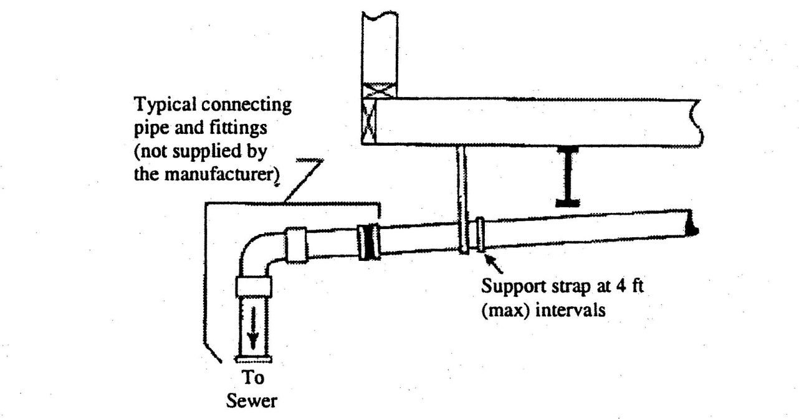
Drainage
Connection to the site sewer

Slide 165
Gas Systems
All gas system work shall be performed in compliance with NFPA 54-National Fuel Gas Code; and other appropriate rules and codes as adopted by the Maine Fuel Board.
Licensed dealers and/or mechanics are prohibited from performing any gas system work.

Slide 166
Fuel Oil Systems
Licensed dealers and/or mechanics may install, in compliance with manufacturer’s instructions, loose shipped fuel oil appliance items.
All other fuel oil system work, not described in the manufacturer’s instructions, including oil supply tanks and fuel oil piping, shall be performed only by a licensed limited tank installer or other technician licensed by the Maine Fuel Board.

Slide 167
Fuel Oil Systems
All fuel oil system work, not described in the manufacturer’s instructions, shall be done in compliance with NFPA 31, Installation of Oil Burning Equipment.

Slide 168
Electrical
Licensed dealers and/or mechanics may:
1. Install, in accordance with the manufacturer’s instructions, electrical equipment shipped loose with the home; and
2. Connect to the main panel to an existing service disconnect.

Slide 169
Electrical
All other electrical work, not described in the manufacturer’s instructions, shall be performed by an electrician licensed by the Electrician’s Examining Board.
All other electrical work, not described in the manufacturer’s instructions, shall be done in compliance with NFPA 70, the 2017 National Electrical Code.

Slide 170
APPENDIX A
ROOF LOAD, WIND AND INSTALLATION ZONES

Slide 171
Roof Load Zones
Counties with 40 psf roof load zones: Washington, Hancock, Aroostook, Somerset, Waldo, Penobscot, Knox, and Piscataquis.
Counties with 30 psf roof zones: York, Cumberland, Kennebec, Sagadahoc, Lincoln, Franklin, Oxford and Androscoggin.

Slide 172
Wind Zones
Wind Zone I counties: Aroostook, Somerset, Waldo, Franklin, Penobscot, Oxford, Piscataquis, York, Cumberland, Kennebec, Sagadahoc, Knox, Lincoln, and Androscoggin.
Wind Zone II (100 mph) counties: Hancock and Washington

Slide 173
Installation Zones
Sites prepared in Washington, Hancock, Aroostook, Somerset, Waldo, Penobscot, Knox, and Piscataquis counties require 24 inches of compacted fill as part of the engineered foundation.
Sites prepared in York, Cumberland, Kennebec, Sagadahoc, Lincoln, Franklin, Oxford and Androscoggin counties require 18 inches of compacted fill as part of the engineered foundation.

