Slide 1
Public Informational Meeting
2022 Individual and Small Group
Major Medical Rate Requests
July 26, 2021
Eric Cioppa, Superintendent
Marti Hooper, Life & Health Actuary
Maine Bureau of Insurance

Slide 2
2022 Individual Market Rate Requests
Companies | Min | Max | Avg Rate Change
Anthem | -12.3% | 4.9% | -3.0%
Harvard | -3.2% | 7.8% | 1.1%
Maine Community Health Options | -8.9% | -1.0% | -5.4%

Slide 3
2022 Small Group Market Rate Requests
Companies | Min | Max | Avg Rate Change
Aetna-PPO | -11.5% | 6.0% | 3.7%
Aetna-HMO | -2.0% | 12.2% | 6.6%
Anthem | -7.5% | 10.0% | 2.4%
Harvard | 1.4% | 6.1% | 2.8%
Maine Community Health Options | -0.8% | 3.5% | 2.1%
United | 8.1% | 13.6% | 11.3%

Slide 6
Clear Choice Plans

Slide 7
MLR 2020 Rebates
Required minimum medical loss ratio (MLR) 80% for individual health insurance
MLR is the percent of medical claims to premium
Rebates are required if minimum averaged over 3 years is not met to return premium overcharged.
Carriers are estimating a total of $29 million in MLR rebates for 2020
Those amounts will be finalized 7/31/2021

Slide 8
2022 Individual Major Medical Plans By Network Type, Metal Level & Carrier
Insurance Carrier | Bronze | Silver | Gold | Platinum | Catastrophic | Network Types
Anthem Blue Cross Blue Shield (800) 547-4317 www.anthem.com | 4 plans including HSA Deductibles: $5,700-7,800 MOOP: $7,000-8,700 | 6 plans including HSA Deductibles: $2,250-5,900 MOOP: $7,000-8,700 | 1 plan Deductible: $2,500 MOOP: $6,000 |  | Deductible & MOOP $8,700 | HMO
Maine Community Health Options (MCHO) (855) 624-6463 www.maineoptions.org | 5 plans including HSA Deductibles: $5,700-8,700 MOOP: $7,000-8,700 | 5 plans including HSA Deductibles: $2,500-5,500 MOOP: $6,000-8,700 | 2 plans Deductible: $1,500-2,500 MOOP: $5,000-6,000 | 1 plan Deductible: $500 MOOP: $3,000 |  | HMO PPO
Harvard Pilgrim Health Care/ (888) 333-4742 www.harvardpilgrim.org | 6 plans including HSA Deductibles: $5,900-8,700 MOOP: $7,000-8,700 | 5 plans including HSA Deductibles: $2,700-6,200 MOOP: $7,000-8,700 | 1 plan Deductible: $1,500 MOOP: $5,000 |  |  | HMO
Notes:
Run through HMO, PPO, POS
Last year, CHO & Harvard used “silver-loading” to compensate for loss of CSR reimbursements. This year, Anthem has spread out costs more evenly through all on-exchange plans.
Anthem will have the cheapest silver plans on the Marketplace in most counties.
Silver-loading is what caused many people to be eligible for $0 bronze plans last year.
Anthem did not rely on “silver-loading” as heavily as other carriers did last year, so fewer people will be able to get $0 bronze plans.
Premium costs for bronze and gold plans may by higher.

Slide 9
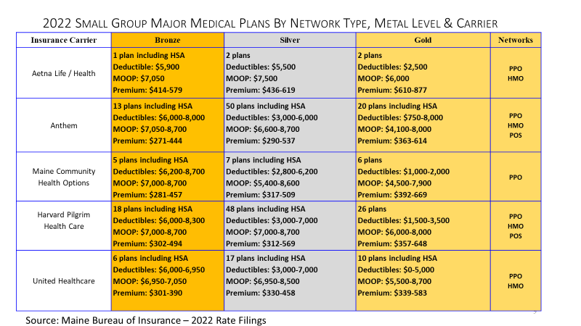

Slide 10
MGARA Reinsurance Changes
Change from prospective to retrospective
Reimburses Member Insurers based on the total eligible claims paid during a calendar year for each insured individual within certain reinsurance thresholds at a specified coinsurance rate
Attachment points proposed for 2022
$76,000 to $250,000 at 100%, nothing above
Insurer’s assumptions for rate reductions due to reinsurance 10.4%-17.5%

Slide 11
Other Benefit Plan Design Changes
Highest Maximum Out of Pocket allowed increased to $8,700 for 2022
Network Tiering Benefits
First dollar coverage in Clear Choice plans for some office visits and prescriptions
11

