Slide 1
M-PWR me Training
For:
users

Slide 2
Information to cover
M-pwr reports
Bill.350 billing details by consumer and service (billing details)
Bill.300 billing details by consumer (Trend)
Filter
Download
Collapse
expand
Dsp.200 disputes – all detail
documents
Account coding solution

Slide 3
crosswalk
Enterprise billing system
Customer code or billing code
Sync key
Billing details – consolidated merge report
M-pwr
Consumer
Line item
Bill.350 Billing details by consumer and service (similar to consolidated merge report)

Slide 4
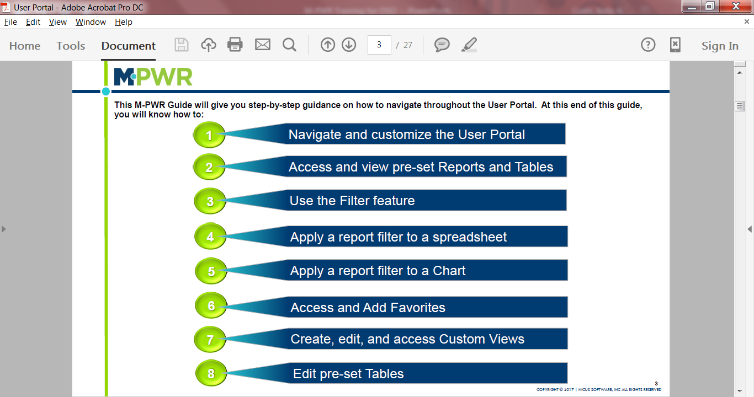
5

Slide 5
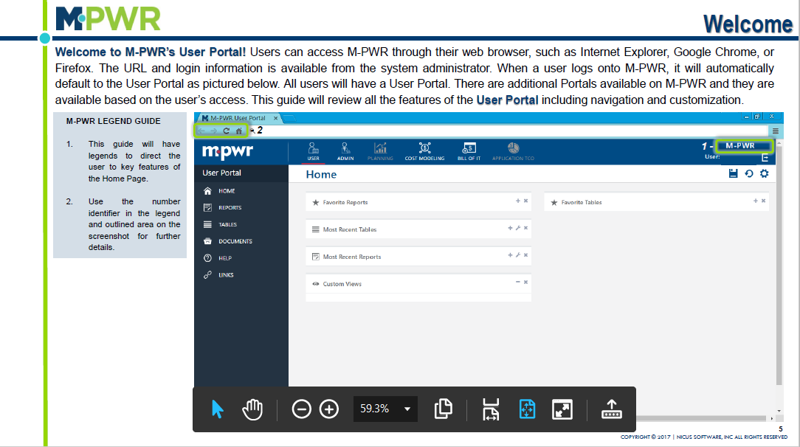
Notes:
We recommend utilizing M-PWR in Chrome

Slide 6
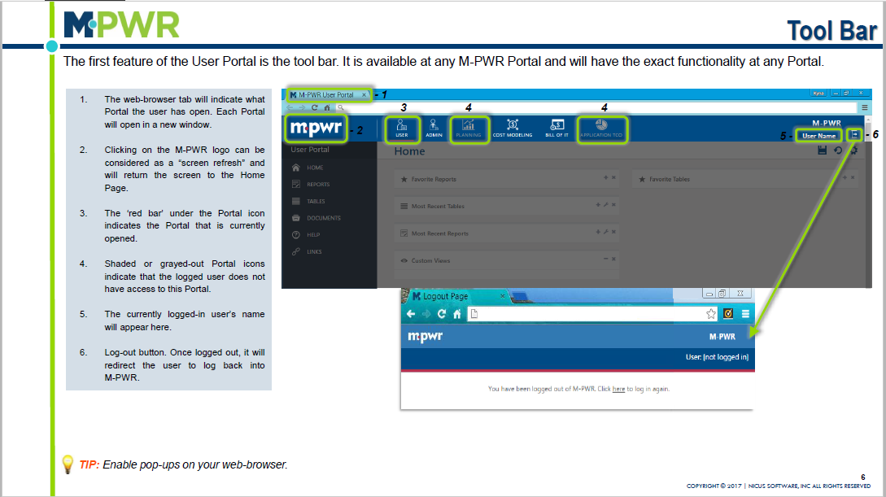
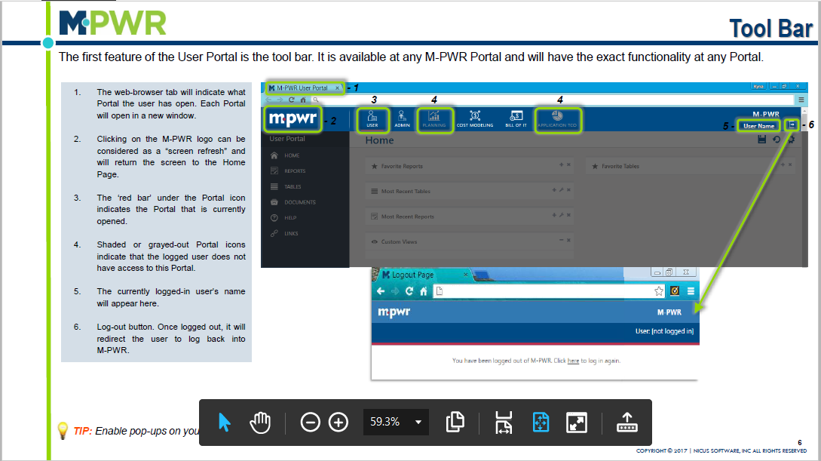

Slide 7
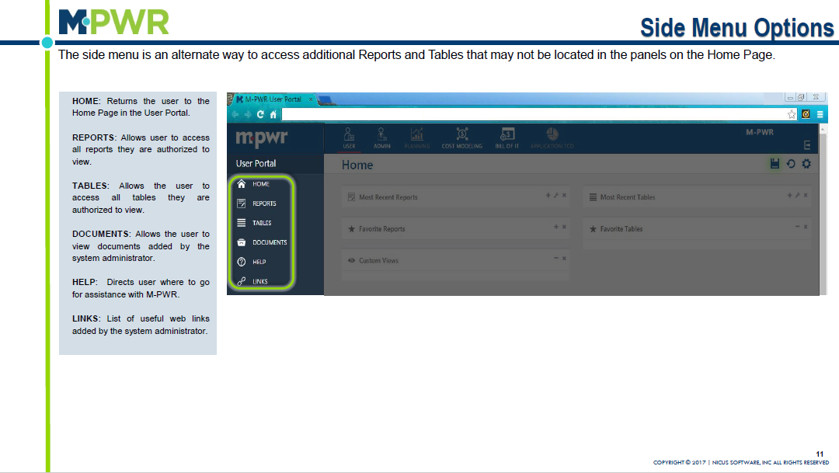

Slide 8
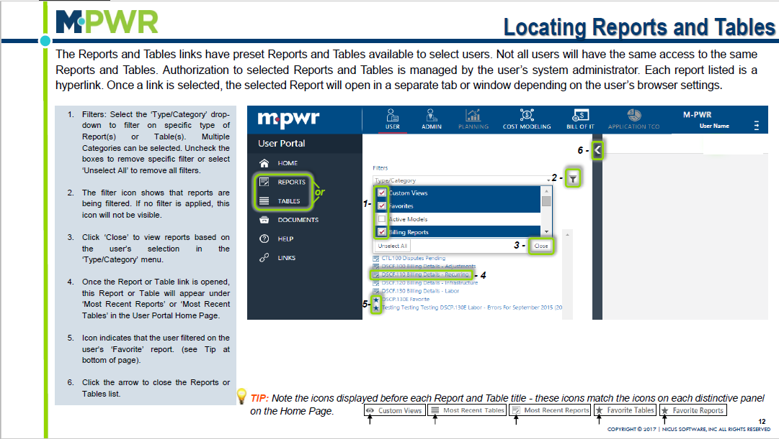

Slide 9
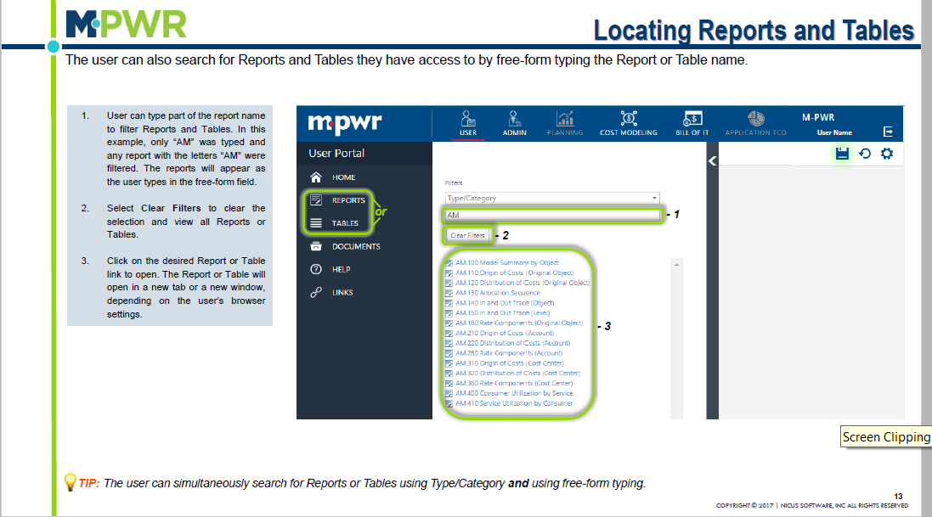

Slide 10
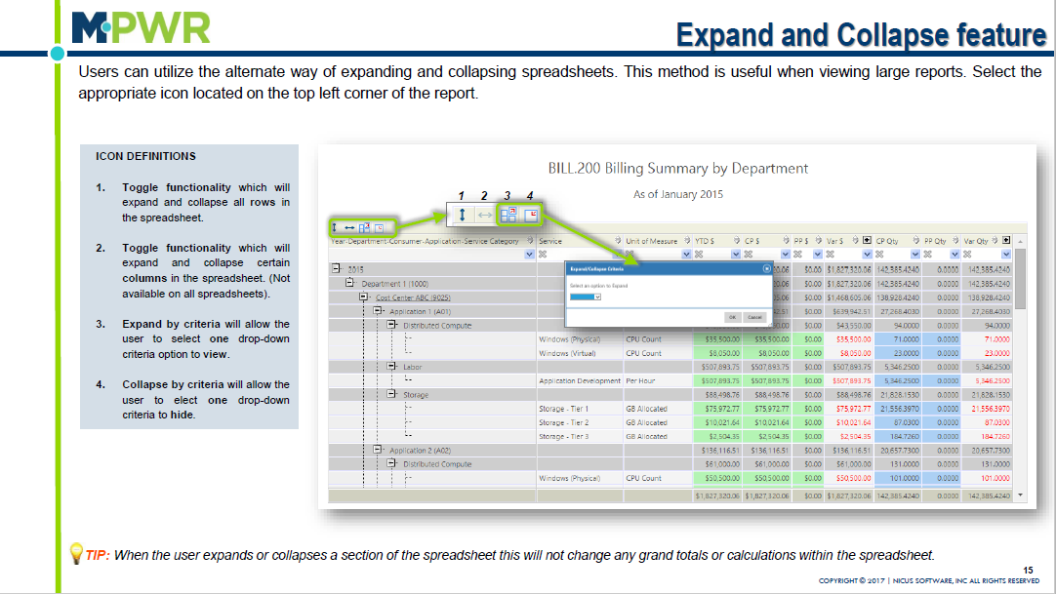

Slide 11
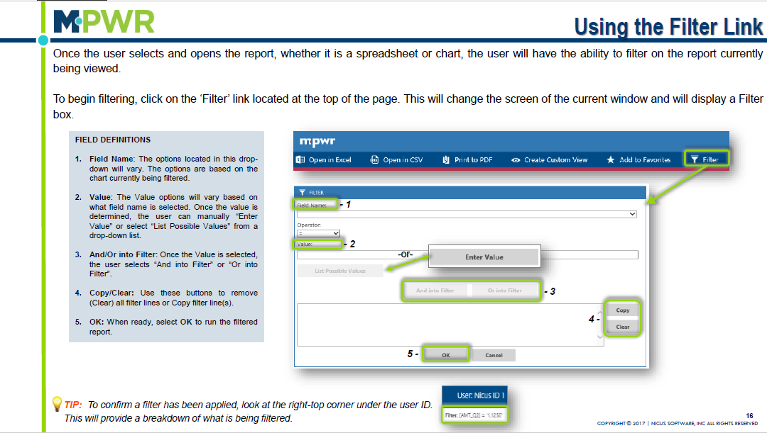

Slide 12
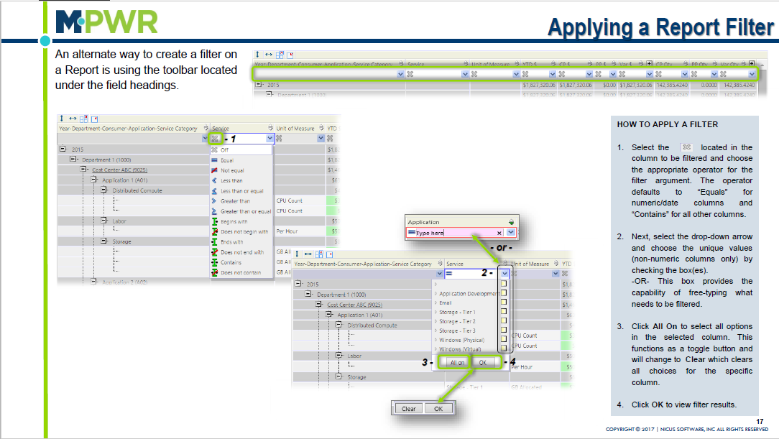

Slide 13
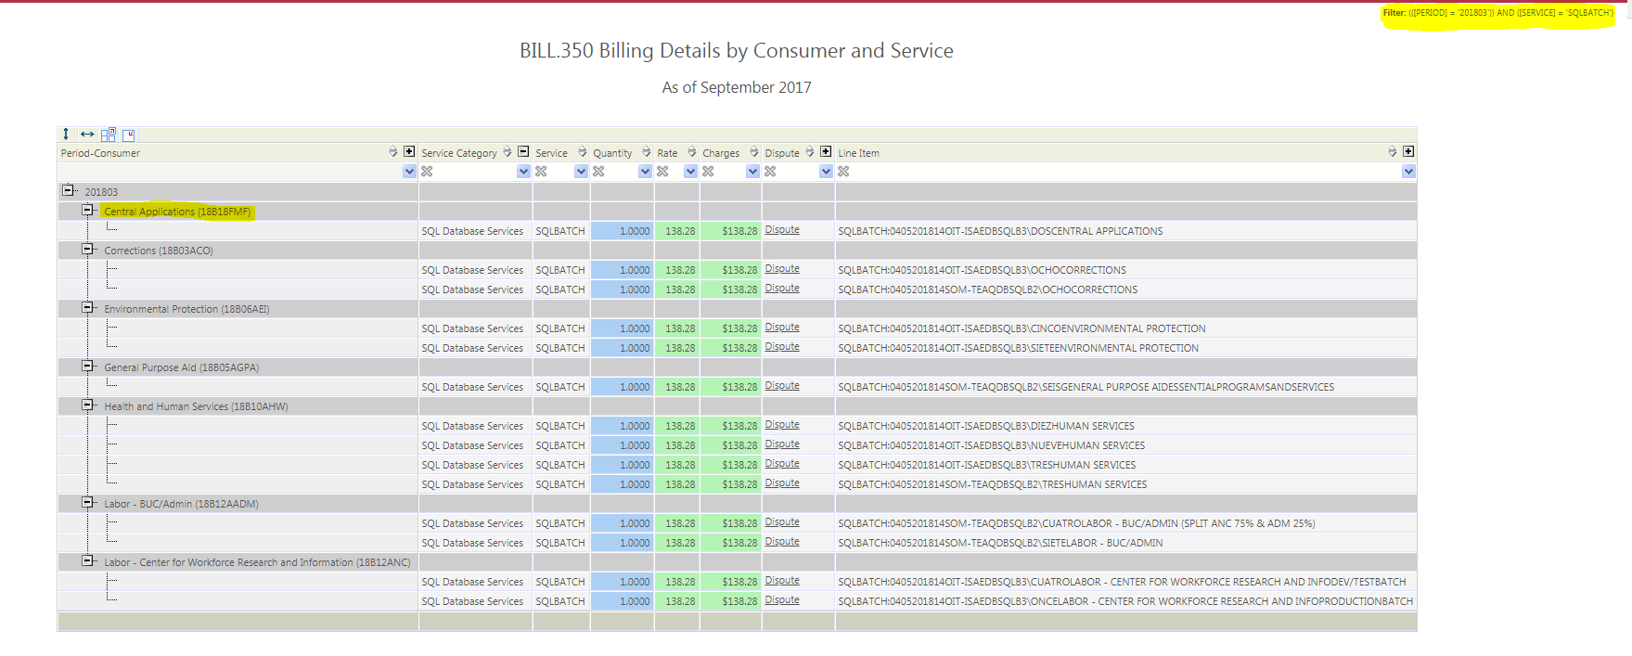
From Bill 350 report, you can drill down in to Billing details by period and consumer
Notes:
Need to show how to submit a dispute utilizing the Bill.350 report along with applicable steps

Slide 14
Bill of IT Flowchart

Slide 15
There is something incorrect on my bill, I need to submit a dispute.

Slide 16
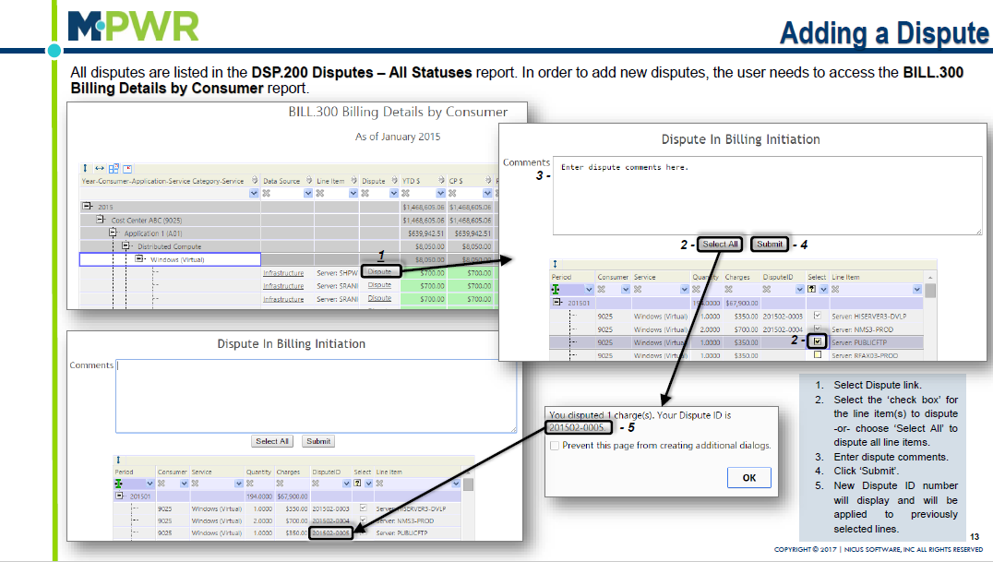
OR the Bill.350 Billing Details by Consumer and Service.

Slide 17
From the BILL.350 report, you can enter a dispute for a Consumer and Service combination by clicking a Dispute link for that line item level.
Notes:
Need to show how to submit a dispute utilizing the Bill.350 report along with applicable steps

Slide 19
Select the item or items you wish to dispute and enter a comment that you want to accompany that dispute and press “Submit”.
Notes:
Explain that by selecting more than 1 dispute at once, M-PWR will summarize all approved disputes on next month’s bill

Slide 20
Once OIT Finance runs the final bill, the approved disputes will appear on the corresponding bill report(s).

Slide 21
Once submitted, the dispute will appear in DSP and CTL reports and the submitter and approver will receive an email notification.
Each record can only be disputed once. After a Dispute ID is generated, the record can no longer be selected. This is to ensure credits are not generated more than once.

Slide 22
Available Bill of IT Web Reports
Category | Report | Description
Billing Reports | BILL.100 Billing Summary by Bus Unit | This report shows final billing information at a Business Unit level for all months that have been processed in M-PWR.
Billing Reports | BILL.200 Billing Summary by Group | This report shows final billing information at a Group level for all months that have been processed in M-PWR.
Billing Reports | BILL.300 Billing Details by Consumer | This report shows final billing information at a Consumer level for all months that have been processed in M-PWR.
Billing Reports | BILL.325 Billing Details by Consumer | This report shows final billing information at a Consumer level by Service Category for all months that have been processed in M-PWR.
Billing Reports | BILL.350 Billing Details by Consumer | This report shows final billing information at a Consumer level by Service Category for the period selected that has been processed in M-PWR.

Slide 23
Available Bill of IT Web Reports Continued
Category | Report | Description
Data Source Billing Reports | DSCF.100 Billing Details - Adjustments | This report shows Adjustments data source information for the most recent month that has been finalized in M-PWR.
Data Source Billing Reports | DSCF.110 Billing Details - Recurring | This report shows Recurring data source information for the most recent month that has been finalized in M-PWR.
Data Source Billing Reports | DSCF.120 Billing Details - Infrastructure | This report shows Infrastructure data source information for the most recent month that has been finalized in M-PWR.
Data Source Billing Reports | DSCF.130 Billing Details - Labor | This report shows Labor data source information for the most recent month that has been finalized in M-PWR.

Slide 24
Available Bill of IT Web Reports Continued
Category | Report | Description
Dispute Reports | DSP.000 Dispute Details | This report shows details of each dispute that has been submitted.
Dispute Reports | DSP.100 Disputes in Open Status | This report shows all disputes that have an Open status.
Dispute Reports | DSP.200 Disputes - All Statuses | This report shows all disputes that have been submitted.

Slide 25
Available Bill of IT Web Reports Continued
Category | Report | Description
Invoice Reports | INV.100 Invoice List | This report shows final invoice amounts at a Business Unit level for all months that have been processed in M-PWR with links to PDFs.

Slide 26
Things to remember
Recommend opening the M-PWR application in Chrome for improved performance.
M-PWR QA Environment
https://www.mpwrmaine.com/mpwr_qa
M-PWR Information + User Guides
http://www.maine.gov/oit/billing/index.html
For questions pertaining to the M-PWR System, email the project team at
MPWR-ME@maine.gov
Effective july 2018, Monthly broadcasts will be sent via email
M-PWR System Access
Oit finance resources and tools http://inet.state.me.us/oit/services/billing/
OIT Billing System Access
OIT Billing System online Security Application (System Access) will need to be completed
OIT Billing System Security Application (System Access)
User
User Portal
Reports
Bill.350 Billing Details by Consumer and Service
Bill.325 billing summary by service category
Bill.300 Billing Details by Consumer
Bill.200 Billing Summary by Department-Consumer
Bill.100 Billing Summary by SOM-Department
DSP.200 Disputes – All Status
Documents
Account Coding Solution

