Slide 1
M-PWR ME Training
For:
Data Source Owners (DSO)

Slide 2
Information to cover
Records of source systems / repositories
Interface files
M-pwr me
Pre-bill.315 Billing summary by data source owner
Pre-bill.320 billing details by data source owner
Data validation
Expand/collapse
Filter
save
Approval / rejection of disputes
Goal(s) for oit Data that are billed:
Improved data quality
Consistency/standardization of data
increasing accuracy of billable items
input matching output (data)

Slide 3
Repositories, interface files, and m-pwr me data validation
Add / Changes / Deletes to billable services must be made in your applicable repository
ALL interface files must be dropped in OIT-BILL-EDQ-PROD No Later than the 5th of every month
EDQ
Records that ‘error out’ upon completion of EDQ will be communicated via email
2 business days to fix errors and resubmit entire interface file
Upon correcting errors, you MUST resubmit the ENTIRE interface file in the specified location
After oit finance runs the prebill process, an email will be sent to both primary & secondary dsos notifying them to log into m-pwr ME and validate their billable charges
1 business day to validate
Dso will need to send an email to oit finance confirming they have validated their data

Slide 4
Flow chart of workflow
Notes:
David – please add a work flow of DSO repository to interface to edq to M-PWR

Slide 5
What the edq does to your data
The EDQ processing includes:
Verify the Service Category is valid
Verify the service is within the correct service category
Verify file headers are valid and in the correct order
Remove duplicate records and place a copy of each duplicate in the error log.
Verify all services have a consumer code
Verify the Consumer code is valid
Verify the Footprints requestor and ticket number is in the correct format (If Available)
Generate an error log if any of the above are incorrect
Email the error log to admins and Finance (future state email will be send to data owner (Primary/secondary), dso director, admin, Finance, and Nate)
Stage the individual files for monthly bill processing
These over-write prior copies of the stored files.
A copy of each service file is stored in EDQ in the event a file is not sent by the data owner within a month but the service must still be billed.
When triggered, consolidate the individual files into the M-PWR Infrastructure, Labor, Recurring, and Adjustment files
During consolidation, apply a hash value to any service with a line item in the Infrastructure, Labor, and Recurring data files.
During mapping, insert a quantity of 1 for the required field of RATE in the Recurring and Adjustment templates if the data is passed from a CTS data template.
During mapping, look up the user email address in the data from the DAFSDW extract based on the individuals name or AD GUID passed in the individual service files. Insert the data into the record in the M-PWR template if found.
During mapping, look up the user position # in the data from the DAFSDW extract based on the individuals name or AD GUID passed in the individual service files. Insert the data into the record in the M-PWR template if found.
During mapping, update the individuals name to a first name, last name MI format for all services.
Post the nicus_Infrastructure, nicus_Labor, nicus_Recurring, and nicus_Adjustments to a designated location for manual consolidation into the M-PWR Import Template.xlsx file.
Notes:
David – please add bullets of what the edq does to the DSO data

Slide 6
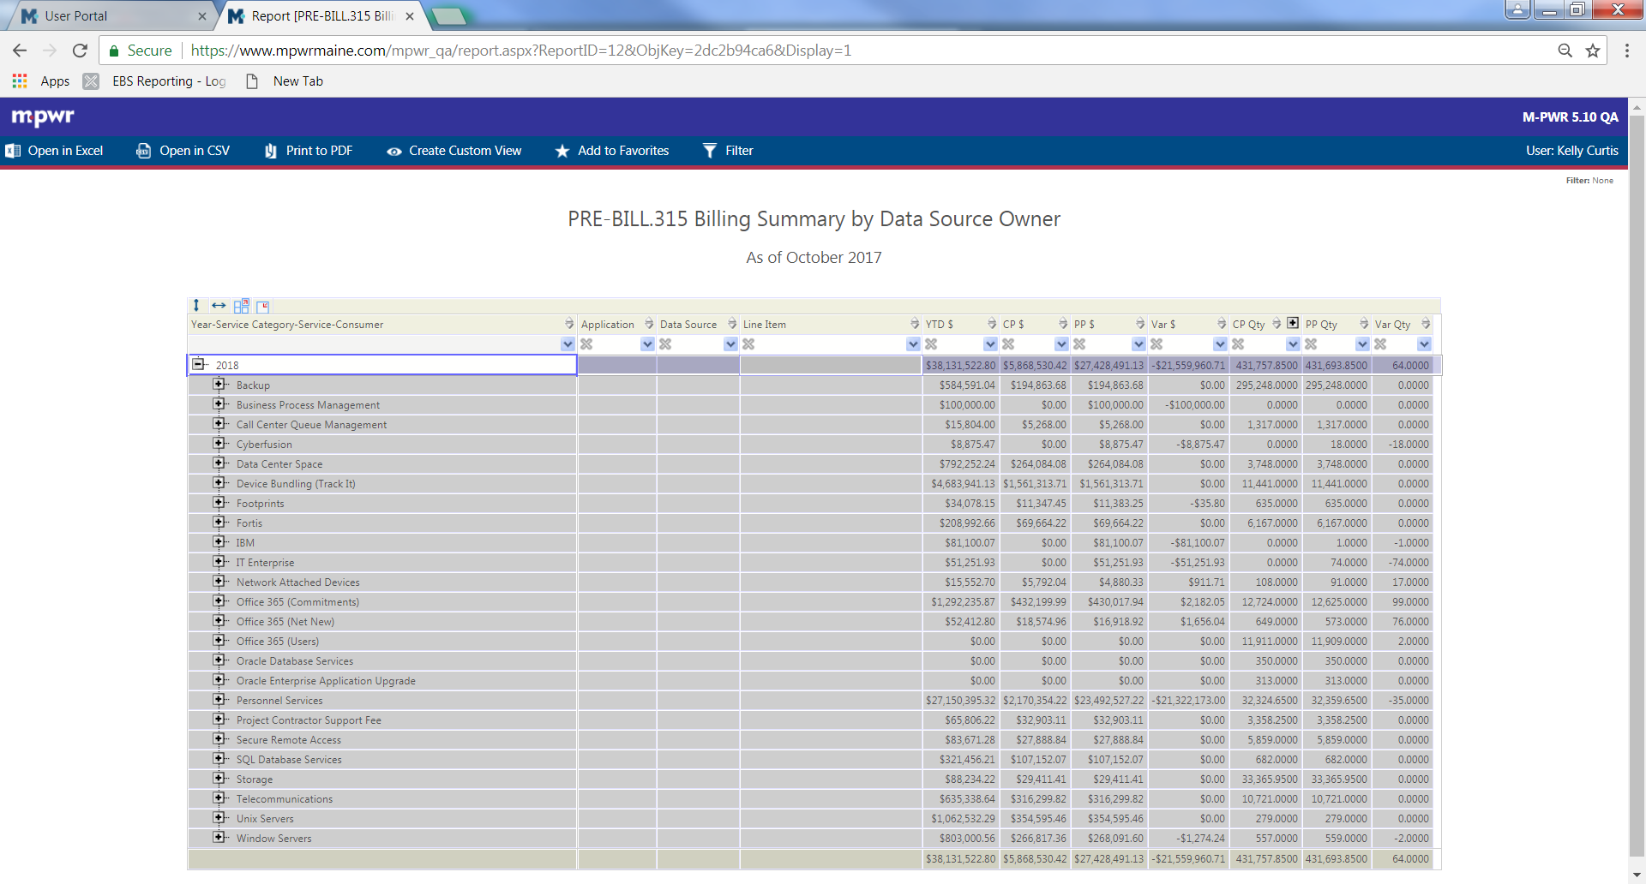
Pre-bill.315 billing summary by data source owner report
User portal
Reports
Pre-bill.315 billing summary by data source owner
Viewing Options
Add a filter before rendering report BY THE SERVICE CATEGORY
Collapse rendered results
Expand by clicking on + beside 2018 Year-service category
Expand by clicking on + beside your service category
Export report to excel (PRE-FILTERED) OR .CSV

Slide 9
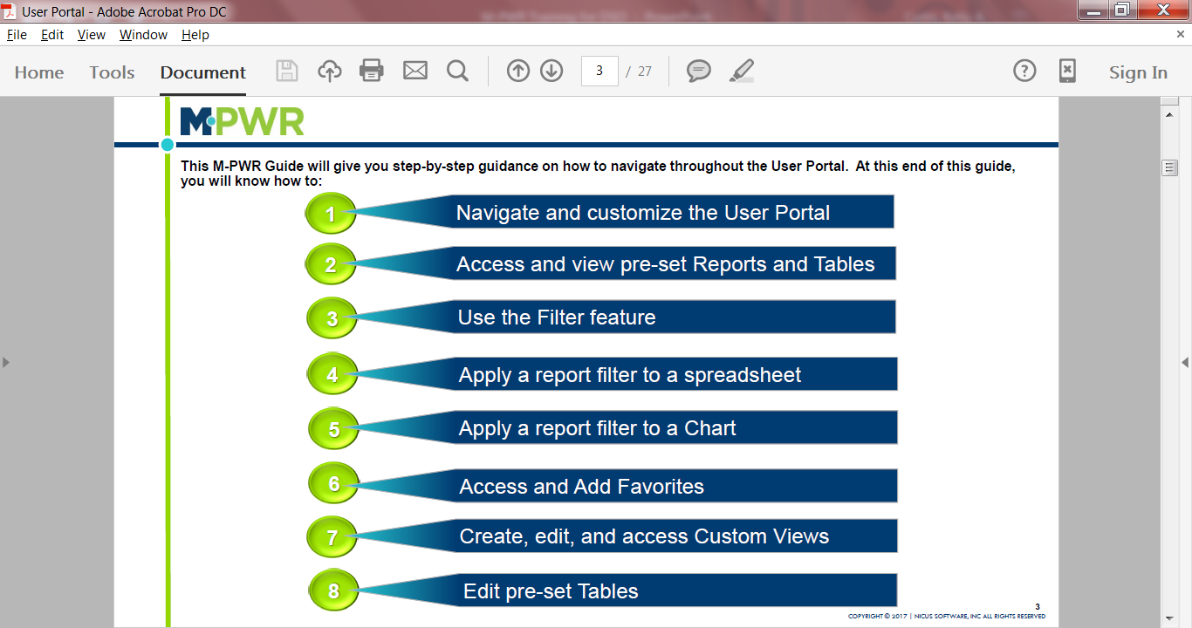
5

Slide 10
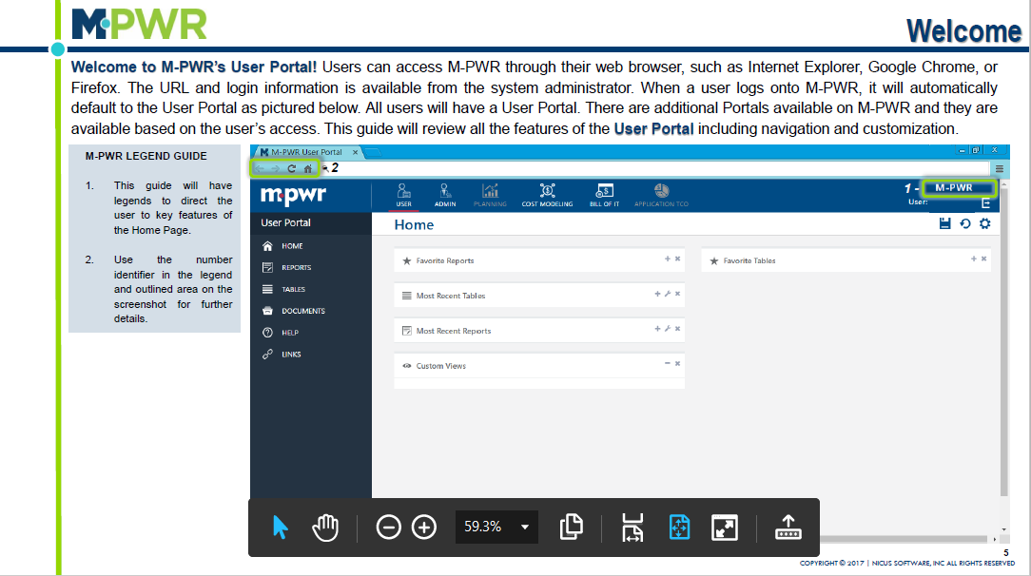
Notes:
We recommend utilizing M-PWR in Chrome

Slide 11
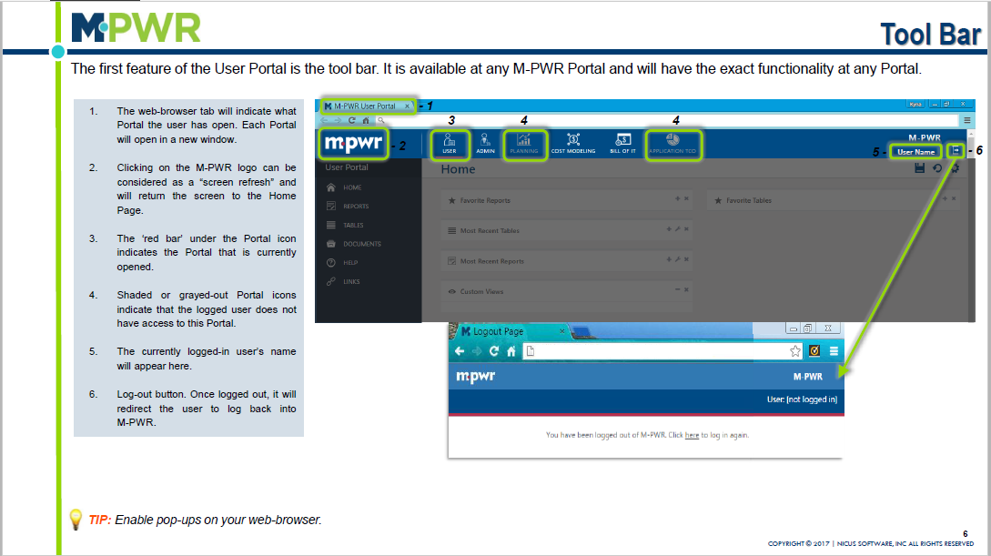
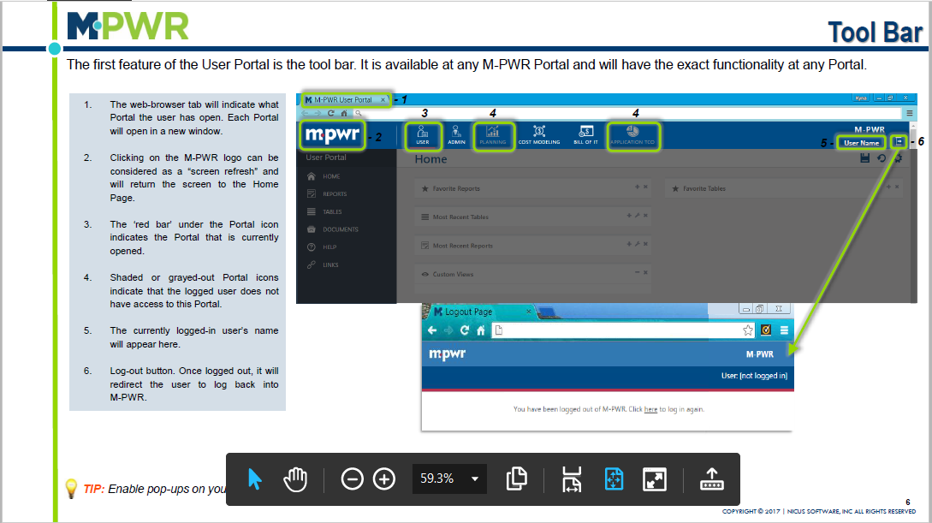

Slide 12
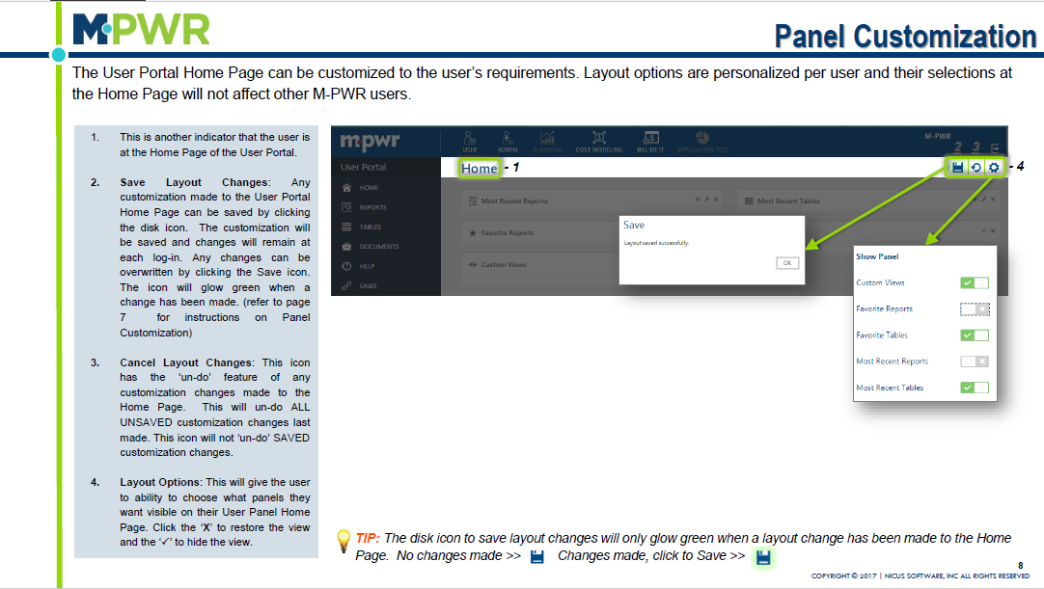

Slide 13
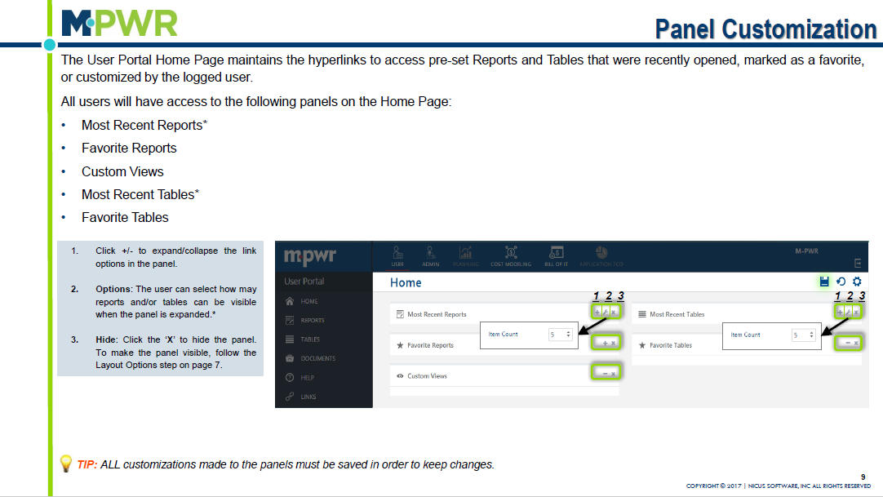

Slide 14
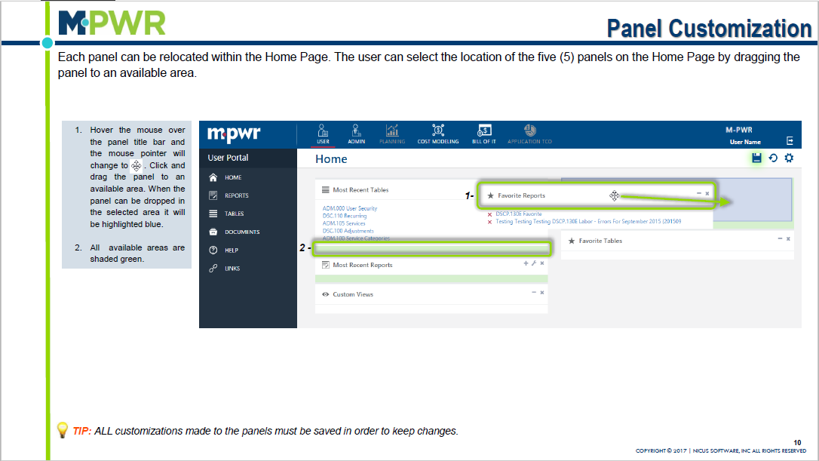

Slide 15
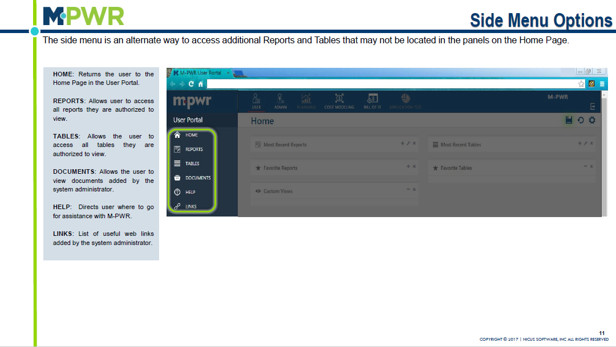

Slide 16
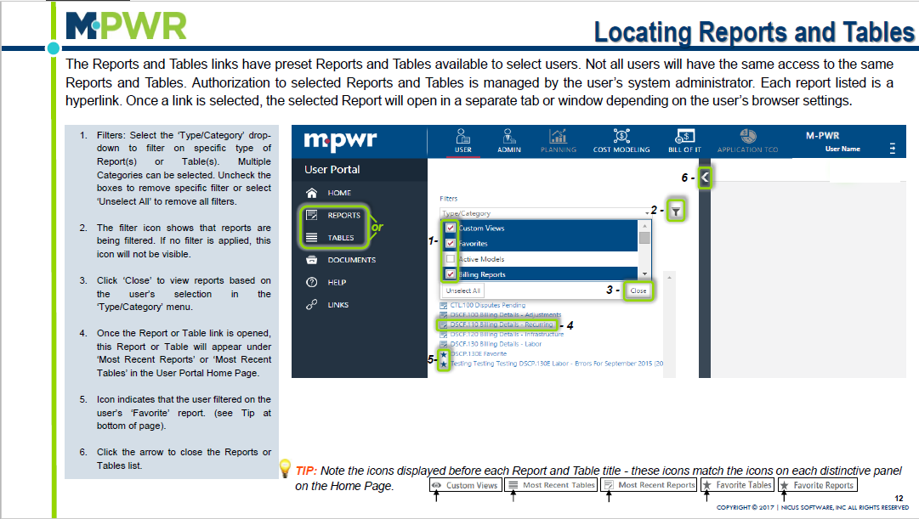
Notes:
We should blank out tables and verbiage that talks about tables

Slide 17
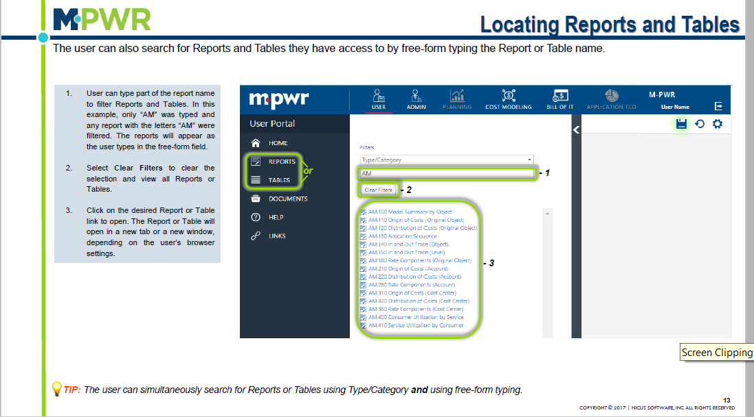
Notes:
We should blank out tables and verbiage that talks about tables

Slide 18
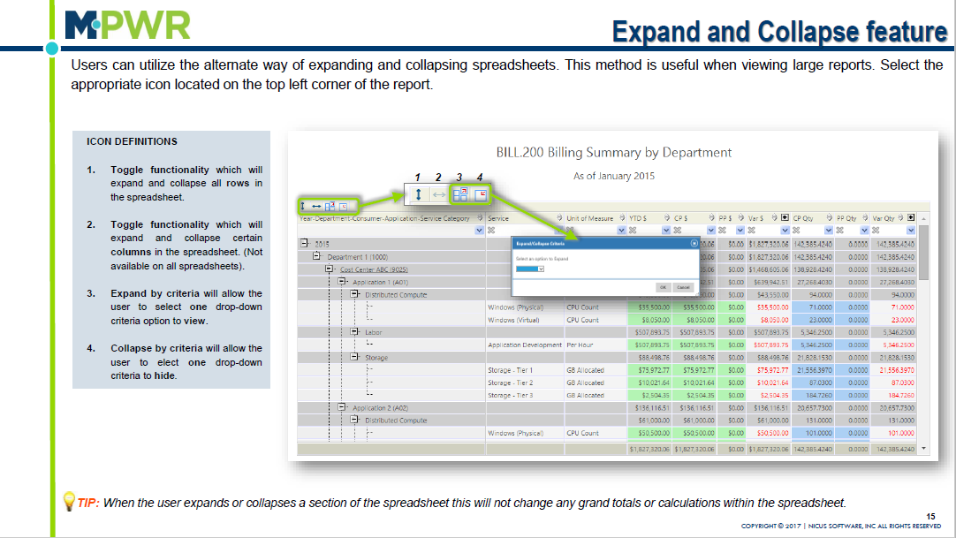

Slide 19
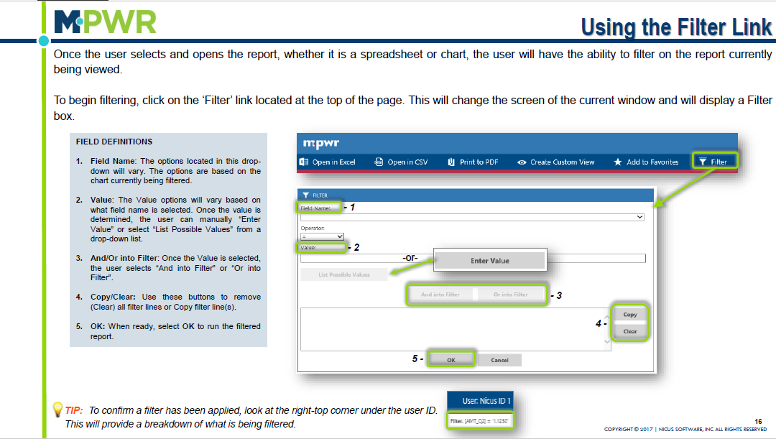

Slide 20
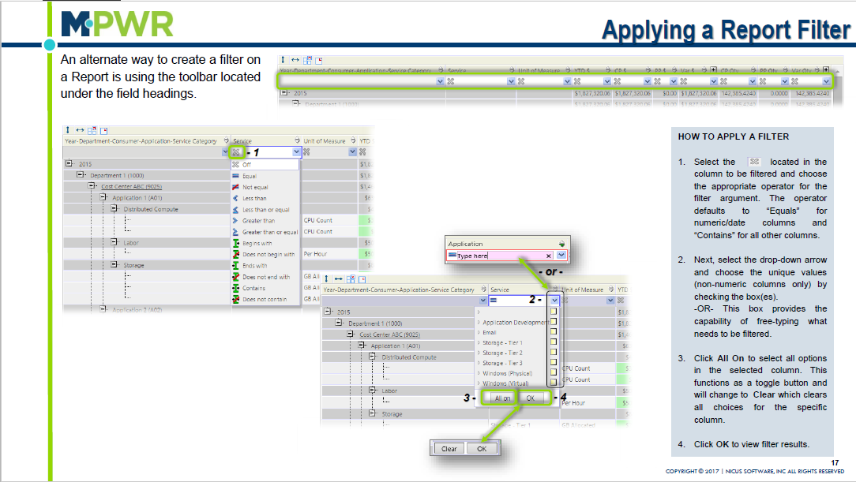

Slide 21
Dispute Approvers
OIT Finance will be the Level 1 Dispute Approvers
DSO will be the Level 2 Dispute Approvers for their service area(s)
Level 2 Approval trumps any selection made by Level 1. If Level 1 Rejects, they can still approve the dispute and the rejection doesn’t matter. After they save a status, the records are removed from CTL.100. They are not able to go back and change their selection.

Slide 22
Once submitted, the dispute will appear in DSP and CTL reports and the submitter and approver will receive an email notification.
Each record can only be disputed once. After a Dispute ID is generated, the record can no longer be selected. This is to ensure credits are not generated more than once.

Slide 23
Notes:
M-PWR Bill of IT Portal

Slide 24
Approving a Dispute
Steps:
There are two types of Approvers, level 1 and level 2. This allows for two levels of approval necessary for disputes to be processed
Go to the Bill of IT Portal and click on Reports on the left menu. In the search bar of the slider, start typing CTL. Then, select the CTL.100 Report.

Slide 25
This report will prompt you to choose a service category you would like approve a dispute for.

Slide 26
After choosing a service category, click on the Update link for the dispute you want to approve or reject.

Slide 27
Level 1Approver (OIT Finance Team)
If the approver is Level 1 they have two status options:
Approved - A Level 1 user should select this status to indicate that they have reviewed the dispute and found it to be accurate and meets any requirements that have been agreed upon.
Rejected - A Level 1 user should select this status to indicate that they have reviewed the dispute and found issues with it.
Note: Level 1 status changes serve as an indicator for the Level 2 Approver. Neither status will cause the dispute to disappear from the CLT.100 Disputes Pending report. This allows them to change the status if needed
OIT Finance will research the dispute.
Create a fp ticket, provide findings in the fp ticket & the assigned M-pwr dispute id
in M-PWR dispute approval/rejection box, oit finance will cite the fp ticket and click either approval or rejected

Slide 28
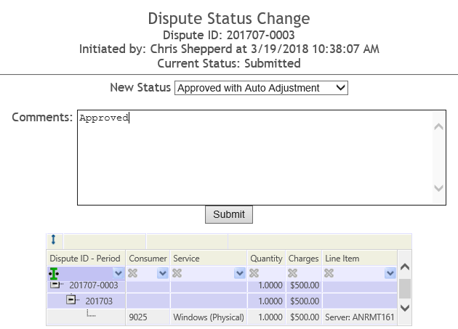
Level 2 (DSO)
If the approver is Level 2 they have three status options:
Approved with Auto Adjustment - M-PWR will submit a negative adjustment record for this via the Adjustments data source.
Note: if an offsetting positive adjustment record needs to be added as well (to move this charge to a different Consumer, Service, etc.) that record will have to be manually added on DSC.100 Adjustments. M-PWR only generates the negative, credit adjustment.
Approved with Manual Adjustment - M-PWR will do nothing with the record, except report it as Approved. If this record needs to be adjusted, an admin should manually add a record for it on the web table DSC.100 Adjustments.
Rejected - M-PWR will do nothing with the record, except report it as Rejected.
Note: Level 2 status changes are final once submitted and cannot be changed. If a status change was made in error, either a manual adjustment must be made to correct it or contact M-PWR Support for additional options.
Choose the correct the status and enter any necessary comments, then click Submit.

Slide 29
Three ways to complete a dispute as a level 2 approver
If the DSO approves with auto adjustment, m-pwr will automatically generate a credit on the next month’s bill. The dso would need to update the fp ticket and close it out.
If the dso approves with manual adjustment, the dso would need to update the fp ticket and assign it back to oit billing team with a status of ‘billable’. Oit finance would process the adjustment manually on the next month’s bill.
If the dso rejects the dispuate, m-pwr will continue to bill for that item. The dso would need to update the fp ticket and close it out.

Slide 30
Email notifications are sent to Submitters and Approvers by default if the Users are set up in the Admin, Security portal with email addresses.
Submitters – receive notifications when their dispute status has changed.
Level 1 – receive notifications when something is ready for them to approve.
Level 2 – receive notifications when something is ready for them to approve.

Slide 31
Bill of IT Flowchart

Slide 32
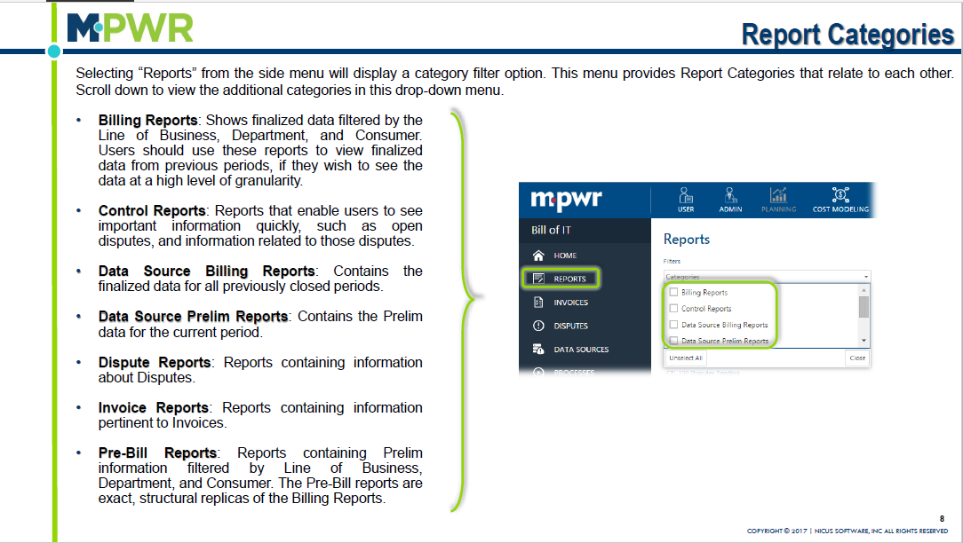

Slide 33
Available Bill of IT Web Reports
Category | Report | Description
Control Reports | CTL.100 Disputes Pending | This report shows all disputes that have an Open status with links to approve or reject if authorized.
Dispute Reports | DSP.000 Dispute Details | This report shows details of each dispute that has been submitted.
Dispute Reports | DSP.100 Disputes in Open Status | This report shows all disputes that have an Open status.
Dispute Reports | DSP.200 Disputes - All Statuses | This report shows all disputes that have been submitted.
Pre-Bill Reports | PRE-BILL.100 Billing Summary by Bus Unit | This report shows preliminary billing information at a Business Unit level for the current month that is being processed in M-PWR.
Pre-Bill Reports | PRE-BILL.200 Billing Summary by Group | This report shows preliminary billing information at a Group level for the current month that is being processed in M-PWR.
Pre-Bill Reports | PRE-BILL.300 Billing Details by Consumer | This report shows preliminary billing information at a Consumer level for the current month that is being processed in M-PWR.
Pre-Bill Reports | PRE-BILL.315 Billing Summary by Data Source Owner | This report shows preliminary billing information at a Service Category level for the current month that is being processed in M-PWR.
Pre-Bill Reports | PRE-BILL.320 Billing Details by Data Source | This report shows preliminary billing information at a Data Source level for the current month that is being processed in M-PWR.

Slide 34
Things to remember
Recommend opening the M-PWR application in Chrome
M-PWR ME testing URL
https://www.mpwrmaine.com/mpwr_qa
AD Sign on
For questions pertaining to M-PWR ME, email the project team at
MPWR-ME.OIT@maine.gov
M-PWR ME Information & User guides
www.maine.gov/oit/billing
Billing questions, email oitfinance@maine.gov
M-PWR ME System Access
OIT Billing System Security Application (System Access) will need to be completed. Online application is available at: http://inet.state.me.us/oit/services/billing located under OIT Billing System Access
DSO
User Portal
Reports
Pre-BILL.315 Billing Summary by data source owner (recommend using)
PRE-BILL.300 Billing Details by Consumer
Pre-BILL.320 Billing Details by data source owner
CTL.100 Disputes Pending
Dsp.200 disputes – all statuses

