Slide 1


digital literacy
what it is,
where it’s at, and
why Maine libraries are involved
Notes:
Digital literacy : what it is, where it’s at, and why Maine libraries are involved

Slide 2


well, what is it?
“
Digital Literacy is the ability to use information and communication technologies to find, evaluate, create, and communicate information, requiring both cognitive and technical skills.
-ALA Digital Literacy Taskforce, 2011
”
Notes:
“Digital Literacy is the ability to use information and communication technologies to find, evaluate, create, and communicate information, requiring both cognitive and technical skills.” -ALA Digital Literacy Taskforce, 2011

Slide 3

information and education
a person who is digitally literate…
possesses the variety of skills – technical and cognitive – required to find, understand, evaluate, create, and communicate digital information in a wide variety of formats;
Notes:
a person who is digitally literate… possesses the variety of skills – technical and cognitive – required to find, understand, evaluate, create, and communicate digital information in a wide variety of formats;

Slide 4

use of technology
is able to use diverse technologies appropriately and effectively to retrieve information, interpret results, and judge the quality of that information;
Notes:
a person who is digitally literate… is able to use diverse technologies appropriately and effectively to retrieve information, interpret results, and judge the quality of that information;

Slide 5

life-long learning
understands the relationship between technology, life-long learning, personal privacy, and stewardship of information;
Notes:
a person who is digitally literate... understands the relationship between technology, life-long learning, personal privacy, and stewardship of information;

Slide 6

social networking
uses these skills and the appropriate technology to communicate and collaborate with peers, colleagues, family, and on occasion, the general public; and
Notes:
a person who is digitally literate... uses these skills and the appropriate technology to communicate and collaborate with peers, colleagues, family, and on occasion, the general public;

Slide 7

digital citizenship
uses these skills to actively participate in civic society and contribute to a vibrant, informed, and engaged community.
Notes:
a person who is digitally literate... uses these skills to actively participate in civic society and contribute to a vibrant, informed, and engaged community.

Slide 8
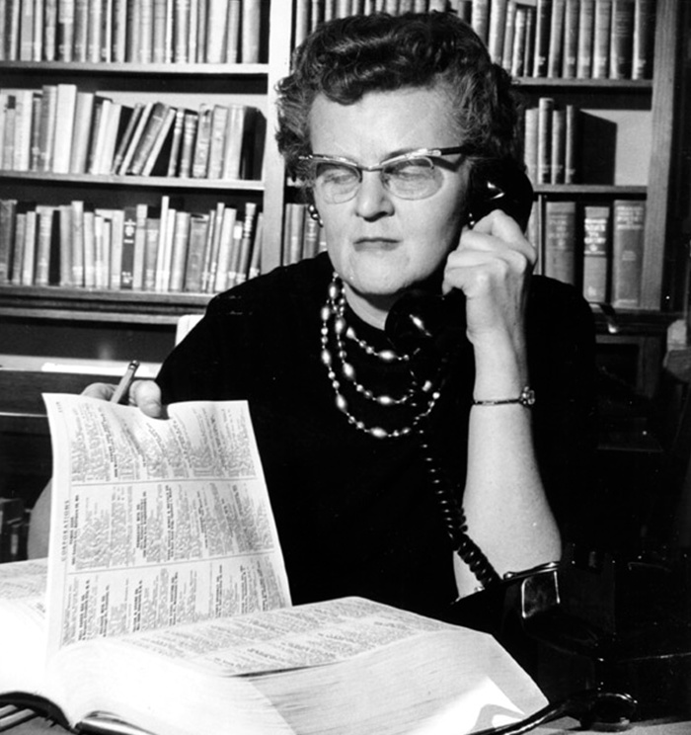
this perception is an old one
does your library match this perception? Or…
Notes:
Is your library perceived as an “old-fashioned” book repository, with shushing librarians?

Slide 9


…is this you?
in many ways, developing digital literacy is something that librarians are already doing for their communities
Notes:
Or is your library a place where the librarians are seen as tech-savvy and able to help with new technology?

Slide 10




libraries are all about
so making the
LITERACY
can make a lot of sense!
over to
(regular)
(digital)
Notes:
Digital literacy is a new form of literacy, one which builds off of the “regular” literacy that libraries have always provided. It makes sense for libraries to include digital literacy as an extension of the same mission.

Slide 11

a new objective?
reconciling the
digital divide
Serve low-income households
Free access to information
Personal, friendly assistance
libraries are the digital bridge!
Notes:
Just as with regular literacy, digital literacy describes a divide: those who are and those who aren’t. Libraries and librarians can help people cross from one side of the “digital divide” to the other.

Slide 12
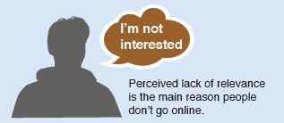
one in five adults are not online
A lack of digital literacy is a major barrier to fully participate in our society
Notes:
One in five adults are not online. Not being online is rapidly becoming a major barrier to being a full participant in a modern society.

Slide 13

civic engagement
benefits of a digitally literate community
35% of people seek information about local government online
54% of U.S. adults went online to get news or information about the 2010 election
Notes:
About 1/3rd of people seek information about local government online. As of 2010, over half of U. S. adults searched for information or news about the national elections.

Slide 14

workforce
8 out of 10 Fortune 500 companies require online job applications
Using the Internet to look for a job reduces average unemployment by 25%
50% of today’s jobs require some tech skills-expected to grow to 77% in the next decade
Notes:
Eight out of ten Fortune 500 companies require online job applications. Using the Internet in a job search reduces the time to find a job by 25%. About half of today’s jobs require some tech skills, and within the next decade, that number will be over three-quarters.

Slide 15

economic development – as a result of the Internet
21% of GDP growth in the last 5 years is a result of the Internet.
10% increase in productivity for small and medium sized businesses
Notes:
The Internet is a massive contribution to the gross domestic product (GDP), accounting for about one-fifth of its growth. Even small- and medium-sized businesses experience growth when they have an Internet presence.

Slide 16

67% of people who access their health info online feel better informed as a patient
80% of Internet users look for health information online
health
Notes:
About two-thirds of patients who find information about their health online feel better-informed, and about four-fifths of Internet users find some information about their health online.

Slide 17

education
Almost half of college students take at least 1 online course.
There have been over 1 million K-12 enrollments in online courses
Notes:
Almost half of college students take at least one online course, and there have been over one million enrollments in online courses for students in kindergarten through twelfth grade.

Slide 18
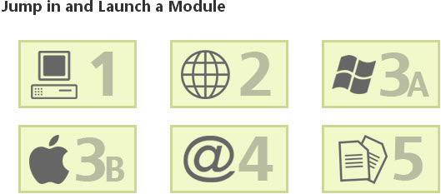
how digitally literate are you anyway?
Digital Literacy Assessment
http://www.digitalliteracyassessment.org
Notes:
Tools for assessing digital literacy: http://www.digitalliteracyassessment.org

Slide 19
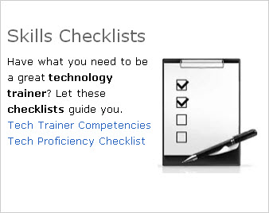
teaching both staff and the public
Tech Training for Libraries
http://www.coloradovirtuallibrary.org/techtraining
Notes:
More tools for assessing digital literacy, as well as tech training skills and complete curricula for libraries interested in holding training in technology skills: http://www.coloradovirtuallibrary.org/techtraining

Slide 20

Edge Initiative libraryedge.org
digital literacy benchmarks for libraries
Notes:
Benchmarks for libraries looking to shape and guide their technology infrastructure and training: http://libraryedge.org

Slide 21

discussion
Notes:
Time for discussion. How can the Maine State Library support your library’s efforts at promoting digital literacy in your community?

Slide 22


digital literacy – where it’s at and who’s involved
alphabet soup to nuts and bolts
Notes:
digital literacy – where it’s at and who’s involved

Slide 23
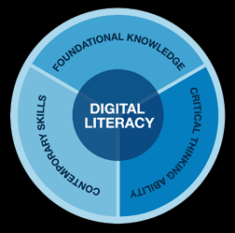
why are we here today?
why is digital literacy so “hot” now?
and why are public libraries talking about it?
Notes:
As you heard on the video the national broadband plan focuses on building access to high speed Internet nationally . South Korea, Finland, Sweden, Japan, and France have faster and cheaper Internet. Obstacles to adoption in the US are price, availability/access, and belief in importance or how revelant. Income, age and education factor in to adoption.

Slide 24
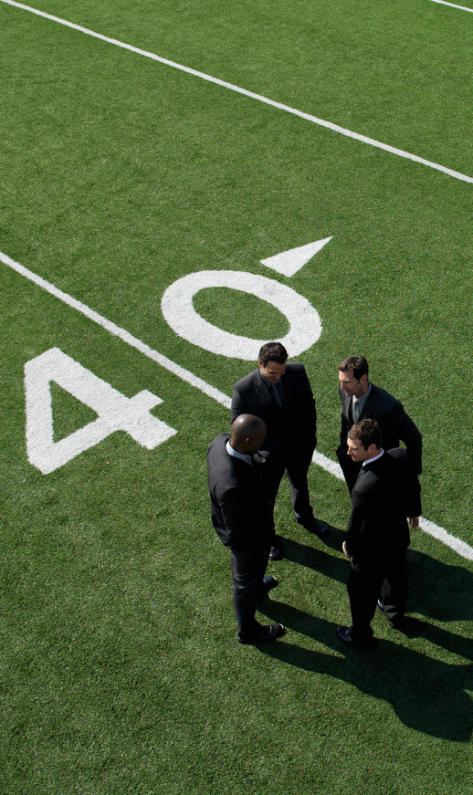
the national players
FCC: Federal Communications Commission
IMLS: Institute of Museum and Library Services
PLA: Public Library Association
OITP: American Library Association Office for Information Technology Policy
COSLA: Chief Officers of State Library Agencies
Gates Foundation
and many more
Notes:
So many players on the national front are putting efforts into digital literacy efforts

Slide 25

National Broadband Plan
Connecting America: The National Broadband Plan, March 16, 2010
Goals and action items
Libraries were mentioned all throughout this 376 page NBBP …
Notes:
Obstacles to adoption in the US are price, availability/access, and belief in importance or how revelant. Income, age and education factor in to adoption.

Slide 26


an entire section of the plan devoted to Addressing Digital Literacy Barriers to Broadband Adoption and Utilization
Libraries on the front lines in the digital literacy efforts
Notes:
The role of digital literacy. How the internet is changing our lives. How devices change how we do business – at work and at home.
How does lack of knowledge affect success in work and the way we manage our lives. We learned some things from the BTOP grant.

Slide 27
what is happening nationally?
The Institute of Museum and Library Services (IMLS) awarded (PLA), a $466,182 grant
PLA will partner with:
OITP
COSLA
.
Notes:
to develop an online collection of digital literacy resources for libraries, patrons. The grant activities will include development of training curricula, technology trainer competencies, handouts, and patron skills assessment.
National efforts for digital literacy to support public libraries. Modeled on digital literacy.gov, Colorado, and other BTOP Learning pages like NY, Maine, etc. Dual focus – staff resources and patron/citizen resources. Patrons versus citizen – how many of our library users are virtual only?

Slide 28



One portal to rule them all…
A national learning portal created by librarians from the best of the best – Digital Literacy.gov and PCC Grants nationwide.
Still in development – DigitalLearn.org
Notes:
National portals to online resources for digital literacy have been created, and attempts to create a single portal are being made (see http://digitallearn.org)

Slide 29
BTOP, PCCs and moving forward
The Maine State Library’s BTOP grant served as one of the building blocks to this national effort.
Laptops, desktops, video conferencing, LearningExpress Library and the Information Commons
Notes:
The American Recovery and Reinvestment Act of 2009, (ARRA )provided the funds for the MSL BTOP PCC grant but also other grants in Maine. (Three Ring Binder, Axiom Technologies, Health Systems)

Slide 30

what is happening at the state level?
Continued funding for LearningExpress Library
Possible staffing for a digital literacy trainer to work with library staff and also train patrons
What else?
Notes:
In Maine, we will continue and sustain efforts – LEL, partnerships with Labor and e-gov, contribute content to national site (FB for seniors) and develop state specific content. Maine focus on small entrepreneurial, craft based businesses? Etsy, Shopify, FB, e-commerce…

Slide 31
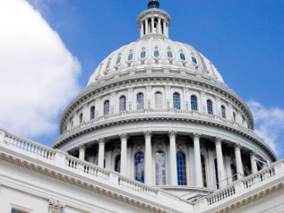
possible federal funding?
FCC money from Universal Service Fund High Cost. Efforts have been on hold due to uncertainty around the election.
Notes:
Big question mark. We want Maine poised to apply for funds if they do become available. If we make efforts within current budgets we can make the argument for expansion.

Slide 32

workforce legislation
H.R. 113 - Workforce Investment through Local Libraries (WILL) Act for the new 113th Congress. This legislation proposes including libraries in the Workforce Investment Act (WIA)
This legislation will amend the Workforce Investment Act (WIA) to include library representation on state and local workforce investment boards as well as assure coordination of employment, training, and literacy services carried out by public libraries.
Notes:
Workforce legislation is being drafted to include libraries as partners in workforce development and training.

Slide 33
workforce legislation
H.R. 113 also recognizes public libraries as an allowable “One-Stop” partner and authorizes new demonstration and pilot projects to establish employment resources in public libraries.
This will allow library users access to workforce activities and information related to training services and employment opportunities, such as resume development, job bank web searches, literacy services, and workshops on career information.
The goal of the WILL Act is to allow libraries the access to WIA funds to continue to provide job search support in communities all across America.
Notes:
This will provide libraries with money and resources to offer employment resources to their communities.

Slide 34
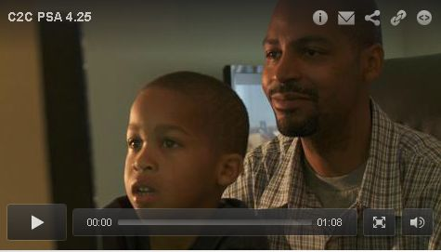


what is Connect2Compete and EveryoneOn?
Notes:
The good – NBB Plan put libraries at the forefront. Work was highlighted re role libraries play by IMLS and Susan Hildreth. What we all learned from BTOP is that capacity at libraries (esp in rural areas) is not the same. All capacity challenged – but more so in rural. In March, FCC and ad Council will begin a very large campaign for low cost Internet access through providers and access to trainer. Some online vendor based – but also to libraries nationally.

Slide 35

Who will be participating?
Time Warner Cable
Comcast
Notes:
Time Warner Cable and Comcast are the only two participants in the national effort to extend low-cost wireless access to low-income families in Maine.

Slide 36
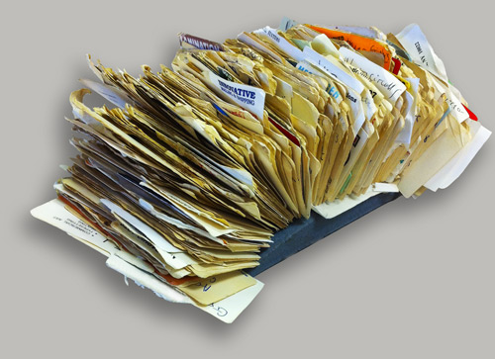
EveryoneOn database, map and public libraries.
The National Ad Council Campaign - what you need to do …
Look at the map and
update the database !
Notes:
The EveryoneOn database will be part of the Ad Council’s national campaign to promote libraries as centers of digital literacy training. All libraries in the state have been placed into this database. It’s up to you to update your library’s entry in this database so that it correctly describes your library’s services!

Slide 37
EveryoneOn – Important Links
Database:
http://www.everyoneon.org/content/tell-us-about-your-training-sites
Map:
http://www.everyoneon.org/locator
PSA:
http://bcove.me/hjno4j4q
Notes:
Database:
http://www.everyoneon.org/content/tell-us-about-your-training-sites
Map:
http://www.everyoneon.org/locator
PSA:
http://bcove.me/hjno4j4q

Slide 38

discussion
Notes:
Further discussion: what sorts of resources would you like to see in a Maine State Library digital literacy portal?

Slide 39
http://www.coloradovirtuallibrary.org/techtraining/
Still more digital literacy resources, especially for trainers
http://digitallearn.org
Digital literacy resources for students and educators
http://www.maine.gov/msl/libs/btop/index.shtml
BTOP resources at the MSL website
http://www.digitalliteracyassessment.org/
Online resource for assessing digital literacy skills
http://www.everyoneon.org/content/tell-us-about-your-training-sites
Form to complete for your library’s EveryoneOn campaign
http://www.ala.org/offices/oitp
ALA’s digital literacy branch
websites
Notes:
http://www.coloradovirtuallibrary.org/techtraining/
Still more digital literacy resources, especially for trainers
http://digitallearn.org
Digital literacy resources for students and educators
http://www.maine.gov/msl/libs/btop/index.shtml
BTOP resources at the MSL website
http://www.digitalliteracyassessment.org/
Online resource for assessing digital literacy skills
http://www.everyoneon.org/content/tell-us-about-your-training-sites
Form to complete for your library’s EveryoneOn campaign
http://www.ala.org/offices/oitp
ALA’s digital literacy branch

Slide 40

Wrapping up…
Please do the Survey:
https://www.surveymonkey.com/s/digitalLit
Add your library info to the EveryoneOn database
Please ask questions, make suggestions and give us your opinions!
Janet McKenney
Janet.McKenney@maine.gov
Jared Leadbetter
Jared.Leadbetter@maine.gov
207-287-5620
Notes:
Please do the Survey: https://www.surveymonkey.com/s/digitalLit . Add your library’s information to the EveryoneOn database. Contact us with your questions and suggestions. Thanks!

