Slide 1
Betsy Enright
Partnership Specialist New York Regional Census Center
802-233-1548
elizabeth.enright@2020censu.gov

Slide 2
U.S. Census Bureau
Largest statistical agency in the U.S.
Leading source of quality data about the nation’s people, places and economy conducting more than 130 Census Bureau Surveys and Programs
Demographic Programs
Decennial Census
American Community Survey
Current Population Survey
American Housing Survey
Economic Programs
Economic Census (Years ending in 2 & 7)
Census of Governments (Years ending in 2 & 7)

Slide 3
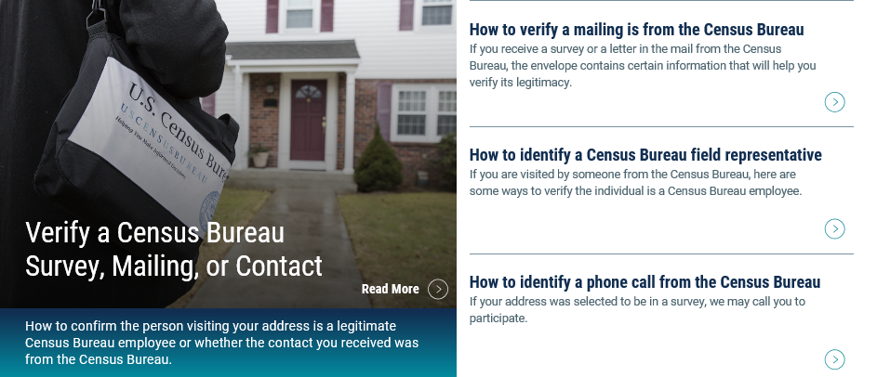
Survey Awareness
Are you in a Census Bureau Survey?
https://census.gov/programs-surveys/surveyhelp.html
Address Canvassing – 2020 Census In Field Operation
Census Employees are working to update Census maps, using laptop computers in many communities across the country
August – October 2019
Report Suspected Fraud to 1-800-923-8282
You can also visit: https://2020census.gov/en/avoiding-fraud.html

Slide 4
The 2020 Census
Count everyone once, only once and in the right place.
Increasingly diverse and growing population
330 million people
Over 140 million housing units
Mandated by Article 1, Section 2 of the U.S. Constitution
Conducted every 10 years ending in zero since 1790
Representation and Funding
The Census is Safe, Easy, & Important!
Notes:
Let’s get started with the 2020 Census….
As I mentioned , the Census is mandated by the United States Constitution and has been around since 1790.
In 1790, Thomas Jefferson was director of the first census. Then In 1790, they only needed 650 enumerators to count 3.9 million residents in 13 states. At the time New York City was the largest urban place with 33 thousand people. In 2010, the Census Bureau needed about 635 thousand enumerators to count a population of about 308 million people
To give you an idea of the magnitude of conducting a Census, A Census is the largest U.S. peacetime mobilization and operation conducted.
In 2020 we will be attempting to count over an estimated 330 million people in 140 million households.
The law requires the Census Bureau to keep your information confidential. Your responses are only used to produce statistics
All Census Bureau workers take a legally binding, lifetime oath to protect your information. Anyone who violates that oath could face jail time, a $250,000 fine, or both.

Slide 5
2020 Census – It Is Important
Determines the number of seats each state has in the U.S. House of Representatives
Defines congressional and state legislative districts, school districts and voting precincts
Determines the annual allocation of $675 billion dollars in federal funding
Medicaid, SNAP, Hwy Planning, Section 8 Housing, Special Education Grants, S-CHIP, Title I Grants, National School Lunch Program, WIC, Head Start, Foster Care, Health Center Programs
Provides insight to governments, business and community planning groups for planning purposes
Provides population benchmarks for nearly every other United States survey

Slide 6
2020 Census – It Is Safe
Private information is never published, including names, addresses (including GPS coordinates), Social Security Numbers, and telephone numbers.
The Census Bureau collects information to produce statistics. Personal information collected by the Census Bureau cannot be used against respondents by any government agency or court.
Census Bureau employees are sworn to protect confidentiality for life.
Violating Title 13 is a serious federal crime. Violators are subject to severe penalties, including a federal prison sentence of up to five years, a fine of up to $250,000, or both.

Slide 7
Cybersecurity—Your Data Are Safe and Secure
Cybersecurity Focus
From the beginning when a respondent answers to the end when the data products are released, data are encrypted, safe, and secure.
Follow industry best practices to protect our networks from external threats and secure data inside the network.
Advanced ability to continually identify, protect, detect, respond, and recover from possible cyber threats.
Continuously improve our security posture.

Slide 8
2020 Census – It Is Easy
Four ways to respond in 2020
Online
Phone
Paper
Personal Visit by Census Employee
Name, age, DOB, race and origin, Hispanic origin, relationship, gender, tenure, operational questions (pop count, name, phone number, overcount, undercount)
We will never ask for:
Your full social security number.
Money or donations.
Anything on behalf of a political party.
Your full bank or credit card account numbers.

Slide 9
Language Support
LANGUAGE SUPPORT ONLINE, BY PHONE, BY MAIL, AS WELL AS ADVERTISING
12 languages
(in addition to English):
Spanish
Chinese
Vietnamese
Korean
Russian
Arabic
Tagalog
Polish
French
Haitian Creole
Portuguese
Japanese
99%
English plus these 12 languages cover 99% of all U.S. households.

Slide 10
Overview of Non-English Language Support
Internet
Self-Response
Census Questionnaire
Assistance
Language Guides (Video and Print)
Language Glossaries
Language Identification Card
Paper Questionnaire
& Mailing Materials
12 Non-English Languages
Respondents will be able to toggle between the languages within the instrument.
12 Non-English Languages
There is a separate phone number for each language. This information is included in the mailing materials.
59 Non-English Languages
Video and print language guides will be available online. Glossaries provide key terminology to bilingual staff. Language Identification Card expanded to 59 languages (50 in 2010). Language listed below are in order of need (top to bottom, left to right).
Spanish
Bilingual mailing materials and questionnaires will be sent to addresses in bilingual tracts.
Mailings will include instructions on responding via Internet or phone in 12 non-English languages.
Spanish
Chinese
Vietnamese
Korean
Russian
Arabic
Tagalog
Polish
French
Haitian Creole
Portuguese
Japanese
Spanish
Chinese (Mandarin and Cantonese)
Vietnamese
Korean
Russian
Arabic
Tagalog
Polish
French
Haitian Creole
Portuguese
Japanese
Spanish | Italian | Khmer | Tamil | Croatian
Chinese | Farsi | Nepali | Navajo | Bulgarian
Vietnamese | German | Urdu | Hungarian | Twi
Korean | Armenian | Romanian | Hebrew | Lithuanian
Russian | Hindi | Telugu | Malayalam | Yoruba
Arabic | Ukrainian | Burmese | Swahili | Czech
Tagalog | Bengali | Punjabi | Yiddish | Igbo
Polish | Greek | Lao | Indonesian | Marathi
French | Amharic | Hmong | Serbian | Sinhala
Haitian Creole | Somali | Albanian | Tigrinya | Slovak
Portuguese | Thai | Turkish | Ilocano | American Sign Language
Japanese | Gujarati | Bosnian | Dutch
During Nonresponse Followup enumerators use:
A bilingual handheld instrument (English/Spanish)
Bilingual materials (English/Spanish)
Instructions to respond online or by phone in 12 non-English languages
Language Identification Card

Slide 11
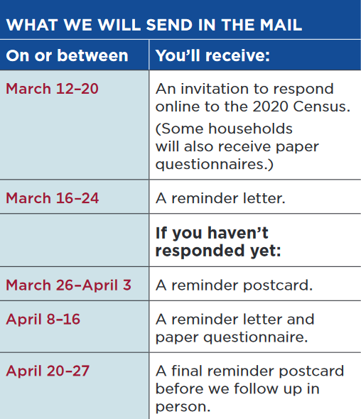
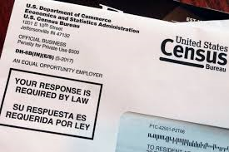
Every household will have the option of responding online, by phone, or by mail.
Every household that hasn’t already responded will receive reminders and a paper questionnaire.

Slide 12
The Census is Safe, Easy, & Important!
Two ways you can help today as a trusted voice in the community.
Sharing the message that the Census is Safe, Easy, & Important
2) Promoting our 2020 Census Jobs!
https://2020census.gov/jobs

Slide 13
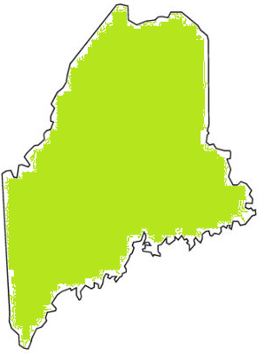
2020 Census Jobs
2020 Maine Recruiting Goal:13,400
Earn extra income while helping your community.
Positions
Enumerators
Recruiting Assistants
Census Field Supervisors
Office Operations Supervisor
Apply now at https://2020census.gov/jobs
There are a limited number of office manager positions remaining in our field offices. Interested applicants should apply through www.USAJobs.gov

Slide 14
Key Milestones for the 2020 Census
August 2019 – New Statistics in Schools classroom activities available online www.census.gov/schools
January 2020 – Advertising campaign begins
March 2020 – Group Quarters (GQ) Enumeration begins
Includes college dormitories, prisons, nursing homes, service-based locations (homeless shelters, soup kitchens, mobile food vans) and homeless count
Mid-March 2020 – Public can begin responding online at www.2020census.gov
Replying by mail or phone will also be an option
April 1, 2020 – Census Day
Mid-May 2020 – July 2020 – Census takers go door to door
December 31, 2020 – Tabulate Data and Release Census Results

Slide 15
Complete Count Committee
What is a Complete Count Committee?
A group of government and community leaders who come together to raise awareness about the 2020 Census and motivate their community members to respond.
Who should be on the Complete Count Committee?
Elected leaders, school department, libraries, workforce development, immigrant organizations, faith-based leaders, senior services, community development and housing, community-based organizations, veterans services, higher education, business, media (not an exhaustive list).
How do we get started?
Appoint a chair; identify the individuals/groups to include; plan a kick-off meeting; form subcommittees to be dedicated to specific areas of need.

Slide 16
The 2020 Census Phases
Education
Awareness
Motivation
Reminder
Thank You
Local governments and community leaders throughout the nation participate in activities highlighting the message that the 2020 Census is imminent and that it is easy, important and safe to participate.
Education Phase – 2018 - 2019
Awareness Phase – January – February 2020
Motivation Phase – March – May 2020
Reminder Phase – May – July 2020
Thank You Phase – Starts July 2020
Notes:
Chapter 4: Timeline Key Communications Phases (page 11)

Slide 17
Next Steps
How WE support Partners
Promotional Materials
Flyers (general and targeted)
Posters
In-language
Content
Sample message for email or blog
Drop in articles
Social media content and links
Graphics
www.census.gov/partners/2020-materials
Partnership presence
Connecting Partners with other partners
What YOU can do now!
Share job recruitment information
Start the Census conversation
Safe, Easy & Important
Become a partner
Start or join a Complete Count Committee (CCC)
Identify opportunities to include Census messaging, materials, or invite Census staff to your event
Notes:
Chapter 4: Timeline Key Communications Phases (page 11)

Slide 18
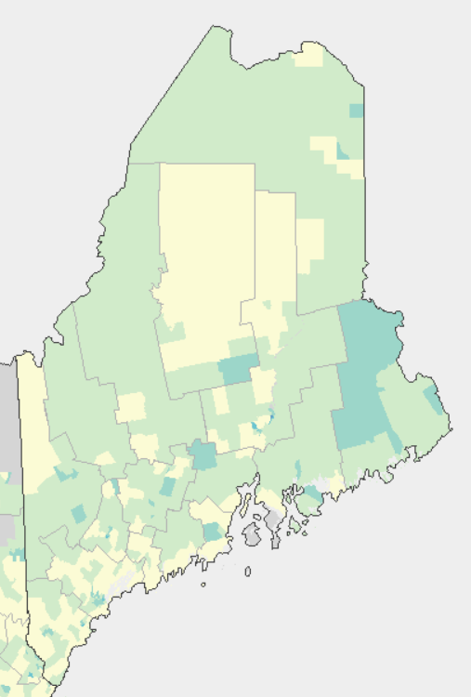
Response Outreach Area Mapper (ROAM)
www.census.gov/roam
Developed to identify hard-to-survey areas
Provides a demographic and socioeconomic characteristic profile using American Community Survey (ACS) estimates
Low Response Score (LRS) is a metric to predict the percentage of households who will not self-respond to the Decennial Census
Darker census tracts are harder to survey than lighter census tracts

Slide 19
Data Dissemination Program
Free Resource to YOU
Opportunities to teach the public how to access our data
Data Presentations
Data Access Workshops and Training Sessions
Webinars
Data and Survey Inquiries
All tools and data available at www.census.gov
American FactFinder
Census Business Builder
My Congressional District
OnTheMap
Subscribe and learn more:
www.census.gov/academy
Notes:
I don’t want to leave here today without mentioning the Census Bureau’s Data Dissemination Program. This program was developed to help you understand and utilize the vast array of data we have available on our website. This is a FREE program, a service we provide to give back to our partners and communities. Our expert staff can customize a training workshop for you or your constituents. Trainings can be done in person or via webinar. Our staff are well-versed in the data tools available on our website, including American FactFinder, Census Business Builder, My Congressional District and others.
The Data Dissemination staff are available to our partners for events to help educate people on the uses of the data.

Slide 20
https://www.youtube.com/watch?v=LXJz7ZfzAuM

Slide 21
Connect With Us
www.2020census.gov
facebook.com/uscensusbureau
twitter.com/uscensusbureau
youtube.com/user/uscensusbureau
instagram.com/uscensusbureau
Notes:
We are very active on social media, so add us!

Slide 22
Contact Us
Partnership Program
Phone: (212) 882-2130
Email: new.york.rcc.partnership@2020census.gov
Website: https://www.census.gov/partners/2020.html
Census Jobs
Field & Office Job Opportunities
Website: www.2020census.gov/jobs
Office Managerial Job Opportunities
Website: www.usajobs.gov
Website: www.census.gov/about/regions/new-york/jobs.html
Data Dissemination Program
Email: census.askdata@census.gov
Phone: 1-844-ASK-DATA
Website: www.census.gov/data/training-workshops.html

