Slide 1
Maine State Library
Census 2020 Webinar – February 12, 2020

Slide 2
Today’s Webinar Presenters
Betsy Enright
Partnership Specialist New York Regional Census Center
802-233-1548
elizabeth.enright@2020censu.gov
Janet McKenney
Director, Library Development
Maine State Library
207-287-5620
janet.mckenney@maine.gov

Slide 3
2020 Census: Key Facts for Libraries

Slide 4
What’s ahead?
What is the census, and why is it
important?
Who is at risk for not being counted?
How will the 2020 Census work?
What can libraries do?
What will the Maine State Library do?
QA/discussion

Slide 5
What is the decennial census?
It’s in the constitution.
Count every person in the U.S. once, and only once, and in the right place.
Essential for:
▫ Federal funding
▫ Determining what’s “rural”
▫ Political representation
▫ Informed decision-making

Slide 6
Does the census affect funds for communities?
YES!
Helps every community get its fair share for schools, health centers, roads, housing assistance and other vital programs.
National School Lunch Program
Medicare
SNAP
Roads
IMLS state grants

Slide 7
Who is at risk of being undercounted?

Slide 8
Are there special challenges for rural residents?
The more rural a county—the higher likelihood of undercount.
Households with PO boxes
Households on rural routes
Low household internet rates
High-poverty areas
Migrant/seasonal farmworkers

Slide 9
Census Timeline – Counting Everyone is a Huge Job
January 21: The U.S. Census Bureau starts counting the population in remote Alaska.
March 12 - 20: Households will receive official Census Bureau mail with information on how to respond to the 2020 Census online, by phone, or by mail.
March 30 - April 1: The Census Bureau will count people who are experiencing homelessness. The Census Bureau counts people in shelters, at soup kitchens and mobile food vans, on the streets, and at non-sheltered, outdoor locations such as tent encampments.
April 1: Census Day is observed nationwide. By this date, every home will receive an invitation to participate in the 2020 Census. When you respond to the census, you'll tell the Census Bureau where you live as of April 1, 2020.
April: Census takers visit college students who live on campus, people living in senior centers, and others who live among large groups of people.
May - July: Census takers will begin visiting homes that haven't responded to the 2020 Census to help make sure everyone is counted.
December: The Census Bureau will deliver apportionment counts to the President and Congress as required by law.

Slide 10
How will the Census work?
Online, by phone, or by mail
▫ Online – smartphone, tablet, or computer
▫ Online – secure and responses encrypted
▫ Online & phone – questionnaire available in
13 languages
About 10 minutes to complete questionnaire
Toll-free Census Bureau phone hotline in 13 languages

Slide 11
How can people respond to the 2020 Census?
Efforts to reach hard-to-count communities
▫ Online and phone questionnaire available in 13 languages
▫ Guides in 59 non-English languages
▫ Census Bureau plans to hire employees who are
▸familiar with neighborhoods
▸reflect diversity of communities
▫ Census Bureau is partnering with “trusted voices” – such as libraries

Slide 12
What is new in the 2020 Census?
Online self-response
Household relationship question
No citizenship question
Census responses are confidential.

Slide 13
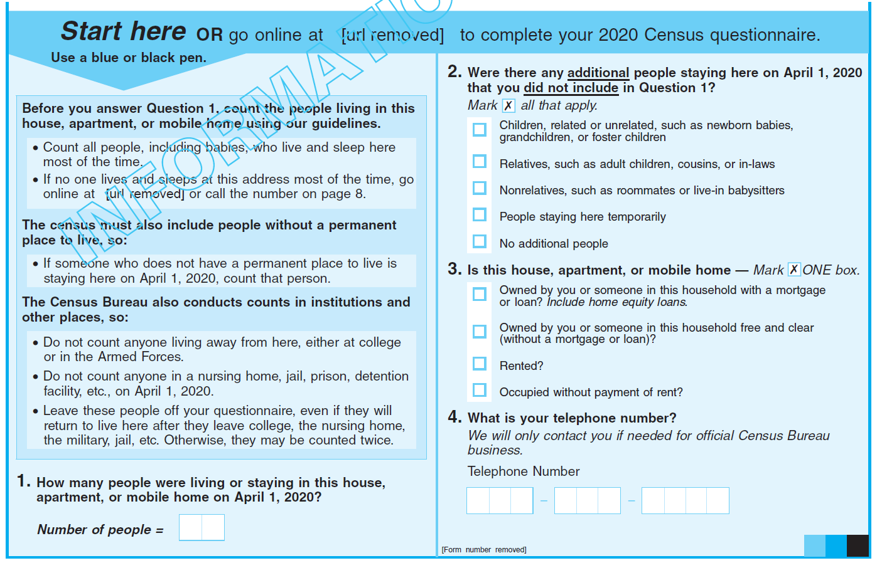
What does the paper census look like?
9 Questions for person 1, and 7 for the additional people counted.

Slide 14
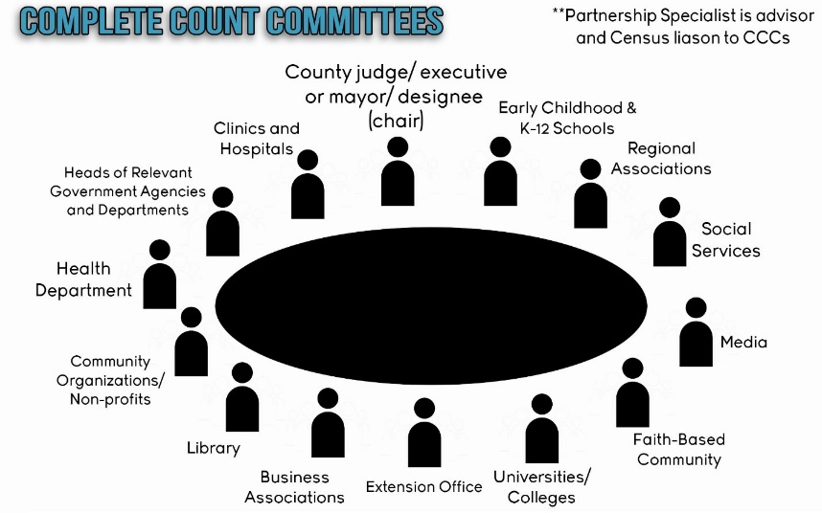
What can libraries do? How can libraries prepare?
Participate in Complete Count Committees
Local communities establish
▫ To increase awareness
▫ To encourage residents to
respond to 2020 Census
▫ 16 libraries in Maine have their own CC committees
The State Complete Count website is at: https://www.maine.gov/ccc/home

Slide 15
What can libraries do? How can libraries prepare?
Prepare for increased use of computers and the Internet
2020 census will encourage
online response
March and April 2020 – Many people may come to libraries to complete census form
Census Bureau job hiring requires online application

Slide 16
What can libraries do? How can libraries prepare?
Raise awareness about census jobs
Census Bureau will hire about 14,000 enumerators
▫ Jobseekers must apply online
▫ Apply online at 2020census.gov/jobs
▫ Maine rate is $20 per hour

Slide 17
What can libraries do? How can libraries prepare?
Help community members apply for census jobs
Hang up a poster with information about Census Jobs
Place census job messages by computers
Assist job seekers with Census application portal
Poster: https://2020census.gov/content/dam/2020census/materials/partners/2019-12/2020-census-job-opportunities.pdf

Slide 18
What can libraries do? How can libraries prepare?
Does your community has hard to count populations ?
https://www.census.gov/roam
Developed to identify hard-to-survey areas
Provides a demographic and socioeconomic characteristic profile using American Community Survey (ACS) estimates
Low Response Score (LRS) is a metric to predict the percentage of households who will not self-respond to the Decennial Census
Darker census tracts are harder to survey than lighter census tracts

Slide 19
What can libraries do? How can libraries prepare?
Share information about the 2020 Census.
Host programs and events to increase awareness of the upcoming census
Highlight the census in newsletters, social media, and on website
Make community members aware of the financial benefits

Slide 20
Financial Benefits to Maine
Counting for Dollars project at George Washington University Institute of Public Policy
Download PDF

Slide 21
What can libraries do? How can libraries prepare?
Fight misinformation, disinformation, and scams.
People may have questions and concerns
Libraries can provide accurate information
Feature counting and numbers into story time
Let parents know the importance of counting kids - https://www.maine.gov/msl/libs/grant_projects/documents/CountingYoungChildreninthe2020Census.pdf

Slide 22
What can libraries do? How can libraries prepare?
Help patrons with self-response.
Learn what you can (and cannot) do to assist patrons
Refer non-English speakers to
Census 2020 phone line
Help people with disabilities connect with Census
https://www.census.gov/library/fact-
sheets/2019/dec/guidelines-for-partners.html

Slide 23
Learn More
▪ ALA: ala.org/census
▪Census Bureau: 2020census.gov
Libraries’ Guide – January 2020

Slide 24
What will the Maine State Library do?
Work with Maine Complete Count Committee and keep Maine Libraries informed.
Connect libraries with Census and local Partnership Specialists in Maine
Provide easy access to posters, fact sheets and other materials via website
▫ Distribute Bookmarks via van delivery
▫ Provide template for stickers and button makers
▫ Stem Activities from Chris Dorman
▫ Storytime book recommendations (counting)

Slide 25
MSL Website Infor on 2020 Census
https://www.maine.gov/msl/libs/grant_projects/Census2020.shtml
US Census contacts in Maine:
Becky Hayes Boober, Partnership Specialist
Field Division/New York Regional Census Center
U.S. Census Bureau
Office: (212) 882-2130
Cell: (207) 387-3926
becky.h.boober@2020census.gov
Elizabeth Enright (Betsy), Partnership Specialist
Field Division /New York Regional Census Center
U.S. Census Bureau
o: (802) 233-1548
elizabeth.enright@2020census.gov

Slide 26
Discussion & Questions
Email me any questions: janet.mckenney@maine.gov

Slide 27
Posters, Fact Sheets and Other Promotional Materials from the US Census
Jobs:
https://sdcclearinghouse.files.wordpress.com/2019/03/censusrecruitassists.pdf
https://www2.census.gov/about/partners/general/2020-recruitment-toolkit.pdf
Counting Kids:
https://2020census.gov/en/who-to-count/young-children.html
Promotional materials
https://www.census.gov/programs-surveys/decennial-census/2020-census/planning-management/promo-print-materials.html
Video
https://www.youtube.com/watch?v=Vn4K3XoywlY

