Slide 1
The New Maine Regional Library System
What’s changing…and what’s remaining the same
Maine Libraries Conference – November 2016

Slide 2
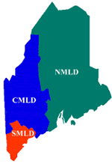
October 1973…
The Maine Regional Library System
Three districts…
Three consultants…
Notes:
The state was divided into three regional districts to serve all library types (public, school, academic and special). The Northeastern Maine Library District (NMLD) serving Aroostook, Hancock, Knox, Penobscot, Piscataquis, Waldo, and Washington counties, the Central Maine Library District (CMLD) serving Androscoggin, Franklin, Kennebec, Lincoln, Oxford, Sagadahoc, Somerset counties and the Southern Maine Library District (SMLD) serving Cumberland, York and selected Oxford county towns (Brownfield, Denmark, Fryeburg, Hiram, and Lovell). At that time, the decisions regarding district size was determined by population as well as available funding for personnel at the Maine State Library.

Slide 3
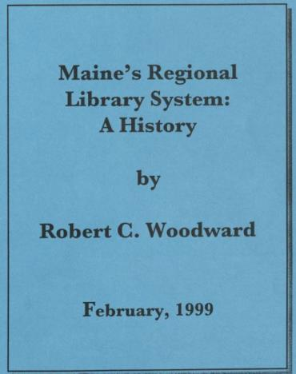
The future of the MRLS was discussed in 1999
Notes:
A paper entitled Maine's Regional Library System: A History was presented by Robert C. Woodward on February 24, 1999, at the Bangor Public Library during a meeting of the Executive Boards from the Central, Northeastern, and Southern Maine Library Districts.
The purpose of the meeting was to discuss the history and future of the Maine Regional Library System.
Mr. Woodward was the first Chair of the Maine Library Commission, and a former director of the Bangor Public Library.
This was the 25th anniversary of the implementation of the MRLS

Slide 4
Success in 1999
The Regional Library Systems Act was working
Concerns about the loss of local autonomy were put to rest.
ARRCs have improved access to collections and services for public and school libraries.
Local library staffs are better prepared through the support offered by the District Consultants.

Slide 5
The report concluded with notes about “unfinished business”
A statewide borrower's card
Many libraries do not tie into the system
They seldom use interlibrary loan services and they seldom call for reference help
What can be done to widen and improve access to library services for residents of those Maine towns?

Slide 6
Technology changes since MRLS was created
1973 Robert Metcalfe links computers together – calls it Ethernet.
1976 Steve Wozniak and Steve Jobs launch the Apple I
1981 The Space Shuttle makes its maiden voyage.
1989 Tim Berners-Lee invents the World Wide Web.
1990 Windows 3.0
1991 Linus Torvalds creates the first version of Linux
1996 Webmail introduced
1996 Maine School and Library Network launches for libraries and schools
1997 Electronics companies agree to make Wi-Fi a worldwide standard for wireless Internet.
2000 USB Flash, jump, stick, thumb drive debuts
2001 The Wikipedia online encyclopedia is founded by Larry Sanger and Jimmy Wales.
2006 Facebook and Twitter
2007 Amazon.com launches its Kindle electronic book (e-book) reader.
2007 Apple iPhone and Google Android OS
2009 Google becomes the dominant search engine
2010 500 million users on Facebook
2010 iPad introduced
2011 Monthly unique visitors to Google surpassed one billion
2013 Surface Pro
2015 Libraries and schools on MSLN get minimum100 mbps fiber connections
Notes:
When you think of where we were in 1973 – No MELIBS, hardly any libraries were automated, very little interlibrary loan, no MARVEL.
There has been an explosion of growth of library services.

Slide 7
Since 1999
MSLN connections go from 56K to T1s to multiple T1s to a network that now offers connections from a minimum of 100 mbps to a gigabit. All fiber…
ILS growth: Minerva and now MILS. More smaller libraries have automated
MaineCat participation
Rapid expansion of ILL plus van delivery
Notes:
The initial intent was to educate, promote and develop interlibrary loan and the use of ARRC reference services in Maine’s public libraries. The Council meetings purpose (as interpreted by Title 27) was to provide the opportunity for the flow of information back and forth from the Maine State Library and the Maine Library Commission. The roles of the regional consultants, district councils, district executive boards and their relationships and focus have undergone significant change. The expansion of continuing education for librarians has been a result of the rapid changes in librarianship and library services. Maine’s unique library governance (57% of Maine public libraries are private/non-profit institutions with the balance being municipal departments) and high rate of public library directors without a library degree (72%) have created needs for training and consulting that are not the norm nationally. Add population sizes, vast geography, lack of regional or county systems built around an ILS and services plus the lack of direct state aid and Maine unique library challenges set it apart nationally.

Slide 8
Gradual evolution at MSL with staff serving libraries
E-rate and technology consultant
Early literacy consultant
STEM librarian
Shift of school library consultant responsibilities
Statewide coverage and service
Notes:
MSL re-worked existing positions and got funding for new positions that were statewide
There was a gradual recognition that these were all consultants … but specialist versus generalists and were serving

Slide 9
Library needs also evolved
Generalist knowledge needed to be expanded
More reliance on subject specialist – on and outside MSL staff
Harder to hire a well rounded “generalist”
Higher expectations from libraries
Notes:
Discomfort grew as libraries consulted with another regional consultant on a special topic and consultants felt inadequate if they did not have the knowledge to provide all consulting services needed by their region. At the State Library level, it is difficult to find and hire a “generalist” today who is equipped to handle all questions from a geographic region. It is more logical to hire librarians with specialties and train them in some of the “generalist” skills. It is not financially viable to employ a cadre of specialists plus three or more regional consultants. The districts had never been created equally. Population made sense from an infrastructure viewpoint but did not from a consulting services delivery model. The NMLD was too vast and the needs from libraries serving small populations statewide were different. The inequities of the original district configurations when viewed by number of libraries and geography grew more obvious as training and consulting needs evolved. Maine is very rural and 70% of our libraries serve populations 5,000 and under.

Slide 10
Process of evaluation
Internal conversations
External conversation with other SLAs
A survey
Fifteen regional meetings
Notes:
The process initially began with the Commission’s Statewide Shared Resources Subcommittee tasked with studying the Maine Regional Library System. After two meetings it was determined logical to look at the District Consultant model because MSL staff felt changes were necessary and had already discussed with some depth. With the recommendation of the committee, Library Development set out to craft a survey, look at the data, hold regional meetings and analyze the results from both. Our intent was to change the model but not without having a discussion with libraries statewide. Many comments from libraries prior to the survey indicated there was a desire at the local library level to move from the generalist to specialist. The survey and regional meetings were intended to widen that discussion, ask for input on the change and allay fears about changing models.
The MSL Consulting Services Survey for Public Libraries was distributed online in October 2015. We had 173 respondents from all counties and library sizes in Maine. After holding a session about the change and survey results at MLA we determined that in spring 2016 we would hold regional meetings to discuss changes and receive feedback face to face to with librarians across the state. We held 15 regional meetings including the MASL Spring Symposium.

Slide 11
Regional meetings
Notes:
MSL staff went on the road

Slide 12
Meeting results
Almost 150 librarians and trustees attended
Feedback forms and notes analyzed
Strong support for proposed change from regional to specialist form of consulting
Hope for MSL to deliver more training and meetings in new regions
Notes:
We had 147 librarians and trustees attend the regional meetings. At the completion of all the meeting we gathered the feedback forms and our notes from each meeting. The results were clear from discussions, feedback forms and notes that there was very strong support for this effort. There were certainly a few concerns but no deep disapproval at the proposed change. Librarian concerns were focused on the lack of a personal relationship with a consultant and the fear that small, rural libraries would be left out or ignored in this new model. The fact that MSL came to 14 areas to cover the state geography was highly appreciated and voices expressed a hope that MSL would deliver more services regionally - (meetings, discussions, CE and demonstrations) after the service model change.

Slide 13
Response to concerns
A new consultant - “Small, Rural library Specialist” Create 9 regions rather than three – to be able to hold meetings and customized CE and info gathering and sharing
Create liaisons at the county level.
Work to fund a school library specialist position
Create a statewide advisory board, with representatives from the 9 new districts
Notes:
Actions in response to concerns raised at meetings and in the survey are being met in two ways
The NMLD open position should be filled by a “Small, Rural library Specialist” whose focus will be on libraries serving populations 5,000 and under.
Library Development specialist staff would also serve as liaisons at the county level. Each specialist will be assigned 35-40 libraries (county/region). There will be a dedicated contact person for each public library.
MSL would work with DOE, Legislative committee and state budget office to fund a school library specialist position

Slide 14
Recommendations to the Maine Library Commission
Create one statewide library district
District will have 9 regions
Each region has an MSL staff liaison
Continue with 2 statewide council meetings yearly
MSL will provide regional training in each region and encourage libraries to meet
Notes:
Recommendations to the Maine Library Commission
Our recommendations to the Commission for action are:
Create one Statewide Maine Library District
The district will have 9 service regions – arranged by single or combined counties but still aligned with the same ARRCs as to not disturb ILL and other current ARRC services
Each region will have an assigned MSL Specialist assigned as the liaison.
Create one statewide advisory board (initial board to consist of volunteer members from CMLD, NMLD, SMLD boards) who will meet to determine best board size and library type distribution and make recommendations to the Commission.
Continue with the 2 required council meetings consistent with Title 27 – one held at MLA each fall and one in the spring with rotating regional locations.
MSL staff will provide regional meetings and trainings in the 9 locations sending a team of specialists to an area at least once a year.

Slide 15
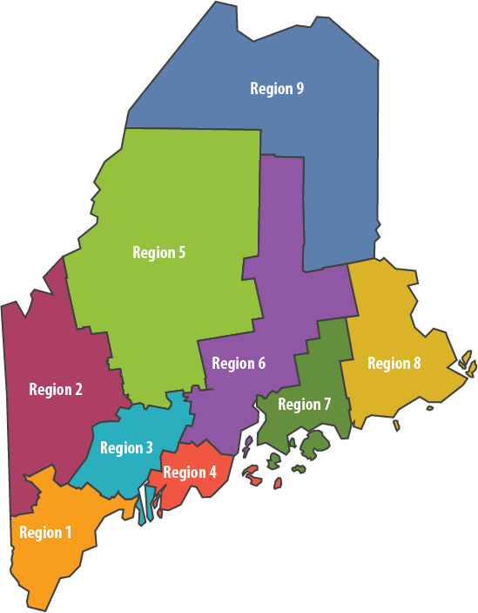
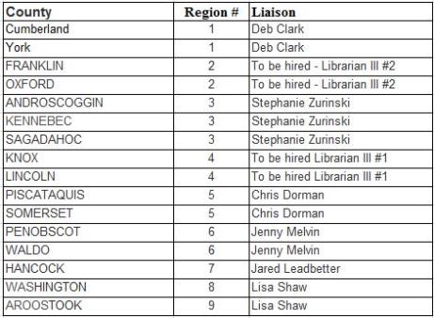
MRLS – Reimagined and Reinvented
New Regions and Liaisons
Notes:
The Aspen institute calls the “Rising to the Challenge: Re-Envisioning Public Libraries, “the culmination of a year-long exploration and examination of the challenges and opportunities facing communities and their public libraries as society moves deeper into the digital era.”
In much the same way – we are recognizing both the challenges and opportunities

Slide 16
Specialists that consult, model and train…
Digital Literacy Jared Leadbetter
Annual report Jenny Melvin
Data/Evaluation Stephanie Zurinski
Strategic Plans Deb Clark
Rural/Small Lisa Shaw
STEM/Robots Chris Dorman
Plus many more specialties…see the handout

Slide 17
A new journey together
The Maine State Library’s missions is to…
help people,
make Maine libraries* stronger
and transform information into knowledge.
* and librarians
Notes:
Libraries have the opportunity – now more than ever – to be their communities haven. The safe place for all to pursue learning, dreams, conversation. To explore the new and treasure the past. We are all things to all people. Be proud of that!

Slide 18
Thank you!
Questions and comments…

