Slide 1
The New Maine Regional Library System
What’s changing…and what’s remaining the same
Maine Libraries Conference – November 2016

Slide 2
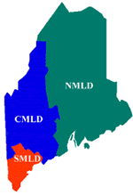
October 1973…
The Maine Regional Library System
Three districts…
Three consultants…
Notes:
The state was divided into three regional districts to serve all library types (public, school, academic and special). The Northeastern Maine Library District (NMLD) serving Aroostook, Hancock, Knox, Penobscot, Piscataquis, Waldo, and Washington counties, the Central Maine Library District (CMLD) serving Androscoggin, Franklin, Kennebec, Lincoln, Oxford, Sagadahoc, Somerset counties and the Southern Maine Library District (SMLD) serving Cumberland, York and selected Oxford county towns (Brownfield, Denmark, Fryeburg, Hiram, and Lovell). At that time, the decisions regarding district size was determined by population as well as available funding for personnel at the Maine State Library.

Slide 3
Transition to a new model
A new consultant - “Small, Rural library Specialist” Create 9 regions rather than three – to be able to hold meetings and customized CE and info gathering and sharing
Create liaisons at the county level.
Work to fund a school library specialist position
Create a statewide advisory board, with representatives from the 9 new districts
Notes:
Actions in response to concerns raised at meetings and in the survey are being met in two ways
The NMLD open position should be filled by a “Small, Rural library Specialist” whose focus will be on libraries serving populations 5,000 and under.
Library Development specialist staff would also serve as liaisons at the county level. Each specialist will be assigned 35-40 libraries (county/region). There will be a dedicated contact person for each public library.
MSL would work with DOE, Legislative committee and state budget office to fund a school library specialist position

Slide 4
Recommendations to the Maine Library Commission
Create one statewide library district
District will have 9 regions
Each region has an MSL staff liaison
Continue with 2 statewide council meetings yearly
MSL will provide regional training in each region and encourage libraries to meet
Notes:
Recommendations to the Maine Library Commission
Our recommendations to the Commission for action are:
Create one Statewide Maine Library District
The district will have 9 service regions – arranged by single or combined counties but still aligned with the same ARRCs as to not disturb ILL and other current ARRC services
Each region will have an assigned MSL Specialist assigned as the liaison.
Create one statewide advisory board (initial board to consist of volunteer members from CMLD, NMLD, SMLD boards) who will meet to determine best board size and library type distribution and make recommendations to the Commission.
Continue with the 2 required council meetings consistent with Title 27 – one held at MLA each fall and one in the spring with rotating regional locations.
MSL staff will provide regional meetings and trainings in the 9 locations sending a team of specialists to an area at least once a year.

Slide 5
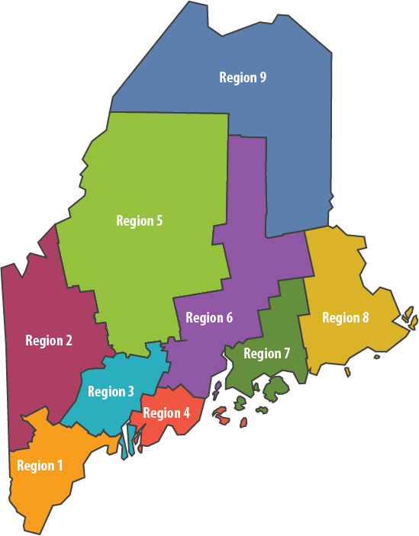
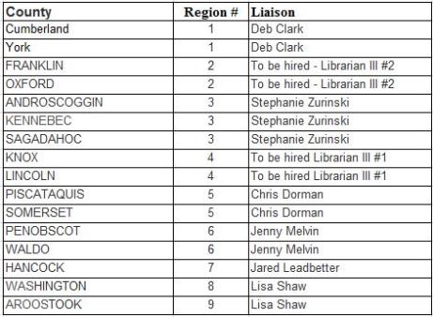
MRLS – Reimagined and Reinvented
New Regions and Liaisons
Notes:
The Aspen institute calls the “Rising to the Challenge: Re-Envisioning Public Libraries, “the culmination of a year-long exploration and examination of the challenges and opportunities facing communities and their public libraries as society moves deeper into the digital era.”
In much the same way – we are recognizing both the challenges and opportunities

Slide 6
Specialists that consult, model and train…
Digital Literacy Jared Leadbetter
Annual report Jenny Melvin
Data/Evaluation Stephanie Zurinski
Strategic Plans Deb Clark
Rural/Small Lisa Shaw
STEM/Robots Chris Dorman
More specialties…see the handout

Slide 7
A new journey together
The Maine State Library’s missions is to…
help people,
make Maine libraries* stronger
and transform information into knowledge.
* and librarians
Notes:
Libraries have the opportunity – now more than ever – to be their communities haven. The safe place for all to pursue learning, dreams, conversation. To explore the new and treasure the past. We are all things to all people. Be proud of that!

Slide 8
Thank you!
Questions and comments…

