Slide 1
Using Social Media for Job Searching & Networking
Patrick Therrien
Technology & Education Training Specialist
Notes:
Hello and Welcome to the Maine State Library’s presentation on How to Use Social Media such as LinkedIn and Facebook for Job Search and Interview Preparation. In this module we discuss how social media is changing the face on how we look for work. If you still think of social media purely for social interaction and status updates, you need to rethink your strategy. It’s a new world, and if you’re not leveraging Facebook, LinkedIn and Twitter for professional networking and job searching, I guarantee you the person who wants the advantage is. It’s a good idea to look at all your social media profiles from the perspective of a potential employer. Make sure you present an image that’s professional, tasteful and that maximizes, rather than minimizes, your appeal to a potential boss.
Did you know that statistics today show that over 70% of jobs are being found by networking? So how are you going to develop your network? You can start by contacting friends, family, neighbors, any associations that you are currently in, your college alumni, and anyone who might help you get information on employment leads.
In today’s job market it is essential that you network in order to be successful. I would recommend LinkedIn as the social media tool for every job seeker. Today HR managers go to LinkedIn when they have a job to fill. LinkedIn is a fast way to build a far-reaching professional network. And in a volatile job market, networking is the #1 way of landing your job. I can’t stress how important it is to be on LinkedIn and to be active. You need to start joining groups within your industry. Set a goal and try connecting to a few new people each and every day.
So, if you're not already on LinkedIn, you definitely need to be. Basically, it's a site that allows you to connect to people you know. It also allows you to see profiles of anyone else on LinkedIn, and gives you ways to connect to them. There are many ways you can use LinkedIn and Facebook in your job search and networking and we are going to cover those strategies in this module.

Slide 2
Social Hiring
Expanding in 2012
Employers creating branded Facebook and LinkedIn company pages
Job Seekers tapping into this market to complement their search efforts
Notes:
Utilizing social media for hiring is only going to grow in 2012 with more employers creating branded Facebook and LinkedIn company pages, tweeting job openings, using Facebook and mobile applications to source candidates. Today more companies are using social media to advertise job openings and accept job applications, and actively networking with and recruiting candidates on social networking sites. In order to be successful in your job search you need to tap into these social networking sites to complement your current job search.
Did you know that job boards only show a small portion of available jobs. This is common knowledge in the HR field, so why do so many people spend so much time on job boards? Because it is a safe environment and they don’t have to put themselves out there face to face trying to talk to people. Social media is the new tool that will help you find that job you are looking for.

Slide 3
Finding Employment Using Social Media
Networking #1
Most successful way to land an interview
You are in competition
You need to set yourself apart
Using normal channels is not working
Notes:
Most job seekers don’t understand that with technology, looking for a job is different in today’s economy. The days of getting a job through applying online to website after website are gone. As Albert Einstein stated “doing the same thing over and over and expecting different results is the definition of insanity.” How is your current method working for you now? By networking you can tap into the unadvertised positions not making it to the job boards. You must understand that you are in competition with others, battling for the few positions available, and you must find different ways to get your name out there to secure an interview. Getting the interview is the toughest part of looking for a job. In order to get that edge you must network. So I ask you “Why is networking so important?”
When you're job searching, who you know is as almost important as your qualifications. Your connections can provide you with inside information on the hiring process and what it's like to work at a company, give you a recommendation, possibly get your resume a closer look, and help you secure an interview.
It’s time for you to be open-minded and think differently about how you’re going to get your next job . I’m not saying you should stop submitting your resume to job banks, corporate websites, or attend job fairs, but these should only consume 20% of your time. The other 80% should be concentrated on networking through social media.
Face-to-Face networking is still the #1 way in finding a job. Social media is the tool to augment your current job search and get yourself connected with the right people. It does not replace the face to face meetings.
Finding a job today is different from the past. In order to get noticed by the hiring managers you need to do something different that will make you stand out amongst your competition. Your goal is to get your resume in the hands of the right people who make the hiring decisions and bypass those normal channels. In this module we will discuss how you can use Social Media such as LinkedIn & Facebook to your advantage.

Slide 4
Why Social Media
Allows you to stand out in the crowd
Opportunity to display your personality & professionalism
Less than 5% of people are finding jobs on job boards
Notes:
Using Social Media in job searching allows you to stand out in the crowd. This shows the employer that you are open to new things and that you understand that you must change in order to succeed in today’s job market.
Your resume tells them you have the skills and talents, but social media allows them to see much more about you. This is definitely an advantage if used properly.
Social media allows you to display your personality and professionalism. Did you know that less than 5% of people today are finding jobs through job boards? For example if you use a major job board such as Monster, there are hundreds of people applying for those positions. What do you think your odds are of getting noticed in that pile?
As of 2011 there are over 100 million members in LinkedIn, 44 million of those are in the United Sates, and over 600 million users in Facebook. So where do you think you should be spending your time: on job boards or trying to connect to those in your market? Remember, you have to do something different to stand out from your competition. Social media can give you the edge over your competitors who aren’t using social media.

Slide 5
Why Use Social Networking Sites
Most effective method
Easy way to connect
Creates a professional image
HR Managers are utilizing this technology!
Notes:
In the past you sent out multiple resumes and hoped you would land a few interviews.
I too fell into that same trap. It got me nowhere. In fact, I realized that I had to do something different so that I would get noticed. The days of sending out resumes and praying for an interview are gone.
Today networking is the most effective thing you can do during your job search.
You need to get out and meet people who can help you with your search.
Now this doesn’t mean that you stop sending resumes out. It does mean connecting with the right people to send your resume to, bypassing normal channels.
Online networking is an easy way to connect with those people that you may not otherwise be able to contact. A resume may talk about your qualifications, but online networking goes beyond that.
Online networking helps you to create a professional image that represents the beneficial qualities you will bring to a company.
Why wouldn't you do something that makes you more likely to get that interview!
According to a SHRM survey, 68% of organizations are currently using social media, with 19% coming on board the social media bandwagon in 2011. Facebook leads the pack when it comes to the sites companies are using: Facebook (45%); LinkedIn (34%); Twitter (28%) and YouTube (18%). http://jobsearch.about.com/
HR Managers are utilizing this technology today! Why not take advantage of it?

Slide 6
Landing That Job Interview
100% completed profile
Most companies will Google your name
Need to ensure you make the “Right” first impression
First 30 seconds focused on your profile
Notes:
So let’s talk about the technology we will use to help you land that interview. Let’s start with LinkedIn. LinkedIn must become the focal point of any job search. So I ask you, how many of you have a 100% complete LinkedIn profile. Most companies today will Google your name and they will look at your LinkedIn profile and you’d better look good. They will also look to see if you have a Facebook page. So you need to ensure that whatever you display on your Facebook page must match the same person you are portraying on your LinkedIn profile. Because social media is out there for everyone to see, you need to ensure that you are making the right first impression.
The first thing that an HR Professional will read is your profile summary. Most HR professionals spend about 90 seconds looking at your profile. The first 30 seconds are focused on your profile summary. If they don’t like your profile summary, that’s about all of the time you get.
So make sure that your profile summary is targeted to the industry that you are attempting to locate employment in.

Slide 7
Create a Profile on LinkedIn
100% Completed Profile
Photo
Executive Summary
Skill Set
Education
3 Recent Positions
3 Recommendations
Edit Profile
Notes:
The LinkedIn profile is the first step in controlling your identity online. What do people find when they Google your name? Having a completed LinkedIn profile communicates your professional brand and lets other LinkedIn members collect, communicate and collaborate with you.
Think of a Brand as a promise. What will you bring to the company if they hire you? The objective is to align who you are to what are they looking for.
HR professionals are watching out for their own position. They need to make sure if they hire you, that you represent a solid decision made by them.
A 100% completed profile includes a photo, an executive summary and skill set, education, 3 recent positions, and 3 recommendations from your connections. To get started just click “edit profile”. LinkedIn does a good job in letting you know what you need to complete in order to get a 100% completed profile.
A good LinkedIn profile represents your career accomplishments and opens the door to new opportunities.
Your profile gives people who are looking for you a quick glance of your skills, your employment history and any recommendations you have.
Users with complete profiles are 40 times more likely to receive opportunities through LinkedIn!

Slide 8
Checklist For a Successful Profile
Make sure it is at 100%
Connect where you want to go
Uneven # of recommendations
Active within 3 groups within your industry
Notes:
So what is the recipe for a successful profile? Make sure it is at 100%. Getting a minimum of 3 recommendations will probably be your hardest task to complete.
When building connections, focus on where you want to go, not where you were. Connecting with people where you used to work is not as effective as connecting with people in the field that you are trying to get into. You still need to connect with them because they could lead you to someone else. Your goal is to connect to people that will take you toward your goal for that desired industry or position.
If reference to recommendations try to keep an uneven number of recommendations. HR professionals look at the number of recommendations that you have given and have received. Make sure that you have not given the same amount that you have received and don’t immediately respond to someone’s recommendations once you have received one wait a couple of weeks before responding. You don’t want it to look like you are giving recommendations just because you are getting one.
Adjust your notifications: There is a way to adjust your notifications so that you are getting updates from LinkedIn on a daily basis. So if this fits your workflow, I suggest taking a look at all of the notifications and settings within LinkedIn.
You need to be active in at least 3 groups within your industry. That means participate at least once a week in each group. The 1st benefit of being active is that it creates an association with the industry and your name. If someone Goggles your name, it might pop up with the post that you commented on. Another benefit is that you are creating relationships with members in that group. You will begin to see who the dominant people in that group are and who is just listening and who has something to say. These people can be great assets when looking for a job. Reach out to them for help.

Slide 9
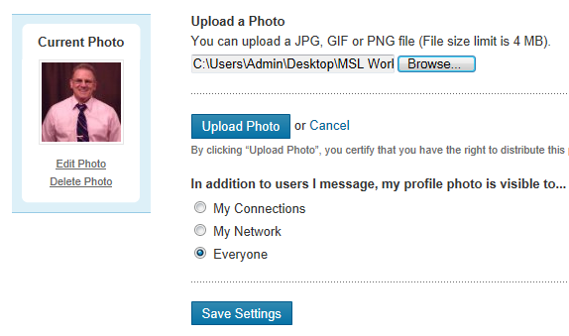
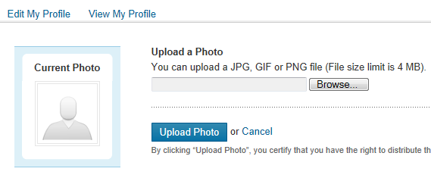
Add a Photo to Your Profile
To add a photo
Click on Profile
Edit
Upload your photo
Photo requirements
JPG, PNG, GIF
File size max 4MB
Pixel 80X80 no larger than 4000X4000
Notes:
So why do you need a picture in LinkedIn. Why would you be on a social networking site and not display who you are? What are you afraid of?
For your personal branding, a photograph is essential. And as they say, first impressions mean everything. People like to put a face with a name and a nice professional photo with you SMILING will go a long way toward helping your networking success.
Would you send out a resume that is incomplete? Your profile on LinkedIn is a resume and you want to make sure that it’s complete.
To add a picture to your profile you can follow these steps:
1. Press on "Profile"
2. Press on "Edit" below the empty space where your picture is supposed to be.
3. Now you can upload a photo.
1. The file type is a JPG, PNG or GIF.
2. The file size is no larger than 4MB.
3. The pixel size is at least 80×80 and no larger than 4000×4000.
If you still have trouble uploading a picture, try using a different browser than what you normally use.

Slide 10
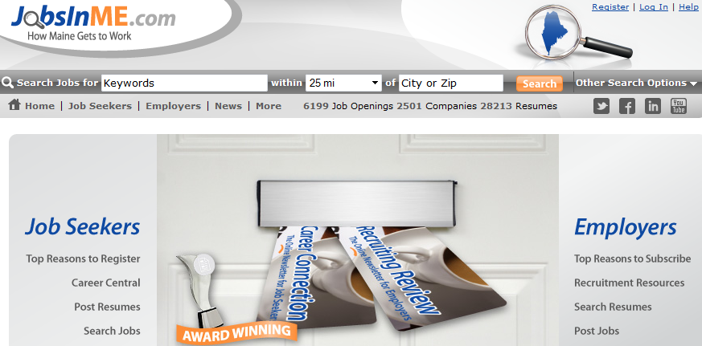
Using LinkedIn for Company Information
1st Step
Check out Job Boards
JobsInMe.com
Indeed.com
MyJobWave.com
Look for possible companies or opportunities
Job description
Notes:
So what’s the first step after completing your LinkedIn Profile? Let’s check out one of the local employment website such as JobsInMe.com You can also use Indeed.com, because they pool from different job boards and put them in one site. What opportunities or companies are you interested in? Is there a particular company you wish to work for? Now that you have located an opportunity, your next logical step is to go to LinkedIn, type in the company name, and look for the people who are associated with that position or the type of people you want to talk to about that particular opening.
Now you are no longer following normal channels. This is where you begin to separate yourself from the pack. The next thing I am going to ask you to do requires a little courage and stepping outside of your comfort zone for some of you. Pick up the phone and call up those people you found on LinkedIn and say “Hello my name is Peter Brown and I’m looking for Mark Sanders, we are friends from LinkedIn.”
“Hello Mark, my name is Peter Brown and I located you on LinkedIn, and I am really interested on finding more information about your great company, not necessarily for a job, but to see what your company is all about. I just want to know if you have just 30 minutes to talk me.”

Slide 11
The Informal Interview
Set up an informal interview
Could be done over the phone
Could be over coffee
Conducted at their office
No more than 30 minutes
Notes:
Setting up an informal interview may seem like a daunting task, but it needs to be done. Using LinkedIn to set up an informal interview is a part of the new job search process because it allows you to familiarize yourself with the position by hearing from someone who has knowledge of it first-hand. They may give you information that is not displayed in the job description. There are three benefits to informal interviews; first, as mentioned above, you gain knowledge about the position that will help you decide whether or not the job is best suited for you; second, you become aware of how that person landed their job ; and third, you now have built a relationship with someone you may be able to use as a reference for that position.
The informal interview can be conducted over the phone, or over coffee; however, if possible, it’s best to meet them at their office so as not to disturb their daily schedule.
Make sure before the interview that your LinkedIn profile is current; chances are he/she is going to look at it before setting up your appointment.
When conducting the interview be sure you have questions ready and written down so as not to waste their time. Spend the first 5 minutes talking about him/her and how he/she likes the company and how he/she got to where they are now. Next, spend 15 minutes talking about the position and what attributes and skills are required to be successful. Finally, spend the last 10 minutes on what you can offer in their field and ask if there is any additional training or qualifications that you need to pursue in order to be successful in that position.
If the interview went well, you could ask if you could use him/her as a reference. If the answer is yes, you now have a reference on the inside which will increase your chances of landing that interview.

Slide 12
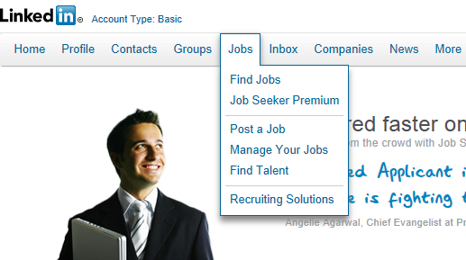
Searching for Jobs @ LinkedIn
Hiring managers and recruiters are using LinkedIn
To post jobs
Source candidates
You can search by utilizing keywords:
Job Title
Keywords
Company Name
Notes:
LinkedIn is where companies want to be when they are hiring. Hundreds of companies are using LinkedIn's Corporate Solutions and many for employment. That's good news for job seekers, because you can use your LinkedIn connections to find a job.
The more connections you have, the better your chances of having a connection who can help with your job search. When you're applying for jobs, be sure to use the connections you have. Someone who is employed at the company, or has connections there, will be able to help your candidacy for employment. On the flip side, be willing to help your connections when they need your advice and referrals.
After you click on “select jobs” you can search by Job Title, Keywords, or Company name.

Slide 13
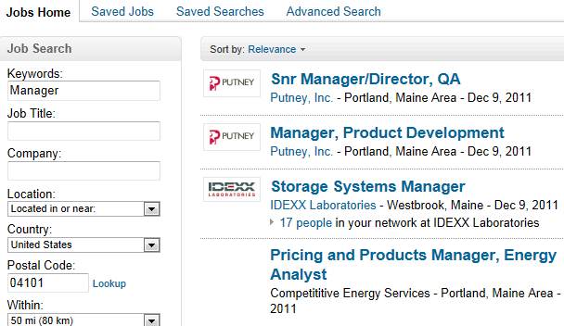
Refining Your Search String
You have the ability to define your search by location
This search provided 28 jobs within my search parameters
Notes:
Displayed here is a job search screen where I used keyword searching and the term “Manager.” Initially, I got numerous jobs from all over the country; therefore, I needed to use a filter. I went down to “location” and used the drop down box and selected “Located in or Near.” Next, I filled in the postal code of 04101 which is a zip code for Portland, Maine. You can also click on “Lookup” and find a zip code to a city should you need one. Then you have the opportunity to select, by drop down box, a distance range around the city you selected. The options are as little as 10 miles and as far as 100 miles and several options in between.
In the example, I used a 50 mile radius and found 28 jobs that met my search criteria. From there I can select a company, then look for people in LinkedIn who work for that company to help me get more information about the company or the position.

Slide 14
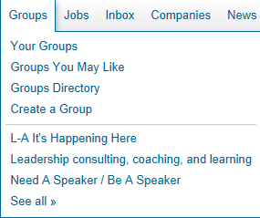
Why Join a Group
Allows you to join group discussions
Learn new information about your field or interests
Discover the most popular discussions in your professional group
Reasons to join LinkedIn groups
Find jobs
Get advice
Demonstrate your expertise
Notes:
How does joining groups help me in my job search on LinkedIn? There are numerous advantages of joining groups within LinkedIn:
You will quickly discover the most popular discussions in your professional groups.
You can take an active part in determining the top discussions by liking and commenting.
You can follow the most influential people in your groups by checking the Top Influencers board or clicking their profile image to see all their group activity.
See both member-generated discussions and news in one setting.
Easily browse previews of the last three comments in a discussion.
NETWORK
Here are seven additional reasons to join LinkedIn groups:
1.Find jobs
2.Get advice
3.Demonstrate your expertise by giving advice
4.Grow your network with people of similar interest
5.Discover people you didn’t know were on LinkedIn
6.Show your affiliations by using Groups’ icons as badges
7.Contact people directly without having LinkedIn’s paid Premium membership. This is a great way to reach out directly to past employees of a company you’re targeting.

Slide 15
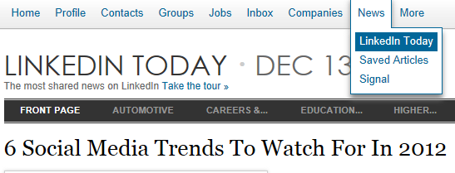
Accessing Latest News
Access some of the latest news that can help your job search
Advantage over those who are not using social media
This is what the professionals are sharing
Notes:
LinkedIn gives you access to some of the latest social media available. Some of these articles pertain to employment or give insight into how social media is affecting how people look for work or other employment topics. Either way you can gain an advantage over those who are not using social media.
LinkedIn offers a social news service that funnels relevant news that users are sharing via the professional social network and Twitter.
http://www.mbaonline.com/social-job-search/

Slide 16
Using Facebook in your Job Search
Not only for social networking anymore
Get news and information on a specific company
You can get advice and tips right on Facebook
Notes:
Facebook happens to be a powerful tool when it comes to connecting with friends, co-workers and colleagues. Friends that know you on Facebook will be more than helpful in trying to find you a job or provide you with some valuable job related information. You are already spending time on Facebook you just need to change how you use Facebook and focus more on networking.
Now I know most of you have Facebook profiles, but how can you use Facebook in your job search and networking? Job Seekers today understand that Facebook is becoming more than a social networking site. There are a variety of Facebook applications that you can use in your job search. You can use the “Like” option when see a company that you would like to work for and follow them on Facebook. You can get updates and company news that give you more information about the company before setting up that informational interview. You can also receive job search tips and advice right on Facebook by visiting some of the job searching engines that offer information and liking them on Facebook.

Slide 17
Personalize your Facebook Profile
Personalize your Facebook URL
You are more likely to be picked up by Google/Bing when someone searches for you
www.facebook.com/username
Notes:
Why would you want to personalize your Facebook Account? First, it looks better, both on Facebook also whenever you are giving out your URL. You could put it at the end of your email signature, or other places where you’d actually spell it out.
By enabling your vanity URL, you are more likely to be picked up and ranked higher by Google, Bing and the rest when someone searches for your name.
It’s simple to personalize your Facebook URL. Just log in to you Facebook account. Now open a second browser window and type in the web address www.facebook.com/username and the username options will appear before you. Select one of the options or you can type one of your own. Once you have selected a personalize URL, you will not be able to edit or transfer this username once you set it.

Slide 18
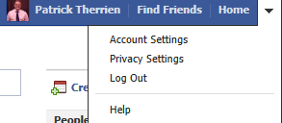
Setting your Privacy Settings
Create different groups
Your privacy settings are located on the right upper part of your home page
Notes:
But before we start using Facebook we need to make sure that we clean up your profile and make sure that your settings are right to protect some of your sensitive information or past activity.
You will want to create different groups of friends which will have different access to your full profile. What you want to do here is get friend requests from people who can help you professionally.
Your privacy settings can be located on the right upper part of your home page under the down arrow. Review all of your settings and make sure that they are set properly. Certain things should be kept private and you want to make sure that you are making the right first impression for those who are seeking you out.
To verify what they will see when they Google your name, click on your name, then click on “View As”, then click on the blue public link to see what your profile will look like to someone outside your network.
As you start to post professional information on your wall, such as articles that pertain to your industry, or a video, or a group discussion, make sure that you make this available to the public. You want them to see the same professional image that they will see on your LinkedIn profile.

Slide 19
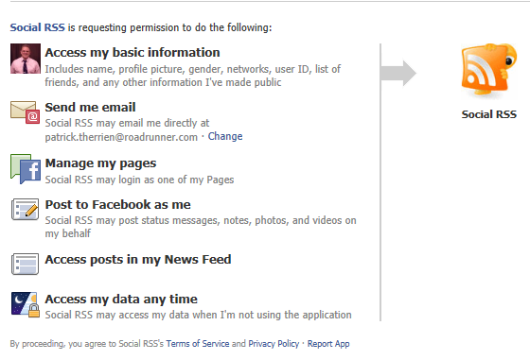
Building your Professional Profile
RSS feed from your blog
Useful status updates
Article from the industry or a specific company
Famous quote focused on your industry
Showcasing your interests
Notes:
A lot of people today have a blogging website. To ensure that your friends and your network see your updates you can plug in the Social RSS feed straight to your profile wall. This saves time having to share things manually and most people really enjoy reading your blog posts.
Instead of sharing pictures of goofy looking dogs, try to update your status with something useful and informative. Examples of this are:
An article about your industry or a specific company
A quote from someone like Stephen Covey
You are trying to showcase what you read and where your interests lie.
The employer already knows what skill sets you have by your resume. Use this opportunity to show a potential employer a little more about yourself. This will turn off some of your friends; however, they need to understand that this is an effective tool to gain an advantage over the competition. Don’t miss this opportunity to brand yourself and show them what you stand for.

Slide 20
Keeping your Image Professional
Quit the games
Use Facebook Events
Networking Group
You may have to block posts from some of your friends.
Flickr or Tumblr
Notes:
As we continue to build your profile, one of the first things I would do is to quit the games on Facebook. We are trying to build a professional brand therefore you need to keep the games off of Facebook to be safe. Next we want to start utilizing one of the features in Facebook called Events.
Just like LinkedIn, Facebook has the capability to create events. This means you can put on an industry event, how about a networking evening relevant to your field? Open it up to the public who are also looking for work, and you would be surprised on who may come to your event. You can build a poster and post it in your local career center, library, and your local supermarkets. On your poster you leave them with a link to contact you for the networking event.
Finally, in order to keep your profile looking professional, you may have to block some of your friends from posting on your wall. This is something that you should think about, because you don’t want to send mixed signals to those professionals who may be checking you out on Facebook.
As you build your event and you build a group with these individuals, you can benefit from the shared information and posts that people will contribute to the group.
By running events you will be positioned as a leader in your field which is obviously handy for your personal brand success.
Don’t forget to check photo sharing sites like Flickr or Tumblr. The picture at your last reunion where your tie is off and you have had a few too many beers, may not sit well with your future employer. Remember we are trying to set a professional image, so let’s make sure that we leave nothing behind to deter that.

Slide 21
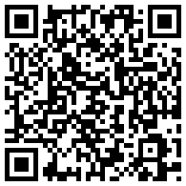
Using a QR Code
Attaching a QR “Quick Response” Code to your resume or cover letter
Link to your blogs
Link to your LinkedIn profile
Attach a URL in your Cover Letter
For your LinkedIn Profile
http://www.linkedin.com/pub/patrick-therrien/3a/a09/335
Notes:
Depending on the position that you are applying for, you may want to add a QR or “Quick Response” Code to your resume or cover letter. You can also add a URL to your LinkedIn profile or a blog that you are currently active in that pertains to your current field or industry. This technology, if used properly, can get you noticed and give the resume reviewer more information about you. This is why it is crucial to have a LinkedIn profile so that you can offer more information about yourself than a typical resume can give. This is the advantage that you are looking for. You want to stand out from your competition and this may be the tool that provides you that avenue.
Ok the question will come up, should I put a link to my Facebook Profile page on my resume? The answer is no! Facebook does not reflect our professional lives. That is what LinkedIn is for. You want to keep a distance between your Facebook profile and your professional profile. You still need to monitor what is on your Facebook page as we have discussed earlier in this module, but we are not going to link to it. If the employer searches for our name and stumbles across it, we still want it to be as professional as possible but we are not giving it up on our resume or cover letter.

Slide 22
Business Cards
Networking tool
Highlights:
Skills
Qualifications
Include:
Title
Areas of expertise
Years of experience
Contact information
Notes:
Business cards are essential when you are job searching and networking. Business cards give you the ability to network while you are running around just doing errands. Your business card will highlight the skills and qualifications you possess for the types of jobs you're targeting. You never know when you might run into someone who can help you in your network and in your search. Your job hunting business card provides all the information your network needs to initiate interest and open the door for future contact for you. You need to contact ALL of your connections in your network and give them several of your business cards and be encouraged to pass them out to potential employers or other contacts who can assist you in your search.
The information in your job hunter's business card should include a title (i.e. Patrick Therrien, Training Consultant), and any specific areas of expertise, including number of years of experience and/or relevant education and certifications.
Your job hunting business card should also include your contact information, such as a phone number and an e-mail address where they can reach you. If you are still employed I would not recommend using your work email address. You can get a free one from gmail.com, yahoo.com, or aol.com.
Finally, before handing out your business cards make sure that your resume, letters of reference, cover letter, and portfolio are all complete should an opportunity present itself.

