Slide 1


Lunch & Learn Webinar Series Community Resilience Partnership Round 7

Slide 2

Series Overview
Supports communities preparing for Community Action Grants
Highlight real-world CRP-funded projects from peer communities
Connect participants with state resources, tools, and technical support
Offers tips to help communities prepare strong grant applications

Slide 3

Series Schedule
March 25: Mobilizing Volunteers for Resilience Projects (video available)
April 1: Waste Diversion & Circular Economy
April 15: Flood Resilience & Vulnerability Assessments
April 29: Powering Resilient Communities
*New* May 11: Wildfire-Ready Communities: Trends, Planning, & Resources
Visit the CRP Website to Register and for Zoom Recordings

Slide 4
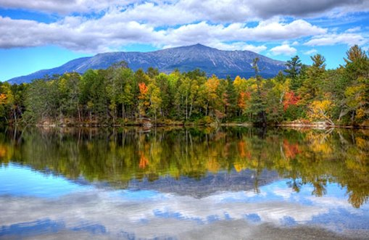
Round 7 Updates
Up to $5.25 million available in this grant round
Community Action Grants
Application Deadline: June 5, 2026, 5 P.M. EST
Service Provider Grants
Next Application Deadline: May 15, 2026, 5 P.M. EST
New opportunity!
Nature-based Design TA Opportunity
Application Deadline: June 19, 2026, 5 P.M. EST

Slide 5
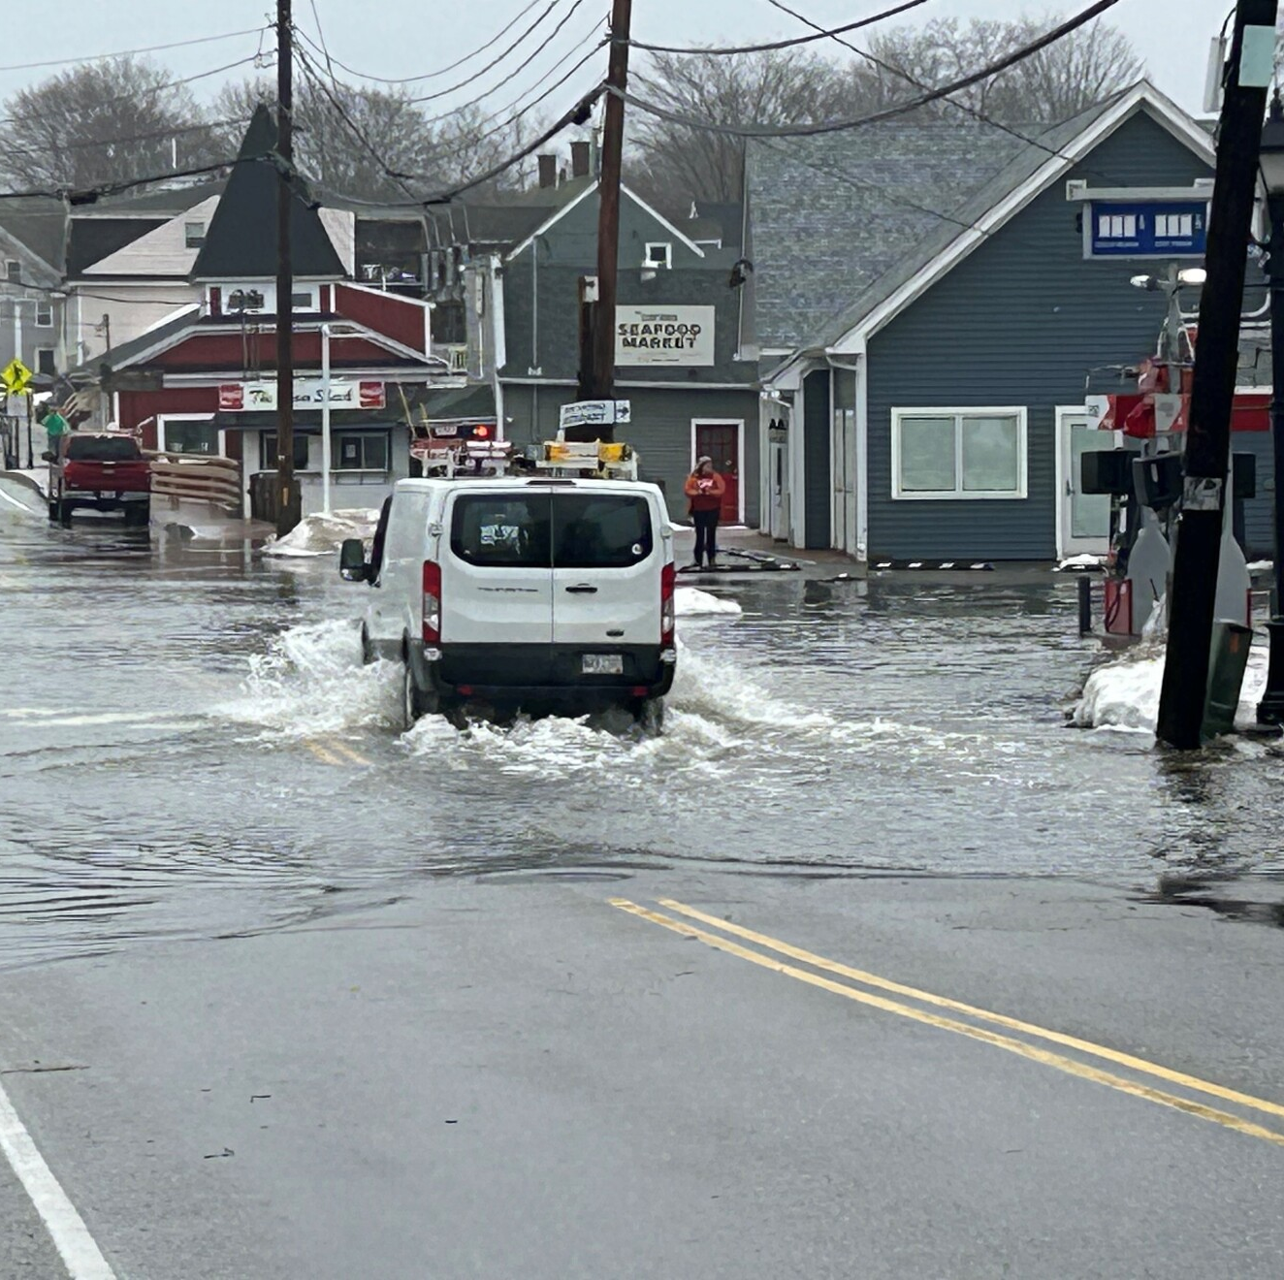
Speakers: Community Vulnerability Assessments and Flood Resilience
Gretchen Anderson, Sustainability Program Coordinator and Sara Mills-Knapp, Director of Sustainability, Greater Portland Council of Governments
Paul Styslinger, Natural Hazards Planner, Maine Emergency Management Agency
Sue Baker, Program Coordinator, Floodplain Management Program

Slide 6
Webinar Reminders
Please remain muted during the presentations
Use the Q&A box to submit questions throughout the session
We’ll address questions during the Q&A portion at the end
This webinar is being recorded and will be shared with participants afterward

Slide 7
Speakers: Community Vulnerability Assessments and Flood Resilience
Gretchen Anderson, Sustainability Program Coordinator and Sara Mills-Knapp, Director of Sustainability, Greater Portland Council of Governments

Slide 8
GPCOG Vulnerability Assessments
CRP Lunch and Learn
April 15, 2026

Slide 9
Agenda
Background: How does GPCOG approach the project
Process: What resources are we assessing and how are we doing it
Results: What are example outputs
Input: What are residents saying
Actions: Recommendations for moving forward
Background
Process
Results
Input
Actions

Slide 10
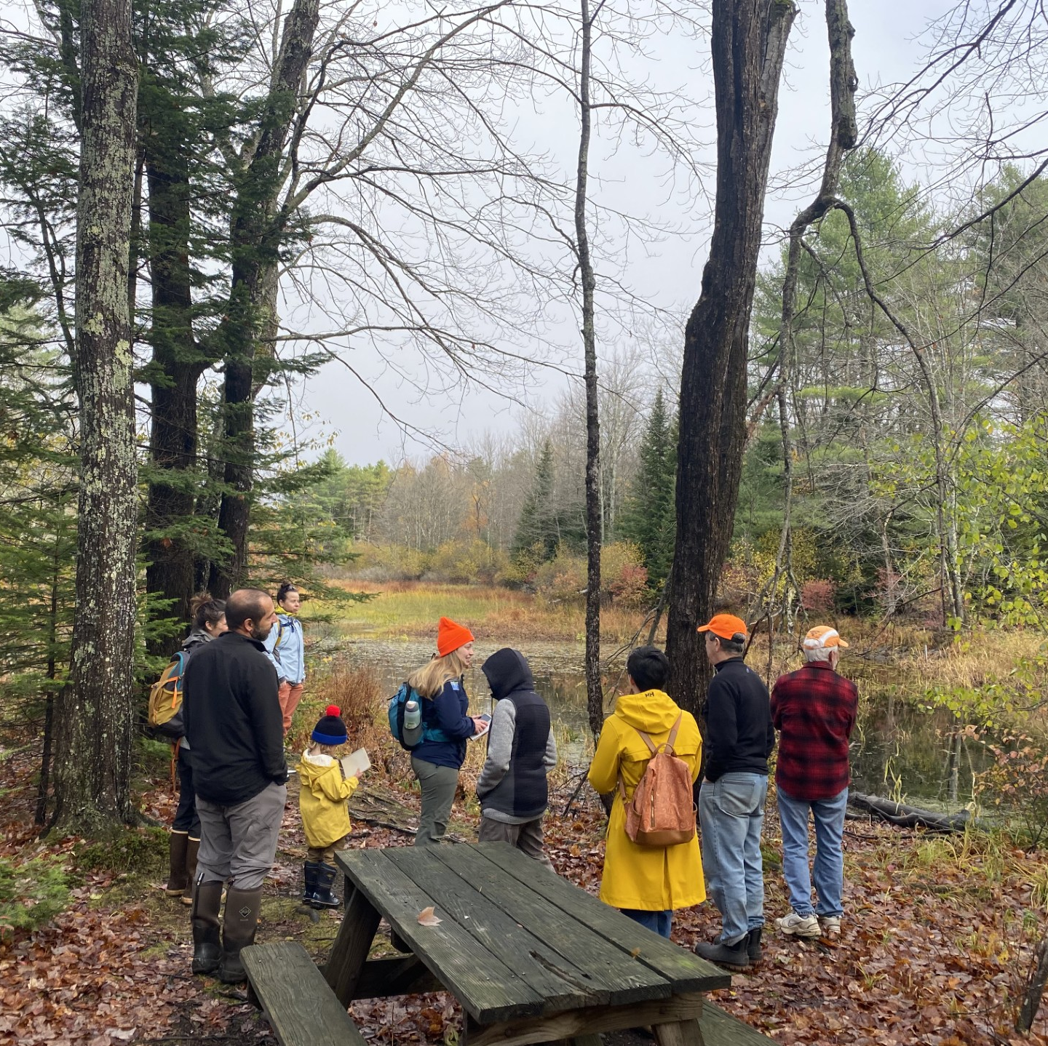
Reminder!
This reflects GPCOG’s approach to vulnerability assessments.
There are many valid ways to structure depending on community needs, capacity, and goals.

Slide 11
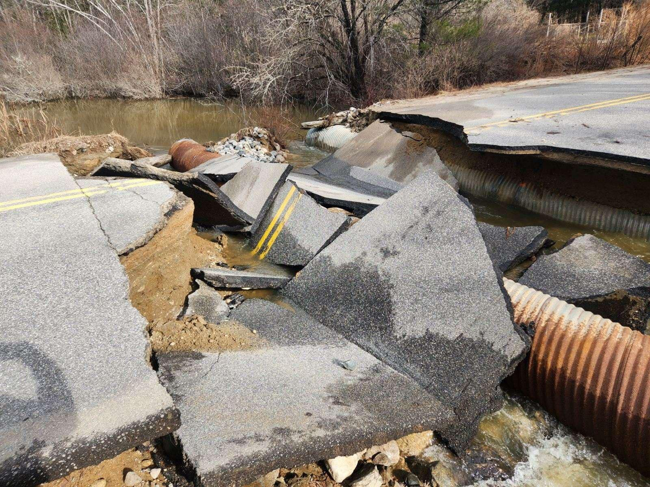
Climate Vulnerability Assessment Objective
Assess areas most at risk of impacts from climate hazards
Identify resources which need additional research or assessment
Prioritize areas of action (funding, resources, time, capacity)
Build resilience
Background
Process
Results
Input
Actions

Slide 12
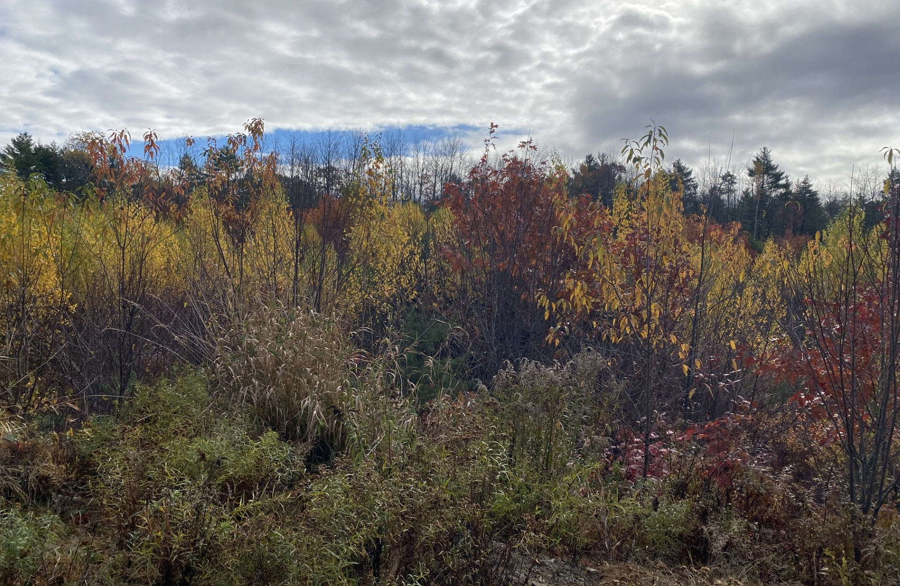
Climate Vulnerability Assessment GPCOG Approach
Data driven
Community engagement light
Technical report
Organized by resource type to highlight connective and cumulative impacts across hazards
Follows existing process we developed during climate action planning
Living document
Background
Process
Results
Input
Actions
Notes:
There are different approaches to vulnerability assessments

Slide 13
Climate Vulnerability Assessment Project Overview
Data Collection
Mapping and Analysis
Recommendations
and Reporting
Community and Municipal Engagement
Grant Assistance
Background
Process
Results
Input
Actions
Notes:
There are different approaches to vulnerability assessments

Slide 14
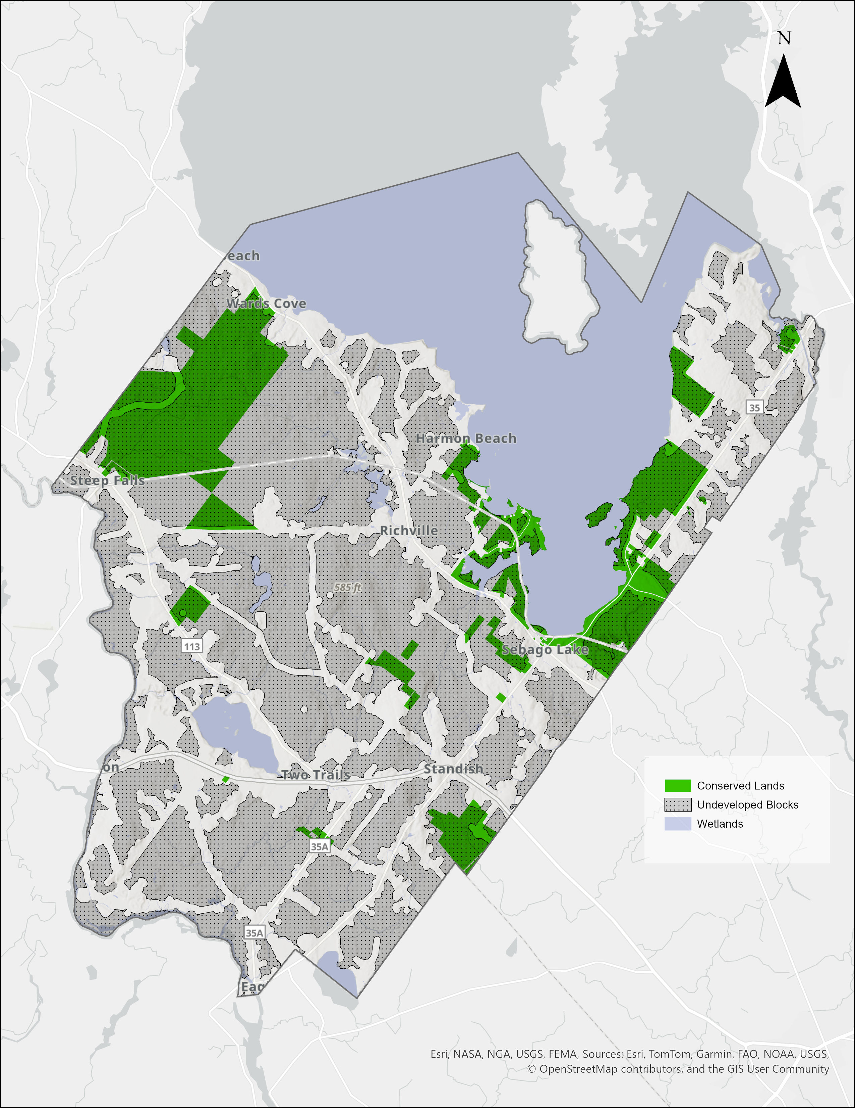
Outline and Content
Climate hazards
Broad and regional in focus
Municipal specific resources and impacts
Infrastructure, Community Resources, People, Natural Resources
Explain why a resource is relevant to climate change
Town specific impacts (as available)
Recommendations
Broad in scope
Developed with staff input
Start to prioritize (low – medium – high)
Incorporate public feedback, where available
Background
Process
Results
Input
Actions

Slide 15




Resources Analyzed
Infrastructure |  | Natural Resources |  | Community Resources |  | People
Transportation |  | Ecosystems |  | Economy |  | Demographics
Buildings |  | Open Space and Conserved Lands |  | Essential Services |  | Socioeconomic
Water Utilities |  | Water Resources |  | Social Services |  | Housing
Power and Communications |  | Erosion |  | Agriculture and Food Systems |  | Public Health
 |  | Land Use, Forests, Carbon Sinks |  | Trails, Parks and Recreation
 |  | Tidal Marshes |  | Archeological and Historic Sites
Background
Process
Results
Input
Actions

Slide 16
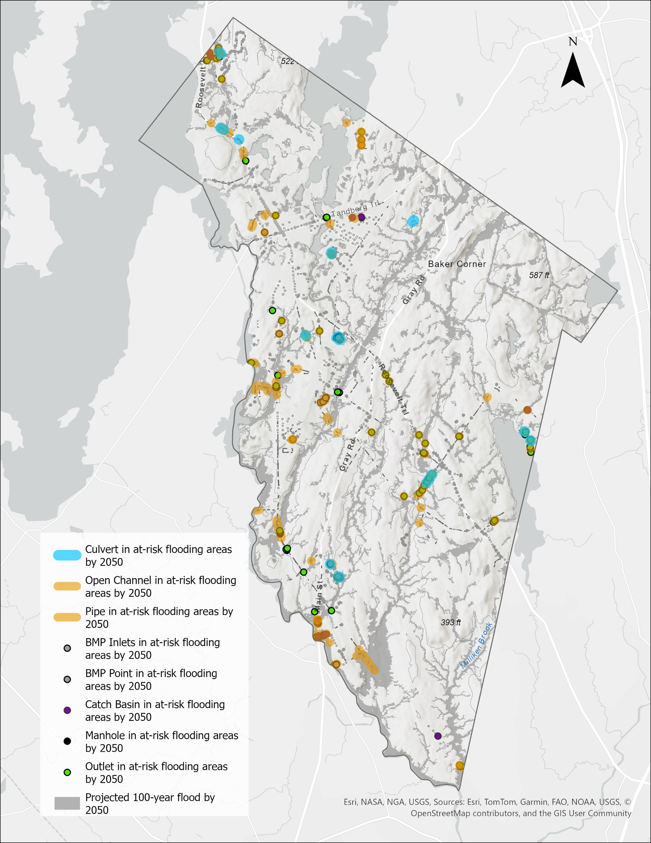
Data
Regional, state, national
First Street Foundation – Flood Factor (vs FEMA)
MGS – Sea level rise
Beginning with Habitat
Maine Climate Change Institute
EPA
Municipal
Available GIS layers from municipality
Surveys and community engagement
Local organizations
Background
Process
Results
Input
Actions

Slide 17
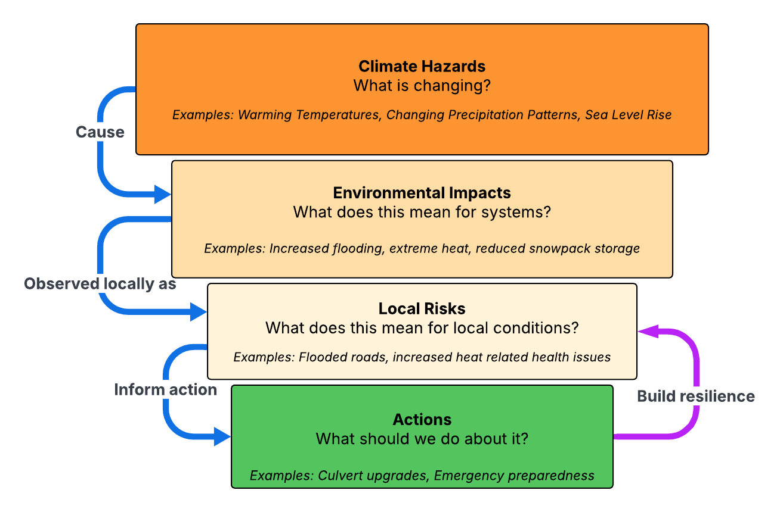




Process
Background
Process
Results
Input
Actions

Slide 18
What this looks like
Resource
Hazard
Impacts
Local Risks
Actions
Warming Temperatures
Changing Precipitation
Develop an alternative access route plan for emergency services during flood events, in coordination with MaineDOT and regional partners
Shortens lifespan, increases cost of repairs, inundated with water, limits access
Bridgton: 8 miles in at-risk areas
Roadways
Warming Temperatures
Changing Precipitation
Lower dissolved oxygen levels, fosters algal blooms, increased stormwater runoff
Windham: No impaired waterways.
Highland Lake = “MS4 Priority Water, Watch List, Sensitive”
Restore riparian buffers using native vegetation consistent with Maine’s Shoreland Zoning and DEP permitting
Waterways
Background
Process
Results
Input
Actions

Slide 19
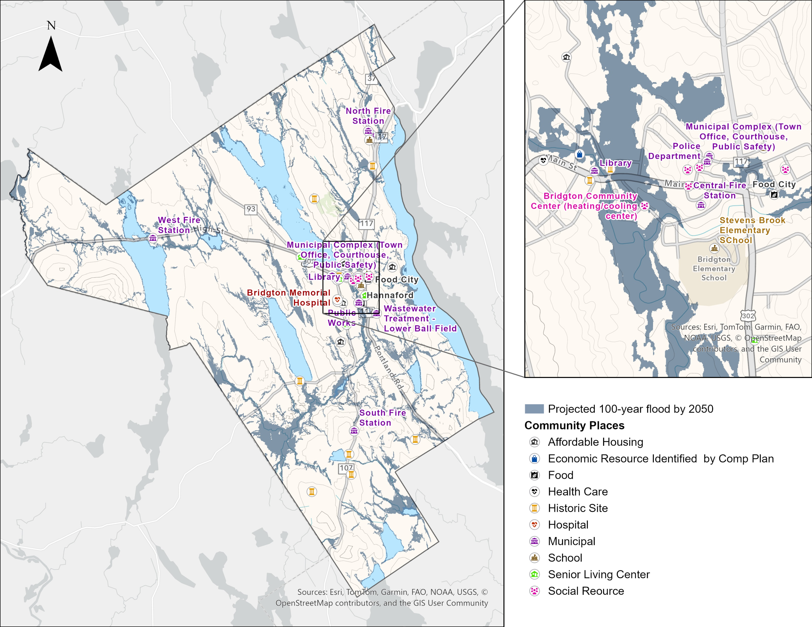
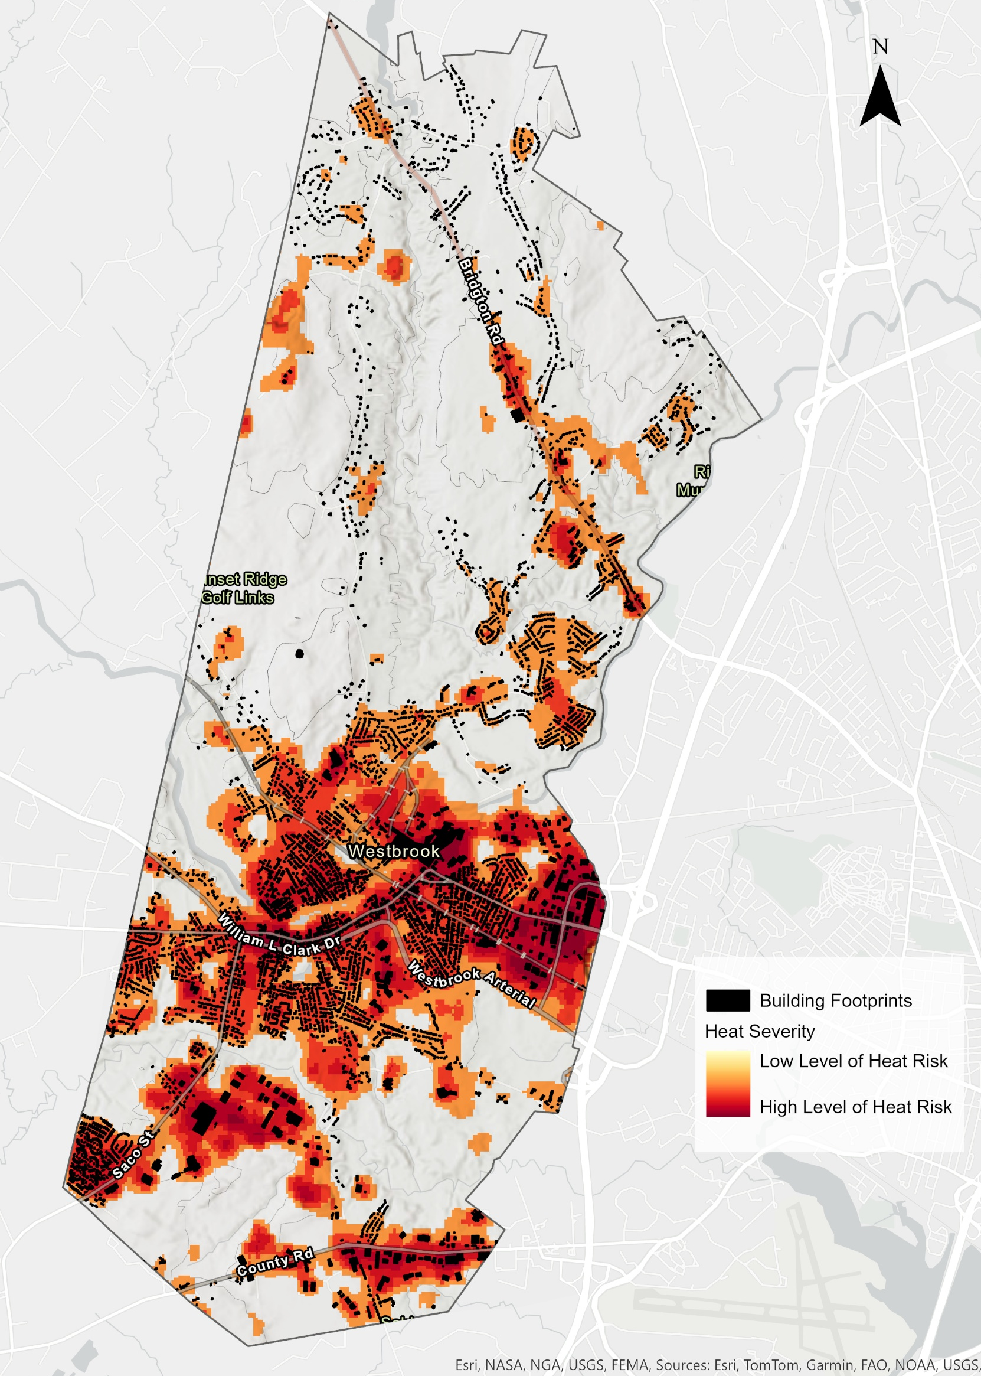
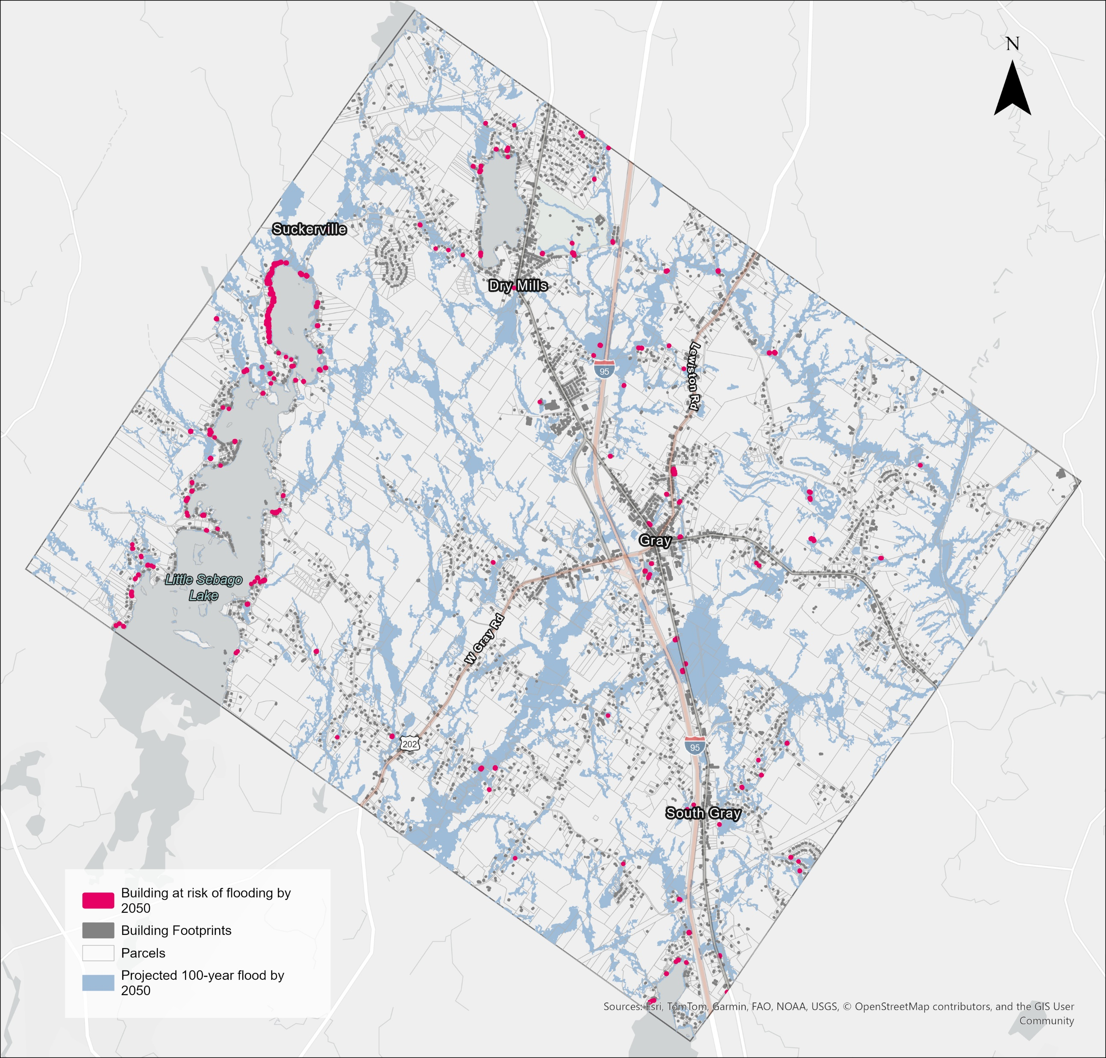
Results and Output
Building impacts in Gray
Community Services in Bridgton
Heat Severity in Westbrook
Background
Process
Results
Input
Actions

Slide 20
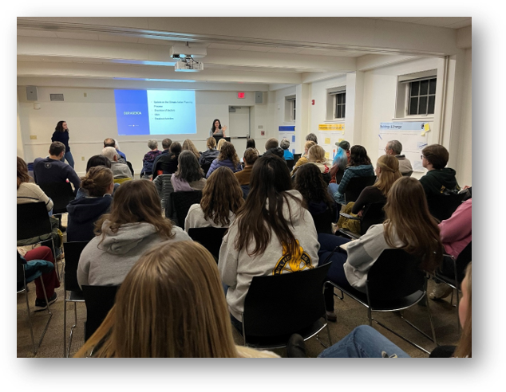
Public Input
Desire for community input (and how to get input) varies by community
Scale-able based on grant and community needs
Surveys
Public workshops
Staff interviews
Stakeholder groups
Pop-ups
Background
Process
Results
Input
Actions

Slide 21
Public Input
Adjust language to match town’s priorities
Public input is strongest when advertised and encouraged through town and local channels
Most respondents want municipalities to take action to address climate change
There is often a vocal contingent that expresses economic concern or distrust of the changing climate​
Background
Process
Results
Input
Actions

Slide 22
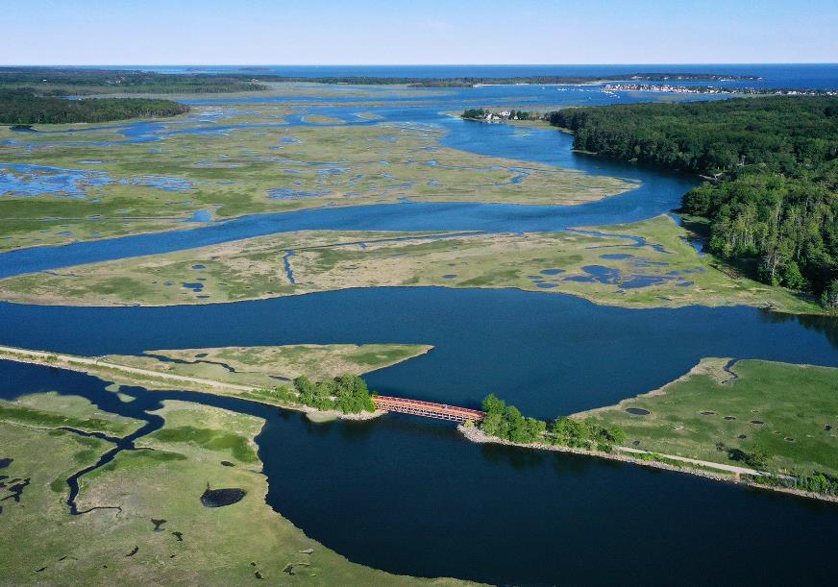
Actions and Recommendations What is GPCOG doing?
Applying for regional grants
Conducting system-wide transportation vulnerability assessment
Developing templates for municipal use
Continue building connections and partnerships externally
Background
Process
Results
Input
Actions

Slide 23
Thank you!

Slide 24
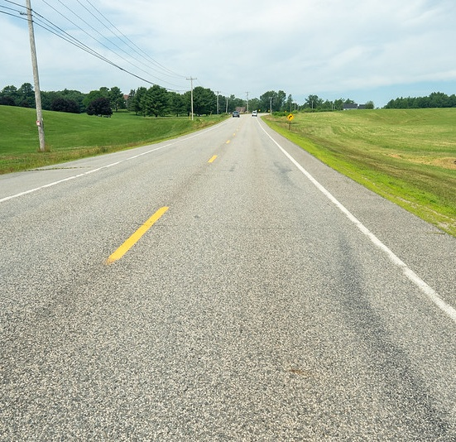
Impacts & Priorities
1
At-risk infrastructure Damage to roads and property, restricted access
Background
Process
Results
Input
Actions

Slide 25
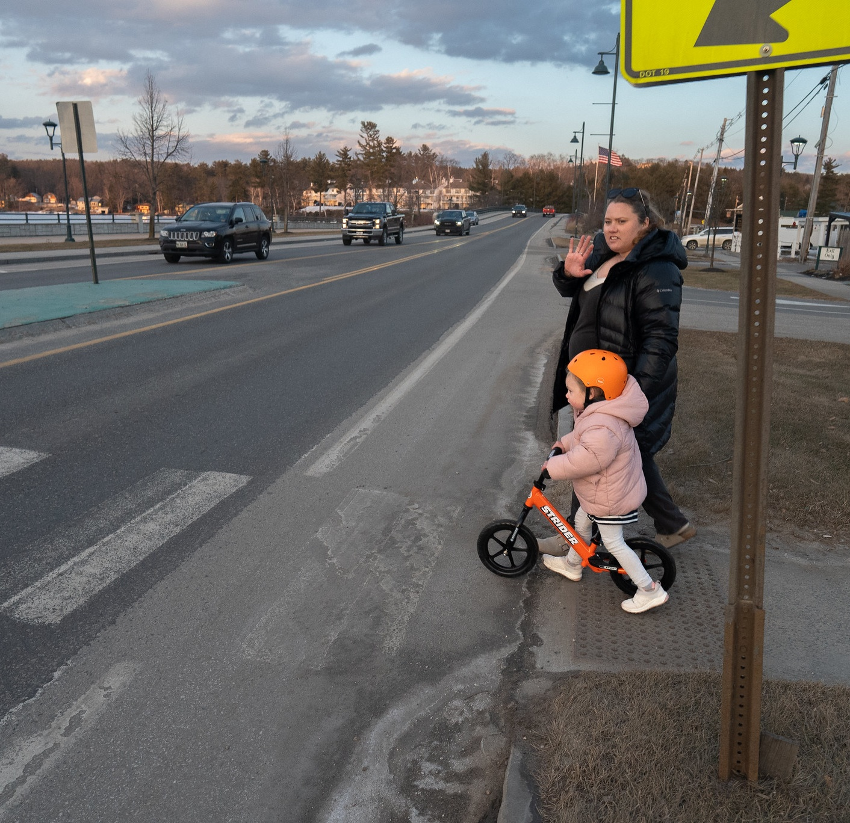
Impacts & Priorities
2
Community Resilience Emergency communication and vulnerable populations
Background
Process
Results
Input
Actions

Slide 26
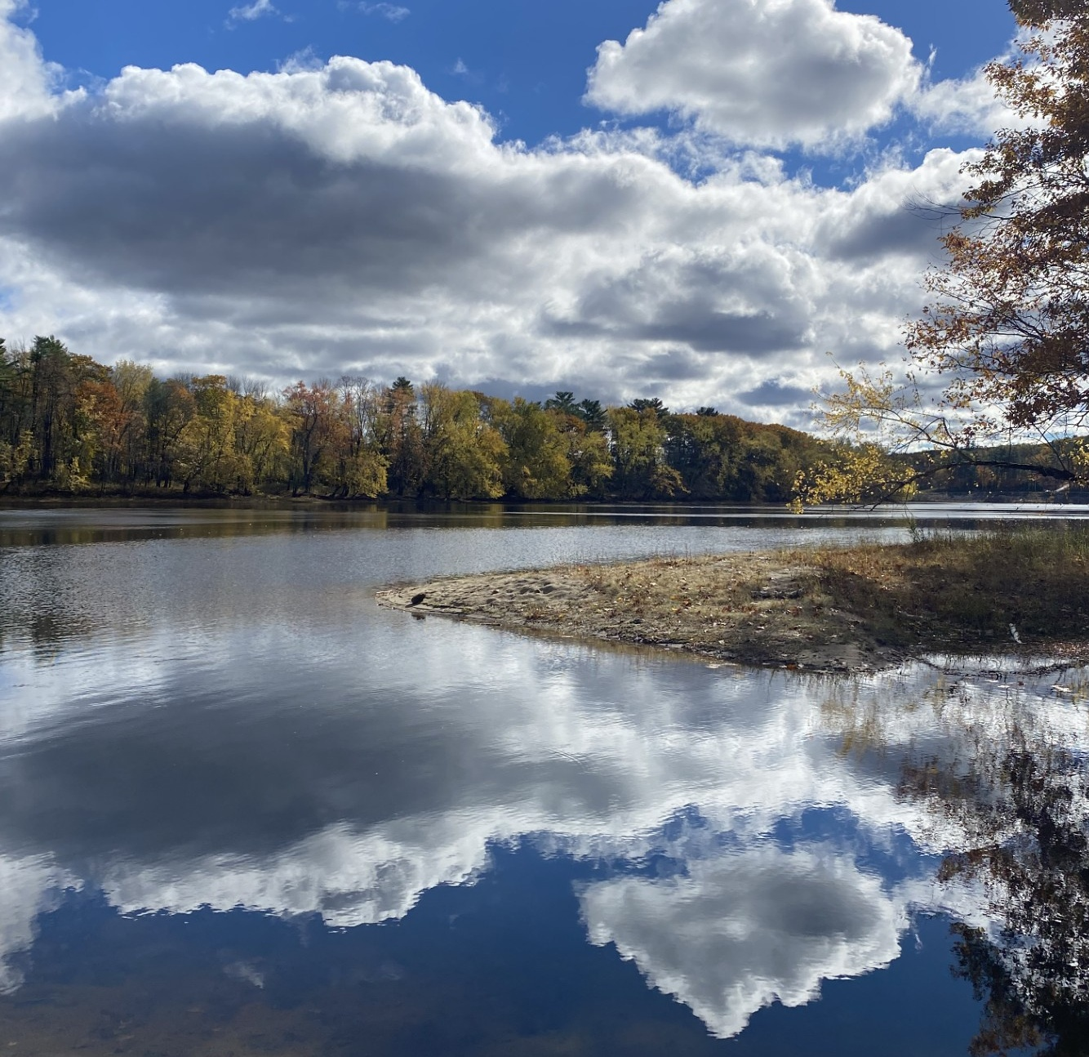
Impacts & Priorities
3
Ecosystem Impacts Conserve land and protect natural resources, especially water resources
Background
Process
Results
Input
Actions

Slide 27
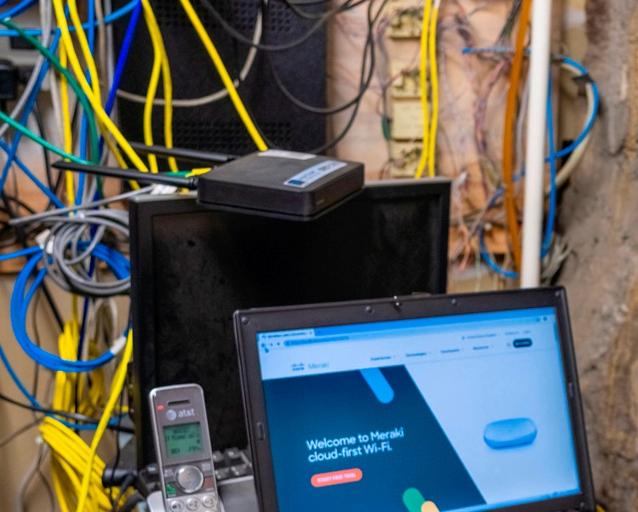
Public Input
Environmental issues of greatest concern
Natural resource pollution
Habitat loss or deforestation
Higher energy costs or strain on the electricity grid
Groundwater contamination
Invasive species
Background
Process
Results
Input
Actions
Notes:
Town specific areas: waste management in Windham
Limited property impacts and concerns

Slide 28
Actions and Recommendations
Transportation:
Complete and maintain a full culvert inventory to assess capacity level and potential for upgrades
Natural Resources:
Ensure zoning ordinances, specifically those along waterways, are enforced and strengthened to protect against erosion
Community Services:
Consider developing climate resilient landscaping management practices at city-owned recreational facilities
People:
Connect with and support organizations that assist vulnerable populations (e.g. food pantries, schools, general assistance)
*Education and outreach strategies across all areas*
Background
Process
Results
Input
Actions

Slide 29
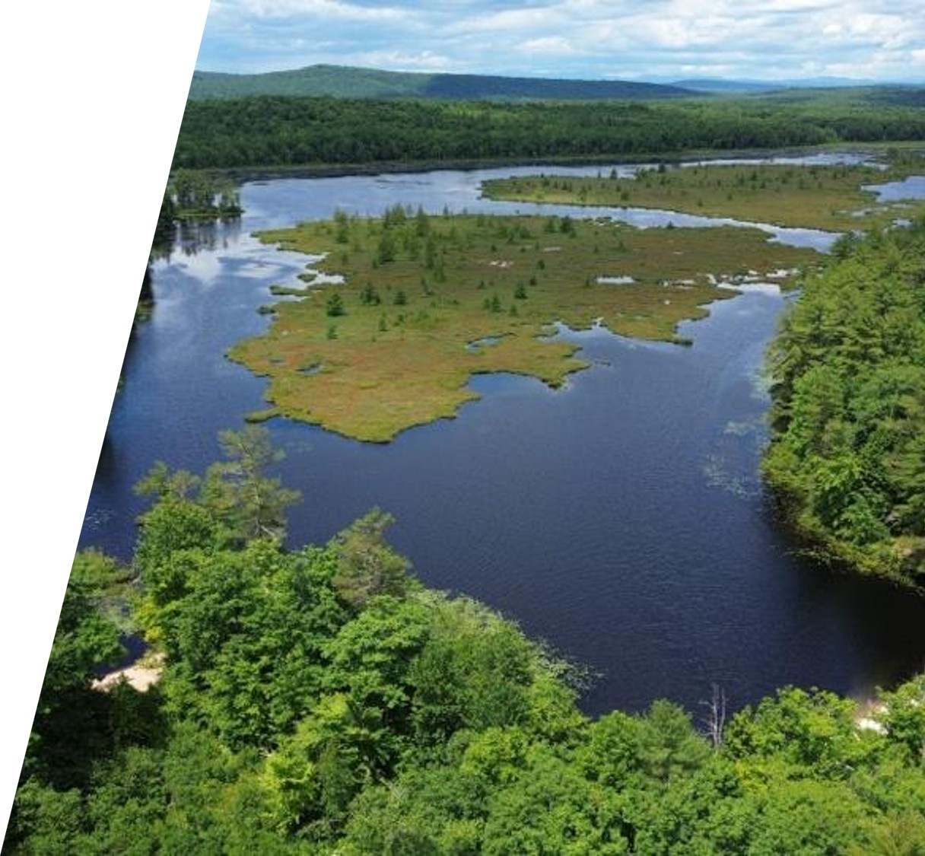
Regional Differences Inland vs Coastal
Infrastructure at greatest risk
Less competing interests in rural communities
Lack of public infrastructure shifts the focus to community response
Greater interest in emergency response with community connections
Framing differs based on priorities and values
Background
Process
Results
Input
Actions

Slide 30
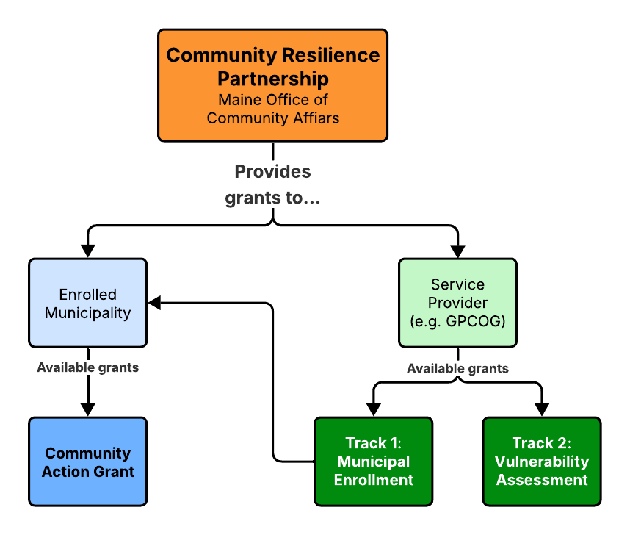

Actions and Recommendations What can municipalities do?
Apply for upcoming state grants (CAG, MIAF)
Build partnerships
Education and outreach
Connect values and priorities across departments
Background
Process
Results
Input
Actions
Notes:
Example:
Windham and New Gloucester – future funding grant round
Durham Energy Project - connects economic development with values around open space and agriculture while leveraging new emerging technologies in batteries and renewable energy

Slide 31
Speakers: Community Vulnerability Assessments and Flood Resilience
Paul Styslinger, Natural Hazards Planner, Maine Emergency Management Agency

Slide 32
Resilience and Community Vulnerability Assessments
Best Practices from MEMA
Paul Styslinger
Natural Hazards Planner

Slide 33
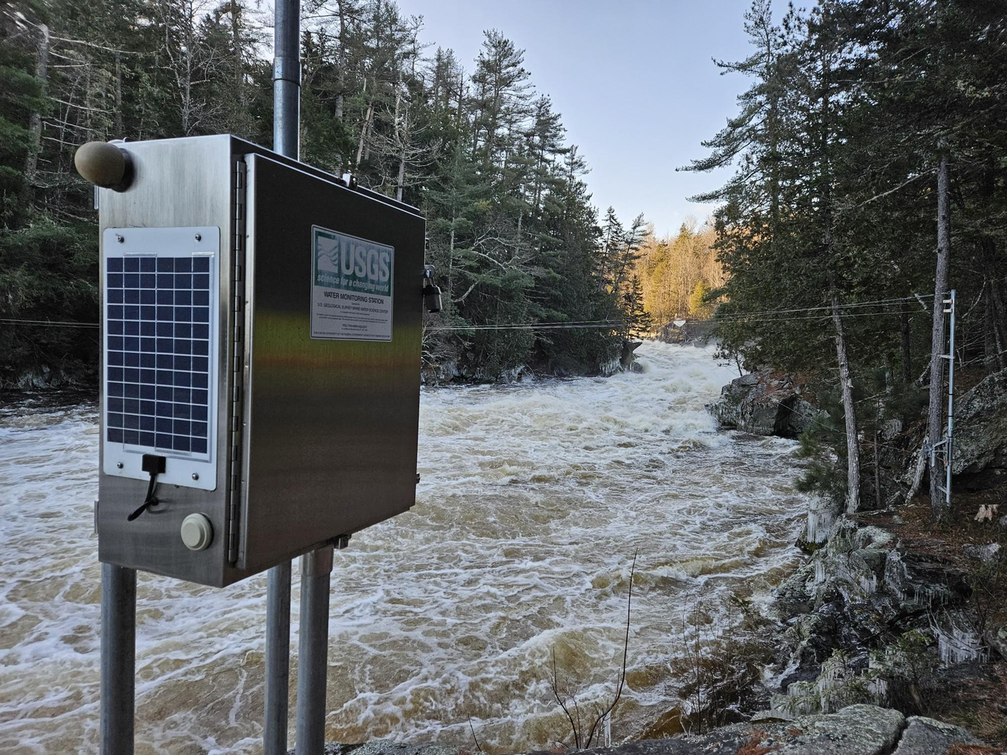
About MEMA (Natural Hazards)
State coordinator for hazard mitigation planning (all 16 counties)
Assist with FEMA Mitigation & Recovery Funding
Update State Hazard Mitigation Plan as well as County and local plans
Help manage Maine’s streamgage network, coastal flood monitoring network, the River Flow Advisory Commission, Drought Task Force, Cooperative Snow Survey, and similar initiatives

Slide 34
Key Takeaways
MEMA would love to provide data and technical resources to support any funded mitigation project – just ask!
With a few best practices, you can use CRP (or other) funded mitigation/vulnerability assessment projects to set your jurisdiction(s) up for other state and federal funding

Slide 35
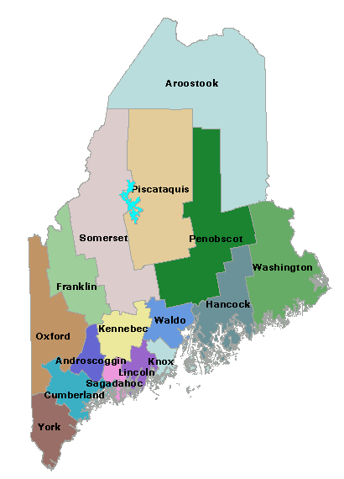
Best Practice #1: Join Forces
Regional partnerships are the best way to address regional problems – and CRP incentivizes this!
Engage with County EMAs, who may have done substantial work for you already
Consider adopting an existing county plan

Slide 36
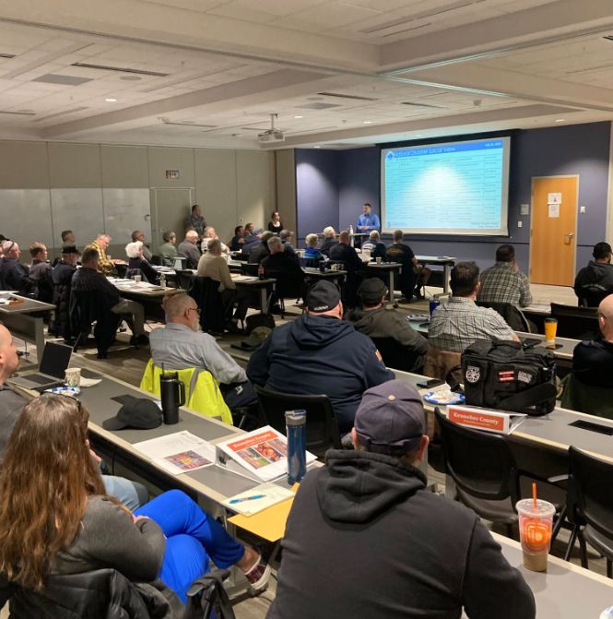
Best Practice #2: Maximize Gatherings
Getting stakeholders together is the hardest part. Make the most of it!
Full hazard assessment, Emergency Operations Plans, and THIRA assessments can all be updated in tandem if done correctly
CRP funds everything from smaller committees to full plans
Same applies to passing resolutions (easier to do just once)

Slide 37
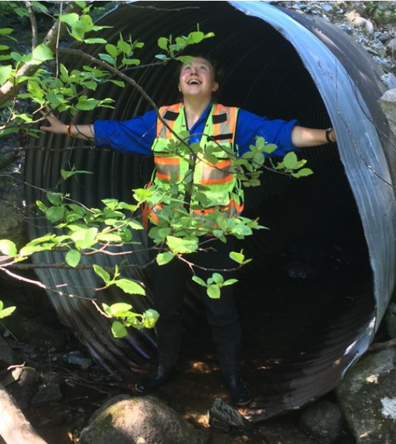
Best Practice #3: If the Funding Fits…
FEMA funding is uncertain at best, and requires lots of planning and compliance capacity, but can be great for specific projects if available
BRIC now focused on shovel-ready capital projects (no longer funds planning or more general work)
CRP funding is the best avenue today for foundational planning work, among many other categories
Also see MaineDOT’s MIAF program (now open) for shovel-ready infrastructure projects, along with Maine Office of Community Affairs’ Funding Finder

Slide 38
Best Practice #4: Leverage Existing Resources
For example…
Maine State Hazard Mitigation Plan
County/Tribal Mitigation Plans
FEMA’s National Risk Index + RAPT
Maine Dry Well Survey
Maine Risk Map
Maine Climate Vulnerability Assessment
Maine Floodplain Management Model
Online Risk Data Hub
Maine Flood Resilience Checklist
Living Shorelines
Maine Coastal Bluff Erosion Maps
Maine Hurricane Evacuation Study
NOAA Digital Coast
…and many more!
Contact paul.styslinger@maine.gov
Starting from scratch should be rare
County/Tribal Hazard Mitigation Plans, State Hazard Mitigation Plans, the upcoming Climate Vulnerability Assessment, and many other documents are great starting points
Contact me! It is my job to connect you to resources. Paul.Styslinger@maine.gov

Slide 39
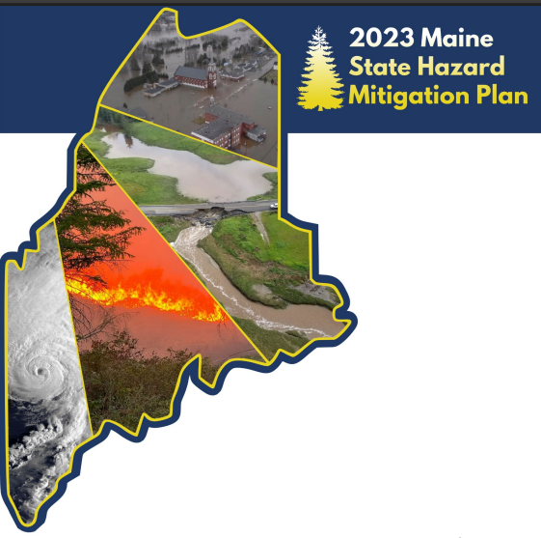
Best Practice #5: Prepare for Plan Updates
Update plans annually and alongside similar work.
Keep the threshold low. A solid plan is a good baseline that can serve for years to come, with low-lift revisions.
Document new projects and project status updates.
Think (and write) about how to “improve” the plan, not just “maintain” or “continue” it

Slide 40
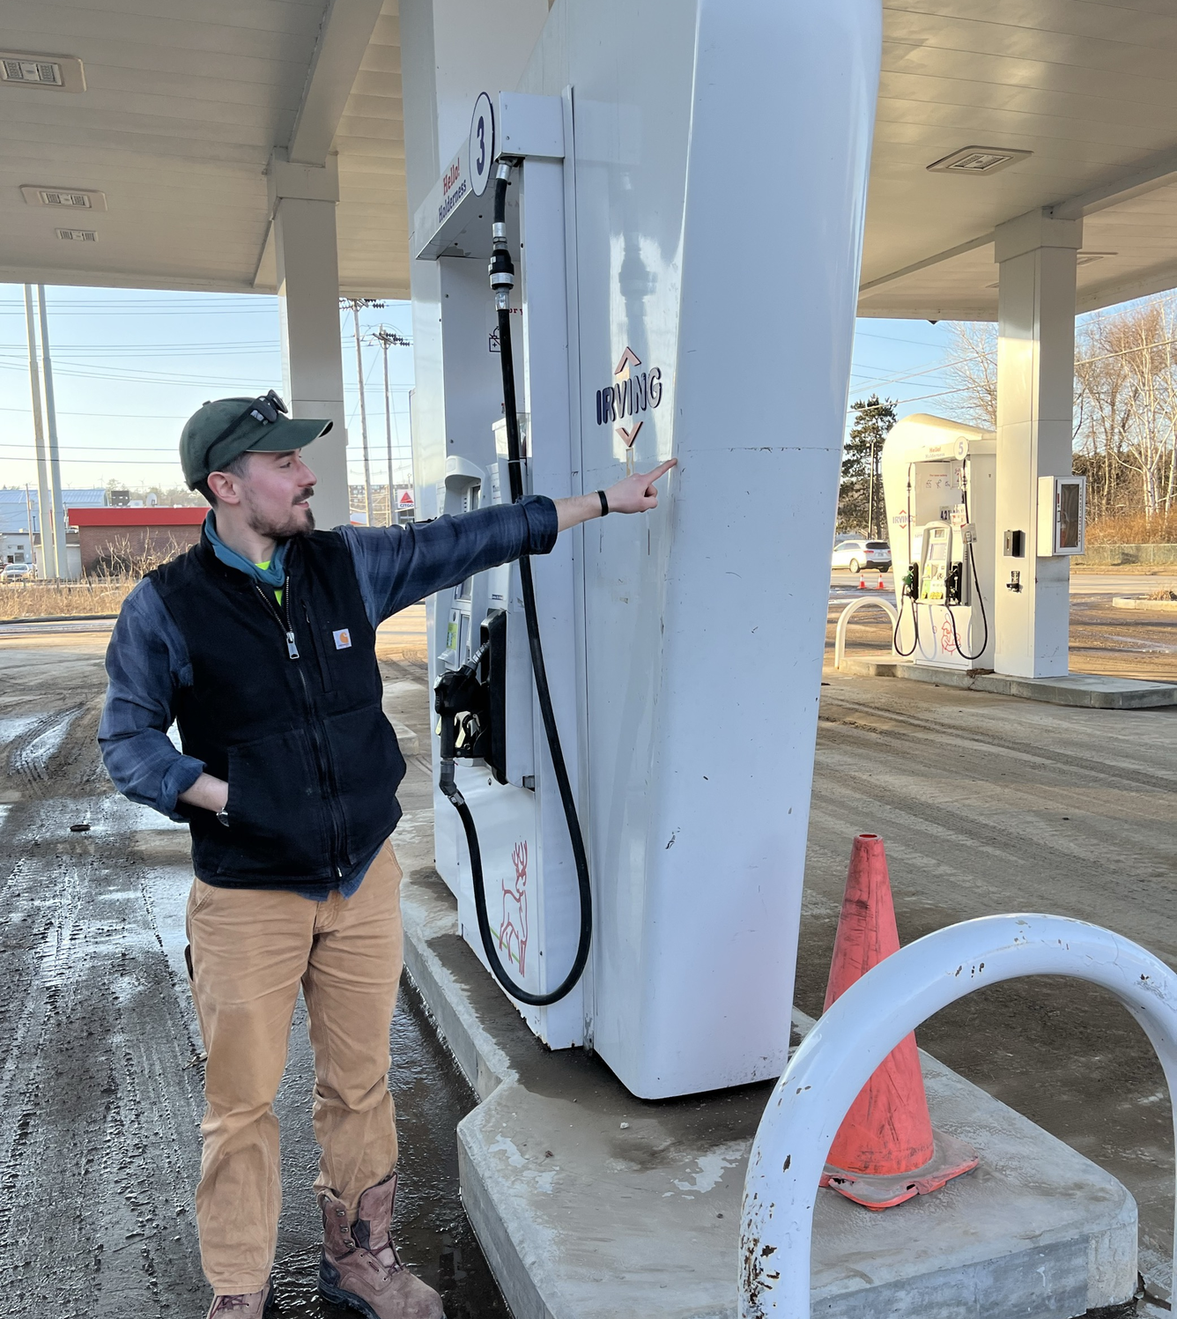
Best Practice #6: Community Stories = Valuable Data
Supplement technical tools with community stories and local knowledge
Prioritize collection of these during vulnerability assessments (and updates)
This is critical for improving real-life scientific models

Slide 41
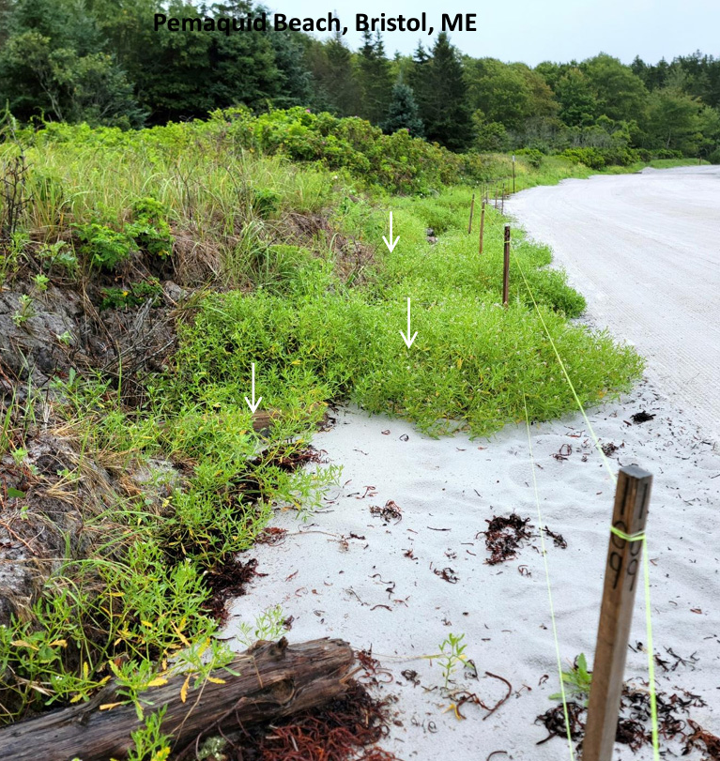
Best Practice #7: Don’t Miss These Mitigation Actions
FEMA-approved Hazard Mitigation Plans require a “comprehensive analysis” of potential solutions, defined by five categories: property protection, land use planning/codes, natural systems protection, structural projects, and education/awareness programs.
In other words: don’t default to just structural solutions

Slide 42
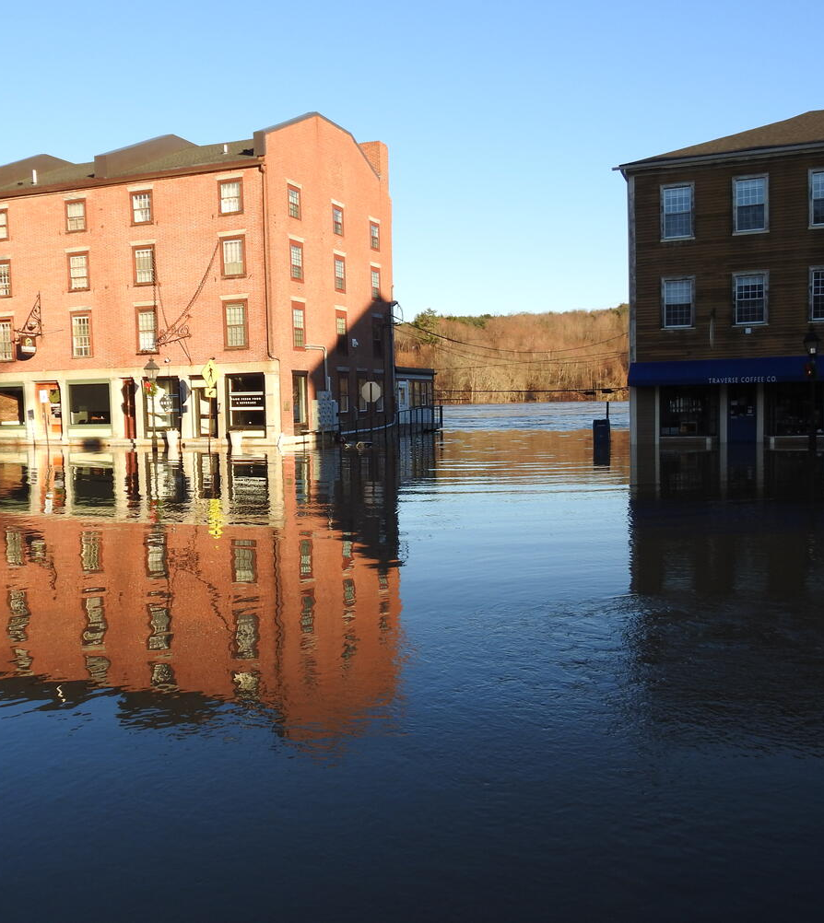
Best Practice #8: Invite Everyone (Directly)
FEMA-approved Hazard Mitigation Plans require you to invite representatives from the following stakeholder groups, at a minimum: local/regional agencies, development regulatory agencies, neighboring communities, businesses/academia, and nonprofits
Don’t just do a Facebook post inviting those who happen to be following your page. Make a list and reach out directly via email.

Slide 43
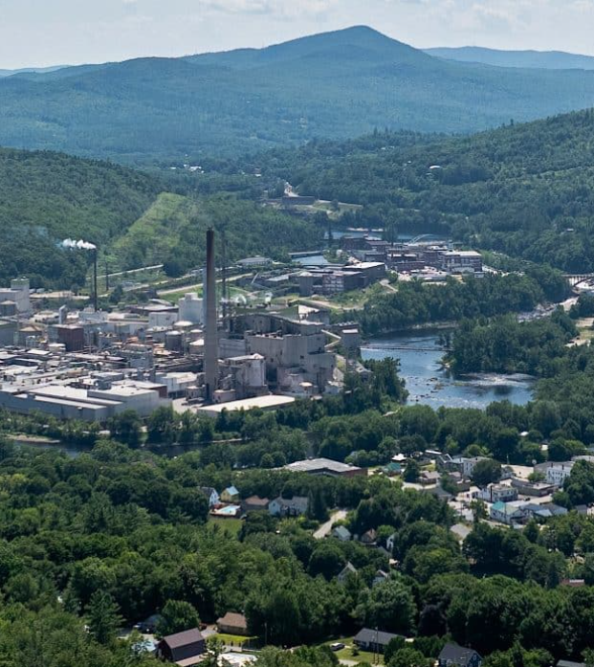
Best Practice #9: Engage Special Districts
Special districts (sewer, water, utility, schools, etc.) are now viewed by FEMA as their own jurisdictions for mitigation planning.
They can no longer apply under a town/city/tribal government umbrella and do not automatically fall under county plans.
Invite them to participate as well!

Slide 44
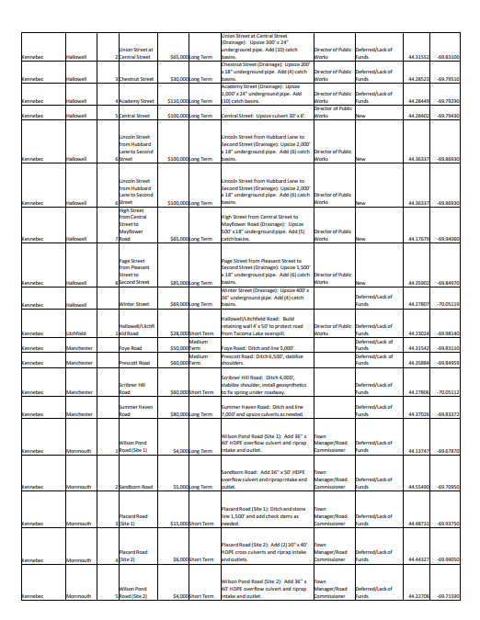
Best Practice #10: Document Everything
…but make it easy on yourself!
Record virtual calls, set up sign-in sheets, and sort emails in a folder for later use and future grant cycles.
Build a digital paper trail that proves you did the work well, and you will be able to leave those County Hazard Mitigation Planning meetings early :)

Slide 45
Thank You!
MEMA would love to provide data and technical resources to support any funded mitigation project – just ask!
With a few best practices, you can use CRP (or other) funded mitigation/vulnerability assessment projects to set your jurisdiction(s) up for other state and federal funding

Slide 46
Speakers: Community Vulnerability Assessments and Flood Resilience
Sue Baker, Program Coordinator Floodplain Management Program

Slide 47


National Flood Insurance Program (NFIP) & Flood Mitigation Resources
Sue Baker, CFM State NFIP Coordinator Floodplain Management Program

Slide 48
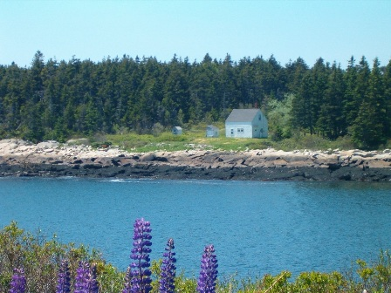
NFIP Overview
Flood Insurance Rate Maps
FEMA maps 1% annual chance
Zone A and V
Foundation for local permitting
Regulations
Via local ordinance adoption (land use)
Minimum standards for floodplain development
Flood Insurance
Federally backed
Can be purchased in participating communities
It can be found in private market. Not priced the same.

Slide 49

There are NO future conditions included in the NFIP regulations or on FEMA flood maps!
How can we be more flood resilient?

Slide 50
Community Resilience Partnership (CRP) Actions
F10: Participate in the National Flood Insurance Program (NFIP)

Slide 51
Benefits of Participation in the NFIP
Federally backed flood insurance availability.
Flood Insurance is mandatory as a condition of federally backed financing (mortgage/equity loan).
Mandatory for some grants and low interest loans.
Eligibility for hazard mitigation grant funding (through MEMA).
Cost to Administer NFIP: Only the time it takes to administer and enforce the local FPM ordinance.
Presidentially declared disaster, access to additional forms of disaster assistance.

Slide 52
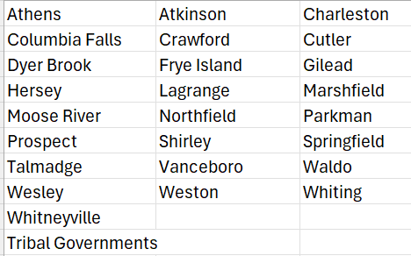
Participation in the NFIP
98% of Maine Communities participate in the NFIP. LUPC participates on behalf of all the unorganized territories.
NON-PARTICIPATING
Notes:
Program does a mailing every 3 years to all non-participating communities.

Slide 53
CRP Actions B12: Support regular professional development training for code officers
Floodplain management is under Land Use certification.
Critical to understanding the requirements of the Program
We provide training to local code officials.
ASFPM www.floods.org
FEMA National Disaster & Emergency Management University (NDEMU) Classroom Courses https://www.fema.gov/floodplain-management/training/courses.

Slide 54
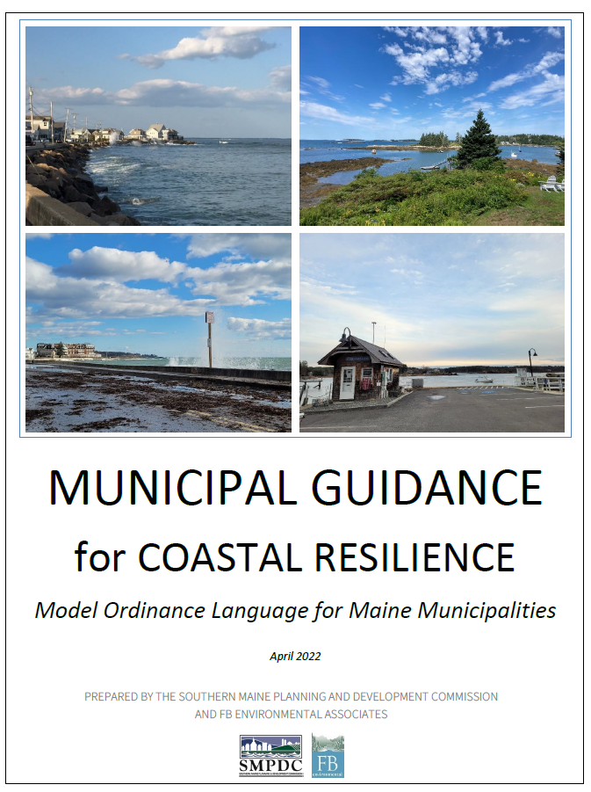
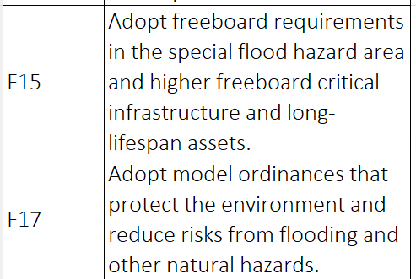
CRP Actions

Slide 55
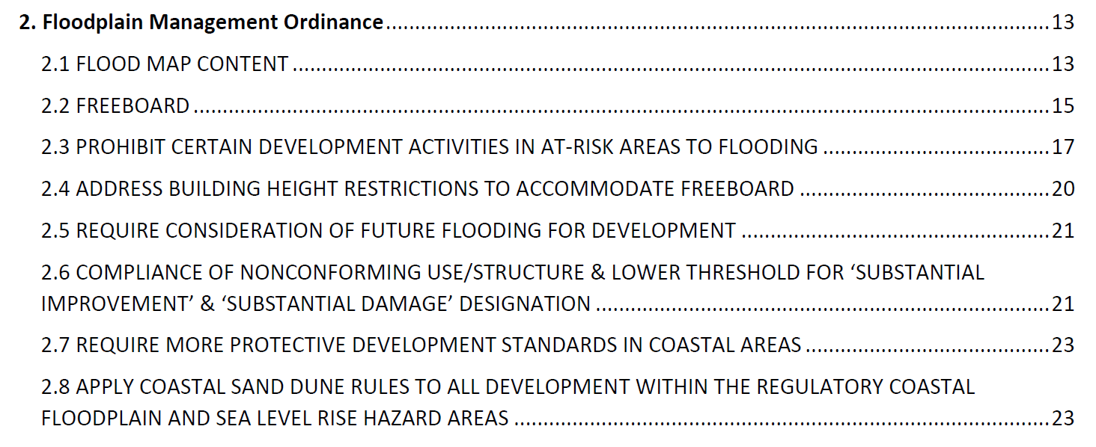
Municipal Guide for Coastal Resilience (SMPDC)
Shoreland Zoning – Subdivision & Site Plan Review - Zoning

Slide 56
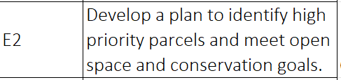
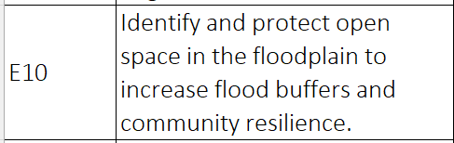
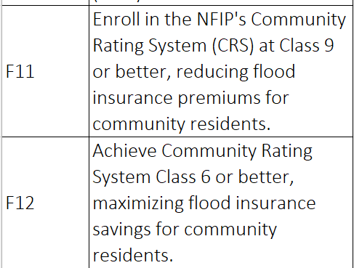
CRP Actions Related to Community Rating System (CRS)
Pause on CRS
Contract with FEMA’s service provider, Verisk has lapsed.
Future will depend on Federal Administration priorities.
Put on this on the back burner for now.

Slide 57
Two Online Mapping Resources Available to All
Maine Floodplain Management Program’s Flood Hazard Map Application http://www.maine.gov/dacf/flood/mapping.shtml
FEMA’s Map Service Center https://msc.fema.gov/portal

Slide 58
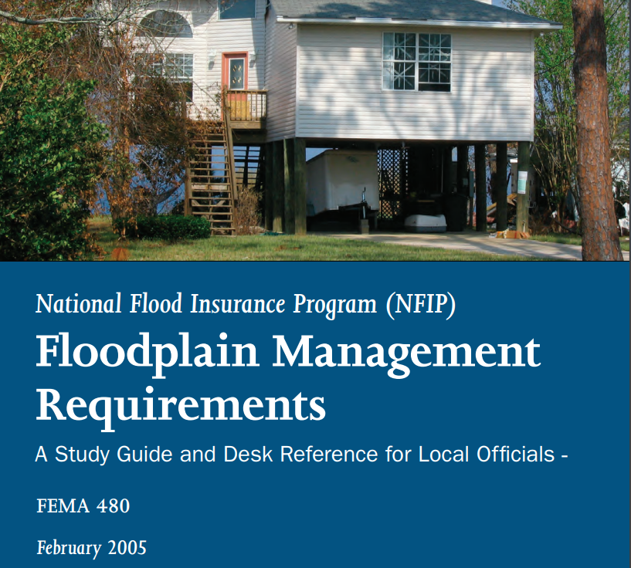
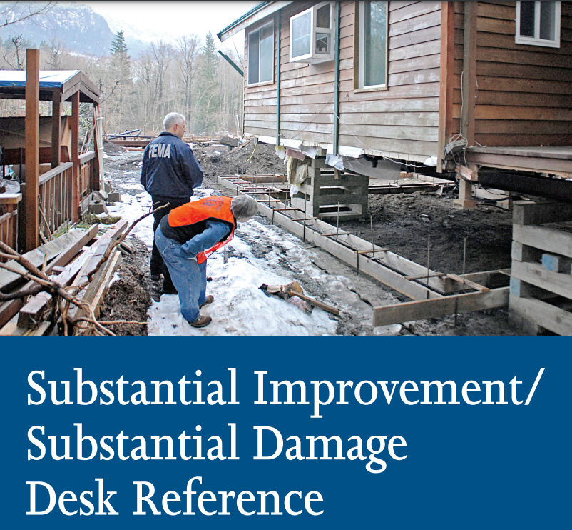
FEMA PUBLICATIONS
https://www.fema.gov/sites/default/files/documents/fema-480_floodplain-management-study-guide_local-officials.pdf
https://www.fema.gov/sites/default/files/2020-08/fema_p_758_complete_r3_0.pdf

Slide 59
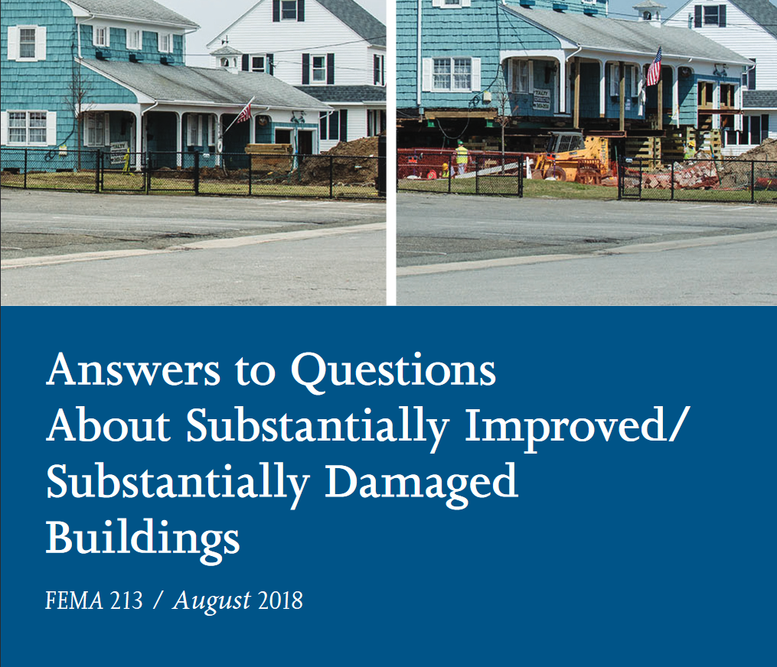
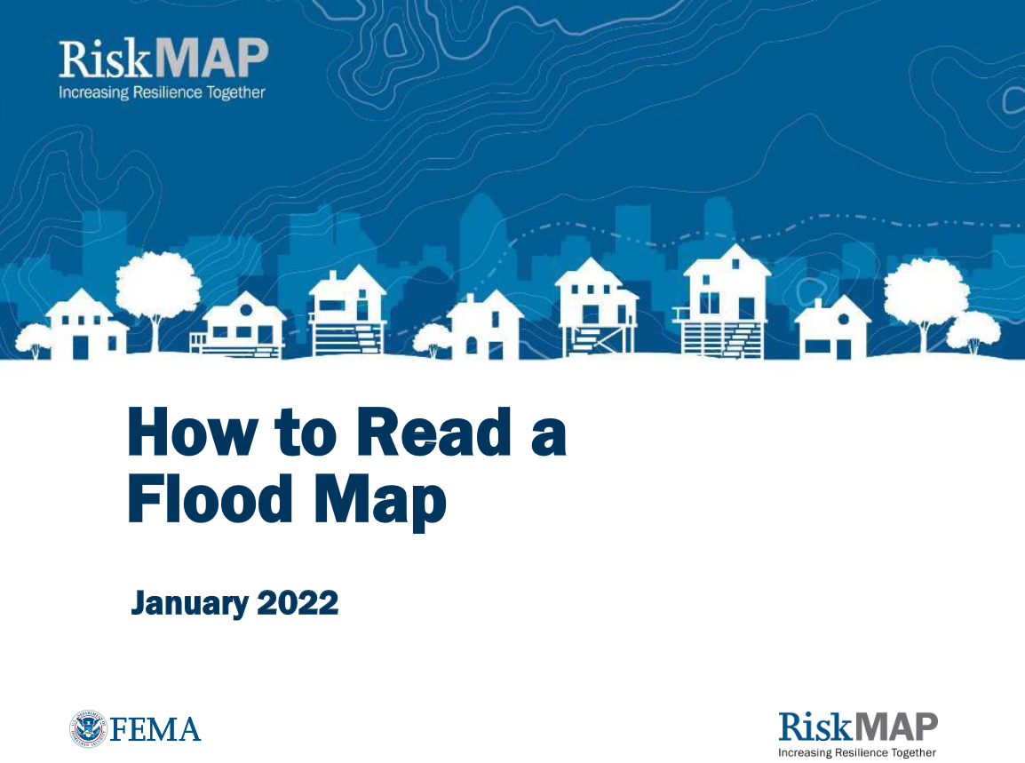
FEMA PUBLICATIONS
https://www.fema.gov/sites/default/files/2020-07/fema_p213_08232018.pdf
https://www.fema.gov/sites/default/files/documents/how-to-read-flood-insurance-rate-map-tutorial.pdf

Slide 60

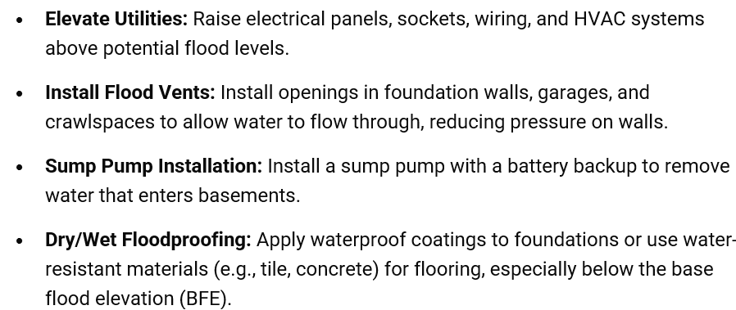
https://www.fema.gov/sites/default/files/2020-07/fema_homeowners-guide-to-retrofitting_guide.pdf

Slide 61

https://www.fema.gov/sites/default/files/documents/fema_protect-your-home-from-flooding-brochure_2020.pdf

Slide 62
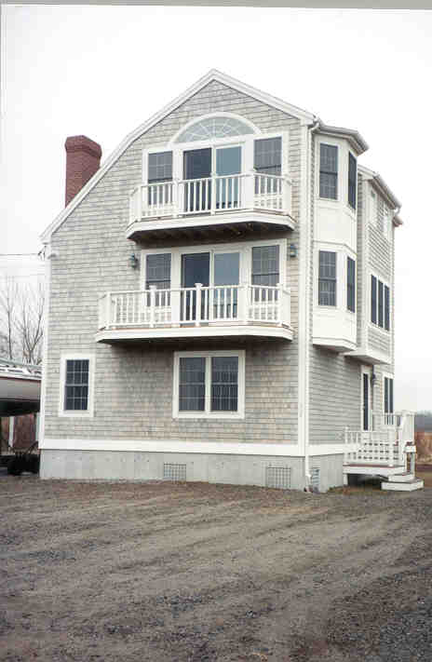
Contact Us
Sue Baker, State NFIP Coordinator
(207) 287-8063
sue.baker@maine.gov
Janet Parker, Planner II (207) 287-9981 janet.parker@maine.gov

Slide 63
Thank you! Lunch & Learn Webinar Series Community Resilience Partnership Round 7

