Slide 1

Sustainability & Resilience Planning
Planning Basics Webinar Series
Friday, November 1, 2024
Notes:
Abbie/Karina (introductions)

Slide 2
Agenda
Division overview
Our work
Climate Action Planning
Current planning projects
Q/A
Notes:
Karina

Slide 3

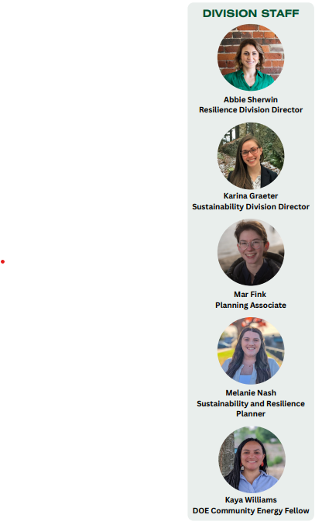
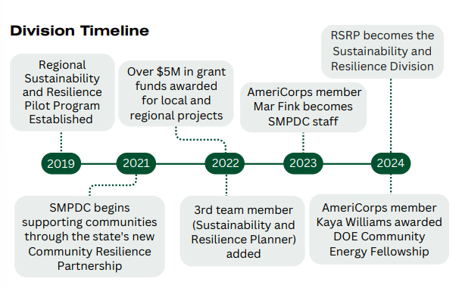
Notes:
Abbie
Overview of division history and staff

Slide 4
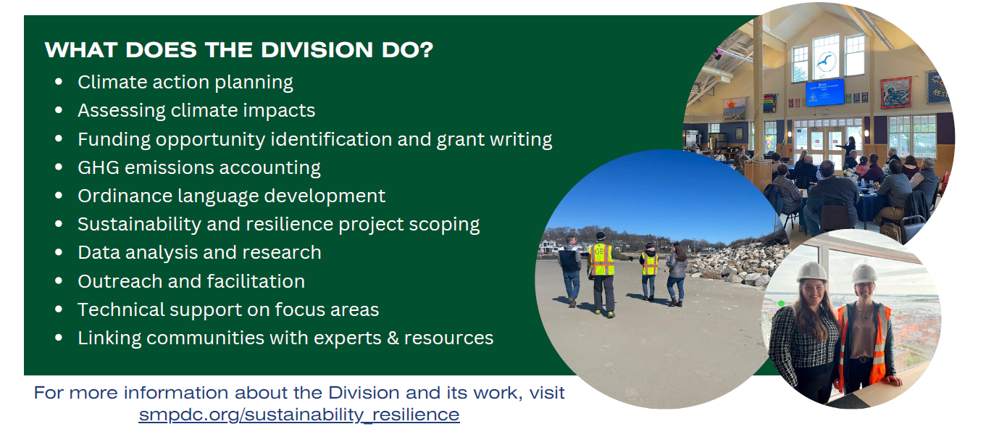
Notes:
Abbie
Overview of the type of work we do

Slide 5
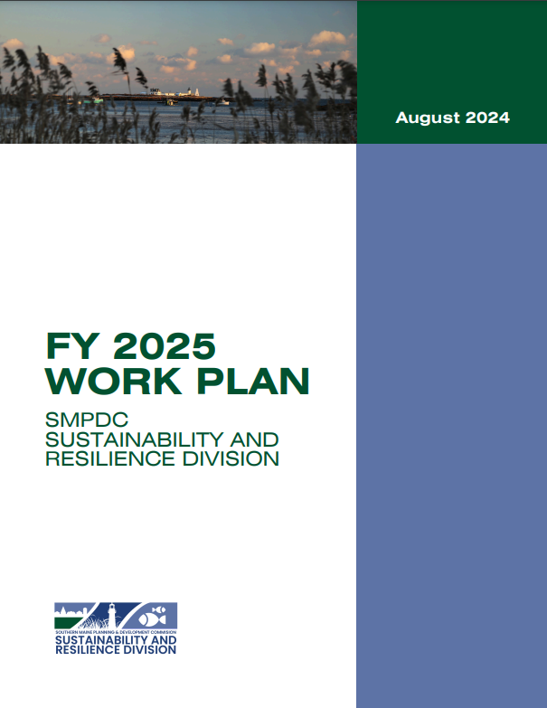
Town fees
Contracts
Grants
Varied Funding
Check out our workplan
Collaboration – intermunicipal, regional, community partners
Assessment – conditions, hazards, impacts, vulnerabilities
Integration – planning, operations, decision-making, fiscal policy, culture
Action – mitigation & adaptation strategy implementation
Guiding Principles
Notes:
Abbie

Slide 6
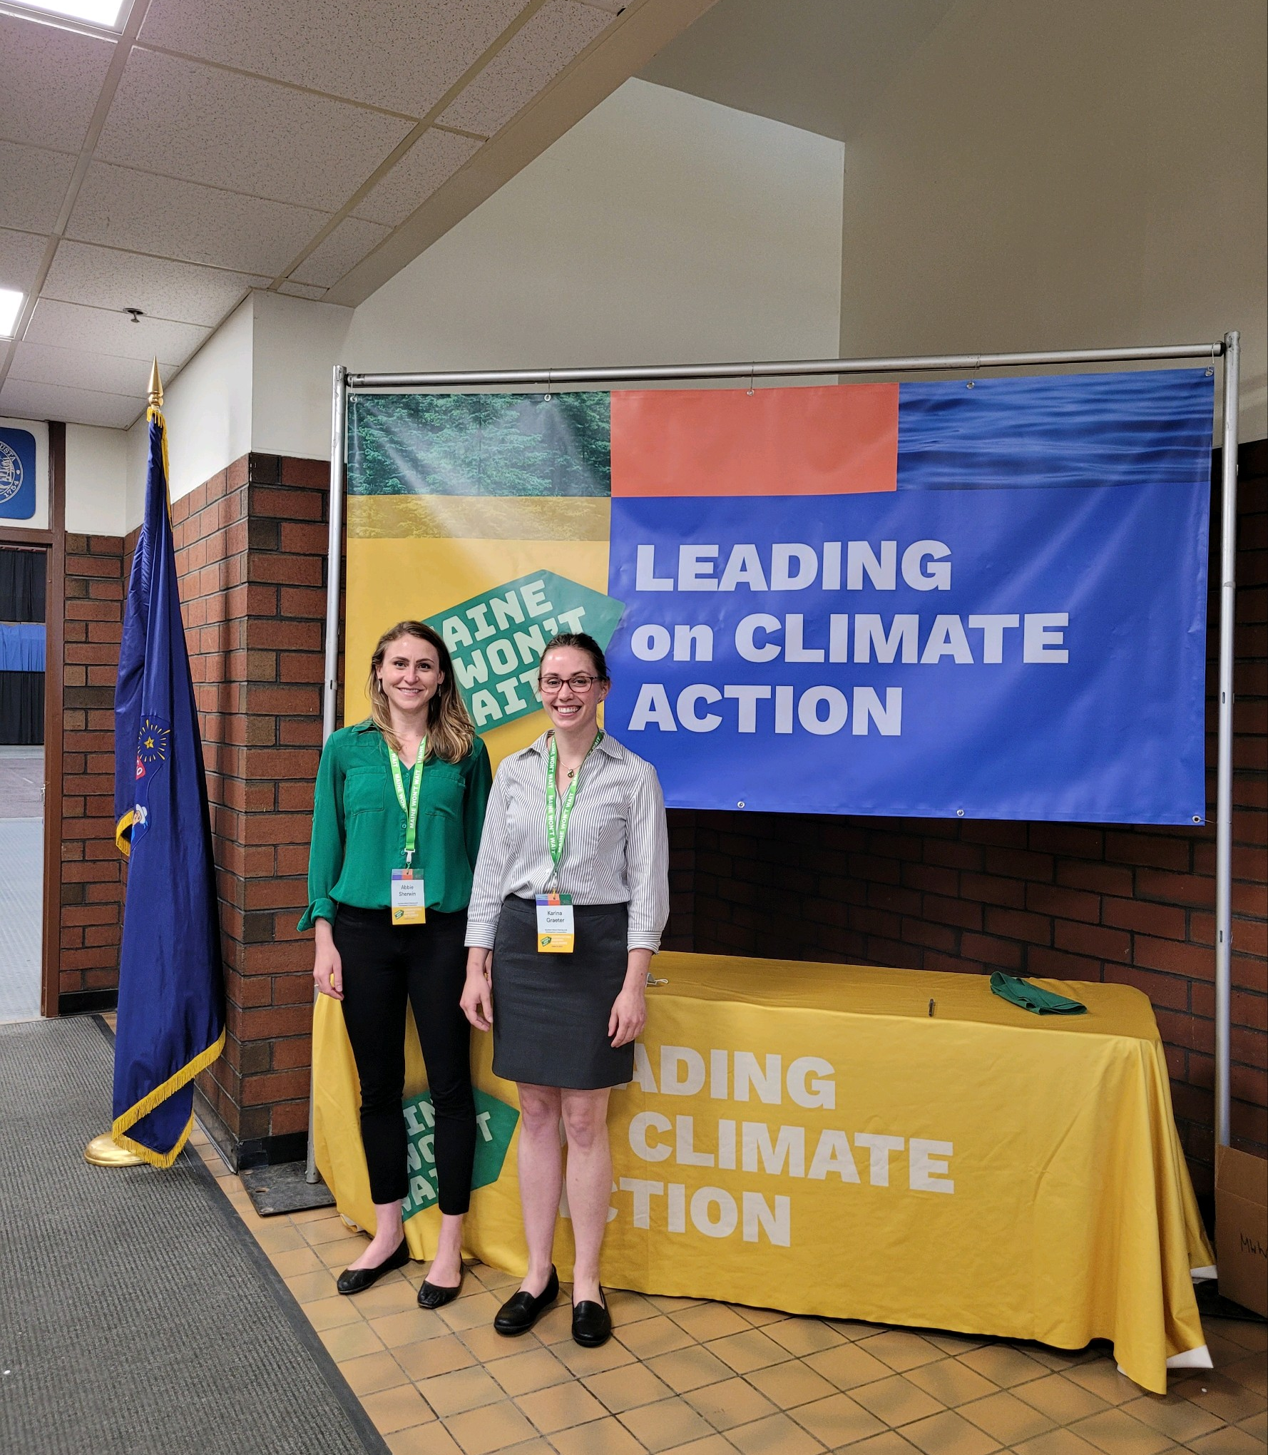
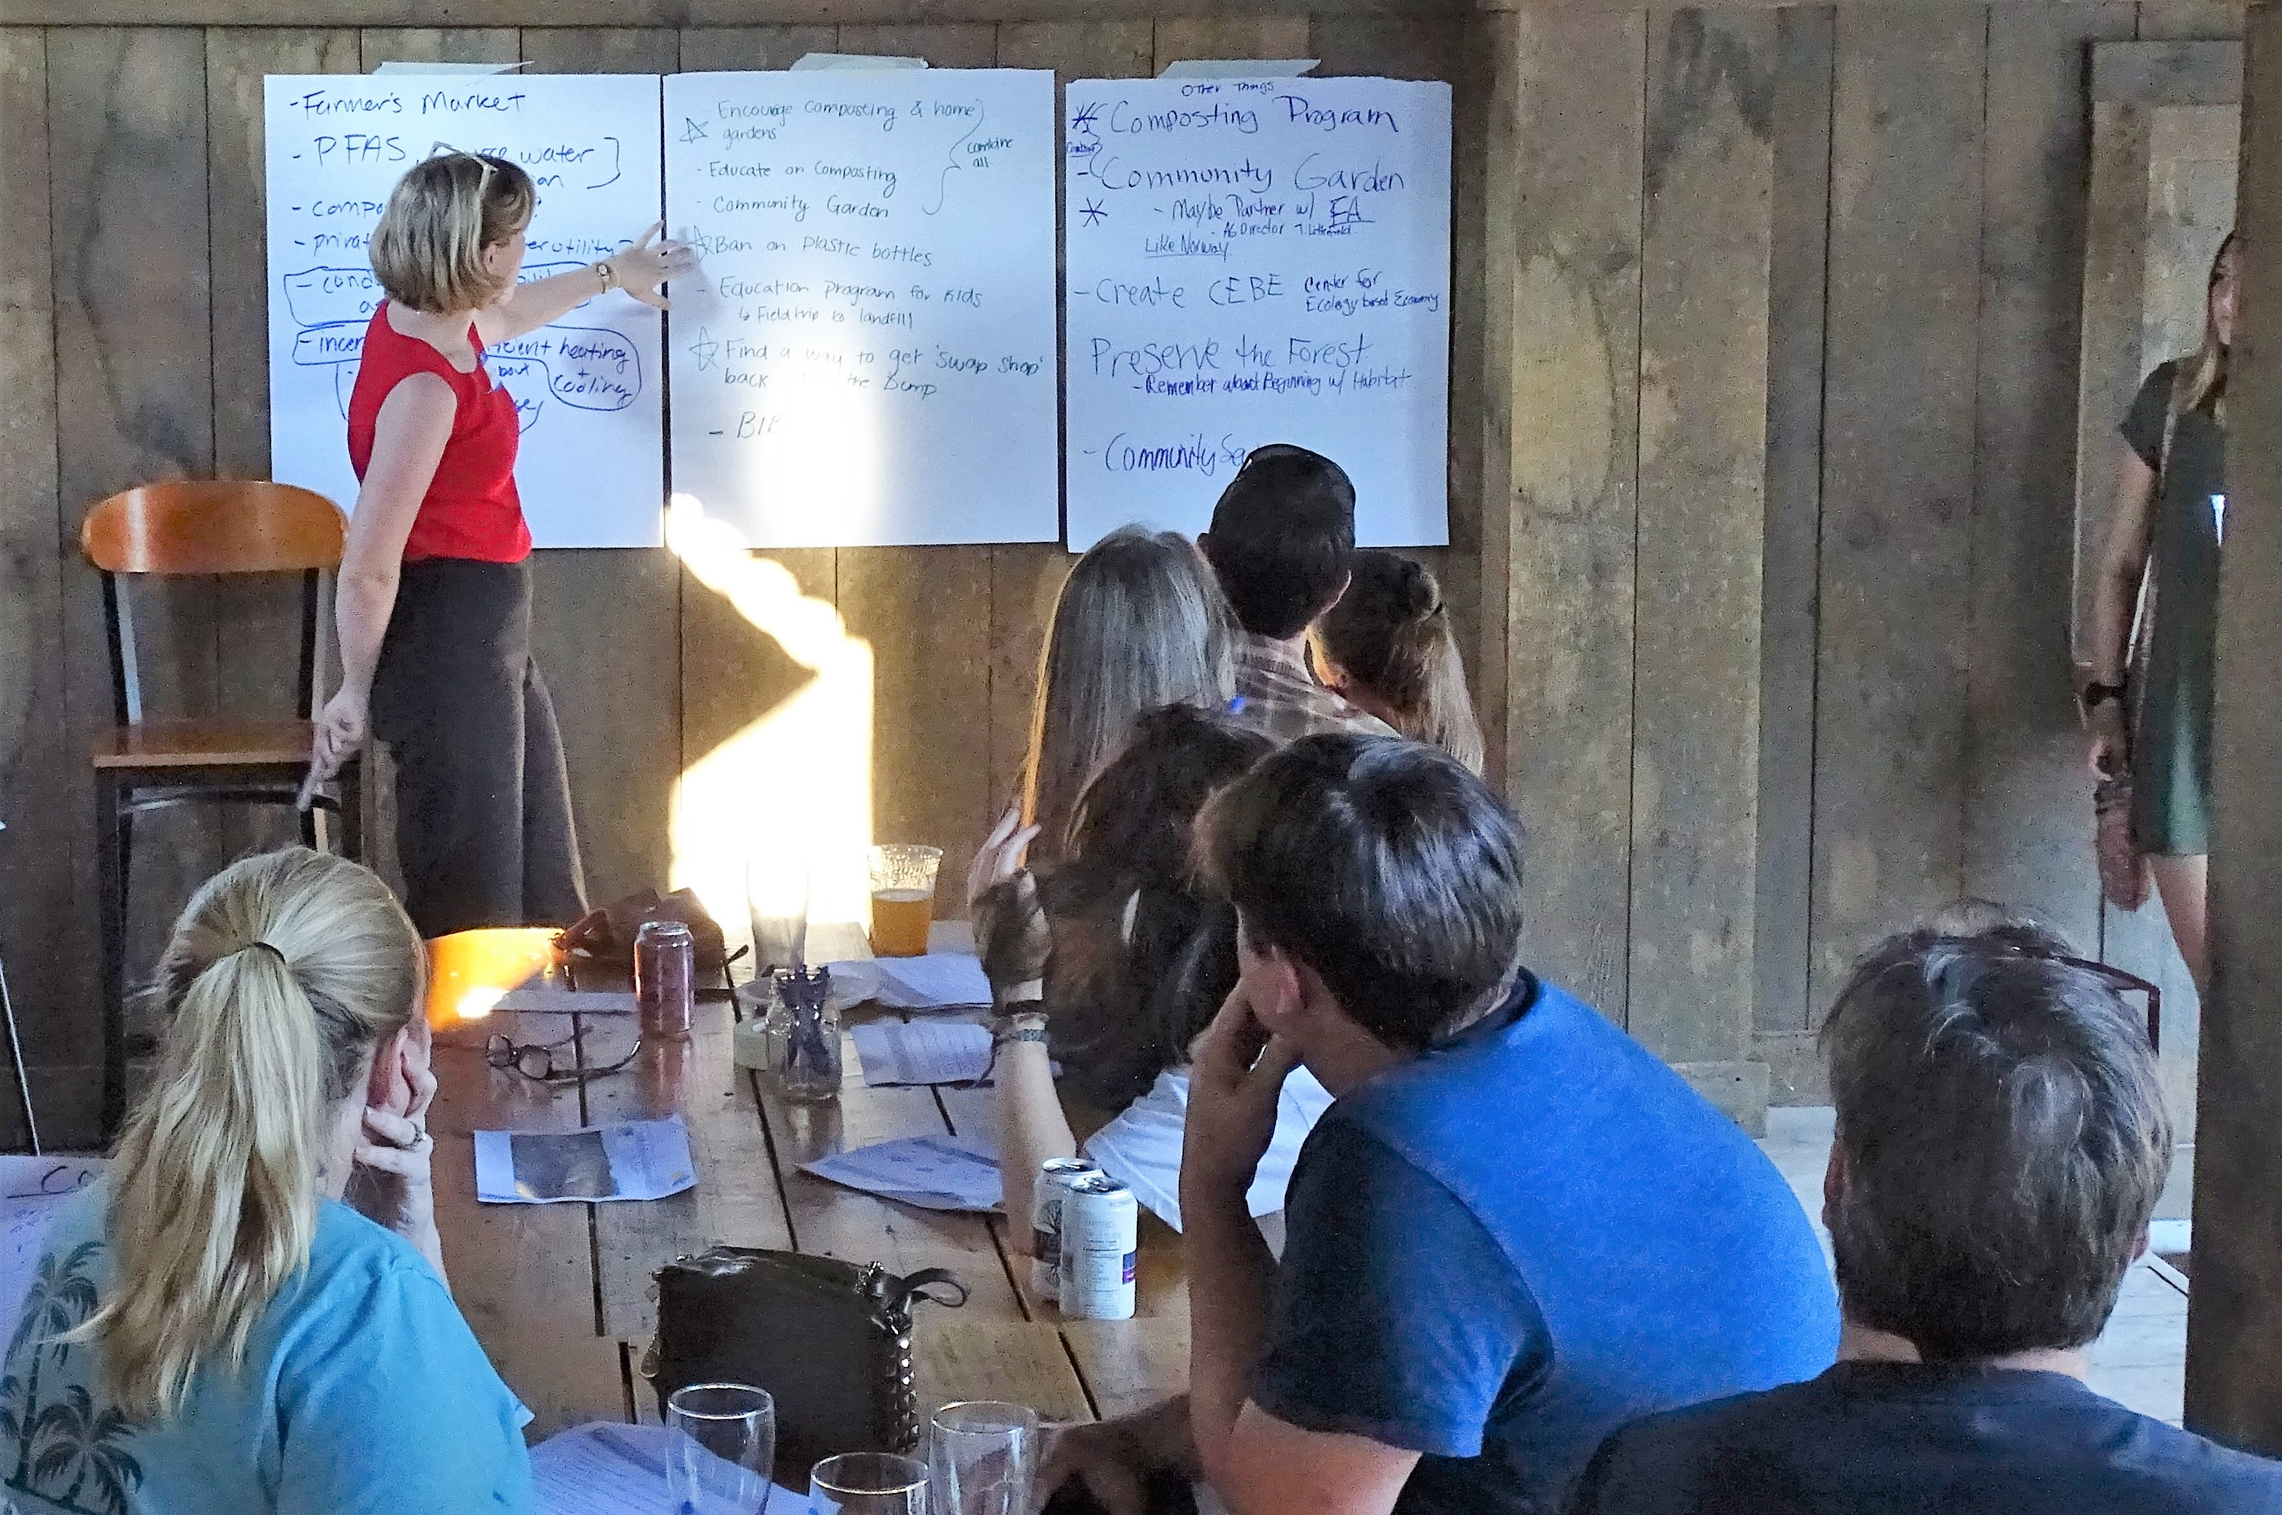
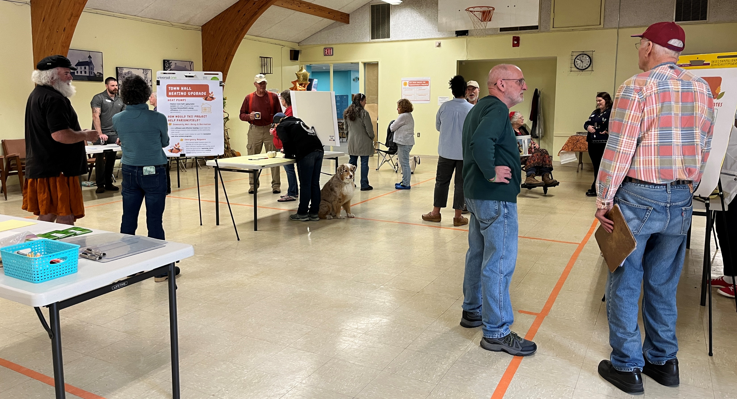
Community Resilience Partnership
Regional Coordinator – Region 1 Coordinator Collaborative
Service Provider – supported 9 communities with CRP enrollment
Community Action Grant (CAG) support – helped communities apply for and manage CAGs
Notes:
Abbie

Slide 7
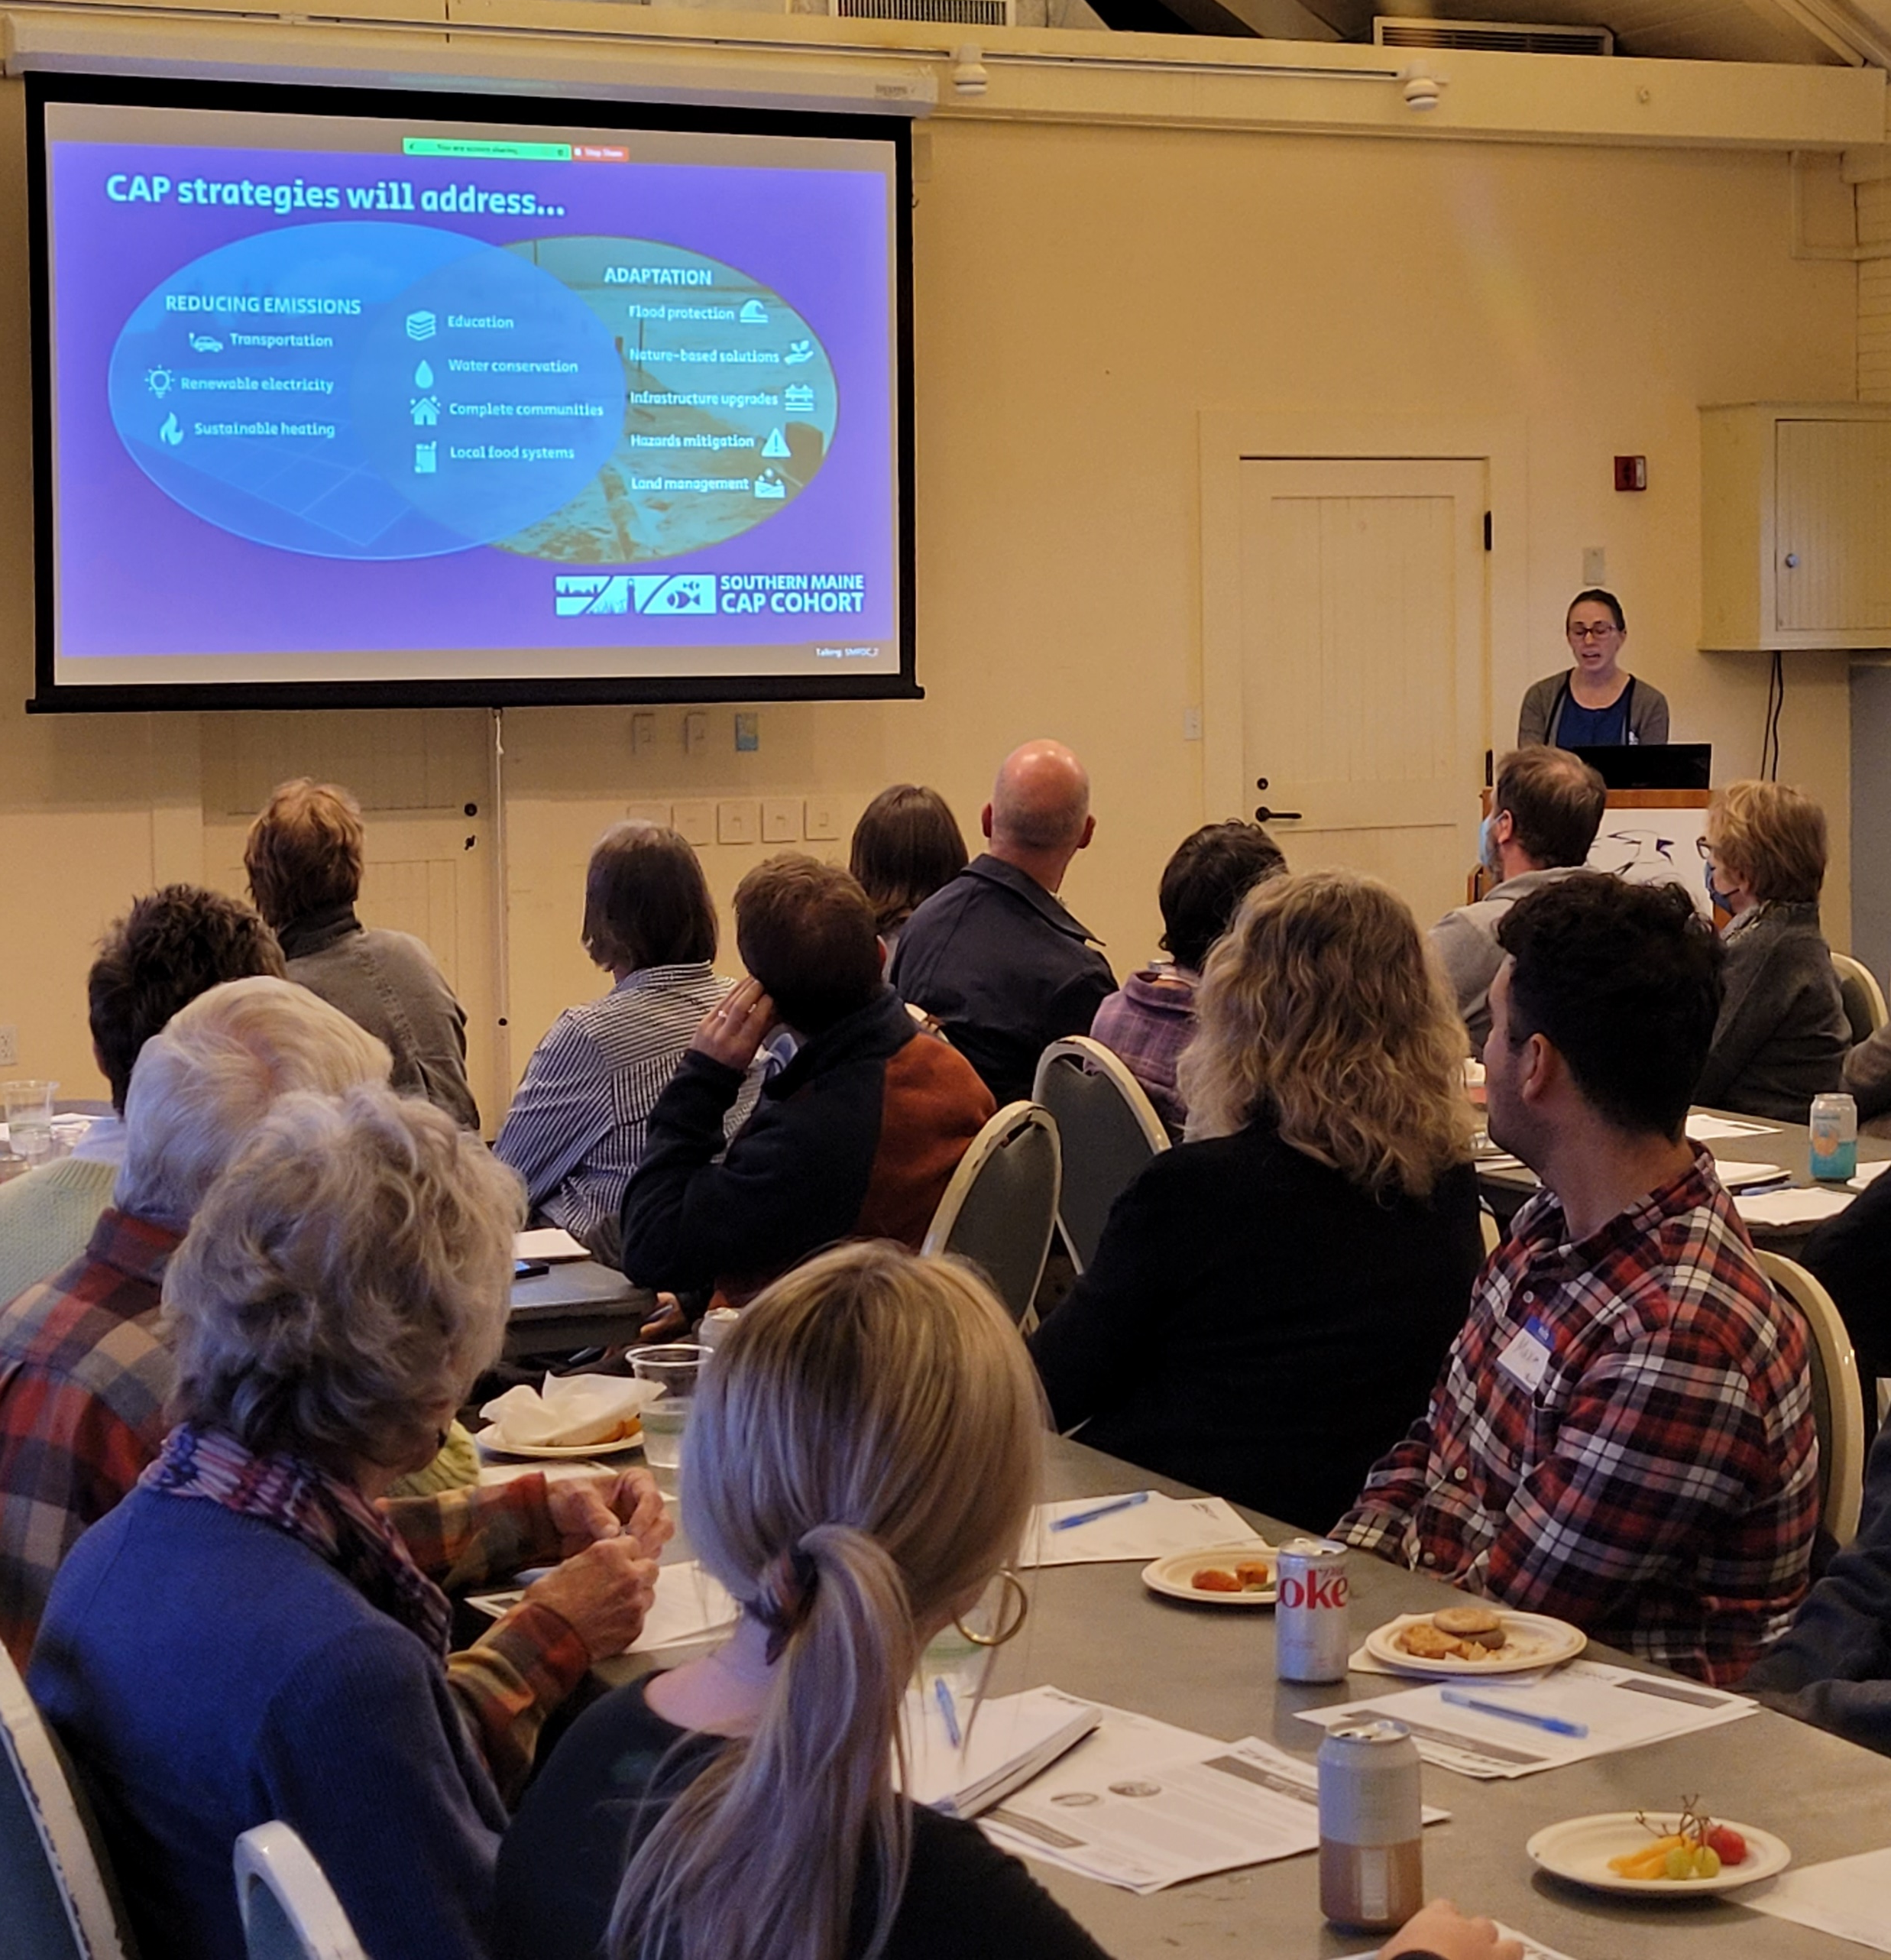
Southern Maine Climate Action Planning (CAP) Cohort
Created 4 regionally informed CAPs with Kennebunk, Kennebunkport, Kittery and Biddeford
Partners: 4 towns, ICLEI, Morris Communications and Zoe Miller Strategies
Funding: CAG, town contributions, JLUS, DACF
Check out project webpage to learn more
Notes:
Karina (task forces, similar timeline, leverage resources, municipal actions & regional strategies, etc.)

Slide 8
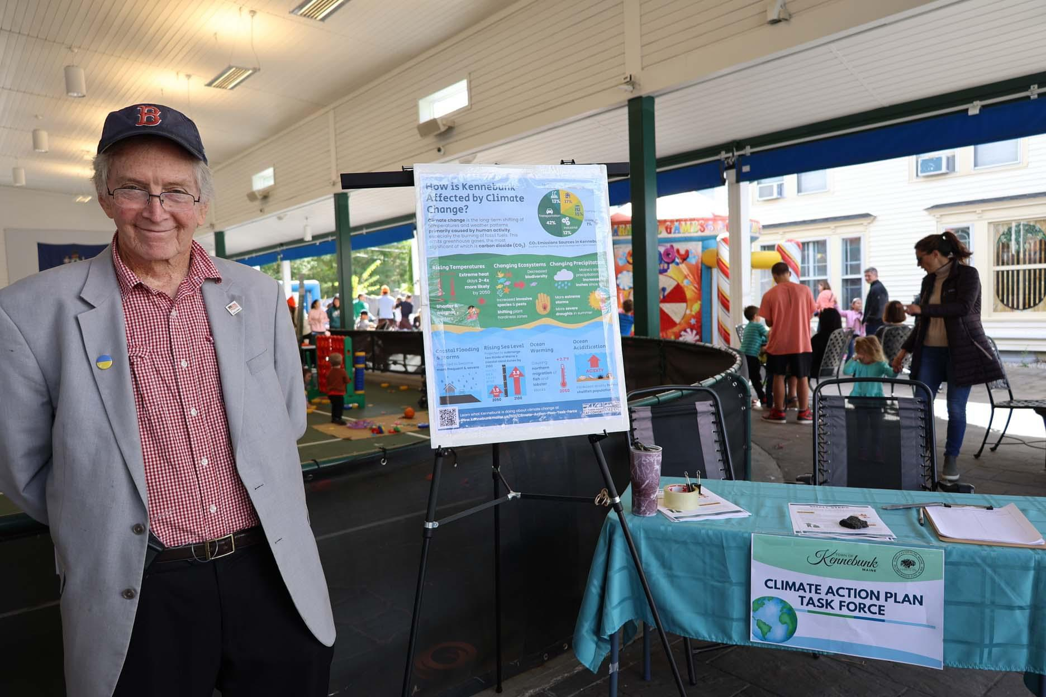
Climate Action Planning Toolkit
Templates
CAP outline
  Community survey
  Strategy matrix
  Plan Development Resources
  GHG emissions protocol
  Vulnerability assessment framework
  CAP best practices
  Community engagement plan
Check out the toolkit on our website
Notes:
Karina

Slide 9
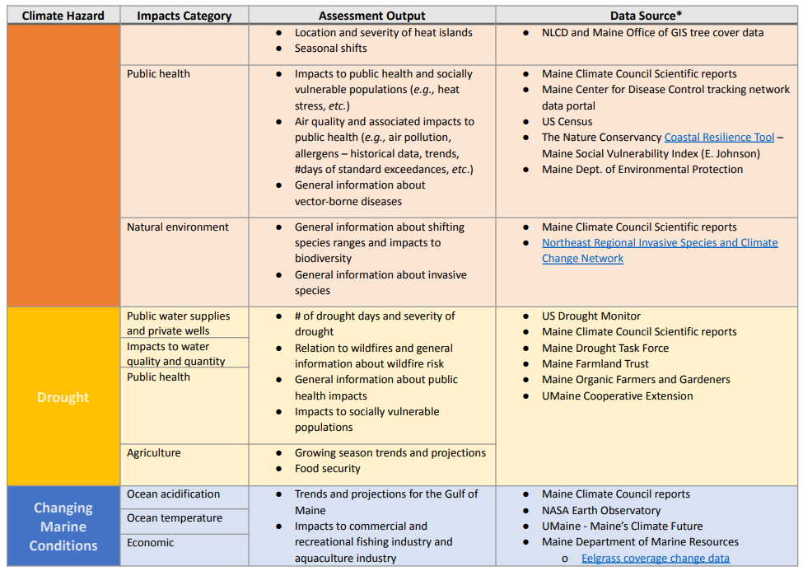
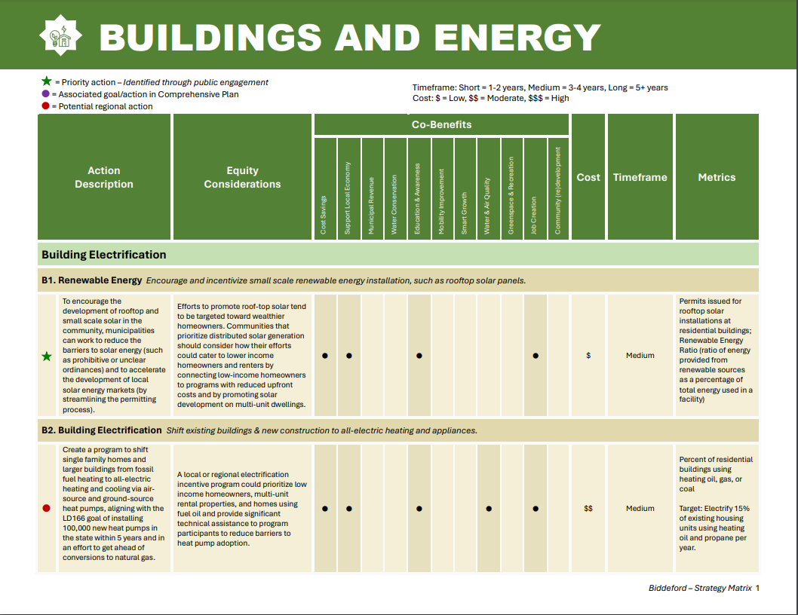
Notes:
Karina

Slide 10

Group Question
Who has received requests for integrating climate change in comp plans/ordinances?
What resources do you use?
Notes:
Abbie

Slide 11
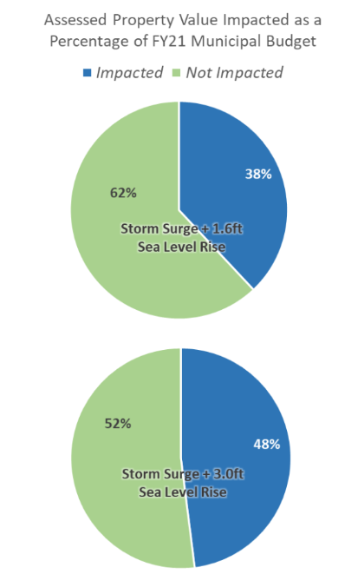
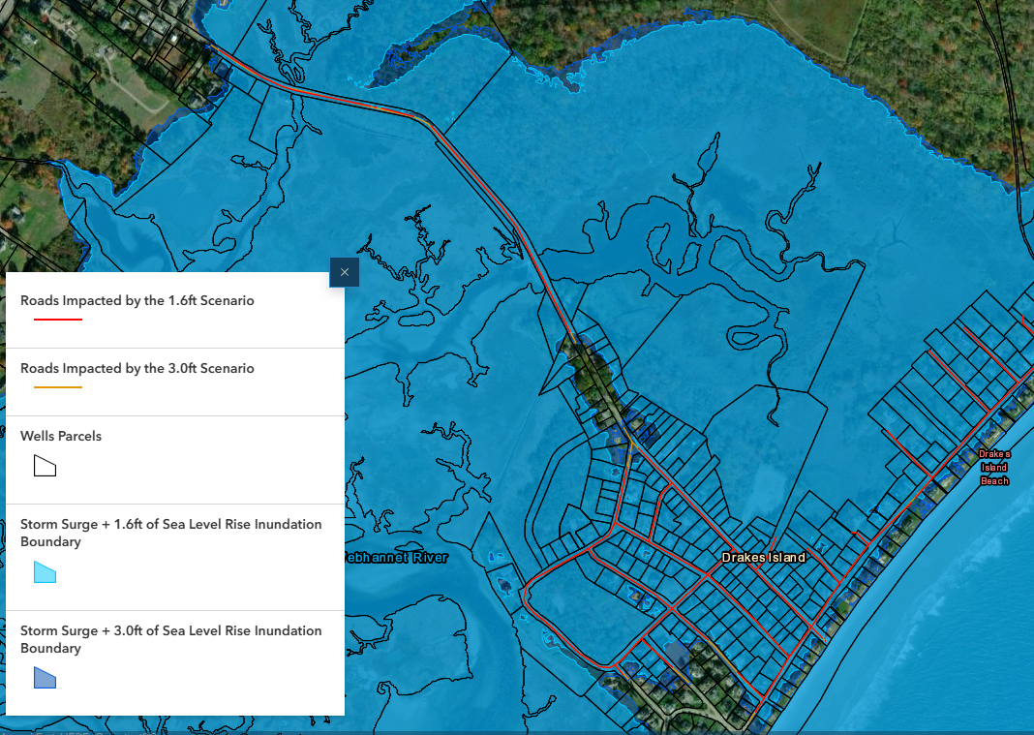
Economic Resilience Assessment & Plan
Regional flood modeling, vulnerability assessment, economic analysis; resilience recommendations & strategies
Partners: Consultants, 6 towns
Funding: EDA Disaster Supplemental Funding
Check out the plan and other project materials on our website
Notes:
Abbie

Slide 12
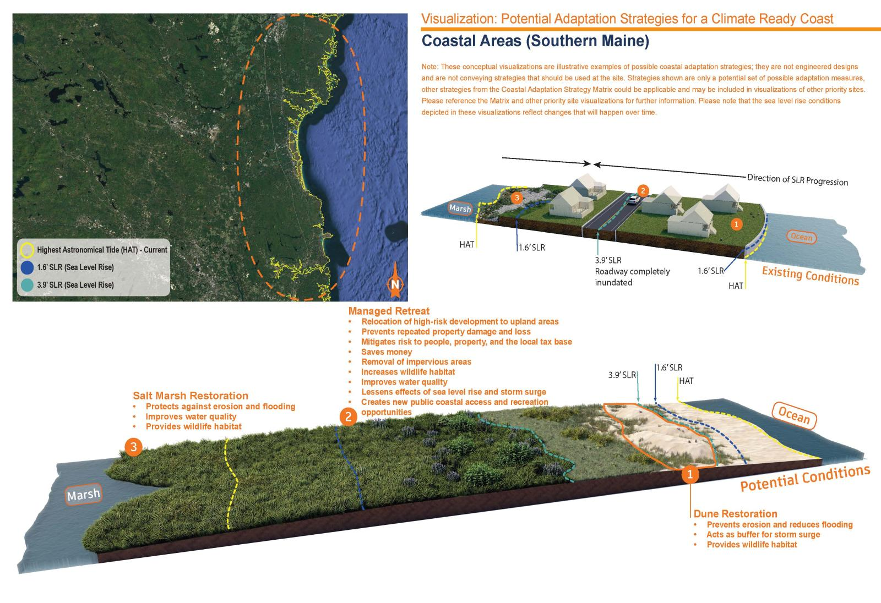
Climate Ready Coast – Southern Maine
Collaboratively developed Regional Coastal Resilience Plan with priority projects ID’d
  Needs assessment; working group; vulnerability assessment; ID priority sites; adaptation strategies; visual renderings; funding opportunities
Partners: Wells Reserve, ME Sea Grant, NOAA, 10 communities
Funding: National Fish & Wildlife Foundation
Check out the project website
Notes:
Abbie

Slide 13
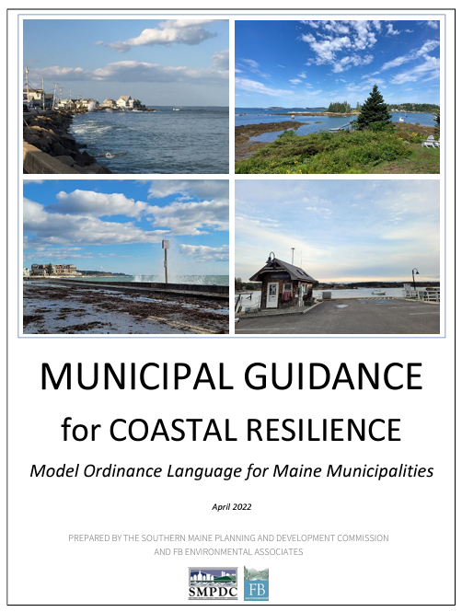
Model Coastal Resilience Ordinance Language
Model ordinance language and guidance for increasing resilience of people, property, and natural environment
  Key considerations, examples from elsewhere, data resources, multiple hazards
Partners: Kittery, Wells, South Portland, Tremont, Vinalhaven, FB Environmental
Funding: ME Coastal Communities Grant
View the guide and other project materials on our website
Notes:
Abbie

Slide 14
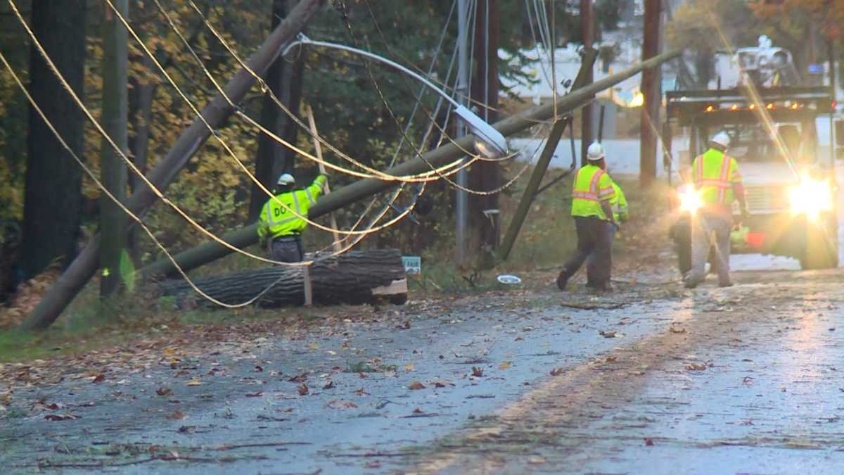
Southern Maine
Energy Resilience Plan
Regional plan bringing together electricity stakeholders in So. Me. To identify strategies for grid resilience.
Partners: TBD stakeholder group
Funding: EDA Disaster Grant
Notes:
Karina

Slide 15

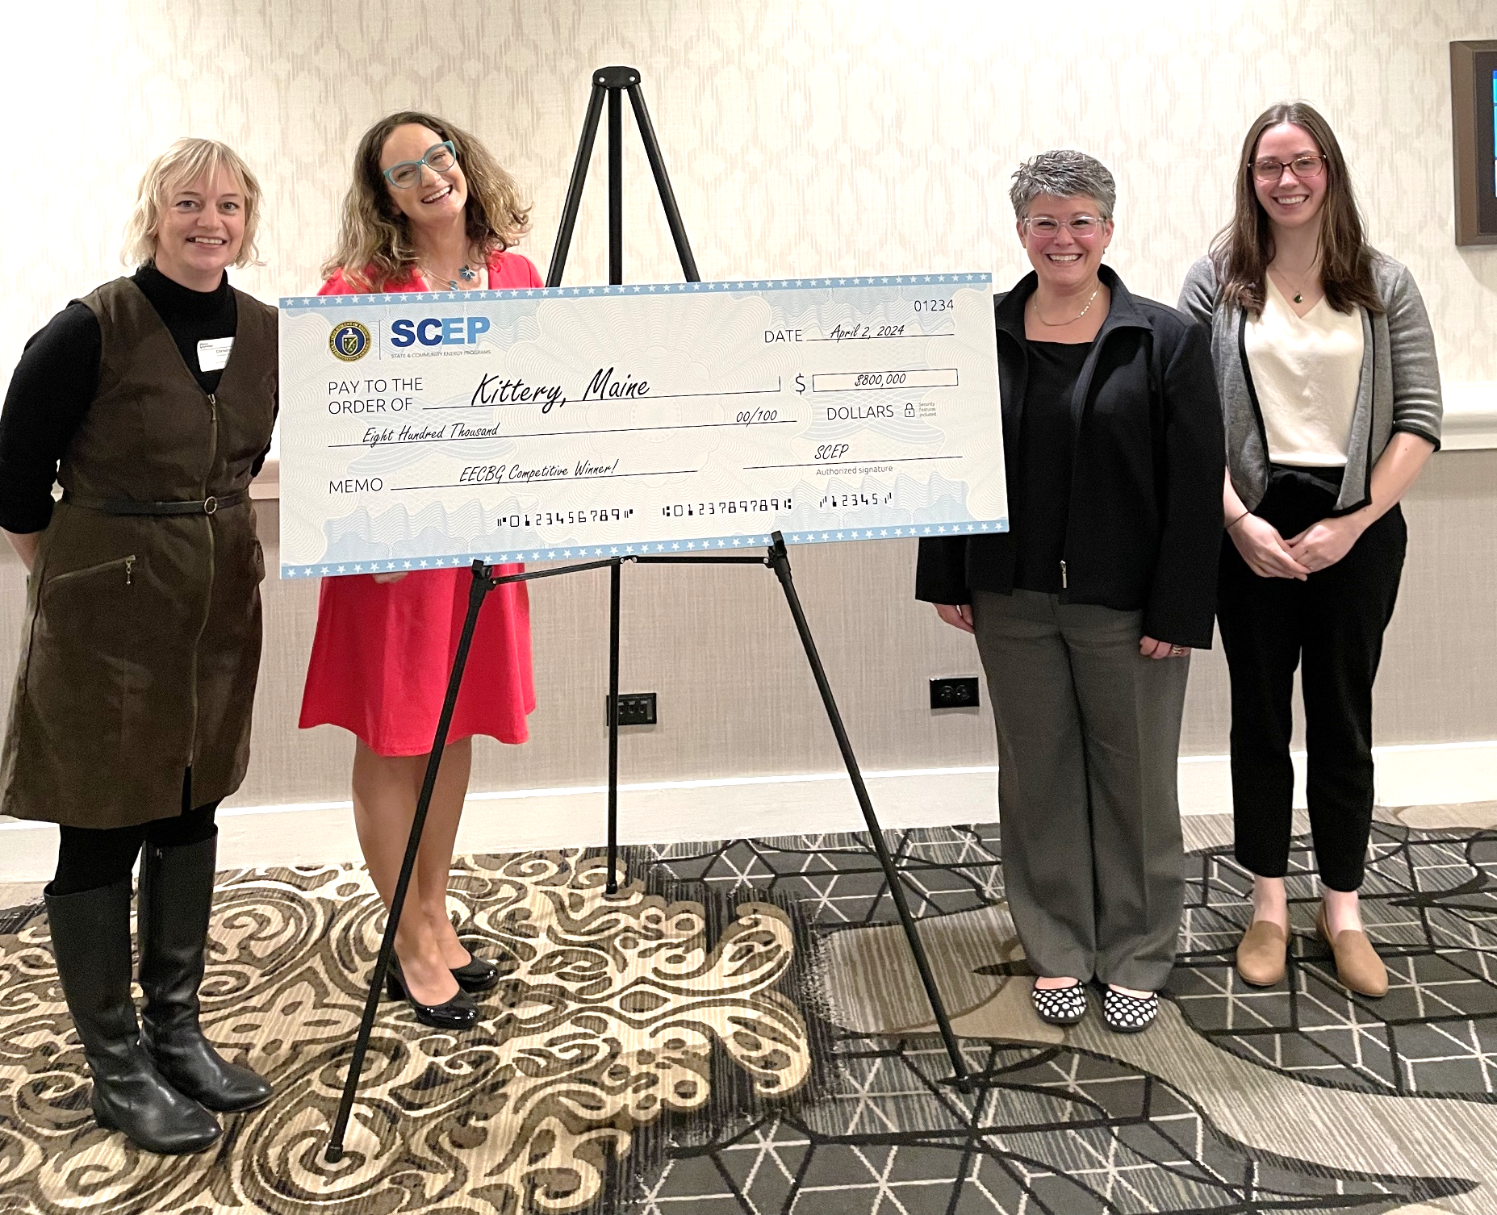
Energy Navigator Pilot Program
3 years of TA and incentives for home energy upgrades, with DOE and AmeriCorps fellows serving as Energy Navigators
Partners: YCCAC, Kittery, Ogunquit, Wells, Kennebunk, Kennebunkport
Funding:Dept. of Energy EECBG Competitive Grant
Notes:
Karina

Slide 16
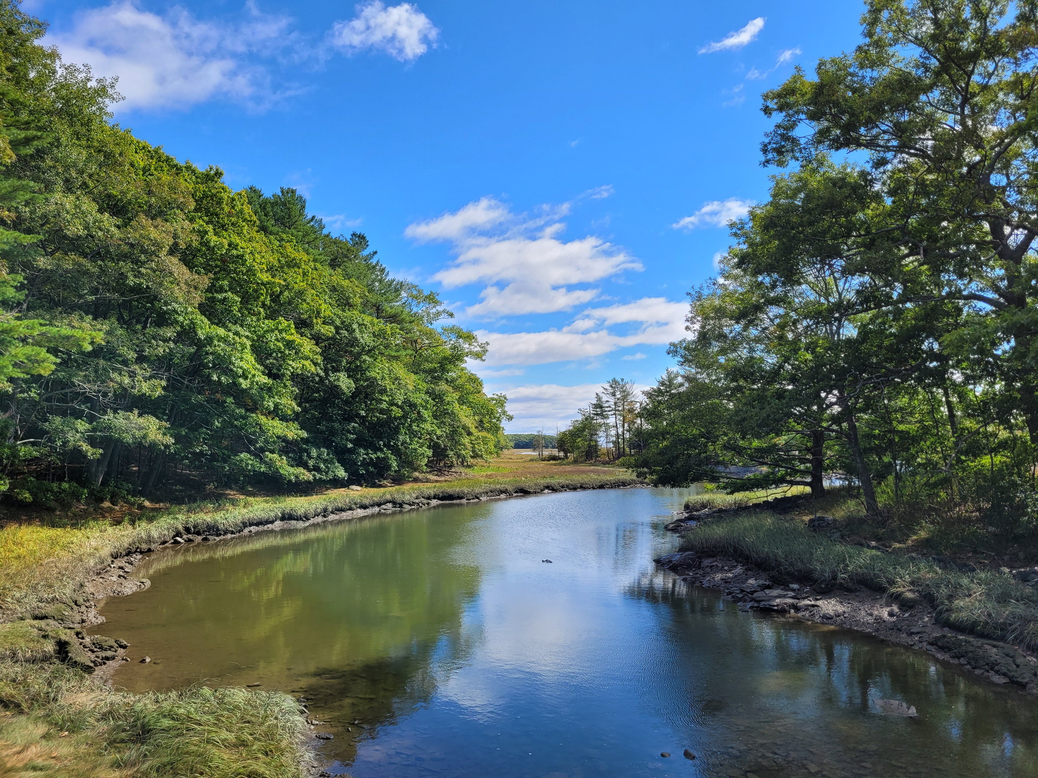

Join us!
Southern Maine
Climate Action Workshop
Join SMPDC, UNE, and other communities to share and develop climate action implementation efforts.
Sa
Municipal board and committee members, municipal staff, community org. members, and interested community members are encouraged to attend!
  Wed. November 13th, 2024
  9:30 AM - 3:00 PM
  University of New England, Biddeford Campus
Register at: https://bit.ly/3BKIV90
Contact kgraeter@smpdc.org for more info
Notes:
Karina

Slide 17
Questions & Discussion
Notes:
Karina & Abbie

Slide 18
Discussion Questions
Tell us about your experience with sustainability & resilience planning!
What successes have you had?
Challenges?
What data/information have you used and what have you found to be most helpful/informative?
What requests/questions do you get from communities?
What needs do you/communities have for this work?
Notes:
Karina & Abbie

