Slide 1

Comprehensive Planning and Lessons Learned
A Northern Maine Perspective

Slide 2
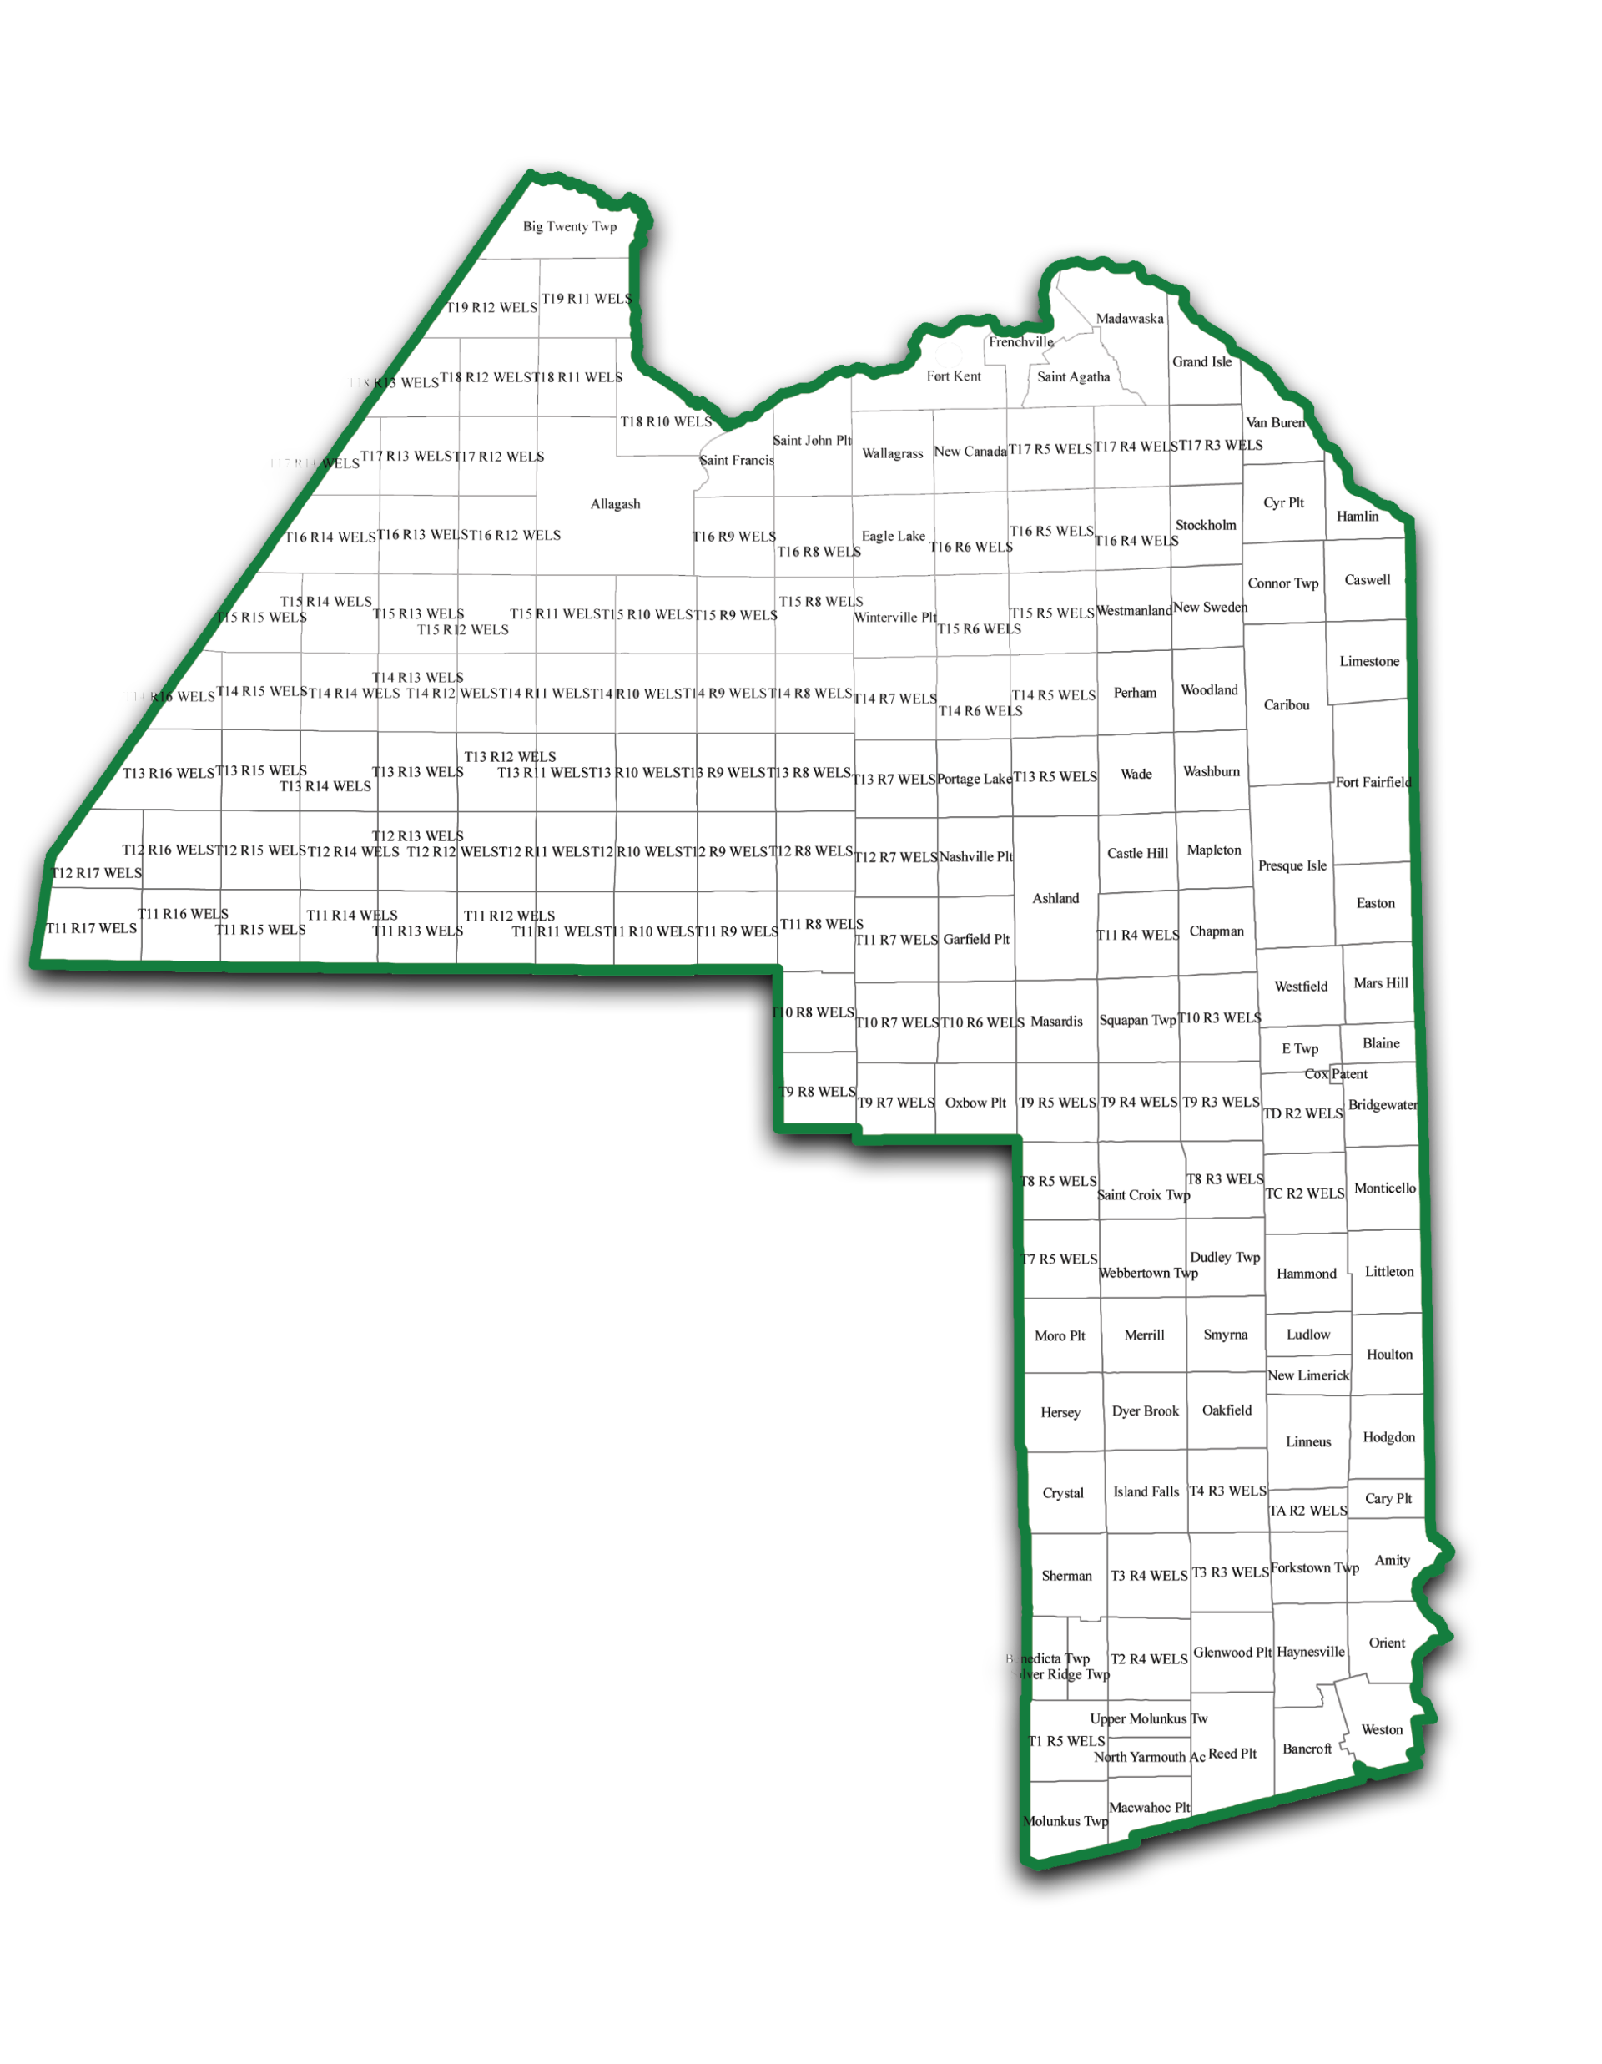
Our Service Area
Overview
Our region contains a mixture of larger communities (3-5) but consists mainly of small rural communities.
There are no municipalities in NMDC’s service area with a population greater than 10,000
There is (was) one planner. Caribou may be looking for an assistant City Manager/Planner.
Generally speaking, planning capacity is lacking in the region.
Many do not have land use regulation other than shoreland zoning
For decades, all the communities suffered from out-migration. Since COVID, this is changing.

Slide 3
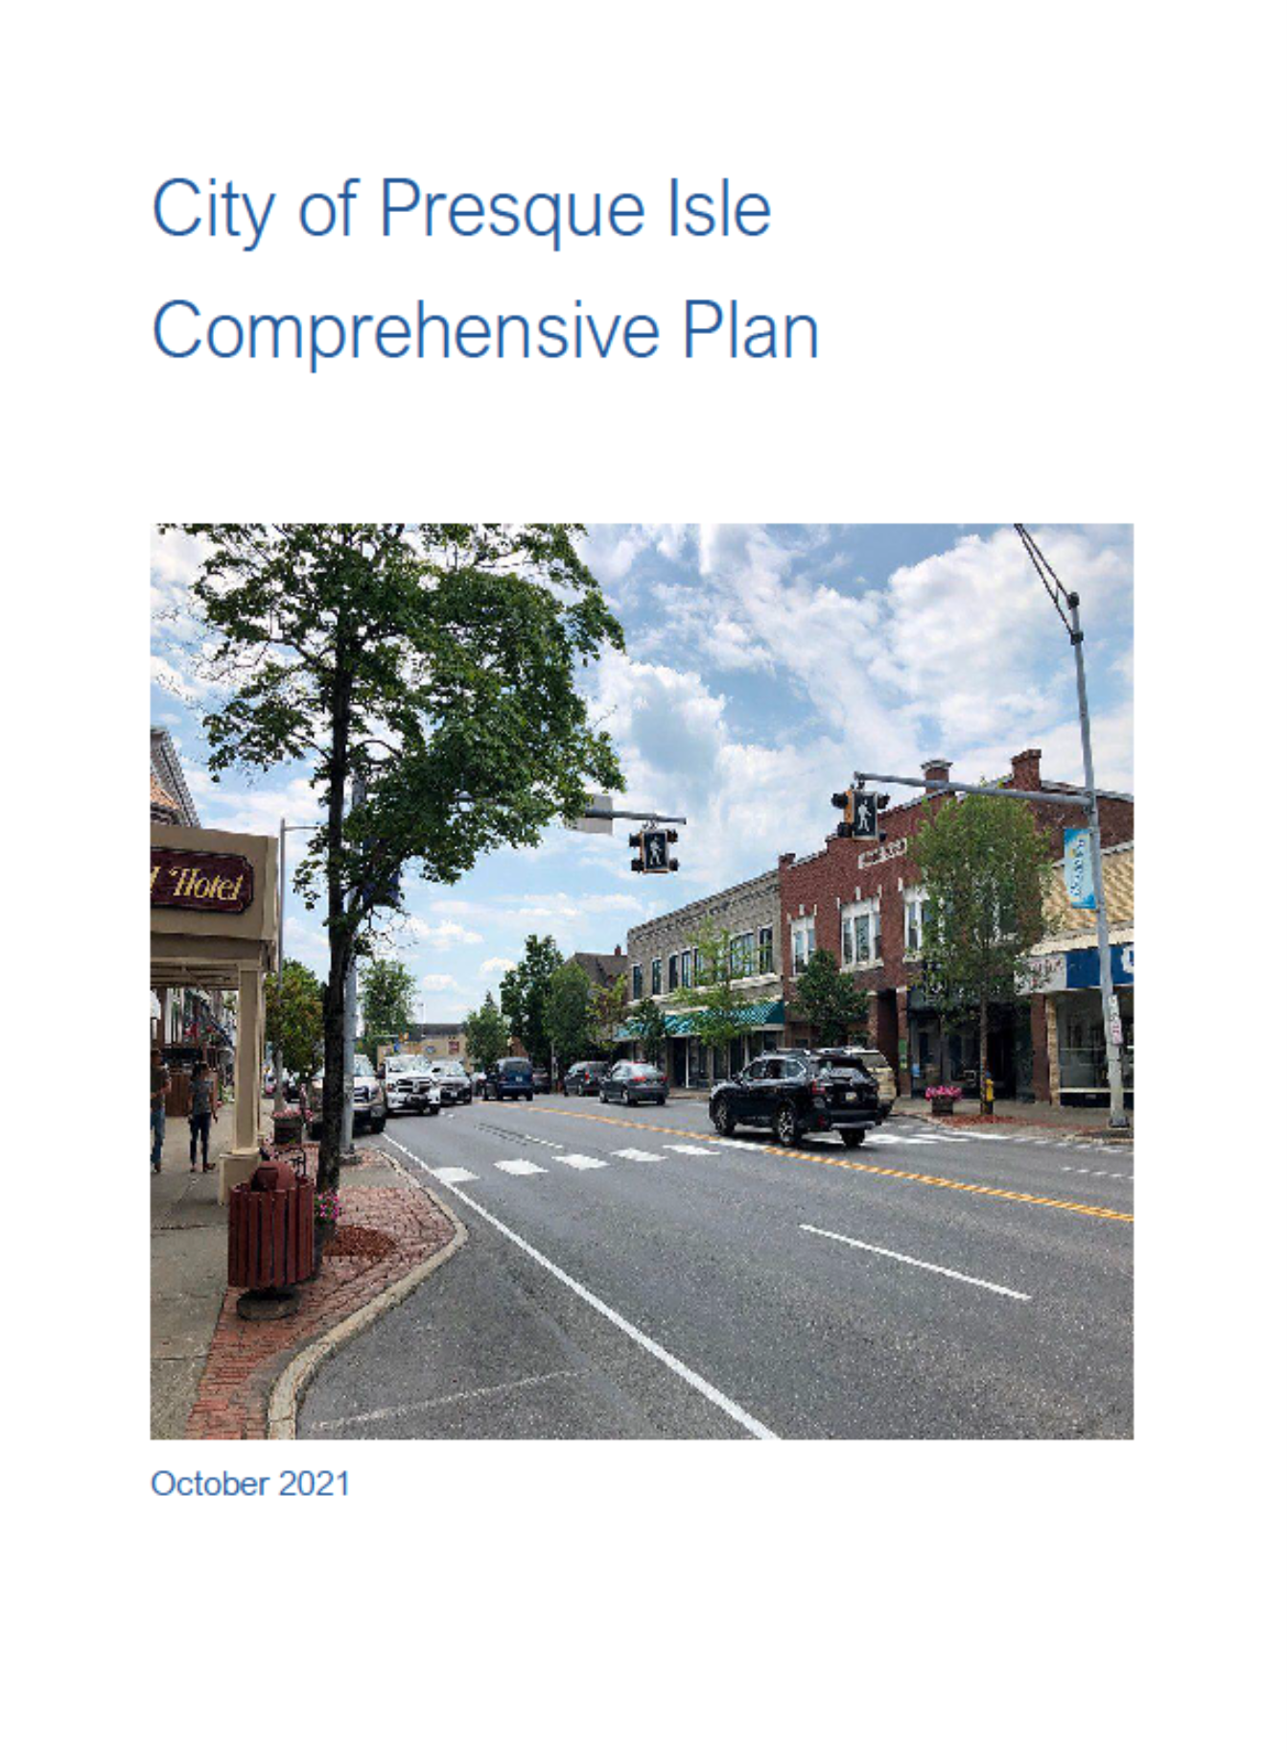
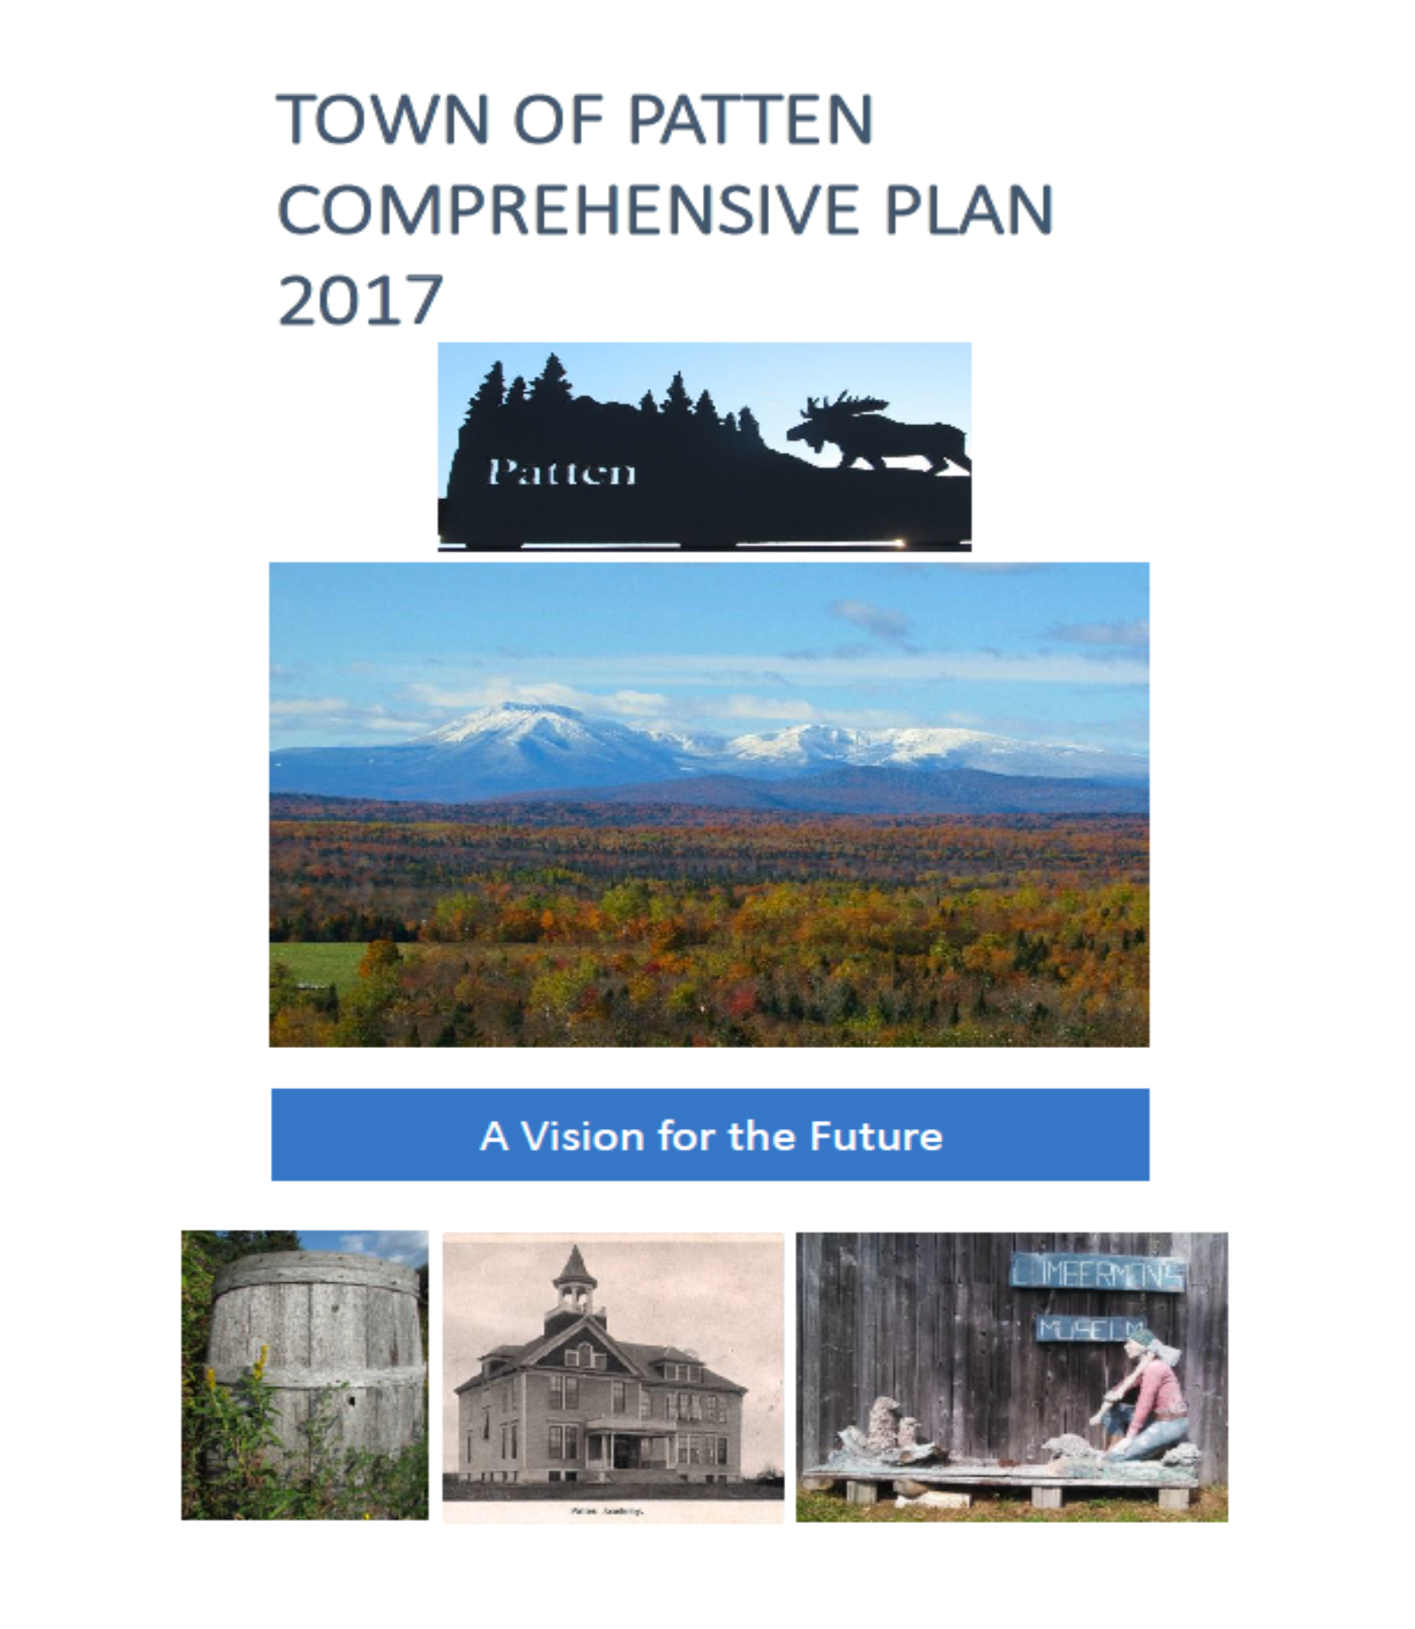
What does comprehensive planning look like?
“Growth” management and comprehensive planning centered around:
Stemming population loss
Planning for the needs of an aging population
Natural Resource Management
Community Development
Land use and land use regulation is/was an after thought

Slide 4
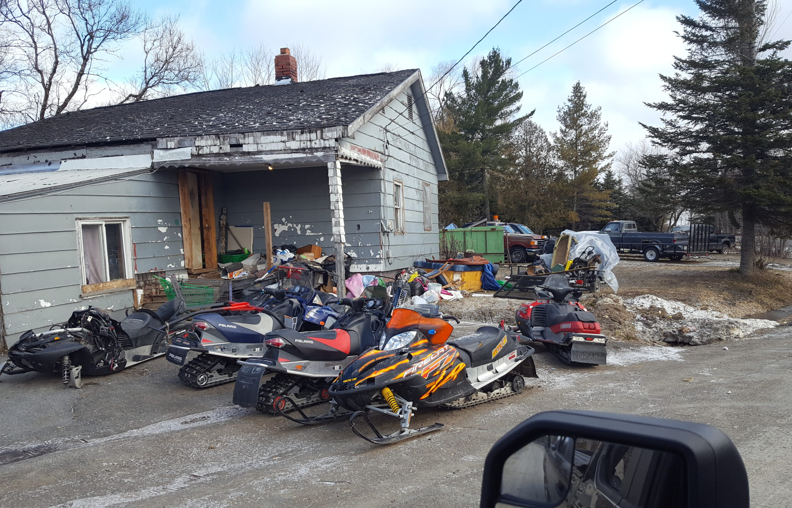
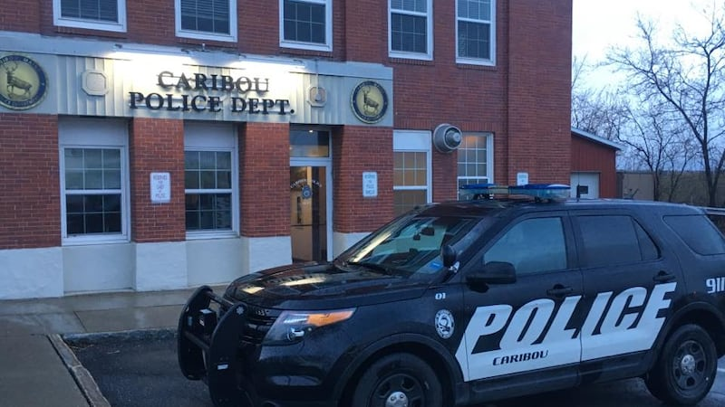
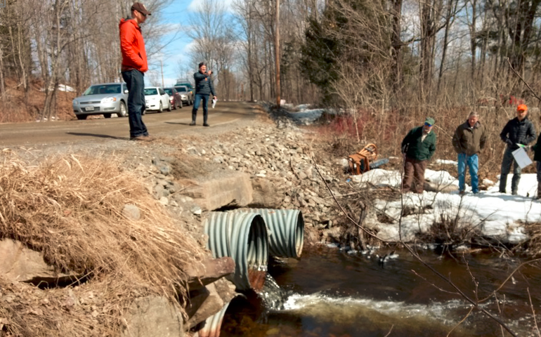
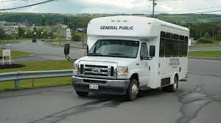
What it looks like on the ground
Blighted Properties
Public Facilities and Services
Natural Resources
Transportation

Slide 5
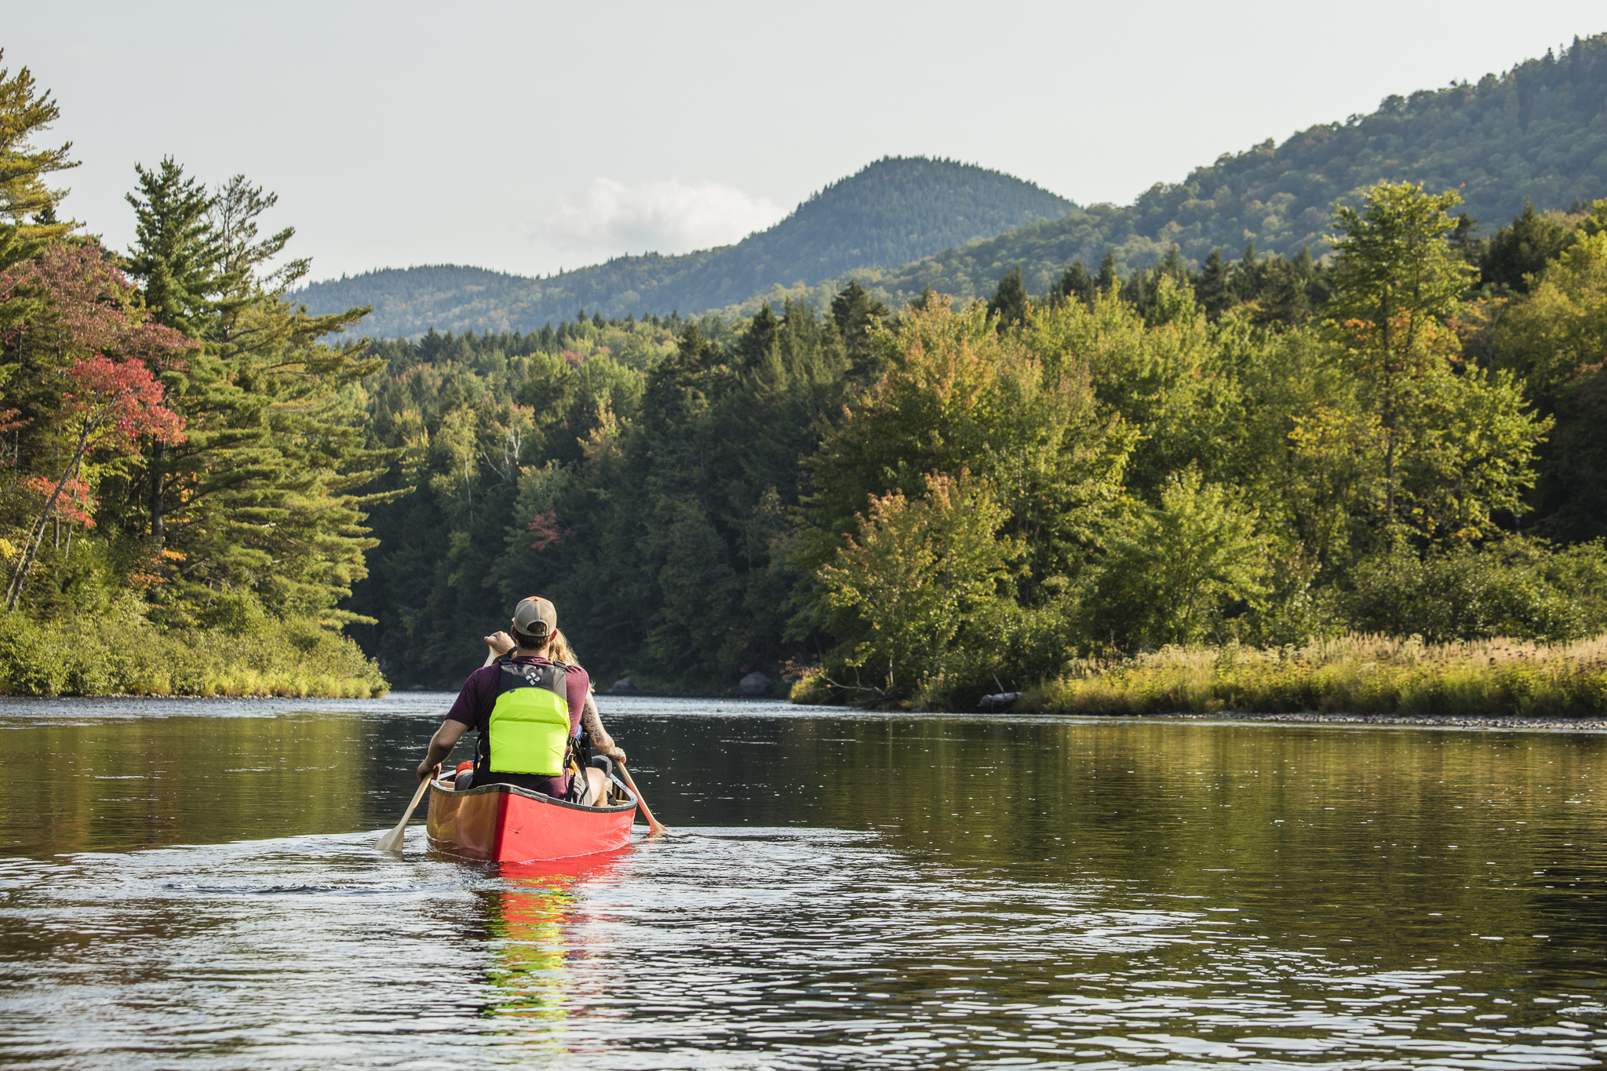

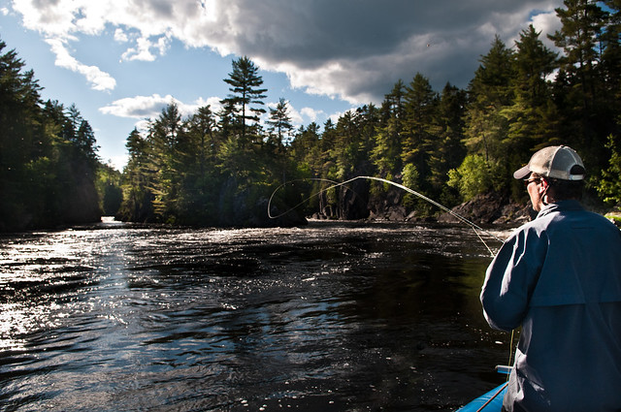
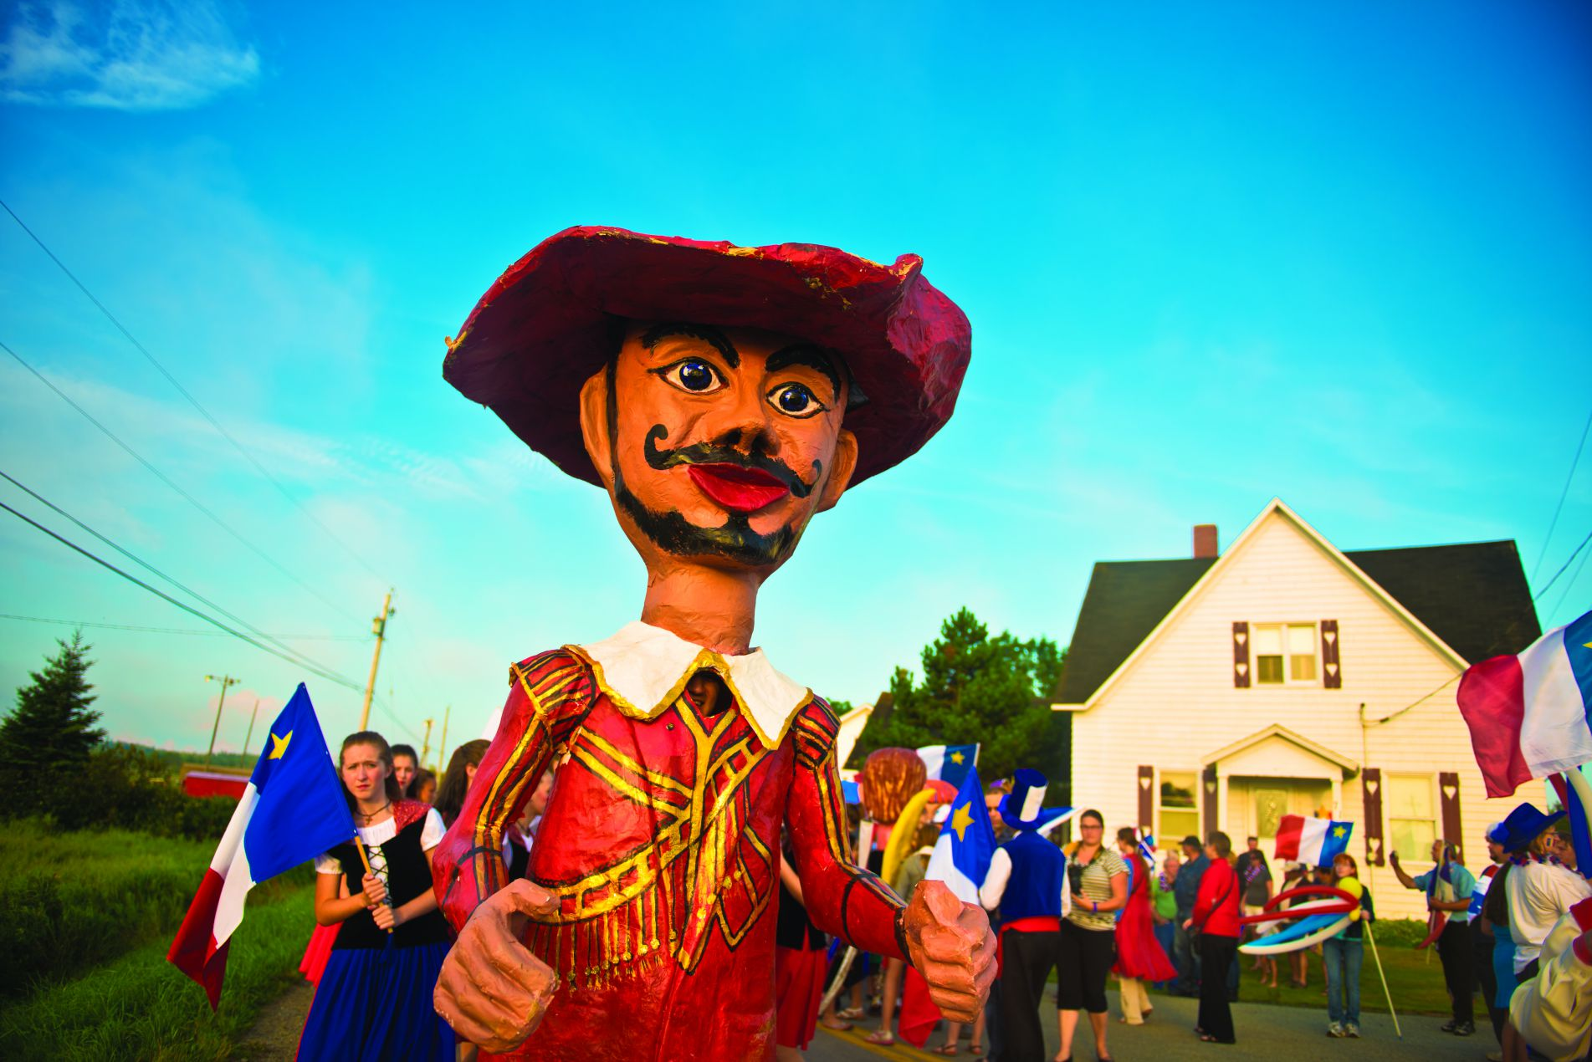
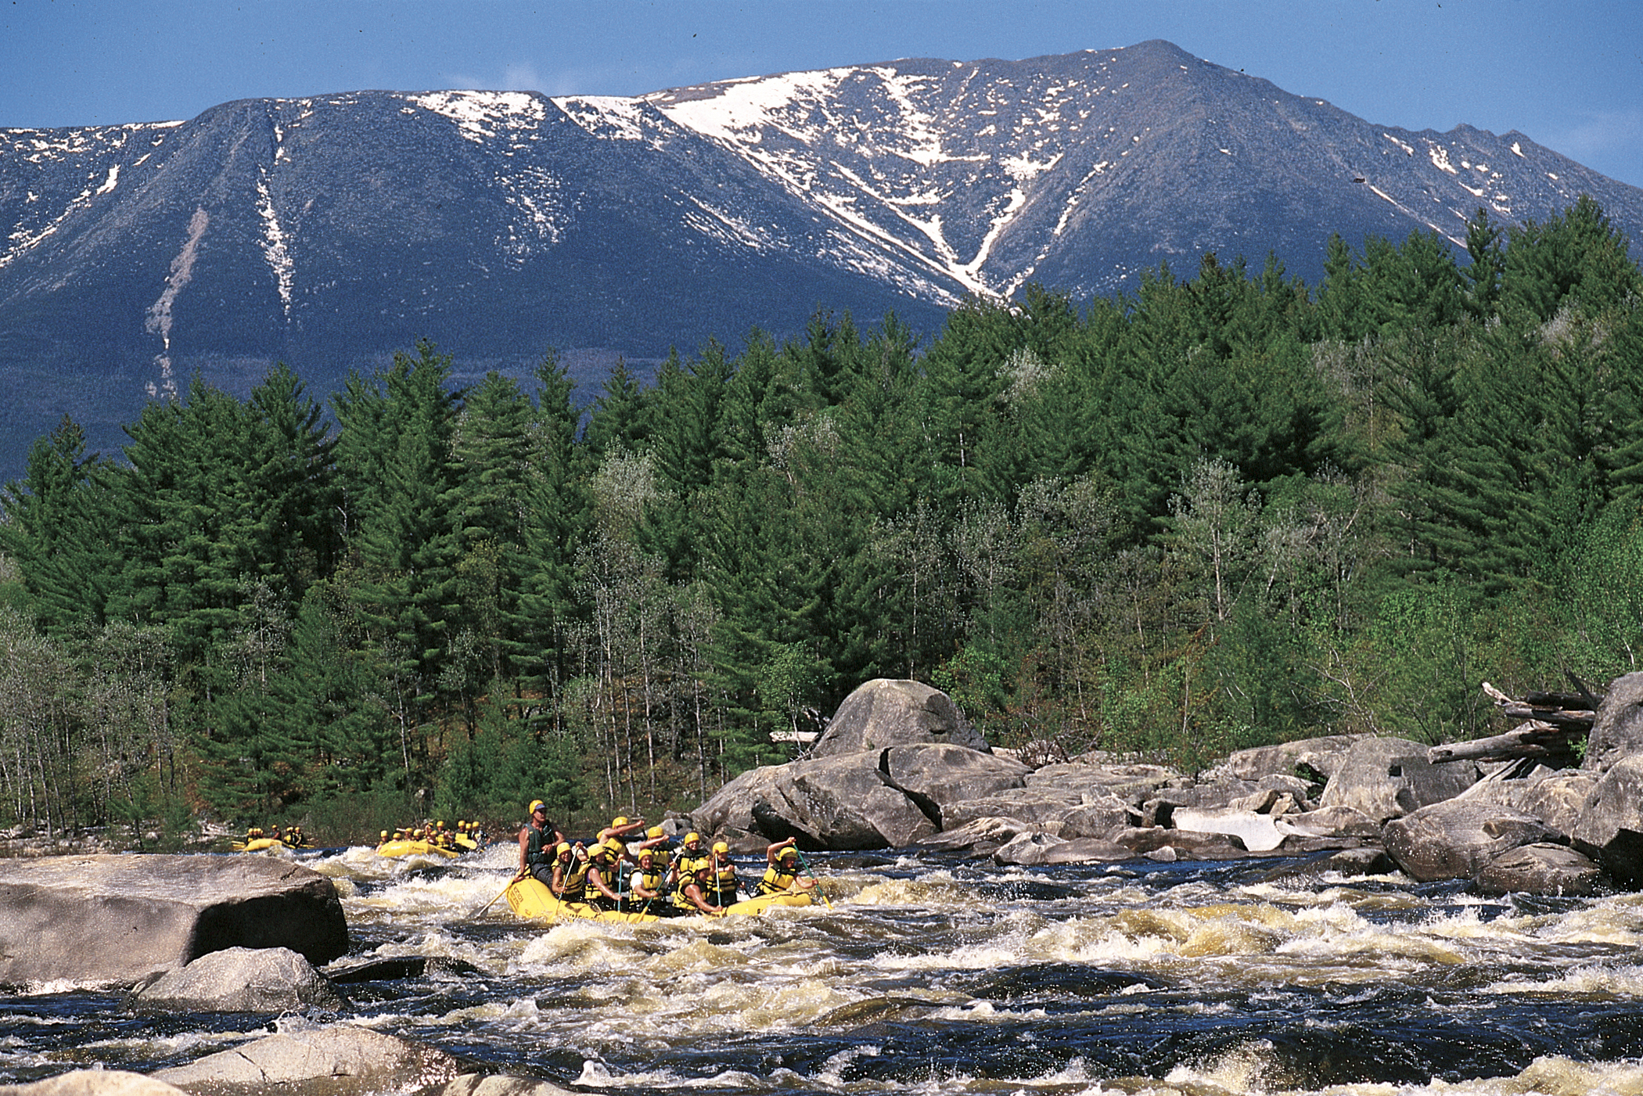
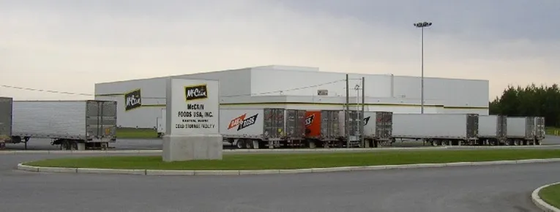
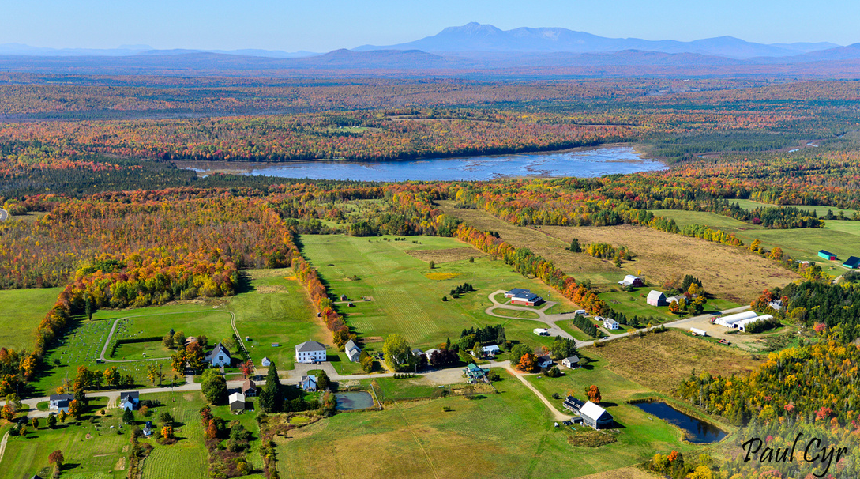
Visioning- Why do you live here

Slide 6
Visioning-Remember why you live here
Perhaps the most overlooked part of the comprehensive planning process
Municipalities want to jump in and write/review. Reactive rather than proactive
True Visioning is the cornerstone of a successful comprehensive plan
There are things some things municipalities have been or are doing to increase participation:
Baking cookies/providing food
Home heating fuel/firewood/gas card raffles
Free transportation to meeting
Booths at festivals/events
Going out and speaking with groups – seniors, recreation, businesses, etc

Slide 7
Visioning- the good and the bad
The Good
The Not So Good
Example: A community envisions itself as having lower crime rates.
Explanation: This vision is too narrow and lacks inspiration. It doesn't paint a picture of a desired future or address underlying issues.
A better vision would focus on creating a safe and inclusive community where residents feel connected and supported.
Limited in scope, lacks inspiration, and fails to address root causes
Example: A community envisions itself as a thriving, sustainable hub where residents enjoy a high quality of life, excellent education, and economic opportunities for all.
Explanation: This vision is inspiring, inclusive, and focuses on long-term outcomes. It provides a clear direction for the community's development.
Aspirational, inclusive, and actionable

Slide 8
The “Nuts and Bolts” or maybe a better term “the stumbling blocks”
Planning Committee
Data Analysis
Future Land Use Plans
The Checklist

Slide 9
The Planning committee
In most cases is the Planning Board.
Well intentioned but often unaware of the time commitment
Often are like minded individuals
After 6-7 months members often burn out and become frustrated
The alternative
Smaller core group of members oversees the entire planning process
Work to bring in other individuals or groups (diverse) to work on certain sections. Agricultural groups for the agriculture section, large land owners, business representatives
In and out in a short period of time but maybe draw interest in other sections.

Slide 10

Data Analysis
Paralysis by analysis- what the heck do we do with all of this information?
Bring it to a manageable level
While a trend isn’t a plan it is often understandable by the planning committee
Instead of worrying about what the 55 year old age group is doing, look at the trend of an aging or a younger population.
Have the conversation of what trends may mean to school enrollments, recreational programs etc

Slide 11
The Land Use Plan
Often the biggest stumbling block of the planning process and usually the most contentious
Many times thought of as a back door zoning ordinance
Growth and rural designations are difficult for the community

Slide 12
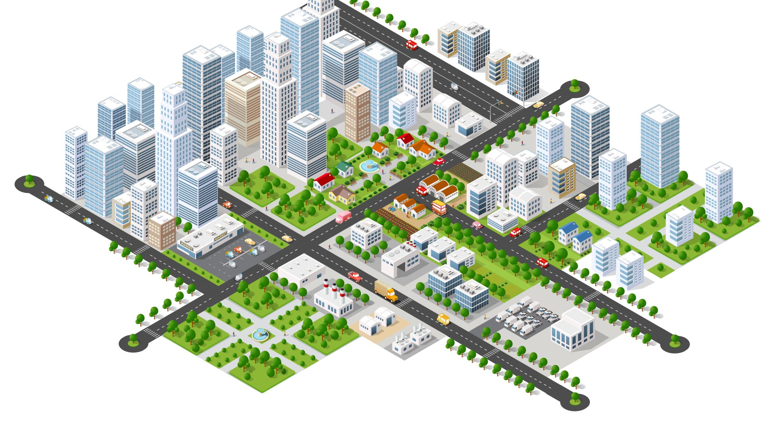
Land Use Plan
The Inventory and Analysis leads to the Land Use Plan.
Helps to manage development and public infrastructure. An uncoordinated pattern of community growth will produce adverse effects on commerce, housing, streets, and public facilities.
One of the most common examples of uncoordinated development is allowing elderly housing to be located where it is inaccessible from the rest of the community.
It does not take long for a community to realize that the entire process of providing services should have been discussed before approving those developments.
Incompatible land uses. Some land may be developed before the community realizes that the land is subject to periodic flooding.

Slide 13
The land Use Plan
We have communities with public sewer (water quality mitigation) that were not designed to accommodate additional growth
What is the correct size- there is no right answer.
We have seen ¾ of a town designated and others just a tiny portion.
In many instances Growth/ Rural exemption

Slide 14
The Land Use Plan
Strong public participation is needed (for the entire plan but particularly for the land use plan).
The designation of Growth and Rural often leaded to the conversations of the “haves vs. have nots.”
Rural designations are thought of as Resource Protection. That should not be the case. Think about what is located there and how do you support the designation
Example Agricultural land uses but then not allowing smaller scale agricultural support such as retail, agritourism etc.
Even non-regulatory strategies can cause problems..”how come my road is chip sealed when the village area is paved?
This is where the Committee often gets cold feet especially when 500 people show up to oppose the Plan.

Slide 15
The Land Use Plan
What is the correct size for a Growth Area? Is there is a right answer?
As planners we need to reduce the fear that this is a “zoning ordinance.”
It is the implementation of the vision…even if the vision is done on the fly.

Slide 16
The Checklist
Somewhat of a Catch 22
Towns seem to like the checklist. Provides guidance and helps them address issues not necessarily thought of.
Ensures that components are addressed for consistency
Sometimes stifles creativity (writing to the test)
A suggestion is to remove the areas not applicable to the municipality. Allagash isn’t concerned with clam flats.
As always, the Plan is the municipalities. There are many other opportunities to be had.

Slide 17

Final Thoughts
Multiple authors- costly in time, money, and political capital
Regional Plans- good if a broad number towns participate
Multi-town plans- we have two. Work well when one govt. is central to all.
Costs- a big stumbling block. Fix a road or plan?
Living in the past-Loring closure in 1994
Unrealistic time frames and expectations. We want a plan on August 5
Times are changing.

Slide 18
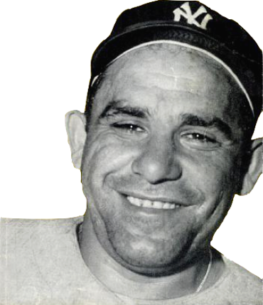
A great Philosopher and word smith once said….
“You got to be careful if you don’t know where you’re going, because you might not get there.”
Yogi Berra

