Slide 1
Transit Outreach & Education
Promoting the use of public transit in maine

Slide 2
Wouldn’t it be awesome if…
Have Transit Information at our fingertips?
We could break the “Stigma” of Public Transit in Maine?
Gain the trust of both young and elder citizens so they would become riders?

Slide 3
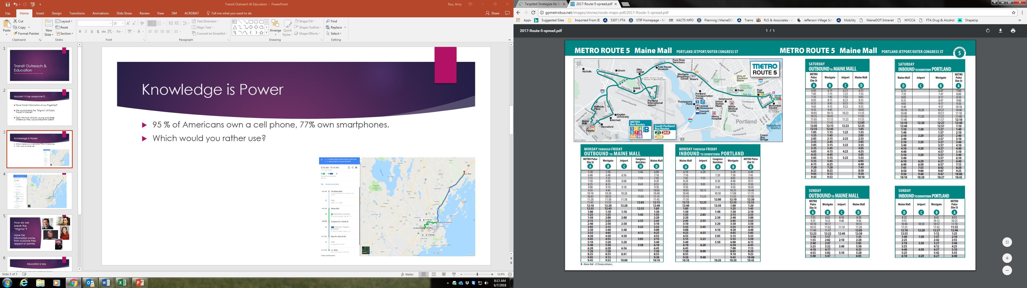
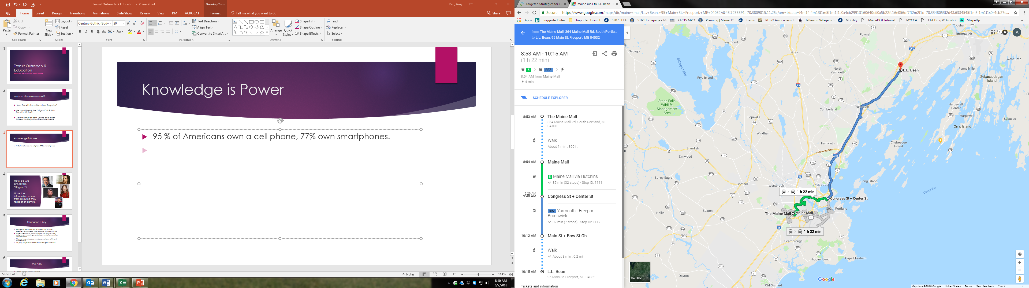
Knowledge is Power
95 % of Americans own a cell phone, 77% own smartphones.
Which would you rather use?

Slide 6

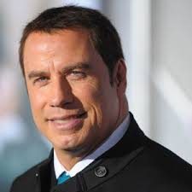



How do we break the “Stigma”?
Have the information come from a source they respect or admire.

Slide 7
No Celebrities, No Problem
Although we may not be able to enlist the help of “local celebrities” to promote our transit agencies, what’s stopping us?
MaineDOT employs a “communications” staff. The staff have backgrounds in marketing and visual communications as well as social networking.
This group has produced commercials on workzone safety and countless others.
The group has great ideas on outreach through social media.

Slide 8
The Plan
Create a “strategic marketing campaign”
Film a series of educational videos.
  Transit 101 – Breakdown types of existing services available
  Value(s) – Show personal and financial benefits of using public transit
  Economic returns, reduction in air pollution, fuel efficiency, reduced traffic, saves money as opposed to owning a second vehicle, increases mobility, Safer, Encourage healthy habits.
  Videos could include shots of regional successes: Seniors making social connections, Businesses building workforce, Commuters making use of transport time, Improved lifestyle through bus staff, Sugarloaf Express testimonials.
  Navigating Public Transit – Regional (tourism regions) informative “How To” videos highlighting area providers; their coverage areas, fees, routes, meet the drivers on a virtual ride… TBD ☺

