Slide 1


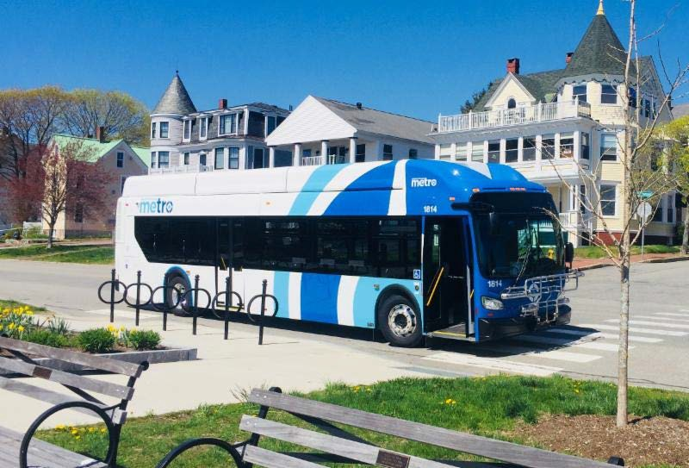

Battery Electric Bus Initiative
Metro | Shuttlebus Zoom
Presentation to Maine Department of Transportation | Multi-modal Committee May 30, 2018

Slide 2

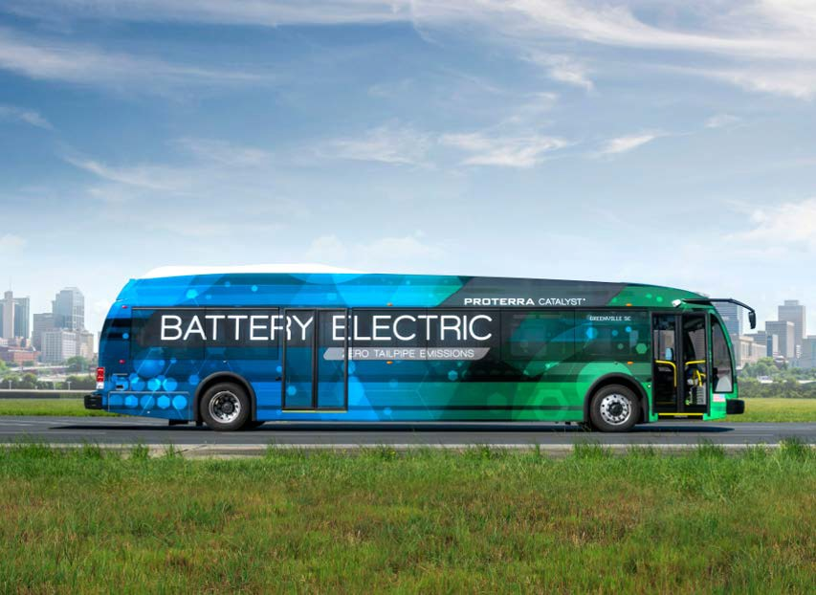
Proposed Project Scope
4-8 Battery Electric Buses
35-40 foot
Replaces pre-2009 existing fleet
Depot + Overhead Charging capability
Manufacturer: Proterra
Project Management: Center for Transportation and the Environment
Federal, State and Local Funding
First phase of a long-term shift to zero emission buses.
Eliminate transit’s impact on local air quality, reduce operating costs,
2

Slide 3
Battery Electric Bus Overview
Number of BEB Manufacturers: 9 (3 legacy transit builders, 6 relative new-comers)
Deployments Nationally: 102 deployments of 655 buses (TCRP, 2018)
Deployments Globally: 173,000 as of 2015 (170,000 in China alone)
FTA Lo-No Grant Program: Incentivizing transit agencies to pursue zero emission buses.
Closest Peers with existing deployments:
MBTA (Boston, MA)
Park City Transit (Park City, Utah)
PVTA (Springfield, MA)
WRTA (Worcester, MA)
3

Slide 4
Battery Electric Bus Overview
Major Historical Challenges:
Capital cost – coming down
Range limitations – going up
Agency technical capacity – external support
Availability and reliability – approaching conventional buses
Extreme climate limits – still a concern depending on duty cycles
Major variables driving BEB project scope:
Bus and route duty cycles (route length, speed, grades, layovers, blocking);
Passenger loads;
Climate and weather;
Layover and transit facility locations and space;
Garage space and power;
Utility rate schedules and costs.
4

Slide 5

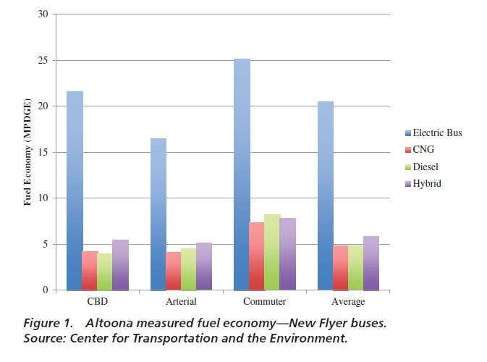
Why Battery Electric Buses? Higher Fuel/Energy Economy
5
Source: Battery Electric Buses – State of the Practice (TCRP, 2018)

Slide 6

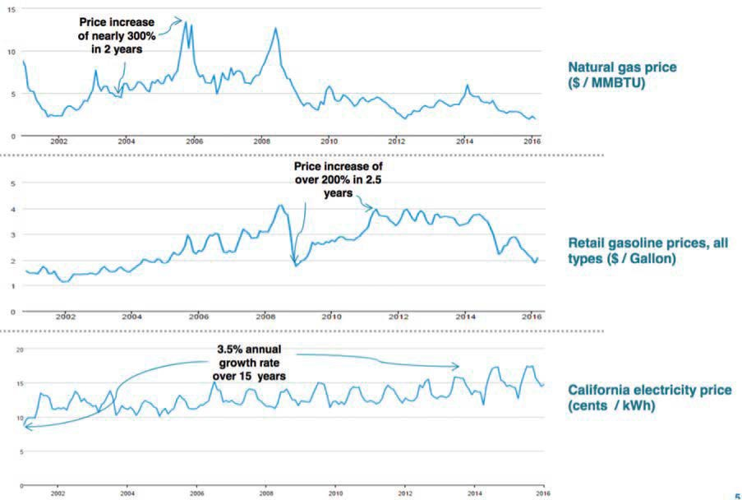
Why Battery Electric Buses? Greater Price Stability
6
Source: Battery Electric Buses – State of the Practice (TCRP, 2018)

Slide 7

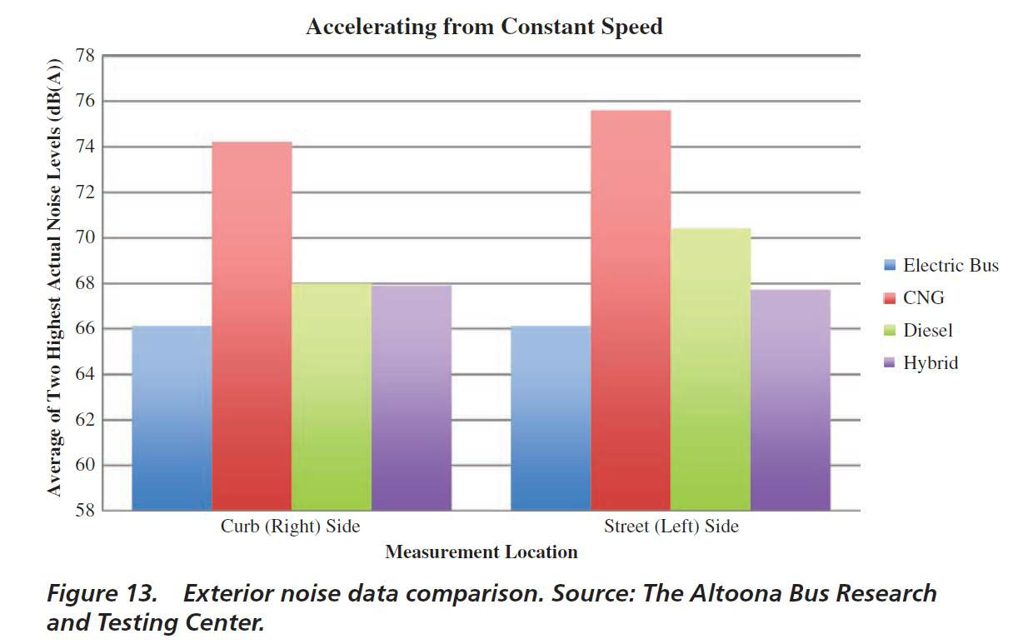
Why Battery Electric Buses? Less Exterior Noise
7
Source: Battery Electric Buses – State of the Practice (TCRP, 2018)

Slide 8

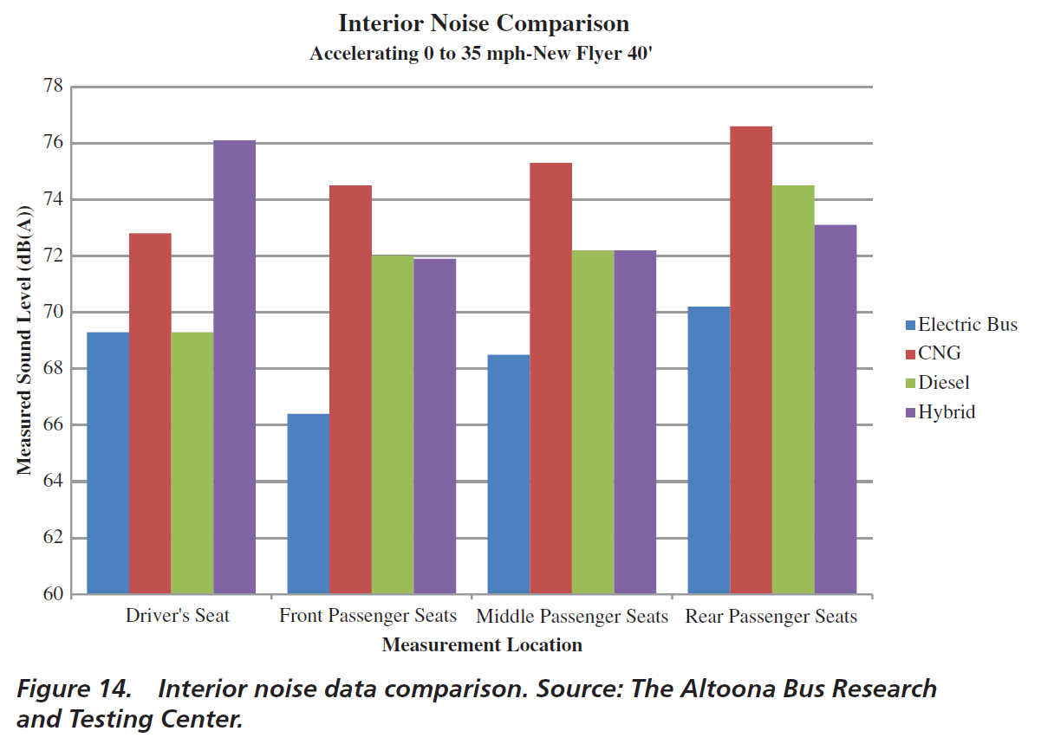
Why Battery Electric Buses? Minimal Interior Noise
8
Source: Battery Electric Buses – State of the Practice (TCRP, 2018)

Slide 9

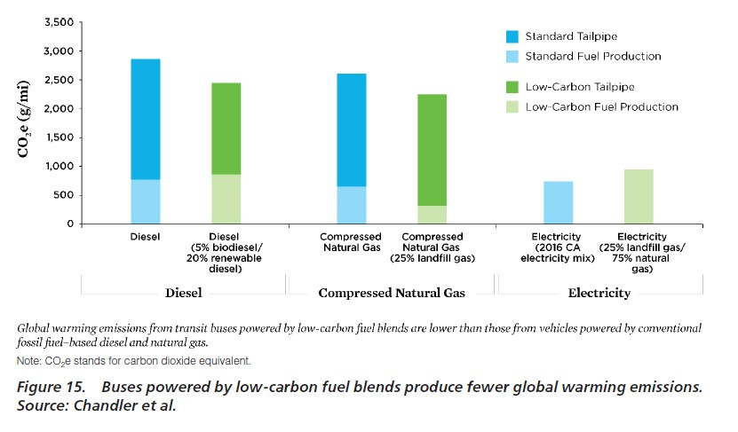
Why Battery Electric Buses? Lower Well-to-Wheel CO₂
9
Source: Battery Electric Buses – State of the Practice (TCRP, 2018)

Slide 10

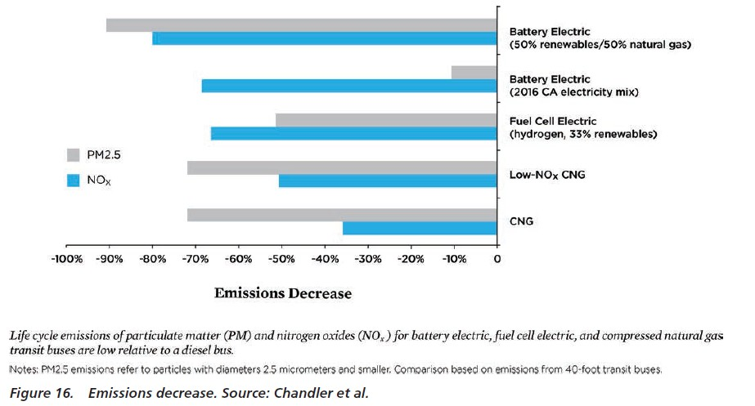
Why Battery Electric Buses? Lower Well-to-Wheel CO₂
10
Source: Battery Electric Buses – State of the Practice (TCRP, 2018)

Slide 11
Why Battery Electric Buses? – Additional Reasons
Lower operating costs – contingent on operating environment, utility rates.
Lower maintenance costs – fewer moving parts to fail, fewer brakes jobs.
Metro’s investment in CNG carries risks due to sole in-state CNG fuel station.
Significant federal grant to support buses, charging infrastructure, and project management and training
Auto, trucking and transit industry is trending toward electric propulsion.
Marketing potential related to zero emission buses can build ridership.
11

Slide 12
Why Now?
FTA Low-No Emission Grant Program ($84 million):
FTA incentives to motivate transit agencies to deploy BEB’s (e.g., waiving procurement req.)
Congress increased program funding from $55 to $84 million.
Program authorized through FFY 2020.
State of Maine VW Settlement Funding:
Eligible use for replacement of pre-2009 diesel buses with electric/zero emission buses.
Metro and Shuttlebus have pre-2009 diesel buses without funding programmed for replacement.
Use of funding practically effective and high profile.
Begin Transition to Zero-emission Fleets
Every near-term diesel/CNG bus purchased slows transition to zero-emission fleet.
Leverage current federal support for extensive project management and training in order to build Maine’s technical capacity.
12

Slide 13
CTE Project Management Services
Coordinates completion of FTA Lo-No Grant Application.
Route modelling to determine optimal deployment.
Rate modelling to determine electricity costs compared to diesel/CNG.
Develops bus specifications and support agencies in executing OEM contract.
Oversees resident vehicle inspections.
Oversees acceptance testing and FTA documentation requirements.
Performance monitoring and reporting.
Completes FTA quarterly reports on grant.
Guides process, knows technology, understands pitfalls, helps agencies build internal capacity.
PACTS Region CAD/AVL Project – PM/Technical consulting costs were 10% of total project cost
13

Slide 14

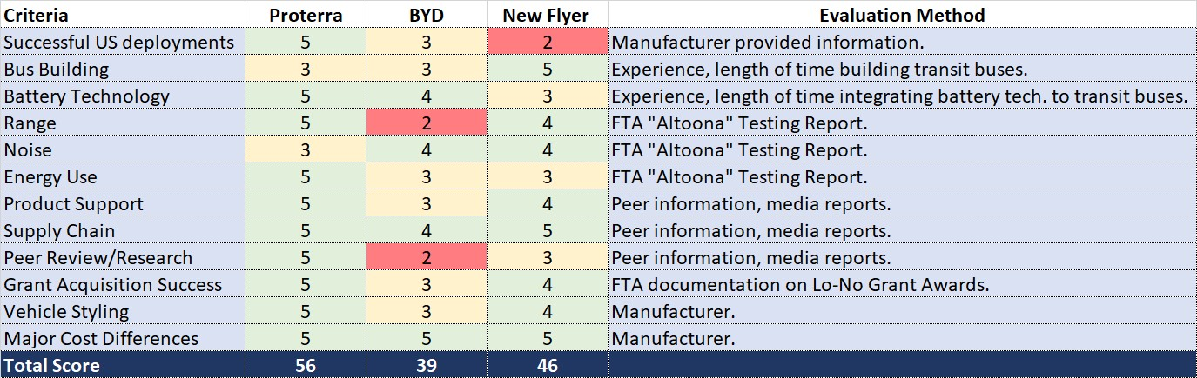
Manufacturer Evaluation
Sources:
FTA Altoona Testing Reports Meetings with Peer Sites Media Reports
Manufacturer Documentation
14

Slide 15
Peer Review on Proterra Buses
WRTA (Worcester, MA); PVTA (Springfield, MA); Park City Transit (Park City, Utah); Foothill Transit (Los Angeles, CA):
Positives:
Satisfied with Proterra’s buses, product-tech support and responsiveness.
Parts availability and shipping are good.
CTE partnership worthwhile at least through production-delivery.
Battery technology.
Negatives:
Parts more expensive
Possible cabin heating concerns
Initial issues with bus building (Worcester, MA): occurred 2013-14 - Resolved
Single front windshield
Lighter weight buses with smaller battery packs not as good in winter
15

Slide 16

Initial Project Scoping
ISSUES | STATUS | OUTCOME
Partner Selection: | Complete | Proterra/CTE
Determine Min. Bus Range Needs: | Complete | Metro requires daily minimum of 175 miles and 17 hours Zoom requires daily minimum of 261 miles and 17 hours.
Utility Coord./Power Evaluation: | In progress | Meeting with Central Maine Power
Electricity Rate Analysis and Costs: | In progress | TBD
Route and Duty Cycle Analyses | In progress | TBD
Charging Model: | In progress | Depot Charging and/or Overhead Conductive
Determine Bus Model/Battery Size: | In progress | Proterra’s E2 has nominal range of 302 miles Factor down x% for cold Factor down y% for grades Factor down z% for high pass. volumes
Model Net Fuel/Maint. Cost Savings: | In progress | TBD
General Funding Approach: | In progress | Cost/Budget Scenarios Developed
16

Slide 17

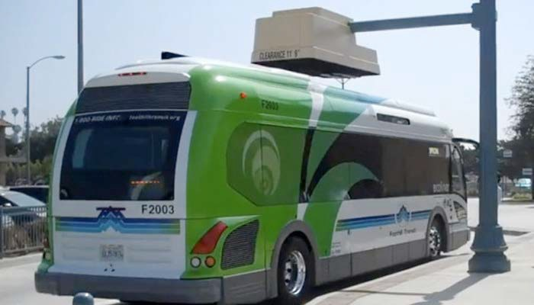

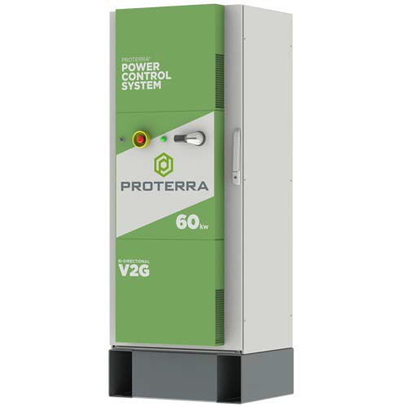

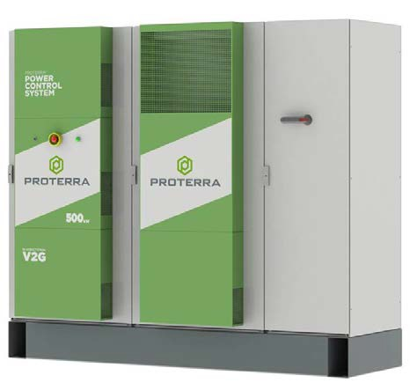
Overhead Charging (On-Route)
Depot Charging (Garage)
17

Slide 18
2018 FTA LOW‐NO EMISSION BUS GRANT PROGRAM
MaineDOT | METRO | SHUTTLEBUS‐ZOOM
Preliminary Cost Estimates and Funding Strategy ‐ Subject to Revision
Revised June 6, 2018
FULL PROJECT | 2 SITES | DEPOT CHARGING + OVERHEAD CHARGING
Project Overview‐Budget |  |  |  |  |  | Proposed Funding Strategy
Project Element | Metro Shuttlebus QTY QTY |  |  | Estimated Unit Cost | Estimated Budget |  | Fed: Lo‐No 59% |  | Fed: 5307 3% |  | State 33% |  | Local 5% | Total 100%
Buses | 4 | 4 | $ 750,000 |  | $ 6,000,000 | 38% | $ 2,280,000 | 5% | $ 300,000 | 50% | $ 3,000,000 | 7% | $ 420,000 | $ 6,000,000
Initial Parts Inventory | 1 | 1 | $ 50,000 |  | $ 100,000 | 100% | $ 100,000 | 0% | $ ‐ | 0% | $ ‐ | 0% | $ ‐ | $ 100,000
Depot Chargers | 4 | 4 | $ 50,000 |  | $ 400,000 | 100% | $ 400,000 | 0% | $ ‐ | 0% | $ ‐ | 0% | $ ‐ | $ 400,000
Depot Charger Installation Engineering | 1 | 1 | $ 25,000 |  | $ 50,000 | 100% | $ 50,000 | 0% | $ ‐ | 0% | $ ‐ | 0% | $ ‐ | $ 50,000
Transformer to Facilty | 1 | 1 | $ 30,000 |  | $ 60,000 | 100% | $ 60,000 | 0% | $ ‐ | 0% | $ ‐ | 0% | $ ‐ | $ 60,000
Depot Charger Installation | 4 | 4 | $ 60,000 |  | $ 480,000 | 100% | $ 480,000 | 0% | $ ‐ | 0% | $ ‐ | 0% | $ ‐ | $ 480,000
Overhead Charging Unit | 1 | 1 | $ 350,000 |  | $ 700,000 | 100% | $ 700,000 | 0% | $ ‐ | 0% | $ ‐ | 0% | $ ‐ | $ 700,000
Overhead Charging Engineering | 1 | 1 | $ 50,000 |  | $ 100,000 | 100% | $ 100,000 | 0% | $ ‐ | 0% | $ ‐ | 0% | $ ‐ | $ 100,000
Overhead Charging Installation | 1 | 1 | $ 250,000 |  | $ 500,000 | 100% | $ 500,000 | 0% | $ ‐ | 0% | $ ‐ | 0% | $ ‐ | $ 500,000
Project Management* | 1 | 1 | $ 270,000 |  | $ 540,000 | 100% | $ 540,000 | 0% | $ ‐ | 0% | $ ‐ | 0% | $ ‐ | $ 540,000
Training | 1 | 1 | $ 50,000 |  | $ 100,000 | 100% | $ 100,000 | 0% | $ ‐ | 0% | $ ‐ | 0% | $ ‐ | $ 100,000
Sub‐total |  |  |  |  | $ 9,030,000 |  | $ 5,310,000 |  | $ 300,000 |  | $ 3,000,000 |  | $ 420,000 | $ 9,030,000

Slide 19
Timeline and Milestones
FTA Lo-No Grant Submittal Deadline:
Anticipated Award Notices:
Contract Execution with Proterra/CTE:
Bus Production (14 months):
Anticipated Delivery:
Testing-Acceptance:
Revenue Service:
June 18, 2018
September 2018
October-December 2018
January 2019-February 2020
February 2020
February-March 2020
Late Spring 2020
18

