Slide 1
Long-Range
Transportation Plan
Public Transit Advisory Council
June 7, 2018
Jennifer Grant, Policy Development Specialist

Slide 2
Long-Range Transportation Plan
Assumptions and Trends
MaineDOT’s Goals
MaineDOT’s Current Strategies
Stakeholder Involvement
Project Timeline
Feedback/Thoughts?

Slide 3
Assumptions
Focus will remain on asset management and maintaining/preserving the system
Performance targets/measures will drive prioritization of investments
Funding needs will increase as availability of funds remains static or decreases

Slide 4
Trends
Aging Population
Labor Market/Low Unemployment
Global Trade/Freight Movement
Urbanization/Shifting Population
Tourism
Technology
Safety
Climate

Slide 5
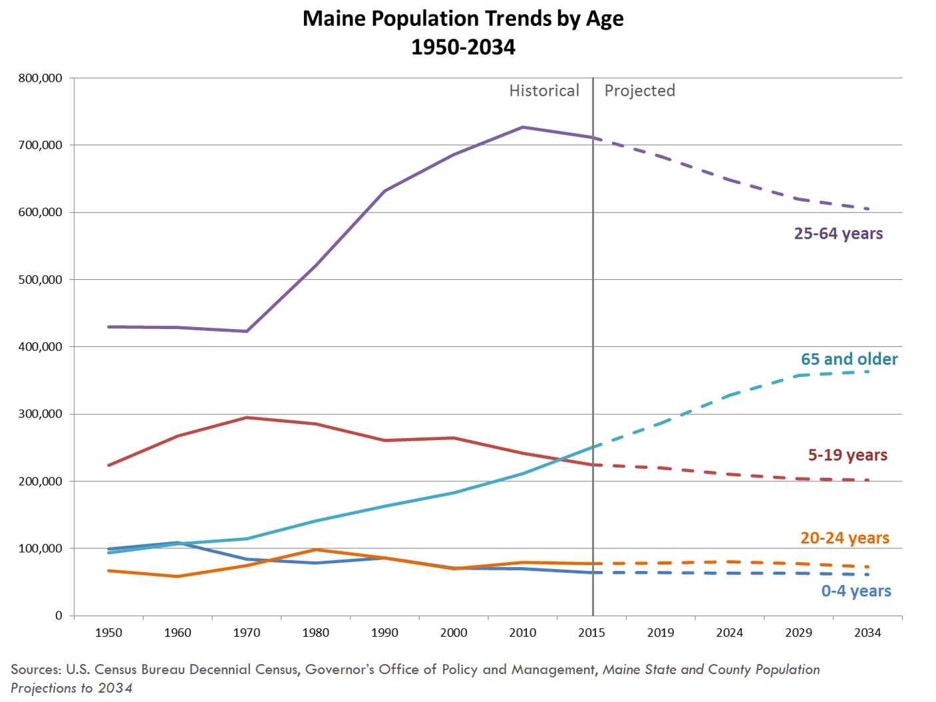
Aging Population
Maine no longer has positive natural change. This trend is expected to continue as baby boomers advance in age.
The prime working-age population is declining and Maine has the oldest median-age of any state in the nation.
Source: US Census Bureau and Maine Dept. of Labor
Notes:
Maine no longer has positive natural change. This trend is expected to continue as baby boomers advance in age.
The prime working-age population is declining and Maine has the oldest median-age of any state in the nation.
More Mainers are aging in place
Some will continue driving which may increase crashes
Others will seek transportation services but will they be available?
Autonomous vehicles may be part of solution
Economy will need to change to adapt to older population
Potential for new pedestrian- and transit- friendly housing

Slide 6
How important is the trend of an Aging Population in shaping the future of transportation in Maine?
Not Important
Less Important
Important
Very Important
Extremely Important

Slide 7
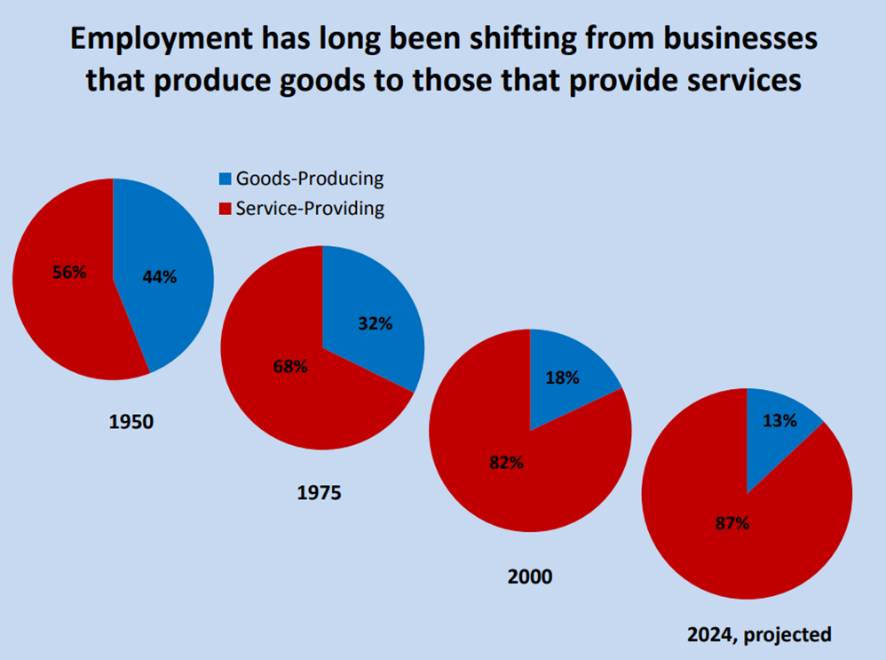
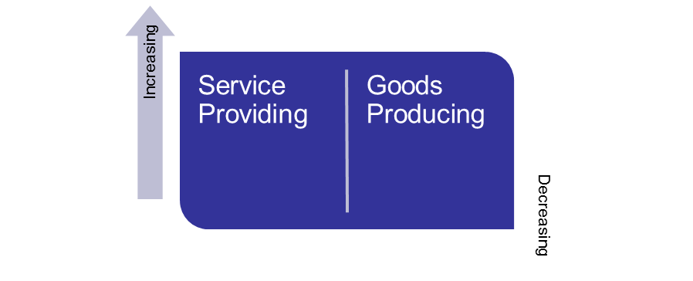
Labor Market/Low Unemployment
Record Low Unemployment
Aging Population, Declining Birth rate
Slow population growth
Smaller labor force
Center for Workforce Research Maine Dept. of Labor www.maine.gov/labor/cwri
What’s happening

Slide 8
How important is the trend of the Labor Market/Low Unemployment in shaping the future of transportation in Maine?
Not Important
Less Important
Important
Very Important
Extremely Important

Slide 9
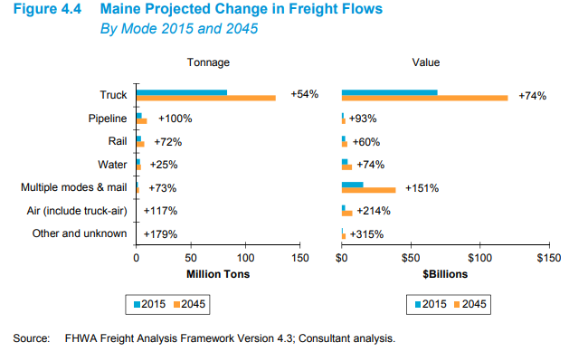
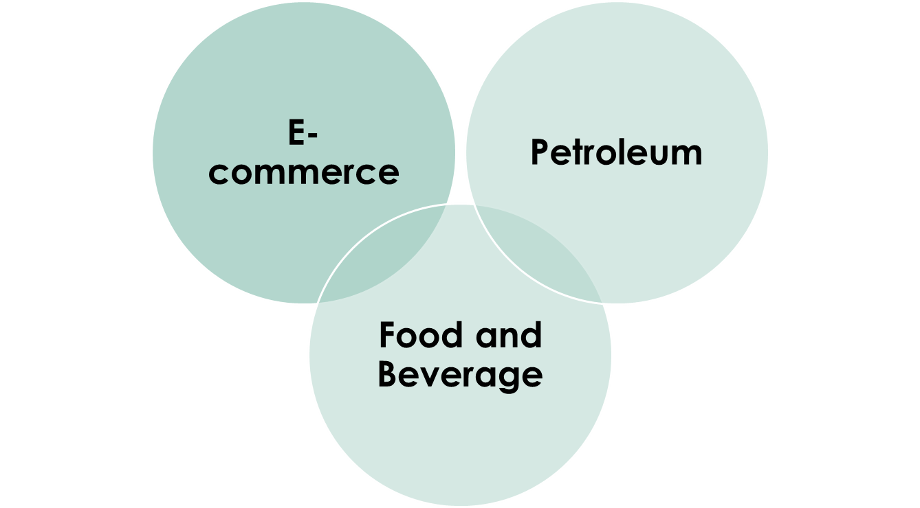
Global Trade/Freight Movement
Projected growth 2-3%/year over next 30 years
Freight flows expected to grow 56% by tonnage and 91% in value by 2045
Maine is capitalizing on niche markets
Ability to be a big player with geographic location
Trucks will still dominate freight movement in and out of Maine

Slide 10
How important is the trend of Global Trade/Freight Movement in shaping the future of transportation in Maine?
Not Important
Less Important
Important
Very Important
Extremely Important

Slide 11
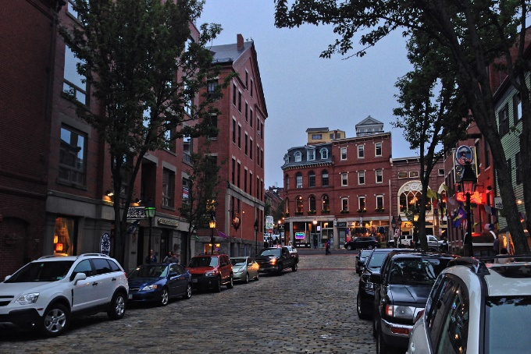
Urbanization/Shifting Population
Notes:
May increase regional congestion.

Slide 12
How important is the trend of Urbanization/Shifting Population in shaping the future of transportation in Maine?
Not Important
Less Important
Important
Very Important
Extremely Important

Slide 13
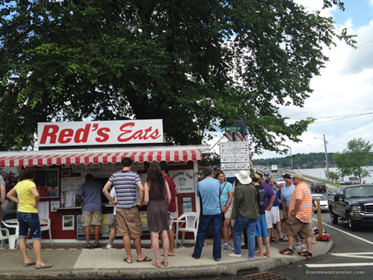
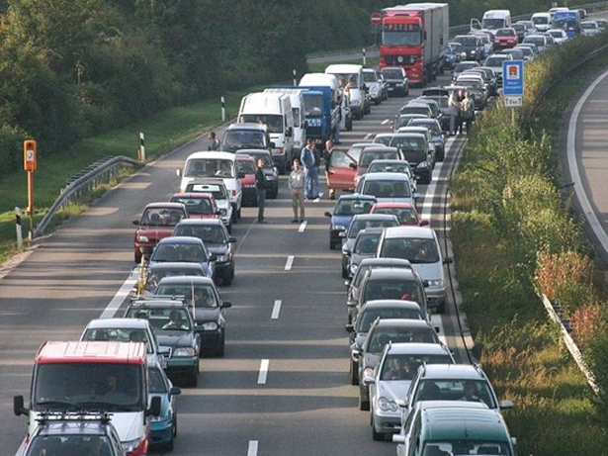
Tourism
Low Unemployment, Gas Prices
Food, beverage and culinary activities; sightseeing popular
Family-friendly, natural appeal
Notes:
May increase seasonal congestion.

Slide 14
How important is the trend of Tourism in shaping the future of transportation in Maine?
Not Important
Less Important
Important
Very Important
Extremely Important

Slide 15
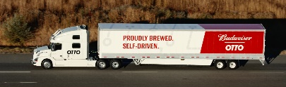
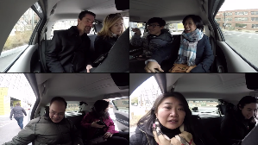
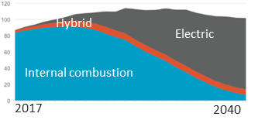
Technology
There has been an automated beer delivery and automated Lyft trips
Automated vehicles, artificial intelligence, and blockchain technology could hit their tipping point within 10 years, continuing to drive smart cities and shared mobility
Otto delivers beer automatically
Cities in Maine are already getting smarter
Automated Lyft in Boston’s Seaport
Investment in automated vehicles should continue at a rapid pace, while the electric vehicles market share is continuing to grow
Smart street lights in Maine
cities and towns
The majority of new vehicles sold in 2040 could be electric
Source: Loup Ventures, Bloomberg New Energy Finance 2017
Notes:
Technology has ability to revolutionize transportation, but:
-Most of the research has been focused on urban (not rural) areas
-There are privacy concerns
-Mainers may not want to be at the forefront of this revolution (or even open to some of it at all)

Slide 16
How important is the trend of Technology in shaping the future of transportation in Maine?
Not Important
Less Important
Important
Very Important
Extremely Important

Slide 17
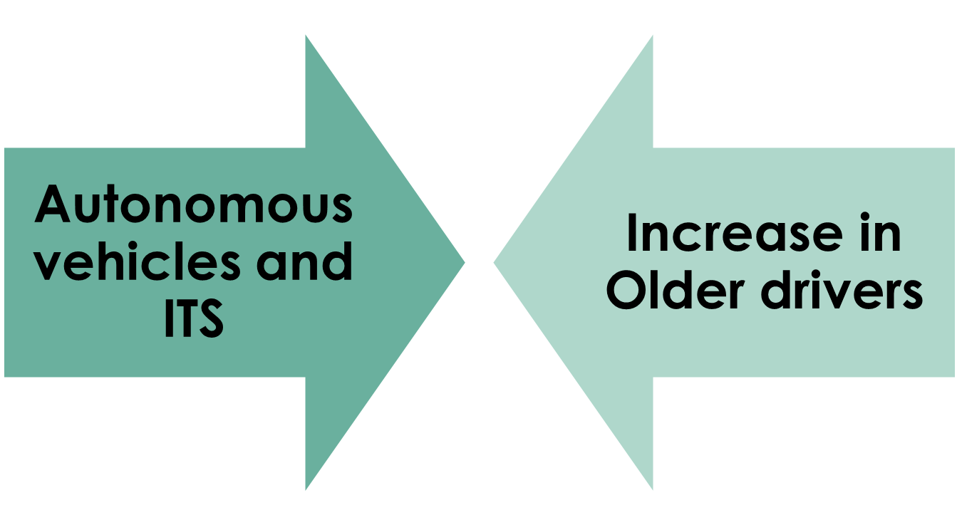
Safety
Notes:
With technological advances in transportation, safety could be vastly improved, crashes and fatalities could decrease dramatically, but with the increase in older drivers, those advances could be challenged.

Slide 18
How important is the issue of Safety in shaping the future of transportation in Maine?
Not Important
Less Important
Important
Very Important
Extremely Important

Slide 19
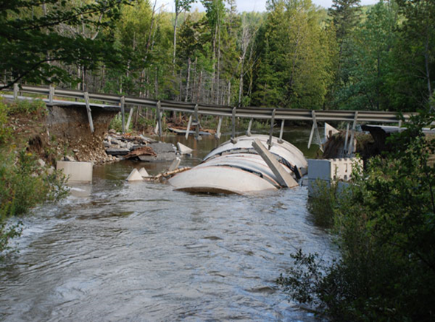
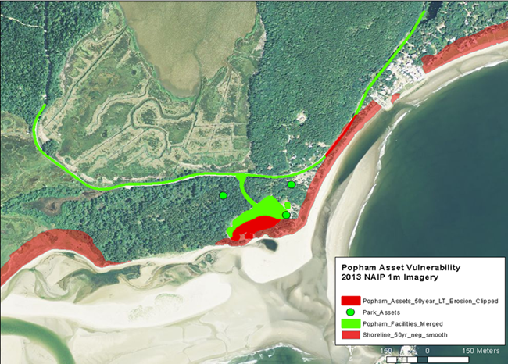
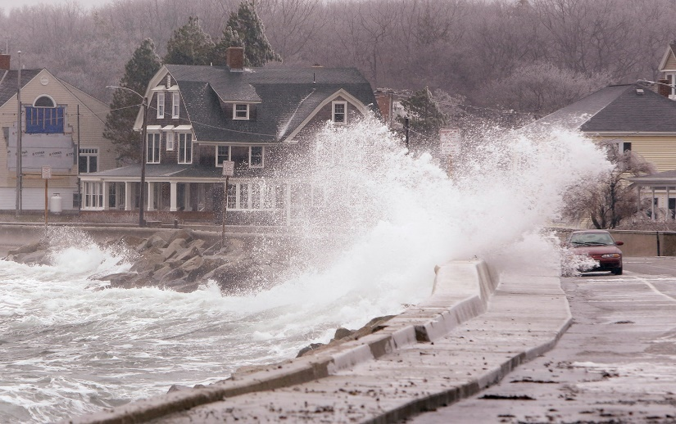
Climate
Current and Future Risks
Extreme weather events
Sea Level Rise
Storm Surge
Notes:
What we found, is that the closer we got to proving the concept of TRAPPD, the less comfortable some of our peers were with considering the less predictable aspects of risk. This is the “overcoming challenges” part of the outline for this talk.

Slide 20
How important is the issue of Climate in shaping the future of transportation in Maine?
Not Important
Less Important
Important
Very Important
Extremely Important

Slide 21
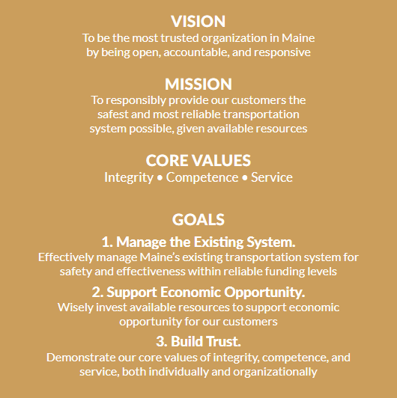
MaineDOT’s Vision, Goals and Strategies
Current Strategies
Maintain and preserve the existing system utilizing asset/performance management strategies
Maximize investments from grants
Partner engagement
Streamline regulatory compliance processes
Notes:
How do these align or mesh with the transportation trends we’ve identified and what will be the implications moving forward?
How will these trends help shape our goals for the transportation system in Maine?
What sort of gaps do you see?

Slide 22
Stakeholder Involvement
RPOs, Non-Metropolitan Officials
Business Community
MPOs
Private Providers of Transportation
Providers and Users of Public Transportation
Ports, Freight Shippers
State Agencies
Tribal Governments
LRTP
Focus Groups
Meetings
Surveys
Public Forums
Notes:
These are some of the stakeholders we plan to engage with, in addition to the general public.

Slide 23
Maine LRTP Update Schedule
May
June
July
August
September
October
Develop Background Resources
Trends | Public Involvement Plan | Requirements | Existing Works
Public & Partner Engagement
Public Survey | Partner Meetings
Develop Technical Resources
Needs | Strategies | System Performance Report | Performance Management Framework | Refine Vision, Goals, and Objectives
Develop Draft LRTP
Public Comment | Final Vision, Goals, and Objectives
Plan Roll Out
Federal Review | Implementation

Slide 24
Feedback/Thoughts?
Are we missing anything?
What is your vision for the future of transportation in Maine?
Notes:
How can MaineDOT prepare in light of all the unknowns?

