Slide 1
Maine Shared Community Health Needs Assessment
Integrating Hospital Community Benefit Requirements
and Public Health Accreditation Standards
Jo Morrissey, CPH, Maine Shared CHNA Program Manager
Notes:
Thank MaryAnn Hayes for generously inviting me here and for the time and attention from the group.

Slide 2
Why?
The purpose of the Maine Shared Community Health Needs Assessment (CHNA) is to:
Prioritize health needs based on community feedback
List resources to address those health needs
Create a report to use in future health improvement planning.
Notes:
It is highly recommended we gather input from members of:
Tribal government
Public health departments
Local and state government
Who have knowledge, information, or expertise relevant to the health needs of the community.
This includes hearing from individuals or organizations serving or representing the interests of the medically underserved, low-income and minority populations who live in the community served by the area’s hospital or public health department.
The definition of medically underserved include populations experiencing health disparities or at risk of not receiving adequate medical care as a result of being uninsured or underinsured or due to geographic, language, financial, or other barriers.

Slide 3

Identifies priorities
Collaborative process
Required every 5 years
Describes:
  Health status
  Determinants of health
  Health Disparities
  Community Assets
Informs Public Health Improvement Plans
Identifies priorities
Collaborative process
Required every 3 years
Community input from:
  Minority populations
  Low-income populations
  Underserved populations
Informs Community Benefit Implementation Strategies
Images of PHAB and IRS from the internet
Notes:
This is a very brief overview of the requirements the health departments and non-profit hospitals have for health assessments. There are more similarities than differences, and no real contradictions.
PHAB requirements focus on the collaborative process. They make suggestions on who to include, but no specific requirements. IRS also has specific requirements on who to include, although they allow for “representatives who serve these populations” instead of members of these populations.
Both require the identification of priorities. Hospitals are required to document the process, the implementation strategies chosen to address health priorities, and progress annually thereafter.
whereas the PHAB requirements see the Health Assessment and the Health Improvement Plan as two separate processes.

Slide 4
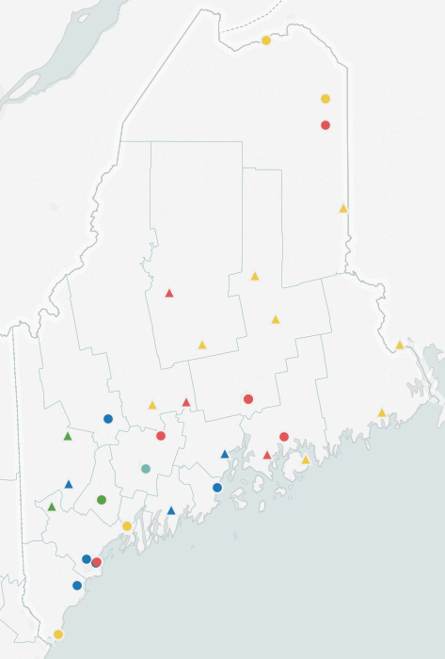
Maine’s Structure:
Four Maine Shared CHNA partners
  (“major health systems”)
  22 affiliated hospitals, including
    2 mental health hospitals
    1 rehab specialty hospital
    8 critical access hospitals
14 “independent hospitals”
  Not part of any of the four “health systems”
  7 critical access hospitals
  Many are non-funding partners in the Maine Shared CHNA
Notes:
Maine currently has 36 hospitals, all non-profit, including 15 critical access hospitals.
Blue, Green and Red dots are hospitals affiliated with the Maine Shared CHNA partners (EMHS, Central Maine, Maine Health, Maine General)
Yellow dots are unaffiliated hospitals, although many are active in the Community engagement process of the Maine Shared CHNA and use the data profiles for their own CHNA.
Triangles are critical
In the 2010 OneMaine Health needs Assessment, Aroostook and Washington Counties 57% and 62 % of survey recipients reported the need to travel outside their area or region for needed health service. (page 107) access hospitals, circles are not.

Slide 5
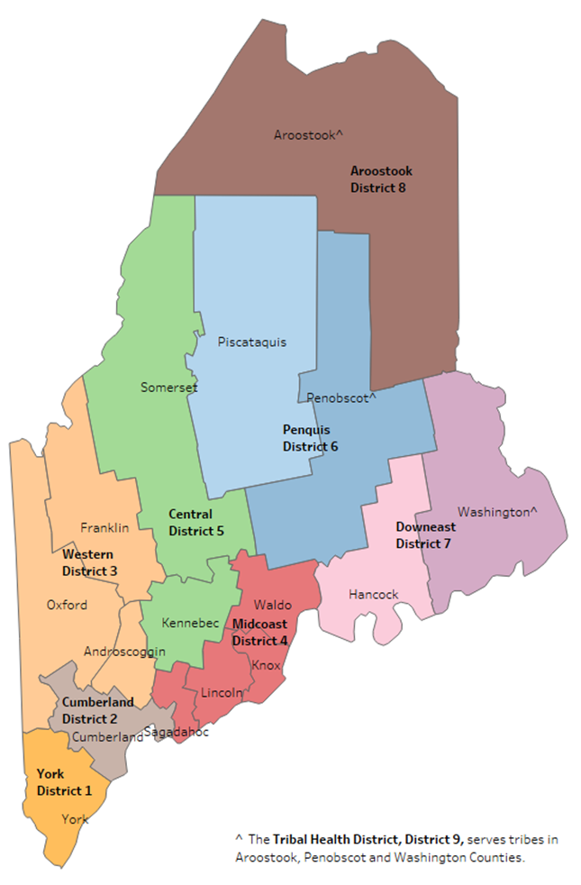
Maine’s Structure:
One accredited State Health Agency (Maine CDC)
  Nine Public Health Districts
  Eight are county-based (serving 16 counties),
  Tribal Health District serves Maine’s four federal recognized Tribes
One accredited Local Health Department (Portland)
One yet-to-be accredited Local Health Department (Bangor)
Notes:
Maine does not have county health departments, and most state health department services are centralized, with contracts with a variety of community-based organizations for local-level services. Each Public Health District has a lead staff person, and a District Coordinating Council, made up of local organization representatives (including health care). The DCC lead district-wide planning processes.
Our two largest cities have the only local public health agencies.

Slide 6
The OneMaine Health
Collaborative forms
(three hospital systems)
2007
First round of statewide forums take place
2010 CHNA Reports published
2010
Maine CDC creates the 2012 State Health Assessment, and joins the OneMaine Health Systems in the Shared CHNA
2012
Central Maine Healthcare joins the Maine Shared CHNA partnership. Maine CDC develops the 2013-2017 State Health Improvement Plan
2013
Formal MOU signed
IRS CHNA rules come into effect
2014
2016 CHNA Reports published;
Second round of forums held;
2016-2018 hospital Implementation
strategies adopted;
District Public Health Improvement Plans developed
2016
2018-2020 SHIP developed
Renamed Collaborative to:
Maine Shared CHNA
2017
Notes:
The first joint community health assessment began as the OneMaine Health Collaborative created in 2007 as a partnership between Eastern Maine Health System, MaineGeneral Health, and MaineHealth. County level reports were created. They enlisted the District Coordinating Councils to assist with the 2010 community forums. Maine CDC created its own State Health Assessment in 2012.
After conversations at the Statewide Coordinating Council for Public Health, the Maine CDC joined these entities, along with other partners in 2012. Central Maine Healthcare joined the group in 2013. In 2014, a formal Memorandum of Understanding was signed by all the above named collaborators.

Slide 7
Structure
Program Manager
Metrics
Committee
Community Engagement
Steering Committee
Vendor:
Market
Decisions
Notes:
The Metrics Committee is charged with creating a
[a] common set of population/community health indicators and measures (core and extended lists);
[b] preliminary data analysis plan (to identify scope of work for Maine CDC and MAINE SHARED CHNA vendor);
[c] processes for reviewing indicators and measures regularly to stay abreast of research; and
[d] recommendations for annual data-related activities and projected costs associated with recommendations.

Slide 8
Metrics Committee
The primary role of this committee is to select indicators for quantitative analyses.
  ~196Indicators
  24 Topics
  31 Data Sources
They provided input on data presentation and display (both printed and on-line displays).
Notes:
Topics include general health, infectious and chronic diseases, environmental health, birth outcomes, cancer, injury, substance use, tobacco , mental health, oral health.
Our transportation-related indicators include:
Alcohol impaired driving deaths
Long Commute—driving alone
% living in rural areas
Ratio of Dentists, Primary Care Physicians, and Mental Health Providers by County
Major data sources are BRFSS, the Maine Integrated Youth Health Survey (Maines version of the YRBS), mortality, cancer registry, hospital discharge data, census data.

Slide 9
Structure
Program Manager
Metrics
Committee
Community Engagement
Steering Committee
Vendor:
Market
Decisions
Notes:
The Community Engagement Committee is charged with creating a
[a] disseminating Shared CHNA state and county-level results;
[b] identifying priorities among significant health issues; and
[c] identifying local, regional, or statewide assets and resources that may potentially address the significant health needs identified.
In order to do this work, the CE committee strives for multi-sector participation (government, non-government, subject matter experts, academia, healthcare, representatives of the underserved populations.
Recruitment for involvement is ongoing and open to any interested parties with an investment in the Maine Shared CHNA Mission and vision which is to make Maine the healthiest state in the U.S.

Slide 10
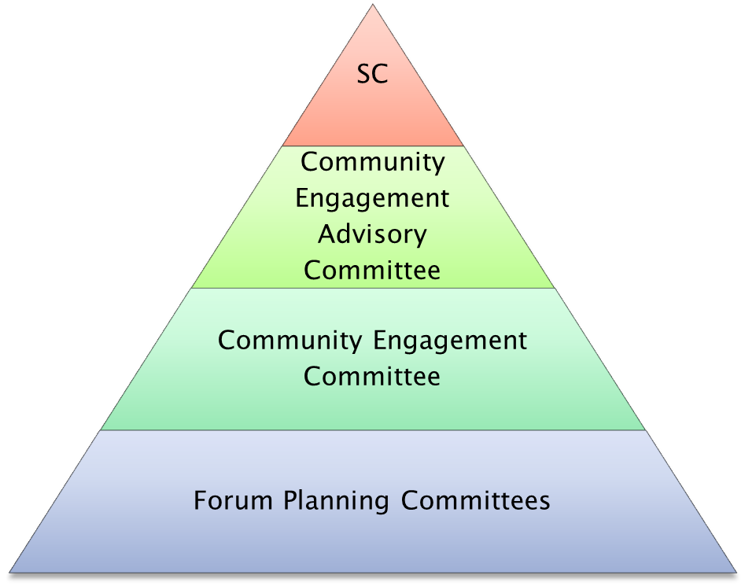
Goals, Roles, & Responsibilities
Provides leadership and stewardship of resources.
Develops timelines, reviews agendas, defines goals, advises PM
Revises guidelines and methodology to meet goals. Develops work plans. Consults on forum materials. Adds timeline details, defines assets
Implements work plans Plans, conducts, and reports on forums, helps to further define assets; provides for a robust CE involvement process
Notes:
The current governing structure of the Maine Shared CHNA.

Slide 11
DRAFT Forum Agenda—as of 5-10
Time Spent | Activity | Speaker/Facilitator
5 minutes | Welcome and Introductions | Local Facilitator
10-15 minutes | Review previous CHNA Priorities and activities since last effort; 2-3 slides supported by a handout. Handout to include comprehensive list of partners and community assets as well as strategies. Compiled by local planning committees. Template to come. | Local Facilitator
25 minutes | Present key findings from Data Profile Q&A | JSI
Option A: Large Attendance 45 minutes Option B: Small Attendance: 35 minutes | Facilitated discussion in breakouts Facilitated discussion in one large group | JSI & Local Facilitator(s) Either JSI or Local Facilitator
20 minutes | Collect Table Responses Clicker voting to prioritize | JSI
10 minutes | Wrap up and next steps | Either JSI or Local Facilitator
Forum Outcomes:
Identify health priorities
Begin to identify community assets to address identified priorities
Strengthen community connections to address health needs
Notes:
Overall prioritization process: Discuss data in full group. Use breakouts to discuss and process the data and choose priorities. For large attendance sessions process as a whole room. A table nominated reporter will present priorities and load them into the clicker program, or report out for full session voting process if clicker program is unavailable.” Entire group votes on top 3 – 4 priorities.
Still on the docket: The actual questions asked during breakouts, survey questions and key informant interview questions.

Slide 12
Combined DPHIP and IS Plan Priorities Maine 2016-2018
Priority Area | Hospital | PHD | Total
Substance Use | 31 | 7 | 38
Obesity | 29 | 8 | 37
MH Services | 19 | 4 | 23
Tobacco/lung health | 14 | 1 | 15
Access to Care | 13 | 0 | 13
CVD | 9 | 3 | 12
hunger/food security/HEALTHY FOOD | 7 | 1 | 8
 | shaded are top 4 per category
Notes:
This is a quick look at what communities across the state said their top health priorities were in the 2015-2016 chna process.
Many other priorities were identified, these were just the ones most often chosen. Other priorities include lead, health literacy, health aging, oral health, transportation, immunizations, adverse childhood experiences, and chronic disease.

Slide 13
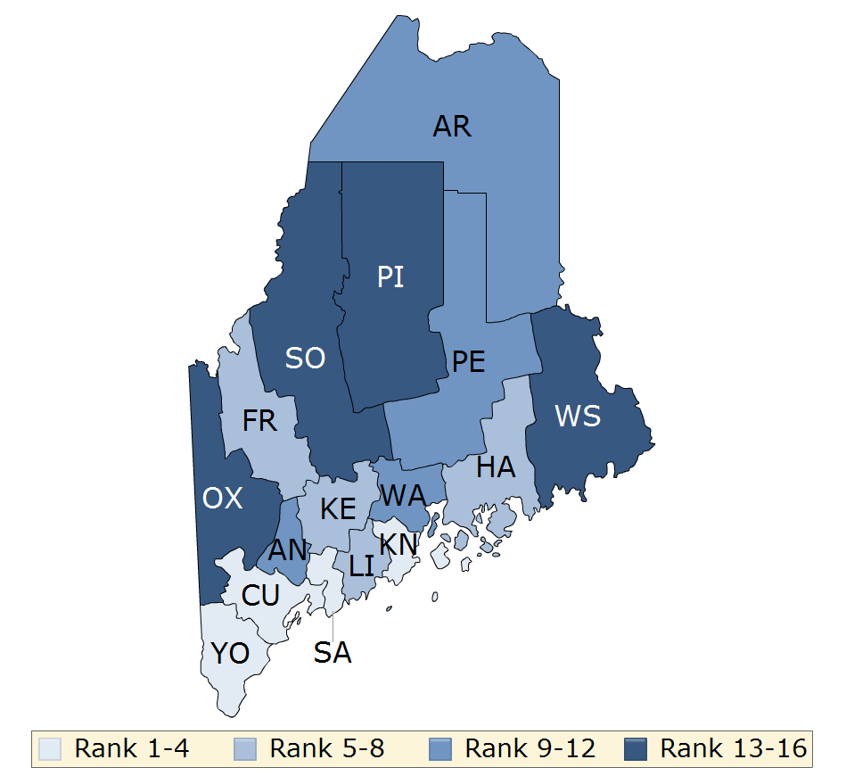
Health Factors
Source: County Health Rankings
Notes:
The map shows distribution of Maine's health factors based on weighted scores for health behaviors, clinical care, social and economic factors, and the physical environment.
In the 2010 OneMaine Health needs Assessment, Aroostook and Washington Counties 57% and 62 % of survey recipients reported the need to travel outside their area or region for needed health service. (page 107)
The map is divided into four equal quartiles with less color intensity indicating better performance in the respective summary rankings.

Slide 14
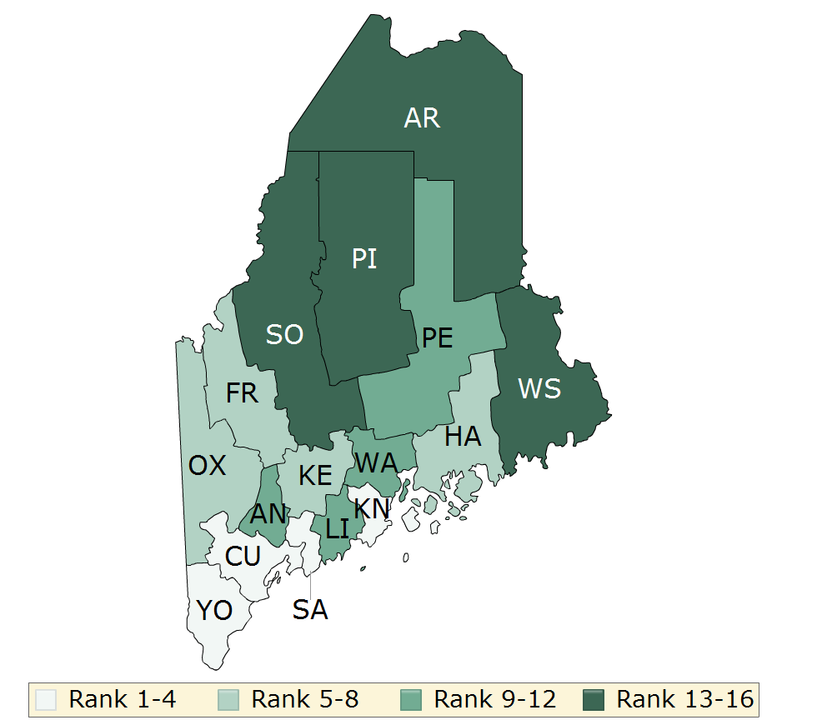
Health Outcomes
Source: County Health Rankings
Notes:
The map shows distribution of Maine’s health outcomes based on equal weighting of length and quality of life.
Note Aroostook, Piscatiquis, Somerset and Washington county are in the lowest quartile.
They also rank below the state average for Physical Activity, Access to exercise opportunities, and social associations (isolation),
The map is divided into four equal quartiles with less color intensity indicating better performance in the respective summary rankings.

Slide 15
Source: County Health Rankings

Slide 16
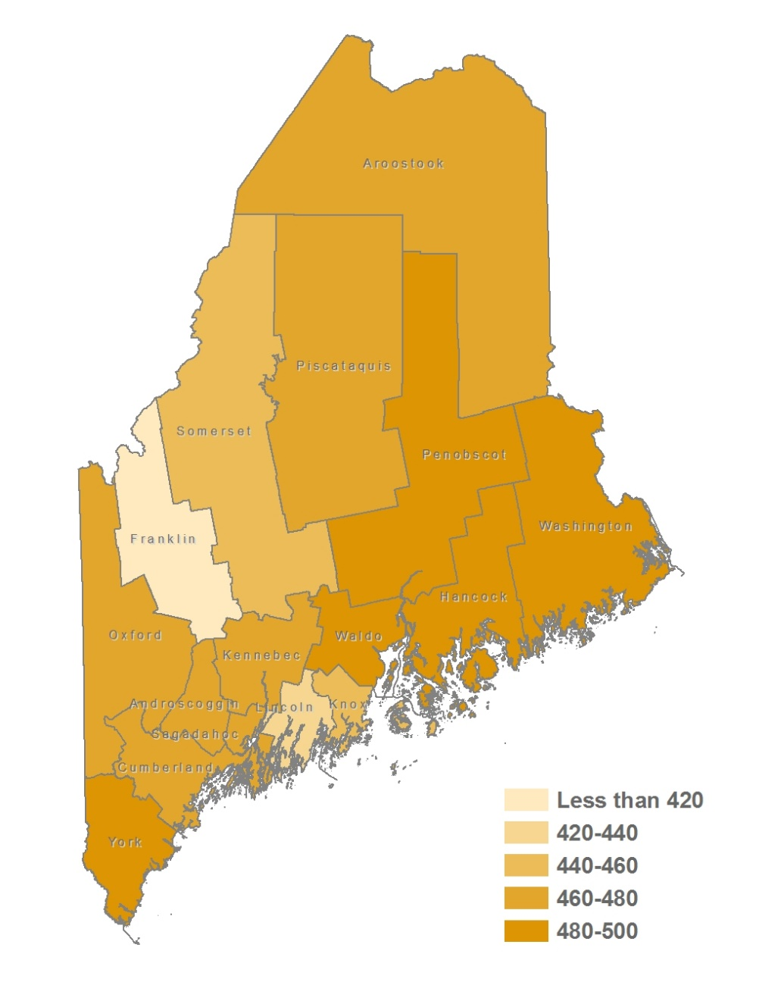
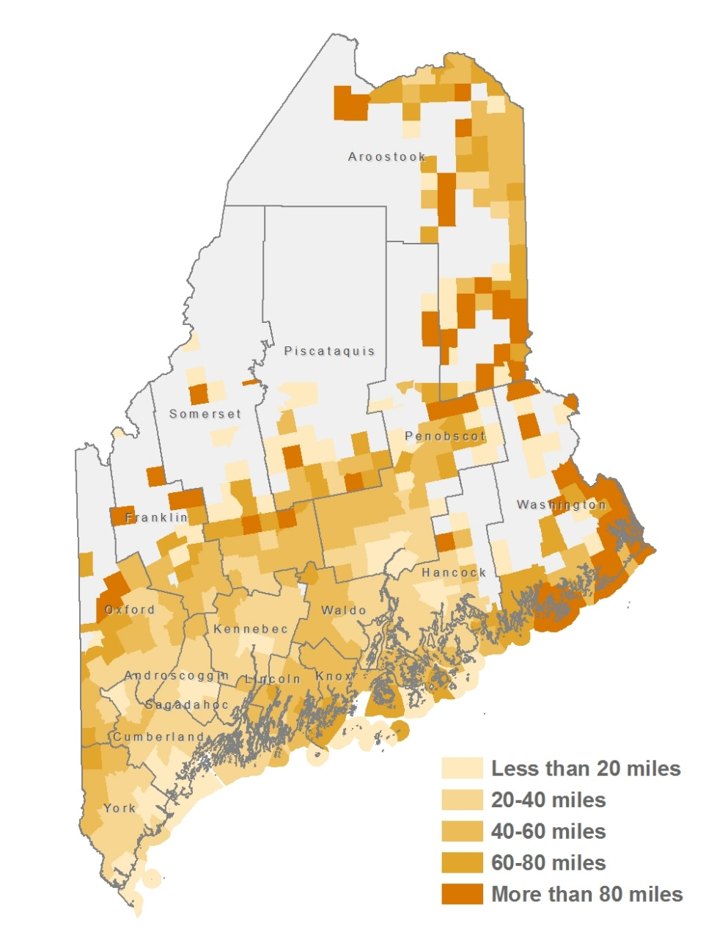
Where One Lives Matters
Age-Adjusted Incidence Rates
All Cancer Sites,
by County
2009-2013
Average Round-Trip Distance For All Cancer Related Care
by Municipality
Madden, P., Charles, J. Maine Cancer Foundation Transportation Needs Assessment Summary Report. 2017, Sept. Market Decisions

Slide 17
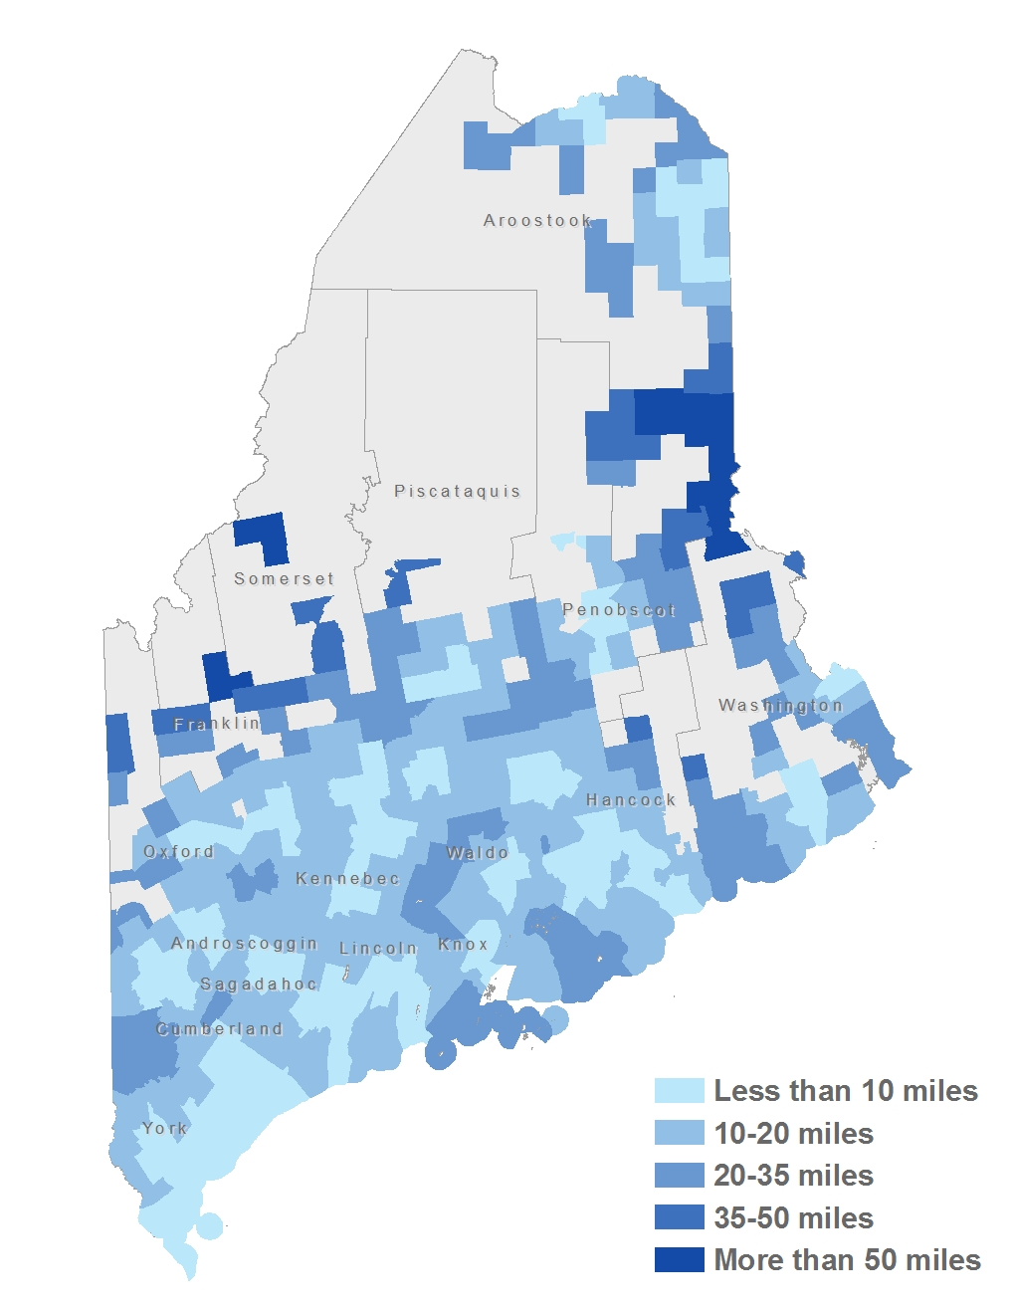
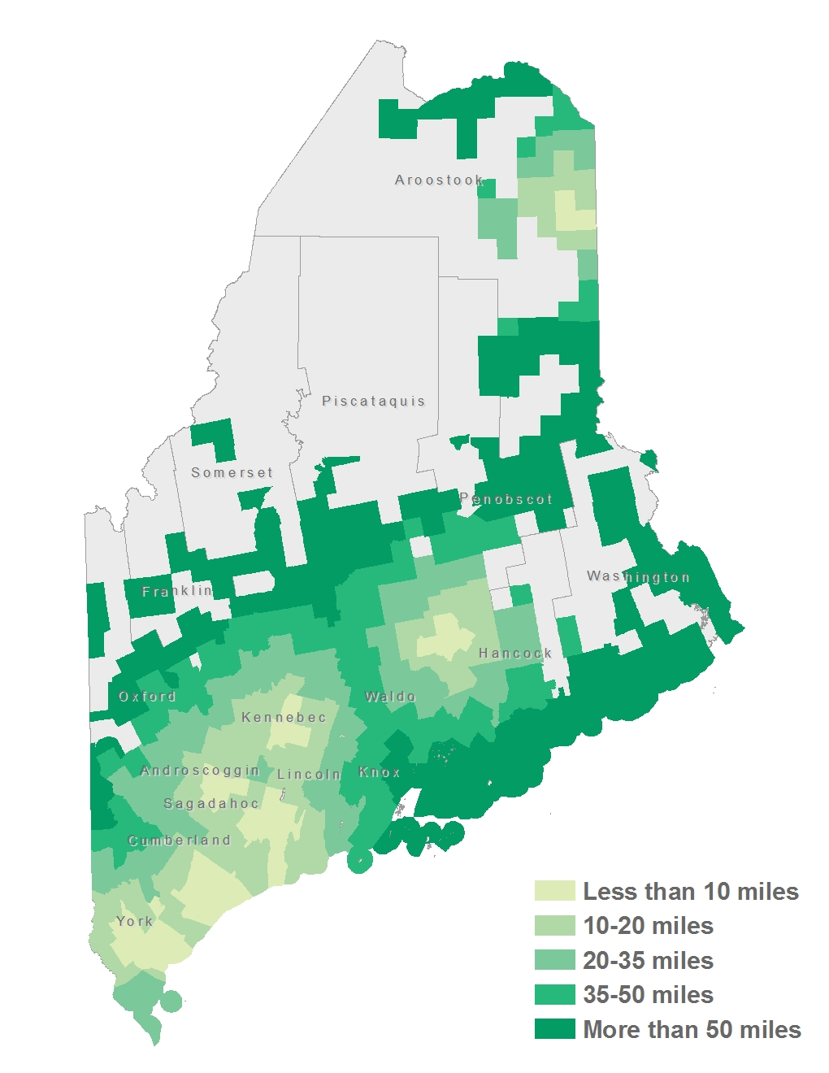
Where One Lives Matters
Minimum travel distance to receive chemotherapy treatment
Minimum travel distance to receive radiation treatment
Madden, P., Charles, J. Maine Cancer Foundation Transportation Needs Assessment Summary Report. 2017, Sept. Market Decisions

Slide 18
Nearly half of the organizations surveyed could not meet the need in their area during the past year
Could you help every cancer patient who contacted your program in the past 12 months?
How are services advertised to patients
Given the high need for transportation, some organizations do not need to advertise their services and find that word of mouth is sufficient.
Provider offices and hospitals
Community outreach and education
Referrals
Local advertising
Notes:
Four out of five Cumberland County transportation programs were unable to meet demand in the past 12 months, highest of any county.
In addition, other previous CHNA reports such as the Western Maine Community Health Needs Assessment listed transportation as their second most important health factor after poverty that lead to poor health outcomes. I’ve included a link to their 2016 report in the resources slide.

Slide 19
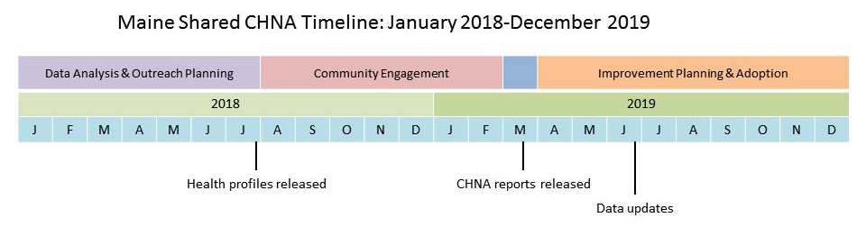
Notes:
Explain the timeline’s highlights:
The next major event will be the release of the Data Health Profiles late summer 2018.
Forums are scheduled across the state between September and November
Additional community outreach will take place depending on local needs and will
Key informant interviews will be conducted, likely with heads of organizations with statewide sphere of influence.
Other efforts may also include presentations at community events or within our community partner’s organizations.
Our vendor will use January and February 2019 to compile, analyze, and perhaps visualize the primary data collected in 2018.
Final CHNA reports (that include all primary and secondary data analysis) will be published by March 29, 2019.
We plan on updating whatever data we can by June 2019—the earliest adoption date for implementation plans amongst our hospital boards. (Explain state/fiscal/calendar differences among our partners)

Slide 20
Please join in the conversation!
There are many opportunities for this including:
  Attend a forum
  Invite presenters to your organization
Notes:
I am happy to facilitate further involvement in this vital step for future planning efforts.

Slide 21
Sources:
County Health Rankings, Maine data: http://www.countyhealthrankings.org/rankings/data/ME
Maine Cancer Foundation (Sept., 2017) Transportation Needs Assessment , prepared by Market Decisions.
Maps of State Outdoor Recreation Plan: http://www.maine.gov/dacf/parks/publications_maps/statewide_recreation_plan.html
2015 Western Maine CHNA report, https://mainehealth.org/-/media/community-health/new-chna/chna-county-report-wmh-smh-final-62216.pdf?la=en p. 27
Oxford County Wellness Committee: FMI: Brendan Schauffler, (207) 890-6323, brendan@healthyoxfordhills.org

Slide 22
Contact Info:
Jo Morrissey
Maine Shared CHNA Program Manager
jlmorrisse@mainehealth.org
207-661-3428
Website:
http://www.maineCHNA.org

