Slide 1
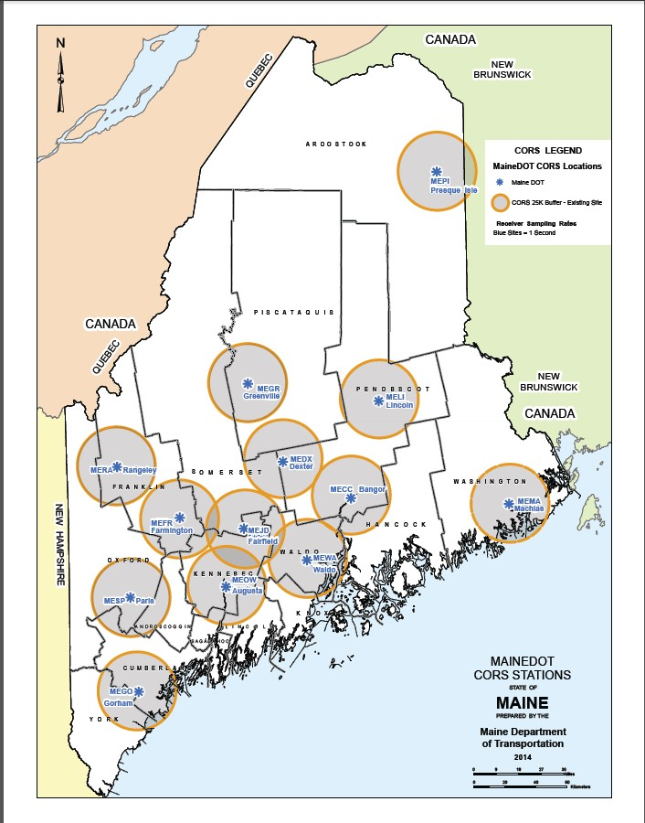
MaineDOT CORS
How to obtain RINEX data files

Slide 2
Obtain Login and Password
Contact:
Harry Nelson: Harold.Nelson@maine.gov 207-624-35l7.
Jason Everett: Jason.Everett@maine.gov
207-624-3657.
Important: Guest Login is no longer an option.

Slide 3
MaineDOT 13 CORS
MaineDOT CORS data is provided free of charge to users who have a Login and Password. RTK users will need a cell phone data plan from a cell phone company.
Data is collected at one second intervals (epochs) and stored at the Augusta Server and is available for Real-Time-Kinematic (RTK) VRS, Single Vector, or RINEX data for post processing.
MaineDOT stores data with original integrity (one second) for 2 months. NGS saves the 1 second data for ‘a period of time’, then parses to 30 second epochs for long term storage.
It is advisable to obtain the RINEX files as soon as possible so you have robust data files to work with.

Slide 4
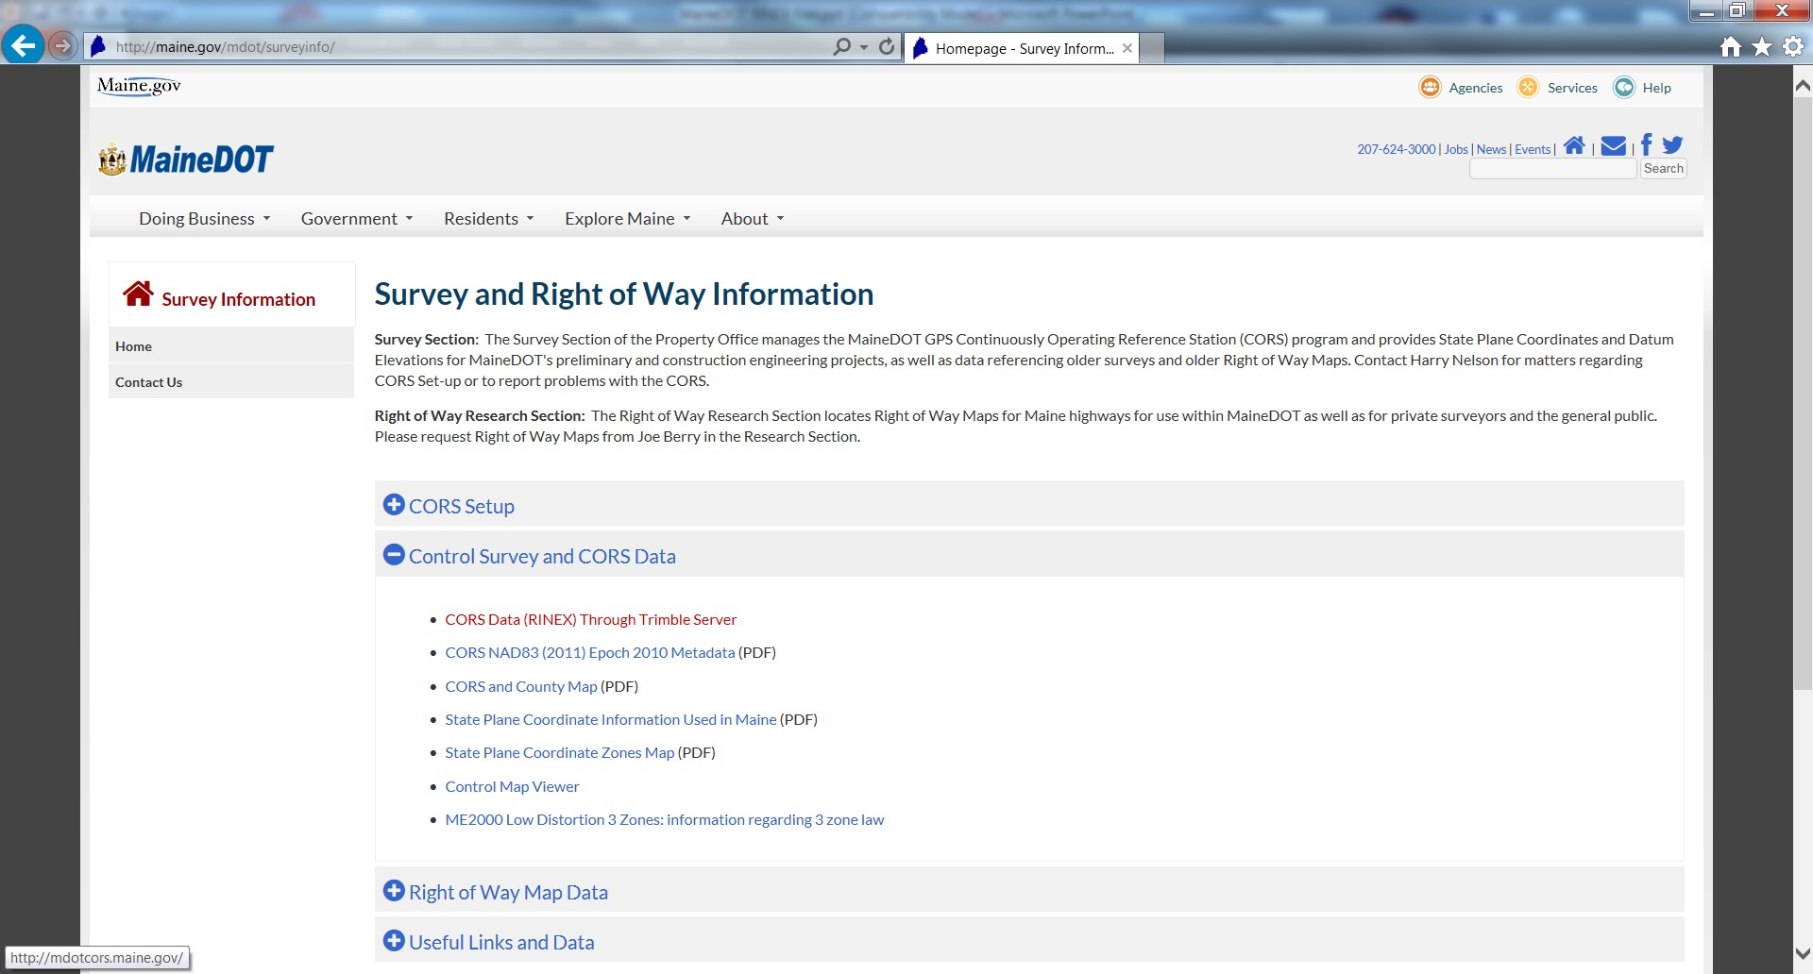
Go to: http://maine.gov/mdot/surveyinfo/
http://www.maine.gov/portal/business/
Select: Control Survey and CORS Data

Slide 5
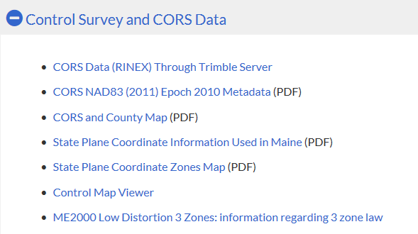
Select:
CORS Data (RINEX) Through Trimble Server

Slide 6
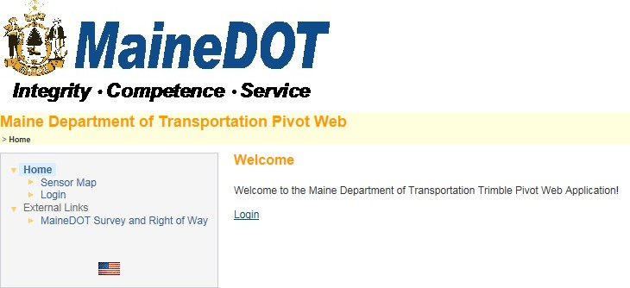
Select Login

Slide 7
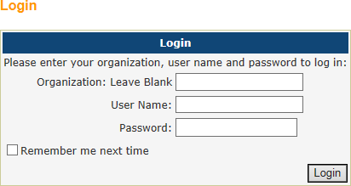
Enter User Name and Password
(Password is case sensitive)
Note: Guest Login is no longer an option

Slide 8
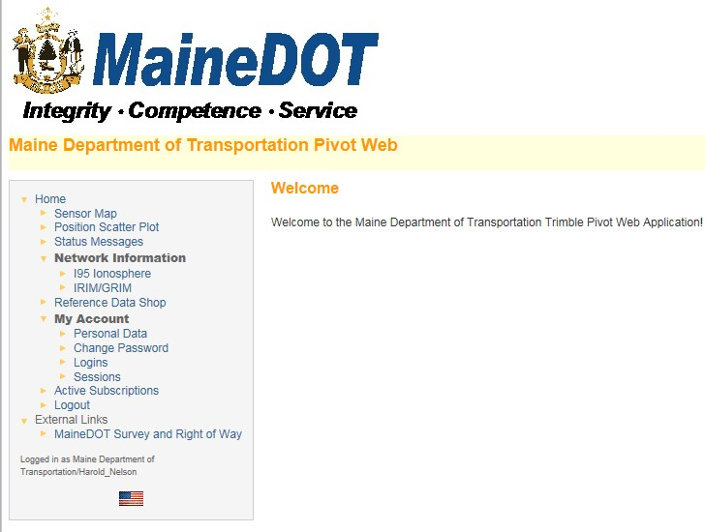
Select Reference Data Shop

Slide 9
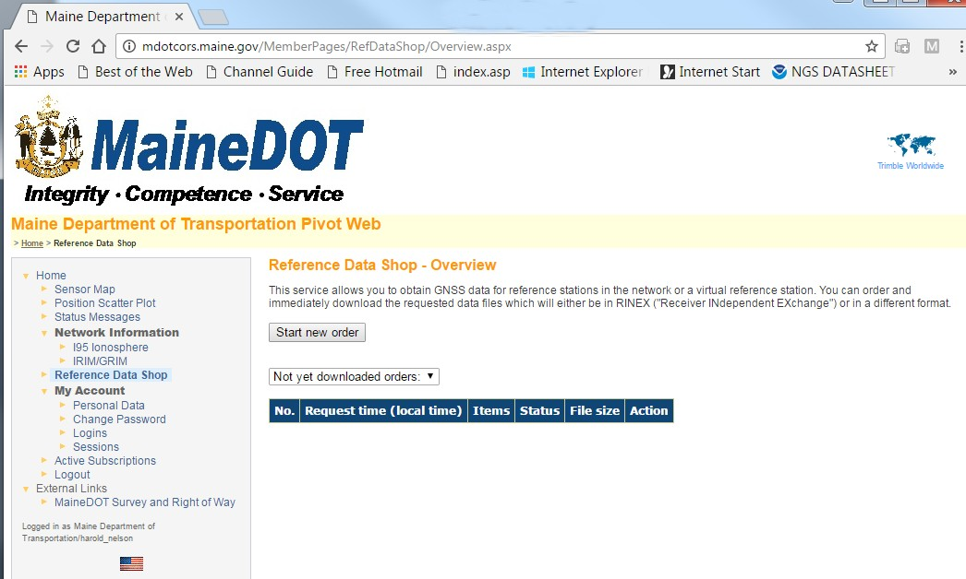
Select: Start New Order

Slide 10
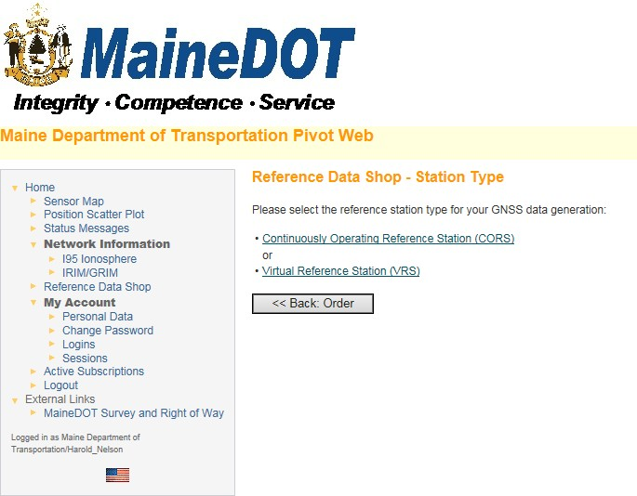
Select:
Continuously Operating Reference Station (CORS)
Note: Virtual Reference Station (VRS) is not an option.

Slide 11
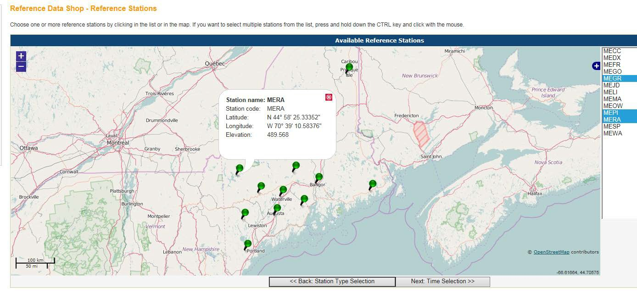
From the listing on the right, select CORS from which you want data
(holding Ctrl key down allows you to do multiple selections)
At bottom of screen Select:
Next:Time Selection

Slide 12
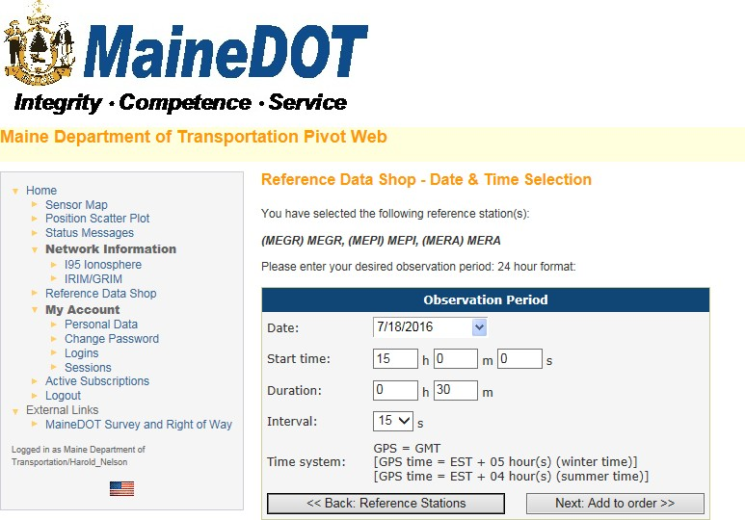
Select:
Date, Start Time, Duration and Interval (Epoch)
Note:
Start Time Input must be the earliest start time of the day and be entered as Greenwich Mean Time aka Coordinated Universal Time, or here as GPS Time.
Duration, in Hours and Minutes, must run to the shutdown time of the last station that day.
Now select:
Next: Add to order>>

Slide 13
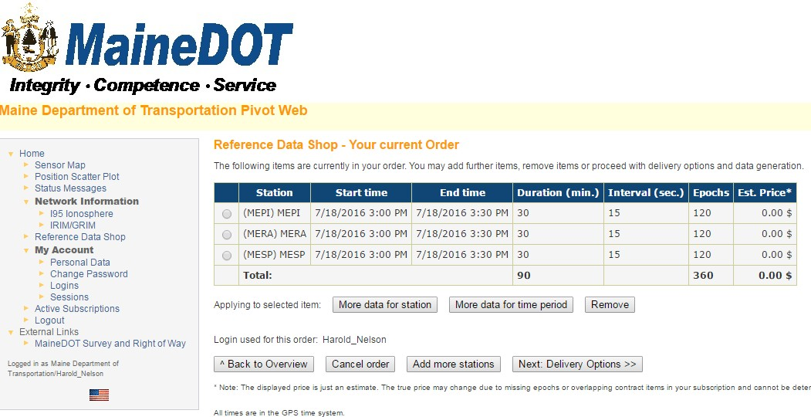
Your Current Order
Disregard Note on pricing. There is no charge for MaineDOT GPS Data Select Next: Delivery Options

Slide 14
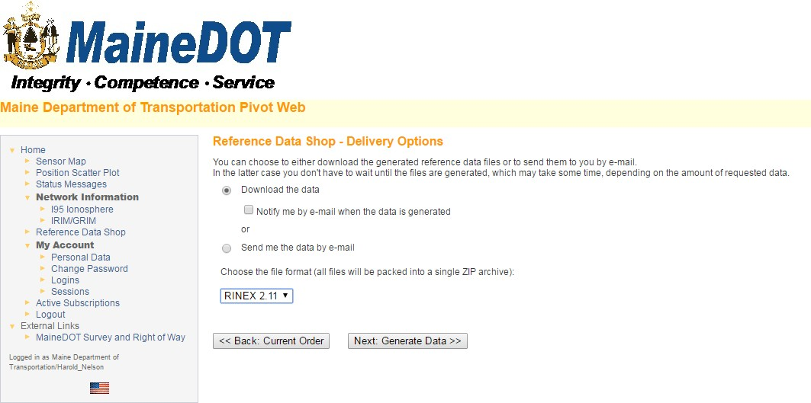
Select Delivery Options
Select
Next: Generate Data

Slide 15
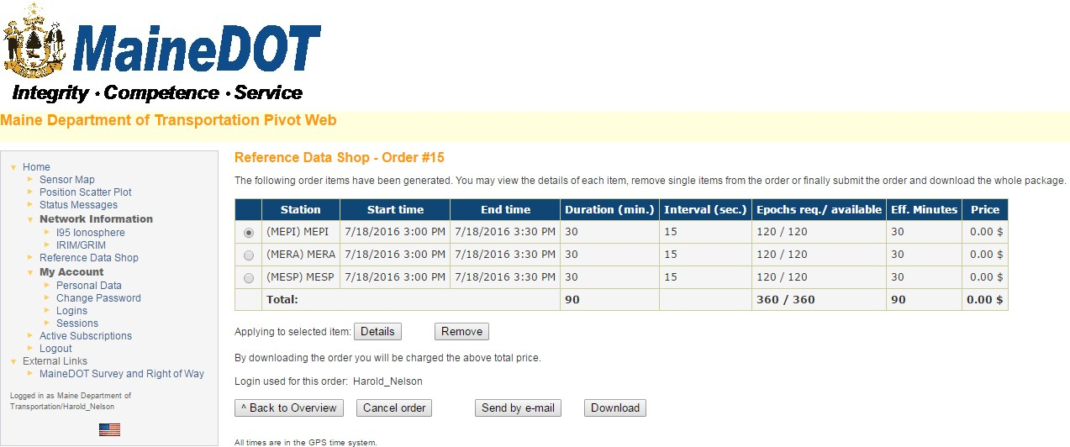
Review Order
Send by email or Download

Slide 16
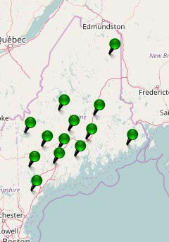
Sensor Map
CORS currently sending data to Augusta are shown in green.
CORS shown in red are not sending data to Augusta.
Depending on the problem, once green again, missing data will be sent to Augusta for the RINEX files. Depending on the issue in some cases, data is not recoverable.

Slide 17
Questions and Comments?

