Slide 1
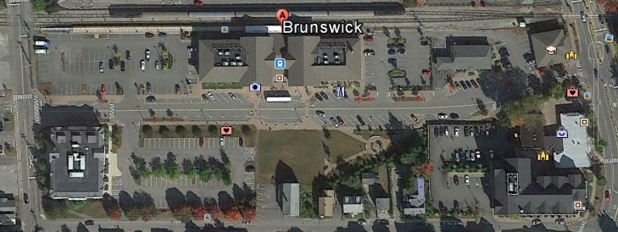
Ferreting Out Economic Benefits of Downeaster Passenger Rail Service An Unfunded Study of the Brunswick Experiment
Pre-existing
Pre-existing
Pre-existing
Pre-existing
Briefing to MDOT PRAC
13 October 2015
Pem Schaeffer
Brunswick, ME
(staterelated/PRAC briefing; ver 13 Oct 5 am)
https://www.scribd.com/doc/284589130/PRAC-PDF-Briefing-13-October-15

Slide 2
Why I’m Here & Who I Am
To present materials ‘on the record’ and facts ‘on the ground’ related to Downeaster economic benefits
Specifically as related to/observed for Brunswick
Extensible to other communities
Minimal editorializing so you can absorb/decide
Retired engineer and Brunswick resident
39 years in complex systems engineering field; second half in Business Development
Opened Brunswick office in 1996; built house in town in 1997
Closely following Brunswick & Maine “goings on,” for 15 years
Inclined to dig into details, facts, and logic associated with civic issues
Conduct unsolicited studies on a pro-bono basis
Multiple advanced degrees
Publisher of “The Other Side of Town” for 6+ years; http://othersideofbrunswick.blogspot.com/
Takeaway: Editorializing will take place at closing.

Slide 3
Outline
Downeaster background
Review of funded economic benefit/development projections
Characterizing projection methodologies/shortcomings
Brunswick Station development plan
Brunswick Station development reality
Numerics as they relate to projections/reality
Anecdotal evidence/scenes around town
And finally, conclusions/editorializing
Appendix: Useful references
Takeaway: An orderly presentation of specifics.

Slide 4
Honoring Agenda Constraints
Significant time limitations apply for this session…
Prepared material includes abundant details…
Accordingly:
Charts will be presented at a skim level
Focus on ‘takeaways’; interested parties can review details after the meeting
Author will reply to post hoc inquiries/requests for follow-up
Presentation can be summarized thus
“The Chase:” Underpinnings of the second coming of passenger rail in Maine are flawed, contrived, and exaggerated. ‘Expert studies’ justifying it are an affront to rational thought, and Brunswick experience confirms it.
Proposals to expand upon resurrected service are unwarranted, unaffordable, and unsustainable. Especially in the face of far more rational options.

Slide 5
Relevant Downeaster Background
Foregone conclusion going in: no demand assessment, no modal tradeoffs
Emotional/intellectual conviction; train lovers vice train riders
Signature Drive (1990)
Petition language:
Many residents, even if they don’t agree, will sign to give voters a yea or nay
Signatures: 54,118 validated; 5,731 invalidated (59,849 total)
Never went to ballot; legislature passed as initiated bill
NNEPRA Legislation (MRSA Title 23, Part 7, Chapter 621)
Creates Maine State Authority, like Turnpike Authority and State Housing Authority (1995)
Mandates establishment of passenger rail service, with “fares to encourage ridership; seek funds to cover operating deficits”
Does not require establishing need or assessing possible modalities
Brunswick service began late 2012
Zero mention
of costs to taxpayers.
Takeaway: “The people have spoken”
is an exaggeration.

Slide 6
Promoting & Projecting Benefits to Brunswick
2005 EDRG Study sponsored by MDOT
2008 CNT Study sponsored by NNEPRA
RFP, SOW, Contract not available via FOAA
2013 CNT Update Proposal; not yet in hand
Parsons Brinkerhoff Benefit Cost Analysis for TIGER Grant Applications
JHR Development Brunswick Station Plan (TIFs, town funds, etc)
Town Council/Downtown Association/All Aboard Brunswick euphoria
MRTC, others attempting to leverage Brunswick’s “exponential economic prosperity” for L/A, Bethel, Montreal, and ???
Takeaway: Consultants & advocates:
“build it and they will come, spend, buy, work, and live.”

Slide 7
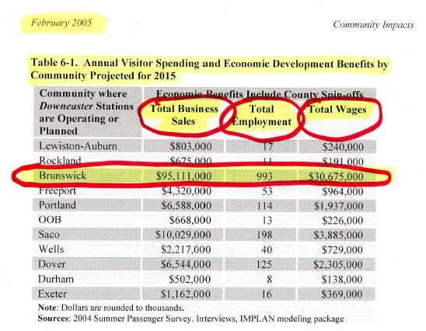
EDRG/MDOT 2005 Study 2015 Projections http://www.edrgroup.com/pdf/report-downeaster-final.pdf
Takeaway: 993 jobs; $1.83 million in weekly business sales; and
$84,000 in daily wages. Now. This doesn’t pass any test of reasonableness.

Slide 8
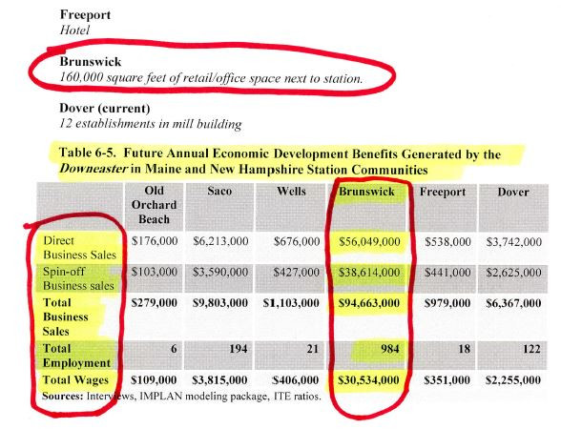
EDRG/MDOT 2005 Projections for 2015 (cont’d)
40,000 sf built to date;
looks like that’s it.
Takeaway: 984 jobs by 2015? Not sure you could find 10 solely attributable to Downeaster.

Slide 9
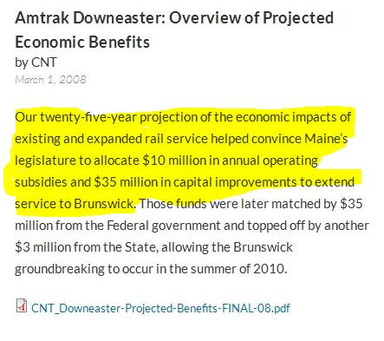
CNT/NNEPRA 2008 Study http://www.nnepra.com/sites/default/files/AmtrakDowneasterOverviewofProjectedEconomicImpacts2.pdf
Huh? Maine Legislature is
providing $10 million annually?
Takeaway: CNT, a Chicago consultancy,
confident of its influence on TOD driven
Government funding. Details of contract
process unavailable due to 7 year record
retention policy. CNT submitted follow up
proposal to NNEPRA in 2013; specifics
being pursued, but not yet received.

Slide 10
CNT Projection Chart 2A: Population Growth
??
TOD!
*#!
Takeaway: 101,000 population increase and 43,000 new households in Maine by 2020?
This study effort was accepted and paid for?

Slide 11
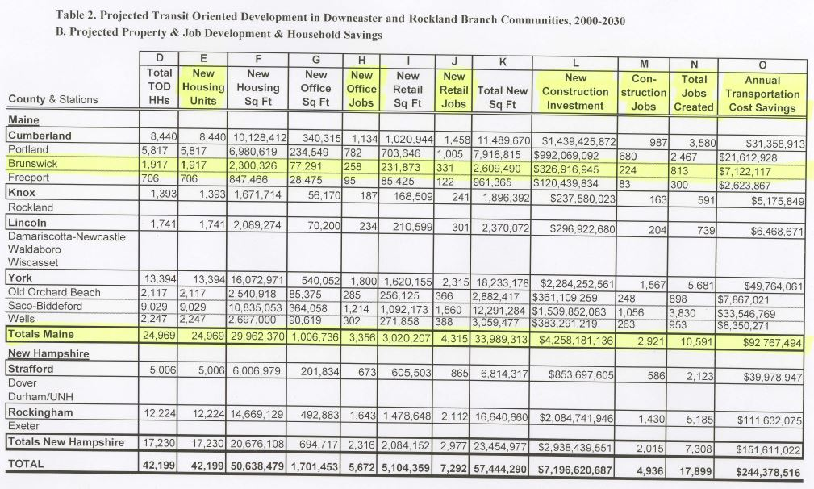
CNT Projection Chart 2B: Property & Job Development
Now it’s 813 Jobs??
TOD!
&#?
Takeaway: Numerous inconsistencies, along with estimates that defy credulity, beg critical questions.
10,000+
Jobs in Maine?

Slide 12
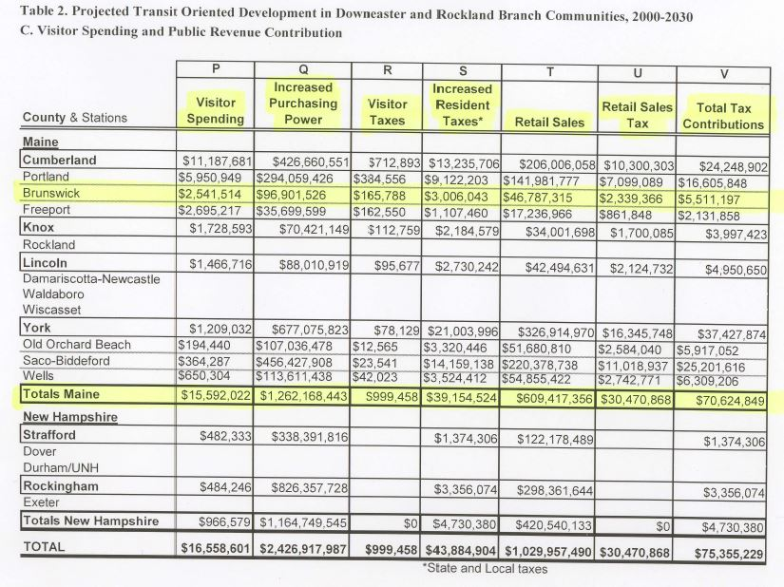
CNT Projection Table 2C: Visitor Spending and Tax Revenue
Nearly
$1 million per week!!
TOD!
$12 million
per week??
Takeaway: At what point does someone say stop!, and ask who’s zooming who?

Slide 13
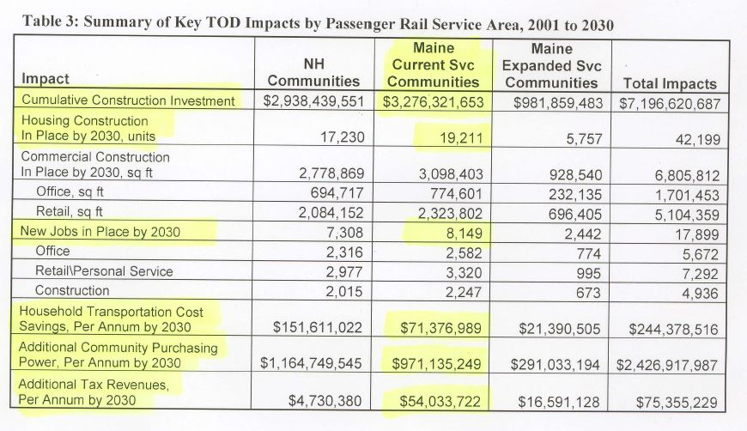
CNT Projections Table 3: Key TOD ‘Impacts’
Takeaway: Shouldn’t numbers like this be declared an insult to our intelligence, and abuse of the public trust?

Slide 14
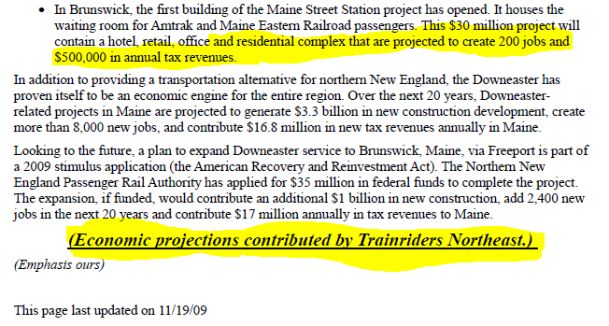
MDOT 2009 Rail Plan Excerpt
http://www.maine.gov/mdot/railplan/railfacts.htm (now down)
Takeaway: Lobbyists used as source for economic projections.

Slide 15
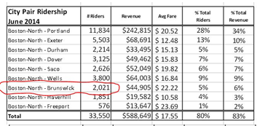
Selected LD 323 Testimony; March 2015 http://www.mainelegislature.org/legis/bills/display_ps.asp?LD=323&snum=127#
Brunswick sees ~ 2000 riders a month, or ~ 67 per day. That’s 34 round trip riders, or 17 per scheduled round trip. How many originate at Brunswick, and how many at points south?
Takeaway: “Exponential economic prosperity”
is a flight of imagination re: Brunswick.

Slide 16
Parsons Brinkerhoff Benefit Cost Analysis
Submitted as part of NNEPRA 2015 TIGER 7 Grant Application (and prior years)
http://www.amtrakdowneaster.com/sites/default/files/Tiger7%20Royal%20Junction%20Siding%20BCA.pdf
Similarly, out of 25 Letters of Endorsement, only 5 were dated after the Portland North extension (Brunswick, Freeport) went into operation.
http://www.amtrakdowneaster.com/sites/default/files/Tiger7%20Royal%20Junction%20Siding%20Project%20Letters%20Of%20Support.pdf
Takeaway: Promotional claims not based on “fresh” data.

Slide 17
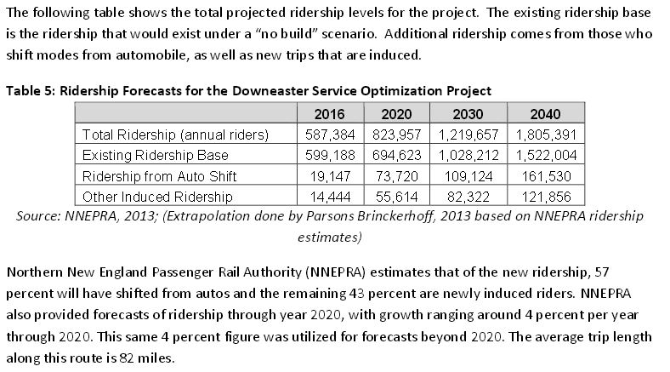
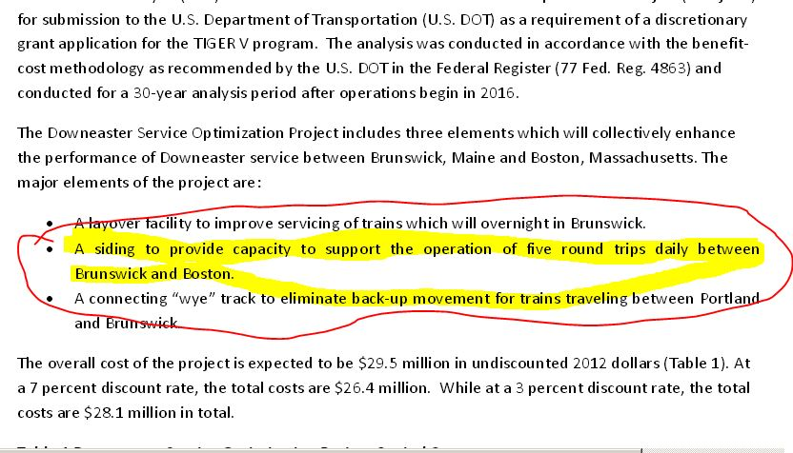
PB BCA Excerpts
This estimate says that ridership will grow by 900,000 plus in 25 years if nothing is done, or by 270,000 more in 25 years if $22 million plus is spent in capital. Note that ‘total ridership’ in 2016 is less than ‘existing ridership’ in 2016.
Go big on projections; you can’t be proved wrong, and TOD speculation requires it to move forward.
Is this objective data?
Takeaway: Reconciling the numbers against each other, and against reality, is ‘challenging.’

Slide 18
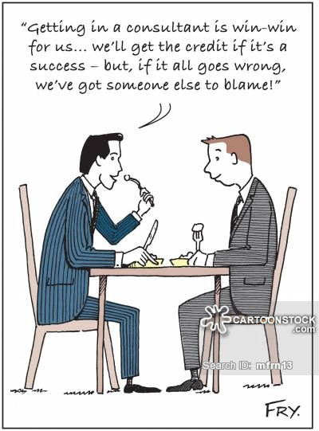
TOD Study Methodologies
Projections, not reality, are the stock in trade
No testing of premise/hypothesis before laying plans
Feasibility not an issue; only magnitude of the benefits
Virtually no post inception audits conducted/published; certainly none put on the record
Accentuate the positives, eliminate the negatives
Ignore capital costs and ongoing subsidies due to lack of fare box recovery
Ignore host community costs for stations, TIF’s, other ongoing expenses
Ignore offsetting effects of economic activity suctioned elsewhere
Brunswick Taxi shuttle costs; $200K per year, via third tier subcontract?
Formulaic, one size fits all, build-out models
Your town & mine can be like NYC, Washington DC, Boston, Philadelphia
New study estimate builds on prior efforts (CNT re. EDRG)
CNT proposal in 2013 to update from 2008 effort?
For a reality check, see: http://www.leg.state.vt.us/jfo/reports/Flyer%20Report%2002-2003.pdf
Who will perform the new Lewiston/Auburn passenger rail study?
Takeaway: Consultants aren’t in business to give unwanted answers.

Slide 19
“Suction?” A Full Page MST Ad, 11 Oct 15
Takeaway: Dollars spent in Boston can’t be spent in Maine!

Slide 20
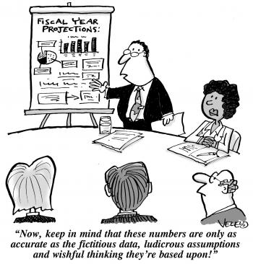
Time for Coffee and a Donut?

Slide 21
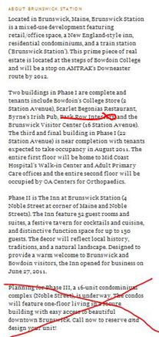
JHR Brunswick Station Plan
Built by Bowdoin College in 1999; later became Brunswick Town Hall in complicated swap.
J. Hillary Rocket (JHR) is a Bowdoin Alum.
The Inn is worthy of a study of its own; TIF, town funds, choosing winners & losers, etc.
Takeaway: Residential and expanded office/retail
phases apparently abandoned/foregone.

Slide 22
JHR Brunswick Station (2)
Takeaway: Several initial tenants disappeared quickly.

Slide 23
JHR Brunswick Station (3)
Takeaway: Not the economic “engine” promised,
regardless of downtown/rail booster euphorics.

Slide 24
JHR Brunswick Station (4)
Plans clearly scaled way back
Takeaway: Studies projected 160,000 sf
of retail/office space; actual is 40,000 sf.

Slide 25
JHR Brunswick Station (5)
Takeaway: Mixed residential/retail phase abandoned.
“Hub-bub” lifestyle didn’t catch on.

Slide 26
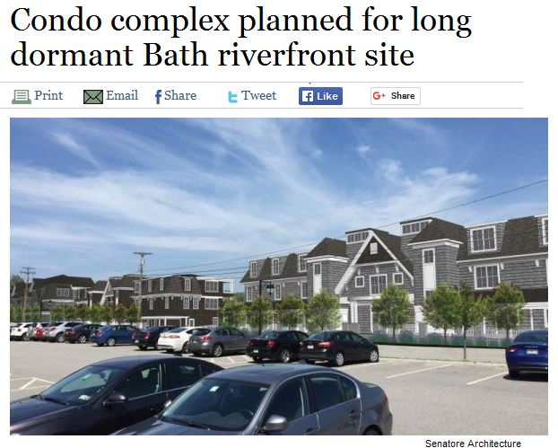
JHR Finds Greener Grass Elsewhere
http://bangordailynews.com/2015/06/17/business/condo-complex-planned-for-long-dormant-bath-riverfront-site/
Takeaway: In Bath, where there is no train service;
40 units vs. 16 once planned at Brunswick Station.

Slide 27
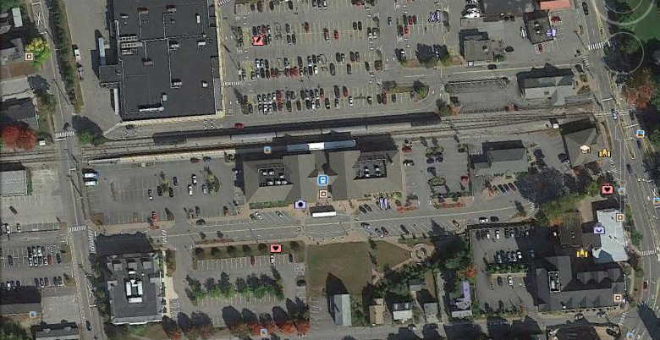
Brunswick Station: A Gamble Based On Consultant Projections, Hopes, and OPM
From Maine Central Railroad
1959 Annual Report
(see appendices for more detail)
Takeaway: Amtrak Downeaster operates in
contravention of realities acknowledged 50-60 years ago.

Slide 28
The Magic of Numbers
Frequent reminders of Downeaster ‘steady growth’
Started from zero; grow to status quo
Operating deficit steady growth; Federal debt ‘steady growth’
Entire schedule skewed to favor travelers heading south, driving net flow of dollars elsewhere
Downeaster ridership totals, in context of total annual travel, are miniscule
See appendix for link and summary
Brunswick ridership totals are similarly irrelevant
Compare to Saco with 5 R/T’s per day, but only 10 more R/T riders than Brunswick; what does that say for expanding Brunswick to 5, or even 6 R/T’s per day? Saco is 1:15 closer to NH and Boston area.
No reporting on points of origination; southbound or northbound travel?
“for those who don’t wish to ride cars or buses”
400 room nights per year at Brunswick Inn and Tavern, which has 52 rooms
slightly more than one per night, with no evidence this is because of the train
Ridership (AADT) for minor side streets just about everywhere far exceeds Downeaster figures; a matter of scale and presentation
McKeen St @ 5 million plus per year; Spring St @ 1.1 million per year
http://me-avcog.civiccities.com/index.aspx?nid=1009
Takeaway: In comparison to ordinary street traffic, and considering
environmental issues, ridership numbers are insignificant.

Slide 29
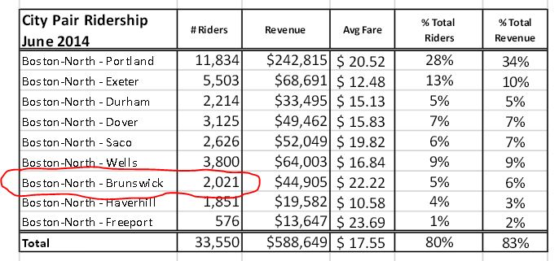
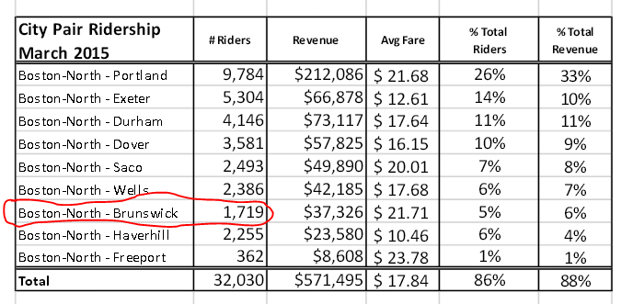
Brunswick Ridership Figures
Taken from NNEPRA Board Meeting Packets:
Averages out to 67 riders per day, 17 per train, or 34 round trippers per day.
http://www.nnepra.com/board-packets-fiscal-year-2014
http://www.nnepra.com/board-packets-fiscal-year-2014
Averages out to 56 riders per day, 14 per train, or 28 round trippers per day.
Takeaway: At an average of 1.7 riders per auto, ridership equates to
20 cars or less per day making round trips between points south and Brunswick.
$22 Million plus for a layover facility to support this ridership is ????

Slide 30
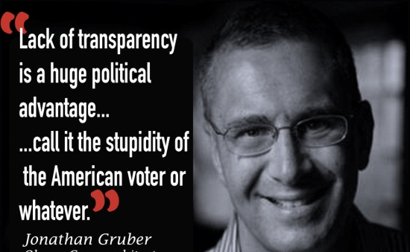
Attempt to Seek Facts of Economic Benefit in Brunswick is Rebuffed
Developed concept and wrote white paper suggesting town/gown (Bowdoin) collaboration in study of Downeaster economic benefit to Brunswick
Could not get council members to sponsor as an agenda item
Proposed metrics tailored to the situation:
Net Effective Adult Daily Discretionary Passenger Flow (volitional train riders)
Net Effective Daily Dollar Flow
Train advocate countered that CNT 2008 Projections were sufficient ‘proof’
http://www.timesrecord.com/news/2014-12-12/Commentary/Afraid_of_Downeaster_Truth.html
Takeaway: What are they afraid of?

Slide 31
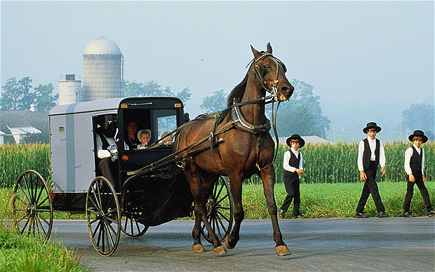
The Socio-political Climate
Dancing for OPM; free money is the order of the day; see Brunswick examples
Government centric mentality; we have a right to the funds
Covetousness: If we don’t get it, someone else will
Elected officials and C of C types flock to ‘free money, drawing down $’
Itinerant TOD Preachers stirring up true believers
Building a $15 million Amtrak Layover Facility is not ‘real-estate development.’
If the response doesn’t fit, dismiss it, and cry ‘train-hater,’ ‘no-it-all,’ and ‘NIMBY’
Environmental: CCUSA
Amtrak waivered engines/fuel
Can’t say the word “bus”
Devotion to “legacy “transportation/infrastructure
Must accept the way or be shunned
Labeled apostates; even name calling in some cases
Takeaway: A near religious belief in something mystical about trains;
an inexplicable belief in miraculous powers that only the second coming
of passenger rail can provide.

Slide 32
Actual & Anecdotal Data Points
JHR not following through on plan; developing residential in Bath instead
Enterprise Auto ceased staffing train arrivals at Brunswick Station
Q: “1 or 2 cars per week?” A: “if that”
Most original tenants at Brunswick Station did not survive
Petrillo’s, steps from Freeport station, cited when pressed ‘a minor up tick’
Red Mill in Topsham, within MRTC walking radius, floundering
Brunswick Hotel: 400 room nights per year from train riders; (1.1 per night; who says they’re BECAUSE of the train)
Ridership realities/subsidy per rider
Study costs
Nova Star struggling, in spite of Downeaster tie-in
Thompson’s Point development, at PTC, also below glowing expectations
Brunswick retail vacancy factor five times that of Portland per PPH report this year
Takeaway: A near religious belief that there is something mystical about trains. An inexplicable belief in miraculous powers that only rail can provide.

Slide 33
A Look at Brunswick Reality
Mental floss prevents truth decay. Ben Franklin observed, "One of the tragedies of life is the murder of a beautiful theory by a gang of brutal facts.“
“As scarce as truth is, the supply always seems to exceed the demand.”
Winston Churchill complained, "Men occasionally stumble over the truth, but most of them pick themselves up and hurry off as if nothing had happened.“
Some thoughts transcend PowerPoint.

Slide 34
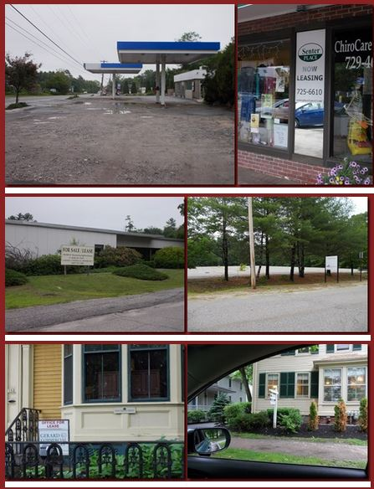
Brunswick Economic Vitality Scenes
Outer Pleasant St (Rte 1) coming in to town, across from “Welcome to Brunswick” sign with list of attractions.
Core downtown business area; steps from station.
Vacant electronic manufacturing facility; convenient to town core.
Park Row; core downtown office area, adjacent to town mall and steps from train station.

Slide 35
Brunswick Economic Vitality Scenes (2)
Steps from intersection of Pleasant St and Maine St; Brunswick’s in-town crossroads.
Steps from Maine St; now a parking lot.
Prime Maine St (in-town) locations; easy walk from train station.
On Cabot Mill (Ft Andross) grounds at North end of Maine St.
Takeaway: Central in-town business area has long lasting, high vacancy factor.

Slide 36
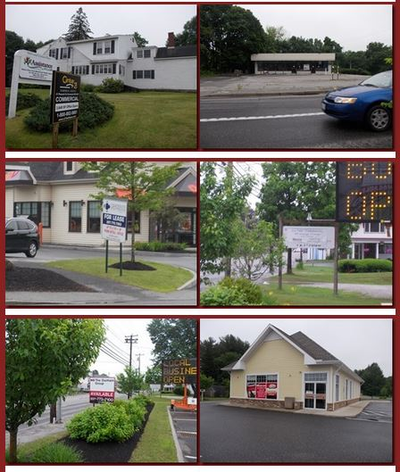
Brunswick Economic Vitality Scenes (3)
Just off
Maine Street
Junction of Pleasant St (Rte 1) and Stanwood St;
Diagonally across from new
Police Station.
Pleasant St (Rte 1) inner business area east of Church Rd.
Takeaway: Entering Brunswick east bound from I-295/Rte 1, or heading out west bound, shows a struggling commercial landscape.

Slide 37
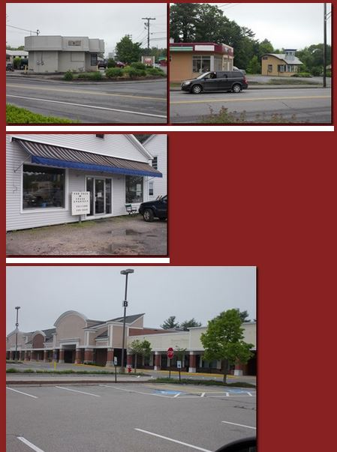
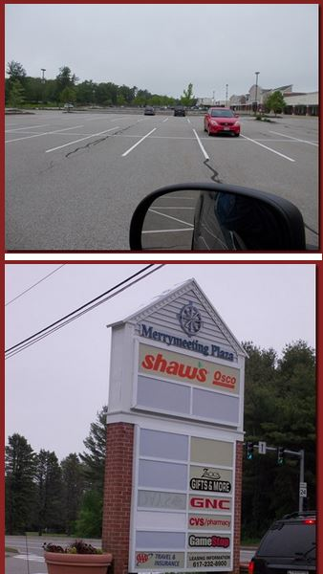
Brunswick Economic Vitality Scenes (4)
Long view of Merrymeeting Plaza from east end; sits across from entrance to redeveloping BNAS
Pleasant St (Rte 1) at Church Road.
Outer Pleasant St;
Rte 1 Northbound.
Marquee at Merrymeeting Plaza.
When Shaw’s leaves, it will likely die.
Merrymeeting Plaza. Becoming ghost town.

Slide 38
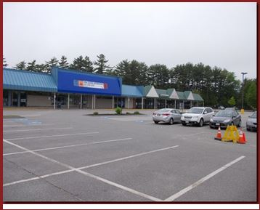
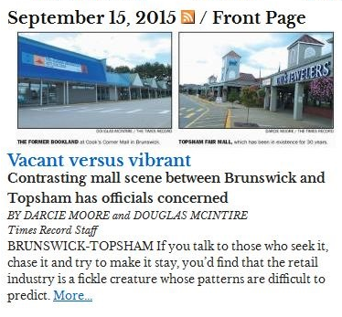
Brunswick Economic Vitality Scenes (5)
“Cooks Corner;” once Brunswick’s premier shopping mall.
Entire north end empty; more closures/moves likely to come.
At junction of Rte 1 and Rte 24.
Includes Sears, Staples, TJ Maxx.
Adjacent to redeveloping BNAS.
Wal-Mart, Lowes, others nearby.
Takeaway: Mall reportedly going to auction; bleeding businesses to Topsham, closure.

Slide 39
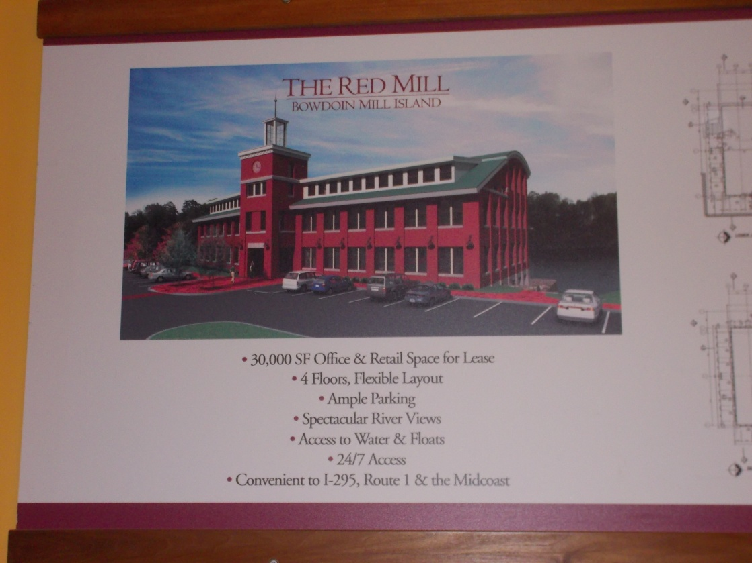
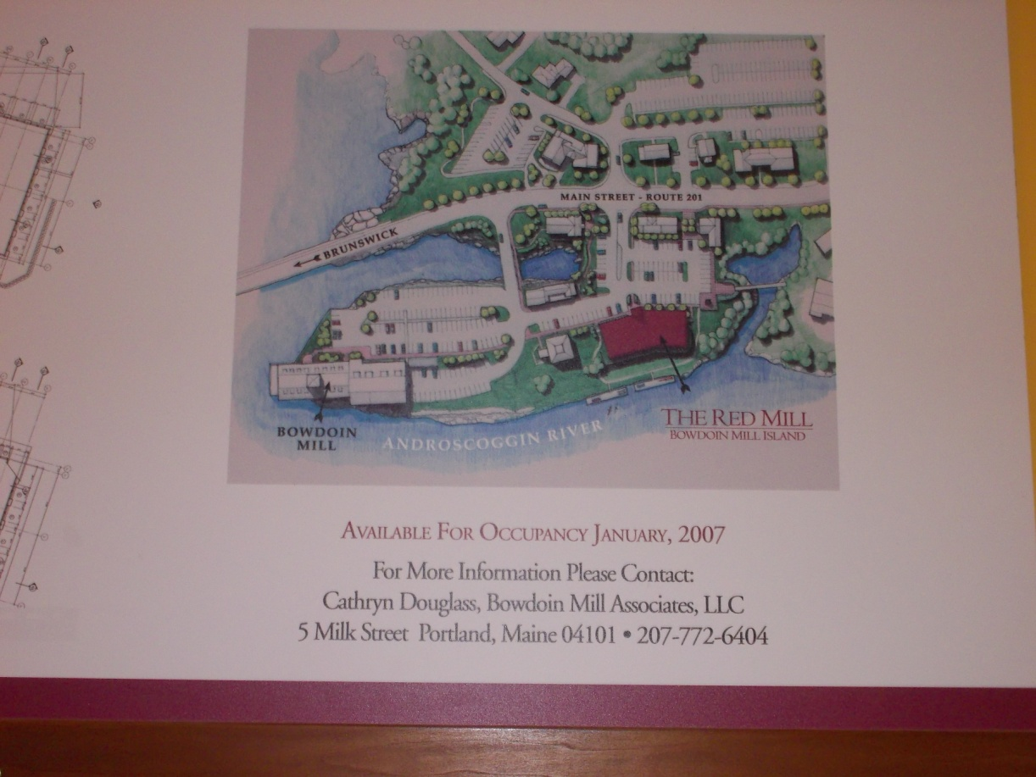
Topsham: Walking Distance from Brunswick Station
30,000 sf “office and retail;”
Waterfront location;
4 floors; ample parking;
New construction.
Takeaway: Short walk from Brunswick
Station; opened well before arrival of
Downeaster service.
“Open for business” in 2007;
Adjacent Bowdoin Mill full.

Slide 40
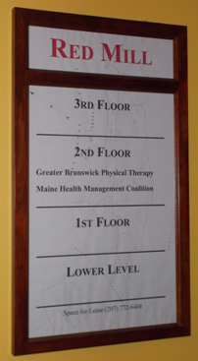
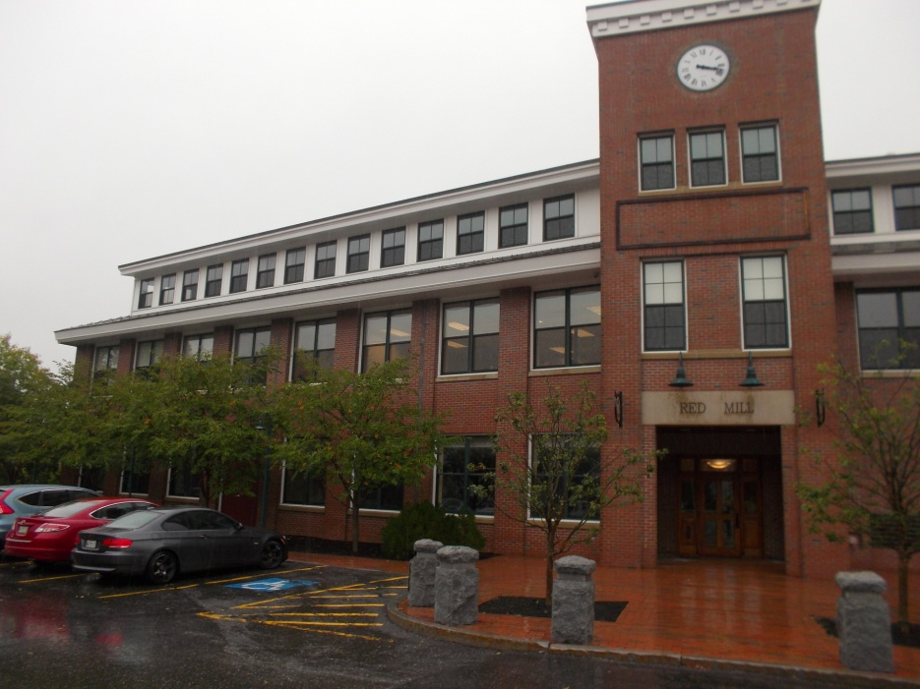
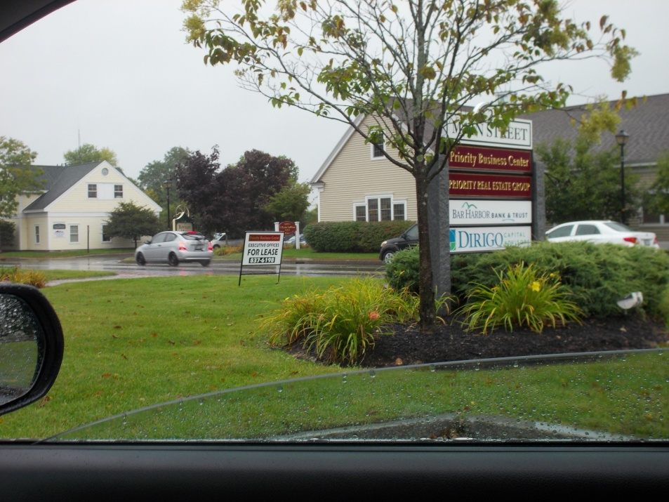
Topsham: Red Mill & Adjacent Area
Partial exterior view
Two health tenants on one floor; three other levels vacant.
Across the street from the Red Mill.

Slide 41
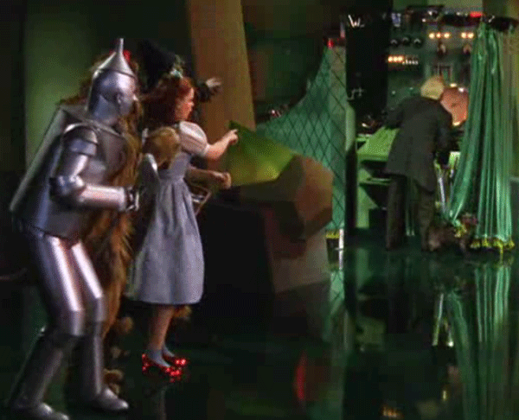
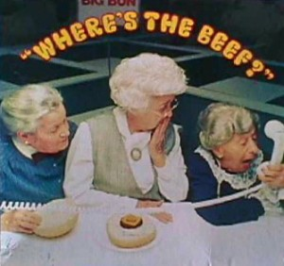
So What?
Study projections couldn’t be more wrong and/or irresponsible
JHR voting with his $, not finishing in Brunswick, and romancing Bath
No one wants to face reality: town officials, AAB, TRNE, MRTC, Legislature, et al
Repetition of the TOD mantra doesn’t change the facts

Slide 42
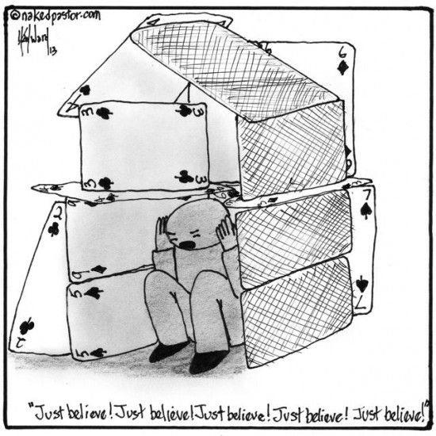
Now, The Editorializing…
The collective body of knowledge used to promote passenger rail resurrection in Maine is a house of cards
Projection built upon projection; one size fits all modeling; accentuating the positive while eliminating the negative; and ignoring facts and reality that would threaten the dream.
Environmental/traffic cases are bogus.
Some lobbyists claim to be in the “Imagination Business;” imagination has more than one meaning.
Using Brunswick as an example to promote expansion to Lewiston, Auburn, and points north is an epic misrepresentation.
Facts on the ground support just the opposite conclusion.
The projections put forward are so unreasonable as to raise serious competence and accountability concerns
“It’s worth the gamble” is a poor way to steward the public trust and huge sums of OPM.
Takeaway: “Incredible economic benefit” and “exponential economic prosperity” are just two of the myths being propagated about Brunswick.

Slide 43
Conclusion
Rail is the least flexible, most expensive, least reliable means of passenger transport
Cost estimates on capital projects typically low by large amounts
Downeaster is not environmentally friendly
Utility and cost effectiveness in a state like Maine is largely non-existent
Inherently road dependent due to geography and population density/distribution
Capital outlays are unaffordable
Lifelong operating subsidies of up to 80% and more
More train lovers than train riders
If demand was there, bus operators would be chasing it
Refusal of Brunswick town council to assess benefit is telling
Investment being made by political dictate, not by transportation experts with objective analysis
Takeaway: The entire set of underpinnings of the Downeaster is flawed, mis-stated, and exaggerated. Now that it’s in existence, the rationale to keep it alive and expanding is even more flawed.

Slide 44
As the old saying goes, “music hath charms….”
Trying to insinuate the principles and benefits of major metropolitan area (NYC, Phila, LA, Boston, Chicago, Wash DC) Transit Oriented Development upon the small, highly distributed, often rural population of Maine is a fool’s errand.
The only reason the attempts continue is because of the siren song of the Oppem Sisters, Soppem, Foppem, and Moppem, even now waiting to take your call…
Federal OPM
“Every time it rains,
it rains… dollars
from others……”
State OPM
Municipal OPM

Slide 45
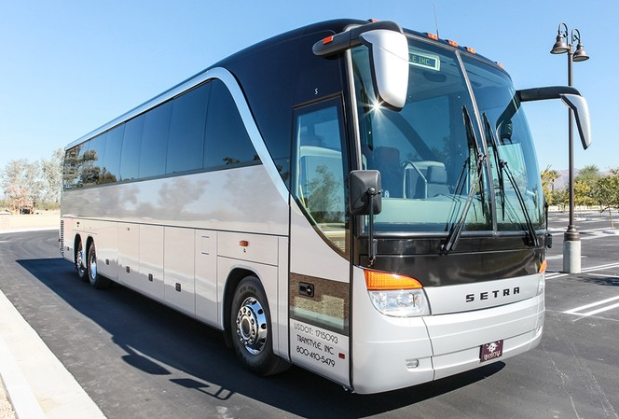
One more time, Maestro!
Widespread use of passenger rail transport died decades ago for logical and cultural reasons of substantial merit.
Exceptions are rare and tailored to unique and specific circumstances.
NNEPRA creation & Downeaster inception devoid of demand assessment and modality tradeoffs
Nothing of sufficient magnitude has occurred since then to justify the second coming of passenger rail.
Examples abound nationwide of failed, over-promoted, vastly over budget attempts to revive past glories.
Modern, cleaner, more flexible, more affordable, and more reliable service options exist, and can be introduced quickly with minor capital expense.
Adapted from a friend: "There seems to be no limit on how much money government is willing to spend to restore a legacy mode of travel that almost nobody is expected to use.“
Takeaway: Return on investment? Are you kidding?

Slide 46
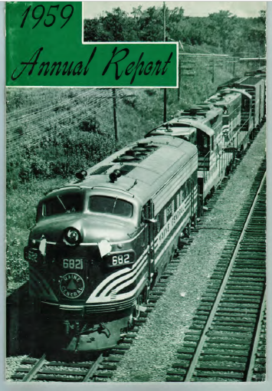
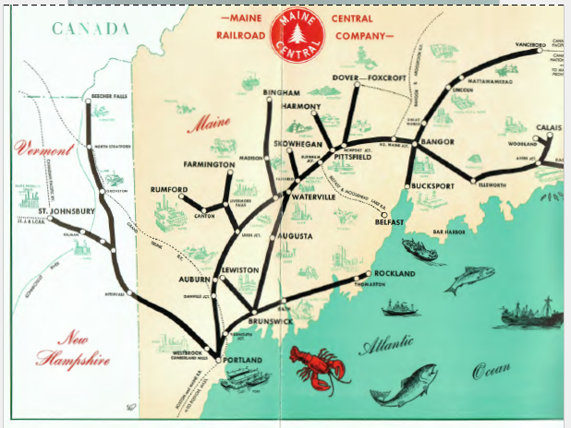
Appendix: Maine Passenger Rail History (MCR)
Takeaway: The age of passenger rail struggle and decline.

Slide 47
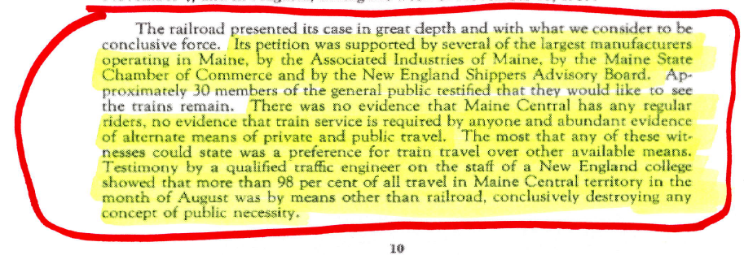
MCR Passenger Rail History (2)
Takeaway: “No regular riders.”

Slide 48
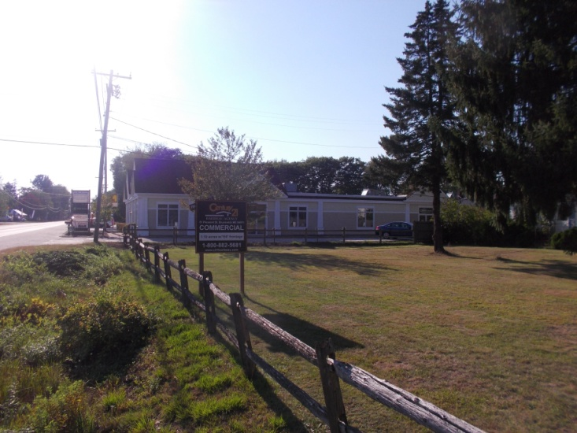
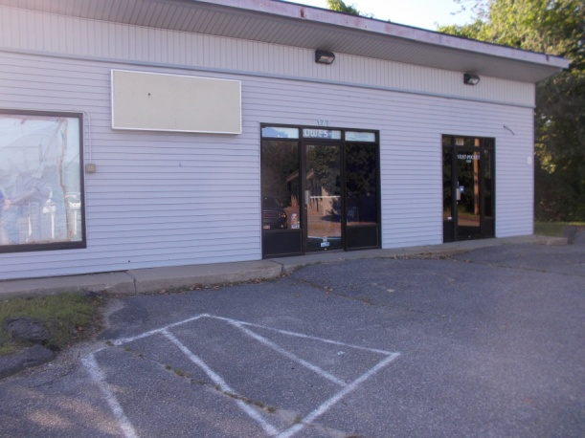
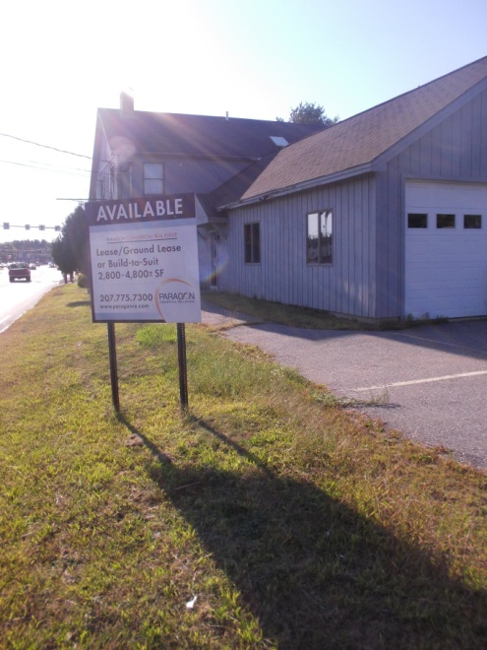
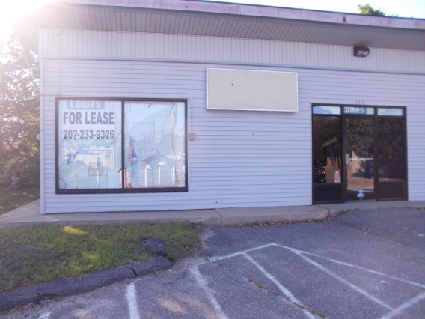
More Scenes of Brunswick Economic ‘Vitality’
All in the Cooks Corner Area

Slide 49
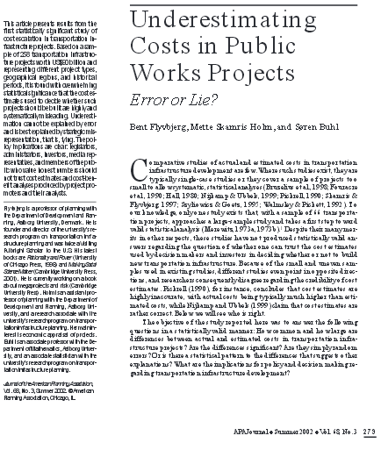
Appendices/References
Getting There Greener
In a contest between a 4,250 hp P42 burning high sulfur diesel, and a 325 hp motor coach burning low sulfur fuel, guess who wins? Before adding in 24/7 idling for the P42?
JAPA 68-3-5 Flyvbjerg - JAPAASPUBLISHED.pdf
Guess what best explains consistent under-estimation of project costs?

Slide 50
CNT 2008 Study Text Clip (Executive Summary/Pages 2&3)

Slide 51
US DOT Bureau of Transportation Stats
Passenger miles by mode, 2013
Air: 589.7 billion, 11.2%
Highway: 4,307 billion, 86.3%
Amtrak: 6.8 billion (2012), 0.1%
Commuter Rail: 11.7 billion, 0.2%*
Transit, Light Rail: 2.6 billion, 0.05%*
Transit, Heavy Rail: 18.0 billion, 0.4%*
“Transit:” 56.5 billion, 1.1%*
Total 4,992.3 billion, 100%
Percent total for all rail modes = 0.75%
http://www.rita.dot.gov/bts/sites/rita.dot.gov.bts/files/publications/national_transportation_statistics/html/table_01_40.html

Slide 52
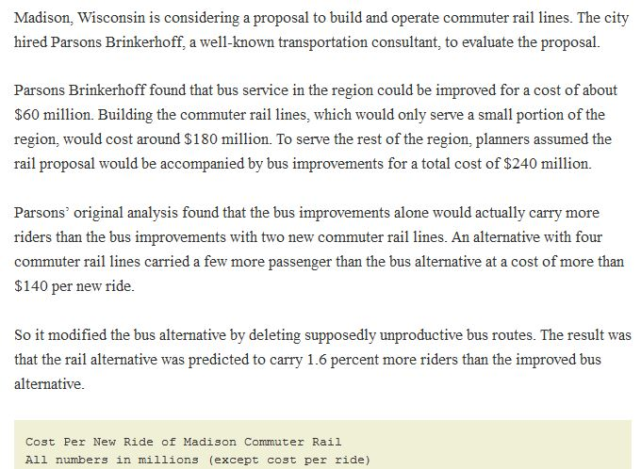
http://americandreamcoalition.org/?page_id=4172 & http://americandreamcoalition.org/?page_id=4182
Continues…….
Continues…….

Slide 53
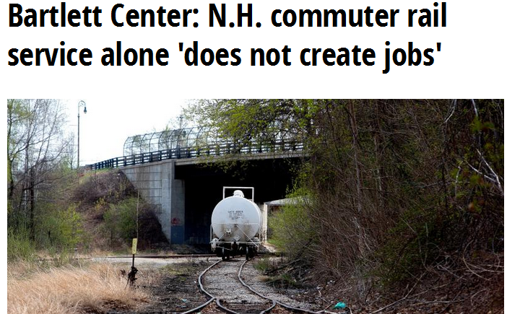
http://www.concordmonitor.com/readerservices/businessxml/16770030-95/bartlett-center-nh-commuter-rail-service-alone-does-not-create-jobs
Champlain Flyer Audit

Slide 54
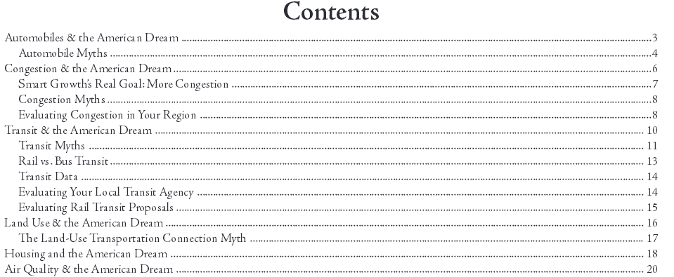
http://americandreamcoalition.org/pdfs/ADGuide.pdf

