Slide 1
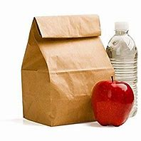
Jazzing Up Your Lunchbox

Slide 2
What do I want to eat?
HEALTHY
FLAVOR/FUN

Slide 3
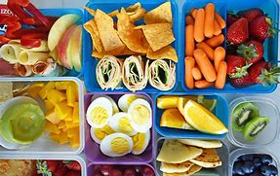
Why not both?!

Slide 4
What is a healthy lunch?
A healthy lunch doesn’t mean eating a salad everyday
A healthy lunch just means finding balance!

Slide 5
Lunchbox Basics
A healthy lunch contains 5 parts
Fruit
Vegetable
Grain
Protein
Dairy
Avoid excess sugar and fat by limiting desserts and fatty condiments
Lunch can be low-cost, tasty, and easy to eat!

Slide 6
MyPlate

Slide 7
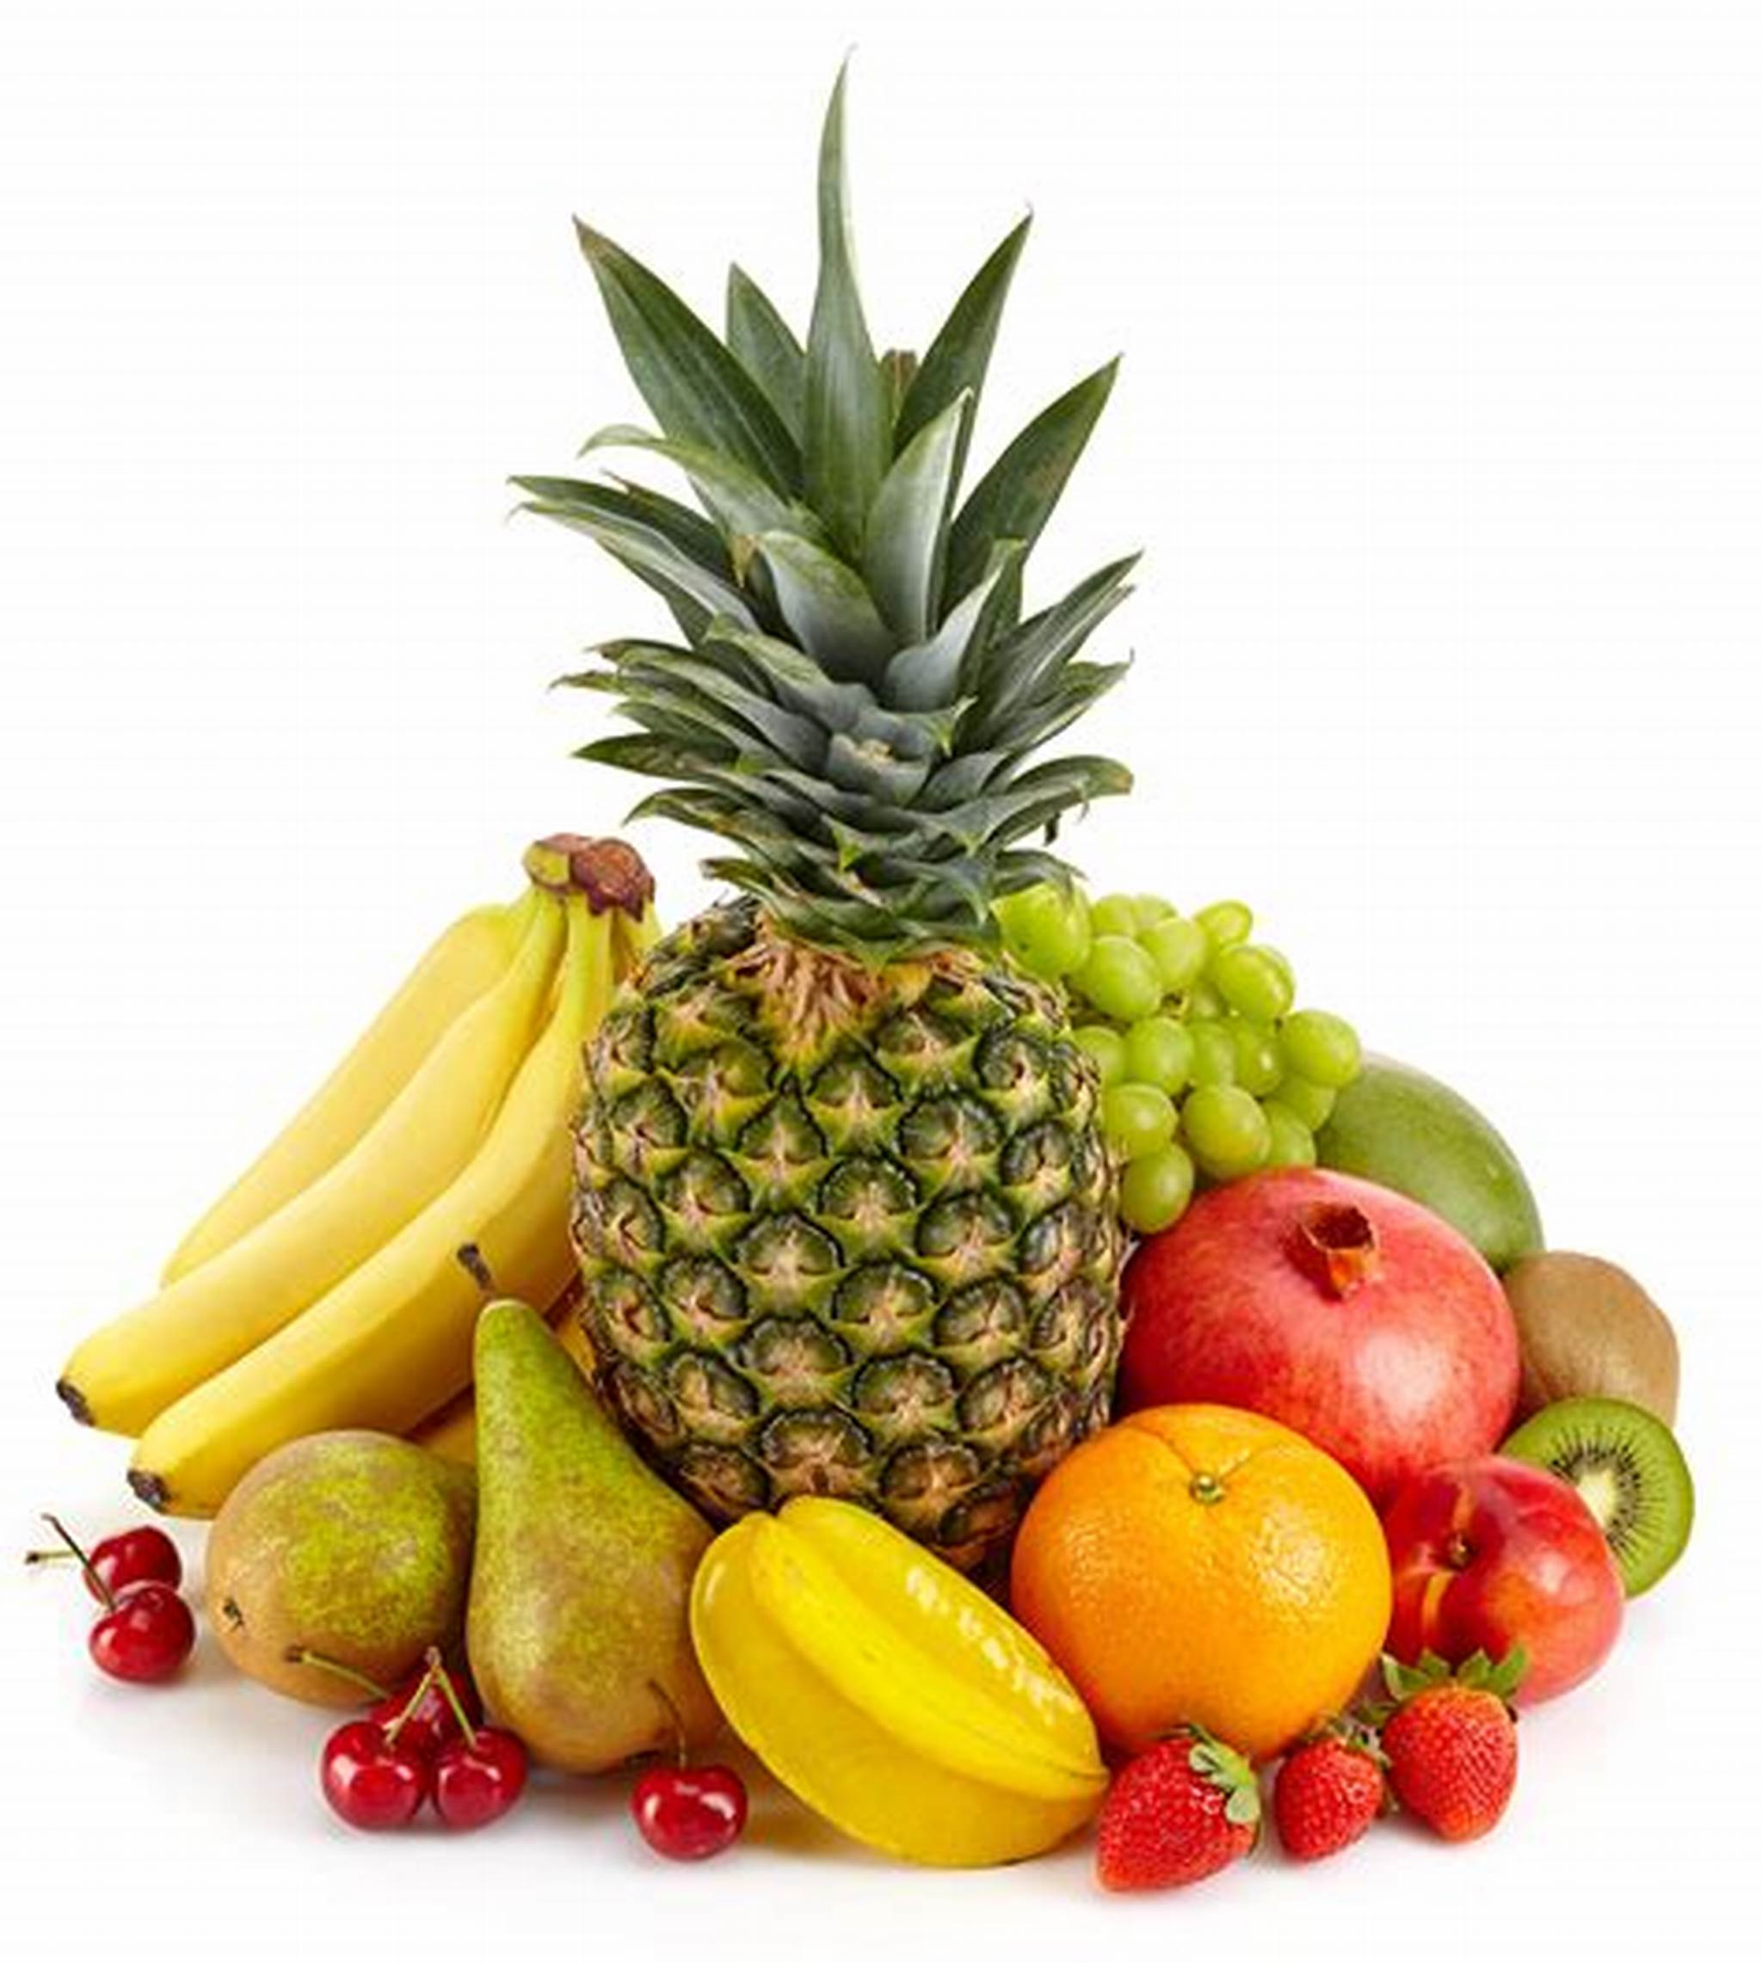
Fruits
Lunch ideas: Sliced apples, banana, orange, applesauce, kiwi, grapes, berries, melons, mixed fruits
Sources of potassium dietary fiber, vitamin C, and folate
Focus on whole fruits

Slide 8
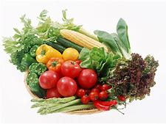
Vegetables
Lunch ideas: lettuce, spinach, tomatoes, onion, peppers, carrots, cucumber, celery, beans
Sources of potassium, dietary fiber, folate, and vitamins A and C
Vary your veggies

Slide 9
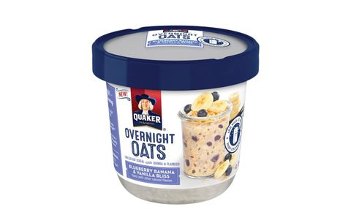
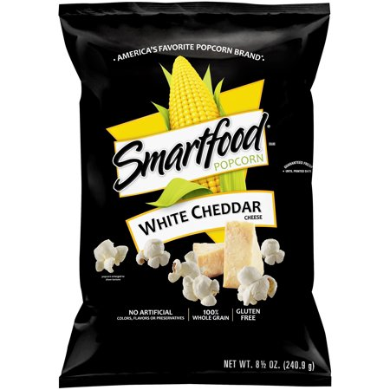
Grains
Breakfast ideas: Oatmeal cups
Lunch ideas: whole wheat bread or tortillas, brown rice, quinoa, whole wheat pasta, popcorn
Sources of fiber, thiamin, riboflavin, niacin, folate, iron, magnesium, and selenium
Make half your grains whole grains

Slide 10
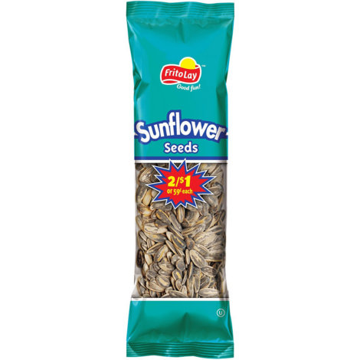
Protein
Lunch ideas: Deli meats, chicken, tuna, hard-boiled egg, peanut butter, hummus, sunflower seeds
Sources of protein, niacin, thiamin, riboflavin, B6, vitamin E, iron, zinc, and magnesium
Choose a variety of lean protein sources

Slide 11
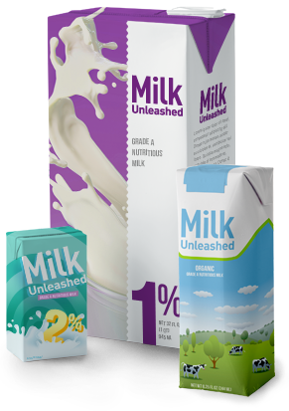
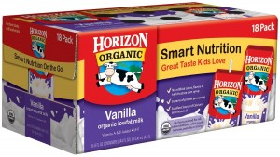
Dairy
Lunch ideas: Milk, cheese, soymilk, yogurt
Sources of calcium, potassium, vitamin D, and riboflavin
Switch to fat-free or low-fat 1% milk

Slide 12
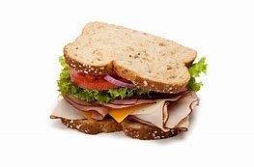
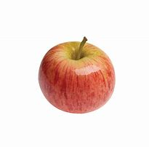
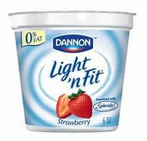
Putting it all together
Turkey Sandwich on Multigrain Brain with 3oz turkey breast, sliced cucumbers, leaf or lettuce, 2 slices tomato, 1 TBS honey mustard
1 Medium Apple
8 oz Fat & Sugar Free Yogurt

Slide 13
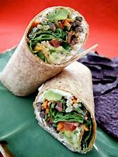
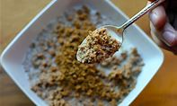
Putting it all together
1 Small Whole Wheat Tortilla with ½ cup black bean spread, 1 cup total: shredded lettuce, carrots, cucumbers, diced tomato, 1 TBS shredded Colby cheese
1 Medium Orange
8 oz Fat & Sugar Free Yogurt with ¼ cup Grape Nuts

Slide 14
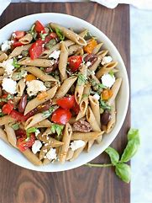
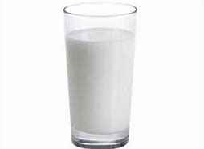
Putting it all together
Greek Pasta Salad made with ½ cup whole wheat pasta, ½ cup chick peas, 1 cup total: diced tomato, cucumbers, peppers, 1 TBS Feta cheese, 5 green olives, 2 TBS fat-free balsamic vinaigrette
1 Medium Banana
8 oz Skim Milk

Slide 15
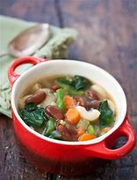
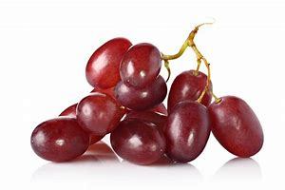
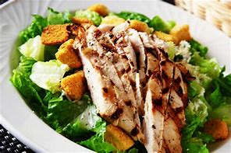
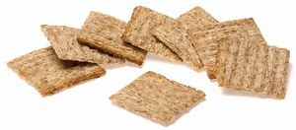
Putting it all together
Chicken Caesar Salad with 3oz grilled chicken breast, I cup leafy green, 2 TBS fat-free Caesar dressing
1 cup Low Sodium Minestrone Soup
6 Low Sodium Triscuits
½ cup grapes
8 oz Skim Milk

Slide 16
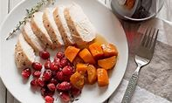
Putting it all together
Leftovers from dinner: 2 oz left over meat, ½ cup potato, rice, or pasta, 1 cup cooked vegetables
1 Medium Fresh Fruit
8 oz Skim Milk

Slide 17
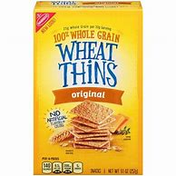
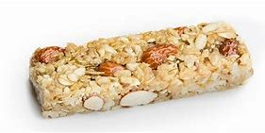
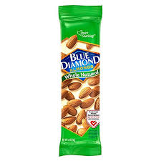
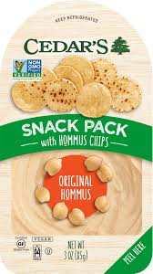
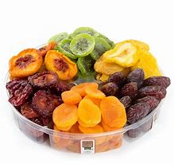
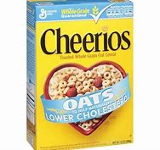
What about snacks
Notes:
Hummus snack packs,

Slide 18
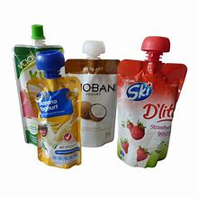
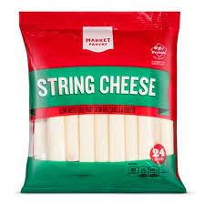
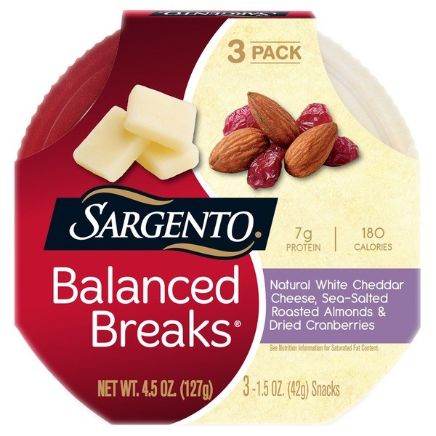
Snacking and Driving
Notes:
Squeezable fruit packets
Squeezable yogurt packets (make sure its low sugar)
String Cheese

Slide 19
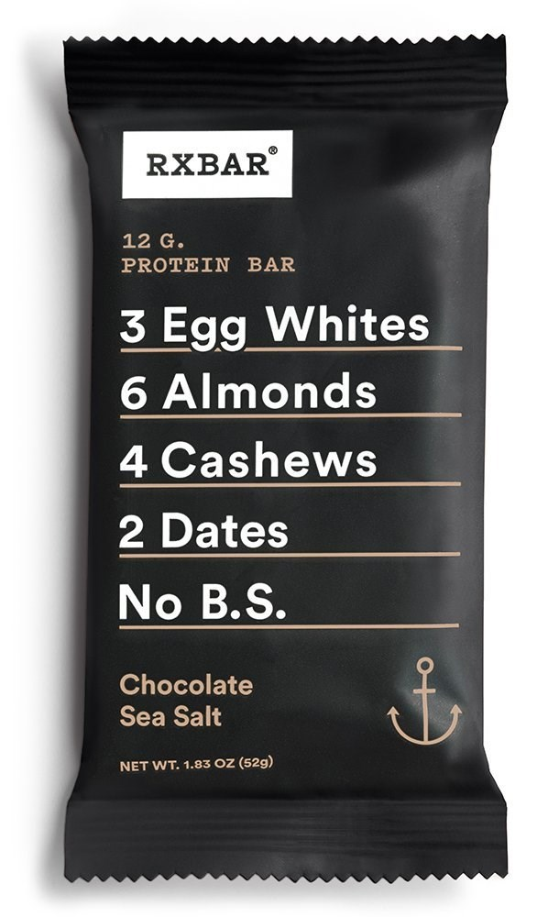
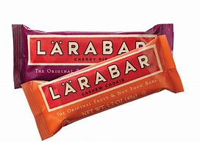
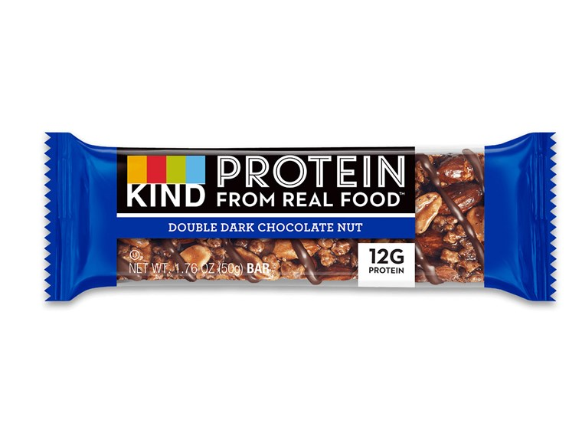
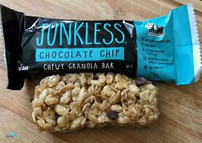
“Healthy” Bars
Notes:
Could talk about sugar- 5g or less is ideal (Some KIND bars fit this criteria, others do not, read the label)
Janice has a list of bars/snacks that I asked her to send you

Slide 20
Check the Label
Granola bar quick guidelines
3 grams of fiber
5 grams of protein
Watch out for sugar! = around 5 grams of sugar

Slide 21
Thank You
QUESTIONS?

