Slide 1
Impacts of Tobacco
Presenter: Emily Moores
Tobacco Prevention and Control Team Manager
Maine CDC
Tobacco and Substance use Prevention and Control Program

Slide 2
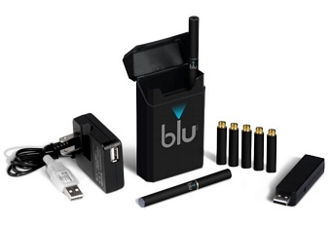
Agenda
Definition of Tobacco Products
Health effects of nicotine
Second and thirdhand smoke
ENDS - Vaping
Maine workplace/public place smoking laws
Data
What you can do
Resources

Slide 3
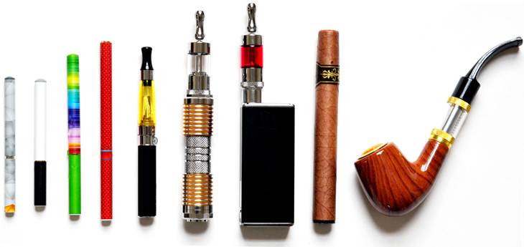
What is a Tobacco Product?

Slide 4
State of Maine
Tobacco Product Definition
"Tobacco product" means any product that is made from or derived from tobacco, or that contains nicotine, that is intended for human consumption or is likely to be consumed, whether smoked, heated, chewed, absorbed, dissolved, inhaled or ingested by any other means, including, but not limited to, a cigarette, a cigar, a hookah, pipe tobacco, chewing tobacco, snuff or snus.
"Tobacco product" also means an electronic smoking device and any component or accessory used in the consumption of a tobacco product, such as filters, rolling papers, pipes and liquids used in electronic smoking devices, whether or not they contain nicotine.
"Tobacco product" does not include drugs, devices or combination products authorized for sale by the United States Food and Drug Administration, as those terms are defined in the Federal Food, Drug, and Cosmetic Act.

Slide 5
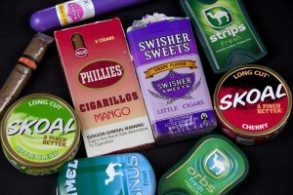
Tobacco Products come in many shapes, sizes and types…
Combustible Tobacco Products, include cigarettes, cigars, and cigarillos (little cigars).
Smokeless Tobacco Products, include chewing tobacco, snuff and snus.
Electronic Products, include e-cigarettes, vaporizers and vape products.
Nicotine is addictive in any form there are no harmless tobacco products.

Slide 6
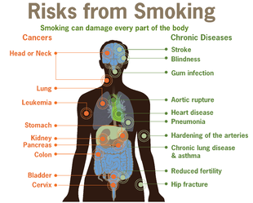
Health Effects of Tobacco Use and Exposure
Notes:
CDC Image
Transition slide.

Slide 7
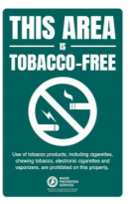
Understanding the Dangers of Tobacco
Tobacco use is the single leading cause of preventable death and disease in Maine and the U.S.
No risk-free level of exposure to secondhand smoke.
Tobacco-free environments change the social norm around tobacco use and promote tobacco-free lifestyles.
Notes:
Responsible for more than 480,000 premature deaths annually.
16 million are living with a disease caused by smoking.
1/5 Adult Mainers smoke. 1/7 U.S. Adults smoke cigarettes. BRFSS.
The risk of most adverse health outcomes caused by smoking is related to the duration and intensity of tobacco smoking, but no level of tobacco smoking is risk free.
SHS exposure causes more than 41,000 deaths each year among U.S. nonsmokers [DHHS 2014].
(CDC, 2014) https://www.cdc.gov/niosh/docs/2015-113/pdfs/cib-67_2015-113.pdf

Slide 8
Nicotine Use Under Age 25
The prefrontal cortex, which controls planning, impulse control, and working memory, continues to develop until about 25 years of age.
Nicotine and substance use exposure during periods of brain development can disrupt the growth of brain circuits that control attention, learning and susceptibility to addiction.
The effects of nicotine and substance use exposure during youth and young adulthood can be long-lasting and include lower impulse control and mood disorders, and prime young brains for addiction.
Notes:
Resource: 2016 Surgeon General Report (ENDS)

Slide 9
Smoking Tobacco Causes
Smoking causes: cancer, heart disease, stroke, lung diseases, diabetes, chronic obstructive pulmonary disease (COPD), including emphysema, chronic bronchitis, & certain cancers.
Smoking increases the risk for tuberculosis, certain eye diseases, and problems of the immune system, including rheumatoid arthritis.
Tobacco smoke contains more than 7,000 chemicals
70 are known to cause cancer
Each puff delivers a mix of chemicals to lungs where they are absorbed into the bloodstream and carried to every organ in the body
Notes:
Many of the chemicals damage DNA
Which controls how cells reporducs
DNA damage can cause cells to mutate and grow uncontrollably
https://www.cdc.gov/tobacco/data_statistics/sgr/50th-anniversary/pdfs/fs_smoking_cancer_508.pdf

Slide 10
Tobacco:
The leading cause of preventable death
The Surgeon General’s Reports from 1964 to 2014 have identified the following cancers caused by smoking:
lungs, trachea, and bronchitis
oropharynx
esophagus
larynx
stomach
bladder
kidney and ureter
pancreas
uterine cervix
colon and rectum
liver
Acute myeloid leukemia
https://www.cdc.gov/tobacco/data_statistics/sgr/50th-anniversary/pdfs/fs_smoking_cancer_508.pdf

Slide 11
Secondhand Smoke
What is SHS?
Smoke from burning tobacco products, such as cigarettes, cigars, or pipes.
Smoke that has been exhaled, or breathed out, by the person smoking.
Maine Exposure Rates
Middle School Youth Exposure: 34.4%
During the past 7 days on how many days were you in the same room with someone who was smoking cigarettes? MIYHS 2017
High School Youth Exposure: 31.1%
During the past 7 days on how many days were you in the same room with someone who was smoking cigarettes? MIYHS 2017
Adult Exposure: 10.9%
During the past 30 days did someone smoke a cigarette, cigar, or pipe anywhere inside your home? BRFSS 2015
Notes:
If this is occurring in the home, lets protect Mainers while they are at work.

Slide 12
Thirdhand Smoke
Is residual nicotine and other chemicals left on indoor surfaces by tobacco smoke.
Exposure by touching contaminated surfaces or breathing in the off-gassing from these surfaces.
Clings to clothes, furniture, drapes, walls, bedding, carpets, dust, vehicles and other surfaces long after smoking ended.
Children and nonsmoking adults might be at risk of tobacco-related health problems when they inhale, swallow or touch substances containing thirdhand smoke
CAN’T be eliminated by airing out rooms, opening windows, using fans or air conditioners, or confining smoking to only certain areas of a home

Slide 13
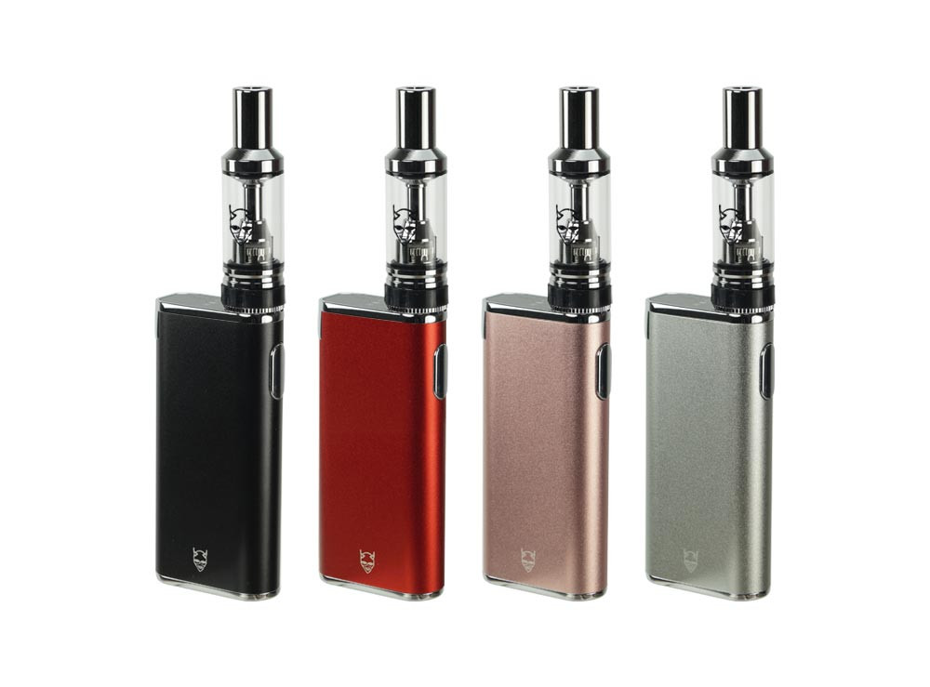
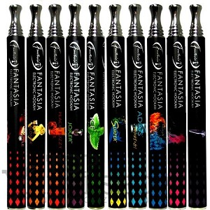
Electronic Nicotine Delivery System
(Vaping)
Notes:
Transition slide

Slide 14
What are
Electronic Nicotine Delivery Systems?
(ENDS)
A device that heats a liquid into an aerosol
User inhales the aerosol
E-cigarettes are a tobacco product
E-cigarettes can contain harmful and potentially harmful ingredients, including:
nicotine
ultrafine particles that can be inhaled deep into the lungs
flavorings such as diacetyl, a chemical linked to lung disease
heavy metals, such as nickel, tin, and lead
Notes:
Ensure audience understands ENDS will be used interchangeably with Vaping.

Slide 15
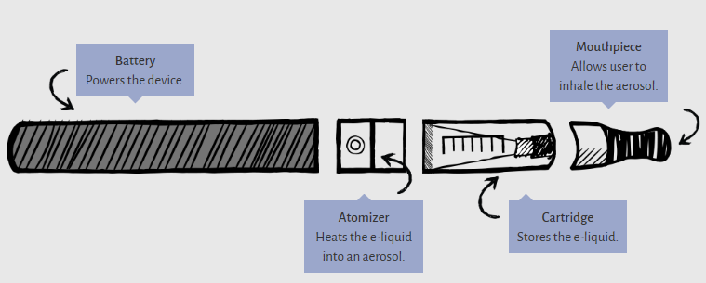
How do they work?
Anatomy of device
US CDC Image
Notes:
There are a variety of shapes, sizes and styles of e-cigarettes. While there might be some variation – this provides an overview of how they work generally.
E-cigarettes create an aerosol by using a battery to heat up liquid that usually contains nicotine, flavorings, and other additives. Users inhale this aerosol into their lungs. E-cigarettes can also be used to deliver cannabinoids such as marijuana, and other drugs.

Slide 16
Types of ENDS devices
US CDC Image
Notes:
Aka Vape Devices

Slide 17
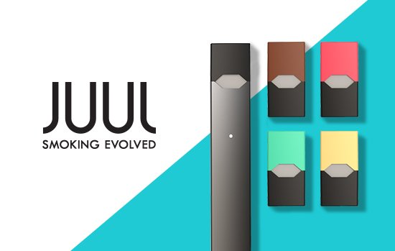
What is a JUUL
Attractive to youth where it looks like a USB drive
They use a USB port to charge
Compact/discrete
Juul Pods have cartridges that are flavored
1 Juul Pod is equivalent to 1 pack of cigarettes (~200 puffs)
Highest market share for an e-cigarette product
JUUL users consider use as JUULing not vaping
Notes:
A Juul is a type of electronic delivery system that also doubles as a USB drive. Some of you may be aware of the increasing popularity among youth of JUUL devices, an e-cigarette that can be concealed easily because it looks like a USB flash drive and has cartridges that are available in many kid-friendly flavors. JUUL now has the highest market share (in tracked channels), surpassing Reynolds’ Vuse as the most popular e-cigarette product. They are discrete and becoming increasing popular with youth. Each JUULpod contains 0.7mL with 5% nicotine by weight, approximately equivalent to 1 pack of cigarettes or 200 puffs.
***Research from Truth Initiative shows that 25 percent of 15-24-year-old JUUL users do not identify their behavior as vaping, instead referring to it as “JUULing.” Furthermore, our research shows that 37 percent of teen and young adult JUUL users are uncertain whether the product contains nicotine when, in fact, all marketed versions of JUUL do contain nicotine.

Slide 18
Not a Harmless Water Vapor
US CDC Image

Slide 19
Laws
T21
Smoking in Public Places
Workplace
Notes:
Transition slide

Slide 20
Tobacco 21 (T21)
LD 1170
Raises tobacco sales age from 18 to 21. (This includes all tobacco products.)
8/2/2017 – Maine became the 4th State to raise the sales age to 21.
The provision of the law went into effect on July 1, 2018.
Grandfathering Clause (3 years): Current 18 year old’s will retain the ability to have cigarettes sold to them if born on or before July 1, 2000.
A customer must have obtained 18 years of age as of, July 1, 2018 to be sold tobacco products.
This law includes: removal of all Minor In Possession or Possession Use and Purchase (MIP/PUP) language in state code.
-- Eliminating MIP/PUP language concentrates enforcement and compliance activities on the source of tobacco rather than the youth purchasing.
Notes:
http://tobacco21.org/
The law is titled: LD 1170 and more information can be found: http://www.mainelegislature.org/legis/bills/getPDF.asp?paper=SP0391&item=1&snum=128
Within this law, it includes a removal of all Minor In Possession or Possession Use and Purchase (MIP/PUP) language in state code. Eliminating MIP/PUP language concentrates enforcement and compliance activities on the source of tobacco rather than the youth purchasing. This is an enforcement method that has seen success with the implementation of Tobacco Retail Licensing (TRL) and consistent compliance checks. http://tobacco21.org/state-by-state/
(So, the intention is so youth will not be “punished” for possession, the focus is at the retailer no making the sale to the under-aged individual.)
11/1/17 – Rules go into effect that remove penalties for underage possession of tobacco products, changes the list of products that are considered tobacco and changes (reflected in slide 1) the fee structure for fines for tobacco retailers for selling to minors.
6/20/2016 – Portland becomes first city in Maine to adopt Tobacco 21.
(The grandfathering clause will not be recognized in the City of Portland. They remain, T21 exclusively.)
Reminder: Remember the definition of Tobacco Products on slide 2. This will raise the legal age to 21 to purchase any of those items, including Electronic Nicotine Delivery Systems.

Slide 21
Workplace Smoking Act of 1985
§1580-A. Smoking in places of employment
Ensure smoking is prohibited in all enclosed areas of public places, outdoor dining areas where food or drink is permitted for consumption, vehicles used in the course of work and outdoor areas where employees perform a services for their employer.
Business Facility: a structurally enclosed location or portion thereof, including vehicles used in the course of work and outdoor areas under the control of an employer at which employees perform services for their employer.
Employee: a person who performs a service for wages or other remuneration under a contract of hire, written or oral, expressed or implied. Employee includes a person employed by the State or a political subdivision of the State.
Employer: a person who has one or more employees. Employer includes an agent of an employer and the State or a political subdivision of the State.
http://www.mainelegislature.org/legis/statutes/22/title22sec1580-A.html
Notes:
http://www.mainelegislature.org/legis/statutes/22/title22sec1580-A.html

Slide 22
Workplace Smoking Policy
Purpose: To protect the employer and employees from the detrimental effects of environmental tobacco smoke.
Each employer shall establish a written policy that prohibits smoking in all structurally enclosed location or portion thereof, including vehicles used in the course of work and outdoor areas under the control of an employer at which employees perform services for their employer.
Smoking shall only be permitted outside in a Designated Smoking Area.
The employer shall post and supervise the implementation of the written policy.
The employer shall provide a copy of this policy to any employee upon request.
Notes:
http://www.mainelegislature.org/legis/statutes/22/title22sec1580-A.html

Slide 23
Designated Smoking Area
(DSA)
An employer may designate an area outdoors for smoking provided that is a minimum 20 feet from windows, entryways, vents, doorways or other openings and it is not in a location that will allow circulation of environmental tobacco smoke into the enclosed areas of the business facility, or a public place, in any way, e.g., through the ventilation system, open windows, and open doors, or any outdoor area where smoking is prohibited by law.
A DSA is not required. An employer may adopt a 100% smoke-free to 100% tobacco-free policy
An area for smoking outdoors may be constructed to protect employees from the weather as long as it is not an “enclosed area.”
Notes:
http://www.mainelegislature.org/legis/statutes/22/title22sec1580-A.html

Slide 24
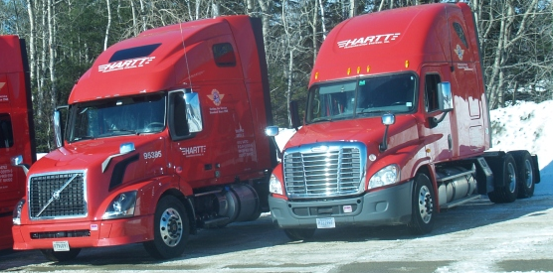
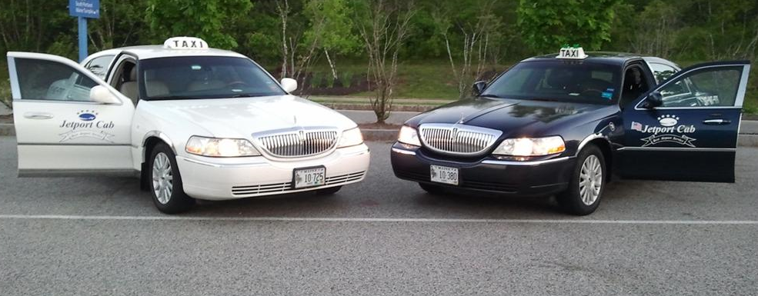
Vehicles used in the course of work
http://www.hartt-trans.com/
http://www.pressherald.com/2014/02/06/road-clearing_budgets_nearly_plowed_under_in_maine_/
http://bangordailynews.com/2013/09/07/news/nation/postal-service-to-offer-thousands-of-early-retirements

Slide 25
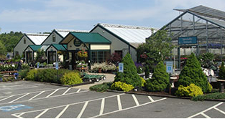
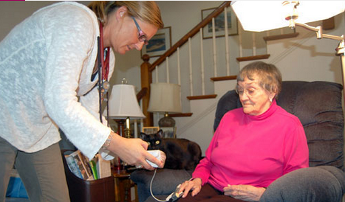
Outdoor Business
http://www.mainetv.net/flagger.htm
Notes:
Laws:
Title 22
Chapter 263 §1580-A. Smoking in places of employment
Chapter 262 §1543. Posting signs
Rules:
Chapter 250: Rules Relating to Smoking in the Workplace

Slide 26
Smoking in Public Places Law
Public Place: Any place not open to the sky into which the public is invited or allowed.
How smoking is defined if the business is a public place: Smoking includes carrying or having in one’s possession a lighted or heated cigarette, cigar or pipe or a lighted or heated tobacco product intended for human consumption through inhalation whether natural or synthetic in any manner or in any form. Smoking includes the use of ENDS.
If business is not a public place: Smoking means carrying or having in one’s possession a lighted cigarette, cigar, pipe or other object giving off or containing any substance giving off tobacco smoke.

Slide 27
Data
Notes:
Transition Slide

Slide 28
Cigarette Smoking, by Year, Maine Adults
Data Source: Maine Behavioral Risk Factor Surveillance System.
Due to changes in survey methodology, BRFSS data collected in 2011 and in subsequent years cannot be compared with data prior to 2011.
Notes:
Definition: Maine adults (aged ≥18 years) who have smoked at least 100 cigarettes and currently smoke every day or some days.
Due to changes in survey methodology, BRFSS data collected in 2011 and in subsequent years cannot be compared with data prior to 2011.

Slide 29
Cigarette Smoking, Total and by Sex, Maine Adults, 2016
Data Source: Maine Behavioral Risk Factor Surveillance System
Notes:
Definition: Maine adults (aged ≥18 years) who have smoked at least 100 cigarettes and currently smoke every day or some days.

Slide 30
Cigarette Smoking by Health Insurance Type, by Year, Maine Adults
YEAR
Data Source: Maine Behavioral Risk Factor Surveillance System.
Measure 3.13 - Trend
Notes:
Definition: Maine adult (aged ≥18 years) respondents who indicated that someone (including themselves) had smoked cigarettes, cigars or pipes anywhere inside their home in the past 30 days.

Slide 31
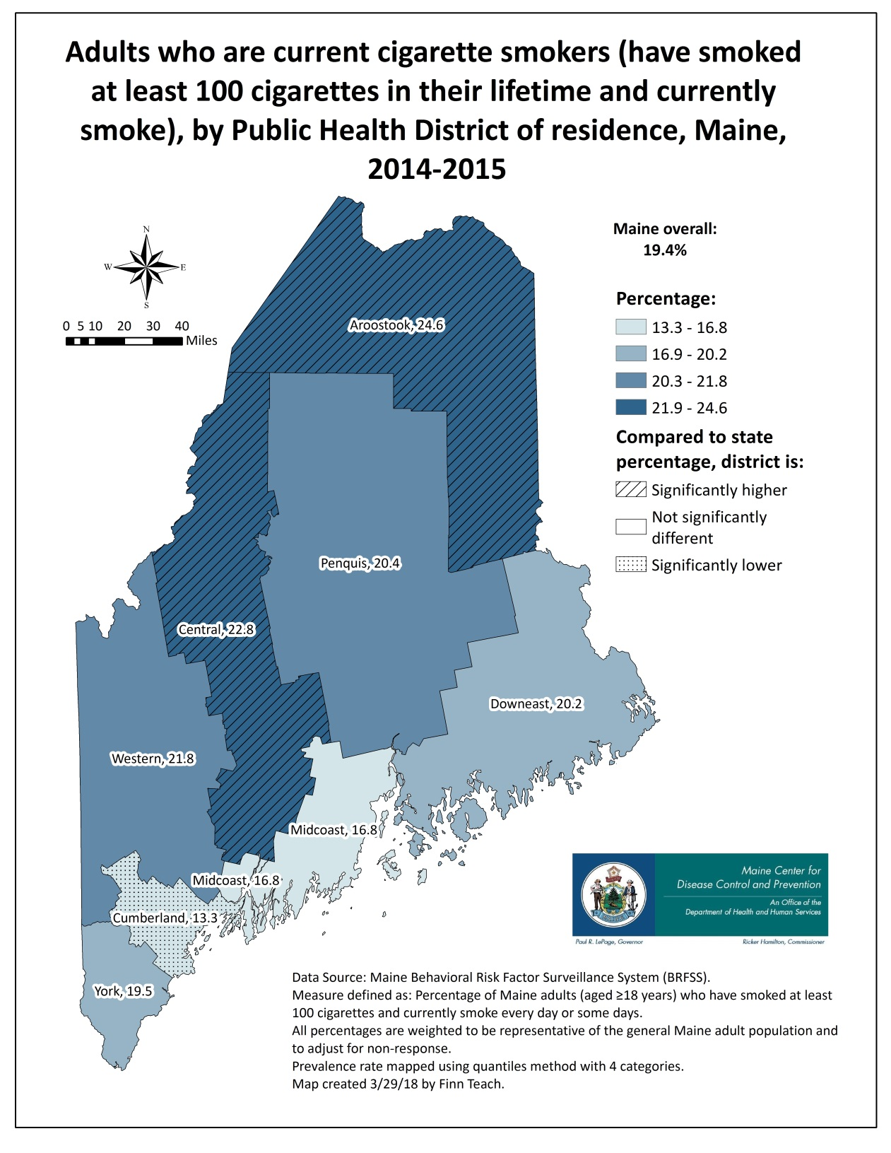
Cigarette smoking, by Public Health District, Maine Adults, 2014-2015
Notes:
Definition: Maine adults (aged ≥18 years) who have smoked at least 100 cigarettes and currently smoke every day or some days.
Measure 2.19

Slide 32
The impact on an employer and
what you can do
Notes:
Transition Slide

Slide 33
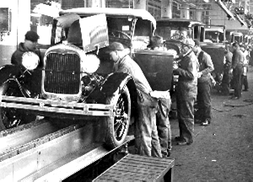
Possible Impact of Tobacco Use Disorders
Lost productivity
Absenteeism
Injuries
Fatalities
Theft
Low employee morale
Increased in health care costs
Legal liability costs
Workers' compensation costs
Notes:
The Diagnostic and Statistical Manual of Mental Disorders, Fifth Edition (DSM-5), no longer uses the terms substance abuse and substance dependence, rather it refers to substance use disorders, which are defined as mild, moderate, or severe to indicate the level of severity, which is determined by the number of diagnostic criteria met by an individual. Substance use disorders occur when the recurrent use of alcohol and/or drugs causes clinically and functionally significant impairment, such as health problems, disability, and failure to meet major responsibilities at work, school, or home. According to the DSM-5, a diagnosis of substance use disorder is based on evidence of impaired control, social impairment, risky use, and pharmacological criteria.

Slide 34
Smoking-U.S. Economy
$300 Billion annually in medical care and lost productivity.
$170 billion for direct medical costs for adults
$156 billion in lost productivity
$5.6 billion in lost productivity to SHS exposure
Costs an employer $6,000 more than a nonsmoker annually
Worksites that allow smoking spend about $728 more per 1,000 square feet annually in maintenance costs for office space than smoke-free worksites.
With U.S. commercial buildings averaging between 12,000 to 19,000 square feet, there is an estimated extra cost of about $9,000 to $14,000 annually
Smoking increases the risk of fires and injuries, which can increase health and building insurance costs by up to 30 percent
Notes:
https://www.cdc.gov/tobacco/data_statistics/fact_sheets/economics/econ_facts/index.htm
https://www.cdcfoundation.org/businesspulse/tobacco-use
https://www.cdcfoundation.org/businesspulse/tobacco-use-resources
“Tobacco use is associated with increased risk of injury and property loss due to fire, explosion, and vehicular collisions.
Tobacco use by workers (most commonly smoking) can increase—sometimes profoundly—the likelihood and/or the severity of occupational disease and injury caused by other hazards present.” (https://www.cdc.gov/niosh/docs/2015-113/pdfs/cib-67_2015-113.pdf

Slide 35
How to reduce tobacco use in the workplace?
Improve tobacco policy
Include other tobacco products such as ENDS
Build in support for tobacco users who may want to quit
Cessation groups or provide information for help to quit (i.e. MTHL)
Provide education opportunities for employees on:
Risks, quit opportunities, quit resources
Provide information on tobacco-related health risks and benefits of quitting to employees and other workers at the worksite (e.g., contractors and volunteers)
Train workers who are exposed or potentially exposed to occupational hazards at work about increased health and/or injury risks of combining tobacco use with exposure to workplace hazards,
about what the employer is doing to limit the risks, and
about what the worker can do to limit his/her risks.

Slide 36
What is Maine Prevention Services?
(MPS)
MPS works to prevent health risks associated with: obesity, tobacco, and other substance use across the state.
The collaborative effort of the Maine CDC and community partners maximizes the health, safety and productivity for those who live, work, and play in Maine.
Notes:
MaineHealth focuses on the tobacco work and can assist local settings with policy adoption.

Slide 37
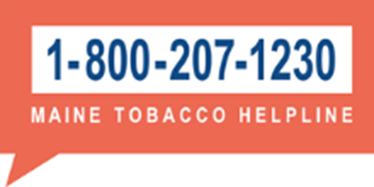
When you are ready to quit, call
the Maine Tobacco HelpLine
It is Free and Confidential
Hours: 8:00 AM - 12:00 AM Daily
Eligibility to receive counseling: All Maine residents are eligible for one call. May receive multiple calls if ready to quit within 30 days.
Medications provided:
Nicotine Gum, Nicotine Patch, Nicotine Lozenge
Up to eight weeks of free, generic, OTC NRT
Evidence Base Resource: Treating Tobacco Use and Dependence Clinical Practice Guideline (U.S. Public Health Service, 2008).
Notes:
The State funds this effort.
Maine Tobacco HelpLine Voucher Program:
Eligibility: No insurance coverage for NRT, Nicotine Patch, Gum or Lozenge for up to 8 weeks, Participant picks up the NRT at their pharmacy of choice, Eligible again after 6 months.
A contract deliverable of the Quitline Capacity Contract is to promote the adoption of the Maine Tobacco HelpLine Fax Referral into the Electronic Medical Record (EMR) of health care system providers in Maine.
FY2012 to FY2014 there were 4 health systems participating, and 2,354 referrals received from the EMRs.
FY2015-FY2017 there were 16 health systems participating, and 8,343 referrals received from the EMRs.

Slide 38
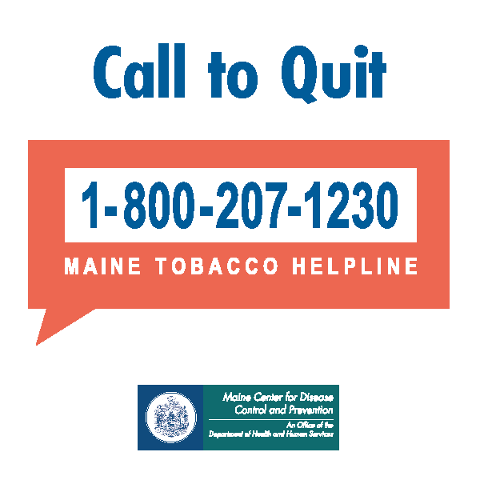
Nicotine Replacement Therapy
(NRT)
7 FDA-approved medications:
patch, (OTC)
gum, (OTC)
inhaler, (Rx)
nasal spray, (Rx)
lozenge, (OTC)
Two non-NRT medications that require Rx:
bupropion SR (brand name Zyban if used for tobacco cessation and Wellbutrin if used as an antidepressant), and
varenicline (brand name Chantix)
OTC-Over-the-Counter
Rx-Prescription
Notes:
Consistent identification and treatment of tobacco use by clinicians and health care systems increases quit rates.
Tobacco dependence is a chronic disease, with most smokers making multiple quit attempts before succeeding, and many of these smokers requiring repeated intervention.
https://www.cdc.gov/tobacco/quit_smoking/cessation/pdfs/coverage.pdf

Slide 39
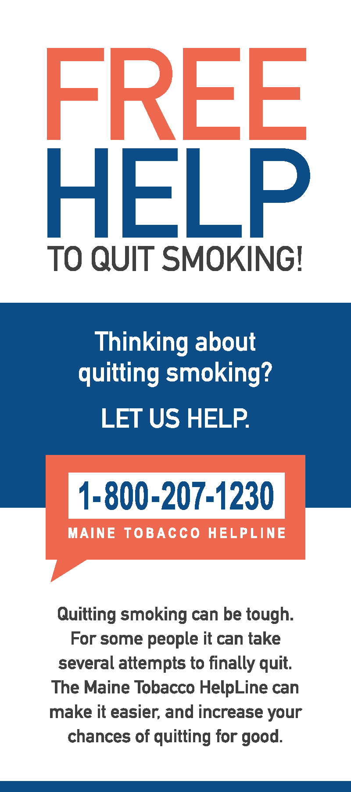
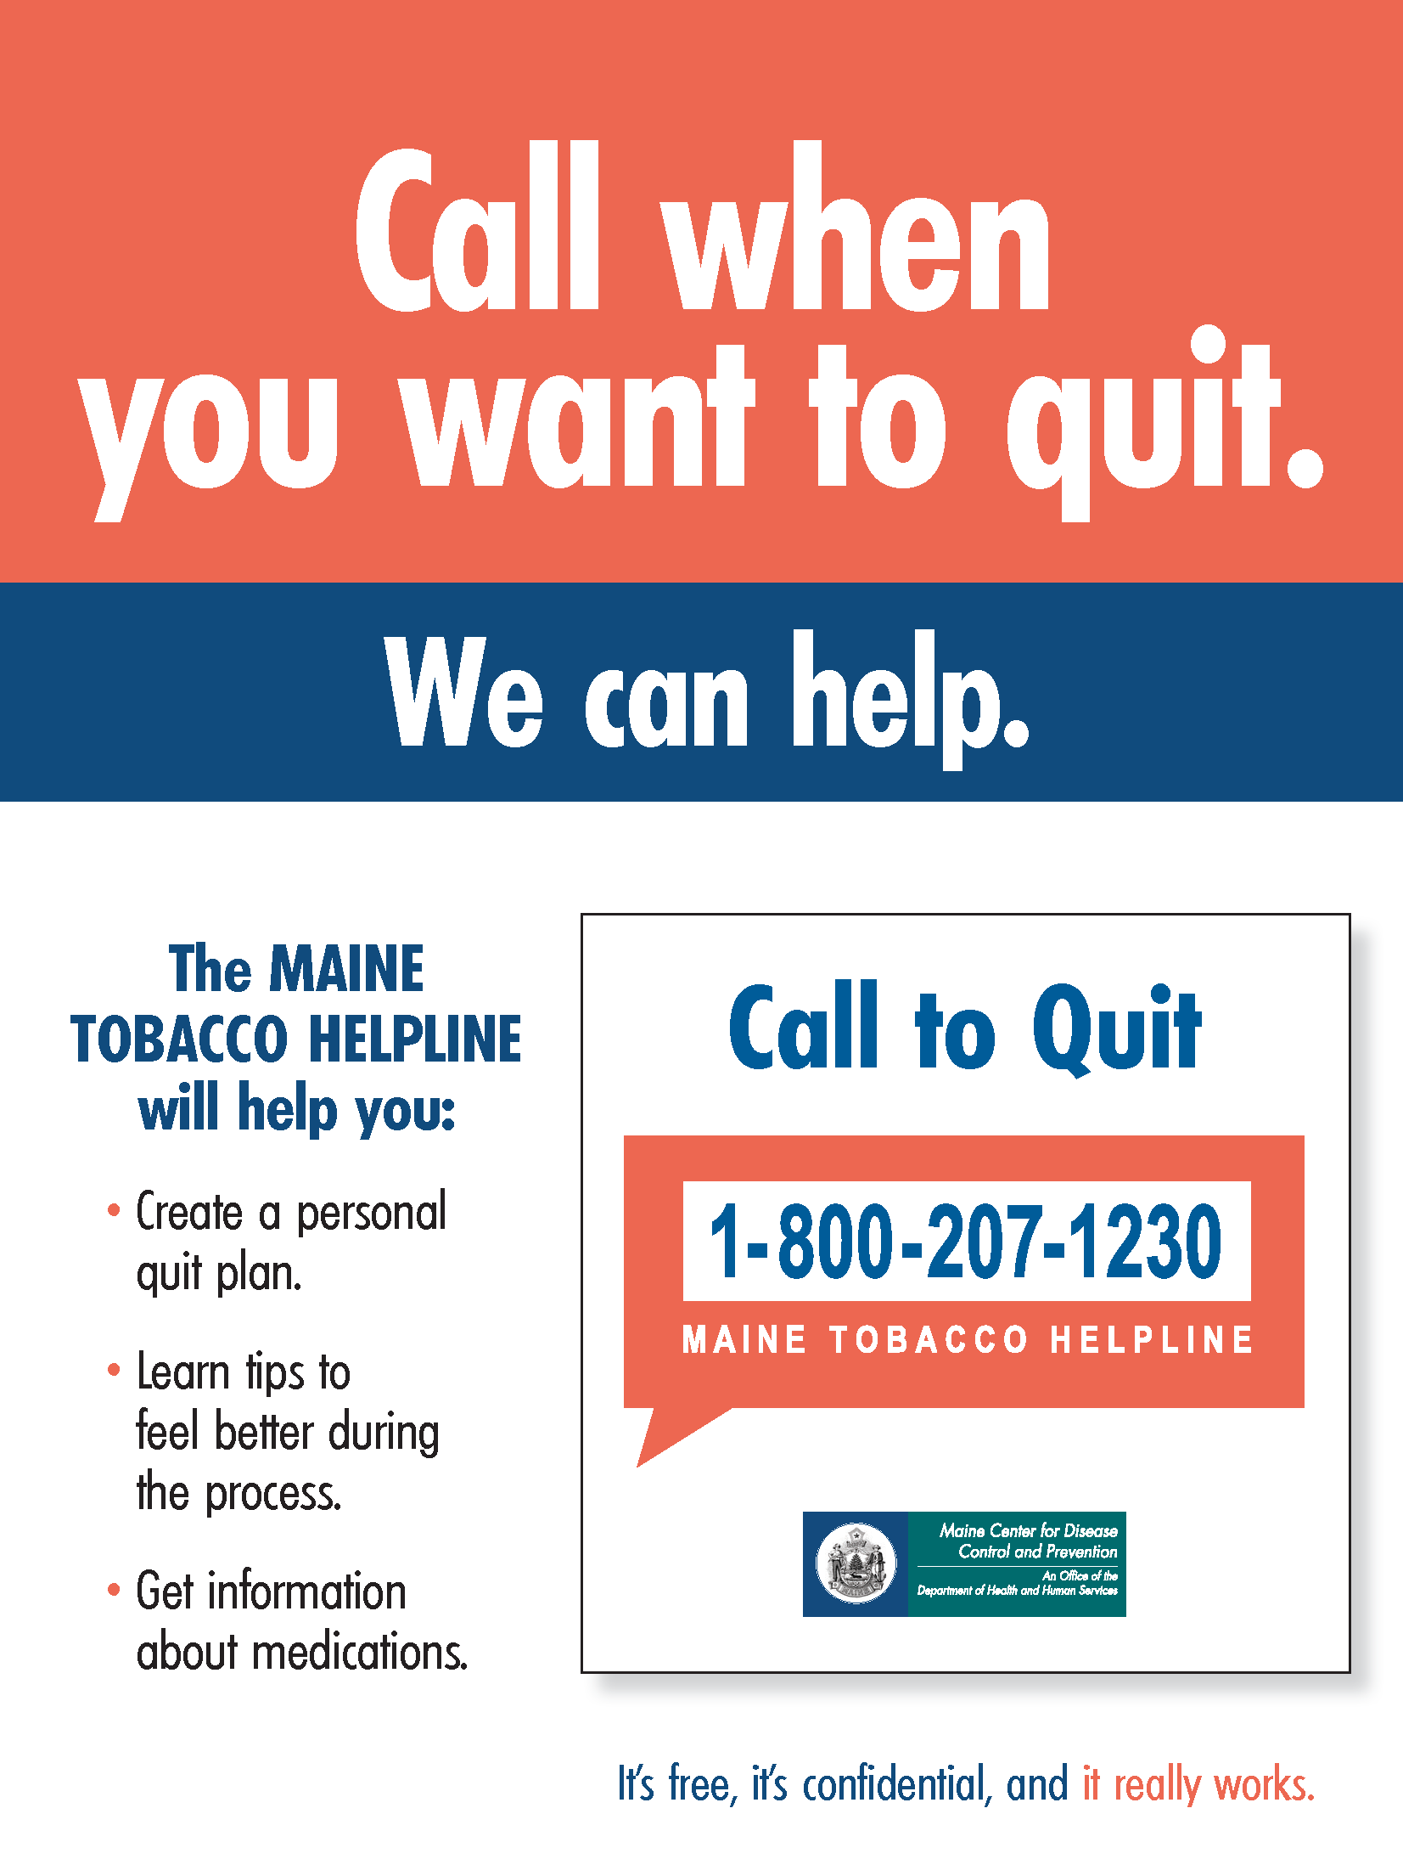
Maine Tobacco HelpLine Resources
Order resources for Free www.mainepreventionstore.com
Notes:
How do you refer a patient to the helpline?
There are two ways to refer a patient to the HelpLine. One way is to offer advice to call the HelpLine, coupled with handing the individual a brochure, card or sticky note with the HelpLine number.
A better way is to use the Electronic Referral Form which, with the patient’s approval, a clinician fills out and faxes or e-mails directly to the HelpLine.
A Specialist from the Maine Tobacco HelpLine then proactively calls the patient.

Slide 40
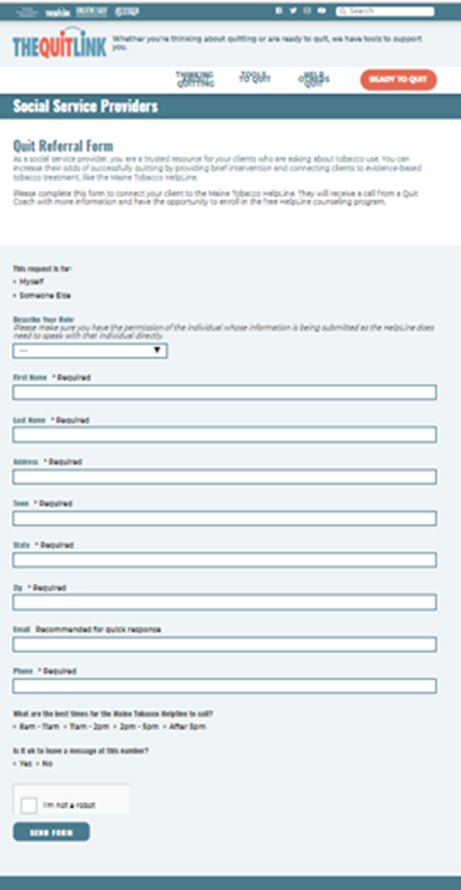
The QuitLink
Thinking about quitting…
Notes:
Now can register for helpline services directly through the quitlink (as well as continuing to also have the 1-800-207-1230 number to register.)

Slide 41
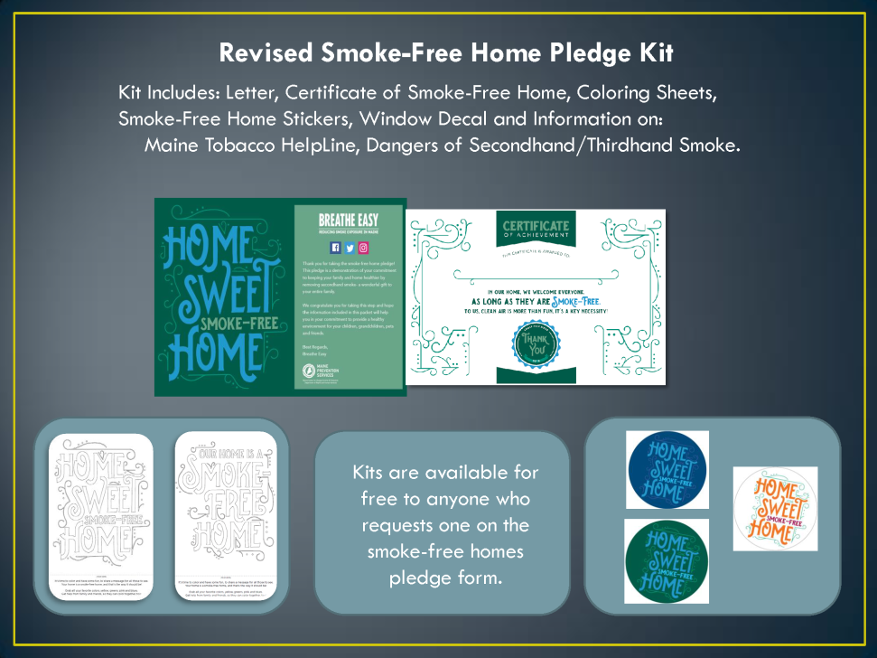
Smoke Free Home Pledge
Not ready to quit but willing to decrease exposure in your home...
Notes:
What happens when someone take the pledge?
BEC tracks the ZIP code and other information asked about the type of housing, smoking status, and whether there are
children in the home for every pledge taken.
Individuals who take the pledge and request a smoke-free kit will receive the kit in the mail. The kit contains materials
to help them keep their home smoke-free, including information about secondhand smoke, quitting smoking, stickers, a
door decal, and coloring cards for kids. Names and addresses are only used for the purposes of mailing out pledge kits
to those who request them.
http://breatheeasymaine.org/wp-content/uploads/sites/2/2016/12/Smoke-Free-Home-Pledge-Info.pdf
http://breatheeasymaine.org/pledge-resources/
The Smoke-Free Home Pledge is a pledge all Maine residents can take to commit to setting their own rules against smoking in their home.
By taking the pledge, individuals are committing to protect their home and family from the harmful effects of second and thirdhand smoke.
Individuals or families can take the pledge online at BreatheEasyMaine.org/pledge

Slide 42
Questions?
Emily Moores
Emily.Moores@Maine.gov
207-287-3268
Tobacco Prevention & Control Manager
of the
Tobacco and Substance Use Prevention and Control Program
At the
Maine CDC

