Slide 1
50 Years: History and Evolution of the JJDPA Core Requirements and Leveraging Federal Resources to Enhance Your State and Local Juvenile Justice Systems

Slide 2
Meet the Speakers
Linda Barry Potter, Juvenile Justice Specialist - Maine.
Jill Ward, Director of Youth Policy and Law Center & Vice-
Chair of Maine’s JJAG
Megan Anderson, Maliseet Tribe Member, Program Director & JJAG Youth Council Member
SEND A HEADSHOT

Slide 3
Agenda
The JJDPA’s Call to Action
Two States’ Response to this Call
Minnesota
Maine
Questions
Getting Involved in Your State

Slide 4
Key Acronyms and Terms
OJJDP: Office of Juvenile Justice and Delinquency Prevention
JJDP Act: Juvenile Justice and Delinquency Prevention Act
JJRA: Juvenile Justice Reform Act of 2018
R/ED: Racial and Ethnic Disparities
CM: Compliance Monitor
SAG: State Advisory Group
DSA: Designated State Agency
STRAD: State and Tribal Relations Assistance Division

Slide 5

History and Purpose of the JJDP Act
Congress enacted the Juvenile Justice and Delinquency Prevention (JJDP) Act (Pub. L. No. 93-415, 42 U.S.C. § 5601 et seq.) to support local and state efforts to prevent delinquency and improve the juvenile justice system.
Enacted by Congress in 1974; amended seven times most recently reauthorized through the Juvenile Justice Reform Act (JJRA) of 2018
Created Title II Formula Grants program
Established the separation, deinstitutionalization of status offenders (DSO), jail removal and racial and ethnic disparity (R/ED) core requirements
(SEC. 102. 34 U.S.C. 11102 (1)(2))

Slide 6
History and Purpose of the JJDP Act
1974
Established Deinstitutionalization of Status Offenders (DSO) and Separation of Juveniles from Adult Inmates Requirements
1980
Established Removal of Juveniles from Adult Jails and Lockups Requirement
1988
Addressed Disproportionate Minority (DMC) Confinement As a Requirement
1977
Increased and Expanded DSO and Separation Requirements and Emphasized Prevention and Treatment
Source: https://ojjdp.ojp.gov/about/legislation

Slide 7
History and Purpose of the JJDP Act
2002
-
Broadened Scope of DMC Core Requirement from ‘Confinement’ to ‘Contact’
2018
Juvenile Justice Reform Act (JJRA) Sign into Law Reauthorizing and Substantially Amended the JJDP Act
DMC Core Requirement Language Amended to Racial and Ethnic Disparities
1992
Amended DSO, Jail Removal, & Separation Requirements
Elevated DMC to a Core Requirement
Established New Programs to Address Gender Bias
Emphasized Prevention and Treatment, Strengthening Families, Graduated Sanctions, and Risk-Need Assessments
Required States to Give Funding Priorities of Grant Allocations to Evidence-based Programs
Reauthorized Title II Formula Grants Program
Source: https://ojjdp.ojp.gov/about/legislation

Slide 8
Core Requirements
Deinstitutionalization of Status Offenders (DSO)
1974
Section 223(a)(11)(B) of the JJDP Act
2018
Racial and Ethnic Disparities (R/ED) (Previously Disproportionate Contact [DMC])
1988
JJDPA
Removal from Jails and Lockups (Jail Removal)
1980
Sight and Sound Separation (Separation)
1974

Slide 9
Two Sides of the Same Coin
Designated State Agency
State Advisory Group
- Ensure Compliance
- Utilize Title II
- Impact Disparity
- Drive Juvenile Justice Improvement

Slide 10
Things to Remember - Three-Year Plan
Plans should:
Illustrate how the state meets all 33 requirements of the JJDP Act, for example:
SAG Roster
DSA Staff
Compliance Manual
R/ED Plan
Juvenile crime analysis
Description of performance goals and priorities.
Plans can be amended annually, include new programs, projects, and activities.
Submit annual performance reports describing progress.
Describe how plan account for scientific knowledge regarding adolescent development and behavior and the effects of delinquency prevention programs and juvenile justice interventions on adolescents.
Post their final state plans on their public websites 60 days after the plans are finalized.
***Plan must include HOW the programs are expected to address the identified juvenile crime problems***

Slide 11
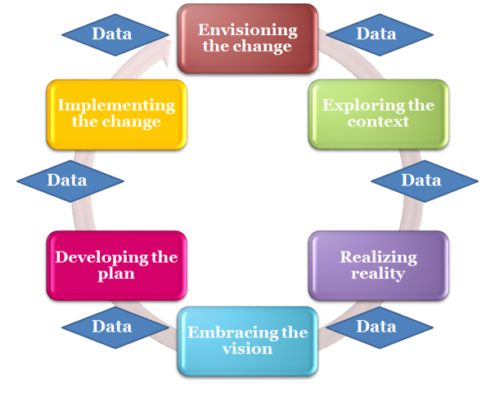
State Plans (Three-Year Plan)
To receive formula grants, a state must submit a comprehensive plan on a 3-year cycle.
Updated annually to reflect the current status of the state’s identified priorities.
Submitted as part of the Title II Formula Grants Program application and should reflect priorities and use of funding.
The SAG participates in the development of the plan.

Slide 12
Three-Year Plan Key Components
Plans should:
Illustrate how the state meets all 33 requirements of the JJDP Act, for example:
SAG Roster
DSA Staff
Compliance Manual
R/ED Plan
Juvenile crime analysis
Description of performance goals and priorities.
Plans can be amended annually, include new programs, projects, and activities.
Submit annual performance reports describing progress.
Describe how plan account for scientific knowledge regarding adolescent development and behavior and the effects of delinquency prevention programs and juvenile justice interventions on adolescents.
Post their final state plans on their public websites 60 days after the plans are finalized.
***Plan must include HOW the programs are expected to address the identified juvenile crime problems***

Slide 13
Minnesota Slides

Slide 14
Core Protections & Maine Law:
Deinstitutionalization of Status Offenders: hhttps://legislature.maine.gov/statutes/15/title15sec3501.html
Removal of Juveniles Charged as Adults from Adult Jails:
https://legislature.maine.gov/statutes/17-A/title17-Asec1611.html https://legislature.maine.gov/statutes/15/title15sec3203-A.html
Separation of Juveniles from Adult Inmates:
https://legislature.maine.gov/statutes/15/title15sec3203-A.html https://legislature.maine.gov/statutes/15/title15sec3501.html

Slide 15
Title II Funding:
Allowable Uses:
https://ojjdp.ojp.gov/funding/fy2022/titleII/fy22-program-budget-areas.pdf

Slide 16

Title II Collaboration:
State Agencies
Website
OJJDP
Subgrantees

Slide 17


Seeding New Ideas:

Slide 18







Creativity in Design:

Slide 19

Question-and-Answer Session

Slide 20
Getting Connected in Your State

Slide 21
SAG Membership Composition Requirements
Member Perspectives
Government
Community
Juvenile justice system experience (3 members)
Providers
Locally elected official
20% younger than 28 years of age when appointed
Law enforcement
Delinquency prevention public agency
Private nonprofit organizations
Volunteers
Alternatives to detention
School violence and alternatives to suspension/expulsion
Disability, mental health, and substance abuse (new)
Child abuse/ neglect
Tribal (new)
Witness advocacy groups (new)
SEC. 223. 34 U.S.C. 11133 (a) (3)(A)

Slide 22
Center for Youth Justice Transformation
Provides responsive resources and training and technical assistance to support states, territories, tribal units, and communities in developing a continuum of juvenile justice services—ranging from prevention to intervention to reentry—that aligns with Office of Juvenile Justice and Delinquency Prevention’s (OJJDP) Title II Formula Grants Program.
Individualized training and technical assistance to states and territories
Quarterly state calls with DSA staff and SAG Chairs
DSA staff cohort programs
Interactive tip sheets, tools, and resources
Peer-learning roundtables
National conferences sessions
COMING SOON – Youth Justice Transformation Institute
CYJT serves all 56 states, territories, & DC.
Over 200 individual TTA requests served.
Questions – cyjt@air.org
Requesting Assistance - https://tta360.ojjdp.ojp.gov

Slide 23
Center for Reducing Racial & Ethnic Disparities
SHAY – Could you add?

Slide 24


Connect With OJJDP
@OJPOJJDP
facebook.com/OJPOJJDP
youtube.com/OJPOJJDP
ojjdp.ojp.gov/enews/newsletter.html
ojjdp.ojp.gov/enews/juvjust.html

Slide 25

Session Feedback
Please complete the evaluation by scanning the QR code: https://www.surveymonkey.com/
Your feedback is appreciated!
This QR code will be customized at a later date

