Slide 1
Ready Check Inject
Epinephrine Syringe Program
Notes:
Maine EMS Ready, Check, Inject Program adapted with permission from the Vermont Department of Health Ready, Check, Inject Epinephrine syringe program.

Slide 2
Epinephrine Syringe Program
Alternative to prescription epinephrine auto injectors as currently used in Maine EMS Protocols for use at the EMT level. Please reference “Allergy Anaphylaxis #1” (Gold 1) in your protocols. This program is also recommended as a review for AEMT and Paramedic providers.
Notes:
The Ready-Check-Inject project was designed to address significant cost increases in epinephrine auto injectors and offer EMTs (as well as AEMTs and Paramedics) the ability to administer intramuscular epinephrine via syringe at significantly lower costs. Although auto-injectors remain the preferred method for EMTs to administer epinephrine, we recognized that these devices are becoming cost prohibitive for many services. Any EMT Level service carry EPI for anaphylaxis provided EMTs have been trained.

Slide 3
Autoinjectors
PROS
Preferred method of delivering epinephrine to patients in anaphylaxis.
Convenient
Pre-filled reduces risk of dosing errors
Auto-injector reduces risk of route errors
Faster time to administer dose compared to syringe method
CONS
Expensive- $100-$500 per set
Expire annually
Improper use poses risk to providers
Notes:
Auto injectors are the preferred and easiest way to administer epinephrine to a patient in anaphylaxis due to their convenience. Autoinjectors reduce the risks of dosing and route errors and the time to administer dose is faster than the syringe method.
Unfortunately the high costs of autoinjectors makes it increasingly challenging for services to maintain stock of adult and pediatric units. Depending on the brand autoinjectors cost $100-500 per set and have an average useable life span of one year before expiring.
Autoinjectors also have high numbers of adverse events due to incorrect use of device, often times it is the person administering the autoinjector who is accidentally injected rather than the intended recipient of the medication.

Slide 4
Syringe Method
PROS
Vials are inexpensive- ~$12 per 1mg vial
Supplies are same as used by AEMTs for other medications
Easy to learn with proper training
CONS
1mg vials pose risk of dosing error
Takes time to assemble
More steps required
Notes:
Syringe method is the second line option following autoinjectors.
This method offers significant financial savings with vials costing roughly $12 per 1mg vial, and all other supplies used are the same used by AEMTs for other medications. With proper training this method is easy to learn, many states allow EMTs to draw epinephrine from vials and have done so safely with no greater rate of adverse events for patients or providers documented
The syringe method does have a number of draw-backs as well. 1mg vials pose an increased risk of dosing and route errors. A more time consuming process to prepare and assemble, means more time before delivery of life saving medication, and more steps means more chances for errors to be made

Slide 5
Epinephrine Syringe Programs in EMS
Multiple states allow EMTs to administer epinephrine via vial and syringe
King County, Washington created “Check & Inject Kits”
Hundreds of BLS administrations of epinephrine
No reported injuries to providers
No adverse patient events
Increased rates of appropriate use of epinephrine
New York State
Check and Inject Kits
Custom syringes with markings for doses of epinephrine
Notes:
Many other states in the US allow EMTs to administer epinephrine via vial and syringe .
Some states include administration as part of their EMT training and protocols and do not use specialized kits.
Places such as King County Washington and New York State have created Syringe Epinephrine Kits to standardize materials and training used, and collect data of kit use.
Other states include: Montana, Alaska, Florida, West Virginia and Oregon.

Slide 6
The Program – Two Sections
Section 1 - A review of Anaphylaxis
Section 2 - Instruction on the administration of EPI for anaphylaxis using the Ready, Check Inject Program

Slide 7
Anaphylaxis
Review of Anaphylaxis

Slide 8
Definition of Anaphylaxis
A severe, potentially life threatening allergic reaction with a rapid onset

Slide 9
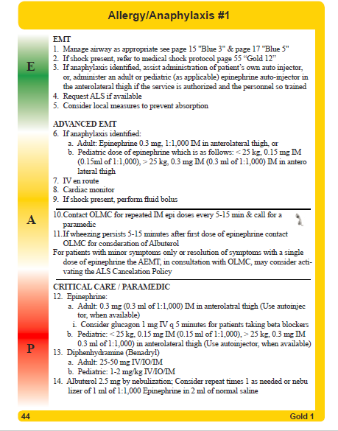
Notes:
Maine EMS has a protocol for anaphylaxis. Maine EMS Protocol, allergic reaction/anaphylaxis- Adult and Pediatric, updated in 2015. The Following slides will show detailed views of the EMT level protocols

Slide 10
Notes:
Protocol Gold 1, for adults and pediatrics in anaphylaxis EMTs may administer an adult epinephrine autoinjector (containing 0.3mg epinephrine) OR administer 0.3mg epinephrine 1:1,000 or 1mg/1mL via syringe for patients weighing more than 25kg or 0.15 mg IM for patients less than 25 kg. For either method the injections must be administered intramuscularly in the anterolateral thigh. Medical direction must be consulted for additional dosing. Of note the new EMT dosing is the same as the AEMT dosing and May be followed by the EMT if trained this will be updated in the 2017 Protocols

Slide 11
Anaphylaxis- Overview
Known/likely allergen exposure AND hypotension or respiratory compromise, OR
Systemic allergic reaction (multi-system) including two or more signs and symptoms affecting theses systems;
Respiratory Skin GI Circulatory Neuro
Notes:
Anaphylaxis is a life threatening systemic reaction. It most commonly presents with shock and/or respiratory distress. Anaphylaxis is typically, but not always, characterized by a rapid onset of symptoms.
Anaphylaxis should be suspected when:
There is a known/likely allergen exposure AND the patient is hypotensive or experiencing respiratory compromise
OR
The patient exhibits two or more of the following signs or symptoms – which are covered in detail on the following slides

Slide 12
Common Causes of Anaphylaxis
Foods—peanuts, treenuts, shellfish, fruits, milk
Insects—bees, wasps
Medications—antibiotics, sulfas, contrast dyes for medical tests
Plants—poison ivy, rubber tree (natural rubber latex)
Chemicals—DEET
Almost anything can cause anaphylaxis
Notes:
The more well known cause of anaphylaxis includes foods such as nuts or shellfish; stinging insects such as bees and wasps, and medications such as antibiotics or sulfas
In cases of insect stings such as bees, multiple stings even in a person who does not have a bee allergy can trigger an anaphylactic reaction
Allergens are not limited to known substances, almost anything can become an allergen. Chronic exposure to substances can cause allergies to chemicals or materials such as latex.

Slide 13
Anaphylaxis- Overview - continued Signs and Symptoms
Respiratory distress
Airway compromise/impending airway compromise
Wheezing or stridor
Swelling of lips, tongue, or any airway structures
Throat tightness
Difficulty or inability swallowing
Notes:
In the following slides are other signs and symptoms of anaphylaxis. Epi should be administered if two or more are present, even if the exposure to an allergen is uncertain and hypotension or respiratory compromise is not present.
Respiratory distress
Airway compromise or impending airway compromise with signs or symptoms such as:
Wheezing or stridor
Swelling of the lips, tongue or any airway structures
Throat tightness
Difficulty or inability swallowing

Slide 14
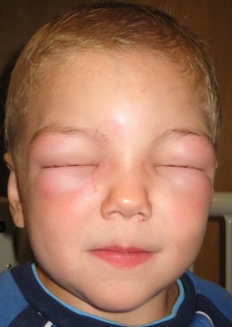
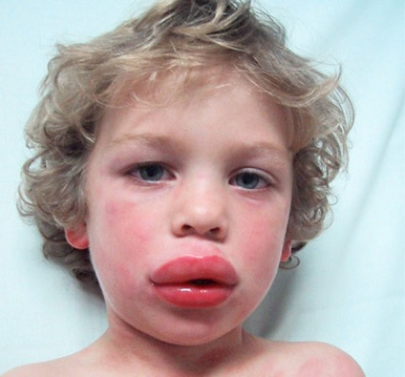
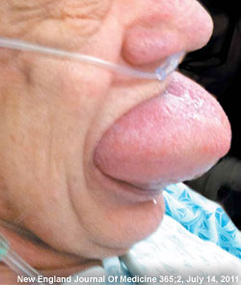
Angioedema
Common areas of swelling
Eye lids
Lips
Tongue
Notes:
Angioedema, swelling, is one of the more common symptoms of anaphylaxis and can be quite dramatic. Angioedema is often seen in areas of the face such as the eye lids, lips and tongue as seen in the photographs below.
Photos:
Child with angioedema of eyes: http://upload.wikimedia.org/wikipedia/commons/b/b9/Angioedema2010.JPG
Child with angioedema of lips: https://www.epharmapedia.com/img/diseases/1304256547.jpg
Angioedema of tongue: https://jeffreysterlingmd.files.wordpress.com/2013/10/angioedema_250x.jpg

Slide 15
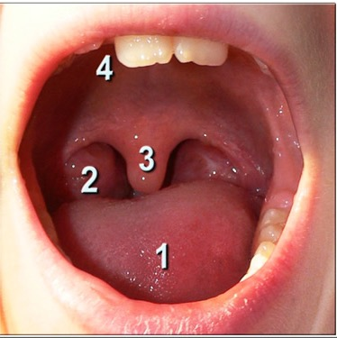
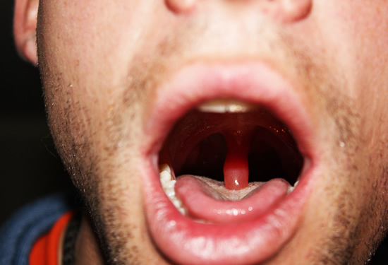
Angioedema
Normal anatomy of mouth: 1-tongue, 2-tonsil, 3-uvula, 4-teeth/roof of mouth.
Angioedema of uvula
Notes:
A more subtle location angioedema may present is the uvula. Just as swelling of the lips and tongue are good indicators of impending airway compromise, swelling of the uvula should be considered a serious sign.
The photograph on the left shows the normal anatomy of the mouth, the photograph on the right shows angioedema of the uvula in a patient experiencing an anaphylactic reaction.
http://www.iainfoctr.com/anaphylaxis/ana-photos.php

Slide 16
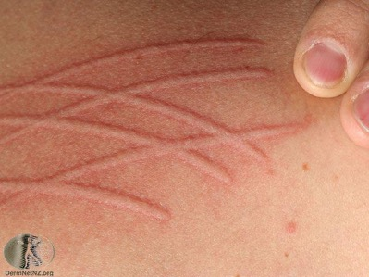
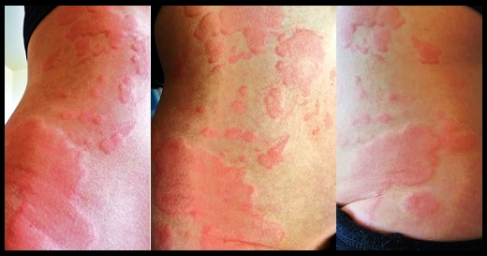
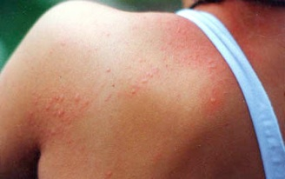
Urticaria- Hives Widespread hives, itching, swelling, flushing
Vary in presentation
Large raised patches
Small raised spots
Hives following areas of scratching
Notes:
Urticaria, or hives, are another common sign of anaphylaxis. Urticaria can present in many different ways and typically causes itching and discomfort. Common presentations include large raised patches (photograph on the left), small raised spots (photograph on the bottom right), or raised hives following areas of scratching (phenomenon known as dermographism) (photograph in the upper right)
The presence of localized hives does not necessarily indicate anaphylaxis. The presence of global urticaria or hives on the face, neck, chest, torso or back may be indicators of a systemic reaction occurring.
Shoulder: http://www.allergycapital.com.au/allergycapital/Exercise_files/Cholinergic.jpg
Torso: http://www.invitehealthblog.com/wp-content/uploads/2013/12/HIVES-GRAPHIC.jpg
Dermographism: http://www.dermnetnz.org/assets/Uploads/reactions/s/dermographism2.jpg

Slide 17
Anaphylaxis- Overview - continued Signs and Symptoms
Gastrointestinal symptoms: vomiting, abdominal pain
Altered mental status, syncope, cyanosis, delayed capillary refill or decreased level of consciousness associated with known or suspected allergic exposure
Signs of shock (Shock Protocol – Maine EMS Protocol Gold 12)
Notes:
Gastrointestinal symptoms such as vomiting or abdominal pain
Altered mental status, syncope, cyanosis, delayed capillary refill or decreased level of consciousness
Signs of shock

Slide 18
Anaphylaxis- Important Reminders
Patients can present in anaphylaxis without a history of allergen
Wheezing may be caused by anaphylaxis but it is not the only sign
Patients often present with no wheezing
Consider patients with history of asthma as having a high risk of anaphylaxis
Not all classic signs and symptoms such as hives or facial swelling must be present in cases of anaphylaxis, and failure to treat can result in death.
Notes:
Many patients who present in anaphylaxis may have no history of allergic reactions or no suspected exposure to an allergen
Wheezing may be caused by anaphylaxis, but it is not the only sign and patients often present with no wheezing at all.
Patients with a history of asthma should be considered at high risk for anaphylaxis
Not all classic signs and symptoms such as hives or facial swelling must be present in cases of anaphylaxis, and failure to recognize and treat can result in death.

Slide 19
What key indicators of anaphylaxis are present?
Notes:
Watch the following video and note how many signs and symptoms of anaphylaxis you observe:
Several key indicators of anaphylaxis are observable in the patient in the video, he demonstrates:
Visible respiratory distress
Audible wheezing and stridor
Visible hives/flushing of face, torso, arm
Angioedema of the eyelids
Patient appears to have a decreased level of responsiveness- appears lethargic

Slide 20
Allergic Reactions
Localized itching or discomfort from insect bites
Runny nose
Sneezing
Watery eyes
Localized hives – redness at site
LOCALIZED
Notes:
Anaphylaxis differs from allergic reactions. Allergic reactions have mild symptoms but do not have the systemic effects seen in anaphylaxis.
A patient with hives at the site of an insect sting but with no change in blood pressure, signs of shock or respiratory compromise is experiencing an allergic reaction.
A patient with hives at the site of an insect sting with respiratory distress and/or signs of shock is experiencing anaphylaxis.

Slide 21
Treatment for Anaphylaxis
Epinephrine
Lifesaving treatment
First line treatment
Reduces airway swelling
Improves respiratory distress
Improves cardiac output, treating shock
Additional ALS treatments
Antihistamines –helps relieve itching
Nebulizers – aid in treating bronchospasms but do not correct the cause
Notes:
Epinephrine is the top priority in anaphylaxis. Epi reduces respiratory stress, reduces swelling of the airway and tissues and increases blood pressure.
Further treatments may include antihistamines and nebulizers but they are not life saving interventions and should never be given before epinephrine in cases of anaphylaxis.

Slide 22
Recurrent Reactions
Reoccurrence of anaphylaxis
Can occur minutes to hours following first reaction
If symptoms recur contact on-line medical control (OLMC) to administer epinephrine at the same appropriate dose
Notes:
A final note on anaphylaxis. Recurrent reactions, or return of symptoms following administration of epinephrine is not uncommon. This can occur minutes to hours following the initial onset of the reaction.
Just as some opiates have a longer duration of action than naloxone, some allergens may have a longer duration of action than epinephrine.
If symptoms recur, contact OLMC to administer epinephrine at the same appropriate dose.

Slide 23
Ready, Check, Inject
Epinephrine Syringe Program
*Some of the following photographs were taken without gloves in order to more clearly show the correct steps. Gloves should always be worn while providing patient care.

Slide 24
READY

Slide 25
Notes:
This slide is a summary of all of the steps needed to draw the medication into the syringe. The slides that follow provide step by step instructions in greater detail. Following the explanations you will have the opportunity to practice.

Slide 26
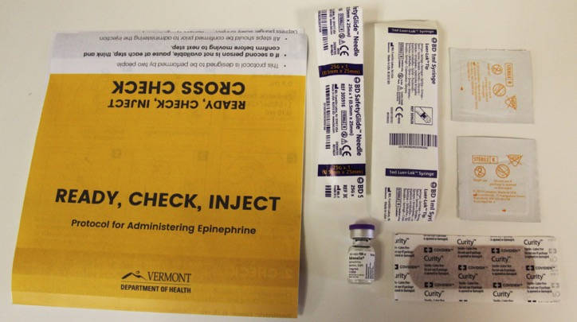
Ready - Supplies
Prepare supplies needed:
1mL vial or ampule of Epinephrine 1:1,000 (1mg/1mL)*
1mL syringe**
1” safety needle***
2 Alcohol prep pads
Bandaid
Sharps disposal container
Notes:
Describe supplies needed and highlight the safety requirements.
1. Reinforce that only a 1mL vial or ampule can be used. Larger multi-dose vials are not acceptable
2. Only 1mL syringes may be used- no other volume syringe is acceptable. The 1mL EPI Safe syringe by Curaplex is acceptable

Slide 27
Ready – Safety Requirements
*A 1mL vial or ampules must be used. Larger multi-dose vials are not acceptable
**Only 1mL syringes may be used- no other volume syringe is acceptable
***Recommended needle gauge is 23-25
Notes:
Describe supplies needed and highlight the safety requirements.
1. Reinforce that only a 1mL vial or ampule can be used. Larger multi-dose vials are not acceptable
2. Only 1mL syringes may be used- no other volume syringe is acceptable. The 1mL EPI Safe syringe by Curaplex is acceptable

Slide 28
Ready
If more than one EMT is present:
One should prepare the supplies and medication as outlined in this section
The other should prepare the patient for injection by exposing and cleaning the site as outlined in step one of the “Inject” section
If only one EMT is present:
Advised to FIRST prepare the patient by exposing and cleaning the site prior to preparation of supplies and medication
Notes:
Before you proceed any further, consider the crew resources you have available
If more than one EMT is present:
One should prepare the supplies and medication as outlined in this section
While the other should prepare the patient for injection by exposing and cleaning the site as outlined in step one of the “Inject” section
If only one EMT is present:
It is advised to FIRST prepare the patient by exposing and cleaning the site prior to preparation of supplies and medication
**Performing the steps in this order prevents the need to prepare the patient for injection while also having to manage an uncapped needle while maintaining sterility of the needle.

Slide 29
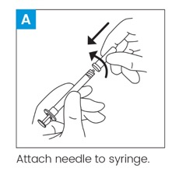
Attach needle to syringe

Slide 30
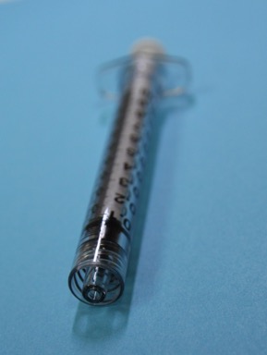
Luer Lock Syringe
Notes:
Threaded end for attaching to needles or IV ports

Slide 31
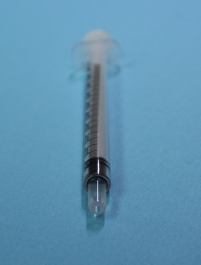
Luer Slip-Tip Syringe
Notes:
Is not threaded and is just pressure fit to a needle make sure it is attached firmly

Slide 32
EPI-Safe Syringe (Curaplex)

Slide 33
Sterile Supplies
Needles and syringes must immediately be attached to each other once removed from packaging
Neither can be removed from packaging and set down
Syringe with capped needle may be placed onto safe, flat and dry surface

Slide 34
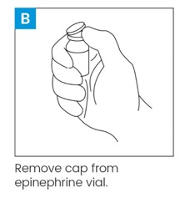
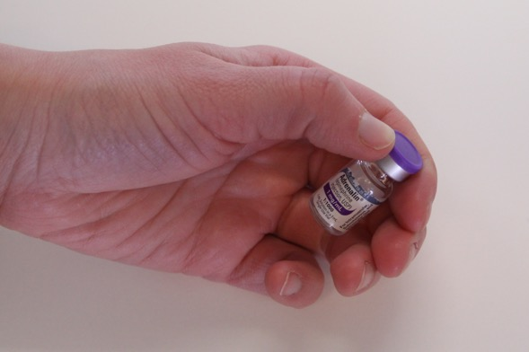
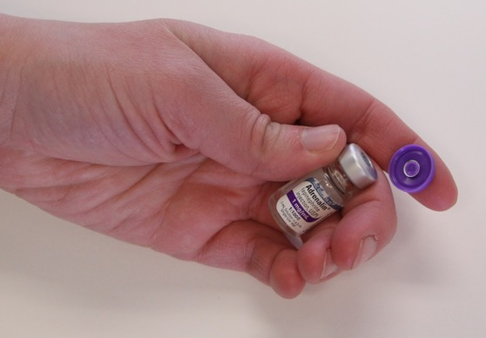
Remove cap from epinephrine vial

Slide 35
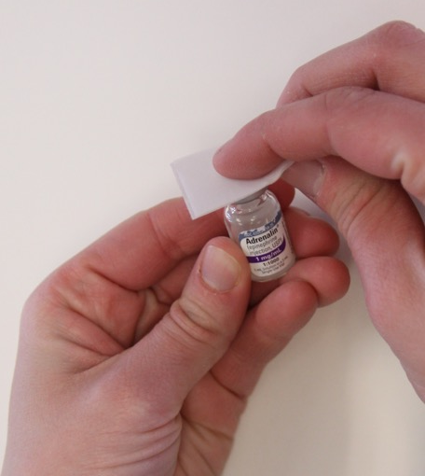
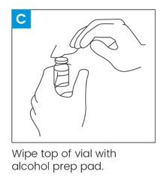
Wipe top of vial with alcohol prep pad

Slide 36
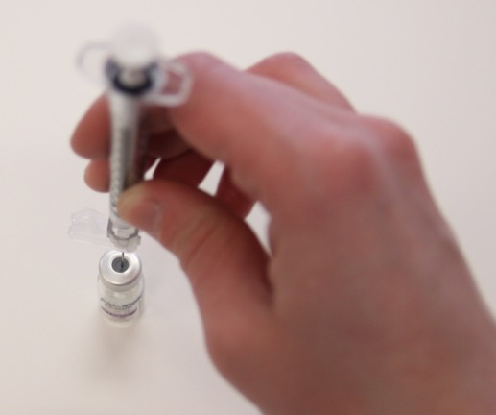
Carefully insert needle into top of vial

Slide 37
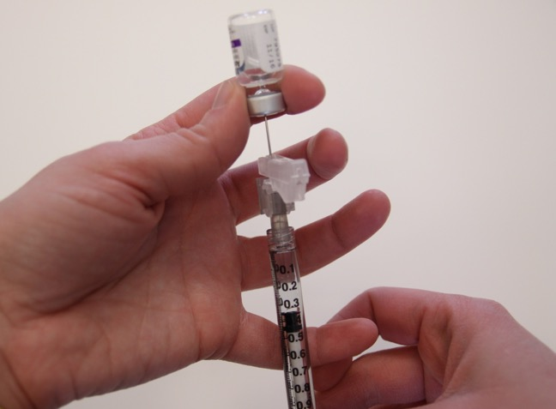
Withdraw desired amount of medication by pulling back on syringe plunger

Slide 38
Method 1: Upside down vial

Slide 39
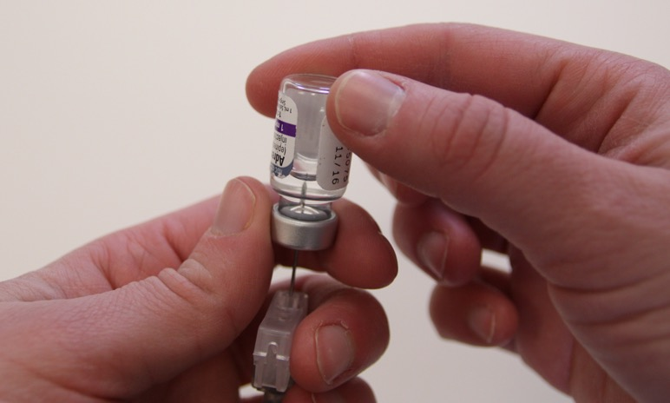
Ensure needle end is within fluid

Slide 40
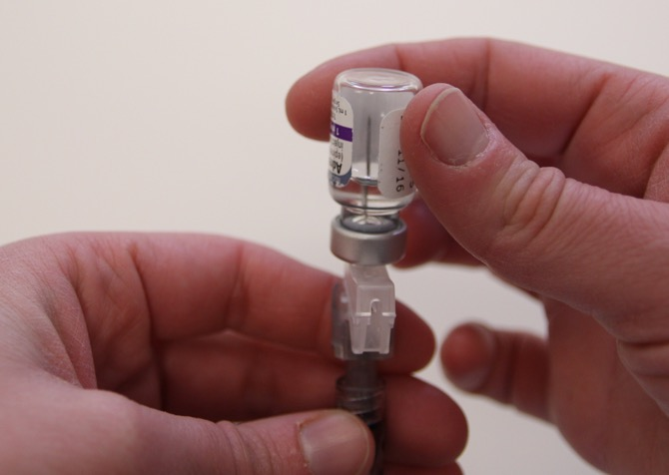
Do not insert needle beyond fluid.
Inserting needle past fluid will cause only air to be drawn into syringe

Slide 41
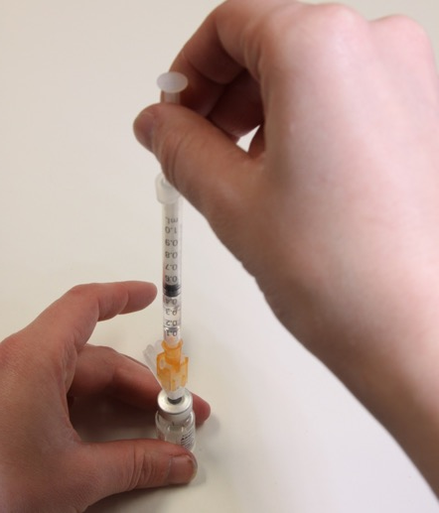
Method 2: Upright Vial

Slide 42
Method 2: Upright Vial
Ensure the needle length is long enough for needle tip to be fully submerged in liquid
If unable to reach fluid, angle vial or use upside down method

Slide 43
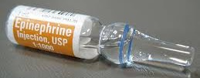
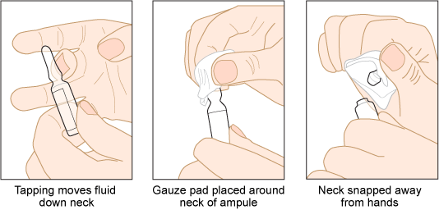
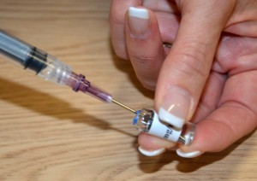
Drawing Medication From an Ampule
Clean ampule neck with alcohol swab
Snap tip off ampule
Attach filter straw to syringe
Remove 0.3mg (0.3ml) or 0.15 mg (0.15ml) epinephrine from ampule based on weight
Switch needle on syringe to 23-25 gauge
https://opentextbc.ca/clinicalskills/chapter/safe-injection-administration-and-preparing-medication-from-ampules-and-vials/

Slide 44
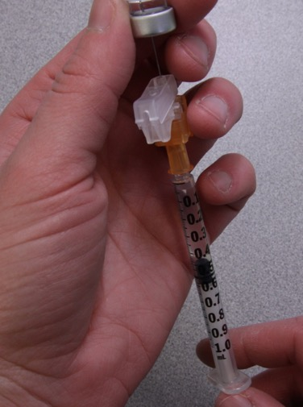
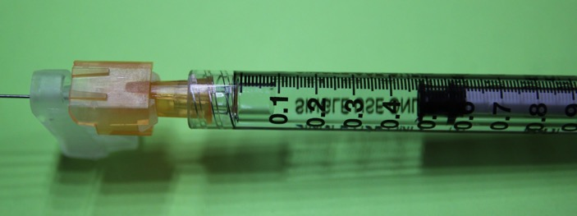
Over-draw 0.1mL greater than correct dose

Slide 45
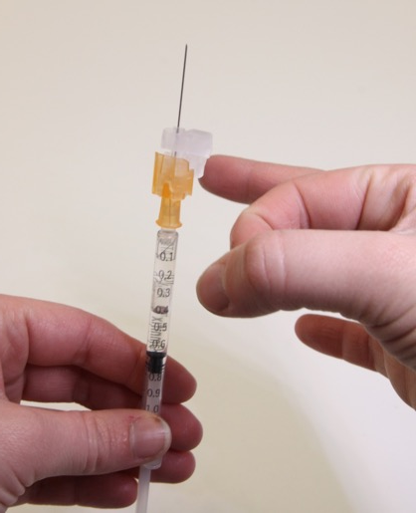
Remove any air bubbles
Remove air bubbles by carefully flicking the barrel of syringe repeatedly until air bubbles have all moved to top

Slide 46
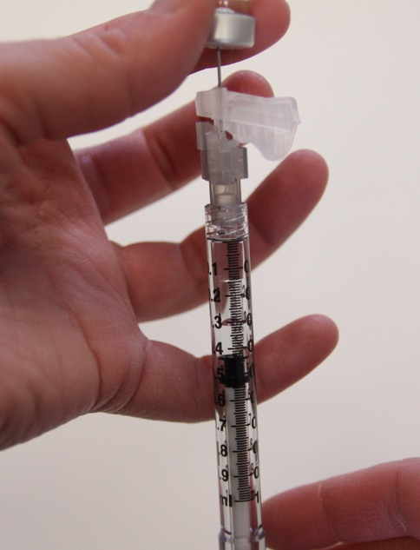
Large air bubble in syringe from inserting needle to far
Air bubbles can be difficult to see and can cause improper dosing

Slide 47
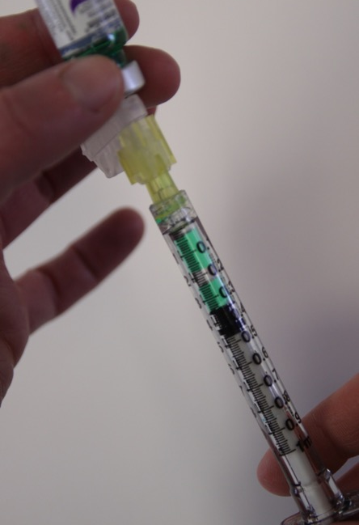
Large air bubbles in syringe
*Fluid dyed for clearer imagery

Slide 48
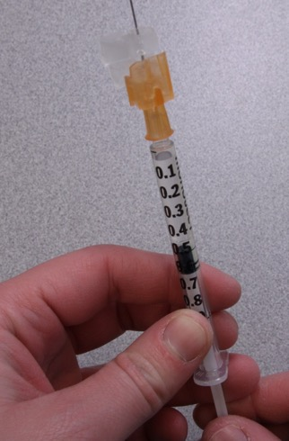
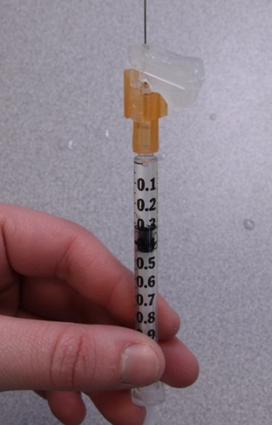
Expel air and excess fluid

Slide 49
Pediatric: 0.15mg = 0.15mL
Pediatric = Under 25kg (55lbs)
*Many pediatric patients weigh greater than 55lbs, in that case the adult dose of 0.3mL is correct

Slide 50
EPI-Safe Syringe (Curaplex)

Slide 52
Cross Check or Re-Check
This is designed to be performed by two people
If a second person is not available, PAUSE at each step, THINK and CONFIRM before moving to the next step
Correct medication: Epinephrine 1mg/1mL
Visually inspect vial or ampule and confirm correct medication
Correct dose:
Adult: 0.3mL
Pediatric (Under 25kg): 0.15mL
Confirm selected dose is correct
Inspect Syringe:
Correct volume for dose
No air bubbles
Visually inspects and confirms

Slide 53
CHECK

Slide 55
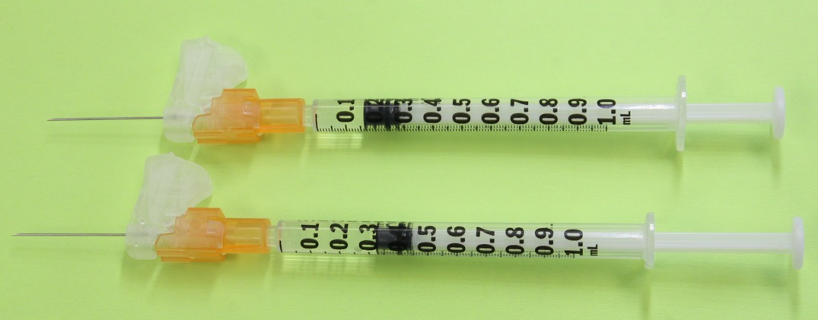
Check volume of medication in syringe is correct

Slide 56
Adult: 0.3mg = 0.3mL
Adults = 55lbs +

Slide 57
Pediatric: 0.15mg = 0.15mL
Pediatric = Under 25kg (55lbs)
*Many pediatric patients weigh greater than 55lbs, in that case the adult dose of 0.3mL is correct

Slide 58
EPI-Safe Syringe (Curaplex)

Slide 60
Cross Check or Re-Check
This is designed to be performed by two people
If a second person is not available, PAUSE at each step, THINK and CONFIRM before moving to the next step
Correct medication: Epinephrine 1mg/1mL
Visually inspect vial or ampule and confirm correct medication
Correct dose:
Adult: 0.3mL
Pediatric (Under 25kg): 0.15mL
Confirm selected dose is correct
Inspect Syringe:
Correct volume for dose
No air bubbles
Visually inspects and confirms

Slide 61
INJECT

Slide 62
Notes:
This is a summary of the inject steps. Each step will be discussed in detail in the further slides. Illustration B shows a one hand injection technique and illustration C shows a 2 hand technique.

Slide 63
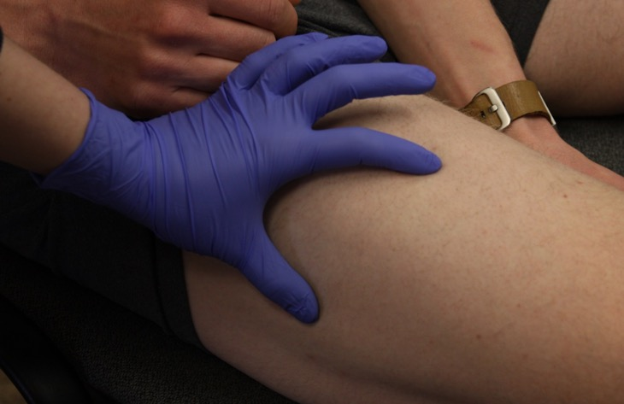
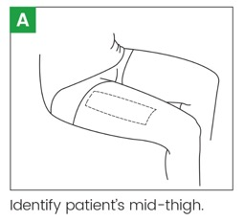
Identify patient’s mid-thigh
Notes:
First you must identify and expose the patients mid thigh. It is acceptable to cut a small hole in patients clothing if you are not able to easily roll up or slide down pants legs to expose the thigh.

Slide 64
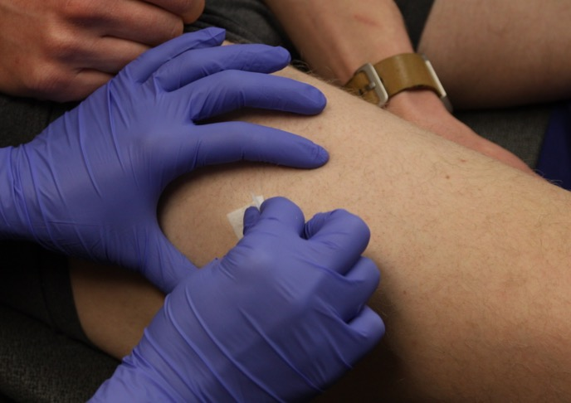
Cleanse selected site with alcohol prep

Slide 65
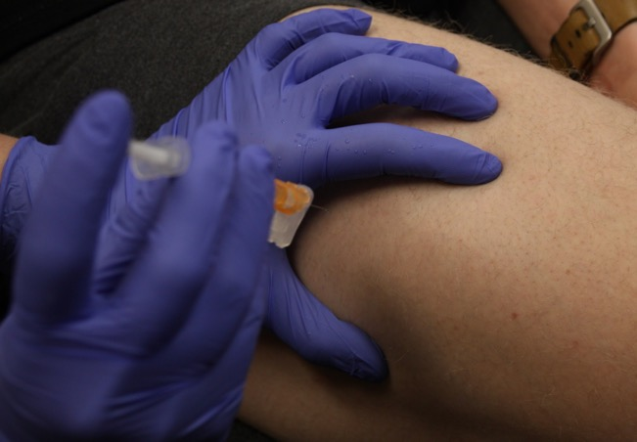
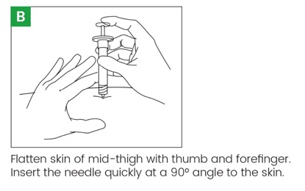
Flatten skin of mid-thigh with thumb and forefinger

Slide 66
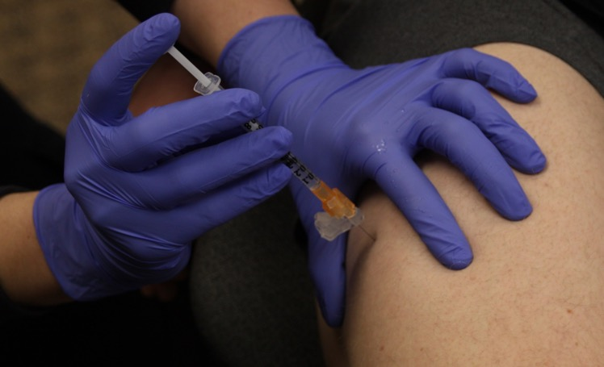
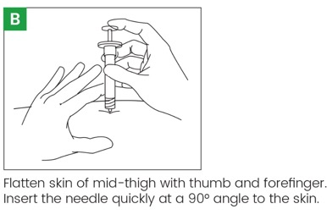
Insert needle quickly at 90° angle to skin

Slide 67
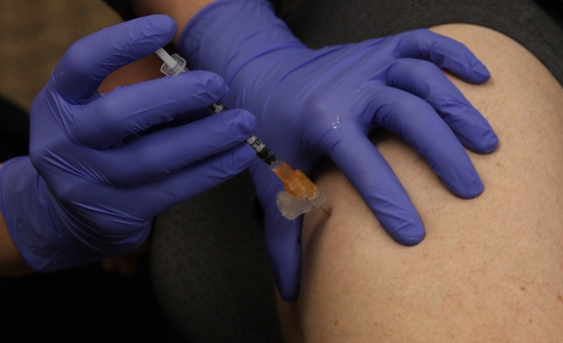
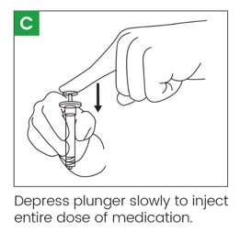
Depress plunger slowly to inject entire dose of medication
Alternative Two hand technique
Notes:
Discuss two hand technique also as option

Slide 68
In children – be sure to stabilize extremity to avoid laceration with patient movement
Notes:
The FDA has recommended that the extremity in a child should be stabilized prior to injection as any sudden movement of the child in reacting to the injection has been shown to cause significant lacerations as the needle is dragged across the skin.
The photos above are from the use of the EPI auto injector.

Slide 69
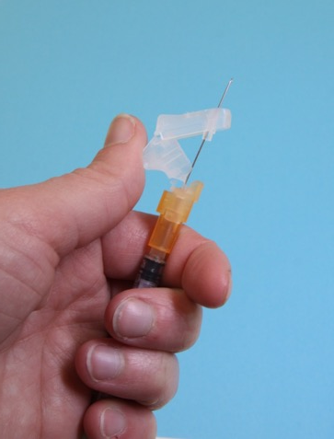
Remove needle and engage needle safety mechanism
Many different types of safety needles exist
Ensure you know how to properly engage the safety of the type of needle utilized

Slide 70
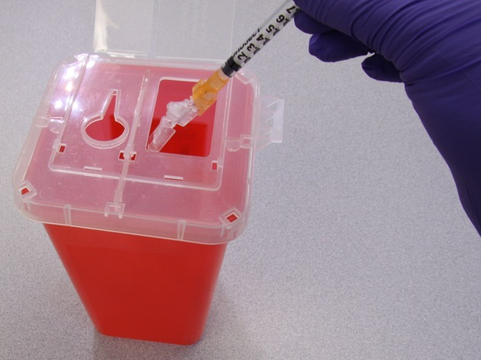
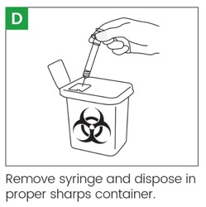
Dispose in proper sharps container

Slide 71
Second needle
If not immediately ready to administer epinephrine after drawing
Engage safety mechanism on needle and leave attached to syringe
Prepare patient and site for administration of epinephrine
Remove needle and immediately attach new, sterile needle to syringe
Place first needle in sharps container
Remove cap from new needle
Administer epinephrine

Slide 72
Re-assess
Monitor your patient’s condition following administration
Side effects of epinephrine are usually mild and dissipate on their own
Side-Effects can include:
Palpitations
Tachycardia/ Tachypneic
Nervousness or apprehensiveness
Restlessness
Tremors
Continually monitor patient for recurrent reactions

Slide 73
Repeat Dosing
All steps are repeated
No recapping or reusing of any needles
No reuse of syringes
Same vial may be used but top must be cleaned with alcohol prep again
If using a glass ampule, a new ampule must be used for each dose

Slide 74
Hands on Training
Thank you for watching the Ready, Check, Inject training presentation
Hands on training with a qualified provider (AEMT, Paramedic, physician, physician extender or registered nurse) must be completed to become approved for Ready, Check, Inject
The Maine EMS approved Skill Sheet must be used to complete and document the hands on training portion of the Ready, Check, Inject Program.
Each service will keep copies of the skill sheets on file and will produce them should they be requested by Maine EMS.
Notes:
Thank you for watching the Ready, Check, Inject training presentation. In order to become approved to administer epinephrine via syringe you must now complete a hands on training. The Ready, Check, Inject Practical training skill sheet must be used for hands on training .

Slide 75
Acknowledgements
We would like to thank Vermont EMS for openly sharing their program including much of this PowerPoint with Maine EMS for use.

