Slide 1
2019 Update
You will need to download the PDF copy to your
Laptop
iPad/tablet
Phone NOT suggested
But, if that’s all you have….
https://www.maine.gov/ems/
Maine EMS Protocols Dec 1, 2019

Slide 2
2019 Update
Three Components:
Train-the-Trainer
Regional/local updates
MEMSEd online
Completion of one
Notes:
Completion of one of the three components are necessary –
either taking the training at a “Train the Trainer”,
being trained by a “Trained Trainer” locally OR
Taking the online version on MEMSEd.
Some of the new protocols are new skills for some licensure levels and will require additional, local training. These items will be highlighted in the upcoming slides and training.

Slide 3
2019 Update
Course Information:
Official Title
“2019 Protocol Update”
Hours
May vary with # of students
Area
Prep/Ops
Others per local course
Notes:
Please note:
Local instructors should ensure that the training center is using the common course title "2019 Protocol Update".
This allows Maine EMS to track participation in the 2019 Protocol Update.
Actual course hours may vary, depending on course size, and number of questions.
If Regions or local services offer other topics in conjunction with this protocol update, it should be noted on the CEH approval request

Slide 4
2019 Update
Instructional Materials:
PPTs
2019 Protocol PDF
Lesson plan
Student resources as listed
Notes:
Materials Location
All instructional materials will be downloadable from a folder located on the MEMS website
PowerPoint presentations for each module
2019 Protocol PDF– ENSURE ALL STUDENTS HAVE DOWNLOADED THE PDF OR HAVE ACCESS TO ONE
Lesson Plan
White papers- MDBP has released 5 new ones (listed on lesson plan resource list) for use in conjunction with protocol update release

Slide 5
2019 Update
Lesson Plan
Instructor resource for teaching
References
Content guide for slides
“What do they mean by…”
Student resources after course
Promotes consistency of information

Slide 6
2019 Update
The Protocols
Notes:
Materials Location
All instructional materials will be downloadable from a folder located on the MEMS website
PowerPoint presentations for each module
2019 Protocol PDF– ENSURE ALL STUDENTS HAVE DOWNLOADED THE PDF OR HAVE ACCESS TO ONE
Lesson Plan
White papers- MDBP has released 5 new ones (listed on lesson plan resource list) for use in conjunction with protocol update release

Slide 7
Authorization
Verbiage changed to reflect opportunity to participate in changes
Staffing will be updated as appropriate
Notes:
This slide is intended to review the legislative authority of the protocols, the state-wide reach of the protocols, comment on the inclusive intention of the protocol review process, list the location of potential off-cycle protocol updates and list the MDPB members participating in the 2019 Protocol Review Process
Important change in verbiage that ALL healthcare providers in EMS system-– not just Physicians and Regional administrators– were given that opportunity to participate in making the changes
MDPB feels strongly that providers SHOULD be involved, makes system stronger
Allows more inclusiveness by providers, many of whom may feel their voices aren’t heard

Slide 8
Protocol Change Process
How are the Maine EMS Protocols Updated?
The Medical Direction and Practices Board (MDPB) reviews and updates the protocols every two years
Changed from every three years starting in 2011
Two processes performed
Notes:
The MDPB reviews and updates the protocols every two years.
This was changed from every three years starting in 2011
Recognized that the pace of medical change is increasing.
The group felt that waiting to update the protocols every three years was too long
would not allow the protocols to be as contemporaneous as possible.
Results from 2 processes

Slide 9
Process #1
Each protocol section assigned 1 – 2 “section authors”
Authors lead MDPB in discussion of possible changes
Change discussions conducted around:
Section author review of subject matter
External input
Notes:
The MDPB breaks the protocols into sections:
Brown/Purple/Grey/Black, Blue, Red, Green, Gold, Yellow, Pink
Each section has 1-2 “authors” who lead the group through a discussion regarding possible protocol changes
These discussions are informed by two processes
The section author’s review of the subject matter as well as external inputs, such as:
Comments directly to the MDPB
Comments from monthly MDPB conference calls – held from Jan 2018 until April 2019
Review of other states’ protocols
Review of the medical literature

Slide 10
Process #1
External Input:
Direct to MDPB via:
State Medical Director
Regional Medical Director
Other MDPB members
Provider and stakeholder comment to MDPB members
Notes:
The MDPB breaks the protocols into sections:
Brown/Purple/Grey/Black, Blue, Red, Green, Gold, Yellow, Pink
Each section has 1-2 “authors” who lead the group through a discussion regarding possible protocol changes
These discussions are informed by two processes
The section author’s review of the subject matter as well as external inputs, such as:
Comments directly to the MDPB
Comments from monthly MDPB conference calls – held from Jan 2018 until April 2019
Review of other states’ protocols
Review of the medical literature
The RESTRAINT protocol is a good example of provider input to the Protocol change process

Slide 11
Process #1
External Input:
Monthly MDPB conference calls
Every 1st Monday, Jan 2018 – Apr 2019
Review of other states’ protocols
Review of medical literature
Notes:
The MDPB breaks the protocols into sections:
Brown/Purple/Grey/Black, Blue, Red, Green, Gold, Yellow, Pink
Each section has 1-2 “authors” who lead the group through a discussion regarding possible protocol changes
These discussions are informed by two processes
The section author’s review of the subject matter as well as external inputs, such as:
Comments directly to the MDPB
Comments from monthly MDPB conference calls – held from Jan 2018 until April 2019
Review of other states’ protocols
Review of the medical literature

Slide 12
Process #2
The MDPB
Recognizes that all changes to the protocols have impacts
Attempts to ensure that any protocol changes are in the best interest of the patient through
Protocols affecting direct patient care
Protocols affecting system design
Notes:
Every protocol change has a potential impact. Most of these impacts are beneficial, and the MDPB attempts to ensure the protocol changes implemented each year are consistently in the patient’s best interest.

Slide 13
Process #2
The MDPB
Reviews the following with each suggested protocol change:
What is the MOTIVATION for the change?
What is the PURPOSE of the suggested change?
What is the EVIDENCE behind the suggested change?
What is the anticipated IMPACT of the suggested change?
Notes:
The MDPB attempts to ensure the protocol changes implemented each year are consistently in the patient’s best interest by following a deliberate process and considers the following with each suggested protocol change:
What is the MOTIVATION for the change? All of our changes should be patient centric. The MDPB’s exclusive means of improving patient care is through the many EMS providers that work within the Maine EMS system, meaning provider benefit is the MDPB’s additional motivation.
What is the PURPOSE of the suggested change? What gap or gaps does the suggested change fill? Or, if no gap is present, how does the suggested change IMPROVE current practice?
What is the EVIDENCE behind the suggested change? How does the change compare to current practice? How STRONG is the level of evidence?
What is the anticipated IMPACT of the suggested change from an educational, quality improvement, communications/interface with the healthcare system, Medical Direction, or financial standpoint?

Slide 14
Notes:
These protocols represent a tremendous amount of work performed by
the MDPB members
Maine EMS Staff
Education Committee
Many, many others.
Their hard work is for naught if these protocols are not meaningful to you and your practice.
These and future protocol changes rely on your input.
Please consider supporting upcoming 2021 protocol changes by sending your comments to any of the MDPB members or participating in future Protocol Conference Calls.

Slide 15
Thank You!
Maine EMS would like to express a note of thanks to the following people for their work on these updates:
Matt Sholl
Kate Zimmerman
Medical Direction and Practices Board
Tim Pieh
Bethany Nash
Don Sheets

Slide 16
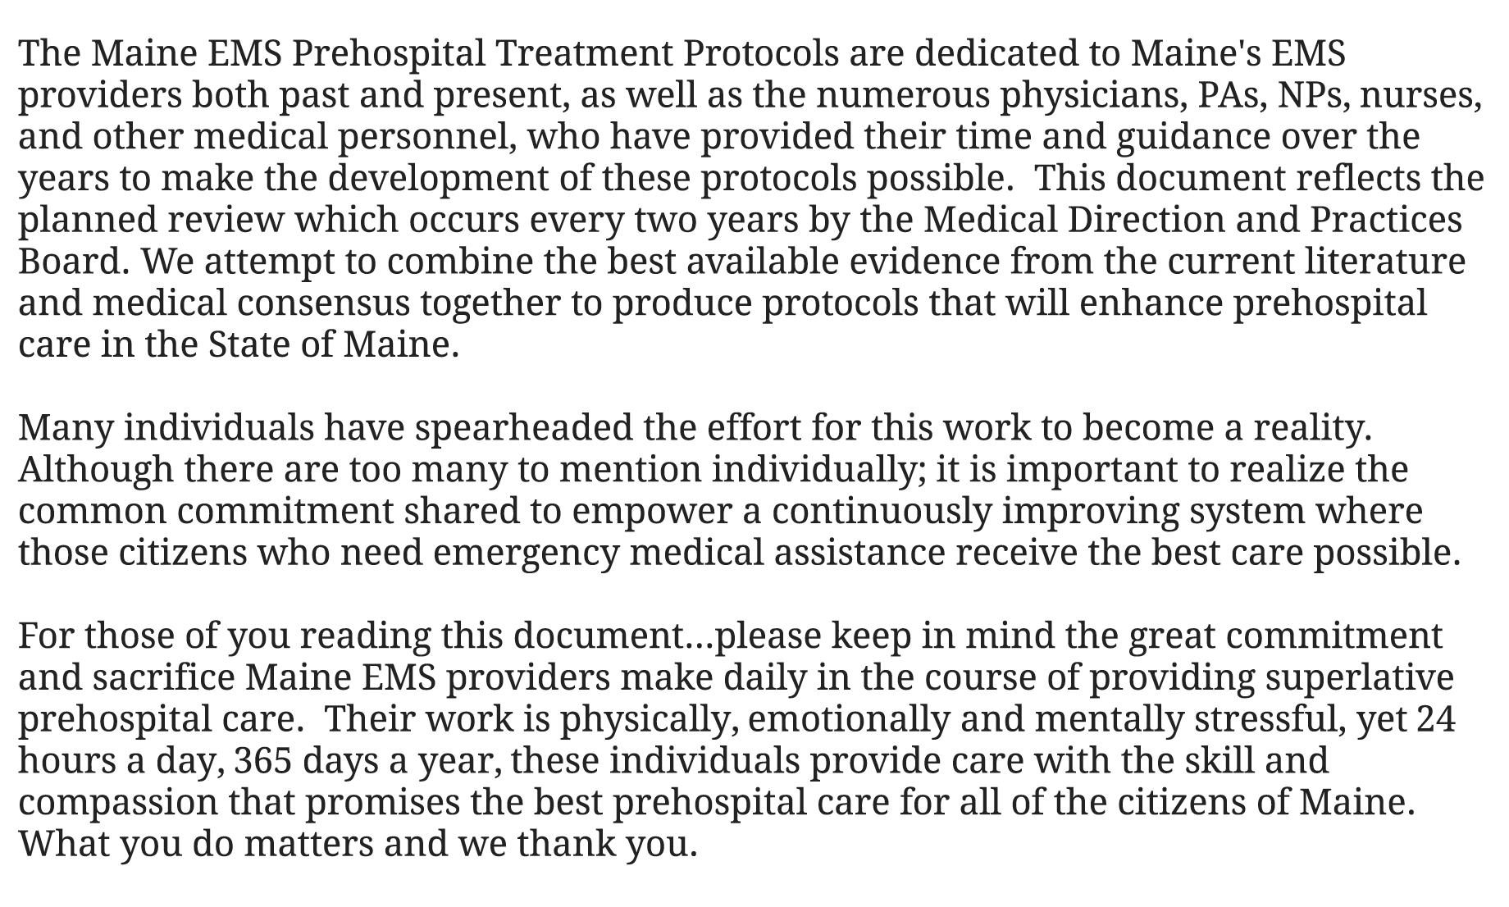
Dedication
Notes:
The MDPB wanted to acknowledge the hard work and dedication of Maine EMS Providers as well as the countless individuals who, over the years, have supported the effort to continually improve the system of care for pre-hospital patients.
Your commitment to the excellent care of Maine’s citizens and visitors is recognized by Maine EMS and the MDPB and this dedication is the MDPB’s first effort to acknowledge your service.

Slide 17
TOC
PDF
All entries linked directly to section pages
Protocol Name
Color and Number
Links within protocols for those referenced within the protocol
Notes:
Instructors can mention that the table of contents has been updated and includes hyperlinks to the specific protocols
Improvement that was requested by providers.

Slide 18
Preface
(New) Legend
E, A, and P not new
Orange- color of PEARLS
New icons 2019
Hospital “H”
EMS-C Bear
Notes:
The Legend has been expanded to include not only the Green E (for EMT), Yellow A (for AEMT), Red P (for Paramedic), the Orange “Pearl” designator, and the OLMC Phone symbol, but has also included 2 additional symbols.
Blue Hospital symbol which is used to designate a potentially complex patient for whom OLMC collaboration may be helpful.
This is not intended to act as a request to access any part of the protocol, but instead act as a “consult” of On-Line Medical Control for patients
EMS for Children Bear symbol
The MDPB worked with a number of Pediatric Emergency Medicine colleagues within Maine around evolving the pediatric (Pink) section this year and including adult and pediatric conditions when appropriate. In those protocols, pediatric specific treatments, including pediatric medication doses, will be designated by the EMS for Children Bear symbol

Slide 19
Brown/Foreword Primary Author: Dr. Kevin Kendall
2019 Protocol Update

Slide 20
Brown 1
Moved to front of protocols
True “foreword”
Notes:
The Brown Section was moved to the FRONT of the protocols to act as a true “foreword”, with the Purple (Definitions) section following the Foreword.

Slide 21
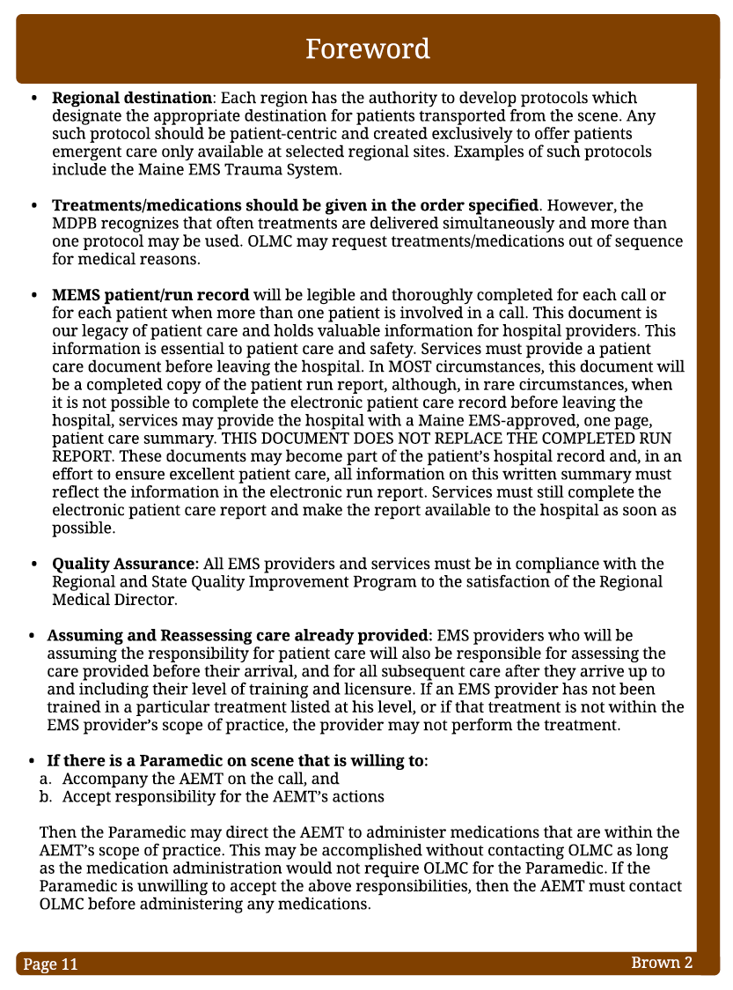
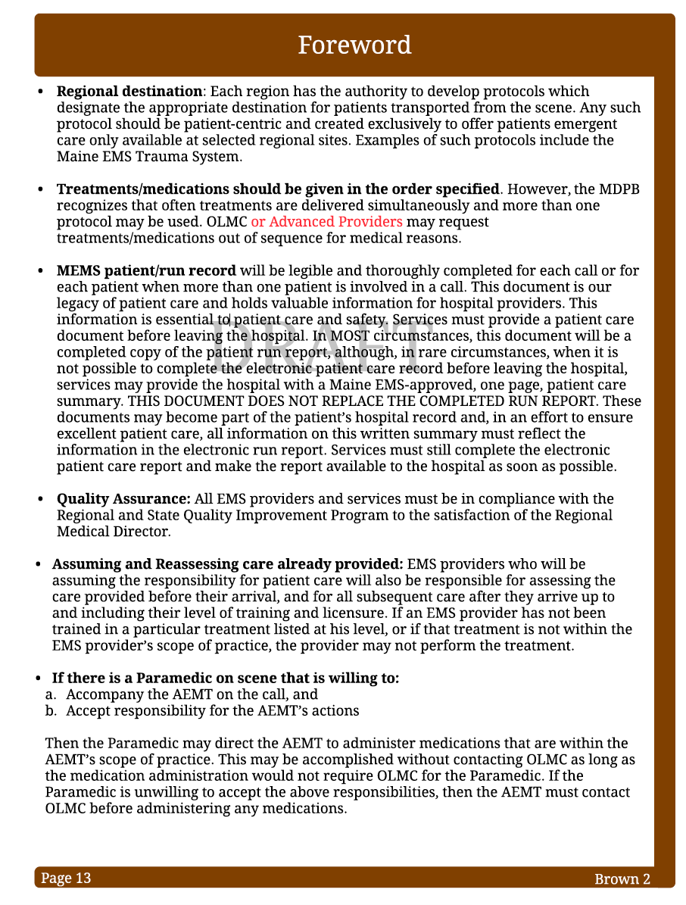
2018
2018
2019
Notes:
Affirmed that protocol actions are listed in anticipated sequence,
however, OLMC or advanced providers may request alternate sequences if felt to be in the patient’s best interest.
The addition of advanced providers was included to allow the responding paramedic to alter the sequence of actions if felt to be in the patient’s best interest.

Slide 22
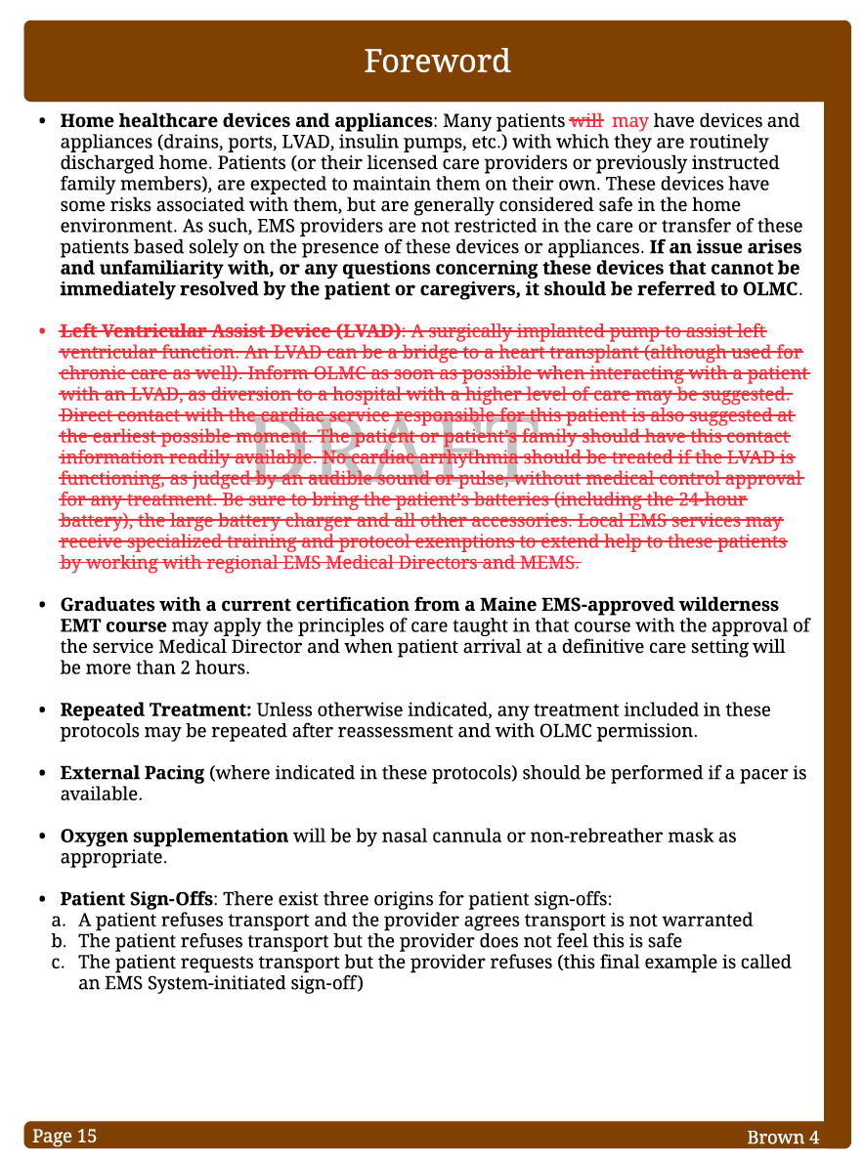
Brown 4
LVAD section moved to Red section
More specific content in Red section
Notes:
The Ventricular Assist Devices section was removed from the Brown Section in lieu of the 2018 VAD Protocol which was placed in the Red Section and was felt to be inclusive of the Brown Section information but more detailed

Slide 23
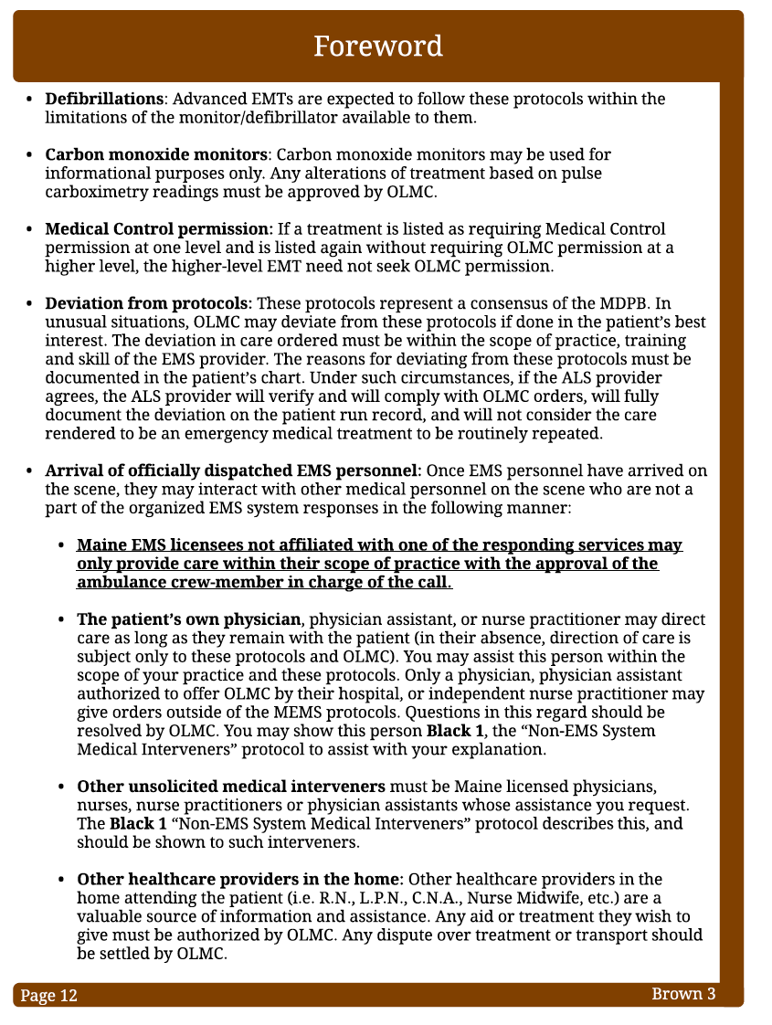
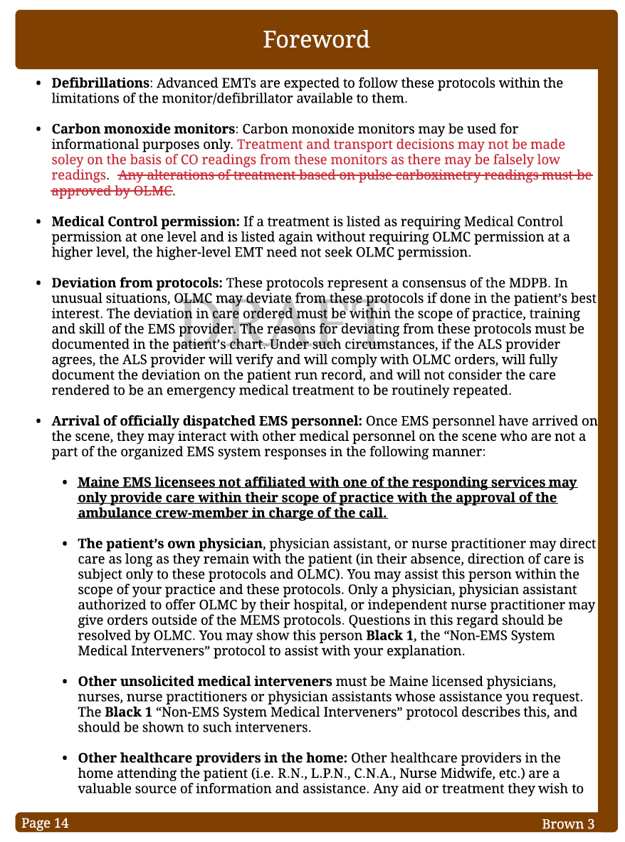
- 2017
- 2019
Notes:
Reference to “alterations of treatment based on pulse carboximetry readings” was removed from the CO Monitors section.
This was based on a recognition that the accuracy of these monitors in diagnosing CO toxicity is not well established and that both “false positives” (i.e. the monitor OVER estimating the patient’s CO level) and “false negatives” (i.e. the monitor UNDER estimating the patient’s CO level) may occur.
This step of removing these devices as a foundation of medical decision-making is in line with many other health care organizations,
American College of Emergency Physicians. Please refer to the 2019 Maine EMS/MDPB “CO Monitors” White Paper.
NFPA Standard for FF Rehab states only that
“FF’s must be assessed for CO poisoning,” It does NOT specifically state the method of assessment (i.e.- finger tip CO monitors)

Slide 24
Brown 5
“Special Circumstance” protocol
Patient-specific
Description of process
Notes:
The Brown Section also describes the process for development of “Special Circumstances Protocols”
Patient-specific
While intended to be comprehensive, Maine EMS protocols may not cover all patient needs
Circumstances in which a patient as a very unique or rare condition requiring highly specialized treatments.
The Brown Section describes the process for development of such Special Circumstances Protocols and highlights the MDPB’s role and responsibility in the development of these protocols.

Slide 25
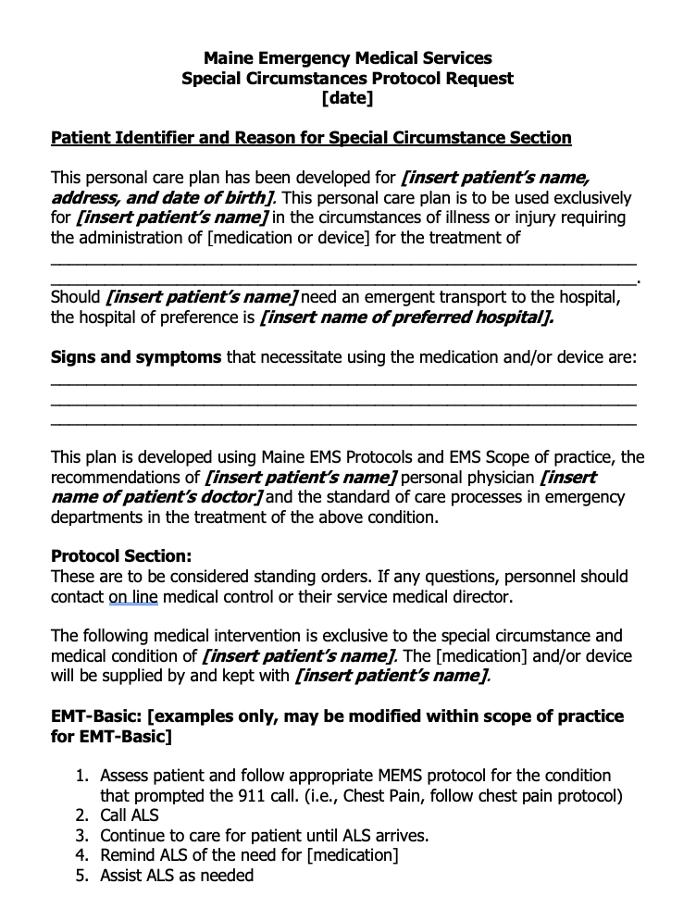
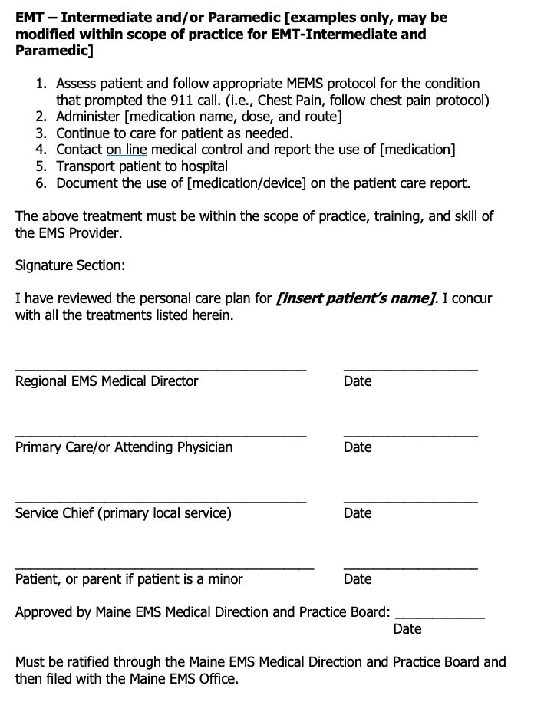
Notes:
The Brown Section also describes the process for development of “Special Circumstances Protocols” which are patient specific protocols While intended to be comprehensive, the Maine EMS protocols may not cover all patient needs, especially circumstances in which a patient as a very unique or rare condition requiring highly specialized treatments. The Brown Section describes the process for development of such Special Circumstances Protocols and highlights the MDPB’s role and responsibility in the development of these protocols.

Slide 26
Purple/ Definitions Primary Author: Dr. Kevin Kendall
2019 Protocol Update

Slide 27
Purple 2
Notes:
EMR Scope of Practice – the EMR scope of practice has broadened in the 2019 Maine EMS protocols
Now Includes the provision of Naloxone by EMRs in conditions of suspected opiate overdose.
APPROVED METHODS OF ADMINISTRATION FOR EMR’S (naloxone)
Intrtanasal
Via Auto-injector
For EMR’s interested in focused training surrounding the use of naloxone for suspected overdose, please contact your Regional EMS Offices or Maine EMS to access Naloxone training resources.

Slide 28
Purple 3
Notes:
Considerations for IO Access – The MDPB continues to recommend manufacturer approved sites for IO placement
However, current literature suggests that humeral head placement MAY be optimal in some patients, particularly those suffering OHCA.
It is speculated that the proximity to central circulation of humeral head placement may be beneficial for some patients, including those suffering cardiac arrest. Please consider this placement site in such circumstances.
OF NOTE: knee replacement has historically been a CONTRAINDICATION for placement of an IO in the knee.
Additionally, shoulder replacement, identified by a midline scar over the anterior proximal humerus would be an CONTRAINDICATION for humeral head placement.

Slide 29
Purple 3
Neonate
Age: less than or equal to 28 days
Young Infant
Age: less than 90 days
(29-90 days old)
Notes:
The 2019 Pink Section includes a new protocol focusing on addressing fevers in neonates and young children.
Important in this protocol is the definition of NEONATE, which for the purposes of the 2019 Maine EMS Protocols means:
A child less than or equal to 28 days.
The protocol additionally identifies YOUNG INFANTS as:
Children less than 90 days old (29-90 days).

Slide 30
Questions???
Notes:
Please make an effort to record questions for the FAQ.

