Slide 1
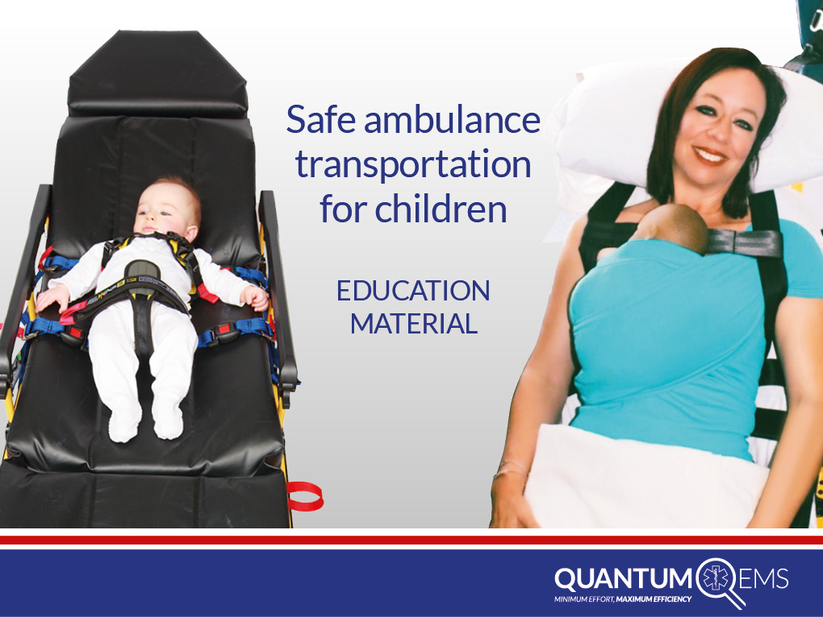

Slide 2


The Need for Pediatric Restraint
In a world without true uniform national standards, it seems hard to believe that in the 21st Century there are many countries that have no legislation regarding infant and child transportation while in an ambulance.
Research in America estimates that ground Emergency Services respond to approximately 30 million emergency calls each year. Around 6.2 million patient transport ambulance trips occur annually, of which nearly 800,000 of those patients are children. Insurance companies report that approximately 10,000 ambulance crashes result in injury or death each year. Researchers suggest that up to 1,000 ambulance crashes involve pediatric patients each year.
This is a problem as there are not any national standards
for restraining children in the back of a moving
ambulance, however we do have interim guidance.

Slide 3
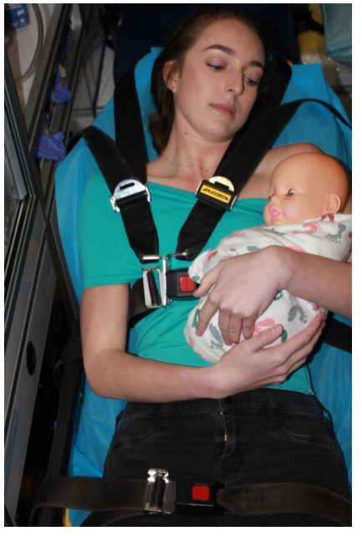
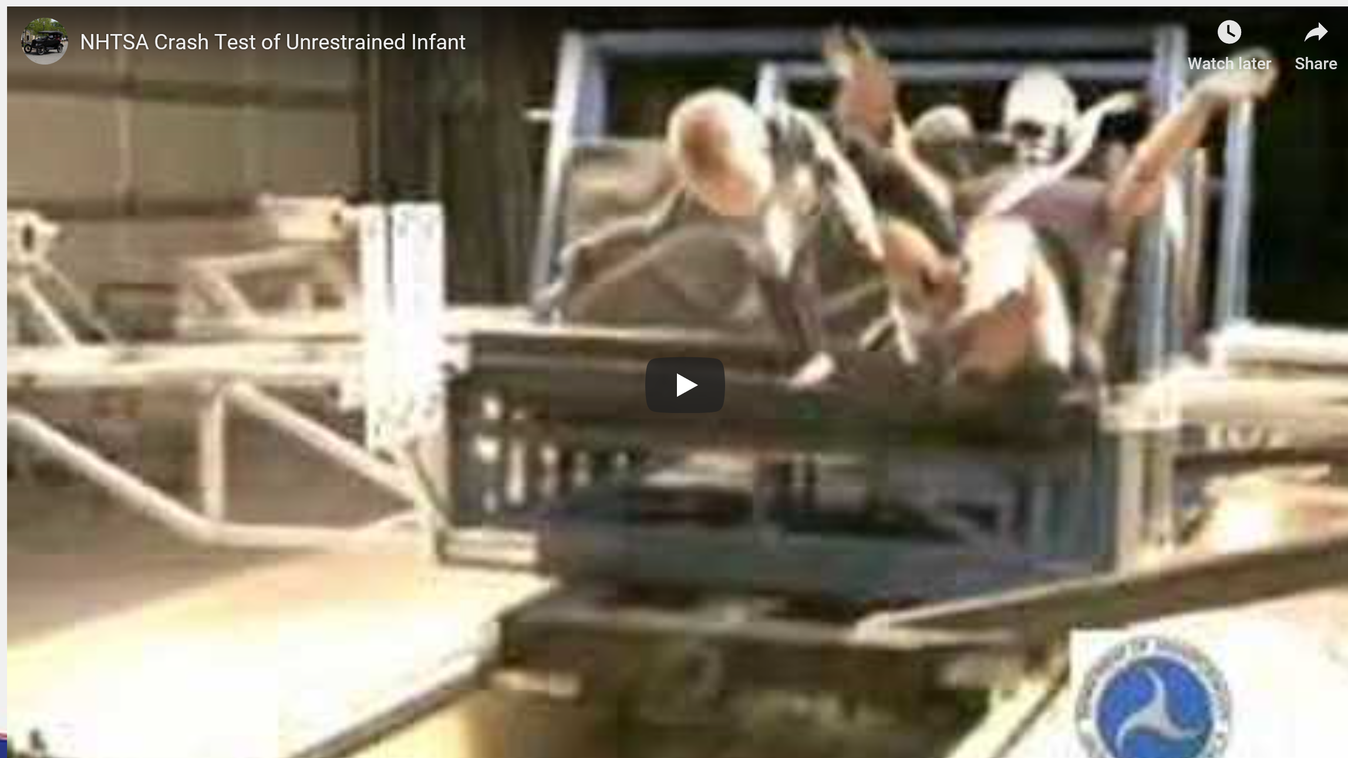
Current Mode of Child Transport
A child passenger, including a new-born, must never be transported on an adult's lap.
New-born's and children must always be transported in an appropriate child restraint system.
Never allow anyone to hold a child during transport.

Slide 4

Interim Guidance
Establishing guidelines for safely transporting children in ambulances has been an endeavor undertaken by various individuals and organizations in recent years. Despite these efforts, this multi-faceted problem has not been easy to solve. While there have been resources developed, such as the Working Group Best-Practice Recommendations for the Safe Transportation of Children in Emergency Ground Ambulances (NHTSA 2012), there remain unanswered questions, primarily due to the lack of ambulance crash testing research specific to children.
The National Association of EMS State Officials (NASEMSO) is committed to advocating for the creation of evidence-based standards for safely transporting children by ambulance. Such standards would ensure a safer environment for the patients who rely on the EMS provider to act on their behalf. Developing standards will require large investments of both time and funding to conduct the required crash testing. If research were started today, it would require at least three years and hundreds of thousands of dollars to complete.
Therefore they have made the following interim guidance:

Slide 5
Interim Guidance
Evidence-based standards for safely transporting children in ambulances should be developed and published by nationally recognized standards development organizations, such as the Society of Automotive Engineers (SAE);
Safe ambulance transport should be considered as a standard of care for the EMS system equivalent to maintaining an open airway, adequate ventilation and the maintenance of cardiovascular circulation; and
There are immediate actions that can be taken to improve pediatric safety in ambulances including, but not limited to:
A) All EMS agencies that transport children should develop specific policies and procedures that address, at minimum the following elements:
1. Methods, training (initial and continual), and equipment to secure children during transport in a way that reduces both forward motion and possible ejection. The primary focus should be to secure the torso, and provide support for the head, neck, and spine of the child, as indicated by the patient’s condition;

Slide 6
Interim Guidance
    2. Considerations for the varied situations that a child who needs transport to a
    hospital or other point of care may present to the EMS professional.
    These include, but may not be limited to a child who is:
      ^{uninjured/not ill,}
      ill/injured, but requiring no intensive interventions or monitoring,
      requiring intensive interventions or monitoring,
      requiring spinal immobilization or supine transport, and
      ^{multiple patients;}
    3. Prohibits children from being transported unrestrained, e.g. held in arms or lap;
    4. Provision for securing all equipment during a transport where a child is an occupant of the vehicle, with mounting systems tested in accordance with the requirements of SAE J3043;
    5. Only use child restraint devices in the position for which they are designed and tested; and

Slide 7
Interim Guidance
  B) EMS agencies should have appropriately-sized child restraint system(s) readily available on all ambulances that may transport children. Additionally, personnel should be initially and recurrently evaluated and trained on the correct use of those restraint systems;
    1. The device(s) should cover, at minimum, a weight range of between five (5) and 99 pounds (2.3 - 45 kg), ideally supporting the safest transport possible for all persons of any age or size;
    2. Only the manufacturer’s recommendations for the weight/size of the patient should be considered when selecting the appropriate device for the specific child being transported; and

Slide 8
Interim Guidance
    C) State EMS officials should act to put interim steps in place while evidence-based standards are developed and implemented, including, but not limited to:
    1. Encourage and support EMS transport agencies to implement cost effective solutions to mitigate risk while transporting children in ambulances; and
    2. Work with other state EMS officials to create uniform approaches and policy language, including, but not limited to a network of information relating to ambulance crash-related injuries; and
    NASEMSO does not recommend or endorse any particular product
https://nasemso.org/wp-content/uploads/Safe-Transport-of-Children-by-EMS-InterimGuidance-08Mar2017-FINAL.pdf

Slide 9

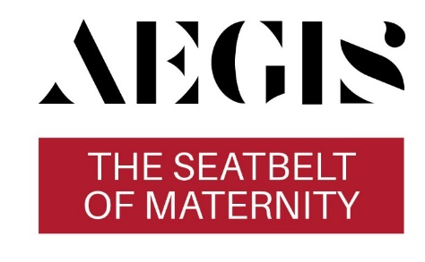
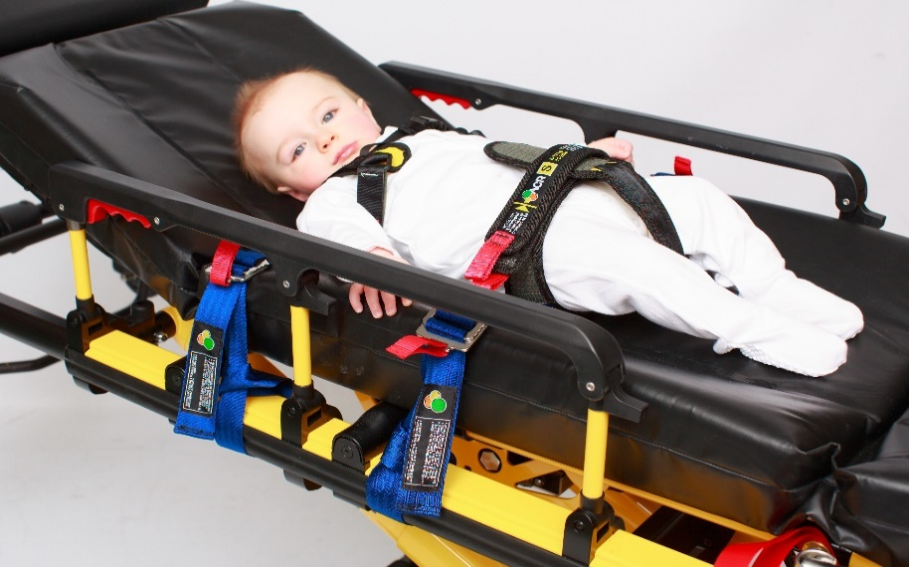
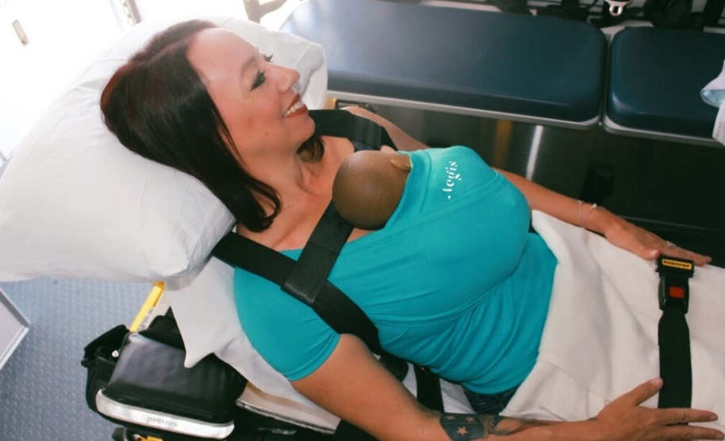
The Solutions
Universal Cot Restraint for Children with full clinical access during trauma
Providing Skin to Skin contact during mother and new born baby ambulance transportation

Slide 10

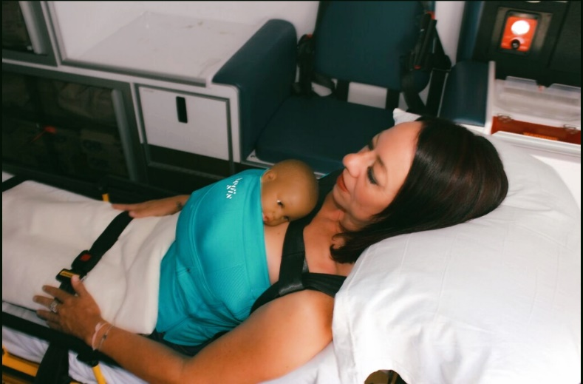
The Solutions
Quantum EMS recognized that thousands of children per year were being transported in the the back of ambulances with inadequate restraining and saw the need for devices that combine the functionality of several restraint devices into one neat package.
The ACR and Aegis offer the broadest weight range of any dedicated pediatric restraint in the world, from newborn’s to 99lbs. The ACR 4 (4lbs-99lbs) and Aegis (newborn’s) have been fully crash tested under acceleration and deceleration and are universal devices capable of being fitted and secured to any brand of ambulance cot quickly, they can also be machine washed for effective infection control.

Slide 11
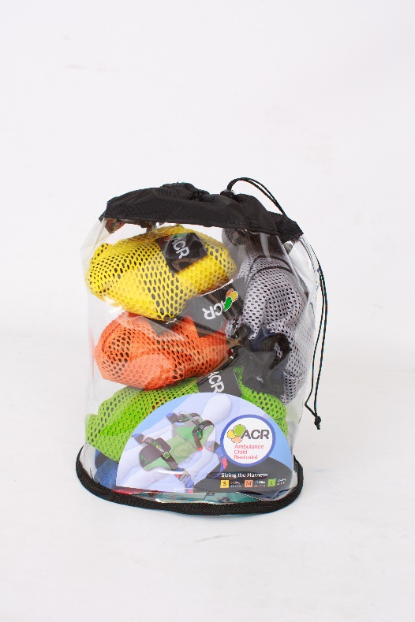

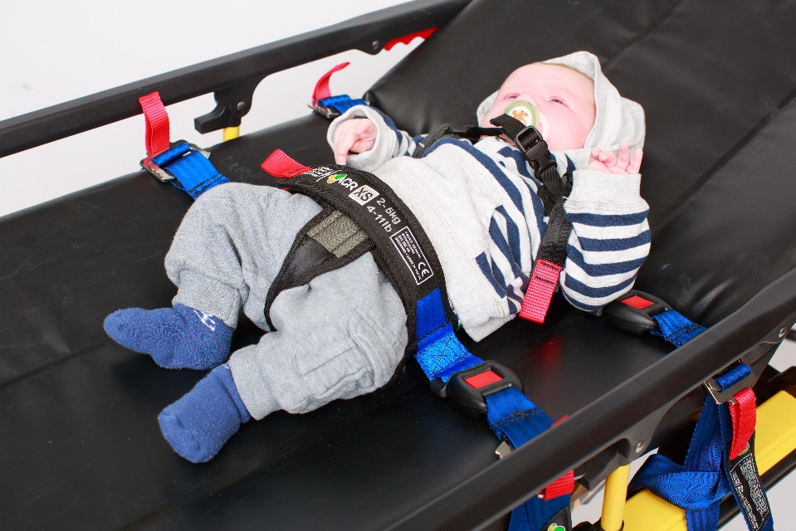

Slide 12
The ACR - Features and Benefits
Allows for the safe, effective, restraint of all children from 4lbs to 99lbs.
Open channel design allows complete patient access from the airway to the waist without un-restraining the child.
The restraint tightens into the mattress of the stretcher not into the child preventing any additional injury to the patient.
Compact packaging, the ACR fits into its own 10 x 10 custom bag taking up less room in the back of an ambulance.
The ACR replaces the need to carry multiple devices to accomplish the task of restraining all size patients
The ACR has been fully crash tested under the strictest of standards
Color coded for easy size identification
^{Machine washable}
^{Proven track record}

Slide 13

How to use the ACR
Click image to play video

Slide 14

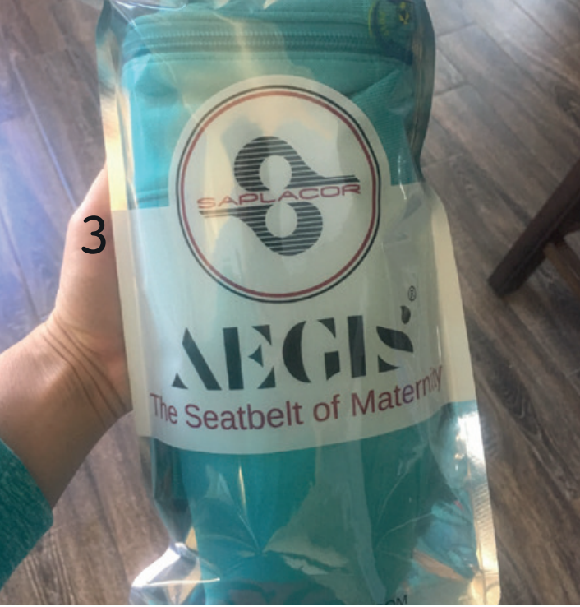
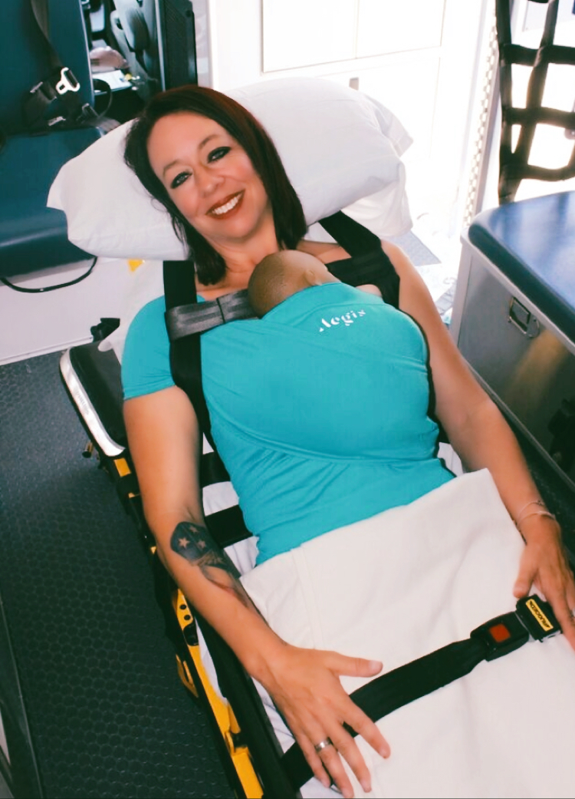

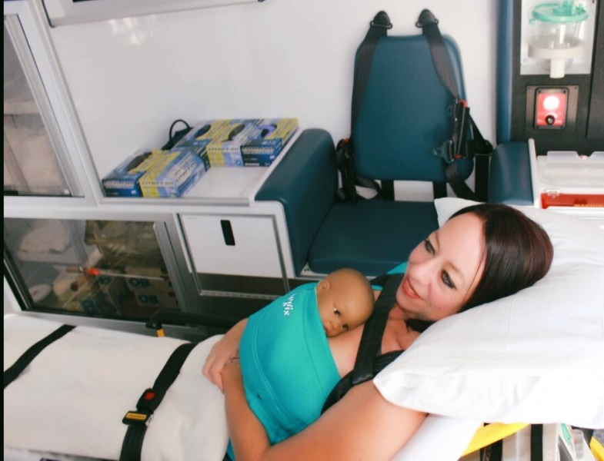

Slide 15
The Aegis - Features and Benefits
Transport both patients with one ambulance and crew. Decrease mother and new-born stress. Suitable for new-borns and early infants 4 to 14 lbs (1.8-6.3 kg). Unisex, single use item with 5 customizable sizes
Skin to skin contact with mother increases healthy microbiome and breastfeeding success. X-Static silver thread knitted throughout AEGIS provides the wrap with thermoregulatory/antimicrobial properties.
New-born's face is visible, easily monitor breathing by mother and transport team. Nano guard supports new-born's head and neck.
Pulls new-born limbs close to the torso in a frog-legged natural anatomical/in utero position.
Harnesses entire new-born torso with 4-way stretch material. Quick emergency access 60 lb tested zipper with two sets of eye hook closures for added security.

Slide 16
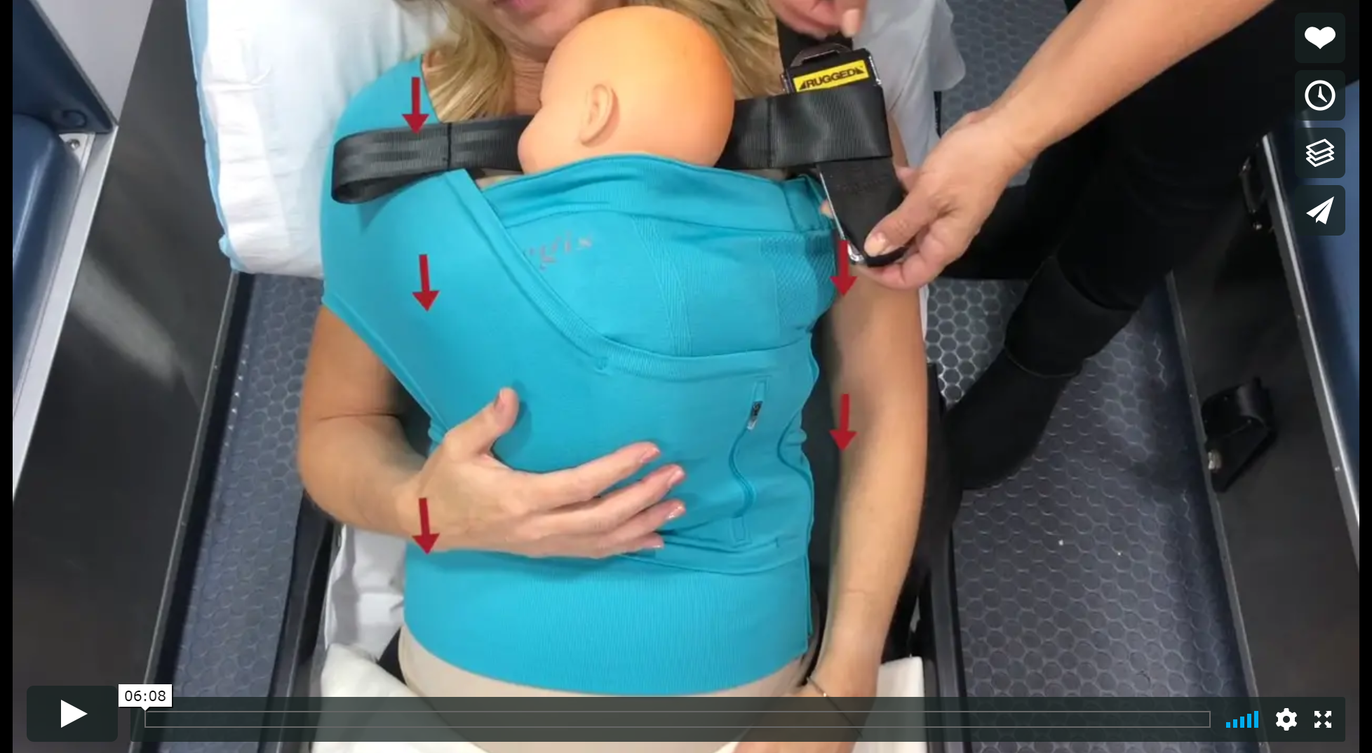
How to use the Aegis
Click image to play video

Slide 17
Peace of Mind – Crash Testing
^{ACR Testing was verified} by VCA, Vehicle Type Approval authority for the UK and EU with more than 30 years experience supports industry by providing internationally recognized testing and certification for vehicles, their systems and components.
Testing was completed per the standards of BS CEN 1789 to 10g
Testing was completed using an impact sled, stretcher and test dummies
Dummies range in sizes from 11kg , 35kg, and 45kg
Testing was completed in 6 different directions including forward, rearward, lateral and vertical
All test equipment was calibrated and quality assurance tests were completed prior to testing

Slide 18

Peace of Mind – Crash Testing
The AEGIS was tested to SAE standards SAE J2917, SAE J3044, SAE J2956 with deviations
on an instrumented adult dummy weighing 170 pounds with a non-instrumented baby dummy weighing 8 lbs; a Stryker test cot was utilized for these tests. The deviations from the SAE standard tests were a raised head rest to a 44 degree angle.
The critical injury and standard limits for crash testing was tested to SAE Cot standards as well as FMVSS 213 car seat standards.

Slide 19
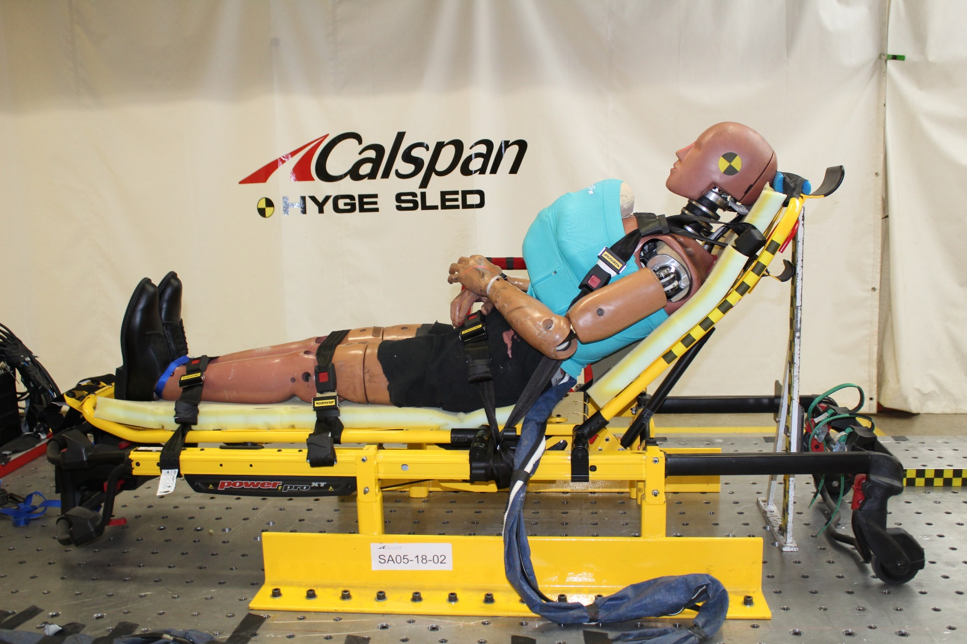
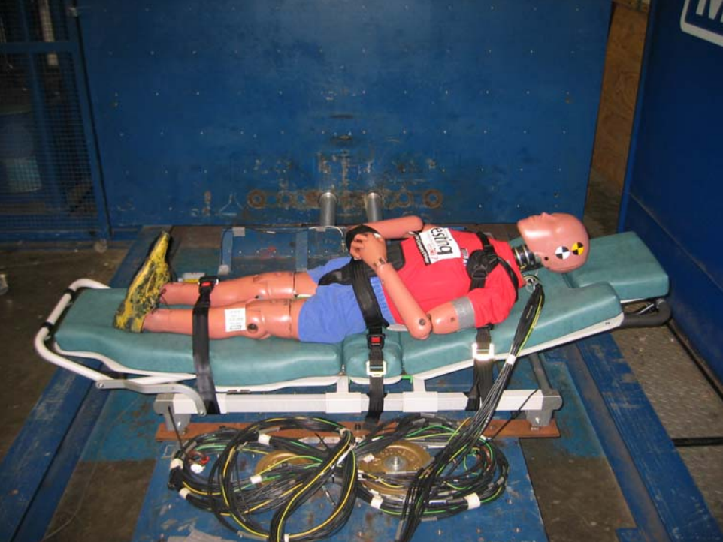
Peace of Mind – Crash Testing

Slide 20
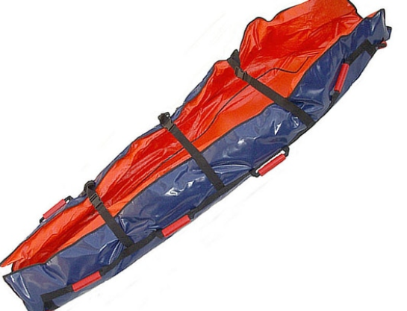
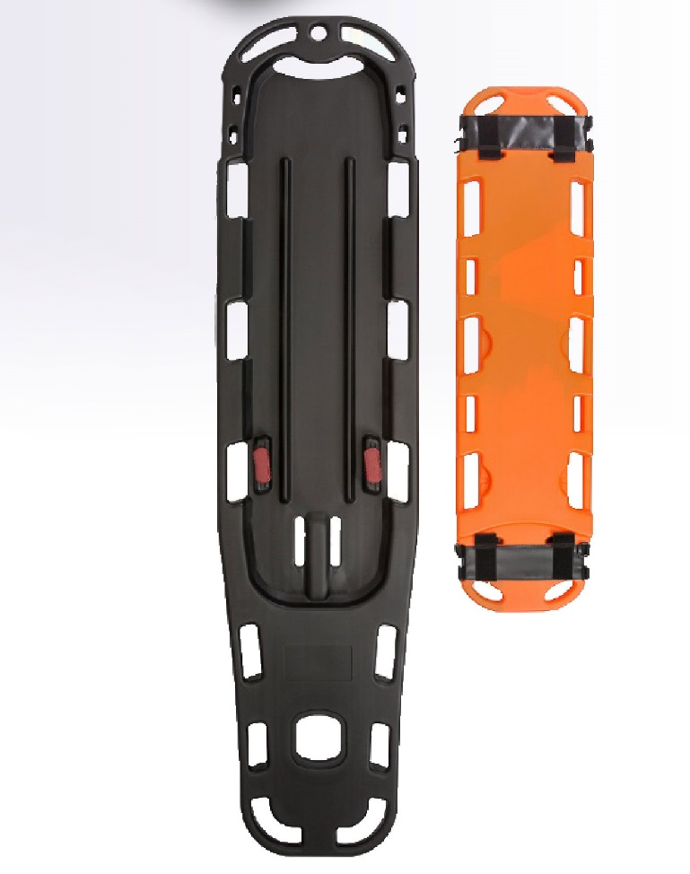
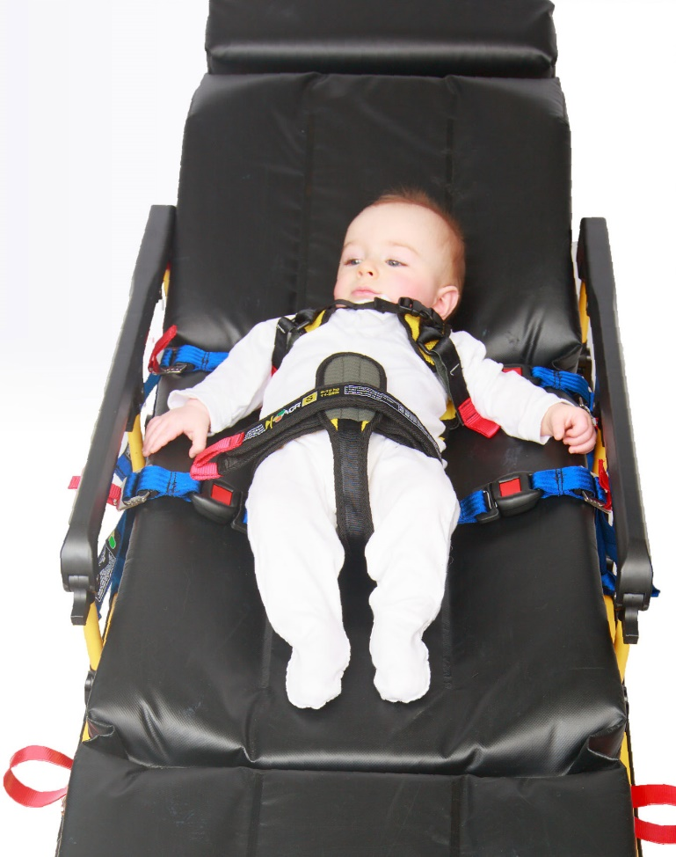
Supporting Child Immobilization Products
Immobilization products such as the Quantum EMS Vacuum Mattress and Combined Pediatric back board can be utilized on a cot for effective child restraint transport and immobilization, in conjunction with the ACR.

Slide 21
Sample list of Customers

Slide 22
Key Considerations
Easy to use and implement, to ensure that a device is not just a check in the box.
Don’t discriminate on size of child. Allow for the safe, effective, restraint of all children, as per suggested guidelines.
Use a Child restraint with a Proven track record. Although there is no US standard at the moment, that does not mean that a restraint can not have some crash testing such as the SAE or BS CEN 1789.
Utilize a device allowing for complete clinical access from the airway to the waist without un-restraining the child.
Utilize a device that does not tighten into the child, but rather tighten into the cot mattress preventing any additional injury to the patient.

Slide 23
Key Considerations
Can be easily be cleaned either by being machine washable or cleaned using a recognised practice.
Use one device for all applications, to accomplish the task of restraining all size patients, as opposed to multiple devices.
Color-coded for easy size identification and implementation. Speed of implementation is key.
Use a device that can be utilized across a number of equipment and vehicles types, to ensure the best clinical outcome.
Ask your Peers, see what they are using and how easy they find their existing solution/Child Restraint.

Slide 24
Summary and More Information
^{Child Ambulance} Transport is Key issue, that can not be ignored.
Act now, don’t wait - know your liability.
Implementing something, is potentially cheaper than a law suit.
Utilize NASEMSO Interim Guidelines for your EMS service.
^{Quantum EMS LLC}
^{Telephone: 516.321.9494}
Email: info@quantum-ems.com
^{Website: quantum-ems.com}

