Slide 1
Medication Shortage Management
and
Alternate Protocol Training
Updated: September 2019

Slide 2
Introduction
Since 2010, EMS has been affected by unprecedented numbers of medication shortages
Multiple reasons for these shortages
Disruptions in supply chain/manufacturing capabilities
Manufacturing practice updates mandated by the FDA
Increased utilization across the system
Decreased profit to manufacturers
Large scale weather events disrupting manufacturing

Slide 3
Noteworthy MEMS Medication Shortages
2010
Epinephrine 1mg/10ml in pre-filled syringes
Naloxone
2011
Fentanyl/Morphine
Midazolam
Magnesium Sulfate
Glucagon
Metoprolol
2017
All medications supplied in “Abboject ®” emergency syringes. Includes the following:
Epinephrine 1mg/10ml in pre-filled syringes
D50
Sodium Bicarbonate in particular

Slide 4
The Purpose of This Presentation
Discuss Maine EMS process to track and respond to drug shortages in general
Alert the Maine EMS provider of the current drug shortages
Educate Maine EMS Providers about alternate protocols if standard medications are unavailable

Slide 5
Maine EMS Shortage Tracking Process
How Maine EMS Tracks Shortages
National dialogue with other state EMS offices
National Association of State EMS Officials
Shortages may be noticed first in another state/region
Local dialogue with Regional Offices (who are notified by partner hospitals)
Maine EMS Operations Team/MDPB
Clinical Pharmacist/Pharmacy Representative on the Medical Direction and Practice Board
Medication manufacturer notices
Monitoring FDA Drug Shortages Web-Sites
http://www.fda.gov/Drugs/DrugSafety/DrugShortages/ucm050792.htm

Slide 6
MEMS Response to Medication Shortages
Recall, the Maine EMS Medical Direction and Practice Board (MDPB) is the only group in the state with legislative authority to create EMS Protocols
The MDPB must therefore closely track drug shortages and create alternate protocols for use when critical medications becomes unavailable

Slide 7
How Would an EMS Service Be Notified of an Alternate Medication or Alternate Means of Medication Delivery
Maine EMS, the MDPB and the six Regional EMS Offices are communicating and discussing medication shortages with local hospital pharmacies on an ongoing basis
Topics included, but not limited to:
Tracking of local medication availability
Creating communication mechanisms should any medication supply chain be threatened
Alerting pharmacies of alternate medication protocols created by the MDPB

Slide 8
How Would an EMS Service Be Notified of an Alternate Medication or Alternate Means of Medication Delivery
Should a hospital run out of any medication, the hospital OR the service should communicate this shortage with the appropriate Regional Office as soon as possible
The Regional Office in turn notifies Maine EMS
Alternate protocols are created as needed
The local hospital is then authorized to deploy the alternate medication or alternate form of the medication and the EMS service/EMS provider are authorized to utilize the alternate protocol or the alternate form of the medication
Alternate protocols for current medication shortages can be accessed on the Maine EMS website

Slide 9
Please Note…
For multiple factors, hospitals may need to rapidly invoke an alternate medication or alternate form of an existing medication
It is imperative that all EMS providers continue to practice the utmost safety in providing medications
This includes providing standard medications in an alternate form or concentration
Such as mixing cardiac epinephrine or using a vial instead of prefilled syringe
Consider working closely with a partner to check medication doses/concentrations/etc. prior to every medication delivery

Slide 10
Frequently Asked Questions
If a medication shortage occurs after hours and I cannot reach a Regional Office or Regional Representative, can I still use the alternate protocol?
How do I know when a standard medication OR the standard form of a medication is no longer available?
What happens when the standard medication supply is reestablished?

Slide 11
After Hours Situations
EMS Services and the local hospital are expected to contact the Regional Office PRIOR TO deploying an alternate protocol.
IF THE SERVICE AND HOSPITAL HAVE NOT BEEN ABLE TO REACH REGIONAL REPRESENTATIVES AFTER DUE DILIGENCE, THE ALTERNATE PROTOCOL MAY BE DEPLOYED
The service and hospital are expected to continue attempts to contact the regional office until such communication is made

Slide 12
Notification of Medication Shortages
Medication shortages can be quickly evolving events
Maine EMS, the MDPB and Regional Offices are following shortages closely
The best mechanism to obtain current information is through either MDPB meetings, Regional EMS meetings or through dialogue with your hospital/medical director

Slide 13
After Medication Shortage is Resolved
Once a medication shortage has been resolved, the alternate protocol is no longer active and operations return to the most current Maine EMS protocols

Slide 14
Current Medication Shortages
As of September 2019, several medications in the EMS formulary are in short supply
Cardiac Epinephrine
D50
Sodium Bicarbonate
Additional medications, in Emergency Syringe form, may also be impacted by this shortage
Atropine

Slide 15
Organization of Medication Slides
Medication
Shortage reason, if known
Estimated duration
Current protocol(s) affected by shortage
Alternative medication or substituted means of delivery
Including why this medication was chosen
Information about new medication (if applicable)
Special Circumstances for Alternate Medication
Pharmacology Information
Indications, contraindications, dose, administration instructions, etc

Slide 16
Alternate Protocols
The remaining slides specifically discuss specific medication shortages and the MDPB’s response to these shortages in the form of alternate medication protocols
As mentioned previously, if additional medication shortages occur, these slides, along with the Maine EMS website and MEMSEd, will be updated

Slide 17
Pre-Filled Cardiac Epinephrine Syringes
Cause of shortage: lack of Abboject® syringes
Expected duration of shortage: months

Slide 18
Pre-Filled Cardiac Epinephrine Syringes Alternate Delivery
May require mixing cardiac epinephrine at the point of patient care.
Current recommendations to pharmacies for packaging materials to mix cardiac epi include:
“If using 1 mg/1 mL ampuls or vials in lieu of emergency syringes, package the vial, diluent, and syringe label in a clear plastic bag prominently labeled with the drug name and strength. Include instructions on preparing a dilution equivalent to a prefilled 1 mg/10 mL emergency syringe (i.e., EPINEPHrine 1 mg - dilute in 9 mL of sodium chloride 0.9%).” -ISMP

Slide 19
Pre-Filled Cardiac Epinephrine Syringes Protocols Affected
Cardiac Arrest Protocols
Cardiac Arrest
Red 7/8
Pediatric Cardiac Arrest
Pink 18
Neonatal Resuscitation
Pink 21

Slide 20
Pre-Filled Cardiac Epinephrine Syringes Alternate Delivery
Materials that should be provided:
Epinephrine 1mg/ml vial (or ampule)
18G needle
10ml syringe
Sodium chloride 0.9% 10ml vial
Alcohol swab
Filter needle (if glass amps used)
Label

Slide 21
Pre-Filled Cardiac Epinephrine Syringes Alternate Delivery Instructions - Vial
Remove caps from each vial
Clean exposed stoppers with alcohol swab
Attach needle to syringe
Draw up 1mg (1ml) epinephrine
Dilute with 9ml sodium chloride 0.9%
Label syringe: ‘epinephrine 1mg/10ml’

Slide 22
Pre-Filled Cardiac Epinephrine Syringes Alternate Delivery Instructions - Ampule
Clean ampule neck with alcohol swab
Snap tip off ampule
Attach filter straw to syringe
Remove 1mg (1ml) epinephrine from ampule
Switch needle on syringe to 18G
Draw up 9ml sodium chloride
Label syringe: ‘epinephrine 1mg/10ml’

Slide 23
50% Dextrose (D50)
Cause of shortage: lack of Abboject® syringes and subsequent vial depletion
Expected duration of shortage:
unknown, >3 months

Slide 24
50% Dextrose (D50): Substitute Medication
10% Dextrose (D10)
This is a less concentrated form of dextrose, but an equivalent dose can be achieved as to that of an “amp” of D50:
250 mL of D10 = 25 grams of dextrose
50 mL of D50 (or an “amp”) = 25 grams of dextrose

Slide 25
50% Dextrose (D50): Current Protocols Affected
Gold 6 – Adult Diabetic/Hypoglycemic Emergencies
Yellow 12 – Combative Patient Protocol

Slide 26
Sodium Bicarbonate
Cause of shortage: lack of Abboject® syringes and new vial design resulting in faulty glass leading to depletion of all forms (syringe, vial, etc)
Expected duration of shortage: unknown, but likely >3 months

Slide 27
Sodium Bicarbonate: Current Protocols Affected
Vials may be dispensed in place of syringes
Vials come in the same concentration and the same 50ml volume
Preparation will be needed before administration but will only require drawing the medication up into a syringe
Protocols Affected:
Red 7/8 – Cardiac Arrest Protocol
Yellow 4 – Antidotes fro Specific Toxins:
Tri-Cyclic Antidepressants

Slide 28
Sodium Bicarbonate: Substitution Options
There are no alternatives for therapeutic substitution of sodium bicarbonate
In light of circumstances in which sodium bicarbonate may have been a treatment option and there is none available – contact OLMC to alert the receiving hospital of your bicarb shortage and ETA
Cardiac arrest in hyperkalemia
Tricyclic overdose with hemodynamic instability or widened QRS
Focus on other therapies for each condition as listed in the MEMS protocols

Slide 29
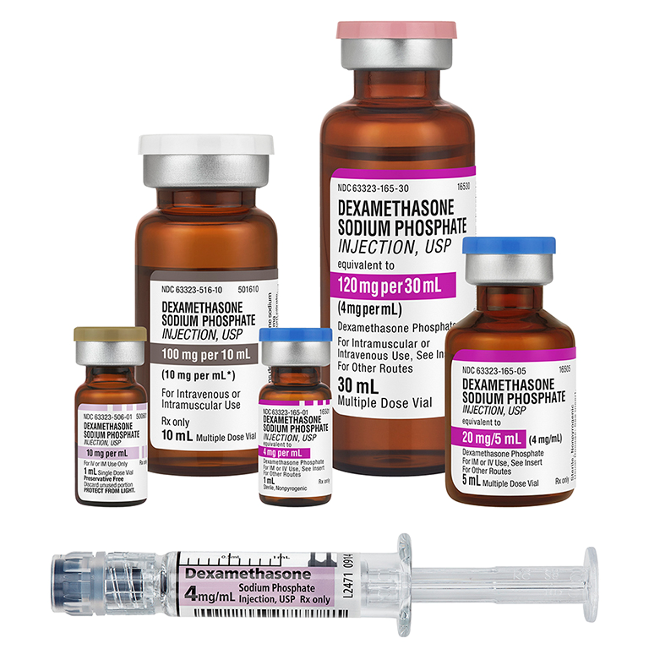
Dexamethasone
Cause of shortage: multifactorial
Duration: Intermittent availability

Slide 30
Dexamethasone
Alternative:
A different concentration is available
10mg/ml (vs preferred and currently stocked, 4mg/ml)
Both strengths are in intermittent supply due to original shortage
The MDPB may revert to the previous protocol steroid, methylprednisolone as an substitute should the shortage become severe

Slide 31
Dexamethasone
Protocols affected:
Blue 9- Respiratory Distress with Bronchospasm 2
Gold 13- Medical Shock #2
Pink 11- Pediatric Respiratory Distress with Wheezing #2

Slide 32
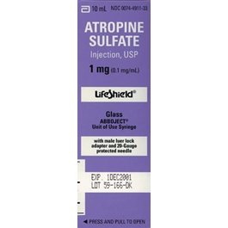
Atropine
Cause of shortage: Multifactorial
Expected duration: Intermittent

Slide 33
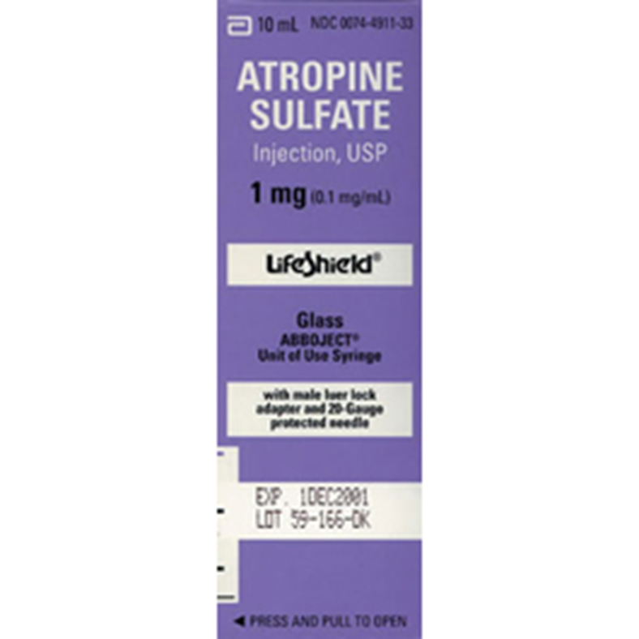
Atropine
Protocols affected:
Red 15- Bradycardia
Yellow 6- Antidotes for specific toxins: Organophosphate/Carbamate

Slide 34
Any Questions?
Contact your Regional Office, Regional Medical Director or Maine EMS with further questions about medication shortages in general

Slide 35
Thank You

