Slide 1
EMS for Children
Marc Minkler
Maine EMS-C Program Manager

Slide 3
EMS-C Disclosure
This project is supported by the Health Resources and Services Administration (HRSA), Maternal and Child Health Bureau (MCHB), Emergency Medical Services for Children (EMSC) State Partnership grant program, Grant # H33MC31622.
This information or content and conclusions are those of the author and should not be construed as the official position or policy of, nor should any endorsements be inferred by HRSA, HHS or the U.S. Government.

Slide 4
The mission of Emergency Medical Services for Children (EMSC) is to reduce child and youth mortality and morbidity resulting from severe illness or trauma.

Slide 5
EMS-C?
Emergency Medical Services for Children
From birth through age 18
26% of Maine’s population – Approximately 335,000 age 18 and under

Slide 6
Early History
1979 – Dr. Calvin C.J. Sia sought legislation through Sen. Daniel Inouye (HI) to improve pediatric care.
1984 – Congress enacted legislation to use federal funds for EMS-C
Preventive Health Amendments of 1984 (PL 98-555)
1985 – Grant process announced
1986 – First grants awarded (AL, CA, NY, OR)
1987 – Maine receives EMS-C grant
2010 – Maine elects to not renew EMS-C grant
2017 – Maine applies and is awarded EMS-C grant
Dr. Calvin C.J. Sia
Notes:
Sen. Inouye’s chief of staff’s daughter was hospitalized and died from meningitis that was poorly treated in an ED
All 50 states, DC, 5 US territories and 3 Freely Associated States have received grants
Freely Associated States are Marshall Islands, Micronesia and Palua

Slide 7
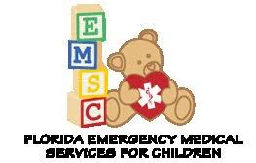
EMS-C Across the Country

Slide 8
Maine EMS-C Organizational Chart
Jocelyn Hulbert
HRSA
Project Officer
Emergency Medical Services for Children Program (EMSC)
Division of Child, Adolescent and Family Health (DCAFH)
Maternal and Child Health Bureau (MCHB)
Atim Effiong
NEDARC
Shaun St. Germain
Maine EMS & EMS-C Program Director
EMS-C Medical Director
Marc Minkler
EMS-C Program Manager
EMS-C Committee

Slide 9
11 Offices and 6 Bureaus
$1.3 billion budget
2,000 employees
Award Grants
Receive regular reports
Sponsor webinars and technical advisory programs

Slide 10
National EMSC Data Analysis Center
Provides technical assistance to EMSC grantees
Located at the University of Utah School of Medicine
Established in 1995 to
Assist in the collection of EMSC data
Help provide define and foster adoption of common EMS definitions
Enhance data collection analysis

Slide 11
What does EMS-C do?
Hospital Systems
EMS
Systems
Integrate pediatric
care across the emergency medical system.
State Resources

Slide 12
Overall Strategy
Communicate Goals
Improve Quality of Care & Outcomes for Children
Meet & Assist Goal Implementation
Review Performance
Report Performance to EMS, Hospitals & Public

Slide 13
The EMS-C program performance measures are a set of standards that were developed to measure long-term progress at both state and national levels of the EMS-C program in key areas of pediatric emergency care.

Slide 14
Maine EMS has received a 4-year grant for
9 performance goals
State Resources
EMS Systems
Hospital Systems
Recognize Pediatric Trauma Capabilities
Recognize Pediatric Medical Emergency Capabilities
Assist with Pediatric Transfer Guidelines & Agreements
Submit NEMSIS data
Pediatric Emergency Care Coordinator
Pediatric Equipment Competency
Develop EMS-C Advisory Committee
Integrate into state statutes
Assist EMS & Hospital systems

Slide 15
Maine EMS has received a 4-year grant for
9 performance goals
State Resources
Develop EMS-C Advisory Committee
Advise on pediatric protocols and care
Help with education and best practices
Integrate into state statues
Make sure EMS-C is important through the future
Assist EMS & Hospital systems
Transports and agreements, insight into EMS care

Slide 16
Maine EMS has received a 4-year grant for
9 performance goals
EMS Systems
Submit NEMSIS data
From EMS PCR
Data helps guide future care
Pediatric Care Coordinator
One per service or can be shared between services
A resource for CEH and purchases
Pediatric Equipment Competency
Personnel knowing how to use service specific pediatric equipment

Slide 17
Maine EMS has received a 4-year grant for
9 performance goals
Hospital Systems
Recognize Pediatric Trauma Capabilities
Recognize Pediatric Medical Emergency Capabilities
What are individual hospital thresholds. We will not define them, but encourage hospitals to have a definition of them
Assist with Pediatric Transfer Guidelines & Agreements
Once a pediatric patient reaches (or better, approaches) this threshold:
Have a plan as to moving the patient
Have agreements for facilities to receive these patients

Slide 18
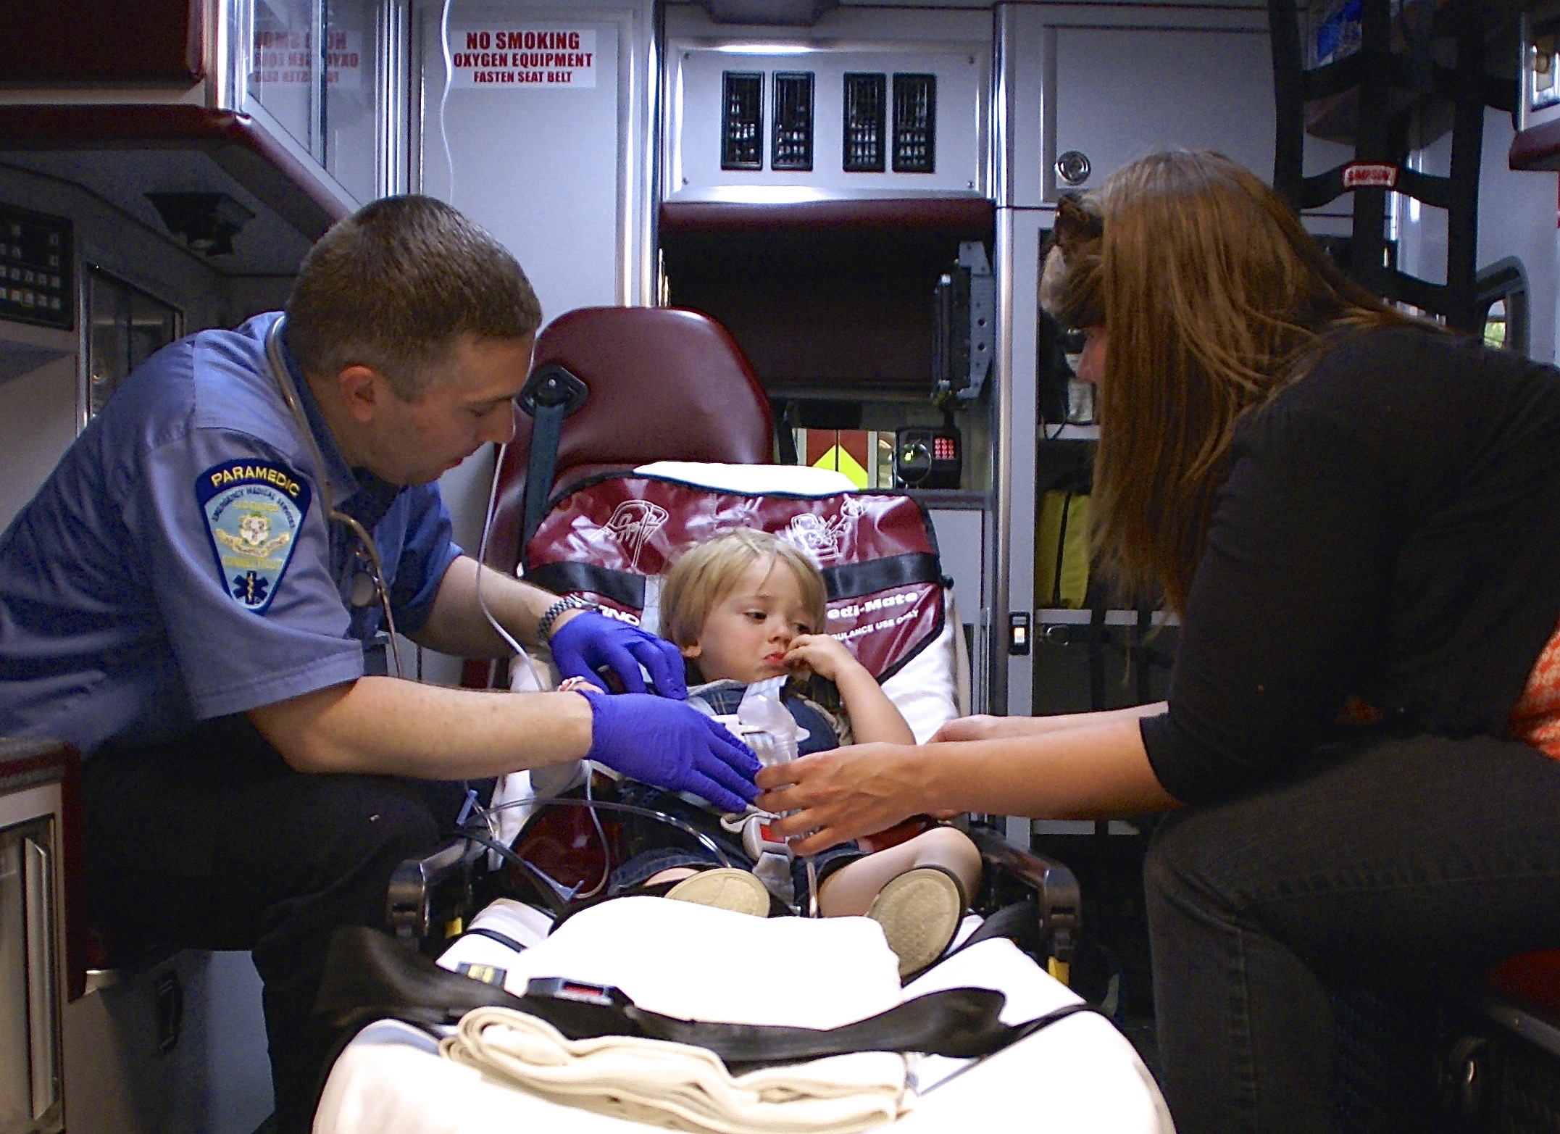
Where are we now?

Slide 19
Maine Pediatric Data
July 1, 2017 – June 30, 2018

Slide 20
272 EMS Agencies in Maine evaluated 11,720 pediatric patients
between July 1, 2017 and June 30, 2018
Data does not include:
Lifeflight
Portland Fire Department/Medcu (started reporting 8/1/18)
United Ambulance (started 8/1/18)
Data for North East Mobile Health Services starts in March 2018.

Slide 28
Where are we going?
Producing education from identified pediatric responses
Meeting with regional and state groups to better communicate
Legislation submitted for pediatric representation on State EMS Board
Collaboration with national partners

Slide 29
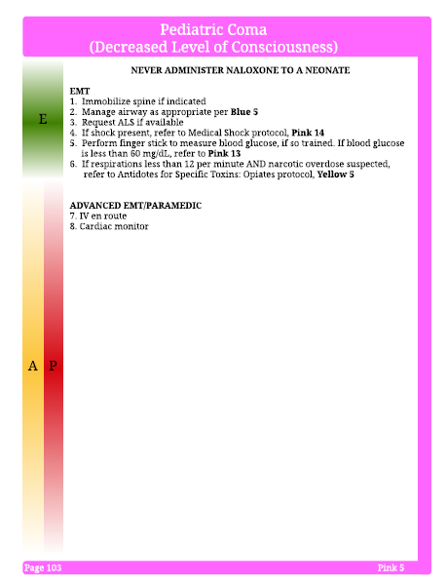

Slide 30
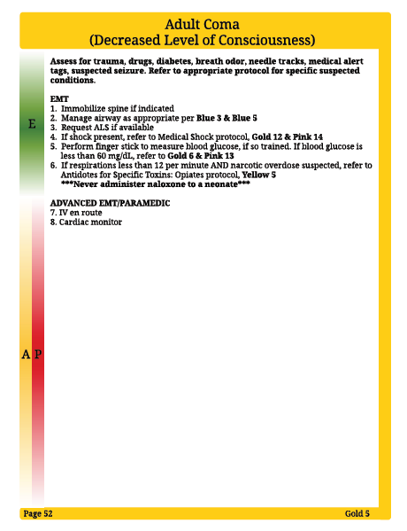

Slide 31
Additional Opportunities
Dedicated Website
School Emergency Guidelines
Concussion Programs
Water Safety Programs
Child Safety Seat Programs
Mannikin Loaners

Slide 32
Years 2 and beyond
Revise
Revise
Revise

Slide 33
Summary / Reflection
Convince –”cause someone to believe firmly in the truth of something”
Latin convincere meaning “to overcome decisively”
versus
Educate – “to develop the faculties and powers of someone”
Latin ducere, meaning “to lead”

Slide 34
Last thoughts
Maine EMS-C is here to help
educate, improve and NOT dictate
For more information:
Visit: maine.gov/ems/
Email: marc.a.minkler@maine.gov
Call: 207-626-3867

