Slide 1

Intranasal Naloxone Administration Training Module for Non-EMS Responders
March 20, 2024
Approved by the Maine EMS Medical Direction and Practices Board.
Notes:
Maine EMS spends a lot of time analyzing data for a variety of different purposes. One of the more important as of late is attempting to support the anecdotal claims of the current crisis in EMS where there are claims that responses times are increasing, calls are going unanswered and there is an insufficient number of EMS clinicians in the state.

Slide 2

Objectives
Non-EMS responders will be expected to recognize their role in and the signs and symptoms of an overdose.
Perform the task of preparing and administering intranasal naloxone.
Identify the possible responses to intranasal naloxone.
Describe how continued support should be provided to the overdose victim.
Responders should understand the difference between opioids and opiates.
Responders should be able to achieve these objectives 100% of the time when interacting with unconscious individuals.
Notes:
This presentation is going to discuss the use of Intranasal naloxone by law enforcement and firefighters. Naloxone is the generic name while Narcan is the trade name. EMS providers must follow the Maine EMS protocols for their respective license level.

Slide 3
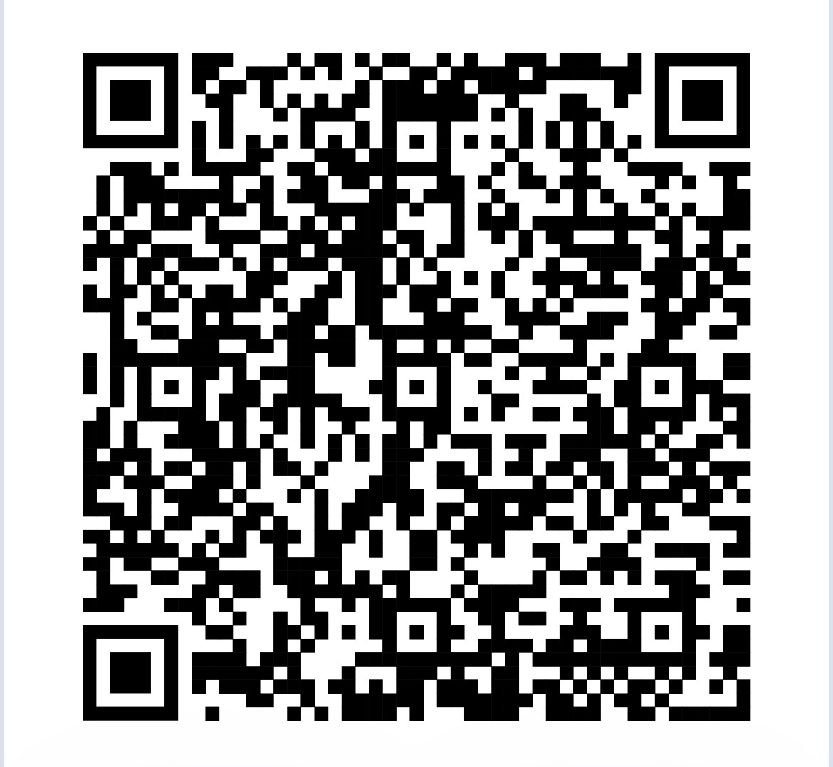
5 MRSA §2353.3
(effective 4/29/14)
Law enforcement officers and municipal firefighters, in accordance with their agency/municipality policies, may administer intranasal naloxone as clinically indicated if the officer or firefighter has received medical training as adopted by the Medical Direction and Practices Board. (paraphrased)
Notes:
The legislation is permissive, not mandatory. The decision about whether a municipality adopt such a policy is a local one.

Slide 4
When is intranasal Naloxone used?
Naloxone is to be administered when someone presents with signs of an opioid overdose or when an opioid overdose is suspected. Opiates/Opioids can cause respiratory depression (slowed breathing), which may lead to a decreased oxygen supply to the brain and may cause brain injury or death.
Notes:
Definitive treatment for an opioid or opiate overdose is the reversal of hypoventilation. Intranasal naloxone is a possible treatment option for trained law enforcement officers and firefighters.

Slide 5
Agency/Municipal Responsibilities
Establish a policy regarding administration of intranasal naloxone by law enforcement officers/firefighters, including:
  Documentation of completion of MDPB-approved training
  Agency-specific supplemental training
  Agency-specific policies/procedures/general orders
Notes:
The municipal policy should include at a minimum: maintaining documenting the completion of naloxone administration training; identifying any agency specific training (e.g. practical training), and any other agency specific policies and procedures. Maine EMS has approved this presentation as meeting the requirements for intranasal naloxone, but will not be retaining records regarding course completion.

Slide 6
Signs of Overdose
Their skin is pale or ashen and/or feels clammy to the touch
Their body is limp/flaccid
Their fingernails or lips have a purple or blue color
They start vomiting or making gurgling noises
They cannot be awakened or are unable to speak
Their breathing or heartbeat slows or stops
Notes:
Definitive treatment for an opioid or opiate overdose is the reversal of hypoventilation. Intranasal naloxone is a possible treatment option for trained law enforcement officers and firefighters.

Slide 7
Opiates and Opioids
Chemicals that act in the brain to:
  Decrease feeling of pain
  Decrease the reaction to pain
  Provide comfort
May be used for pain from injury or post-operative procedures (i.e. surgery) or as part of long-term care for cancer or other terminal diseases.
Both opiates and opioids can be misused.
Notes:
An opioid is a synthetic or semi-synthetic alkaloid that acts on the central nervous system to decrease perception of and reaction to pain. They are also used to increase pain tolerance. They are prescribed for acute, debilitating, chronic pain, or palliative care.

Slide 8
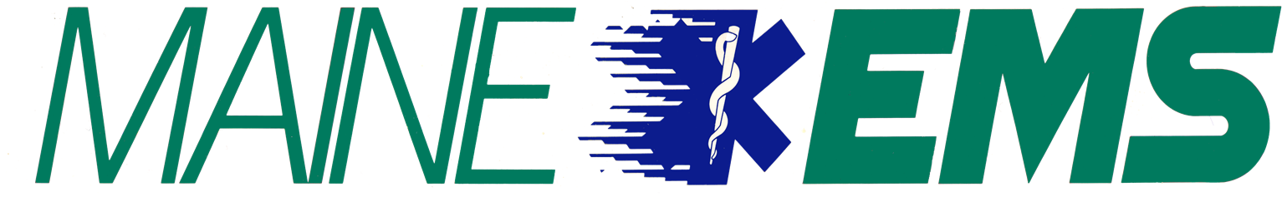
Opiates and Opioids
Some people make a clear distinction between these two groups of narcotic drugs when they speak about them.
Other people use the two terms interchangeably or prefer one over the other.
Opiates
Opiates are chemical compounds that are extracted or refined from natural plant matter (poppy sap and fibers).
Opium
Morphine
Codeine
Heroin

Slide 9
Opiates and Opioids
Opioids
Made in a lab or synthesized.
Partially synthesized from chemical components of opium. Other popularly used opioid molecules are designed and manufactured in laboratories.
The pharmaceutical industry has created more than 500 different opioid molecules. Some are widely used medically, some are not. Examples of well-known opioids used medically in the US include:
Dextromethorphan (available in the U.S. without prescription as, e.g., NyQuil, Robitussin, Theraflu, Vicks)
Dextropropoxyphene (e.g., Darvocet-N, Darvon)
Loperamide (e.g., Imodium)
Hydrocodone (e.g., Vicodin)
Oxycodone (e.g., Oxycontin, Percocet)
Oxymorphone (e.g., Opana)
Meperidine (e.g., Demerol)
Methadone (e.g., Dolophine)
Fentanyl/fentanil (e.g., Ultiva, Sublimaze, Duragesic patch)
Carfentanyl/carfentanil (e.g., Wildnil, for veterinary use)
Buprenorphine (Suboxone/Subutex)

Slide 10
Naloxone Effectiveness
Naloxone can quickly reverse an overdose by blocking the effects of opioids. It can restore normal breathing within 2 to 3 minutes in a person whose breathing has slowed, or even stopped, as a result of opioid overdose.
More than one dose of naloxone may be required when long acting or large doses of opioids are involved
Notes:
Remember, Narcan is specific to opiate and opioid overdoses! It will NOT reverse the effects of other drugs/medications, such as benzodiazepine (e.g. Valium and Versed), alcohol, marijuana, sedatives, bath salts, PCP, methamphetamine, cocaine, etc.

Slide 11
Naloxone Effectiveness
Naloxone will not reverse the effects of other medications/drugs that are not opioids.
For example; Benzodiazepines [diazepam(Valium), midazolam(Versed), lorazepam(Ativan), alprazolam(Xanax)], cocaine, LSD, ecstasy, bath salts, tranquilizers, methamphetamines, Xylazine, and marijuana.
Notes:
Remember, Narcan is specific to opiate and opioid overdoses! It will NOT reverse the effects of other drugs/medications, such as benzodiazepine (e.g. Valium and Versed), alcohol, marijuana, sedatives, bath salts, PCP, methamphetamine, cocaine, etc.

Slide 12
Medication for Opioid Use Disorder (MOUD)
Methadone is an opioid that may be used as a pain reliever but is also commonly prescribed to treat Opioid Use Disorder (OUD).
Suboxone and Subutex are brand names for the opioid buprenorphine, which may be used as a pain reliever but is also commonly prescribed to treat OUD. Suboxone comes in film strips and tablet form.
  These drugs help reduce the craving for opiates and opioids and treat withdrawal symptoms.
Methadone and buprenorphine are never used alone as the sole plan for the treatment of OUD but are used in combination with counseling and skill-learning efforts.
Notes:
There are two common opioid/opiate addiction treatment drugs: methadone and suboxone. Vivitrol is another that is gaining popularity among some medical providers.

Slide 13
Elements of Opioid Use Disorder
Taking larger amounts or taking drugs over a longer period than intended.
Persistent desire or unsuccessful efforts to cut down or control opioid use.
Spending a great deal of time obtaining or using the opioid or recovering from its effects.
Craving, or a strong desire or urge to use opioids.
Problems fulfilling obligations at work, school, or home.
Continued opioid use despite having recurring social or interpersonal problems.
Giving up or reducing activities because of opioid use.

Slide 14
Elements of Opioid Use Disorder
Using opioids in physically hazardous situations such as driving while under the influence of opioids.
Continued opioid use despite ongoing physical or psychological problems likely to have been caused or worsened by opioids.
Tolerance (i.e., need for increased amount, or diminishing effect of continued use).
Experiencing withdrawal (opioid withdrawal syndrome) or taking opioids (or a closely related substance) to relieve or avoid withdrawal symptoms.

Slide 15
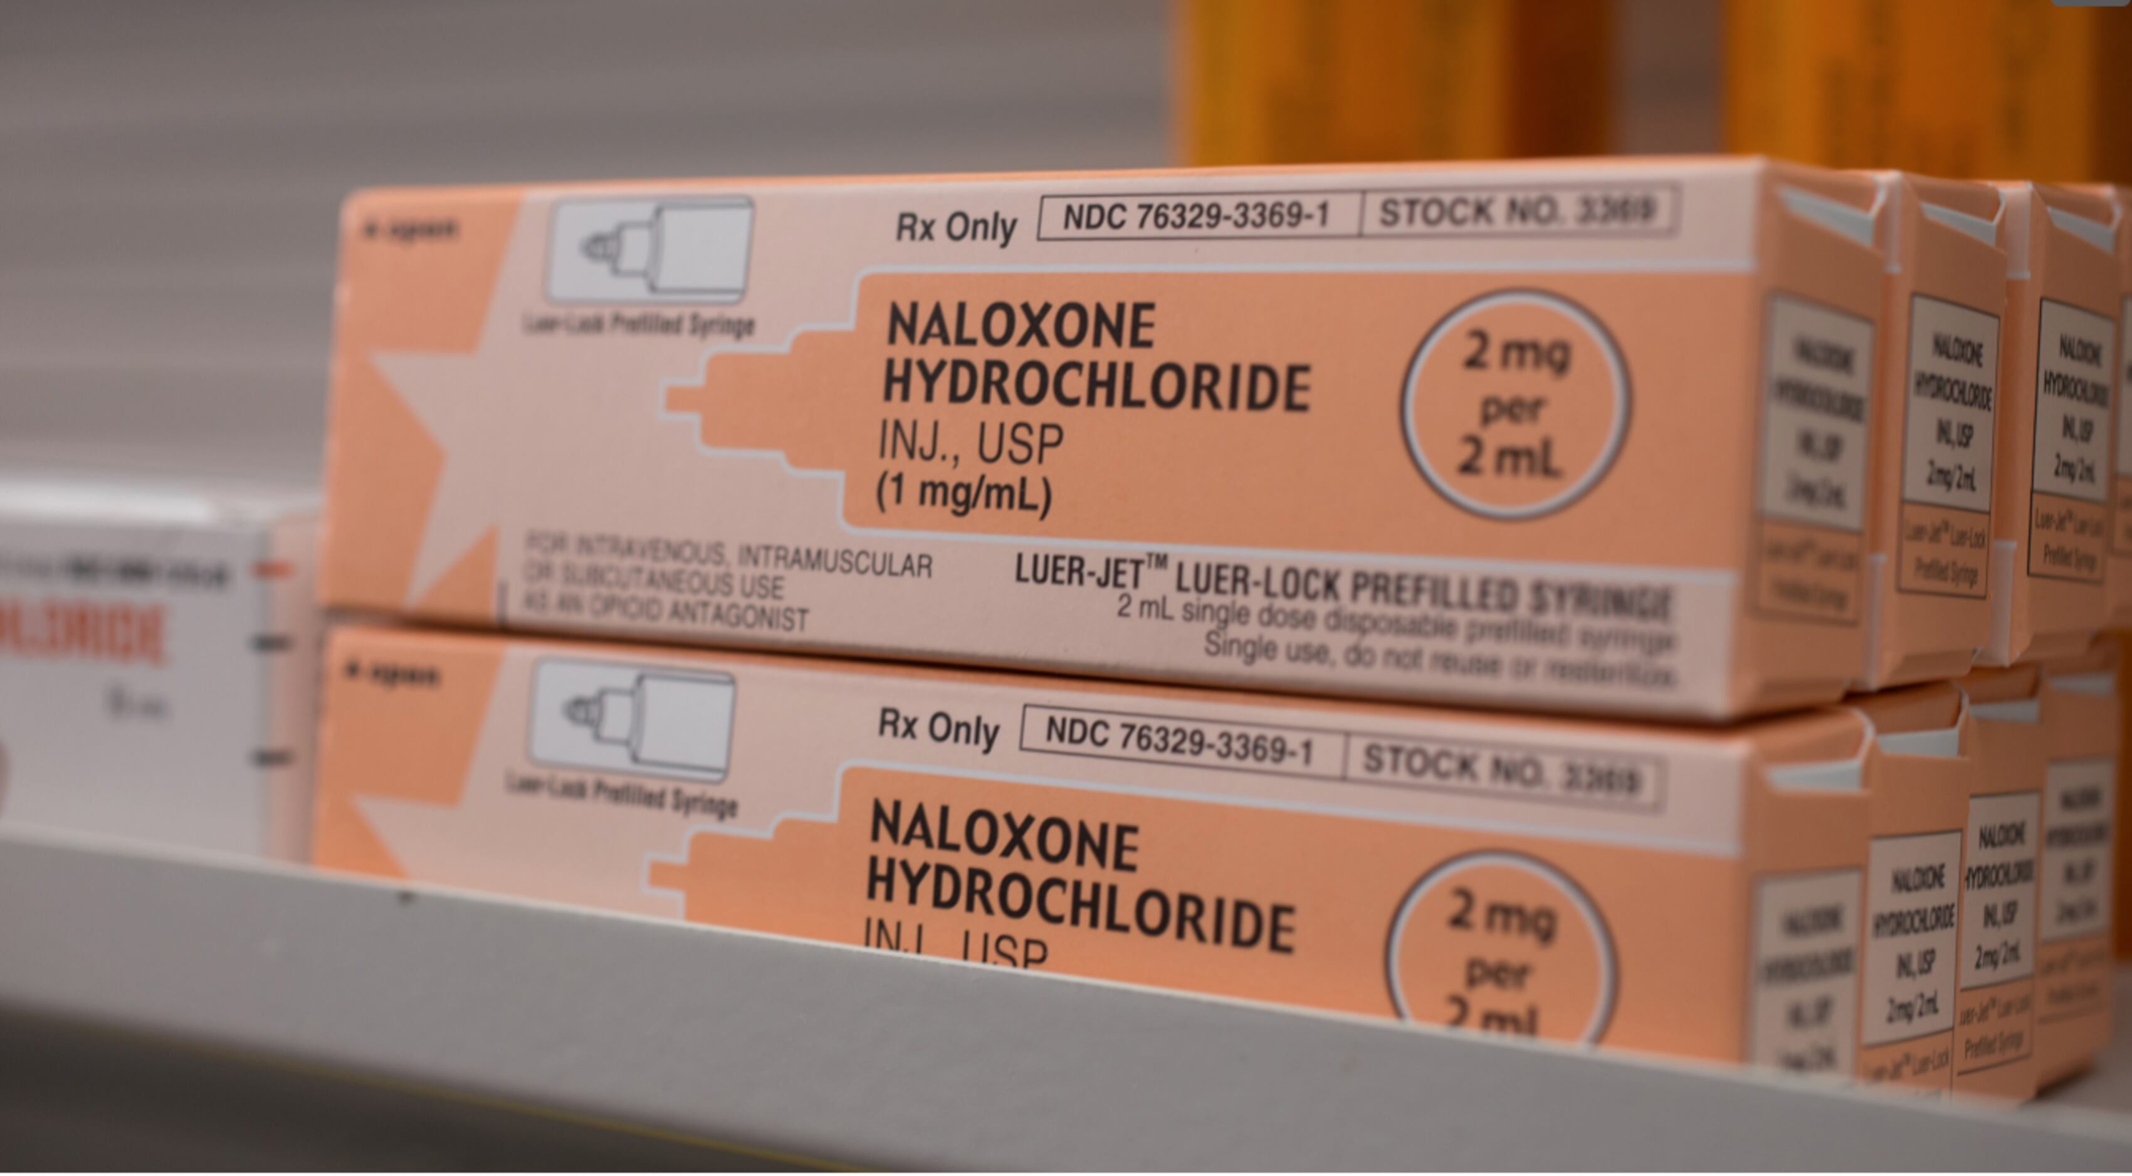
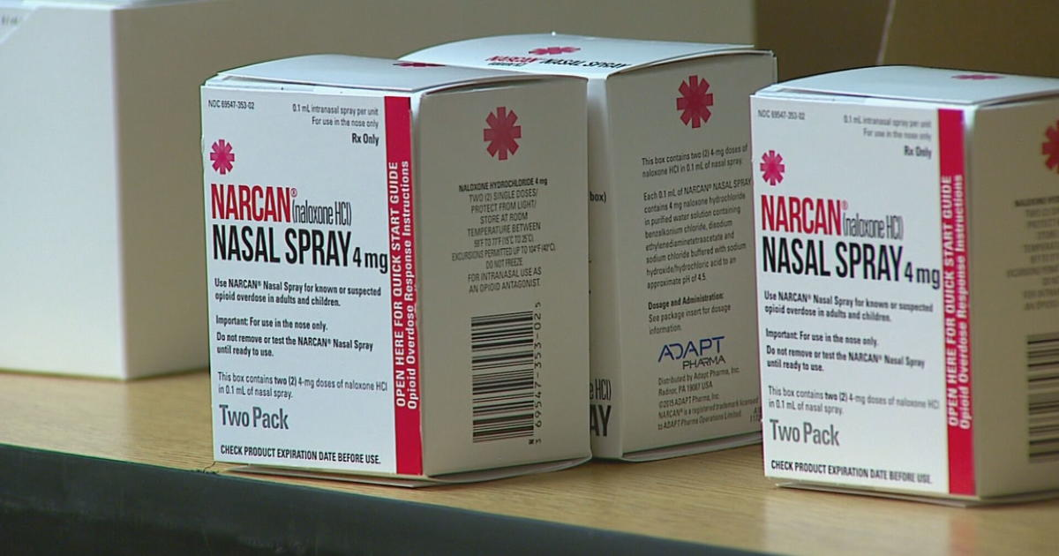
Intranasal Naloxone
Naloxone (Narcan®) is used to counter the effects of opioid overdose such as central nervous system and respiratory depression.
Naloxone is NOT effective against respiratory depression due to non-opioid drugs (or other causes).
Notes:
Naloxone can reverse central nervous system and respiratory depression due to an overdose of opioids opiates. It is not effective against respiratory depression due to non-opioid drugs. Thus, it is important to recognize the signs and symptoms of an opioid or opiate overdose and use naloxone appropriately.

Slide 16
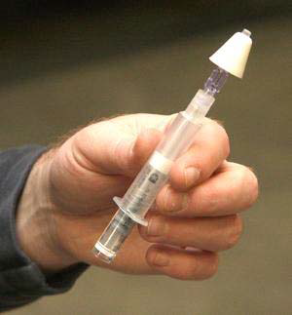
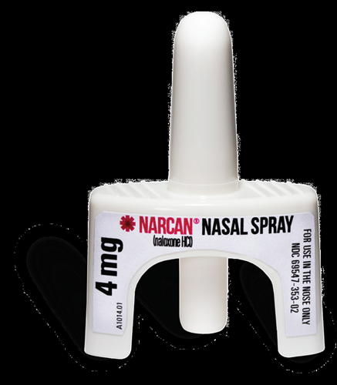
Why Intranasal Naloxone?
Very low risk of exposure to blood (no needle)
Can be administered quickly and with little training
Onset of action is rapid
Very effective when used properly and in a timely manor
Notes:
There are many reasons to administer intranasal naloxone. It minimizes the risk for blood borne pathogen exposure. It can be rapidly administered and naloxone has a rapid onset with peak effect within a few minutes.

Slide 17
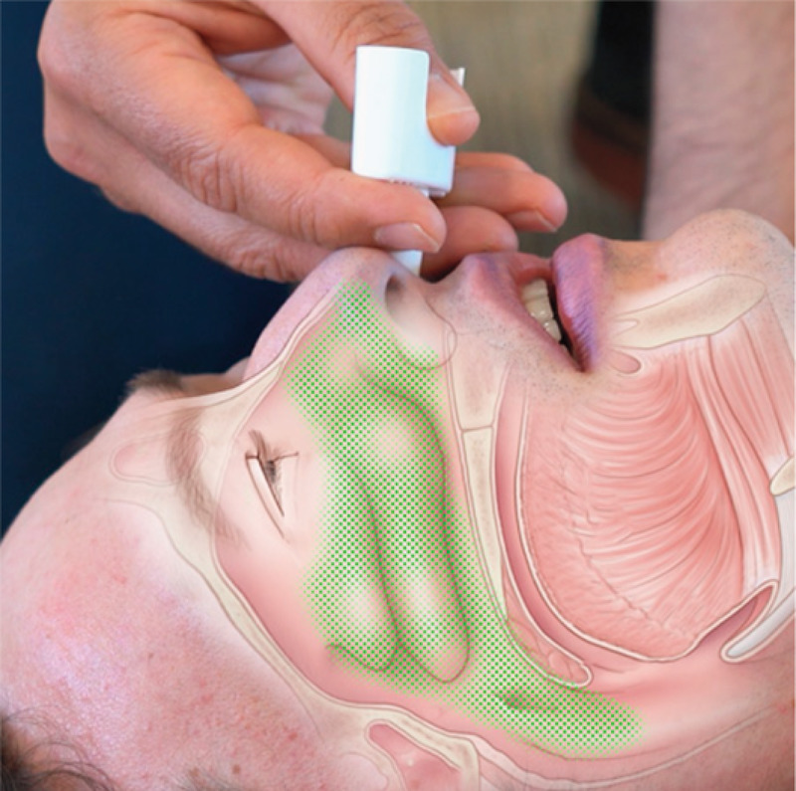
Intranasal Naloxone
Works quickly due to large surface area of the nasal cavity which is beneficial for absorbing medication directly into the bloodstream.
Notes:
The medication is sprayed in a large area and rapidly absorbed.

Slide 18
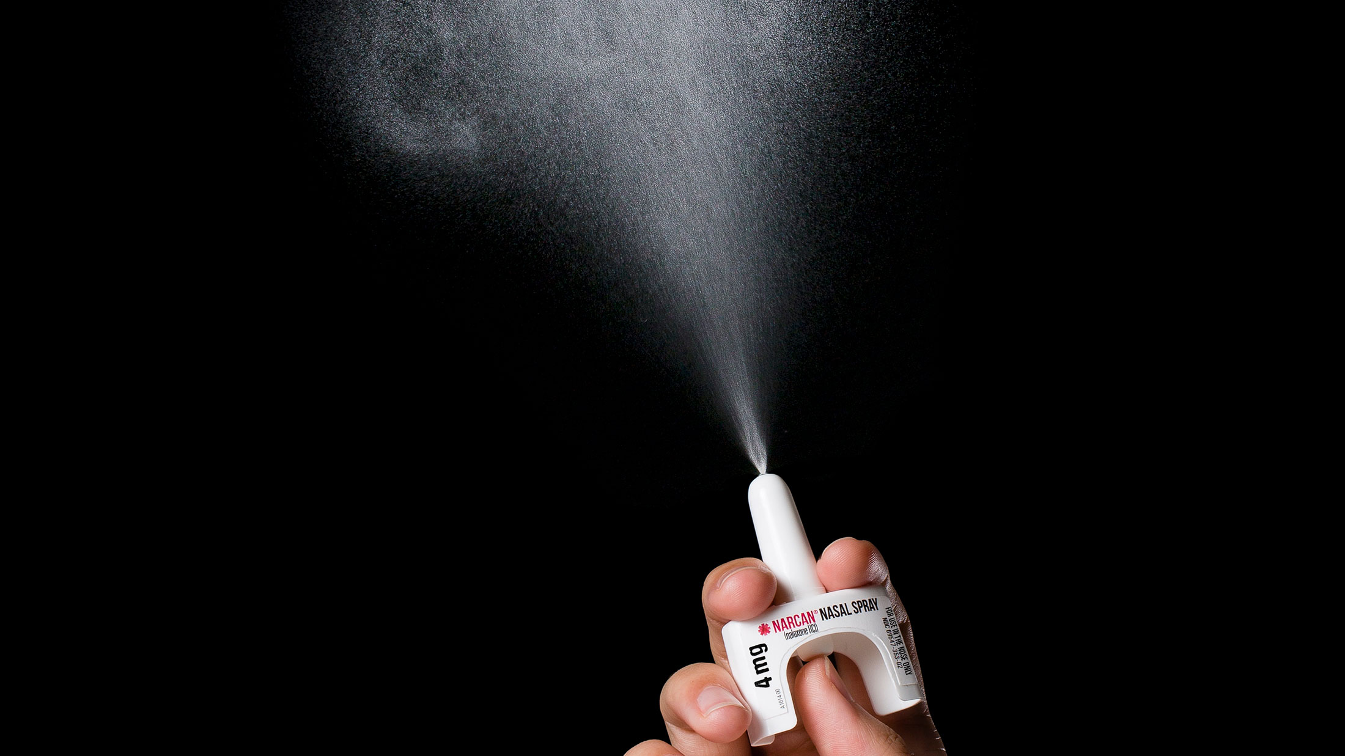
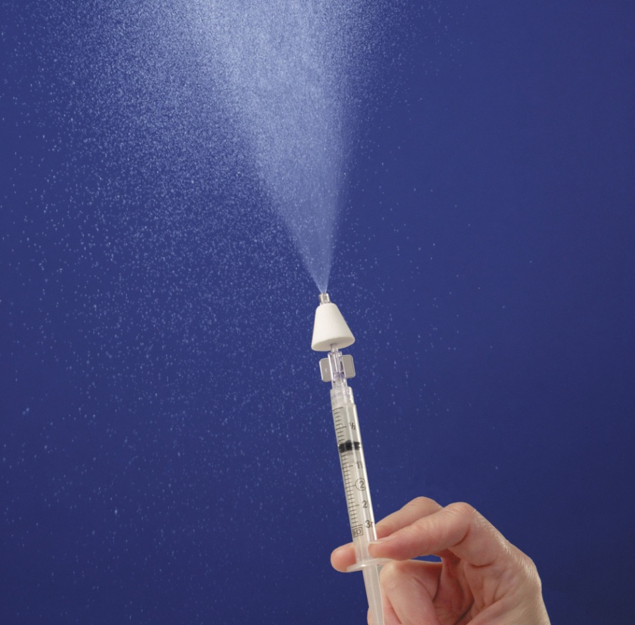
Why is it used with an Atomizer?
Administering the liquid drug as a fine mist covers more of the surface, like spray paint or hair spray and increases amount absorbed into the bloodstream.
Notes:
The atomizer helps spread the distribution of the medication.

Slide 19
What does an overdose look like?
General
  May not be responsive to voice or touch stimulation
  Their body may be limp/flaccid
  Possibly not able to be awakened
  Possibly not able to speak
Breathing
  Possibly breathing less than 6 breaths per minute
  Their breathing or heartbeat may slow or stop
  Snoring deeply/gurgling sounds may be present
  They may start vomiting or making gurgling noises
Notes:
There are many signs and symptoms of an opioid or opiate overdose, but intranasal naloxone is indicated for a patient with respiratory arrest or hypoventilation.

Slide 20
What does an overdose look like?
Further assessment
  Bluish color on the skin, nails, or lips
  Small pupils
  Skin is extremely pale and/or feels clammy to the touch
  Fingernails or lips may have a purple or blue color
Notes:
There are many signs and symptoms of an opioid or opiate overdose, but intranasal naloxone is indicated for a patient with respiratory arrest or hypoventilation.

Slide 21
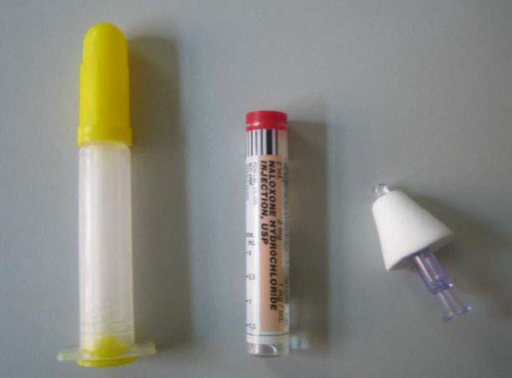
Option 1: Adult Nasal Atomizer Use
Administer one-half of the syringe (1mg) nasally with the atomizer. Wait 2-5 minutes to see if this is effective. If not, administer the second half in the other nostril.
Equipment needed:
  Prefilled naloxone syringe (2 mg/ 2ml)
  Atomizer attachment (mucosal atomizer device, “MAD”)
  See following slides for preparation
Notes:
Each tube of naloxone contains 2 mg of naloxone. For intranasal administration, this is 1mg of Naloxone per nostril. Administer ½ tube in one nostril and wait a minute to see if this is effective. If the patient is still not adequately breathing, administer the second ½ of the tube into the other nostril. Also consider contacting poison control (800-222-1222) if more than one drug use is suspected. EMS Providers: follow the Maine EMS protocols for your respective license level.

Slide 22
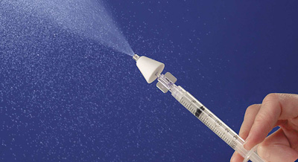
Nasal Atomizer Use

Slide 23
Preparation: Step 1
Notes:
For equipment, you will need one luer-jet needle free syringe, one vial of naloxone, and one atomizer.

Slide 24
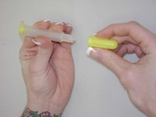
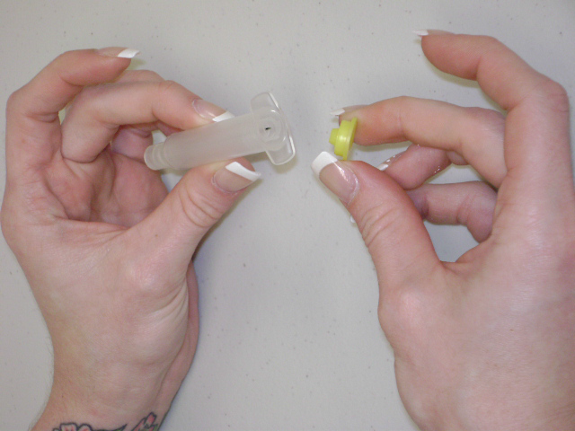
Preparation: Step 2
Notes:
Remove the caps from both ends of the luer-jet needle free syringe.

Slide 25
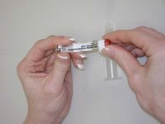
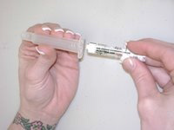
Preparation: Step 3
Notes:
Remove the red cap from the naloxone vial. Screw the now open end of the vial into the syringe. It will become difficult to turn when it is threaded enough.

Slide 26
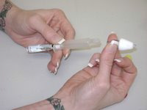
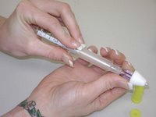
Preparation: Step 4
Notes:
Attach the nasal atomizer to the opposite end.

Slide 27
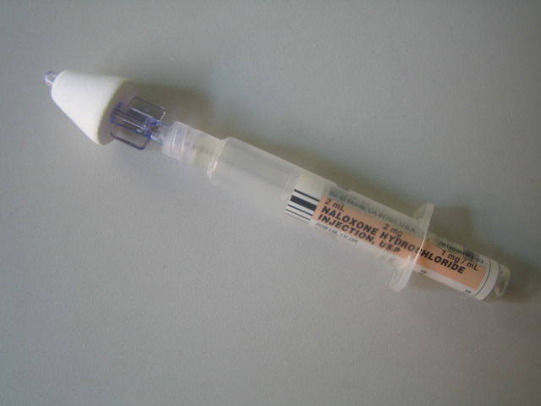
One Luer Attached Atomizer
Notes:
This is what your final product should look like!

Slide 28
Administration
Assemble kit (if applicable).
Gently but firmly place the atomizer in one nostril and spray.
If only one nostril is available, put all of the medication on that side.
Gently roll the patient onto their side or the recovery position.
Call for medical assistance via radio communications or 911.
Consider contacting poison control if other poisons are suspected : (800) 222-1222
Notes:
The administration will take some choreographing of your team members. Continue to ventilate your patient, assess the nares and suction as needed. Control your patient’s head and place the atomizer in one nare while carefully occluding the opposite nostril.

Slide 29
Option 2: NARCAN NASAL SPRAY
FDA Approved
Set single dose
No Assembly
High concentration
CANNOT be titrated
http://www.narcannasalspray.com/helpful-resources/

Slide 30
Administration
Remove NARCAN Nasal Spray from the box. Peel back the tab with the circle to open the NARCAN Nasal Spray.
Hold the NARCAN nasal spray with your thumb on the bottom of the plunger and your first and middle fingers on either side of the nozzle.
Gently insert the tip of the nozzle into either nostril.
  Tilt the person’s head back and provide support under the neck with your hand. Gently insert the tip of the nozzle into one nostril, until your fingers on either side of the nozzle are against the bottom of the person’s nose.
Press the plunger firmly to give the dose of NARCAN Nasal Spray.
  Remove the NARCAN Nasal Spray from the nostril after giving the dose.
If additional NARCAN Nasal Sprays are available, repeat every 2 to 3 minutes until the person responds or emergency medical help is received.

Slide 31
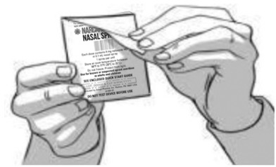
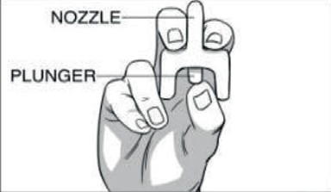
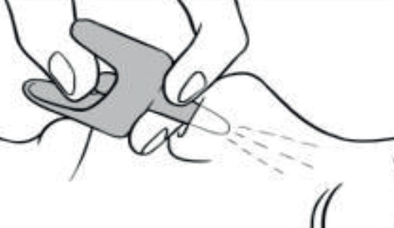

Slide 32
Safety Considerations
Naloxone’s duration of action is relatively brief (as short as 30 minutes).
The duration of action for narcotics can be very long (as long as a day).
All patients who receive naloxone must be monitored closely for recurrent symptoms, including altered mental status, respiratory depression, and circulatory compromise.
Patients may need another dose of naloxone.
Medical oversight is ideal post-overdose.
The patient may become confused, agitated, and possibly violent
Notes:
Once naloxone has been administered, it is vital to continue to monitor the patient. The half-life of naloxone is brief and can be as short as 30 minutes. As the effect of the naloxone fades, the signs and symptoms of an opioid overdose can return. Recurrent altered mental status, respiratory depression, or circulatory compromise can follow quickly; therefore, constant patient monitoring and frequent reassessment is essential.

Slide 33
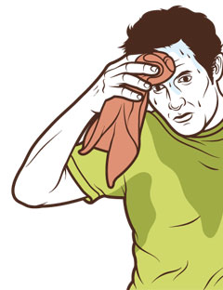
Adverse Reactions
In some cases, intranasal naloxone may cause:
  Withdrawal symptoms
    Confusion
    Agitation and even aggression
    Fast heart rate
    “Goosebumps”
    Yawning
    Nausea / Vomiting
    Seizures
    High blood pressure or Low blood pressure
  Fear of causing withdrawal should not prevent use when the person is unresponsive
Notes:
Naloxone works by creating narcotic withdrawal, which may also cause the above signs and symptoms. These are common in the chronic narcotic user who has been administered naloxone. Nevertheless, if a patient is in respiratory arrest secondary to an narcotic overdose, the administration of naloxone is a life-saving time-critical action.

Slide 34


Children and Infants
Remember, children have smaller noses, and some of the medication may run out of the nose and down the back of the throat. This will not do any harm.
When an opioid overdose is suspected in a child, administer the same dose/amount as for an adult.
Notes:
Remember to suction the child’s nose prior to the administration of naloxone.

Slide 35
Skills Practice
Given a scenario:
  Demonstrate administration of intranasal naloxone on an adult intubation head
  Prepare an intranasal naloxone atomizer using the required equipment (if applicable)
  Demonstrate as well as explain how you would provide continued support
  Always request Emergency Medical Services, dial 911
Notes:
If your agency develops a skills practice session, consider using a scenario that incorporates preparing the atomizer, demonstrating how to administer intranasal naloxone, and describing what else you would provide to the patient.

Slide 36
Course Summary
What we learned:
  Why intranasal naloxone is available as an option for bystanders who witness overdose.
  What an opioid overdose looks like.
  The reasons that justify the use of intranasal naloxone.
  How to prepare an intranasal Atomizer.
  How and when to use the intranasal Atomizer and Auto-injector.

Slide 37
References
“Narcan® Nasal Spray – Anyone Can Save A Life.” Narcan®, 4 Jan. 2024, https://narcan.com/
Ortega R, Nozari A, Baker W, Surani S, Edwards M. Intranasal naloxone administration., N Engl J Med 2021;384(12):e44., https://www.nejm.org/doi/full/10.1056/NEJMvcm2020745. Accessed 4 Jan. 2024
“Lifesaving Naloxone.” Centers for Disease Control and Prevention, 21 April 2023, https://www.cdc.gov/stopoverdose/naloxone/index.html#:~:text=Naloxone%20quickly%20reverses%20an%20overdose,opioids%20like%20fentanyl%20are%20involved. Accessed 4 Jan. 2024
“Overdose Prevention & Naloxone Manual.” Substance Abuse and Mental Health Services Administration, 4 Jan. 2024, https://www.samhsa.gov/resource/ebp/overdose-prevention-naloxone-manual
“Naloxone.” Drugs.com©, https://www.drugs.com/naloxone.html, Accessed 4 Jan. 2024

