Slide 1
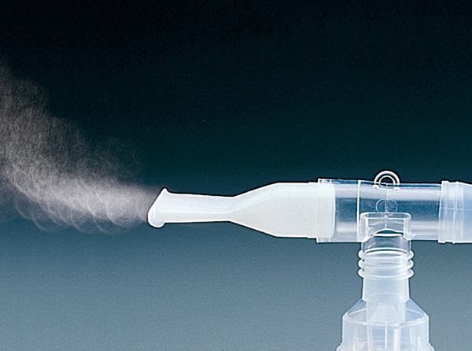
Nebulizer Use by EMTs
November 2021
Notes:
November 2021 Program

Slide 2
Objectives
After completing this training program, the EMT will be able to:
Describe the process of medication nebulization
List and describe the various delivery devices for medication administration using nebulization
List the indications for administration of the albuterol/ipratropium bromide medication combination by the EMT, in accordance with Maine EMS protocols

Slide 3
Objectives
After completing this training program, the EMT will be able to:
List the steps for setting up a nebulizer set, adding medication, and administering nebulized medications and/or saline per Maine EMS protocols
Explain proper documentation procedures for the use of nebulized medications

Slide 4
Note
This program teaches the use of nebulization, and specifically the nebulization of Ipratropium Bromide & Saline. Clinicians are reminded to review current Maine EMS protocols, pandemic guidelines or other protocols which may supersede methods of care, and any contemporary changes in clinical performance.
This program MUST be tied to a practical skills session to help ensure competency with service specific equipment and procedures.
Notes:
Emphasize that the skills are developed by the knowledge AND practical practice

Slide 5
What is Nebulization?
Much like an ocean breeze, by blowing oxygen over or through a liquid, small droplets of the liquid medication are picked up and carried along with the oxygen.
It relies on
Proper pressure of the oxygen/air source.
Proper amount of liquid medication.
Proper inhalation by the patient to inspire the medicated mist.
Notes:
If any of the three factors are not in sync, the nebulization of medication is ineffective. Pressurized gas creates the force to deliver the medication, the amount of liquid determines how much medication is carried by the pressurized gas, and the patients’ depth and effort at breathing determine how much medication enters the lungs allowing the medication to have its intended effects.

Slide 6
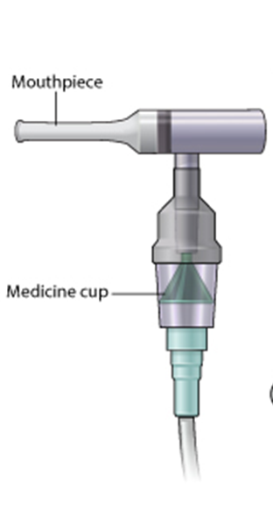
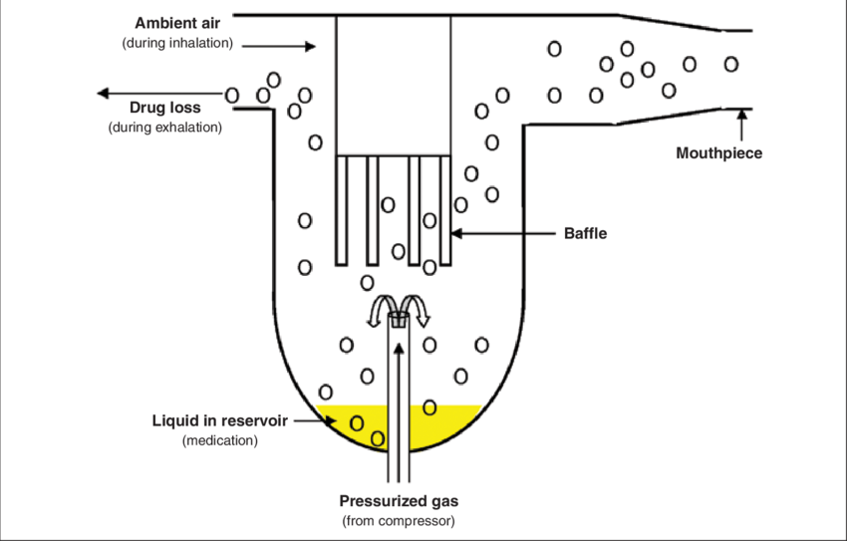
What is Nebulization?
Notes:
By forcing pressurized gas into or over the liquid, a mist is formed of tiny droplets. As the patient breathes in, these droplets are inhaled. Some droplets are wasted when the patient exhales, but with proper settings, this is minimized.

Slide 7
What is Nebulization?
In home environments, the pressure source is often air.
In EMS, we use pressurized oxygen.
Oxygen is set at to at least 8 lpm
If lower, the liquid is not picked up
If higher, the liquid is picked up too fast and blown into air vs. being inhaled by patient
Notes:
Many patients have home nebulization kits, and these rely on small air compressors to create the pressure to bubble through the liquid and form a medicated mist.
It is important for the provider to set the O2 regulator between 6 and 8 liters per minute, as lower settings result in not enough pressure and flow to create the medicated mist and deliver the drug to the patient, whereas too high of a setting will create more mist than the patient can breathe in and will simply waste the medication (and not benefit the patient) by blowing the mist out of the exhalation port.

Slide 8
What is a Nebulizer?
Hand Held Style
Mask Style
Notes:
Considered “small volume nebulizers” (SVN)
Nebulizer typically come disassembled and have many variations, but consist of some basic components:
Tubing to connect to the pressurized gas source
A medication cup for the liquid medication
A baffle for collecting large droplets (often this is part of the cap)
A cap for the medication cup
A T-connector (may or may not be used for mask style administration)
A mouthpiece or mask
Corrugated plastic tubing (some manufacturers do not use this) that create a space for any “spare” exhaled medicated mist

Slide 9
Nebulization Delivery Devices
Once the medication is picked up in the oxygen, it is delivered by inhalation as a mist to the patient.
Inhalation can be done by:
A mouth-piece (hand-held nebulizer, aka HHN)
A mask
A BVM
A CPAP
Alternate devices
Notes:
The mist can be administered to the patient through a variety of methods that will depend upon the situation and patient condition.

Slide 10
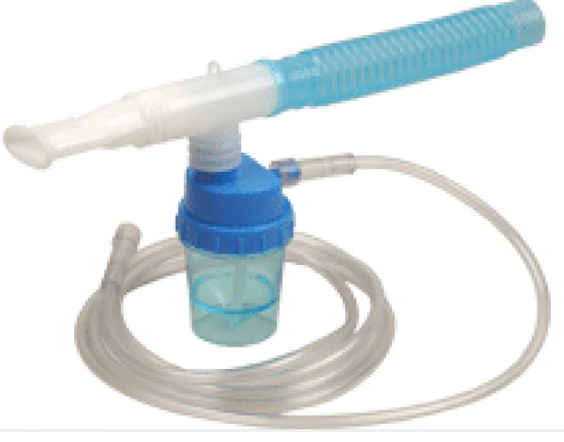
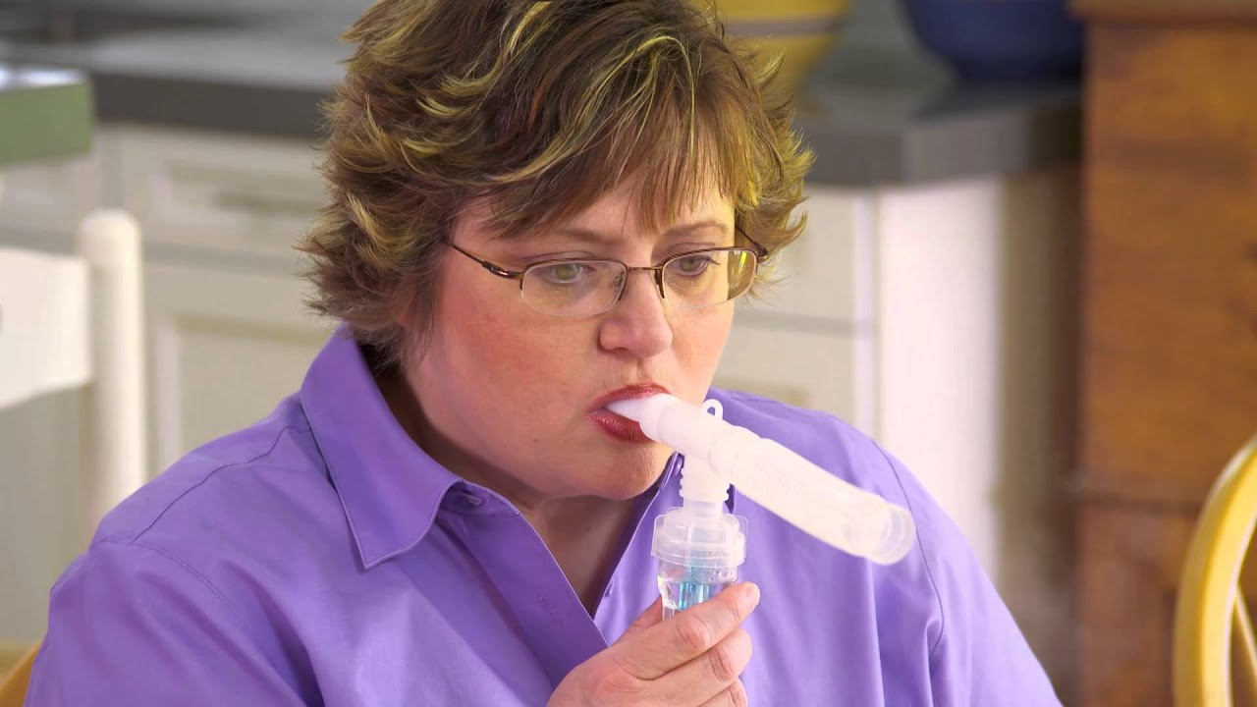
Nebulization Delivery Devices
Hand-Held Nebulizer (HHN)
Requires patient to hold device
Can be challenging for patients who try and talk with their hands
Can be challenging for exhausted patients
Significant exhalation of medication and possible infectious agents
Boundtree
Notes:
The most common method of nebulized medication is through a hand-held nebulizer (HHN). This involves attached a mouthpiece to the T-connector, and depending upon the manufacturer, a plastic corrugated tubing extension.
This method is helpful in preventing claustrophobia that some patient feel with a mask style delivery, and lets the patient be in charge of the medication delivery (especially if they have the need to cough, which can be common).
The drawback to this method is a patient who has been a lengthy period of respiratory distress and is worn out/tired. They may not be able to physically hold the device, and the provider would be in very close contact to exhaled respirations and likely has other tasks besides holding the nebulizer for the patient. Providers should focus on the medication therapy and try to limit questions during medication delivery as patients will remove the mouthpiece to answer questions. Additionally, those who tend to talk using their hands may inadvertently remove the mouthpiece.

Slide 11
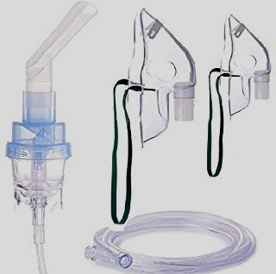
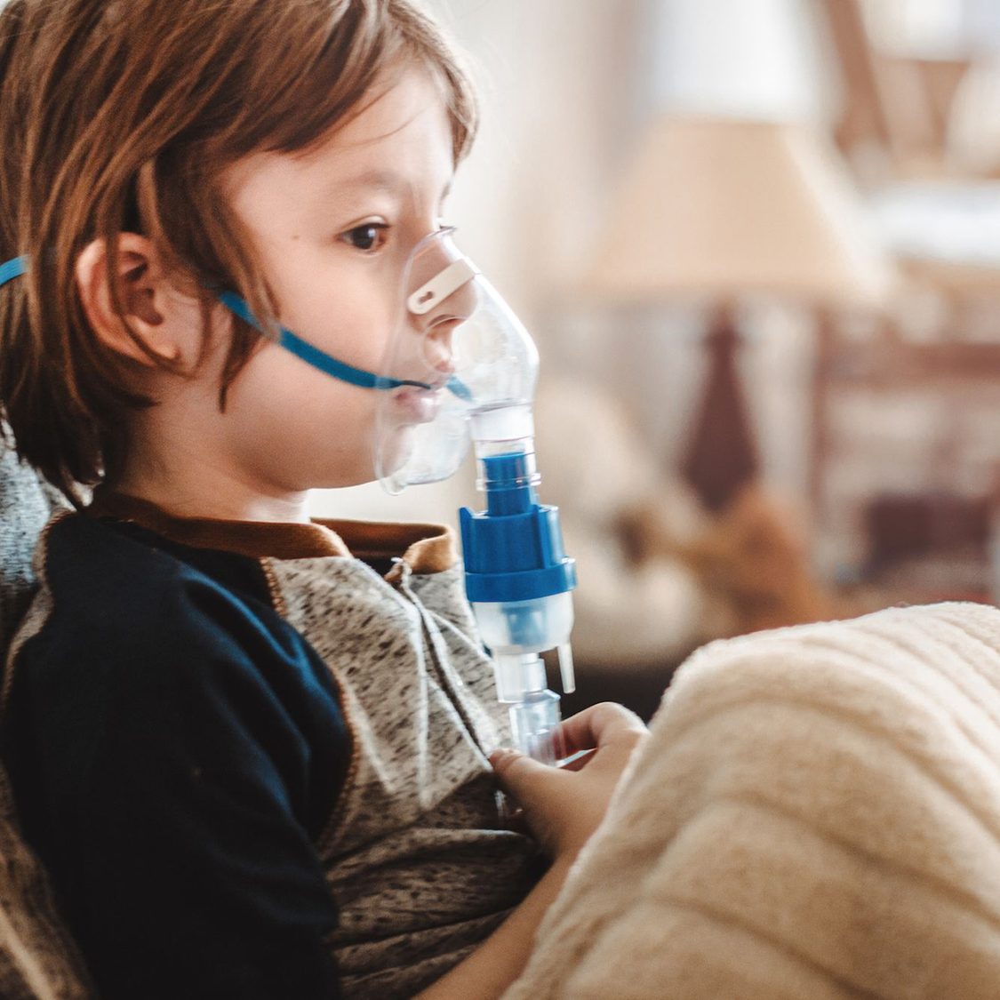
Nebulization Delivery Devices
Mask
At least 8 lpm to prevent rebreathing of CO₂
Adult & pediatric size masks
Can also remove bag from NRB and use
Boundtree
Notes:
A mask delivery method can be beneficial as the patient or provider does not need to hold the device. It can also reduce the excess waste from the exhalation port. Masks may be packaged separately or in the kit, and typically have 2 large openings to allow for exhalation. The mask portion of a NRB can also be used by puling off the connector at the bottom of the NRB where the oxygen and reservoir bag attach. It is critical that when using a mask, the O2 regulator is set at 8lpm to prevent potential rebreathing of exhaled CO2 as 6lpm my not clear the exhaled gas from the mask in a timely manner. Additionally, the straps should be adjusted to provide a snug fit, and the nose clip (if present) should be gently molded to the bridge of the patient’s nose. Some patients may find the mask very claustrophobic and may need coaching and reassurance. Monitor your oxygen supply careful to ensure you do not run out of oxygen while a mask is in use.

Slide 12
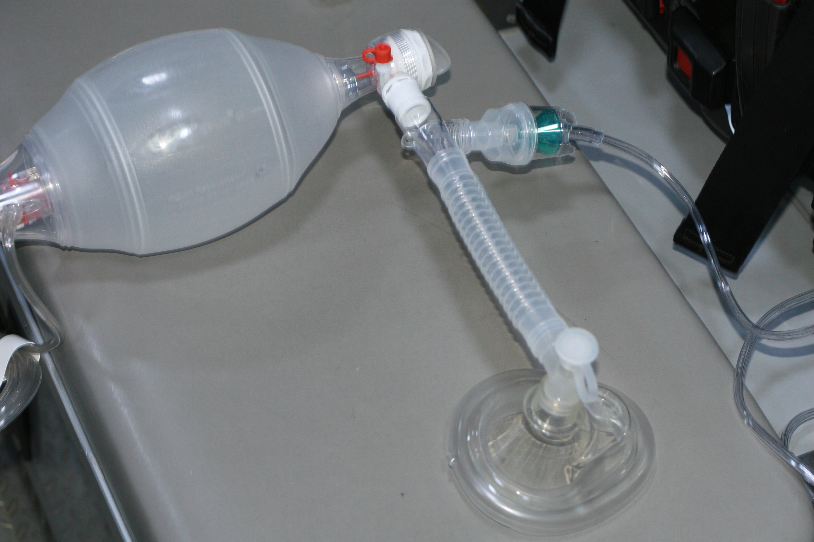
Nebulization Delivery Devices
BVM
Less waste as nearly all medication is being ventilated into patient.
T-connector and corrugated tubing can be used to connect the medication cup
Need to have two oxygen sources – one for the BVM (15 lpm) and 1 for the nebulizer (6-8 lpm)
Notes:
If a patient needs to receive nebulized medication via BVM, the nebulizer is placed in line. Some BVMs have an available commercial attachment, while others will use a standard nebulizer and use the T-connector and corrugated tubing to connect between the BVM and the face mask or advanced airway. Connect the BVM to the manufacturer recommendation oxygen flow rate (typically 12-15 lpm) and the nebulizer is connected to a flow rate of 6-8 lpm. Be mindful of keeping the medication cup upright to avoid spilling the liquid medication.

Slide 13
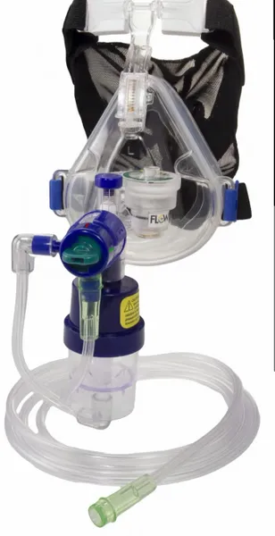
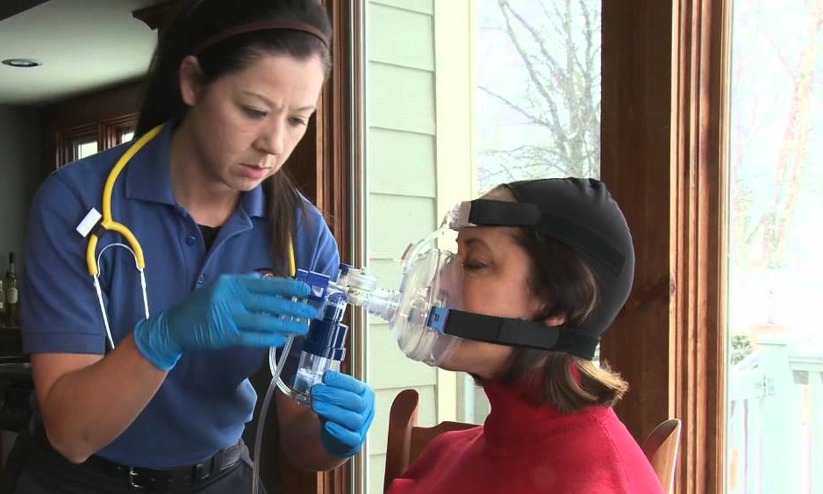
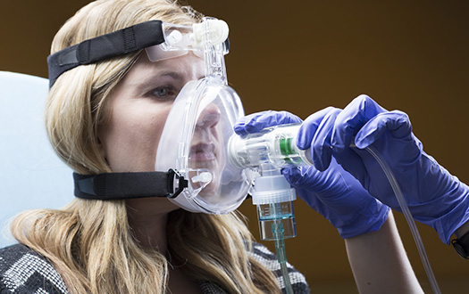
Nebulization Delivery Devices
CPAP
Use oxygen setting recommended by CPAP manufacturer
Works by being connected in-line or attached to the mask directly
EMS1.com
EMS1.com
Boundtree
Notes:
When a CPAP mask is used, ensure the CPAP is adjusted and being supplied by the oxygen flow rate per manufacturer recommendations. Often a manufacturer has specific in-line nebulizer attachments for their specific CPAP model. The medication cup may be attached directly to the CPAP mask (typically without the T-connector) or in-line by using the T-connector in the CPAP supply tubing. In cases of in-line attachment, it is important to make sure the medication cup stays upright to prevent spilling of the liquid medication.

Slide 14
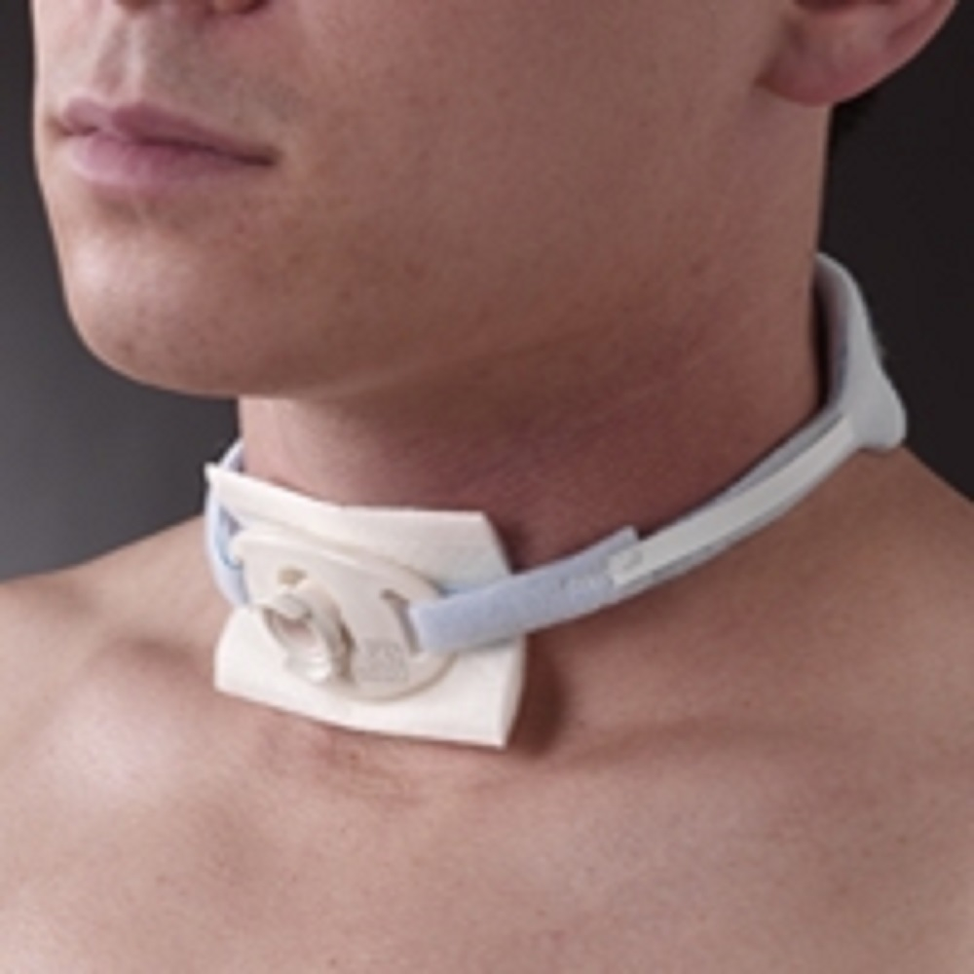
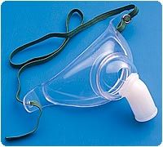
Nebulization Delivery Devices
Tracheostomy
Use oxygen setting recommended by manufacturer
Works by being connected in-line or attached to the mask directly
Uses a trach mask to fit over the neck and deliver medication directly into the tracheostomy opening.
Tracheostomy
Trach mask
Notes:
Trach nebulization requires specific equipment, and can be used to nebulize medications, such as ipratropium bromide, or saline to loosen secretions to assist with suctioning.

Slide 15
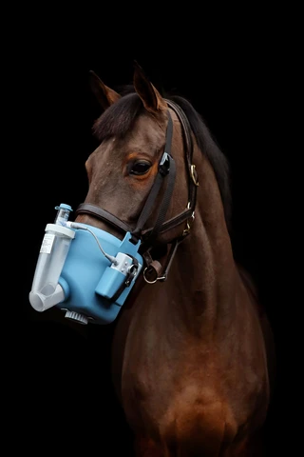
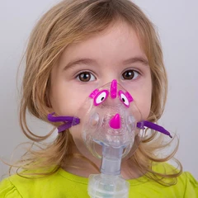
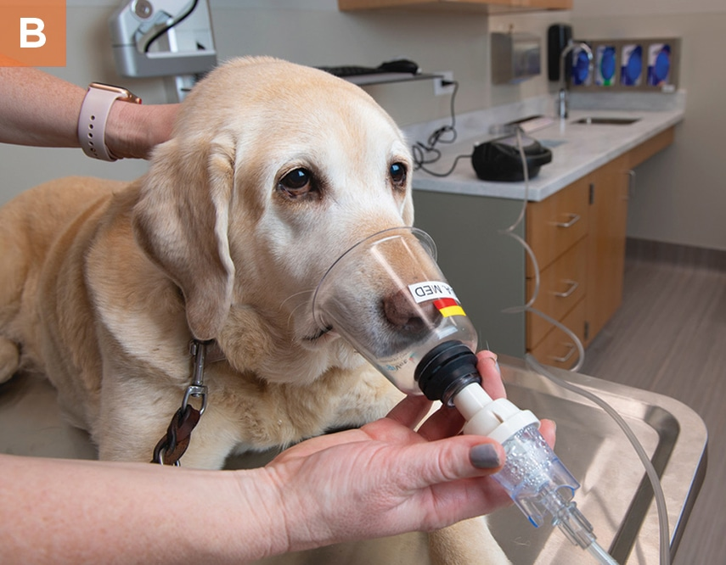
Nebulization Delivery Devices
Alternate Devices
Specific applications - follow manufacturer guidelines
Notes:
A variety of other delivery devices exist. These are specific to situations and focus mainly on the pediatric population. Specific attachments also exist for patients with tracheostomies. Providers may also see or use them if part of K9 response teams and for other animals. Follow manufacturer instructions for usage.

Slide 16
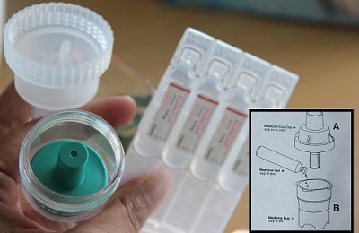
Nebulization Delivery Hints
Keep the nebulizer cup upright.
Coach the patient to take deep breaths to allow medication to penetrate deep into lung tissue.
As medication volume decreases, tap/flick sides of medication cup to break up droplets on side of cup.
Before adding additional medication to the medication cup, ensure the gas source is shut off.
Notes:
Encourage patient to breath deeply and fully.

Slide 17
Nebulization Disadvantages
Nebulization creates a great deal of exhaled respiratory droplets that can carry infectious diseases. Providers should wear proper PPE, including masks and eye protection
Ensure the patient compartment is well ventilated.
Notes:
PPE is of great importance, especially given pandemic. Other options of care (such as metered dose inhalers (MDIs) may be more appropriate to prevent aerosol spread.

Slide 18
What Can be Given By Nebulization?
Many medications are given by nebulization, including:
Albuterol
Ipratropium Bromide
Racemic Epinephrine
Saline
Not all are within the scope of the EMT
Notes:
Other license levels and hospitals may nebulize a variety of meds. EMTs have a more limited scope.

Slide 19
What about Maine?
Effective December 1, 2021, EMTs in Maine will be able to:
Administer the mixed medication Ipratropium Bromide/Albuterol
This is only this mixed medication and not albuterol by itself
Via hand-held, mask, BVM, or CPAP
Administer nebulized saline
Loosen secretions if suctioning a tracheostomy

Slide 20
Medication Rights
Right to Refuse
Patients with decision-making capacity can refuse some, or all, treatments (consider use of OLMC)
Right Reason
Is this medication clinically indicated?
Right Patient
Confirm name and date of birth
Notes:
Remember to explain what the medication is and why you are giving it so the patient can make an informed decision. Although EMS typically does not have to manage more than 1 patient at a time, it is important for documentation and tracking to ensure you have the correct demographics and patient if more than one is present.

Slide 21
Medication Rights
Right Medication
Is this medication within protocol and scope of practice?
Be cautious – some medications look/sound similar
Ensure it is not expired or cloudy/contaminated
Correct concentration
Notes:
A slide on medication cross check is a deeper dive into this in a few slides

Slide 22
Medication Rights
Right Time
Frequency of administration
Right Route
How is this medication supposed to be administered (IM, orally, nebulized, etc.)
Right Check
For any allergies or contraindications to the medication
Notes:
Ensure of dosing frequency (every 5 min, every hour, or whatever is called for). Ensure the medication is being administered the right way (e.g. nitro can be given sublingually, topically or IV, bu the formulation is very different for all three methods)
Even if you have assessed for allergies early in the assessment, this is a safety double check.

Slide 23
Medication Cross Check
Many medications can look and sound very similar but have very different effects
Be safe – use a cross check to help avoid errors
Have partner read and confirm the medication for correct
Medication Name
Concentration
Expiration Date

Slide 24
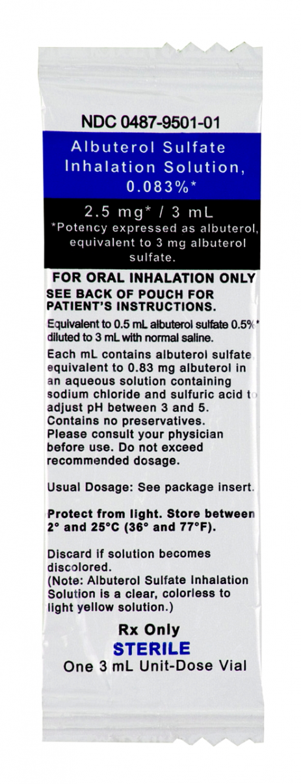
Medication Cross Check
Albuterol vs.
Ipratropium Bromide vs. Tobramycin
Albuterol vs.
Ipratropium Bromide vs.T obramycin
Notes:
Note the similarities of both outer and inner packaging f these medications. It is easy in emergencies and the EMS environment to mistake one for the other. Always cross check to ensure you give the right medication.

Slide 25
What is Ipratropium Bromide/Albuterol?
Also known as DuoNeb or Combivent
Are not separate medications – they are mixed and pre-packaged together
Ipratropium Bromide is an anticholinergic
Reduces spasms of the smooth muscles and decreases mucous production

Slide 26
What is Ipratropium Bromide/Albuterol?
Albuterol is a β2 agonist, meaning it is a Bronchodilator
Stimulates the release of norepinephrine to relax smooth muscles in the lungs and open (dilate) the airways (bronchi)
Giving Albuterol & Ipratropium Bromide together increases bronchodilation and benefit
Has minimal cardiac effects or effect on blood pressure

Slide 27
When should I give it?
In 2021 Maine EMS protocols, found on Blue 7
Patient has signs and symptoms of respiratory distress
Bronchospasm / wheezing associated with:
Asthma
Chronic Bronchitis
COPD
Emphysema

Slide 29
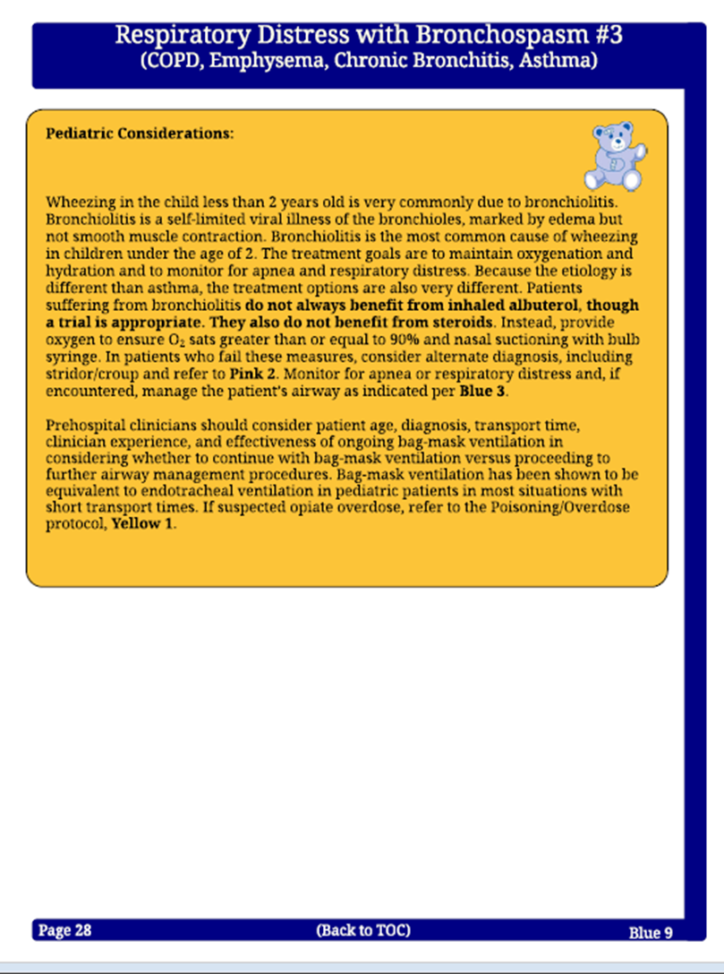
PEARLS

Slide 30
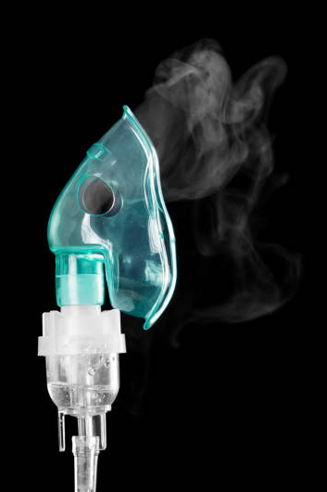
What are the adverse effects?
Tachycardia/palpitations
Tremors
Sore throat
Muscle cramps
Nausea/vomiting
Hypertension
Angina
Nervousness/anxiety
Dizziness
Headache
Sweating

Slide 31
Precautions
May cause severe bronchospasm from repeated, excessive use
Ask patient if they have already used their Metered Dose Inhaler (MDI) or nebulizer and how many doses they have self administered
Can still be administered but be mindful of increased chance of side effects, consider use of OLMC

Slide 32
Contraindications
Patients under 1 year of age
Contraindicated if patient has a known hypersensitivity
Ask patient or parent/guardian if they have ever had a reaction to Albuterol or Ipratropium Bromide
Patients with chronic lung/respiratory conditions will often know if they cannot take these medications

Slide 33
Dosage
Adult & Pediatric: Packaged in a pre-mixed “bullet” containing:
0.5mg Ipratropium Bromide, and
2.5 mg Albuterol
Pre-mixed into 2.5 ml saline.
Administered by nebulized aerosol connected to 6-8 lpm of oxygen; may repeat every 5 minutes for a total of 3 doses
Additional doses may be administered with OLMC
Notes:
Do not mix yourself or use one medication without the other

Slide 34
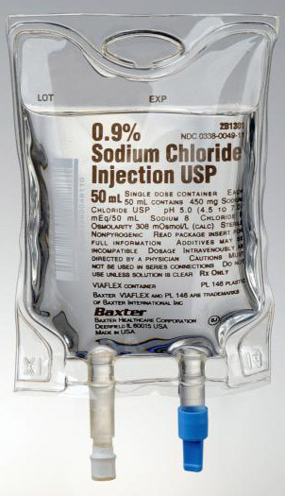
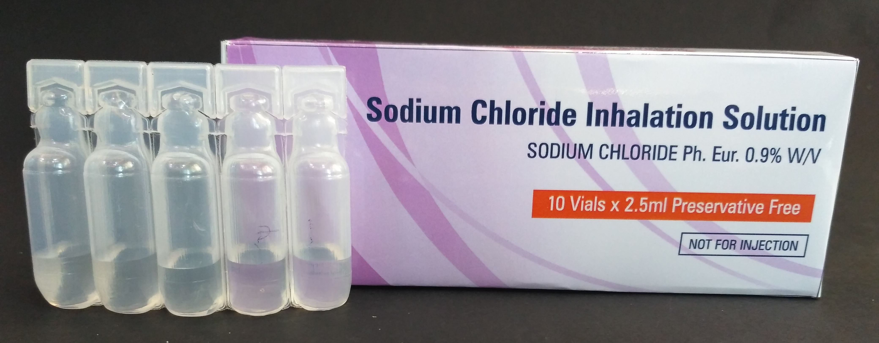
What is Nebulized Saline?
Is NOT the IV fluid or IV flush Normal Saline
Is NOT saline used to irrigate/flush wounds
Is saline designated for inhalation use, typically in a bullet
Notes:
Please ensure that EMTs do not use IV flushes, IV bags, or saline other than “for inhalation use”

Slide 35
When should I give it?
In 2021 Maine EMS protocols, found on Blue 15
Patient with an established tracheostomy has signs and symptoms of respiratory distress or failure
Suction is ineffective and thick secretions are noted
3mL Saline into medication cup and nebulized to help loosen secretions

Slide 36
Assessment
Perform a thorough patient assessment prior to administration of nebulized medication, including:
Physical assessment
Vital Signs
Lung Sounds
Pulse Oximetry
Ensure you request or have ALS enroute. Remember, the hospital may be your closest ALS – do not delay transport to wait for ALS.

Slide 37
Assessment
It is extremely important to re-assess your patient after treatment for changes and continuation of appropriate care
Is the medication actually reaching the patient’s lungs?
Is there improvement in vital signs?
Is there improvement in patient lung sounds?
Is there improvement in chest expansion volume?
Is there improvement in patient’s ability to speak?
Is there NO improvement?
Does the patient continue to deteriorate?

Slide 38
Documentation
Providers must document the clinical indications for using nebulized ipratropium bromide/albuterol or saline
Document device used (hand-held, mask, etc.)
Document number of doses, time of administration, and any effects/changes in patient condition

Slide 39
Skills
Proper use of nebulizers (of any type) MUST be paired with skills-based training.
Assembling and using a nebulizer requires a practical skills session allowing EMTs to assemble the various devices and practice delivery of nebulized medication.
Taking this course alone is NOT adequate to complete your education in nebulizer use.
Please attend an in-person skills session through your service or region to help ensure competency.
Skill sheets are available on the Maine EMS website under the “Protocols” tab

Slide 40
Thank You! This completes the 2021 Maine EMS Nebulizer Presentation

