Slide 1
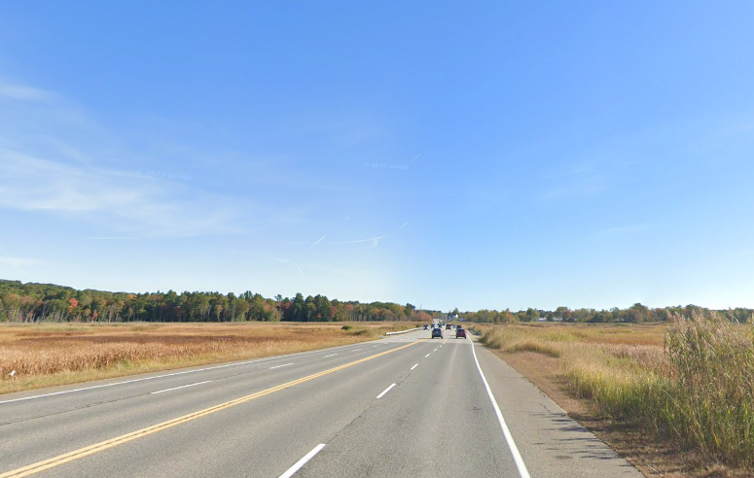

ROUTE 1 SCARBOROUGH MARSH
Ernie Martin
Project Manager, MaineDOT
Paul Pottle P.E.
Project Manager, Stantec
25657.00

Slide 2
Presenters
Ernie Martin- Project Manager, MaineDOT
Paul Pottle- Project Manager, Stantec
Curtis Thompson- Transportation Engineer, MaineDOT
Dakota Hewlett- Active Transportation Planner, MaineDOT

Slide 3
Agenda
Project Existing Conditions/Purpose
Proposed Design Overview
Pilot Demonstration Project Overview
Traffic Modeling
Bicycle/Pedestrian Facilities
Schedule & Next Steps
Questions and Comments

Slide 4
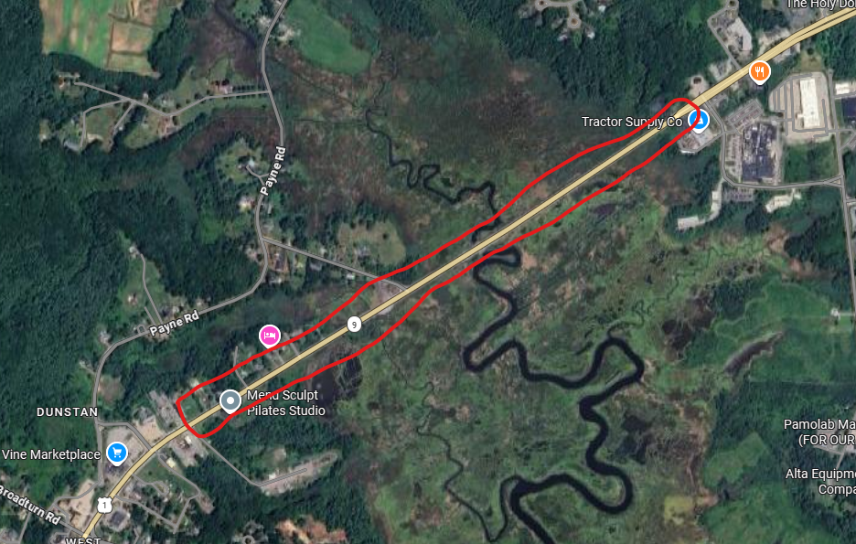
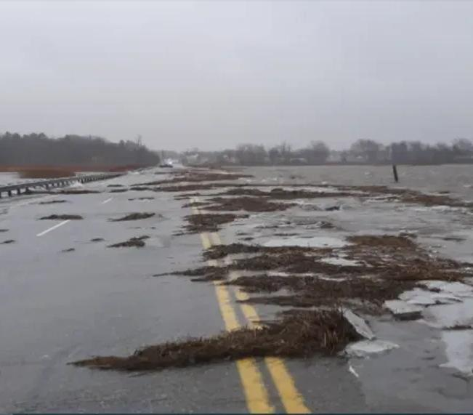
Project existing conditions
Project limits: 1 mile section of Route 1 between Dolloff Way and Southgate Road
Roadway elevations are between elevation 5 & 6 and are prone to flooding during major storm events

Slide 5
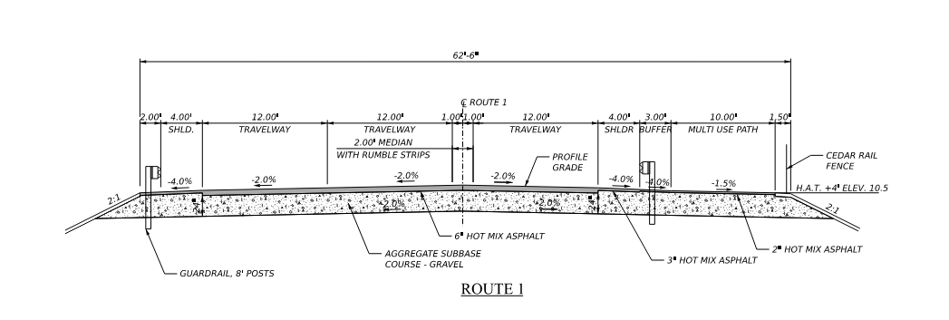
DESIGN OVERVIEW
Proposed Typical Section:
1 – 12’ Travelway lane Northbound
2 – 12’ Travelway lanes Southbound
10’ Multi-use path
4’ Shoulders
Roadway to be raised approximately 4’ to reach H.A.T. of 10.5 at the edge of the Multi-use path

Slide 6
Demonstration project overview
Goals & Purpose of project is to validate the proposed design under actual conditions. It will:
Compare modeled traffic performance with actual conditions
Identify potential issues such as congestions, safety concerns and driver confusion
Evaluate impacts to adjacent roadways and surround neighborhoods
Collect Measurable Data (travels times, delays, safety indicators)
Increase public understanding through demonstration.
What to expect during the Pilot Demonstration:
Temporary lane changes using striping, delineators, cones, and barriers
Advance warning through message boards
Temporary changes to traffic patterns
Traffic monitoring equipment in place
Roadway restored to existing configuration after the pilot

Slide 7
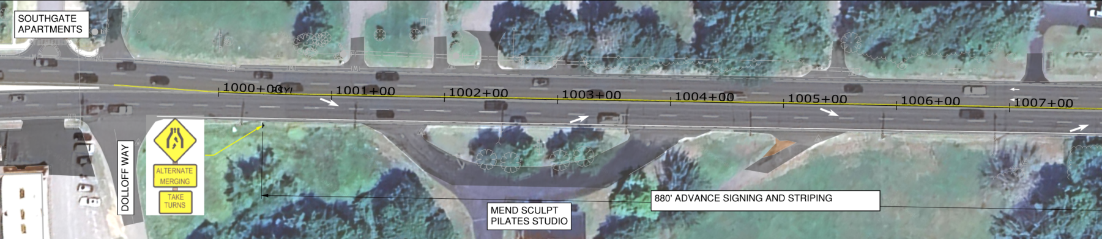
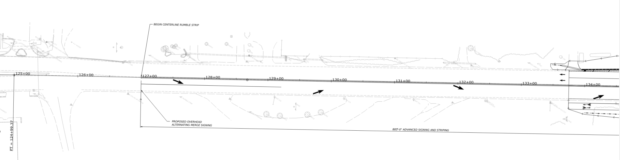

Slide 8
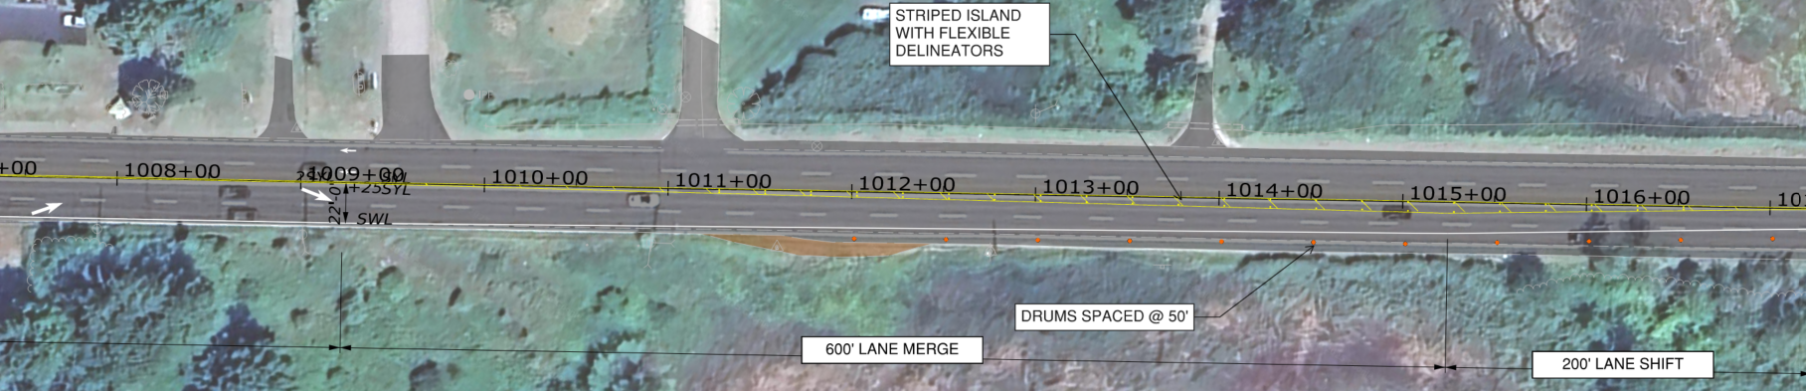
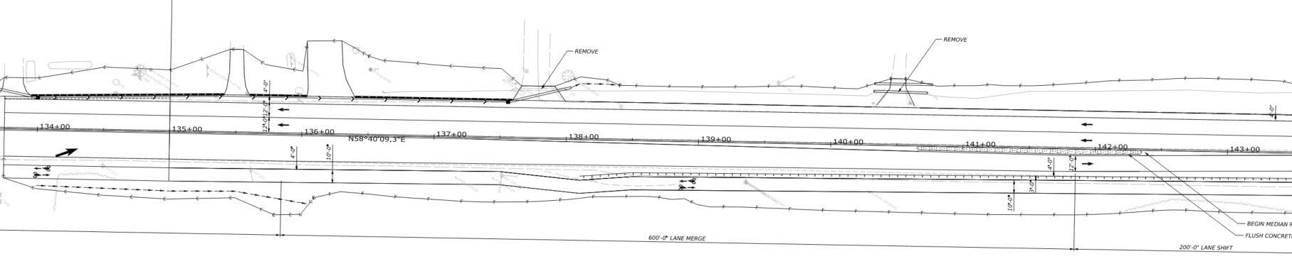

Slide 9
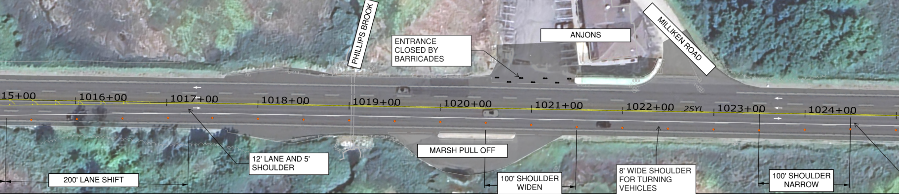
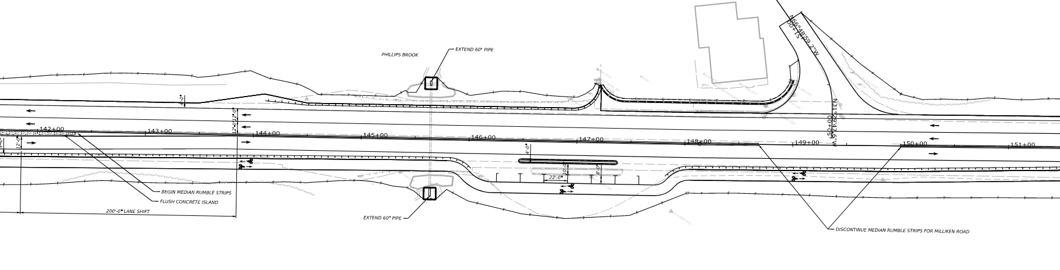

Slide 10
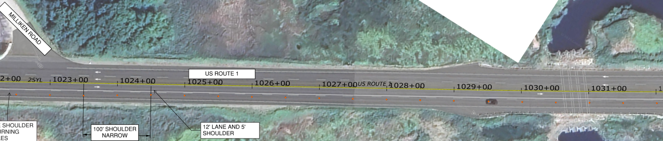
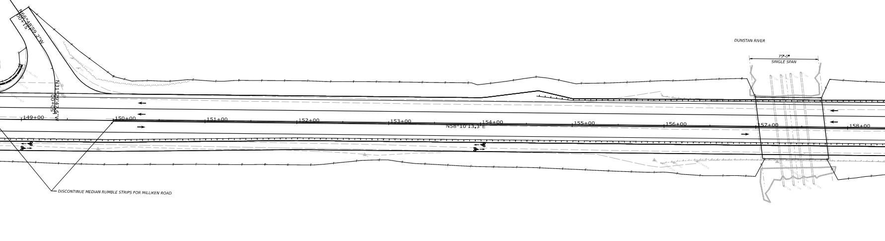

Slide 11
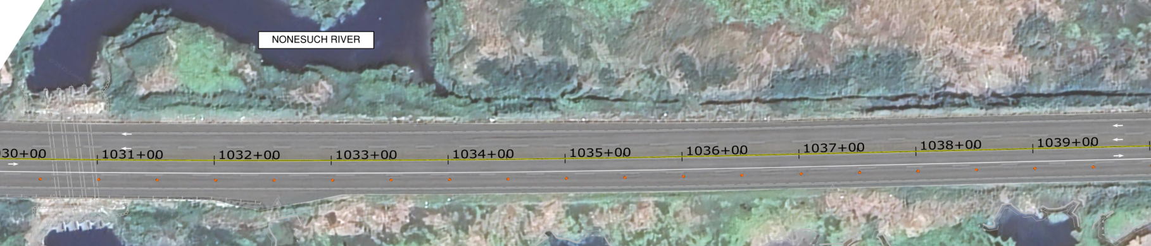
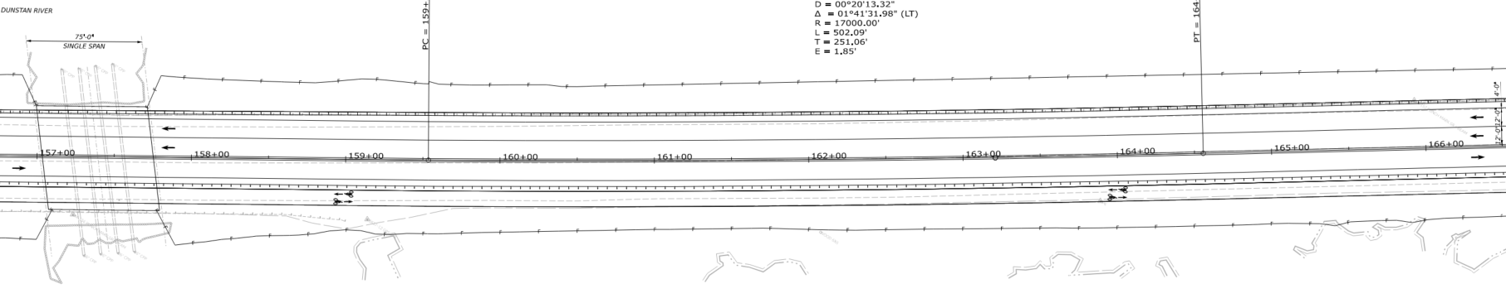

Slide 12
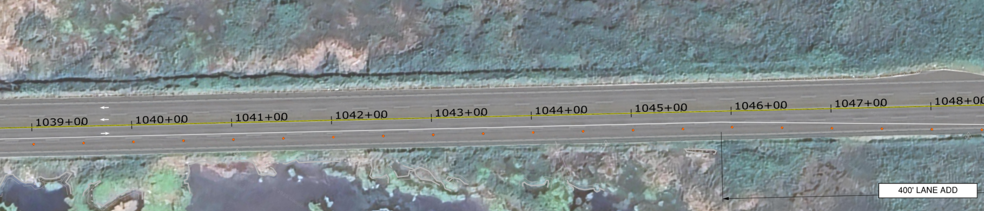
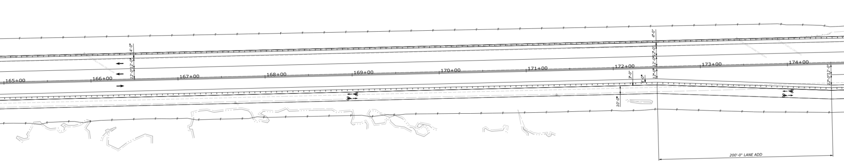

Slide 13
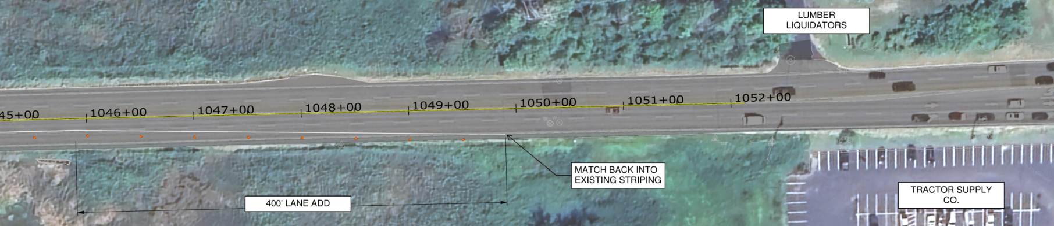
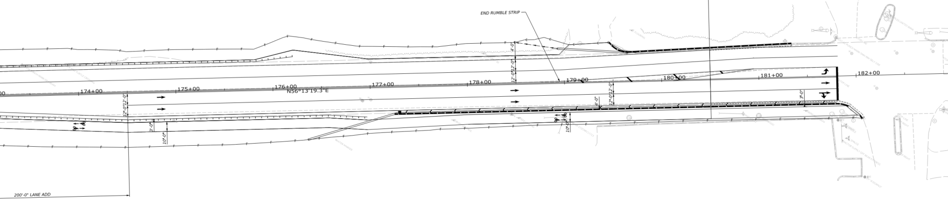

Slide 14
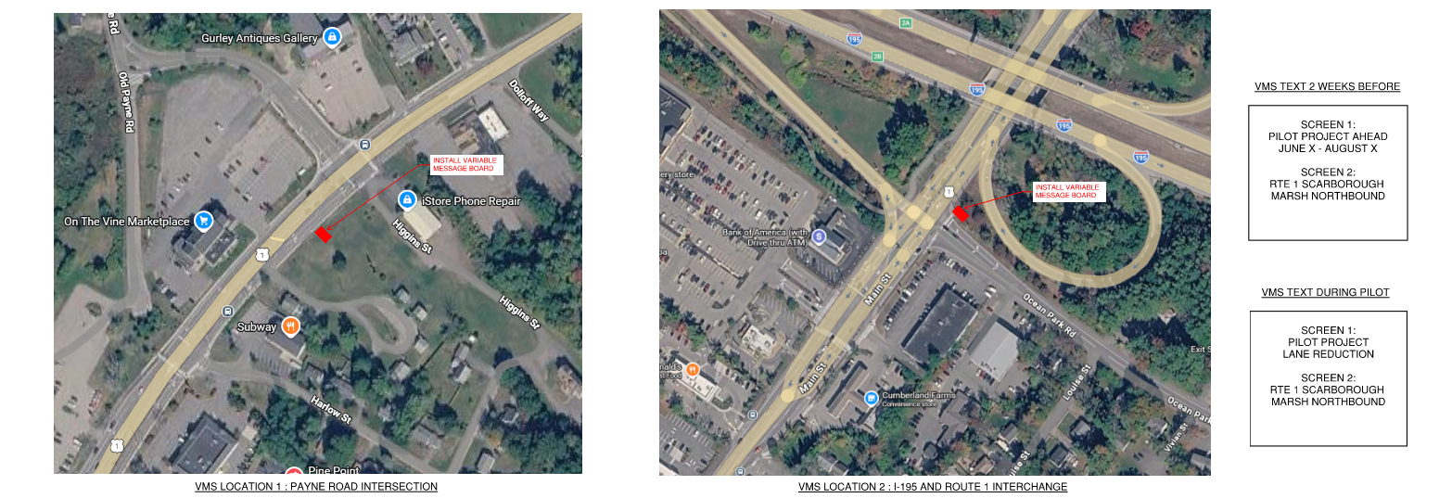
Advance warning sign LOCATION PLACEMENT

Slide 15
Traffic Modeling
Curtis Thompson- MaineDOT

Slide 16
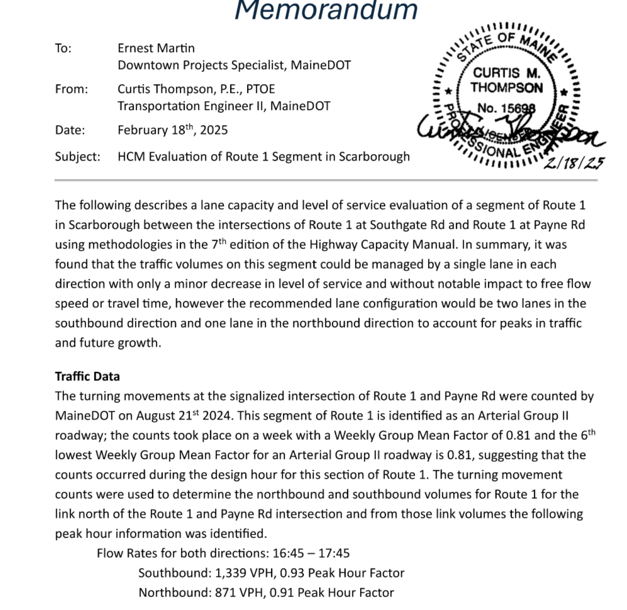
Traffic Evalution

Slide 17
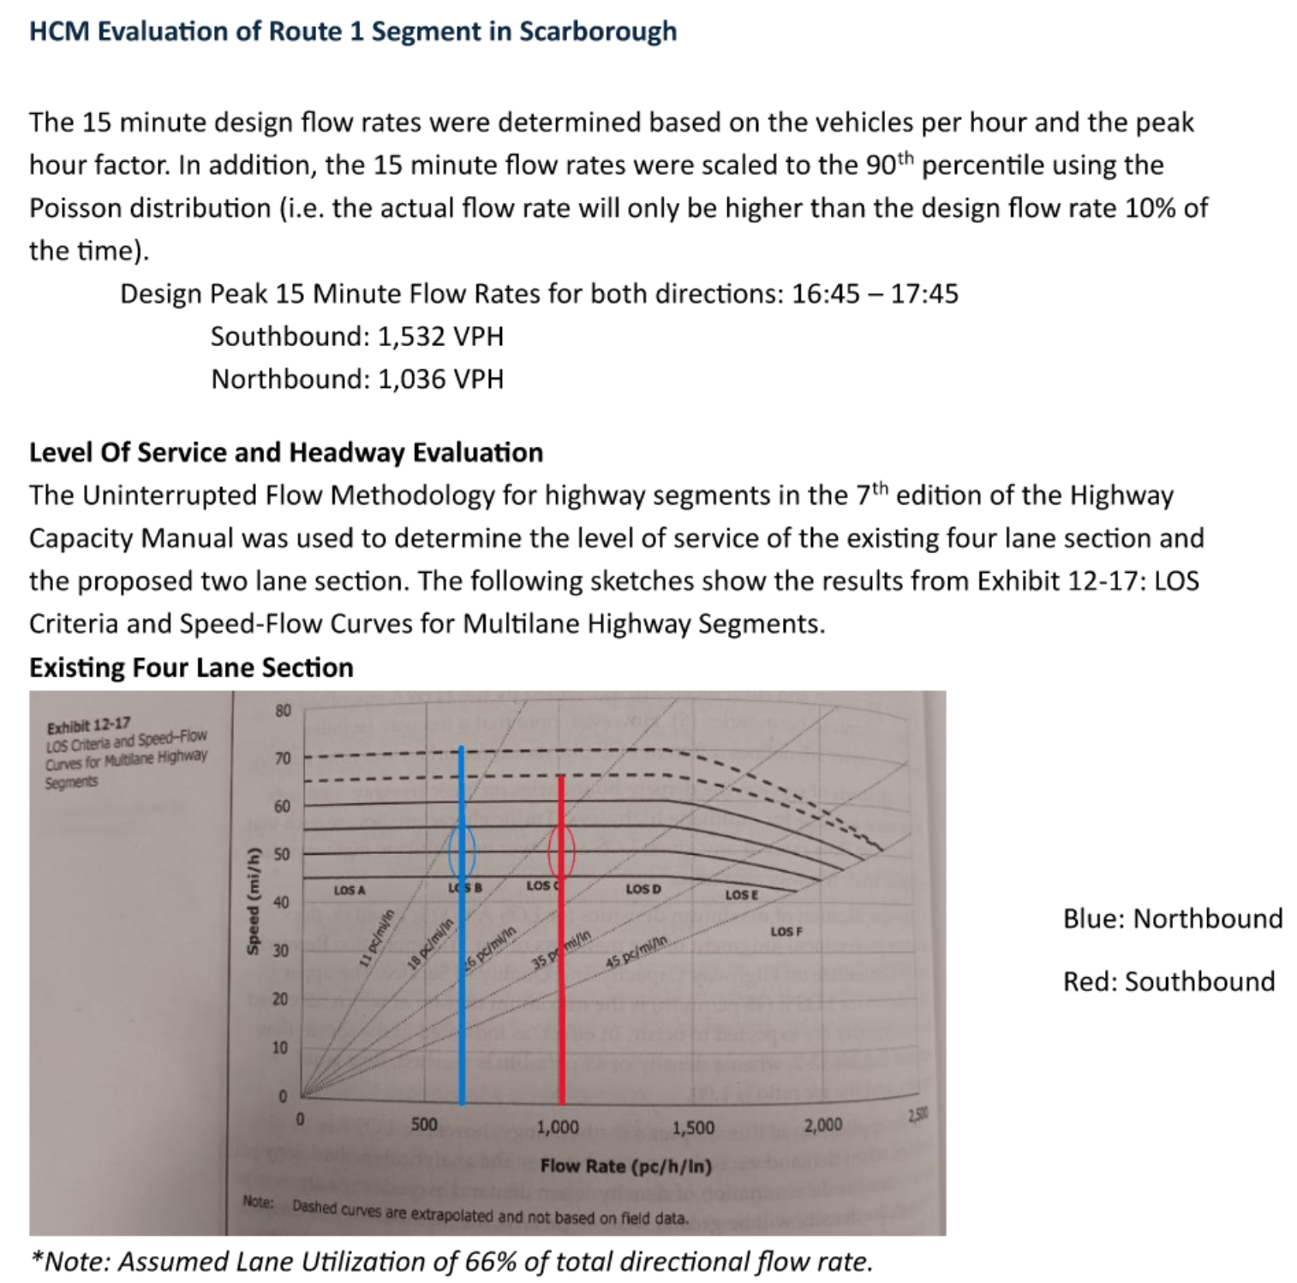
Traffic Evaluation

Slide 18
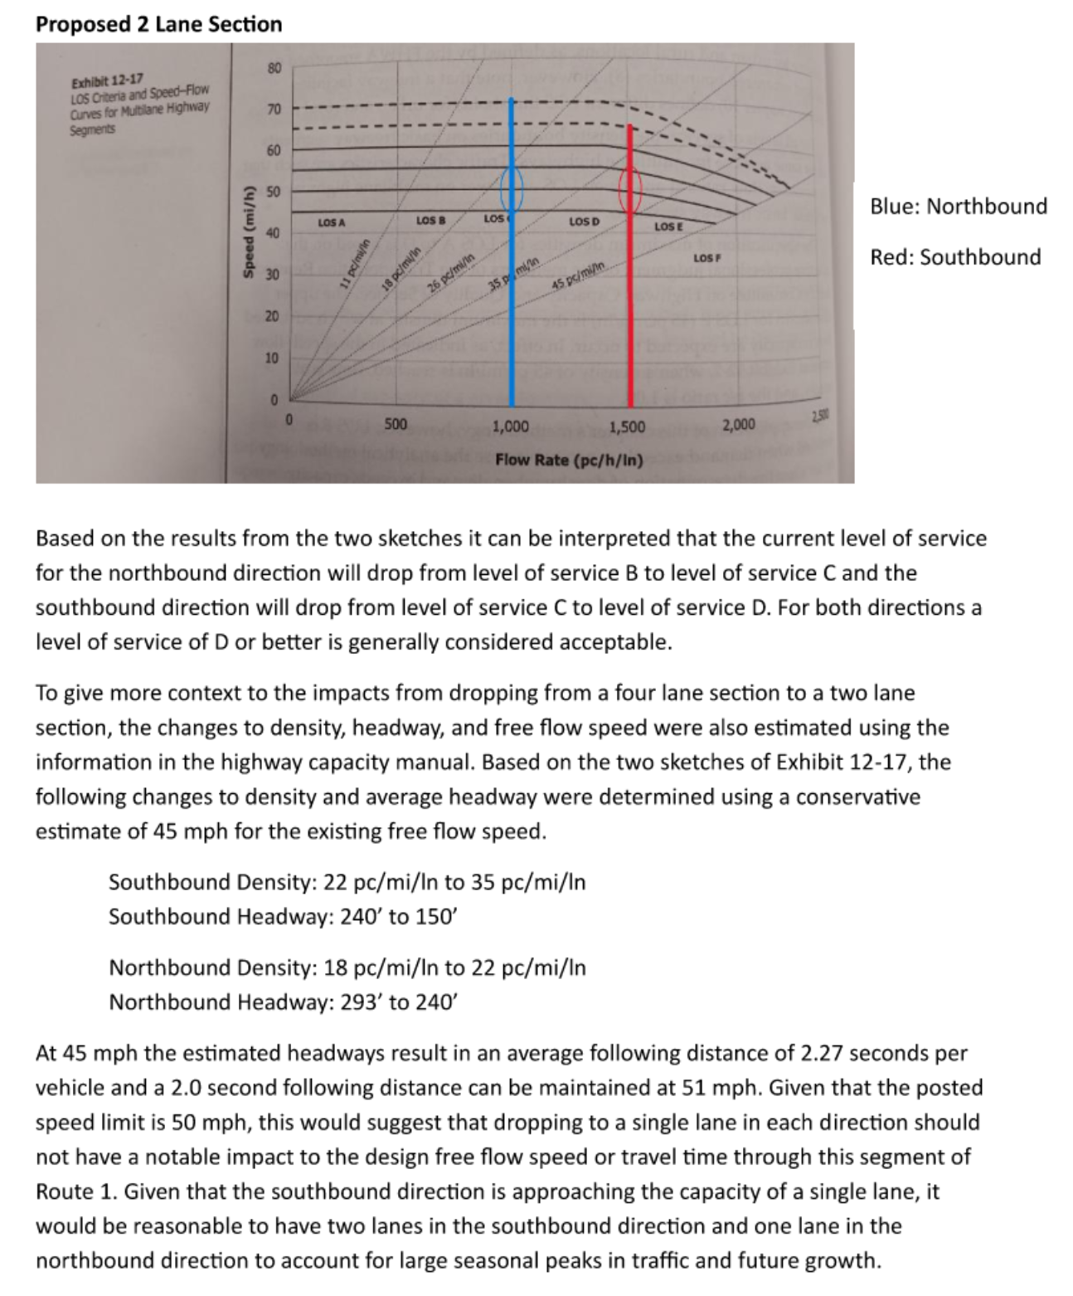
Traffic Evaluation

Slide 19
Bike/Ped Connectivity
Dakota Hewlett- MaineDOT

Slide 20
Project schedule
May 6th, 2026: Town Council workshop, 5:30pm
May 29, 2026: Pilot package complete
June 1, 2026:
Variable message boards installed
Public outreach begins (media, website, social media)
June 15, 2026: Temporary traffic pattern implemented
August 10, 2026: Roadway returned to existing configuration
Date TBD: Data review by MaineDOT and the Town of Scarborough

Slide 21
Council Questions & Answers

