Slide 2
Tom Sexton
Northeast Region Director
tom@railstotrails.org
Notes:
10 state region, 30 years, like working in NH with the NH Rail-trails. Next week 4 stops in NH and 9 total field meetings including MA and ME. I’m not deep in each state., nor should RTC be since there are now so many trail builders (includes volunteers).

Slide 3
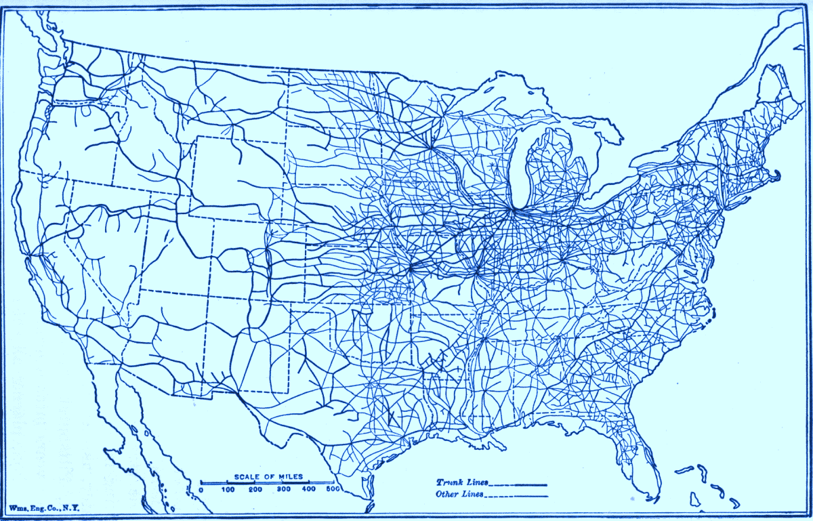
1916:
250,000+ miles
active railway
(Association of American Railroads)
Notes:
With time, automobiles became ubiquitous, leading to the demise of the railroads and America’s second transportation revolution.
With the decline of the railroad, thousands of miles of rail corridor were no longer needed.
1950 and 1960: railroads faced increasing competition from trucking companies. ICC regulations made it difficult for the railroads to compete.
1970: nearly a quarter of the nation’s 275,000 miles of railroad were being operated under bankruptcy
1980: Staggers Rail Act passed
Deregulated the railroads, made it much easier for railroads to abandon lines, allowing them to become much more competitive
Triggered a mass wave of abandonments: 4,000 – 8,000 miles per year
1983 Congress realized valuable resource being lost. Passed National Trails System Act Amendments which allowed federal government to regulate the disposition of soon-to-be abandoned railroad lines and established “railbanking.”

Slide 4
Rail-trail history in U.S.
Today:
140,000 miles
active railway
(Federal Railroad Administration)
Notes:
With time, automobiles became ubiquitous, leading to the demise of the railroads and America’s second transportation revolution.
With the decline of the railroad, thousands of miles of rail corridor were no longer needed.
1950 and 1960: railroads faced increasing competition from trucking companies. ICC regulations made it difficult for the railroads to compete.
1970: nearly a quarter of the nation’s 275,000 miles of railroad were being operated under bankruptcy
1980: Staggers Rail Act passed
Deregulated the railroads, made it much easier for railroads to abandon lines, allowing them to become much more competitive
Triggered a mass wave of abandonments: 4,000 – 8,000 miles per year
1983 Congress realized valuable resource being lost. Passed National Trails System Act Amendments which allowed federal government to regulate the disposition of soon-to-be abandoned railroad lines and established “railbanking.”

Slide 5
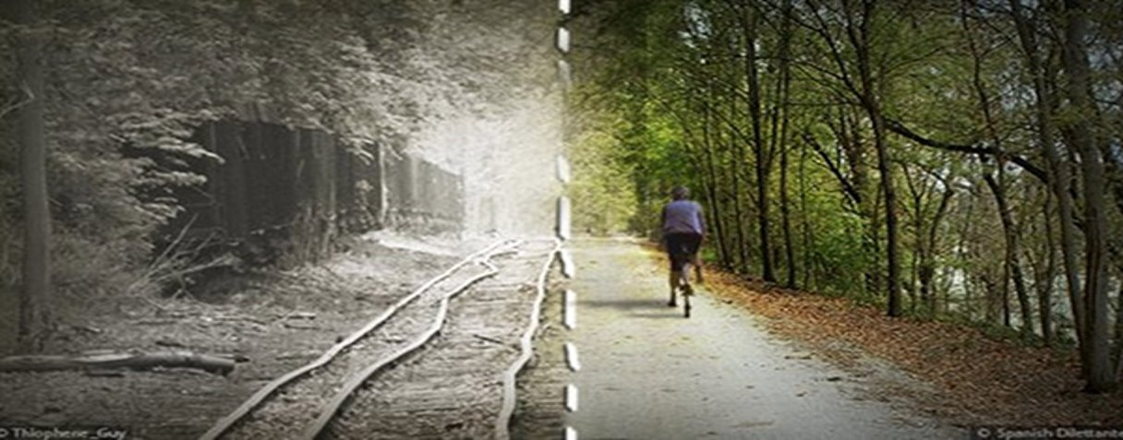
1986: 250 miles
2021: 24,000
Rail-Trail Miles
Notes:
Warner Rail Trail section at Bagley Field.
https://concordlakesunapeerailtrail.com/current-work-blog/page/4/

Slide 6
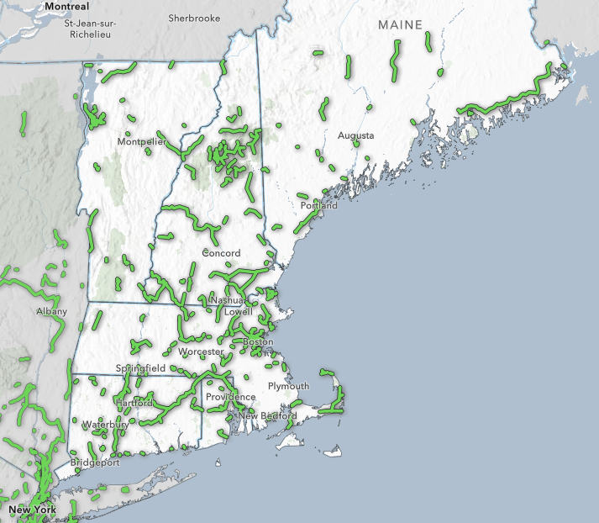
Multi-use trail
as seen on TrailLink™
Notes:
Every 4-5 years I hold a policy and trail Devo meeting with leaders from the Northeast. I asked for a regional system map. This is what we looked at 2 years ago when 20 of us got together at Cardigan Mt. - 2 Trail leaders from each state and 6 RTC staff. We’ve met a total of 4 times to fine tune and also agree on a detailed scope of work.

Slide 7
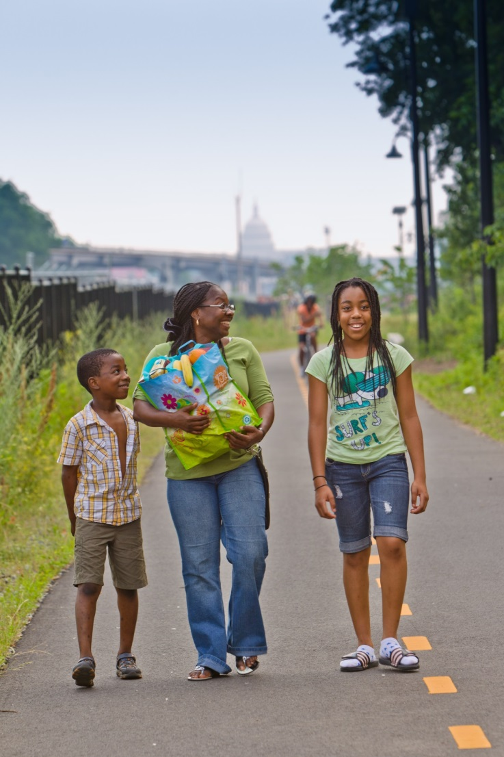
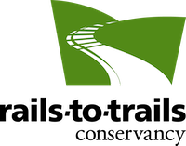
Rails-to-Trails Conservancy
We are building a nation connected by trails. We reimagine public spaces to create safe ways for everyone to walk, bike and be active outdoors.
Notes:
Emphasize RTC’s goal of corridor preservation (not “taking the railroads away”)

Slide 8
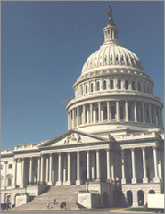
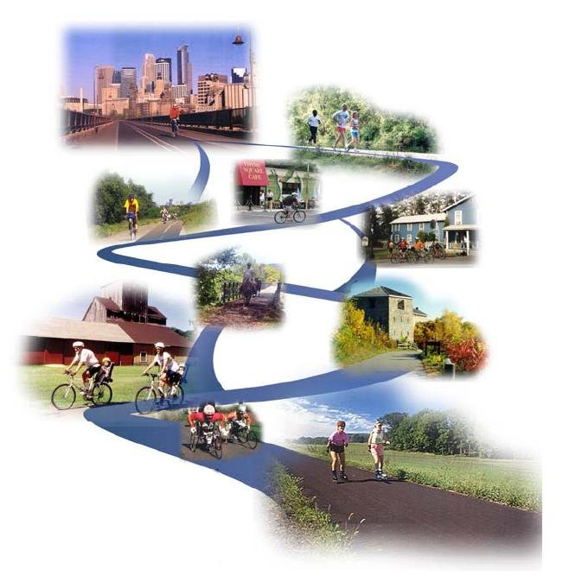
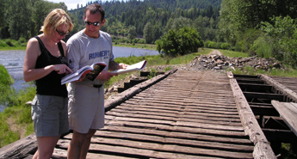
What does RTC do?
Notes:
Technical assistance (robust website) , TrailLink and policy work at fed level (some state capitols) to streamline programs, but mostly get funding. 48 people

Slide 9
RTC’s Resources
Trail-Building Toolbox
  •Resource Library
  • Webinars
  • Trail Blog and Magazine
TrailLink
Trail Expert Network
e-Newsletter
TEN Facebook Page
Early Warning System
Technical Assistance

Slide 10
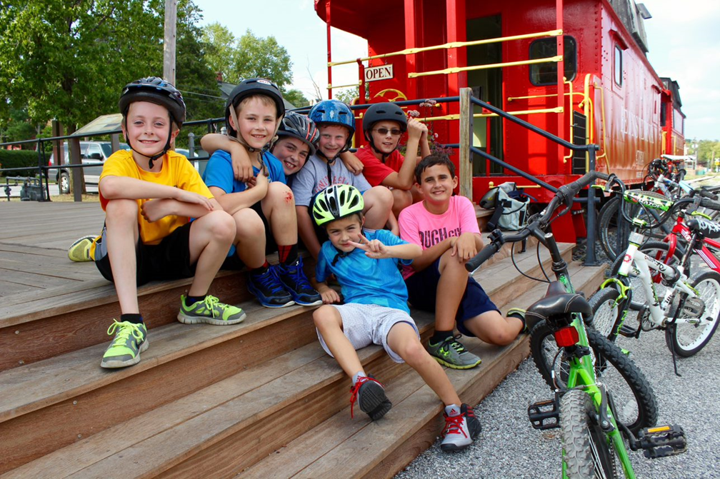
Building a New England Network
Goal is to unite the 6 states

Slide 11
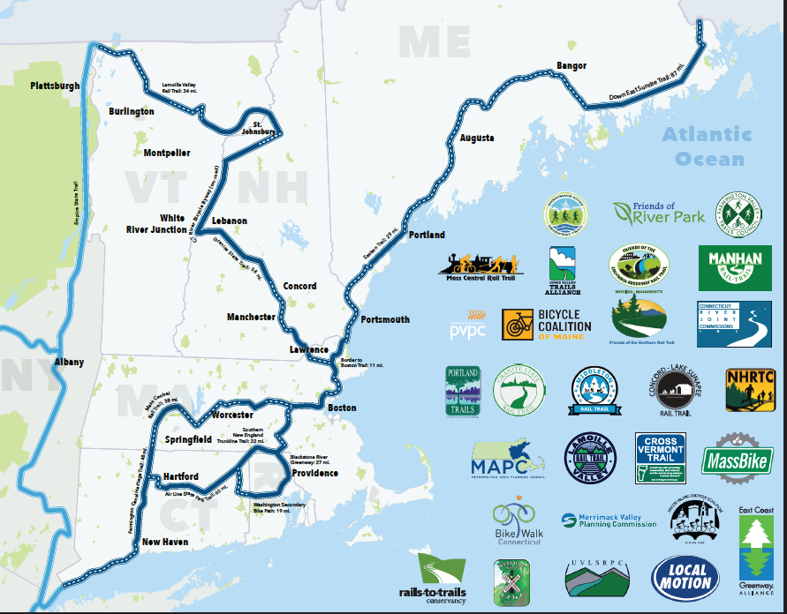
Notes:
This was the result of the collaboration of the 20 and others since then. Opportunities in NE and NH.
Challenges in NE and NH – not regional funders – bully pulpits,. Bring in potential funders. Key people. They help make you make decisions. Some weak state programs some stronger. Biz not a player.

Slide 12
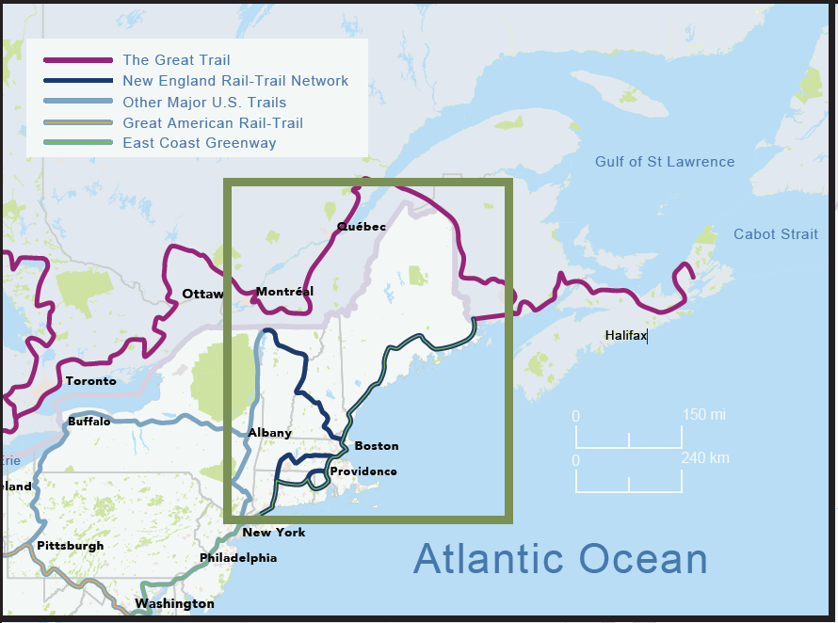
Notes:
So given all this, let’s see New Eng. first in a larger context of existing and other envisioned trails. You and NH are part of a larger region of 2300 miles major spines – half done. Detail legend – 5.
There are preformatted side styles that you can find under the “New Slide” dropdown menu. They are preformatted with text styles and positioning to offer consistent and clean layouts
Each slide has their own inverted color selection if needed
Instructions for formatting full-bleed image slides with the RTC frame are included in the notes section of the sample slides.

Slide 13
Trails are a good long-term investment
Don’t close or move away
Low Impact
Community-based
Preclude no one
Preserves railroad ROW and railroad heritage

Slide 14
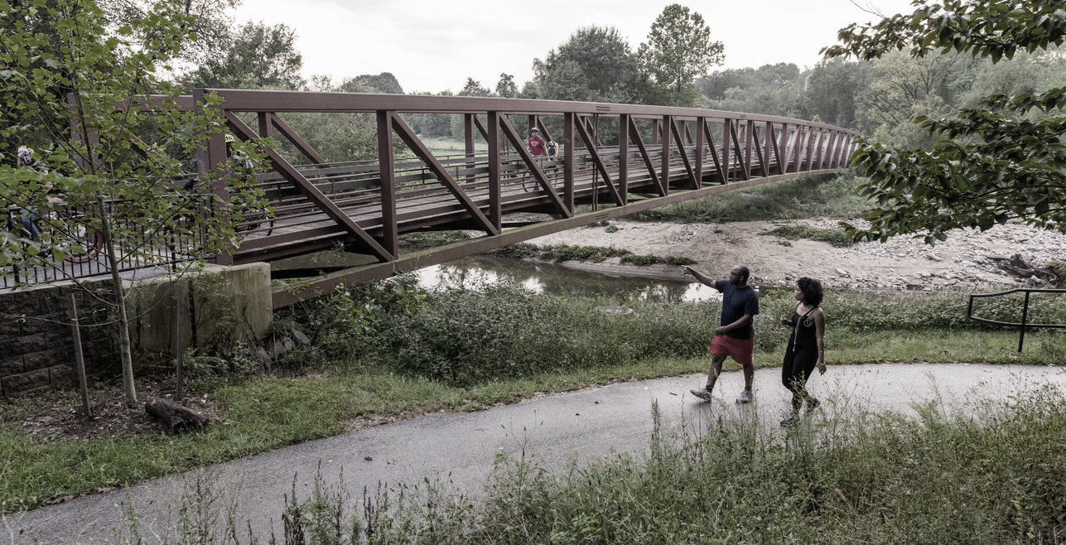
connectivity matters for the MT. Division Rail-Trail
When trail connections are made, usage increases by 40-80%
Notes:
Eric
Build upon the 20+ years of excellent work here in Bogota.
The pilot project will be a start but vision bringing it into the City to create the kind of connections that we know are transformative and even more impactful for everyone.

Slide 15
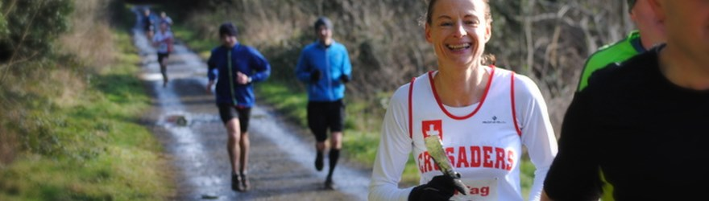
Trails & Trail Network Benefits
Health
Economic
Mobility
Sustainability
Notes:
The positive public association with trails can be an important opportunity for coalition building to achieve larger regional economic development goals.
Example: Industrial Heartland Trails Coalition
Better planning: planning trail networks and active transportation systems has the ability to pull multiple agencies such as economic development, health, planning and transportation together to create more holistic visions of sustainable regions.

Slide 16
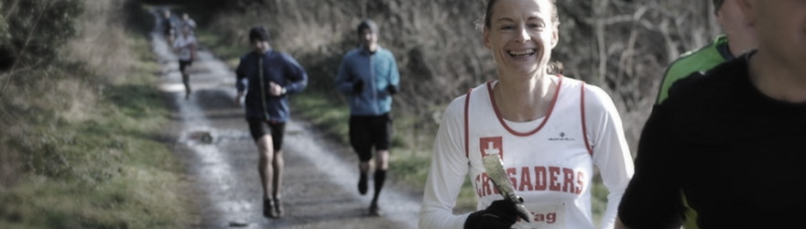
sustainability
U.S. Emission reduction savings from active transportation range from $1Billion to 3.7 Billion
Notes:
Average spending of $5–7 million along most multi-use trails.
The positive public association with trails can be an important opportunity for coalition building to achieve larger regional economic development goals.
Example: Industrial Heartland Trails Coalition
Better planning: planning trail networks and active transportation systems has the ability to pull multiple agencies such as economic development, health, planning and transportation together to create more holistic visions of sustainable regions.

Slide 17
savings from u.s. mode shift
mode shifting short car trips to walking and biking trips saves
$3.2 Billion
Notes:
Average spending of $5–7 million along most multi-use trails.
The positive public association with trails can be an important opportunity for coalition building to achieve larger regional economic development goals.
Example: Industrial Heartland Trails Coalition
Better planning: planning trail networks and active transportation systems has the ability to pull multiple agencies such as economic development, health, planning and transportation together to create more holistic visions of sustainable regions.

Slide 18
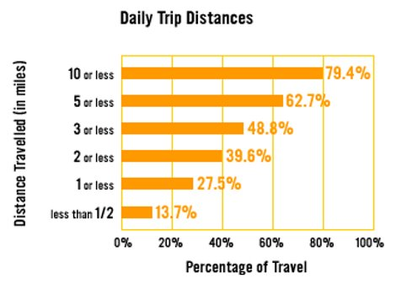
Many Trips can be made by Bicycle and foot

Slide 19
health
u.s. savings from increased physical activity due to walking/biking is $20 Billion
Notes:
The positive public association with trails can be an important opportunity for coalition building to achieve larger regional economic development goals.
Example: Industrial Heartland Trails Coalition
Better planning: planning trail networks and active transportation systems has the ability to pull multiple agencies such as economic development, health, planning and transportation together to create more holistic visions of sustainable regions.

Slide 20
OHIO & ERIE CANAL TOWPATH TRAIL
37 percent of trail users meet or exceed recommended weekly levels of physical activity
More than half use the trail for health and exercise (54 percent)
Health-care cost savings for trail users are as much as $4 million ($14–21 per user)

Slide 21
U.S. economic impact of multi-use trails
$10.6 billion
in local spending
(most conservative estimate)
from 2,128 multi-use trails
Notes:
Average spending of $5–7 million along most multi-use trails.
The positive public association with trails can be an important opportunity for coalition building to achieve larger regional economic development goals.
Example: Industrial Heartland Trails Coalition
Better planning: planning trail networks and active transportation systems has the ability to pull multiple agencies such as economic development, health, planning and transportation together to create more holistic visions of sustainable regions.

Slide 22
OHIO & ERIE CANAL TOWPATH TRAIL
$ Annual number of trail users: 222,0051
$ Spending on “hard goods” (including bikes, clothing, etc.): $3.7 million
$ Spending on “soft goods” (including food, beverages, etc.): $159,000
$ Spending on lodging: $3 Million

Slide 23
MON RIVER TRAIL SYSTEM ECONOMIC Impact
More than 205,000 people visit the trails annually
$6 million annually to the Morgantown, West Virginia, region
Trail users (20% from 17 states) spent about $230 per year on hard goods
Average tourists (50+ miles away) spend $316 per trip while staying in the area
Bicyclists spent more than non-bicyclists on lodging ($100 vs. $59)
  Soft goods ($15 vs. $10)

Slide 24
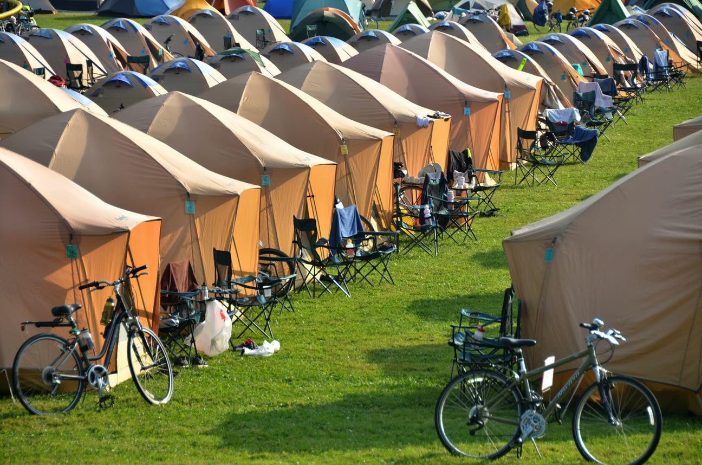
WEST VIRGINIA SOJOURNS
2015 - West Virginia Sojourn’s economic impact from 98 riders was $38,176
2016 - 130 people economic impact of more than $31,000
19 Sojourns with 5000 riders netted $2 million

Slide 25
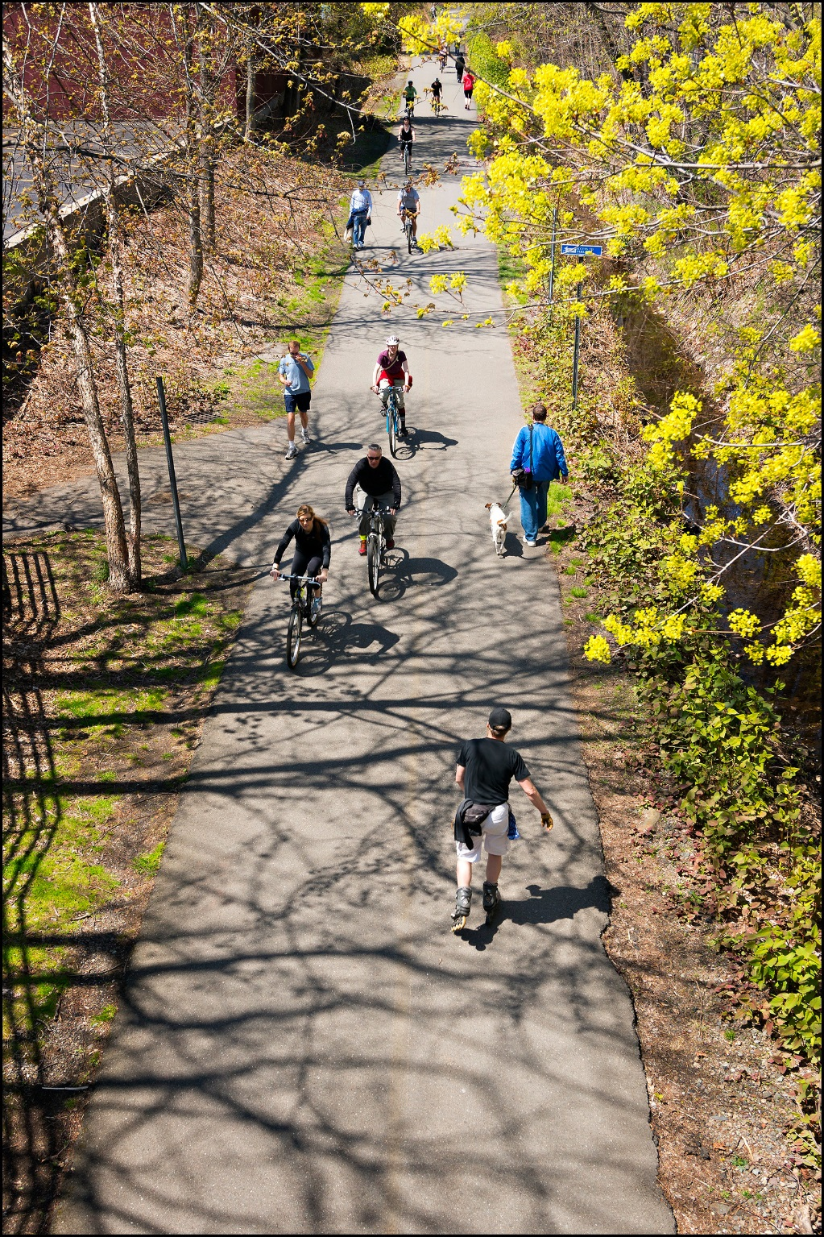
Trail Towns
Economic revitalization that places trails as the centerpiece of community revitalization.
Notes:
Bridge the Urban, suburban and rural threshold, this is the ultimate goal.

Slide 26
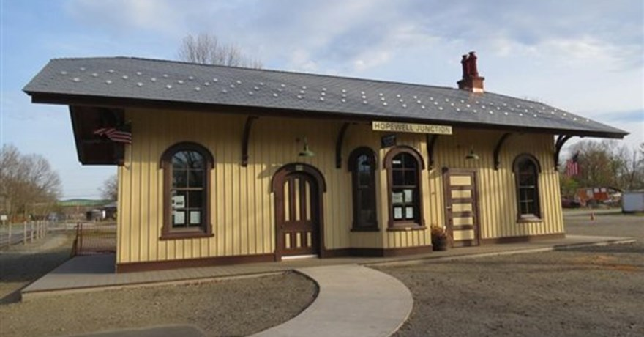
Coordinated network of services & amenities
Restaurants
Accommodations
Bike shops
Cultural and historic sites
Regional/national parks
Camp sites

Slide 27
Trails are a good long-term investment
They don’t close or move away
Low Impact
Community-based
Preclude no one
Preserves railroad ROW and railroad heritage

Slide 28
Tom Sexton
Northeast Region Director
tom@railstotrails.org
Notes:
10 state region, 30 years, like working in NH with the NH Rail-trails. Next week 4 stops in NH and 9 total field meetings including MA and ME. I’m not deep in each state., nor should RTC be since there are now so many trail builders (includes volunteers).

