Slide 1
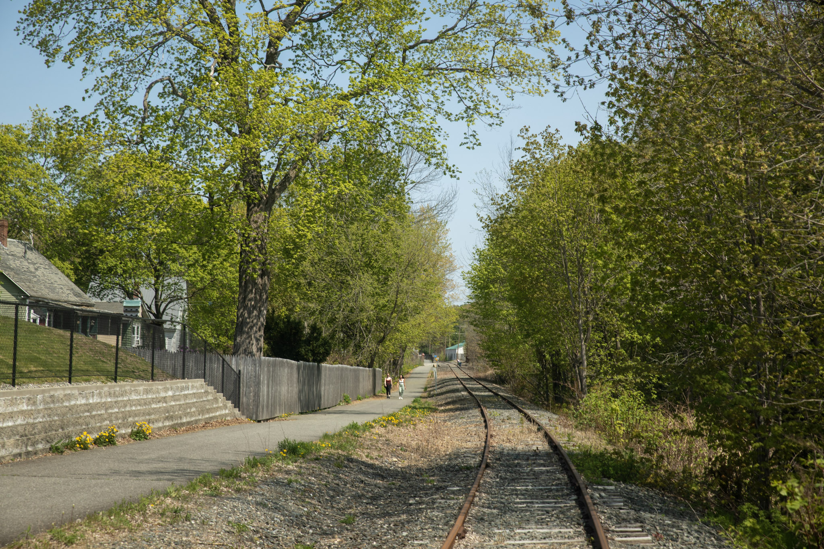
Lower Road
Rail Use Advisory Council (RUAC) public meeting MEETING
June 22, 6-7:30 pm
Photo courtesy of Keith Luke, 2023

Slide 2
What is a Rail Use Advisory Council?
A process established by the Legislature in 2021 for review of nonrail recreational or nonrecreational transportation use on state-owned rail corridors
      The council shall review and make recommendations on the likelihood, benefits and costs of potential uses of the rail corridor, including, but not limited to, rail use, trail use or bikeways.
MaineDOT may establish a RUAC upon petition by one or more governmental entities that represent communities along a state-owned rail corridor
Within 9 months, Council submits a recommendation regarding use of the corridor
        May include majority and minority reports
        Process will include 1 public meeting

Slide 3
What rail Corridor is under review?
State-owned Lower Road Rail Corridor
    Begin: MP 29.5 (Federal St., Brunswick)
    End: MP 63.0 (east end of rail bridge, Augusta)
    Midcoast Railservice operates first 1 mile in Brunswick
    Freight service concluded in late 1990s/early 2000s
Purchased by MaineDOT under the Rail Preservation Act in 1991
  Use of railroad line. The department may lease the railroad line, or otherwise contract for operation of the railroad line, to a railroad operator, or it may hold and manage the railroad line for future transportation use.

Slide 4
What uses will be considered?
Maintain and Preserve Existing Rail Corridor
    Continue to preserve rail for future use
Interim Trail until Rail
    Remove rail and convert to interim trail
Rail with Trail
    15’ trail offset from rail or 10.5’ with fence (design exception required)
Other considerations
    Motorized vs non motorized uses
    Maintenance responsibility

Slide 5
What are the next steps?
Finalize Rail Corridor Study
  End of December
Hold 2 additional council meetings
    June 28th, July 26th, August 30th
Develop recommendation for MaineDOT commissioner
  End of August
MaineDOT Commissioner may submit recommendation(s) (if applicable) for legislative review

Slide 6
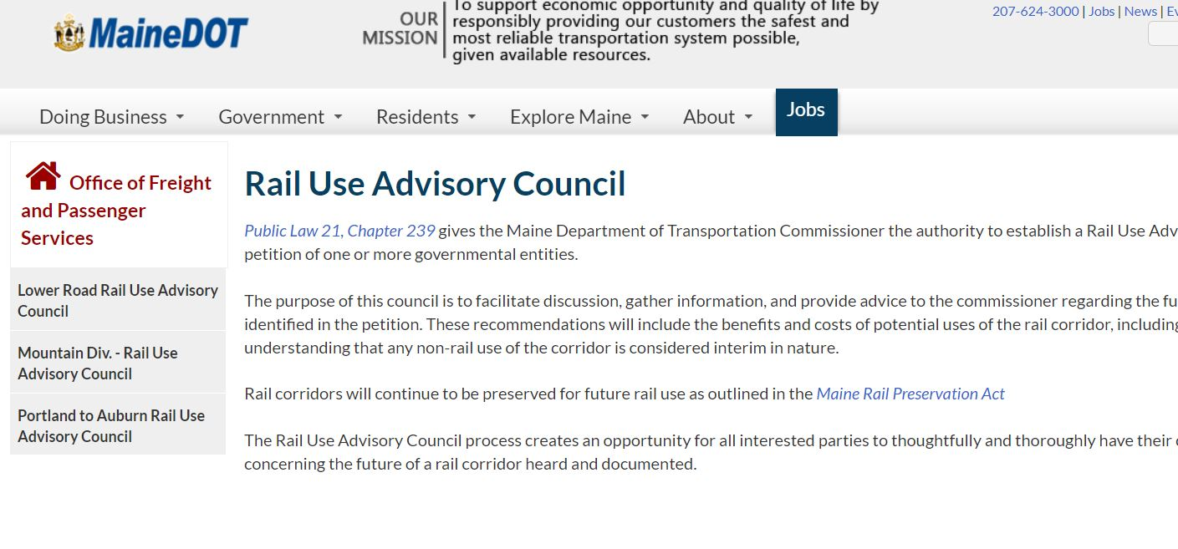
Where CAN I FIND MORE INFORMATION?
https://www.maine.gov/mdot/ofps/ruac/index.shtml
Web Search: “MaineDOT RUAC”

