Slide 1
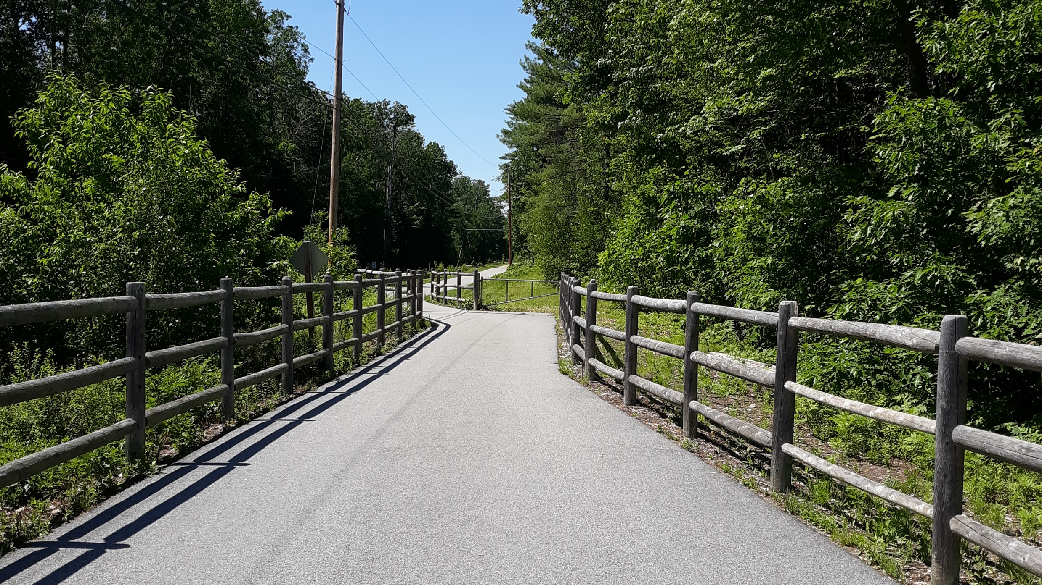

Additional Funding Sources for Bike Trails

Slide 2

Economic Development Administration
TRAVEL, TOURISM & OUTDOOR RECREATION
PROMOTING AMERICA’S TOURIST COMMUNITIES
Through the Travel, Tourism & Outdoor Recreation program, EDA is focused on accelerating the recovery of communities that rely on the travel, tourism and outdoor recreation sectors. $750 million of EDA’s American Rescue Plan funds are allocated to support the following efforts:
State Tourism Grants: $510 million in non-competitive awards to help states quickly invest in marketing, infrastructure, workforce and other projects to rejuvenate safe leisure, business and international travel.
Competitive Grants: $240 million to help communities that have been hardest hit by challenges facing the travel, tourism and outdoor recreation sectors to invest in infrastructure, workforce or other projects to support the recovery of the industry and economic resilience of the community in the future.

Slide 3
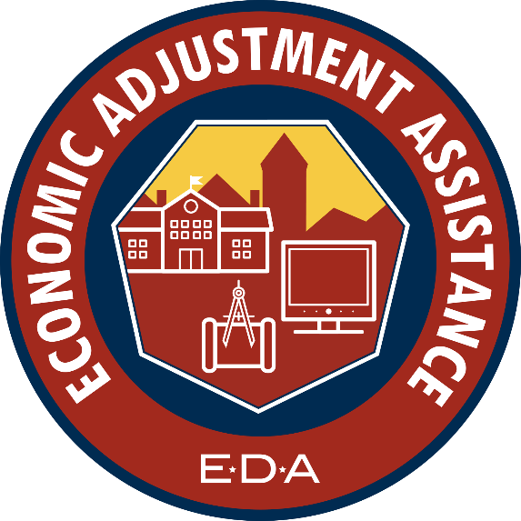
Economic Development Administration
ECONOMIC ADJUSTMENT ASSISTANCE
EDA’s American Rescue Plan Economic Adjustment Assistance program makes $500 million in Economic Adjustment Assistance grants available to American communities.
The Economic Adjustment Assistance program is EDA’s most flexible program, and grants made under this program will help hundreds of communities across the nation plan, build, innovate, and put people back to work through construction or non-construction projects designed to meet local needs.
A wide range of technical, planning, workforce development, entrepreneurship, and public works and infrastructure projects are eligible for funding under this program.
All EDA programs must show a job creation aspect to them.

Slide 4
Northern Border Regional Commission
Applicable to Oxford County (not Cumberland County)
Fryeburg currently applying for a link from Mtn Division Trail to their downtown
Funded two trail related projects in Maine in 2019 including a 9 mile bike trail in Millinocket. Also funded trail connections in other states over the years
Received significant increase in funding through ARPA
Governor and State DECD make determinations on which projects to move forward
NBRC also contributed to the town of Fryeburg’s Outdoor Recreation Economy Study last year

Slide 5
Congressional Earmarks
Recently reinstituted!
Eastern Trail is a recipient for design of a section of trail (approximately 600k)
Need to work with congressional delegation through their process
Mtn Division might be a good project because of the regional nature of the project, seems to have broad support and it also crosses two congressional district boundaries.

Slide 6
Brownfields Funding
Number of agencies receive or have funding (including SMPDC, GPCOG, AVCOG, Maine DEP) through EPA.
Use assessment money and clean up funding to assess and remove old ties and then cap the bed.
Not sure if it’s been used previously
SMPDC and others have extensive Brownfields experience and this might be a creative use of the funding.
EPA was very engaged and funded the Fryeburg Outdoor Rec Study of last year.

Slide 7
Bipartisan Infrastructure Law (BIL)
Transportation Alternatives Program (TAP)
Recreational Trails Program (set aside within TAP)
Congestion Mitigation and Air Quality (CMAQ) program
Carbon Reduction Program - new formula funded program
Active Transportation Infrastructure Investment Program - New competitive grant program for multi-jurisdictional projects that can also be used for planning and design

Slide 8

TIF Funding through towns

Slide 9
Private Donations/Fundraising

