Slide 1
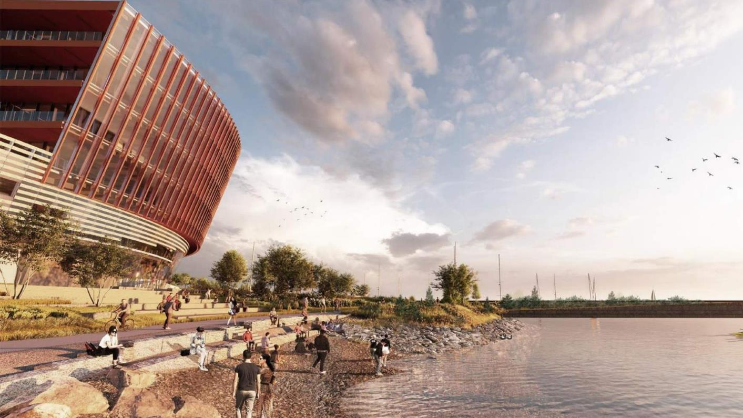
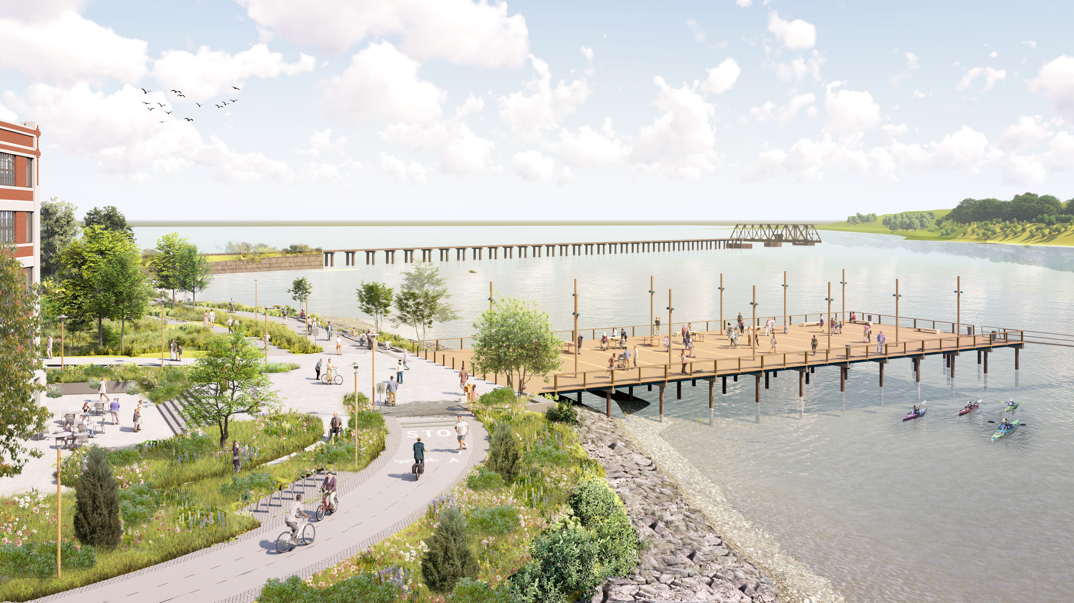
East Deering pathways to bridge the gap project TECHNICAL PRESENTATION
Component #1- Early Action Project
Public Meeting
WIN 028940.10
April 2025

Slide 2
background
2024 – MaineDOT and the Initiative for Digital Engineering and Life Sciences (IDEALS) applied for a Rebuilding American Infrastructure with Sustainability and Equity (RAISE) GRANT to create connections, improve safety, and facilitate access for the multimodal traffic in and around the future campus of the Roux Institute at Northeastern University.
The design for several project elements within the Pathways to Bridge the Gap RAISE Grant was started by IDEALS during the Northeastern University Campus Site Development.
These project elements, and other new components, will now be constructed under the Pathways to Bridge the Gap RAISE Grant as a series of MaineDOT Construction Projects.

Slide 3
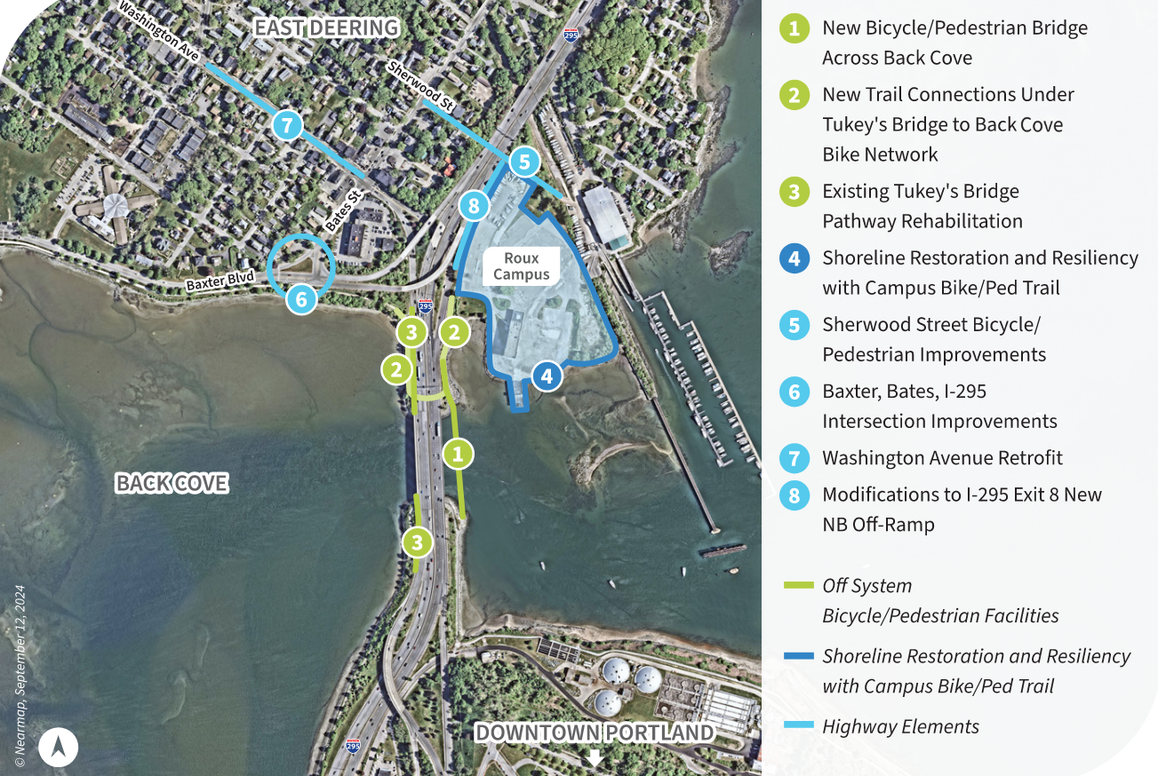
components
There are 8 separate elements that will be included in this RAISE Grant.
There are 3 off system Bike/Ped Facilities Elements, 1 Shoreline Restoration and Resiliency w/Campus Path Element, and 4 Highway Elements
Element 8, Modifications to Exit 8 – New NB Off Ramp, is the only element without a multimodal aspect, but the New Campus Path will be within the Ramp Right of Way where it runs adjacent.
Campus Site

Slide 4
Components
There are 8 total Elements that will be combined into 3 separate Components. These Components will each be their own separate construction project under the RAISE Grant.
1 Grant → 3 Components (Construction Projects) → 8 Elements

Slide 5
components

Slide 6
Early action projects
The rest of this presentation will focus on Component #1 - Early Action Projects, which will consist of the following 3 Elements:
Shoreline Stabilization
Harden costal shoreline around campus path
Increases climate change resiliency
New Coastal Path
Coastal pathway bordering shoreline and campus perimeter
Connects shared-use bridge, Back Cove Path and Sherwood Street to shoreline, campus and bus stop
Sherwood Street Improvements
Between Veranda Street and Bean Pot Drive
Shared-Use path and sidewalk additions
MaineDOT will release subsequent presentations that will focus on Components #2 & #3 later, as those components progress.

Slide 7
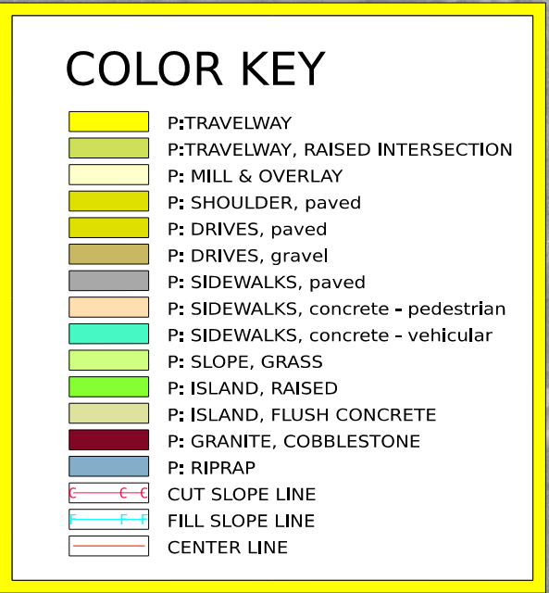
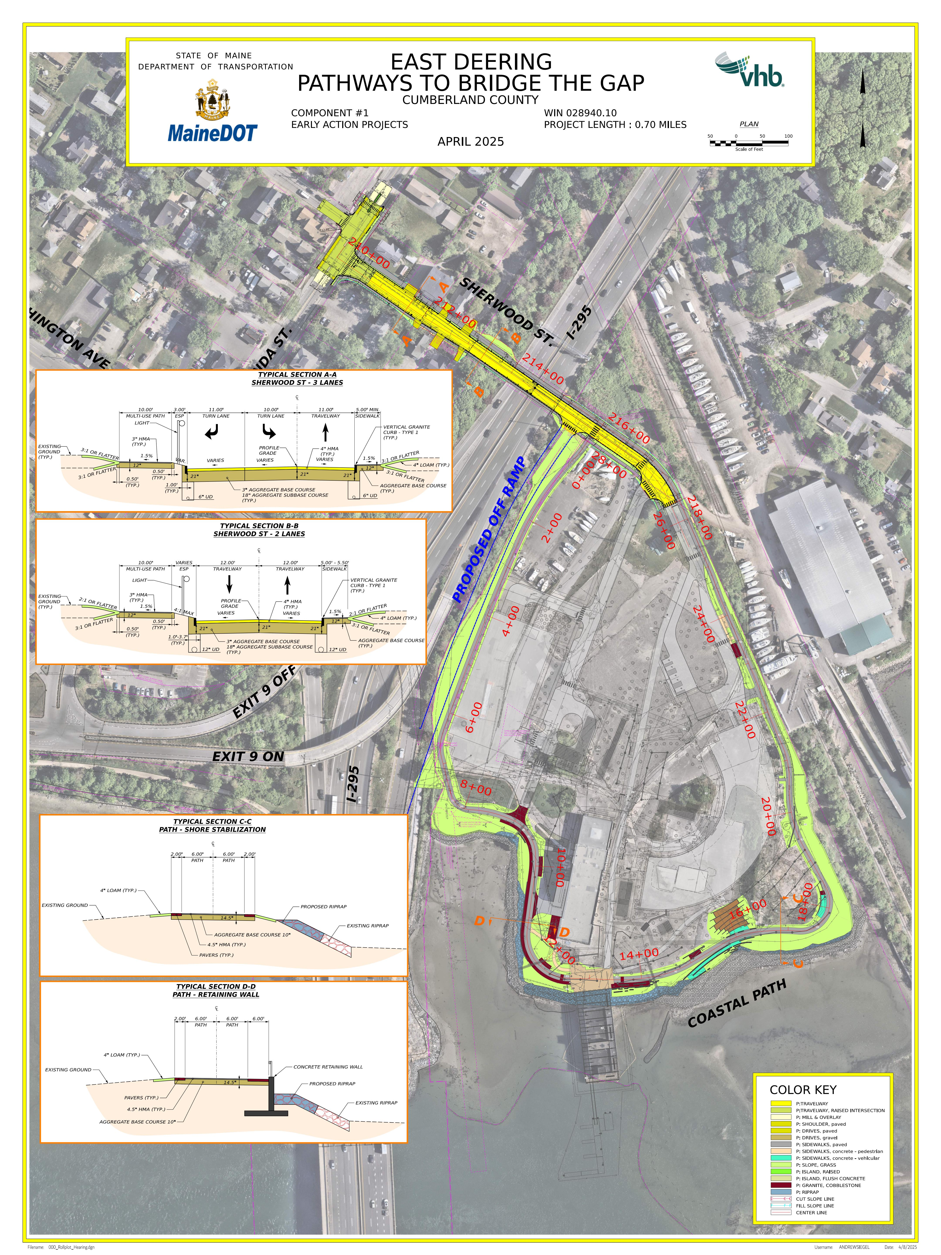
Hearing Plan
A copy of this hearing plan may be downloaded as a PDF from a link included on this website.
A color key is included in the bottom right of this Hearing Plan. “P:” denotes proposed work.

Slide 8
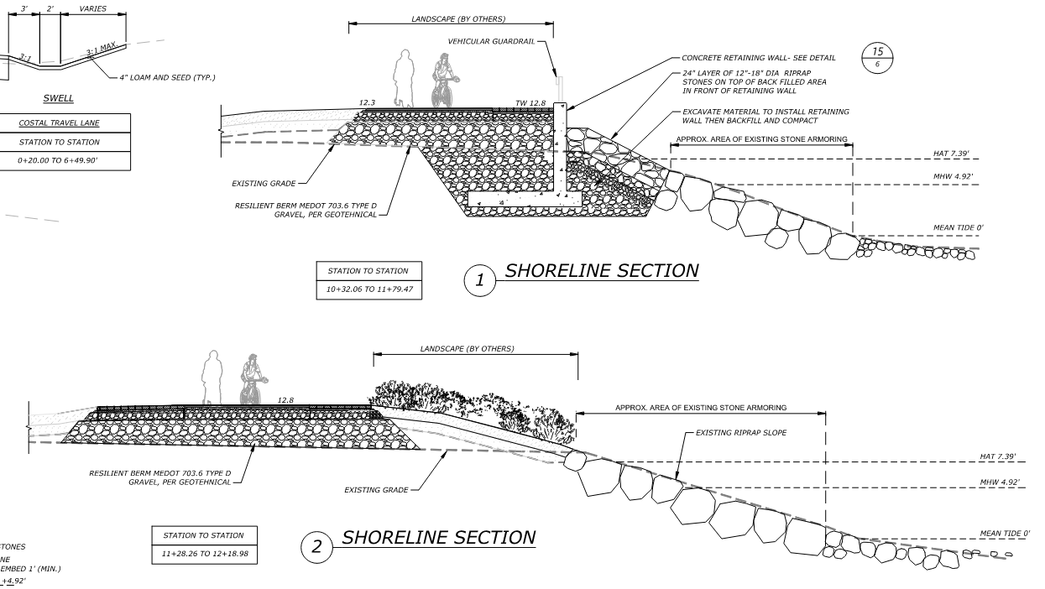
Shoreline Stabilization
Shoreline Stabilization will consist of utilizing existing riprap stone armoring, raising the elevation of the path in some locations, installing retaining walls in select locations, and adding landscape and more riprap stone armoring.

Slide 9
Shoreline Stabilization
Areas shown in BLUE on the outside of the PATH will receive new riprap armoring.
Areas shown in GREEN on the outside of the PATH will receive landscape treatments.
Retaining Wall
Limits of Shoreline Stabilization
in Component #1

Slide 10
New coastal Path
Coastal Path
The Coastal Path will be a new 12’ wide pedestrian facility around the perimeter of the campus.
Surface type of the path varies between pavement, concrete, pavers, and cobblestone.
This portion also includes additional improvements such as lighting, landscaping, hardscaping, and a new metro bus stop.
Note that some features shown inside the path and outside the limits of this project are not yet in place and will be constructed as part of the campus construction, separate from this MaineDOT project.

Slide 11
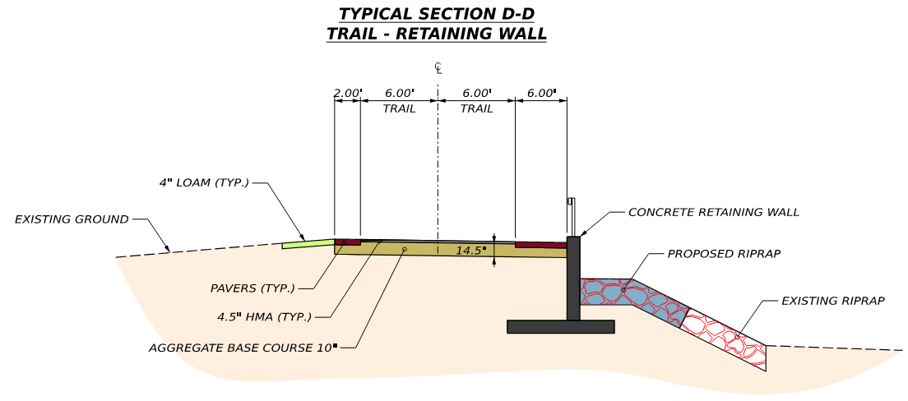
New coastal PATH – First half
N
PIER PLAZA
This portion of the path will start at Sherwood St and end at the Pier Plaza in the lower left
The path from STA 0+00 to 6+00 will be inside the future off-ramp right of way.
This section will be paved except for the pier plaza, which will be granite pavers, and other areas shown in MAROON will be granite cobblestone.

Slide 12
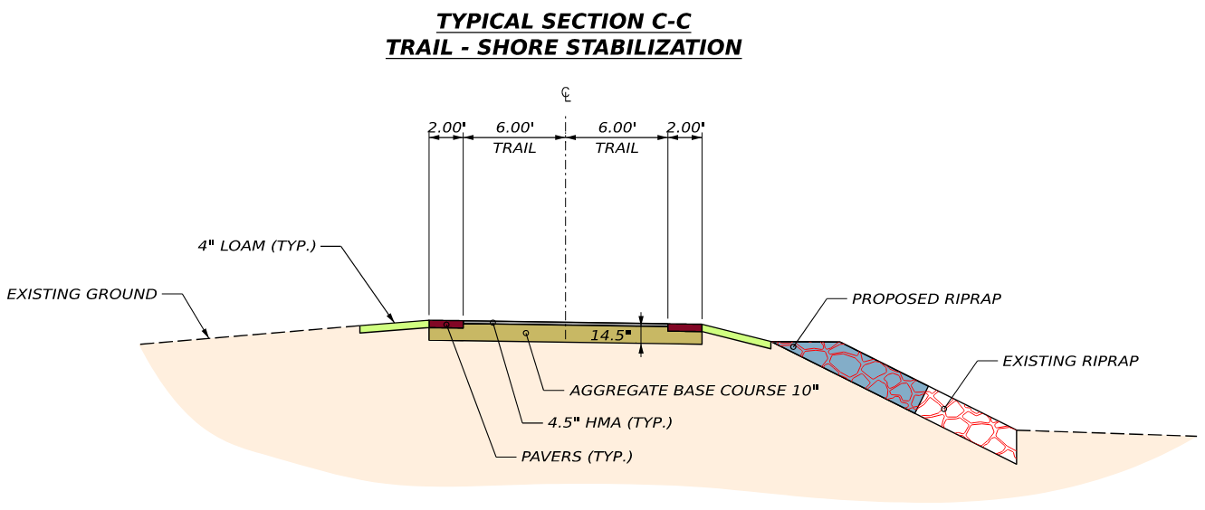
New coastal PATH – second half
N
This portion of the path will start at the Pier Plaza just off screen in the upper left and will extend to where it matches into the path that will be include in the Sherwood Street Element.
Areas shown in MAROON will be granite cobblestone and the terraced wood seating area is shown in BROWN near STA 16+00. From STA 22+00 to the I-295 bridge the path will be concrete.

Slide 13
New coastal PATH
There will be two new walls constructed along the path. In the bottom left the wall shown in RED will be constructed as part of this project. The wall shown in ORANGE in the upper right will be constructed ahead of time as part of the campus construction. This will need to be done to allow for the construction of the new Alfond Center Building ahead of the MaineDOT Project.

Slide 14
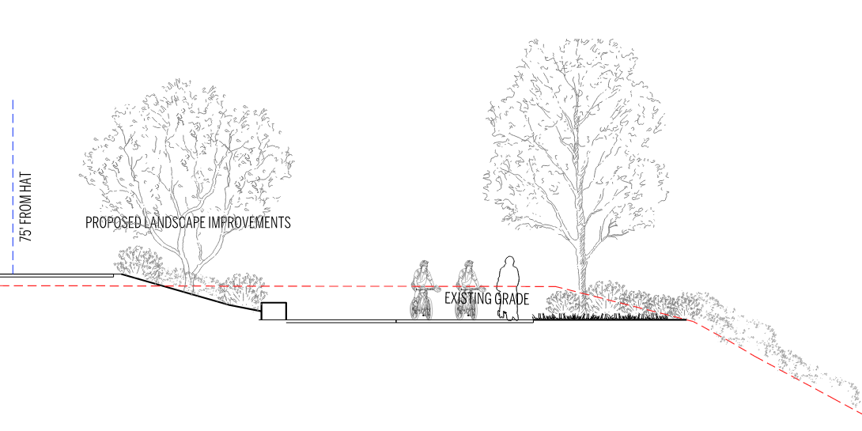
New coastal PATH
Landscape – The New Coastal Path will have proposed landscaping throughout which will match the context of the campus and the shoreline. Some landscape elements will be specifically designed to make the shoreline more resilient as shown in the shoreline stabilization slides.

Slide 15
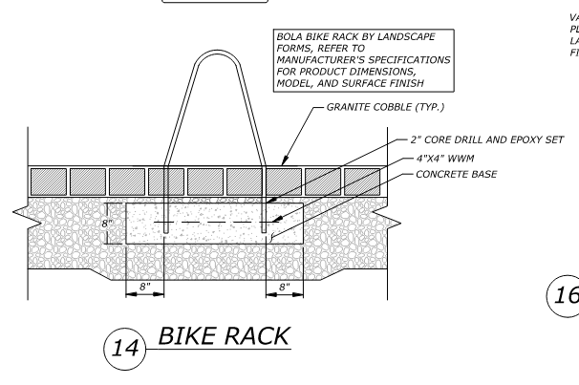
New coastal PATH
BIKE RACKS ON GRANITE COBBLESTONE PAVERS
TERRACED WOOD SEATING AREA
Hardscape – The New Coastal Path will have many proposed hardscaping element throughout. Some of these include:
Pedestrian lighting
Bike Racks
Cobblestone Pavers
Terraced Wood Seating Area
Stone Sitting Walls
Pier Plaza
PIER PLAZA

Slide 16
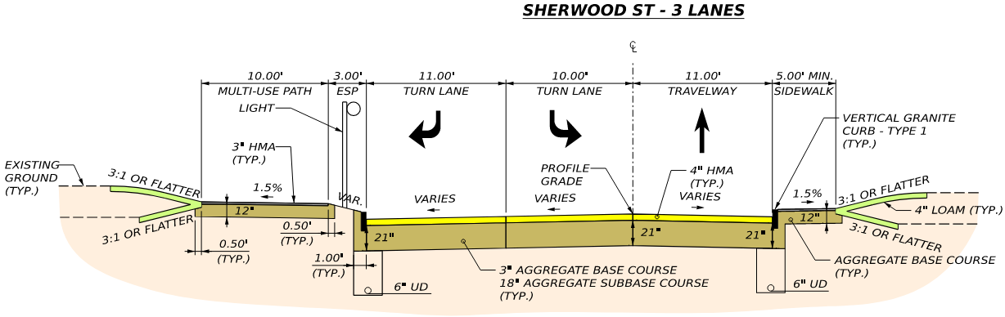
Sherwood St
Sherwood Street Improvements
Full Reconstruction – New Gravel, Pavement, Granite Curb, and Drainage.
The roadway alignment and profile generally match existing.
A new 10’ Wide Paved Multi-Use Path with lighting on the north side and a new paved sidewalk on the south side.
Separate right and left turn lanes at Veranda St.
N

Slide 17
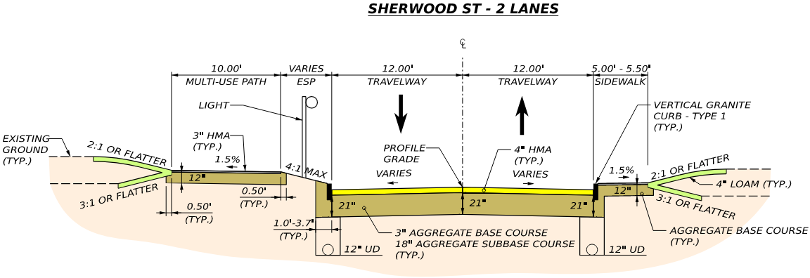
Sherwood St
Sherwood Street Improvements
Full Reconstruction will extend to the limits of the public right of way and connect into campus roadways.
The new 10’ Wide Multi-Use Path and sidewalk will extend under the bridge and connect into the campus pedestrian facilities including the 12’ wide coastal path, which will be concrete east of I-295.
Light fixtures west of I-295 will be the City’s standard light fixtures, but light fixtures east of I-295 will be the same style as the other light fixtures on the campus
Note that a short section of the future off ramp connection will be constructed as part of this project, so the future off-ramp construction project will be able to connect with minimal impacts to Sherwood St.
N

Slide 18
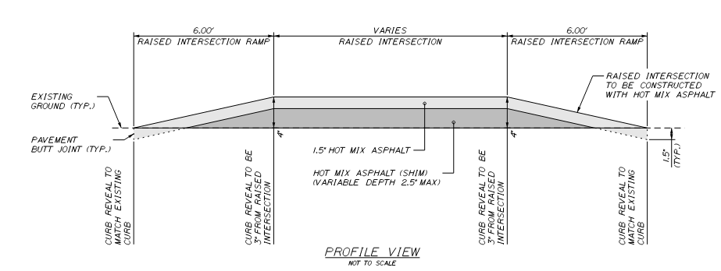
Sherwood St
N
Sherwood Street at Veranda Street Improvements
The intersection of Sherwood Street and Veranda Street will become a Raised Intersection.
A Raised Intersection adds a 4” vertical deflection on all sides of the intersection. Similar to a speed hump or raised x-walk, but the whole intersection will be raised.
The Raised intersection will:
improve safety by reducing speeds and reducing the severity of crashes
emphasize pedestrian crossings and promote pedestrian friendly movements
calm traffic and improve the urban environment
increase visibility by installing additional lighting at the intersection

Slide 19
Schedule – Component #1
August 2025 - 100% Plans
January 2026 - Project Advertise
June 2026 - Construction Begin
June 2027 - Construction Complete

