Slide 1
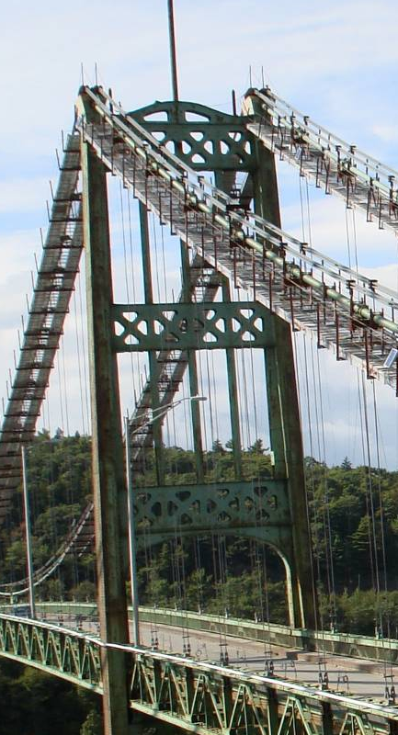
Tower Sections

Slide 2
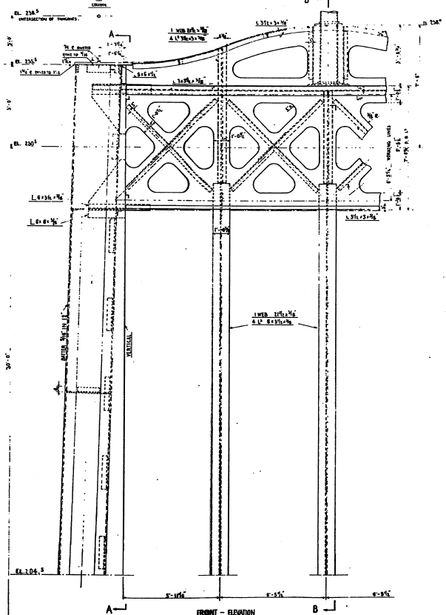
Tower Section Details (1 of 3)
Sections TT1-TT4
Two identical sections from each tower (four total)
Flame cut at EL 205 and EL 225
Sections are between diaphragm centered at EL 230.5 and diaphragm centered at EL 200.5.
Sections should be approximately 20 ft in length.
Sections should not contain any portion of the diaphragms.
keep

Slide 3
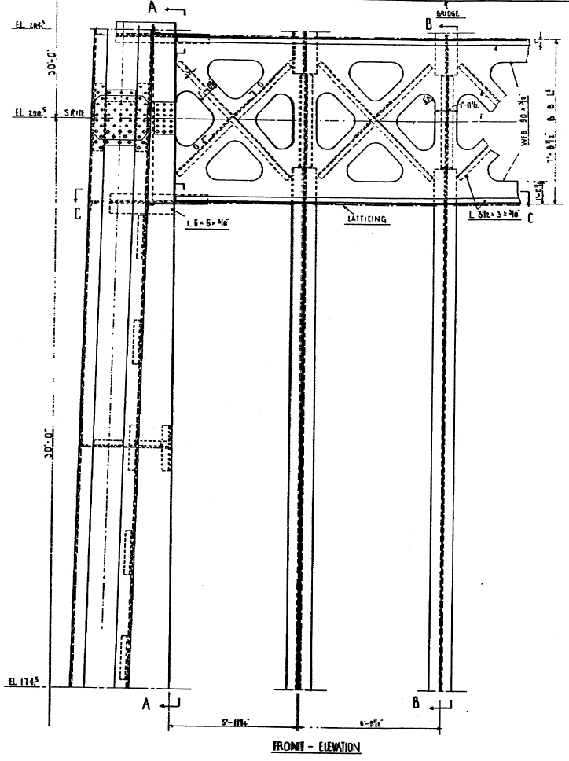
Tower Section Details (2 of 3)
Sections TM1-TM4
Two identical sections from each tower (four total)
Flame cut at EL 175 and EL 195
Sections are between diaphragm centered at EL 200.5 and diaphragm centered at EL 170.5.
Sections should be approximately 20 ft in length.
Sections should not contain any portion of the diaphragms.
keep

Slide 4
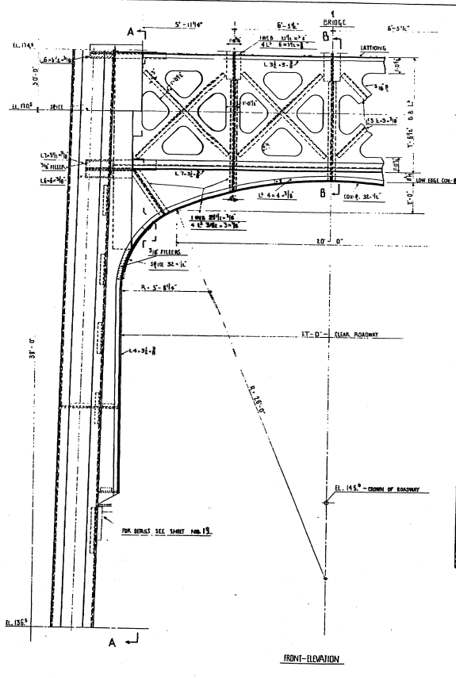
Tower Section Details (3 of 3)
Sections TB1-TB4
Two identical sections from each tower (four total)
Flame cut at EL 137 and EL 157
Sections are between diaphragm centered at EL 170.5 and diaphragm centered at EL 131.5.
Sections should be approximately 20 ft in length.
Sections should not contain any portion of the diaphragms.
keep

Slide 5
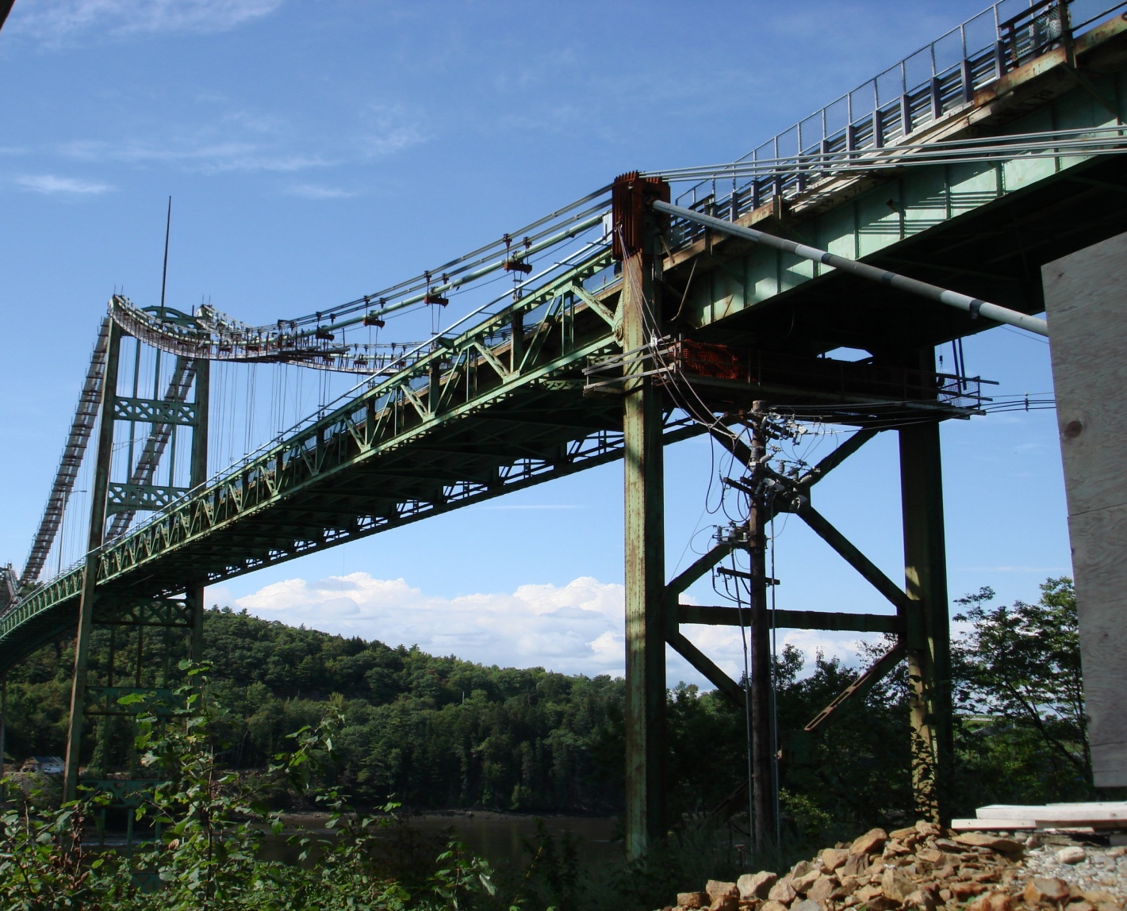
Cable Bent Posts

Slide 6
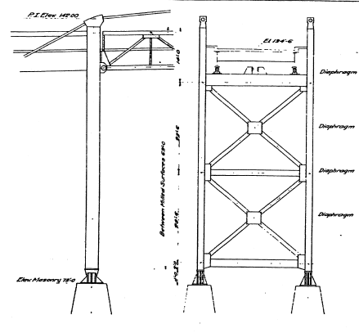
Bent Post Section Details
Sections BP1-8
Two sections from each bent post (eight total)
Flame cut above and below diagonal bracing gusset plates.
Sections should be approximately 16-17 ft in length.

Slide 7
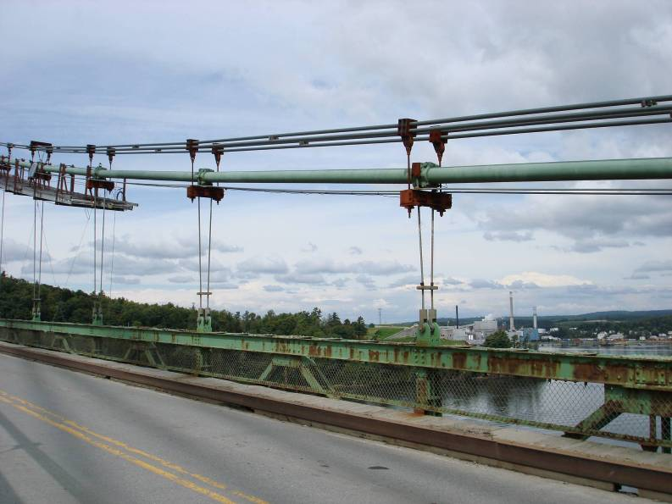
Main Cable (with clamps)

Slide 8
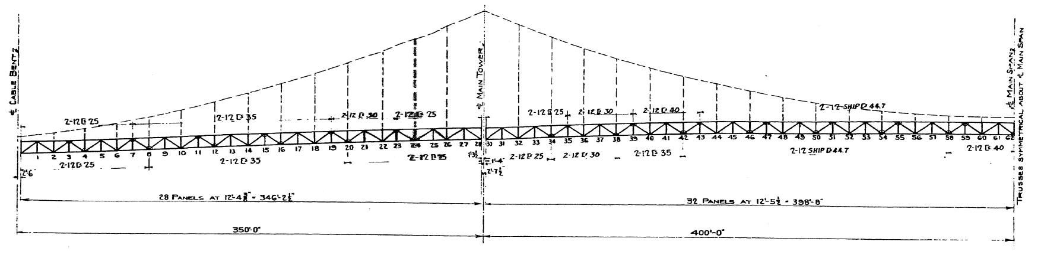
Main Cable Details
All main cable sections shall include clamps at either end. Cuts shall be made approximately 1-2 ft. from end of clamps.
Sections shall be taken from either north or south cable and either east or west end depending on which section is least damaged during demolition.
MC1 shall be the section of cable between panel points 6 and 8
MC2 shall be the section of cable between panel points 16 and 18
MC3 shall be the section of cable between panel points 24 and 26
MC4 shall be the section of cable between panel points 34 and 36
MC5 shall be the section of cable between panel points 42 and 44
MC6 shall be the section of cable between panel points 54 and 56

Slide 9

Main Cable Bent Saddles

Slide 10
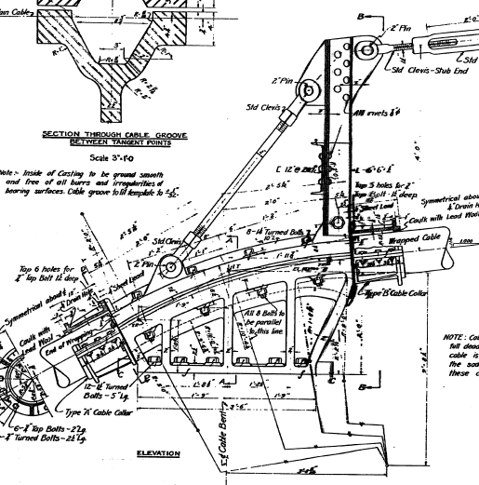
Cable Bent Saddle Details
CBS 1-4 shall consist of the original cable bent saddles as shown on page 14 of the original drawings.
Cable can either be removed or cut above and below saddles.
Saddles can either be unbolted or top of bent post can be flame cut.
Portions of the current saddle configuration that are part of the main cable retrofit need not be saved.

Slide 11
Suspender Cables with End Sockets

Slide 12
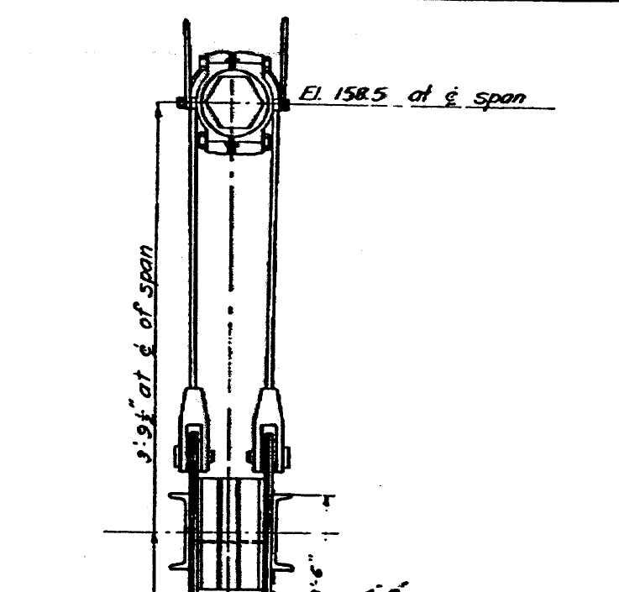
Suspender Cable Details
SC 1-4 are to be salvaged by removing (and saving) the pins, or alternately, by flame cutting the base of the pad-eye plates to which the pins attach.
The salvaged cables shall be kept in one piece.
The supplementary cables used in the retrofit need not be saved.
SC 1 is to be taken from panel point 4
SC 2 is to be taken from panel point 6
SC 3 is to be taken from panel point 52
SC 4 is to be taken from panel point 54
As each panel point location may correspond to four different but identical locations on the actual bridge, the pieces shall be salvaged from the least damaged of the four pieces.
Flame cut location
if pins are not to
be removed

