Slide 1
Unit 2 Mid-Unit Assessment

Slide 2
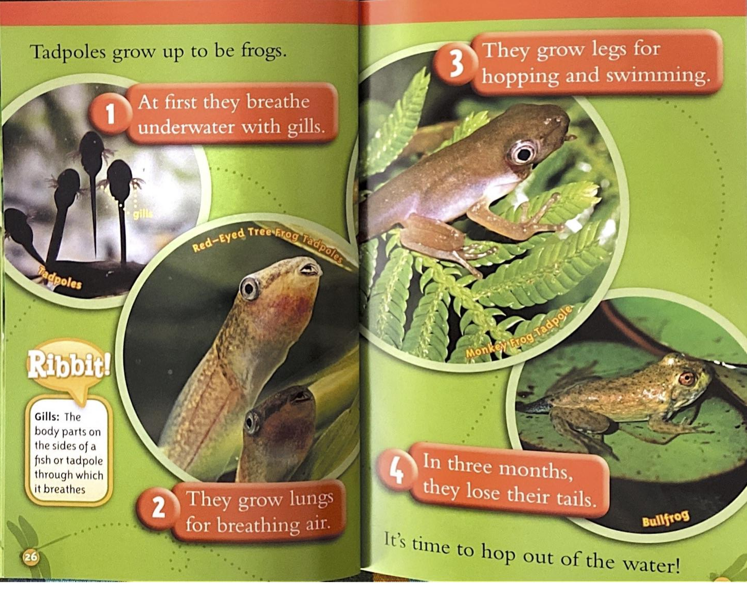


Slide 3
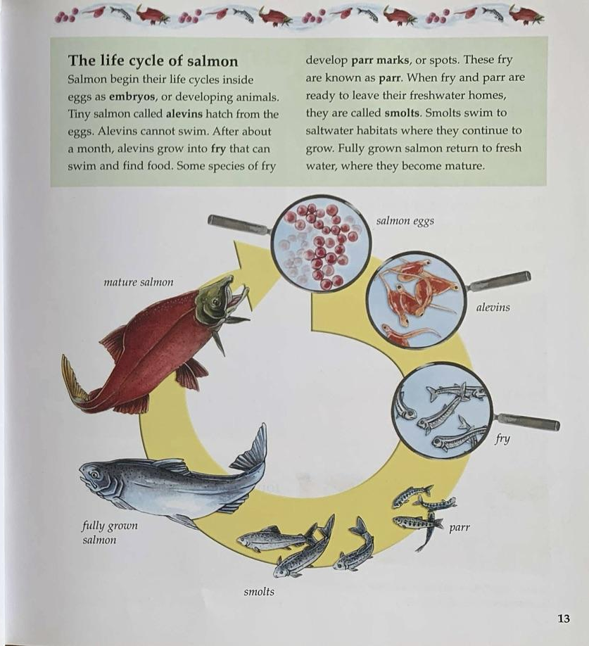

Slide 4
Choose one of the questions below.
What information did you learn about frogs?
What information did you learn about salmon?
Talk, draw, and write to show your thinking.
Use details from the text.

