Slide 1
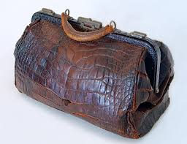
The Lady with the
Alligator Purse

Slide 2
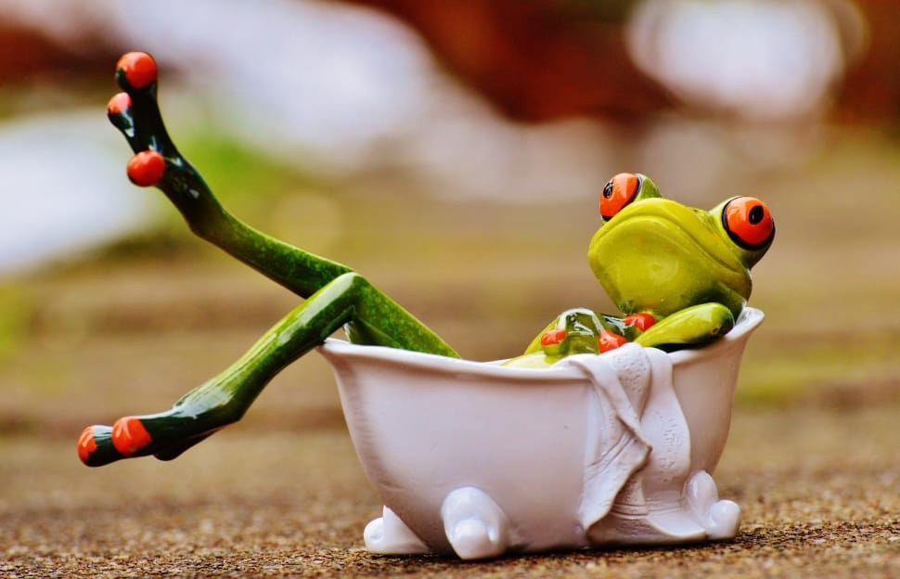
Ms. Penny had a froggy,
His name was Jumping Jim.
She put him in the bathtub
To see if he could swim.

Slide 3
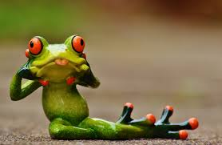
He drank up all the water,
He ate up all the soap.
He tried to eat the bathtub,
But it wouldn’t go down his throat.

Slide 4
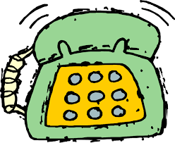
Ms. Penny called the doctor,
Ms. Penny called the nurse,
Ms. Penny called the lady
With the alligator purse.

Slide 5
In came the doctor,
In came the nurse,
In came the lady
With the alligator purse.

Slide 6
“He’s sick” said the doctor,
“He’s not well,” said the nurse,
“Nonsense!” said the lady
With the alligator purse.

Slide 7
“Medicine!” said the doctor,
“Juice!” said the nurse,
“Pizza!” said the lady
With the alligator purse.

