Slide 1
This is the Way

Slide 2
This is the way we use our tools,
Use our tools, use our tools.
This is the way we use our tools
so early in the morning.

Slide 3
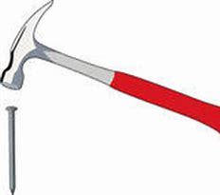
This is the way we hit the nails,
Hit the nails, hit the nails.
This is the way we hit the nails,
so early in the morning.

Slide 4
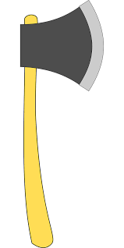
This is the way we chop the wood,
chop the wood, chop the wood.
This is the way we chop the wood,
so early in the morning.

Slide 5
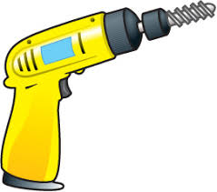
This is the way we drill a hole,
drill a hole, drill a hole.
This is the way we drill a hole,
so early in the morning.

